Slide 1
CS 5323
Role-Based Access Control (RBAC)
Prof. Ravi Sandhu
Executive Director and Endowed Chair
Lecture 4
ravi.utsa@gmail.com
www.profsandhu.com
© Ravi Sandhu
World-Leading Research with Real-World Impact!

Slide 2
Access Control
Fixed
policy
Discretionary Access Control (DAC), 1970
Mandatory Access Control (MAC), 1970
Role Based Access Control (RBAC), 1995
Attribute Based Access Control (ABAC), ????
Flexible
policy
© Ravi Sandhu
World-Leading Research with Real-World Impact!
2

Slide 3
Access Control
Fixed
policy
Ownership gives discretion
One-directional information flow
Discretionary Access Control (DAC), 1970
Mandatory Access Control (MAC), 1970
Policy neutral
Role Based Access Control (RBAC), 1995
Attribute Based Access Control (ABAC), ????
Flexible
policy
© Ravi Sandhu
World-Leading Research with Real-World Impact!
3

Slide 4
The RBAC Story
Standard
Adopted
Proposed
Standard
RBAC96
paper
Ludwig Fuchs, Gunther Pernul and Ravi Sandhu, Roles in Information Security-A Survey and Classification of the Research Area, Computers & Security, Volume 30, Number 8, Nov. 2011, pages 748-76
© Ravi Sandhu
World-Leading Research with Real-World Impact!
4
Notes:
This is a somewhat busy slide
It shows a bird’s eye view of RBAC
There are many details that need to be debated and filled in
Some of these will be discussed in the subsequent panel
For our purpose the bird’s eye view will suffice

Slide 5
RBAC: Role-Based Access Control
  Access is determined by roles
  A user’s roles are assigned by security administrators
  A role’s permissions are assigned by security administrators
First emerged: mid 1970s
First models: mid 1990s
Is RBAC MAC or DAC or neither?
  RBAC can be configured to do MAC
  RBAC can be configured to do DAC
  RBAC is policy neutral
RBAC is neither MAC nor DAC!
© Ravi Sandhu
World-Leading Research with Real-World Impact!
5

Slide 6
RBAC96 Model
© Ravi Sandhu
World-Leading Research with Real-World Impact!

Slide 7
RBAC96 Model Family
ROLE HIERARCHIES
USER-ROLE
ASSIGNMENT
PERMISSIONS-ROLE
ASSIGNMENT
USERS
ROLES
PERMISSIONS
...
SESSIONS
CONSTRAINTS
© Ravi Sandhu
World-Leading Research with Real-World Impact!
7
Notes:
This is a somewhat busy slide
It shows a bird’s eye view of RBAC
There are many details that need to be debated and filled in
Some of these will be discussed in the subsequent panel
For our purpose the bird’s eye view will suffice

Slide 8
RBAC96 Model Family
RBAC3
ROLE HIERARCHIES +
CONSTRAINTS
RBAC1
ROLE
HIERARCHIES
RBAC2
CONSTRAINTS
RBAC0
BASIC RBAC
© Ravi Sandhu
World-Leading Research with Real-World Impact!
8
Notes:
This is a somewhat busy slide
It shows a bird’s eye view of RBAC
There are many details that need to be debated and filled in
Some of these will be discussed in the subsequent panel
For our purpose the bird’s eye view will suffice

Slide 9
Founding Principles of RBAC96
  Abstraction of Privileges
    Credit is different from Debit even though both require read and write
  Separation of Administrative Functions
    Separation of user-role assignment from role-permission assignment
  Least Privilege
    Right-size the roles
    Don’t activate all roles all the time
    Limit roles of a user
    Limit users in a role
  Separation of Duty
    Static separation: purchasing manager versus accounts payable manager
    Dynamic separation: cash-register clerk versus cash-register manager
© Ravi Sandhu
World-Leading Research with Real-World Impact!
9

Slide 10
ROLES AS POLICY
A role brings together
  a collection of users and
  a collection of permissions
These collections will vary over time
  A role has significance and meaning beyond the particular users and permissions brought together at any moment
© Ravi Sandhu
World-Leading Research with Real-World Impact!
10

Slide 11
ROLES VERSUS GROUPS
Groups are often defined as
  a collection of users
A role is
  a collection of users and
  a collection of permissions
Some authors define role as
  a collection of permissions
Most Operating Systems support groups
  BUT do not support selective activation of groups
Selective activation conflicts with negative groups (or roles)
© Ravi Sandhu
World-Leading Research with Real-World Impact!
11

Slide 12
HIERARCHICAL ROLES
Primary-Care
Physician
Specialist
Physician
Physician
Health-Care Provider
© Ravi Sandhu
World-Leading Research with Real-World Impact!
12

Slide 13
HIERARCHICAL ROLES
Supervising
Engineer
Hardware
Engineer
Software
Engineer
Engineer
© Ravi Sandhu
World-Leading Research with Real-World Impact!
13

Slide 14
PRIVATE ROLES
Hardware
Engineer’
Supervising
Engineer
Software
Engineer’
Hardware
Engineer
Software
Engineer
Engineer
© Ravi Sandhu
World-Leading Research with Real-World Impact!
14

Slide 15
EXAMPLE ROLE HIERARCHY
Director (DIR)
Project Lead 1
(PL1)
Project Lead 2
(PL2)
Production 1
(P1)
Quality 1
(Q1)
Production 2
(P2)
Quality 2
(Q2)
Engineer 1
(E1)
Engineer 2
(E2)
PROJECT 1
Engineering Department (ED)
PROJECT 2
Employee (E)
© Ravi Sandhu
World-Leading Research with Real-World Impact!
15

Slide 16
EXAMPLE ROLE HIERARCHY
Project Lead 1
(PL1)
Project Lead 2
(PL2)
Production 1
(P1)
Quality 1
(Q1)
Production 2
(P2)
Quality 2
(Q2)
Engineer 1
(E1)
Engineer 2
(E2)
PROJECT 1
Engineering Department (ED)
PROJECT 2
Employee (E)
© Ravi Sandhu
World-Leading Research with Real-World Impact!
16

Slide 17
EXAMPLE ROLE HIERARCHY
Director (DIR)
Project Lead 1
(PL1)
Project Lead 2
(PL2)
Production 1
(P1)
Quality 1
(Q1)
Production 2
(P2)
Quality 2
(Q2)
Engineer 1
(E1)
Engineer 2
(E2)
PROJECT 1
PROJECT 2
© Ravi Sandhu
World-Leading Research with Real-World Impact!
17

Slide 18
EXAMPLE ROLE HIERARCHY
Project Lead 1
(PL1)
Project Lead 2
(PL2)
Production 1
(P1)
Quality 1
(Q1)
Production 2
(P2)
Quality 2
(Q2)
Engineer 1
(E1)
Engineer 2
(E2)
PROJECT 1
PROJECT 2
© Ravi Sandhu
World-Leading Research with Real-World Impact!
18

Slide 19
CONSTRAINTS
Mutually Exclusive Roles
  Static Exclusion: The same individual can never hold both roles
  Dynamic Exclusion: The same individual can never hold both roles in the same context
Mutually Exclusive Permissions
  Static Exclusion: The same role should never be assigned both permissions
  Dynamic Exclusion: The same role can never hold both permissions in the same context
Cardinality Constraints on User-Role Assignment
  At most k users can belong to the role
  At least k users must belong to the role
  Exactly k users must belong to the role
Cardinality Constraints on Permissions-Role Assignment
  At most k roles can get the permission
  At least k roles must get the permission
  Exactly k roles must get the permission
© Ravi Sandhu
World-Leading Research with Real-World Impact!
19

Slide 20
CONSTRAINTS
Formalized in RCL2000 paper
  Ahn, G. J., & Sandhu, R. (2000). Role-based authorization constraints specification. ACM Transactions on Information and System Security (TISSEC), 3(4), 207-226.
© Ravi Sandhu
World-Leading Research with Real-World Impact!
20

Slide 21
NIST RBAC Model
© Ravi Sandhu
World-Leading Research with Real-World Impact!

Slide 22
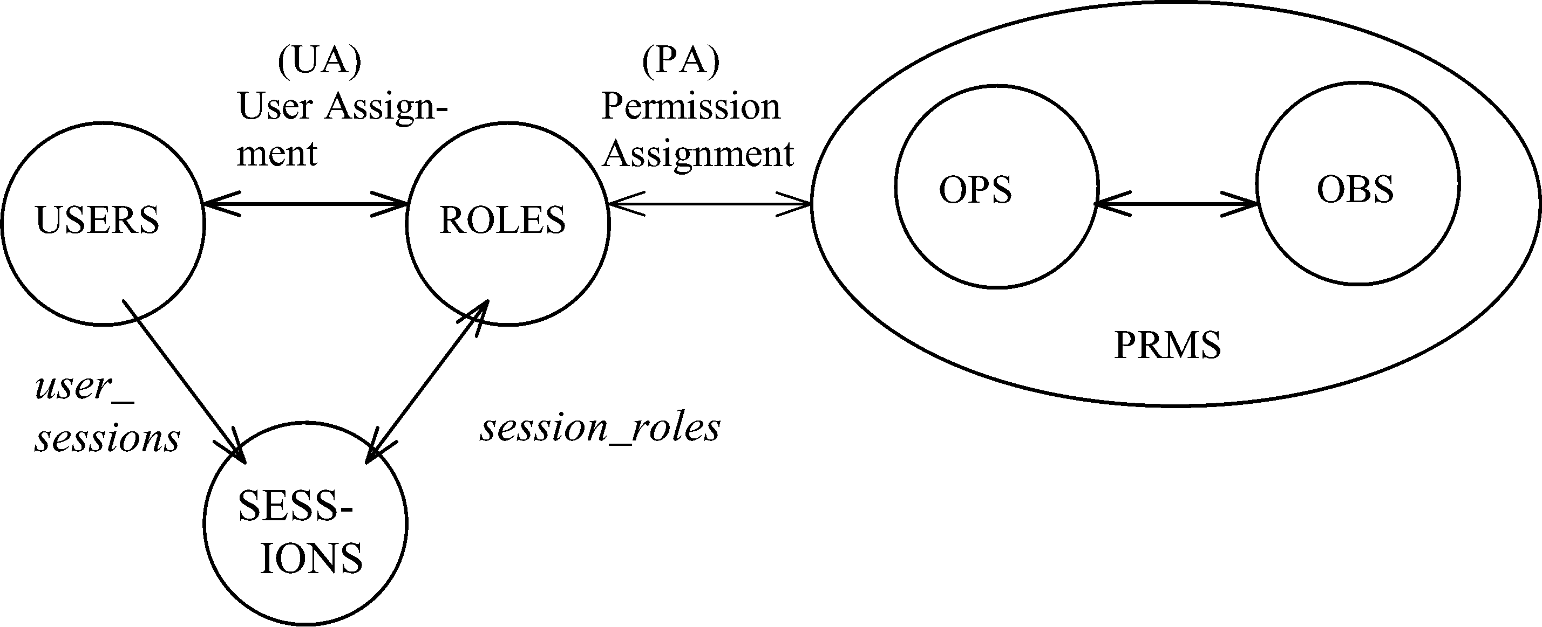
NIST MODEL: CORE RBAC
© Ravi Sandhu
World-Leading Research with Real-World Impact!
22

Slide 23
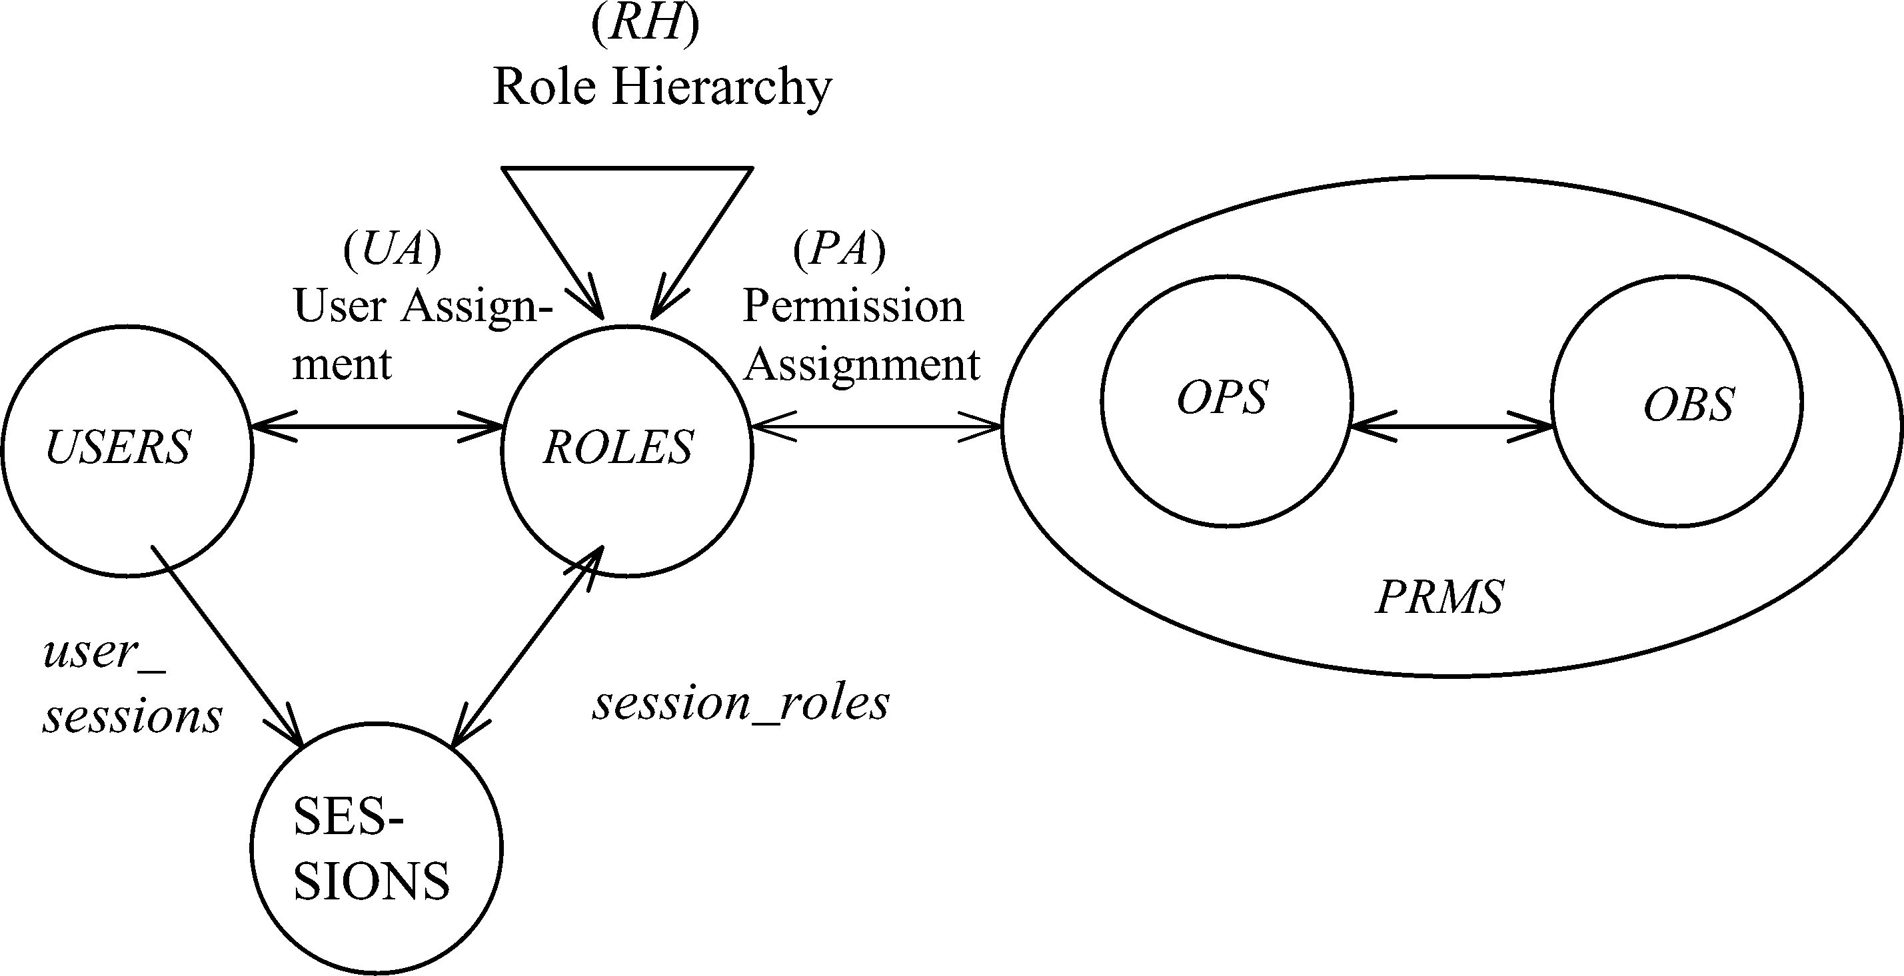
NIST MODEL: HIERARCHICAL RBAC
© Ravi Sandhu
World-Leading Research with Real-World Impact!
23

Slide 24
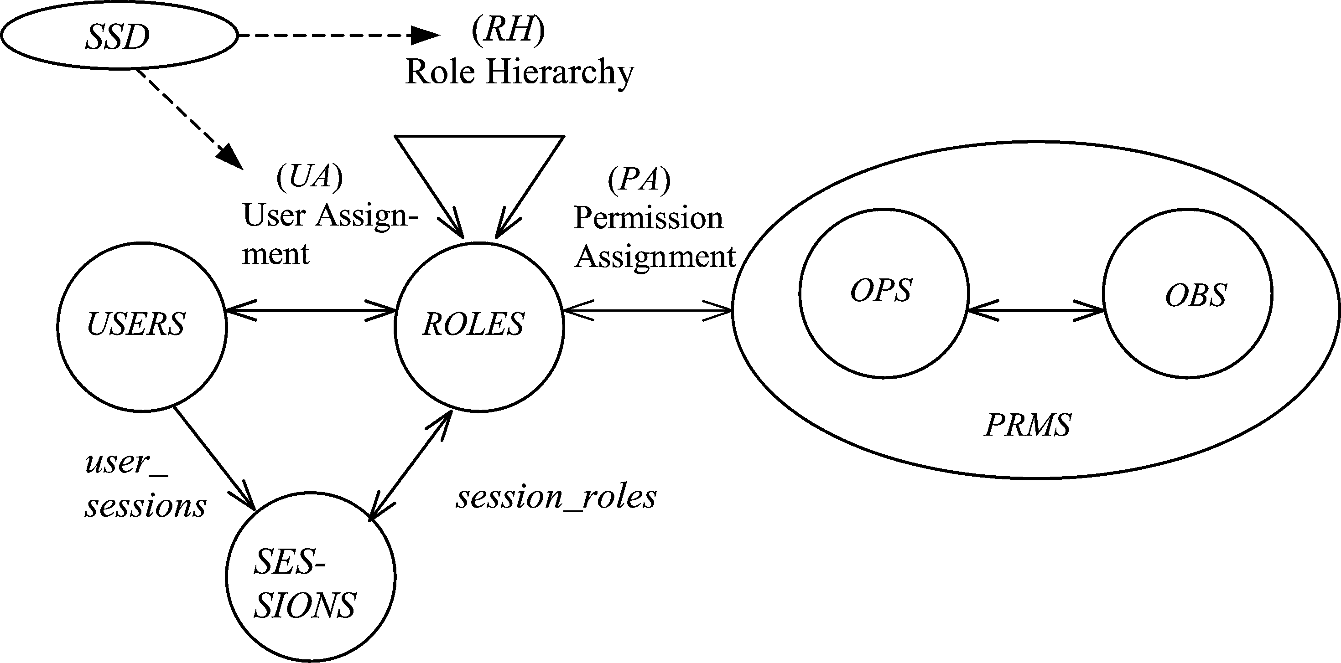
SSD IN HIERARCHICAL RBAC
© Ravi Sandhu
World-Leading Research with Real-World Impact!
24

Slide 25
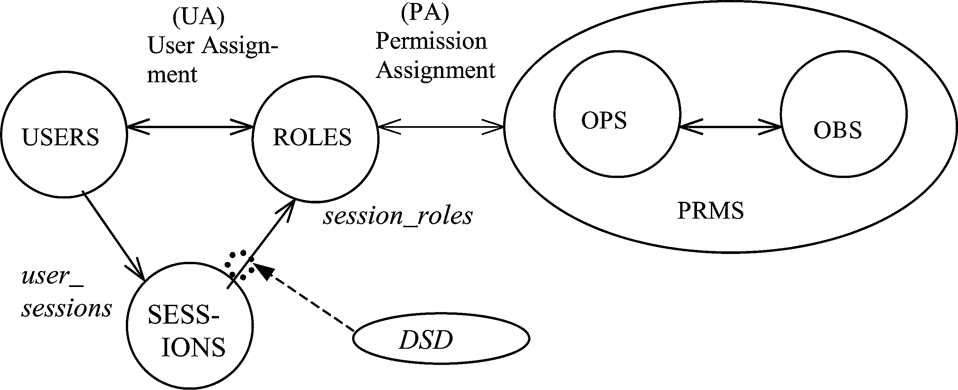
DSD IN HIERARCHICAL RBAC
© Ravi Sandhu
World-Leading Research with Real-World Impact!
25

Slide 26
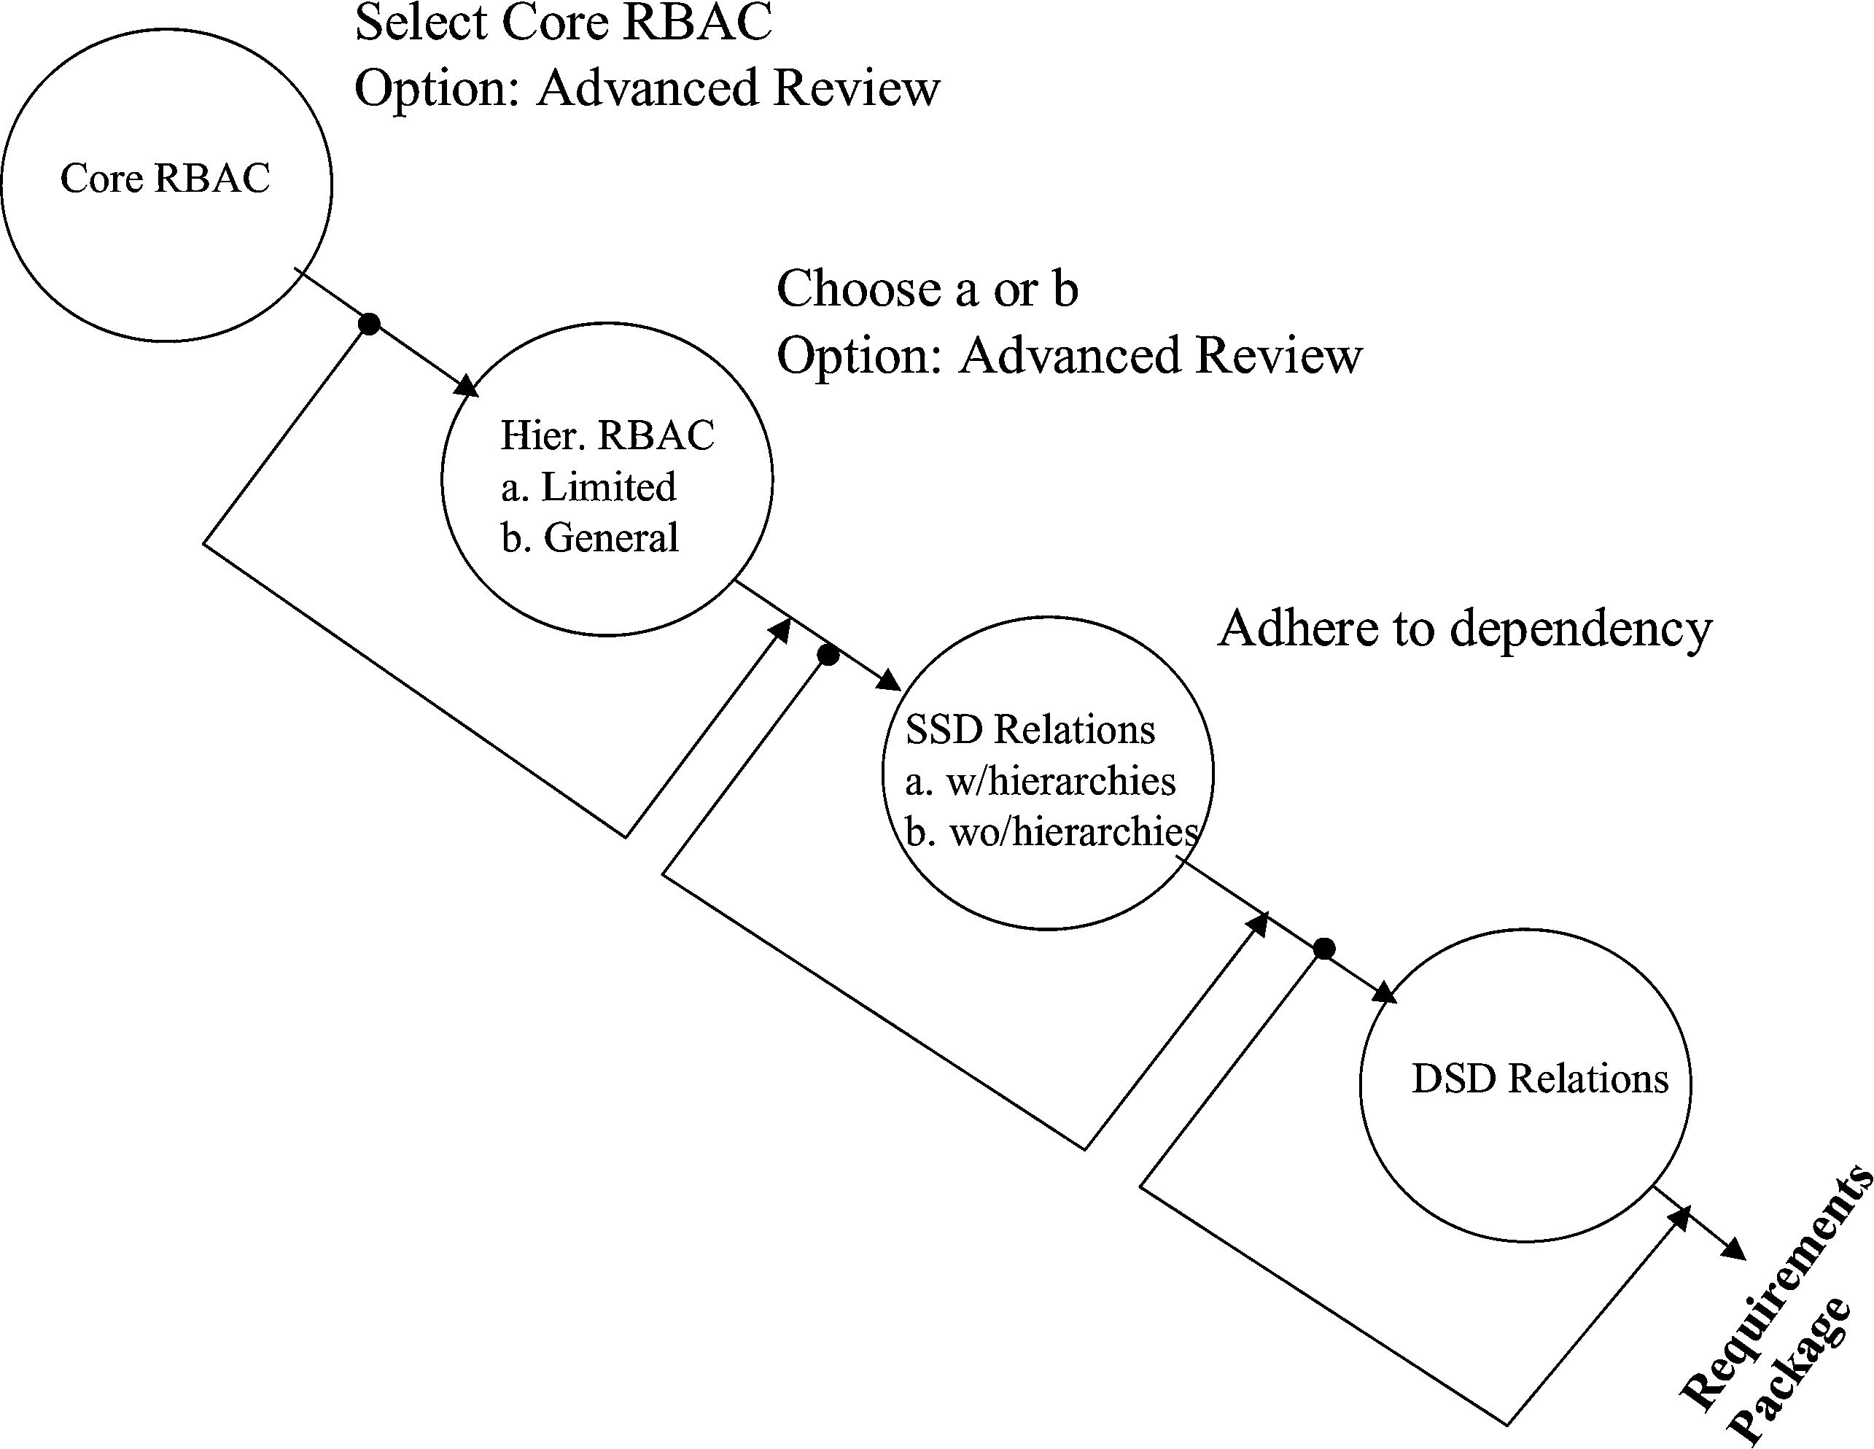
NIST MODEL FAMILY
© Ravi Sandhu
World-Leading Research with Real-World Impact!
26

Slide 27
Compare RBAC96 Model Family
RBAC3
ROLE HIERARCHIES +
CONSTRAINTS
RBAC1
ROLE
HIERARCHIES
RBAC2
CONSTRAINTS
RBAC0
BASIC RBAC
© Ravi Sandhu
World-Leading Research with Real-World Impact!
27
Notes:
This is a somewhat busy slide
It shows a bird’s eye view of RBAC
There are many details that need to be debated and filled in
Some of these will be discussed in the subsequent panel
For our purpose the bird’s eye view will suffice

Slide 28
RBAC Administration
© Ravi Sandhu
World-Leading Research with Real-World Impact!

Slide 29
ARBAC97 Model
Separation of regular roles and administrative roles
Formalized in ARBAC97 paper
  Sandhu, R., Bhamidipati, V., & Munawer, Q. (1999). The ARBAC97 model for role-based administration of roles. ACM Transactions on Information and System Security (TISSEC), 2(1), 105-135.
© Ravi Sandhu
World-Leading Research with Real-World Impact!
29
Notes:
This is a somewhat busy slide
It shows a bird’s eye view of RBAC
There are many details that need to be debated and filled in
Some of these will be discussed in the subsequent panel
For our purpose the bird’s eye view will suffice

Slide 30
EXAMPLE REGULAR ROLE HIERARCHY
Director (DIR)
Project Lead 1
(PL1)
Project Lead 2
(PL2)
Production 1
(P1)
Quality 1
(Q1)
Production 2
(P2)
Quality 2
(Q2)
Engineer 1
(E1)
Engineer 2
(E2)
PROJECT 1
Engineering Department (ED)
PROJECT 2
Employee (E)
© Ravi Sandhu
World-Leading Research with Real-World Impact!
30

Slide 31
EXAMPLE ADMIN ROLE HIERARCHY
Senior Security Officer (SSO)
Department Security Officer (DSO)
Project Security
Officer 1 (PSO1)
Project Security
Officer 2 (PSO2)
© Ravi Sandhu
World-Leading Research with Real-World Impact!
31

Slide 32
MAC in RBAC
© Ravi Sandhu
World-Leading Research with Real-World Impact!

Slide 33
MAC Liberal -Property
+
-
H
M1
M2
-
+
L
Read
Write
© Ravi Sandhu
World-Leading Research with Real-World Impact!
33
Notes:
This is a somewhat busy slide
It shows a bird’s eye view of RBAC
There are many details that need to be debated and filled in
Some of these will be discussed in the subsequent panel
For our purpose the bird’s eye view will suffice

Slide 34
RBAC96 Liberal -Property
+
HR
LW
M1R
M2R
M1W
M2W
LR
-
HW
Read Write
© Ravi Sandhu
World-Leading Research with Real-World Impact!
34
Notes:
This is a somewhat busy slide
It shows a bird’s eye view of RBAC
There are many details that need to be debated and filled in
Some of these will be discussed in the subsequent panel
For our purpose the bird’s eye view will suffice

Slide 35
RBAC96 Liberal -Property
user ∈ xR, user has clearance x
user ∈ LW, independent of clearance
Constraints
  session ∈ xR iff session ∈ xW
  read can be assigned only to xR roles
  write can be assigned only to xW roles
  (O,read) assigned to xR iff
  (O,write) assigned to xW
© Ravi Sandhu
World-Leading Research with Real-World Impact!
35

Slide 36
RBAC96 Liberal -Property
user ∈ xR, user has clearance x
user ∈ LW, independent of clearance
Constraints
  session ∈ xR iff session ∈ xW
  read can be assigned only to xR roles
  write can be assigned only to xW roles
  (O,read) assigned to xR iff
  (O,write) assigned to xW
NIST Model cannot express these constraints
© Ravi Sandhu
World-Leading Research with Real-World Impact!
36

Slide 37
MAC Strict -Property
+
H
M1
M2
-
L
Read
© Ravi Sandhu
World-Leading Research with Real-World Impact!
37
Notes:
This is a somewhat busy slide
It shows a bird’s eye view of RBAC
There are many details that need to be debated and filled in
Some of these will be discussed in the subsequent panel
For our purpose the bird’s eye view will suffice

Slide 38
RBAC96 Strict -Property
+
HR
M1R
M2R
M1W
LW
HW
M2W
LR
-
Read Write
© Ravi Sandhu
World-Leading Research with Real-World Impact!
38
Notes:
This is a somewhat busy slide
It shows a bird’s eye view of RBAC
There are many details that need to be debated and filled in
Some of these will be discussed in the subsequent panel
For our purpose the bird’s eye view will suffice

Slide 39
RBAC96 Strict -Property
user ∈ xR, user has clearance x
user ∈ {LW,HW,M1W,M2W}, independent of clearance
Constraints
  session ∈ xR iff session ∈ xW
  read can be assigned only to xR roles
  write can be assigned only to xW roles
  (O,read) assigned to xR iff
  (O,write) assigned to xW
© Ravi Sandhu
World-Leading Research with Real-World Impact!
39

Slide 40
DAC in RBAC
© Ravi Sandhu
World-Leading Research with Real-World Impact!

Slide 41
Variations of Grant
Strict DAC
  Only owner has discretionary authority to grant access to an object.
  Example:
    Alice has created an object (she is owner) and grants access to Bob. Now Bob cannot grant propagate the access to another user.
Liberal DAC
  Owner can delegate discretionary authority for granting access to other users.
    One Level grant
    Two Level Grant
    Multilevel Grant
© Ravi Sandhu
World-Leading Research with Real-World Impact!
41

Slide 42
One-Level versus Two-Level-Grant
Owner can delegate authority to another user but they cannot further delegate this power.
In addition to a one level grant the owner can allow some users to delegate grant authority to other users.
Alice
Bob
Charles
Alice
Bob
Charles
Dorothy
© Ravi Sandhu
World-Leading Research with Real-World Impact!
42

Slide 43
Variations of Revoke
Grant-Independent Revocation
  Any authorized revoker can revoke
  Easier to do in RBAC
Grant-Dependent Revocation
  Only original grantor can revoke
  Need additional roles to accomplish in RBAC
© Ravi Sandhu
World-Leading Research with Real-World Impact!
43

Slide 44
Common Aspects
Creation of an object O in the system requires the simultaneous creation of
  3 administrative roles
    OWN_O, PARENT_O, PARENTwithGRANT_O
  1 regular role
    READ_O
Also simultaneous creation of 8 Permissions
  canRead_O
  destroyObject_O
  addReadUser_O, deleteReadUser_O
  addParent_O, deleteParent_O
  addParentWithGrant_O, deleteParentWithGrant_O
Destroying an object O requires deletion of 4 roles and 8 permissions in addition of destroying the object O
© Ravi Sandhu
World-Leading Research with Real-World Impact!
44

Slide 45
Common Aspects
OWN_O
Administration of roles associated with object O
OWN_O
PARENTwithGRANT_O
PARENT_O
READ_O
PARENTwithGRANT_O
      destroyObject_O
      addParentWithGrant_O
      deleteParentWithgrant_O
addParent_O
deleteParent_O
      addReadUser_O
      deleteReadUser_O
canRead_O
PARENT_O
Role permissions
Administrative role hierarchy
© Ravi Sandhu
World-Leading Research with Real-World Impact!
45

Slide 46
Grant Variations in RBAC96
Strict DAC cardinality constraints
  Role OWN_O = 1
  Role PARENTwithGRANT_O = 0
  Role PARENT_O = 0
One-level grant cardinality constraints
  Role OWN_O = 1
  Role PARENTwithGRANT_O = 0
Two-level grant cardinality constraints
  Role OWN_O = 1
© Ravi Sandhu
World-Leading Research with Real-World Impact!
46

Slide 47
Grant Variations in RBAC96
Strict DAC cardinality constraints
  Role OWN_O = 1
  Role PARENTwithGRANT_O = 0
  Role PARENT_O = 0
One-level grant cardinality constraints
  Role OWN_O = 1
  Role PARENTwithGRANT_O = 0
Two-level grant cardinality constraints
  Role OWN_O = 1
NIST Model cannot express these constraints
© Ravi Sandhu
World-Leading Research with Real-World Impact!
47

Slide 48
Grant-Dependent Revoke in RBAC96
U1_PARENT_O
U1_READ_O
U2_PARENT_O
U2_READ_O
Un_PARENT_O
Un_READ_O
READ_O role associated with members of PARENT_O
© Ravi Sandhu
World-Leading Research with Real-World Impact!
48

Slide 49
OM-AM and PEI
© Ravi Sandhu
World-Leading Research with Real-World Impact!

Slide 50
OM-AM
A
s
s
u
r
a
n
c
e
What?
Objectives
Model
Architecture
Mechanism
How?
© Ravi Sandhu
World-Leading Research with Real-World Impact!
50

Slide 51
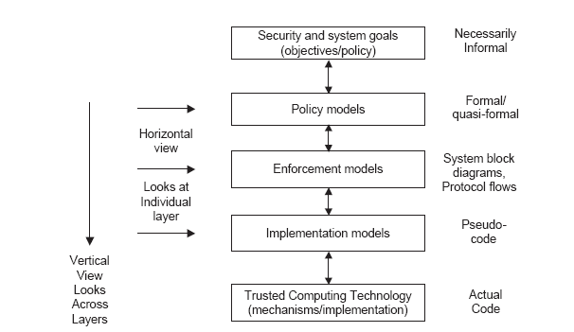
PEI Models
Idealized
Enforceable
(Approximate)
Codeable
© Ravi Sandhu
World-Leading Research with Real-World Impact!
51

Slide 52
RBAC: SERVER PULL
E model
Client
Server
User-role
Authorization
Server
© Ravi Sandhu
World-Leading Research with Real-World Impact!
52
Notes:
This is a somewhat busy slide
It shows a bird’s eye view of RBAC
There are many details that need to be debated and filled in
Some of these will be discussed in the subsequent panel
For our purpose the bird’s eye view will suffice

Slide 53
RBAC: CLIENT PULL
E model
Client
Server
User-role
Authorization
Server
© Ravi Sandhu
World-Leading Research with Real-World Impact!
53
Notes:
This is a somewhat busy slide
It shows a bird’s eye view of RBAC
There are many details that need to be debated and filled in
Some of these will be discussed in the subsequent panel
For our purpose the bird’s eye view will suffice

Slide 54
RBAC: PROXY-BASED
E model
Client
Proxy
Server
Server
User-role
Authorization
Server
© Ravi Sandhu
World-Leading Research with Real-World Impact!
54
Notes:
This is a somewhat busy slide
It shows a bird’s eye view of RBAC
There are many details that need to be debated and filled in
Some of these will be discussed in the subsequent panel
For our purpose the bird’s eye view will suffice

Slide 55
MAC or LBAC or BLP (or Biba)
BLP enforces one-directional information flow in a lattice of security labels
BLP can enforce one-directional information flow policies for
  Confidentiality
  Integrity
  Separation of duty
  Combinations thereof
Policy
Objective
© Ravi Sandhu
World-Leading Research with Real-World Impact!
55

Slide 56
MAC
Confidentiality
Integrity
Separation
One-Direction
Information Flow
© Ravi Sandhu
World-Leading Research with Real-World Impact!
56

Slide 57
DAC
Owner Discretion
Access Matrix
Capabilities,
Access Control Lists
Access Control Relations
© Ravi Sandhu
World-Leading Research with Real-World Impact!
57

