Slide 1
CS 5323
Attribute-Based Access Control (ABAC)
Prof. Ravi Sandhu
Executive Director and Endowed Chair
Lecture 5
ravi.utsa@gmail.com
www.profsandhu.com
© Ravi Sandhu
World-Leading Research with Real-World Impact!

Slide 2
Access Control
Fixed
policy
Discretionary Access Control (DAC), 1970
Mandatory Access Control (MAC), 1970
Role Based Access Control (RBAC), 1995
Attribute Based Access Control (ABAC), ????
Flexible
policy
© Ravi Sandhu
World-Leading Research with Real-World Impact!
2

Slide 3
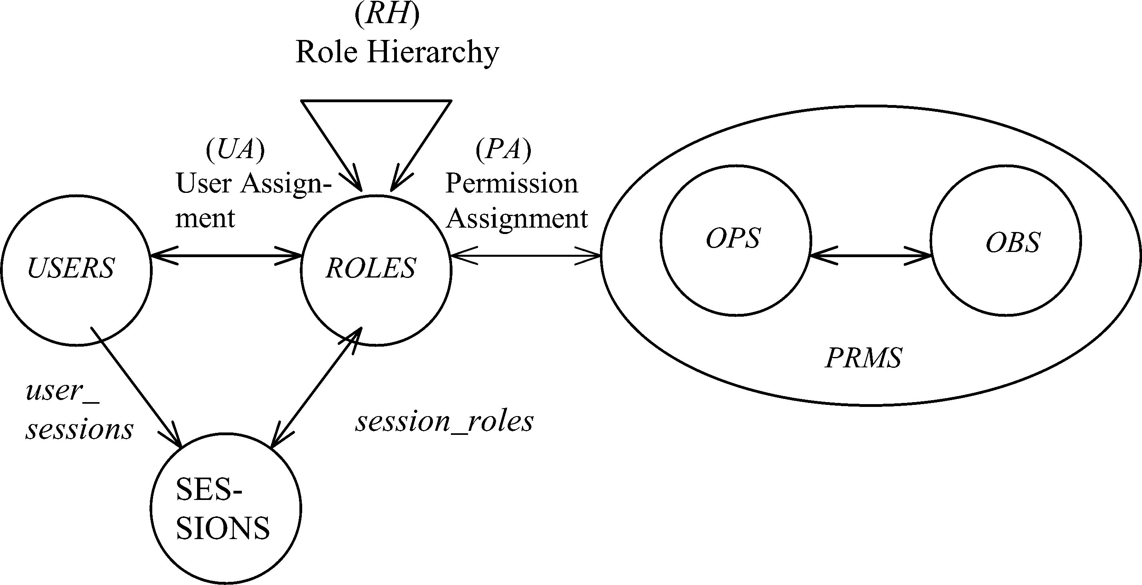
RBAC Shortcomings
Hard Enough
Impossible
Constraints
© Ravi Sandhu
World-Leading Research with Real-World Impact!
3

Slide 4
The RBAC Story
NIST-ANSI
Standard
Adopted
NIST-ANSI
Standard Proposed
RBAC96
model
Ludwig Fuchs, Gunther Pernul and Ravi Sandhu, Roles in Information Security-A Survey and Classification of the Research Area, Computers & Security, Volume 30, Number 8, Nov. 2011, pages 748-76
© Ravi Sandhu
World-Leading Research with Real-World Impact!
4

Slide 5
ABAC Status
Standard
Adopted
Proposed
Standard
RBAC96
paper
1990?
2017
ABAC still in pre/early phase
© Ravi Sandhu
World-Leading Research with Real-World Impact!
5

Slide 6
ABAC is not New
User (Identity)
Attributes
Public-keys +
Secured secrets
© Ravi Sandhu
World-Leading Research with Real-World Impact!

Slide 7
ABAC is not New
User (Identity)
X.500
Directory
X.509
Identity Certificates
Attributes
Public-keys +
Secured secrets
Pre Internet, early 1990s
© Ravi Sandhu
World-Leading Research with Real-World Impact!

Slide 8
ABAC is not New
User (Identity)
X.509
Attribute
Certificates
X.509
Identity Certificates
Attributes
Public-keys +
Secured secrets
Post Internet, late 1990s
© Ravi Sandhu
World-Leading Research with Real-World Impact!

Slide 9
ABAC is not New
User (Identity)
Attributes
SPKI Certificates
Public-keys +
Secured secrets
Post Internet, late 1990s
© Ravi Sandhu
World-Leading Research with Real-World Impact!

Slide 10
ABAC is not New
User (Identity)
Attributes
Anonymous
Credentials
Public-keys +
Secured secrets
Mature Internet, 2000s
© Ravi Sandhu
World-Leading Research with Real-World Impact!

Slide 11
ABAC is not New
Attributes
Action
Authorization Decision
User
Subject
Yes/No
Object
Context
XACML
Policy
Mature Internet, 2000s
© Ravi Sandhu
World-Leading Research with Real-World Impact!

Slide 12
ABACα and ABACβ Models
© Ravi Sandhu
World-Leading Research with Real-World Impact!

Slide 13
ABACα Features
  ABAC-alpha covers
    DAC: strict DAC
    MAC: LBAC with tranquility
    RBAC: RBAC0 and RBAC1
 | Subject attribute Value constrained by creating user ? | Object attribute value constrained by creating subject ? | Attribute range ordered? | Attribute function returns set value? | Object attribute modification? | Subject attribute modification by creating user?
DAC | YES | YES | NO | YES | YES | NO
MAC | YES | YES | YES | NO | NO | NO
RBAC0 | YES | NA | NO | YES | NA | YES
RBAC1 | YES | NA | YES | YES | NA | YES
ABAC-alpha | YES | YES | YES | YES | YES | YES
© Ravi Sandhu
World-Leading Research with Real-World Impact!
13

Slide 14
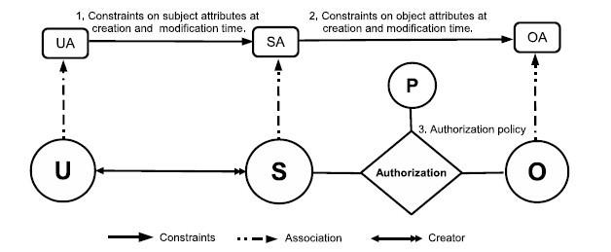
ABACα Model Structure
Policy Configuration Points
Just sufficient mechanism to do
simple forms of DAC, MAC, RBAC
© Ravi Sandhu
World-Leading Research with Real-World Impact!
14

Slide 15
ABACα Authorization Policy
  DAC
  MAC
  RBAC0
  RBAC1
© Ravi Sandhu
World-Leading Research with Real-World Impact!
15

Slide 16
ABACα Subject Attribute Constraints
  MAC creation
  modification FALSE
  RBAC0
  RBAC1

Slide 17
ABACα Object Attribute Constraints
  DAC Creation
  Modification
  MAC Creation
  Modification FALSE

Slide 18
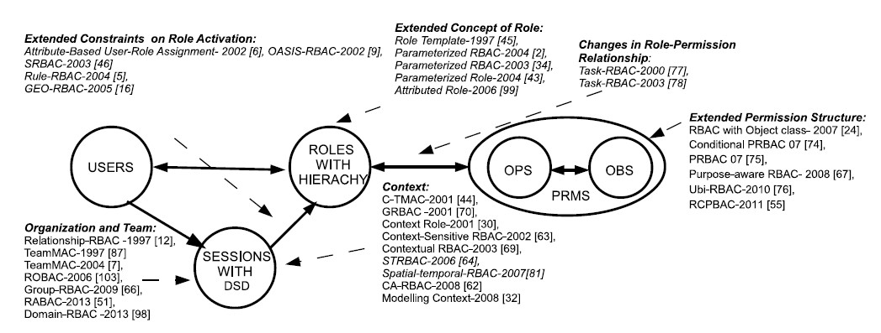
RBAC Extensions
1,4
1, 2, 4, 5
1, 4, 5
4, 5
1, 2, 3, 4, 5
4
1, 4, 5
1. Context Attributes
2. Subject attribute constraints policy are different at creation and modification time.
4. Policy Language
5. Meta-Attributes
3. Subject attributes constrained by attributes of subjects created by the same user.
World-Leading Research with Real-World Impact!
18
Notes:
Give examples about what is excluded

Slide 19
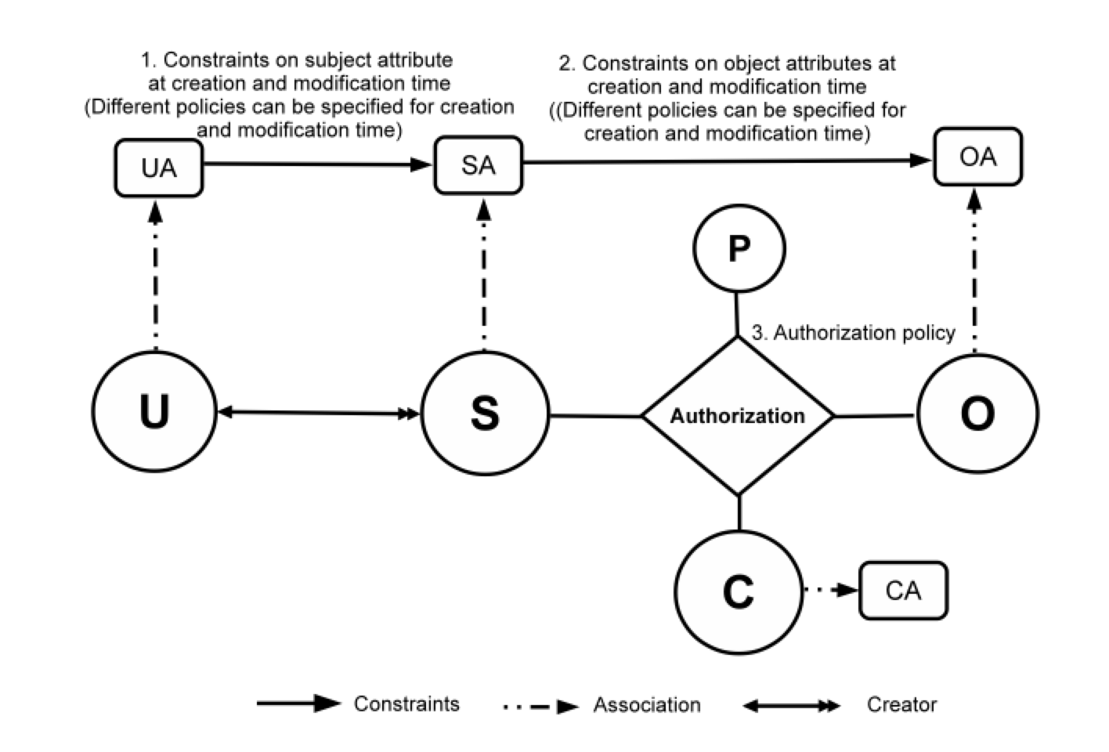
ABAC_{β} Model
Can be configured to do many
but not all RBAC extensions
19
Notes:
Show abac-alpha
Then for each type of extension, highlight the extensions to ABAC
23 and 24 integrated

Slide 20
Roles and Attributes
© Ravi Sandhu
World-Leading Research with Real-World Impact!

Slide 21
Roles and Attributes
Attribute-
Centric
Role is just another attribute. Nothing special about it.
Dynamic
Roles
Compute user roles from user attributes
Role-
Centric
Attributes constrain permissions of roles for each user
© Ravi Sandhu
World-Leading Research with Real-World Impact!
21

Slide 22
User-Role Assignment Problem
Hard Enough
Impossible
Constraints
© Ravi Sandhu
World-Leading Research with Real-World Impact!
22

Slide 23
Dynamic Roles
Rule-Based RBAC (RB-RBAC)
Attributes
Expressions
Roles
Constraints
Permissions
Attributes
values
Users
© Ravi Sandhu
World-Leading Research with Real-World Impact!
23

Slide 24
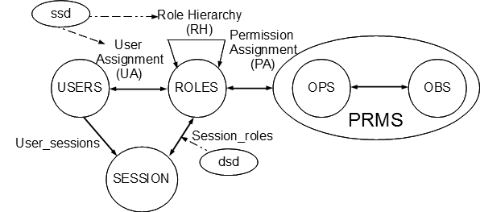
Role Explosion Problem
Role Explosion
Number of roles is supposed to be much smaller than number of users.
Role Explosion : Different roles have to be defined for slightly different sets of permissions.
© Ravi Sandhu
24

Slide 25
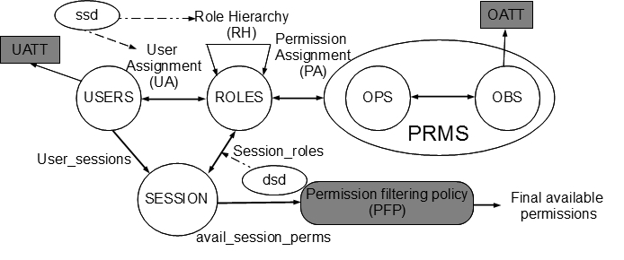
RABAC (Role-Centric ABAC)
© Ravi Sandhu
World-Leading Research with Real-World Impact!
25

Slide 26
Example
Doctor
Attending Doctor
Patient
One doctor role for each set of patients.
Patient Document
Revealed for specific project.
prj1
Visit Doctor
Time and devices constraints, etc.
prj2
prj3
One VisitDoctor role for each project.
prjn
© Ravi Sandhu
World-Leading Research with Real-World Impact!
26

Slide 27
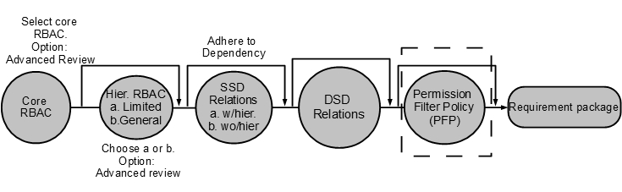
RABAC wrt NIST RBAC Model
© Ravi Sandhu
World-Leading Research with Real-World Impact!
27

Slide 28
UCON Model
© Ravi Sandhu
World-Leading Research with Real-World Impact!

Slide 29
Usage Control (UCON)
Security
Objectives
Security Architectures
© Ravi Sandhu
World-Leading Research with Real-World Impact!
29

Slide 30
Building UCON_{ABC} Models
Continuity
  Decision can be made during usage for continuous enforcement
Mutability
  Attributes can be updated as side-effects of subjects’ actions
© Ravi Sandhu
World-Leading Research with Real-World Impact!
30

Slide 31
Building UCON_{ABC} Models
Continuity
  Decision can be made during usage for continuous enforcement
Mutability
  Attributes can be updated as side-effects of subjects’ actions
© Ravi Sandhu
World-Leading Research with Real-World Impact!
31

Slide 32
Examples
Long-distance phone (pre-authorization with post-update)
Pre-paid phone card (ongoing-authorization with ongoing-update)
Pay-per-view (pre-authorization with pre-updates)
Click Ad every 30 minutes (ongoing-obligation with ongoing-updates)
Business Hours (pre-/ongoing-condition)
© Ravi Sandhu
World-Leading Research with Real-World Impact!
32

Slide 33
UCON_{ABC} Model Space
 | 0(Immutable) | 1(pre) | 2(ongoing) | 3(post)
preA | Y | Y | N | Y
onA | Y | Y | Y | Y
preB | Y | Y | N | Y
onB | Y | Y | Y | Y
preC | Y | N | N | N
onC | Y | N | N | N
N : Not applicable
© Ravi Sandhu
World-Leading Research with Real-World Impact!
33

Slide 34
A Family of UCON_{ABC} Core Models
© Ravi Sandhu
World-Leading Research with Real-World Impact!
34

Slide 35
UCON_{preA}
Online content distribution service
  Pay-per-view (pre-update)
  Metered payment (post-update)
© Ravi Sandhu
World-Leading Research with Real-World Impact!
35

Slide 36
UCON_{onA}
Pay-per-minutes (pre-paid Phone Card)
© Ravi Sandhu
World-Leading Research with Real-World Impact!
36

Slide 37
UCON_{preA}: pre-Authorizations Model
UCON_{preA0}
  S, O, R, ATT(S), ATT(O) and preA (subjects, objects, rights, subject attributes, object attributes, and pre-authorizations respectively);
  allowed(s,o,r) ⇒ preA(ATT(s),ATT(o),r)
UCON_{preA1}
  preUpdate(ATT(s)),preUpdate(ATT(o))
UCON_{preA3}
  postUpdate(ATT(s)),postUpdate(ATT(o))
© Ravi Sandhu
World-Leading Research with Real-World Impact!
37

Slide 38
UCON_{preA0}: MAC Example
L is a lattice of security labels with dominance relation ≥
clearance: S → L
classification: O → L
ATT(S) = {clearance}
ATT(O) = {classification}
allowed(s,o,read) ⇒ clearance(s) ≥ classification(o)
allowed(s,o,write) ⇒ clearance(s) ≤ classification(o)
© Ravi Sandhu
World-Leading Research with Real-World Impact!
38

Slide 39
DAC in UCON: with ACL (UCON_{preA0})
N is a set of identity names
id : S → N, one to one mapping
ACL : O → 2^{N x R}, n is authorized to do r to o
ATT(S)= {id}
ATT(O)= {ACL}
allowed(s,o,r) ⇒ (id(s),r) ∈ ACL(o)
© Ravi Sandhu
World-Leading Research with Real-World Impact!
39

Slide 40
RBAC in UCON: RBAC₁ (UCON_{preA0})
P = {(o,r)}
ROLE is a partially ordered set of roles with dominance relation ≥
actRole: S → 2^{ROLE}
Prole: P → 2^{ROLE}
ATT(S) = {actRole}
ATT(O) = {Prole}
allowed(s,o,r) ⇒ ∃role ∈ actRole(s), ∃role’ ∈ Prole(o,r), role ≥ role’
© Ravi Sandhu
World-Leading Research with Real-World Impact!
40

Slide 41
DRM in UCON: Pay-per-use with pre-paid credit (UCON_{preA1})
M is a set of money amounts
credit: S → M
value: O x R → M
ATT(s): {credit}
ATT(o,r): {value}
allowed(s,o,r) ⇒ credit(s) ≥ value(o,r)
preUpdate(credit(s)): credit(s) = credit(s) - value(o,r)
© Ravi Sandhu
World-Leading Research with Real-World Impact!
41

Slide 42
UCON_{preA3} : DRM Example
Membership-based metered payment
  M is a set of money amount
  ID is a set of membership identification numbers
  TIME is a current usage minute
  member: S → ID
  expense: S → M
  usageT: S → TIME
  value: O x R → M (a cost per minute of r on o)
  ATT(s): {member, expense, usageT}
  ATT(o,r): {valuePerMinute}
  allowed(s,o,r) ⇒ member(s) ≠ ∅
  postUpdate(expense(s)): expense(s) = expense(s) + (value(o,r) x usageT(s))
© Ravi Sandhu
World-Leading Research with Real-World Impact!
42

Slide 43
UCON_{onA}: ongoing-Authorizations Model
UCON_{onA0}
  S, O, R, ATT(S), ATT(O) and onA;
  allowed(s,o,r) ⇒ true;
  Stopped(s,o,r) ⇐ ¬onA(ATT(s),ATT(o),r)
UCON_{onA1}, UCON_{onA2}, UCON_{onA3}
  preUpdate(ATT(s)),preUpdate(ATT(o))
  onUpdate(ATT(s)),onUpdate(ATT(o))
  postUpdate(ATT(s)),postUpdate(ATT(o))
Examples
  Certificate Revocation Lists
  revocation based on starting time, longest idle time, and total usage time
© Ravi Sandhu
World-Leading Research with Real-World Impact!
43

Slide 44
UCON_{B}
Free Internet Service Provider
  Watch Ad window (no update)
  Click ad within every 30 minutes (ongoing update)
© Ravi Sandhu
World-Leading Research with Real-World Impact!
44

Slide 45
UCON_{preB0}: pre-oBligations w/ no update
S, O, R, ATT(S), and ATT(O);
OBS, OBO and OB (obligation subjects, obligation objects, and obligation actions, respectively);
preB and preOBL (pre-obligations predicates and pre-obligation elements, respectively);
preOBL ⊆ OBS x OBO x OB;
preFulfilled: OBS x OBO x OB → {true,false};
getPreOBL: S x O x R → 2^{preOBL}, a function to select pre-obligations for a requested usage;
preB(s,o,r) = Λ(obs_i,obo_i,ob_i) ∈ getPreOBL(s,o,r) preFulfilled(obs_{i},obo_{i},ob_{i});
preB(s,o,r) = true by definition if getPreOBL(s,o,r)=∅;
allowed(s,o,r) ⇒ preB(s,o,r).
Example: License agreement for a whitepaper download
© Ravi Sandhu
World-Leading Research with Real-World Impact!
45

Slide 46
UCON_{onB0}: ongoing-oBligations w/ no update
S, O, R, ATT(S), ATT(O), OBS, OBO and OB;
T, a set of time or event elements;
onB and onOBL (on-obligations predicates and ongoing-obligation elements, respectively);
onOBL ⊆ OBS x OBO x OB x T;
onFulfilled: OBS x OBO x OB x T→ {true,false};
getOnOBL: S x O x R → 2^{onOBL}, a function to select ongoing-obligations for a requested usage;
onB(s,o,r) = Λ(obs_i,obo_i,ob_i, t_i) ∈ getOnOBL(s,o,r) onFulfilled(obs_{i},obo_{i},ob_{i} ,t_{i});
onB(s,o,r) = true by definition if getOnOBL(s,o,r)=∅;
allowed(s,o,r) ⇒ true;
Stopped(s,o,r) ⇐ ¬ onB(s,o,r).
Example: Free ISP with mandatory ad window
© Ravi Sandhu
World-Leading Research with Real-World Impact!
46

Slide 47
UCON_{C}
Location check at the time of access request
Accessible only during business hours
© Ravi Sandhu
World-Leading Research with Real-World Impact!
47

Slide 48
UCON_{preC0}: pre-Condition model
S, O, R, ATT(S), and ATT(O);
preCON (a set of pre-condition elements);
preConChecked: preCON → {true,false};
getPreCON: S x O x R → 2^{preCON};
preC(s,o,r) = Λ_{preCon_i ∈ getPreCON(s,o,r)} preConChecked(preCon_{i});
allowed(s,o,r) ⇒ preC(s,o,r).
Example: location checks at the time of access requests
© Ravi Sandhu
World-Leading Research with Real-World Impact!
48

Slide 49
UCON_{onC0}: ongoing-Condition model
S, O, R, ATT(S), and ATT(O);
onCON (a set of on-condition elements);
onConChecked: onCON → {true,false};
getOnCON: S x O x R → 2^{onCON};
onC(s,o,r) = Λ_{onCon_i ∈ getOnCON(s,o,r)} onConChecked(onCon_{i});
allowed(s,o,r) ⇒ true;
Stopped(s,o,r) ⇐ ¬onC(s,o,r)
Example: accessible during office hour
© Ravi Sandhu
World-Leading Research with Real-World Impact!
49

Slide 50
UCON_{ABC}
Free ISP
  Membership is required (pre-authorization)
  Have to click Ad periodically while connected (on-obligation, on-update)
  Free member: no evening connection (on-condition), no more than 50 connections (pre-update) or 100 hours usage per month (post-updates)
© Ravi Sandhu
World-Leading Research with Real-World Impact!
50

Slide 51
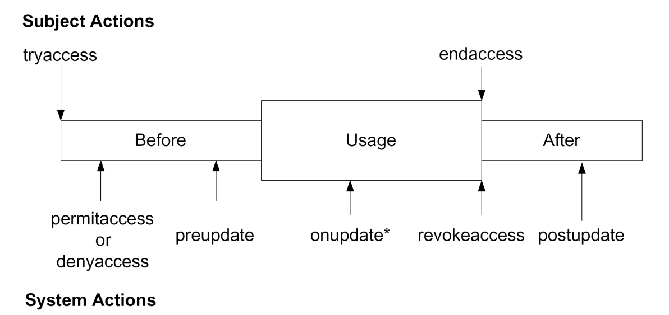
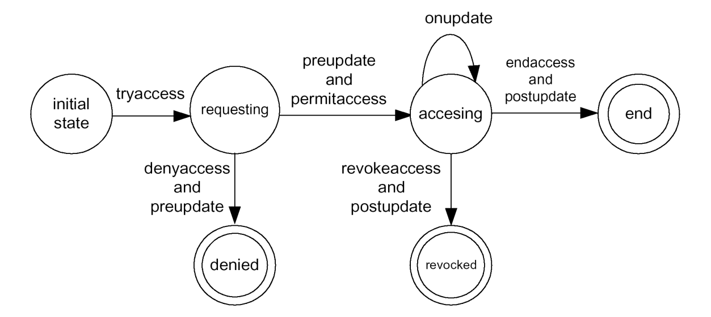
Logic Model of UCON
Actions: boolean expressions built from attributes in two states.
  Alice.credit’=Alice.credit - $50.0
Two types of actions:
  Control actions: change the state of single usage process
    Actions performed by the subject
    Actions performed by the system
  Obligation actions:
    Actions that have to be performed before or during an access.
    May or may not be performed by the requesting subject and on the target object.
© Ravi Sandhu
World-Leading Research with Real-World Impact!
51

