Slide 1
CS 5323
Relationship-Based Access Control (ReBAC)
Prof. Ravi Sandhu
Executive Director and Endowed Chair
Lecture 6
ravi.utsa@gmail.com
www.profsandhu.com
© Ravi Sandhu
World-Leading Research with Real-World Impact!

Slide 2
Access Control
Fixed
policy
Discretionary Access Control (DAC), 1970
Mandatory Access Control (MAC), 1970
Role Based Access Control (RBAC), 1995
Attribute Based Access Control (ABAC), ????
Flexible
policy
© Ravi Sandhu
World-Leading Research with Real-World Impact!
2

Slide 3
Access Control
Fixed
policy
Discretionary Access Control (DAC), 1970
Mandatory Access Control (MAC), 1970
Relationship Based Access Control (ReBAC), 2008
Role Based Access Control (RBAC), 1995
Attribute Based Access Control (ABAC), ????
Flexible
policy
© Ravi Sandhu
World-Leading Research with Real-World Impact!
3

Slide 4
Access Control
Fixed
policy
Discretionary Access Control (DAC), 1970
Mandatory Access Control (MAC), 1970
Relationship Based Access Control (ReBAC), 2008
Role Based Access Control (RBAC), 1995
Attribute Based Access Control (ABAC), ????
Flexible
policy
© Ravi Sandhu
World-Leading Research with Real-World Impact!
4

Slide 5
ReBAC Models
© Ravi Sandhu
World-Leading Research with Real-World Impact!

Slide 6
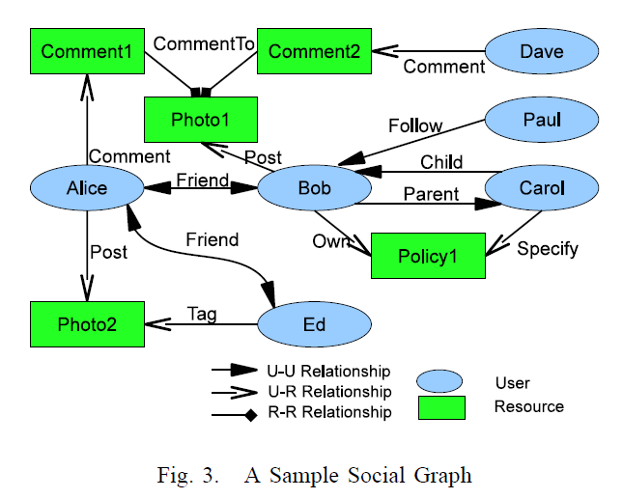
Online Social Networks (OSNs)
Social graph is modeled as a directed labeled simple graph G=<U, E, Σ>
Nodes U as users
Edges E as relationships
Σ={σ₁, σ₂, …,σ_{n}, σ₁⁻¹, σ₂⁻¹,…, σ_{n}⁻¹}
as relationship types supported
© Ravi Sandhu
World-Leading Research with Real-World Impact!
6

Slide 7
Access Control in OSNs
Policy Individualization
Users define their own privacy and activity preferences
Related users can configure policies too
Collectively used by the system for control decision
User and Resource as a Target
e.g., poke, messaging, friendship invitation
User Policies for Outgoing and Incoming Actions
User can be either requester or target of activity
Allows control on 1) activities w/o knowing a particular resource and 2) activities against the user w/o knowing a particular access requestor
e.g., block notification of friend’s activities; restrict from viewing violent contents
© Ravi Sandhu
World-Leading Research with Real-World Impact!
7

Slide 8
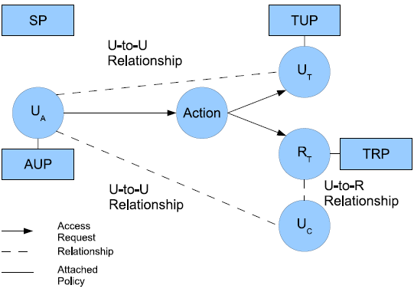
U2U ReBAC (UURAC) Model
U_{A}: Accessing User
U_{T}: Target User
U_{C}: Controlling User
R_{T}: Target Resource
AUP: Accessing User Policy
TUP: Target User Policy
TRP: Target Resource Policy
SP: System Policy
Policy Individualization
User and Resource as a Target
Separation of user policies for incoming and outgoing actions
Regular Expression based path pattern w/ max hopcounts (e.g., <u_{a}, (f*c,3)>)
© Ravi Sandhu
World-Leading Research with Real-World Impact!
8

Slide 9
Access Request and Evaluation
Access Request <u_{a}, action, target>
u_{a} tries to perform action on target
Target can be either user u_{t} or resource r_{t}
Policies and Relationships used for Access Evaluation
When u_{a} requests to access a user u_{t}
u_{a}’s AUP, u_{t}’s TUP, SP
U2U relationships between u_{a} and u_{t}
When u_{a} requests to access a resource r_{t}
u_{a}’s AUP, r_{t}’s TRP, SP
U2U relationships between u_{a} and u_{c}
© Ravi Sandhu
World-Leading Research with Real-World Impact!
9

Slide 10
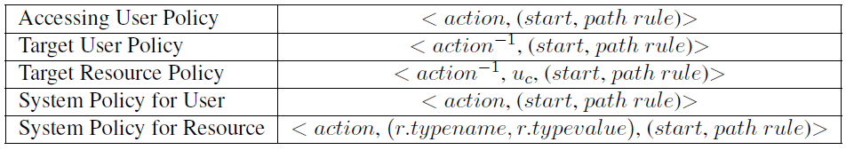
Policy Representations
action⁻¹ in TUP and TRP is the passive form since it applies to the recipient of action
TRP has an extra parameter u_{c} to specify the controlling user
U2U relationships between u_{a} and u_{c}
SP does not differentiate the active and passive forms
SP for resource needs r.typename, r.typevalue to refine the scope of the resource
© Ravi Sandhu
World-Leading Research with Real-World Impact!
10

Slide 11
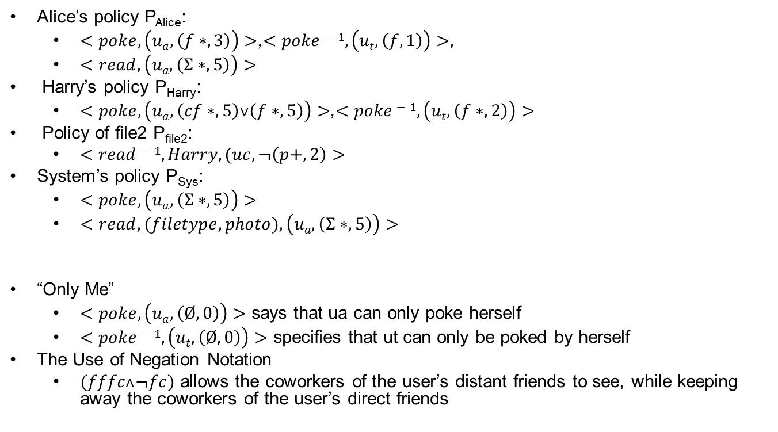
Example
© Ravi Sandhu
World-Leading Research with Real-World Impact!
11

Slide 12
Beyond U2U Relationships
There are various types of relationships between users and resources in addition to U2U relationships and ownership
e.g., share, like, comment, tag, etc
U2U, U2R and R2R
U2R further enables relationship and policy administration
© Ravi Sandhu
World-Leading Research with Real-World Impact!
12

Slide 13
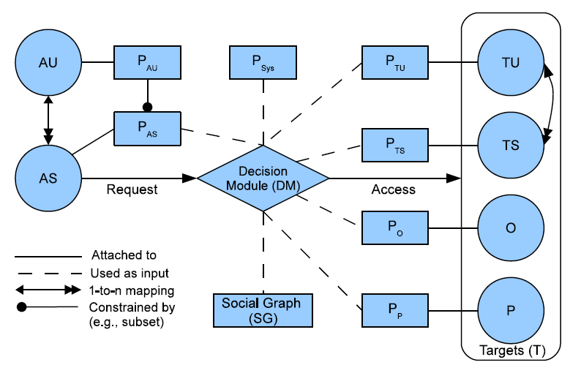
U2U, U2R & R2R ReBAC (URRAC) Model
AU: Accessing User
AS: Accessing Session
TU: Target User
TS: Target Session
O: Object
P: Policy
P_{AU}: Accessing User Policy
P_{AS}: Accessing Session Policy
P_{TU}: Target User Policy
P_{TS}: Target Session Policy
P_{O}: Object Policy
P_{P}: Policy for Policy
P_{Sys}: System Policy
© Ravi Sandhu
World-Leading Research with Real-World Impact!
13

Slide 14
Differences with UURAC
Access Request
(s, act, T) where T may contain multiple objects
Policy Administration
User-session Distinction
Hopcount Skipping
Local hopcount stated inside “[[]]” will not be counted in global hopcount.
E.g., “([f*,3][[c*, 2]],3)”, the local hopcount 2 for c* does not apply to the global hopcount 3, thus allowing f* to have up to 3 hops.
© Ravi Sandhu
World-Leading Research with Real-World Impact!
14

Slide 15
Policy Conflict Resolution
System-defined conflict resolution for potential conflicts among user-specified policies
Disjunctive, conjunctive and prioritized order between relationship types
<share-1, (own ∨ tag ∨ share)>
<read-1, (own ∧ tag)>
<friend_request, (parent > @)>
© Ravi Sandhu
World-Leading Research with Real-World Impact!
15

Slide 16
Beyond Relationships
ReBAC usually relies on type, depth, or strength of relationships, but cannot express more complicated topological information
ReBAC lacks support for attributes of users, resources, and relationships
Useful examples include common friends, duration of friendship, minimum age, etc.
© Ravi Sandhu
World-Leading Research with Real-World Impact!
16

Slide 17
Attribute-based Policy
<quantifier, f(ATTR(N), ATTR(E)), count ≥ i>
+0
+1
+1
+2
+2
-2
-2
-1
-2
-1
-0
∀[+1, -2], age(u) > 18
∃[+1, -1], weight(e) > 0.5
∃{+1, +2, -1}, gender(u) = “male”
© Ravi Sandhu
World-Leading Research with Real-World Impact!
17

Slide 18
Attribute-based Policy
Node attributes
Define user’s identity and characteristics: e.g., name, age, gender, etc.
Edge attributes
Describe the characteristics of the relationship: e.g., weight, type, duration, etc.
Count attributes
Occurrence requirements for the attribute-based path specification, specifying the minimum
© Ravi Sandhu
World-Leading Research with Real-World Impact!
18

Slide 19
Example: No Attributes
Bob
f
Dave
f
f
Alice
Ed
f
Harry
f
f
f
Carol
Fred
George
f
f
f
f
© Ravi Sandhu
World-Leading Research with Real-World Impact!
19

Slide 20
Example: Node Attributes
Bob
f
Dave
f
Occupation = ‘student’
Occupation = ‘student’
f
Alice
Ed
f
Harry
f
Occupation = ‘teacher’
f
f
Carol
Fred
George
f
Occupation = ‘student’
f
Occupation = ‘teacher’
f
Occupation = ‘student’
f
<access, (u_{a}, ((f*, 4): ∃[+1, -1], occupation = ‘student’, count ≥ 3)))>
© Ravi Sandhu
World-Leading Research with Real-World Impact!
20

Slide 21
Example: Edge Attributes
Since = Feb, 2014
Bob
f
Dave
Since =
June, 2013
f
f
Since = Aug, 2008
Alice
Ed
f
Harry
f
Since = May, 2009
Since = Aug, 2010
f
f
Carol
Fred
George
f
f
f
f
<read, Photo1, (u_{a}, ((f*, 3): ∀[+1, -1], duration ≥ 3 month, _)))>
© Ravi Sandhu
World-Leading Research with Real-World Impact!
21

Slide 22
ReBAC Models
Object-to-Object
© Ravi Sandhu
World-Leading Research with Real-World Impact!

Slide 23
Object Relationships in ReBAC
ReBAC for OSN generally considers only user to user relationship
OSN has very specific types of resources – photos, notes, comments, which are strongly tied to users.
Even though some ReBAC models consider general computing systems beyond OSNs they still need users/subjects existence in relationship graph.
© Ravi Sandhu
World-Leading Research with Real-World Impact!

Slide 24
ReBAC in General Beyond OSNs
user₁
Participant-of
project₁
Participant-of
folder₁
Supervises
Member-of
doc₁
folder₂
doc₂
Member-of
Member-of
A sample Relationship Graph for Organizational Environment [RPPM, Crampton et al. ,2014 ]
© Ravi Sandhu
World-Leading Research with Real-World Impact!
24

Slide 25
Existence of Object Relationship Independent of User
Object Relationship in Object –Oriented System (Inheritance, Composition and Association)
History of a Git Project (Version Control System) is a DAG
© Ravi Sandhu
World-Leading Research with Real-World Impact!

Slide 26
Limitations of Existing ReBAC Models
Cannot configure relationship between objects independent of user.
Cannot express authorization policy solely considering object relationship.
© Ravi Sandhu
World-Leading Research with Real-World Impact!

Slide 27
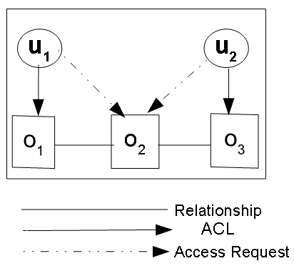
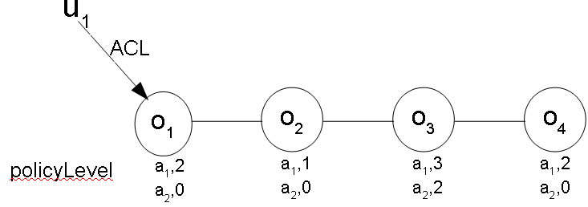
How the model would look like?
Object to Object Relationship Based Access Control
Policy Level Example
policyLevel(a₁ ,o₁) =2
policyLevel(a₂ ,o₁) =0
policyLevel(a₁,o₂) =1
policyLevel(a₂ ,o₂) =0
policyLevel(a₁ ,o₃) =3
policyLevel(a₂ ,o₃) =2
policyLevel(a₁ ,o₄) =2
policyLevel(a₂ ,o₄) =0
ACL(o₁) = {u₁}
ACL(o₂) = {}
ACL(o₃) = {u₂}
© Ravi Sandhu
World-Leading Research with Real-World Impact!

Slide 28
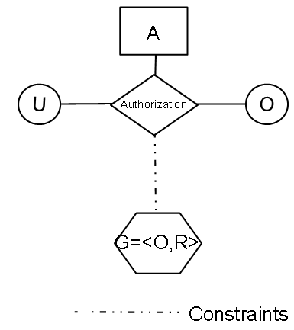
OOReBAC: Model Components and Definition
© Ravi Sandhu
World-Leading Research with Real-World Impact!

Slide 29
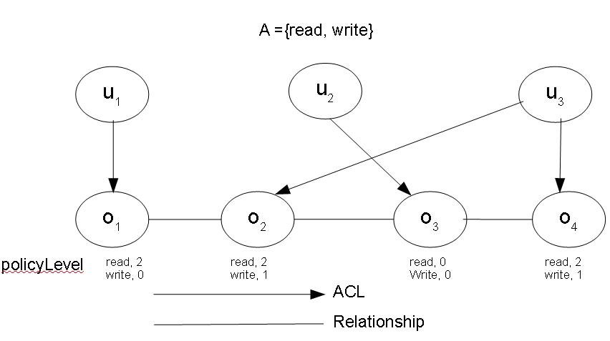
OOReBAC: An Example
Sequence of operations and its outcome:
Configuration:
Sequence of operations and its outcome:
© Ravi Sandhu
World-Leading Research with Real-World Impact!

Slide 30
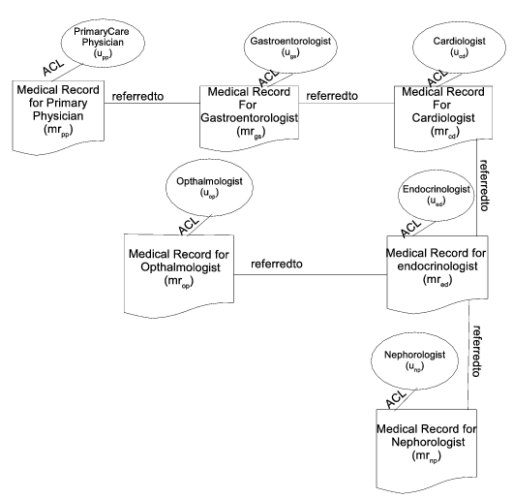
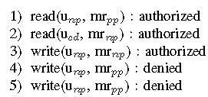
OOReBAC: Application
An OOReBAC Instantiation
Sequence of Operations and Outcomes
© Ravi Sandhu
World-Leading Research with Real-World Impact!

Slide 31
ABAC-ReBAC
Comparison
© Ravi Sandhu
World-Leading Research with Real-World Impact!

Slide 32
ReBAC Vs. ABAC
?
ReBAC
ABAC
Are they Comparable ?
Can Attributes Express Relationships?
Can ReBAC Configure ABAC? Vice versa?
Do they have equal expressive power?
If not
Which one is more expressive?
© Ravi Sandhu
World-Leading Research with Real-World Impact!

Slide 33
Attribute Types
Attribute Value Structure
Atomic-valued or Single-valued Attribute (e.g. gender)
Set-valued or Multi-valued Attribute (e.g. phoneNumber)
Structured Attribute (e.g person-Info (name, age, phoneNumber ))
Attribute Value Scope
Entity Attribute (e.g. friend)
Non-entity Attribute (e.g. age)
Boundedness of attribute range
Finite Domain Attribute (e.g. gender)
Infinite Domain Attribute (e.g. time)
Attribute association
Contextual or Environmental Attribute (e.g. currentTime)
Meta Attribute (e.g. role(user) = manager , task(manager) = supervise)
Attribute mutability
Mutable Attribute
Immutable Attribute
© Ravi Sandhu
World-Leading Research with Real-World Impact!

Slide 34

Attribute Function Composition
$$f:X→Y$$
$$g:Y→Z$$
$x∈X , g\left(f\left(x\right)\right)∈Z$
© Ravi Sandhu
World-Leading Research with Real-World Impact!

Slide 35
Assumptions
All non entity attribute are finite domain
Entity attribute functions are partial functions defined on existing entities only
Inner attribute function in an attribute function composition should always be entity attributes
Structured attribute is a multivalued tuple of atomic or set-valued attributes. So it is more expressive than atomic or set-valued attribute.
© Ravi Sandhu
World-Leading Research with Real-World Impact!

Slide 36
ReBAC Classification
Figure 3.: ReBAC Framework
© Ravi Sandhu
World-Leading Research with Real-World Impact!

Slide 37
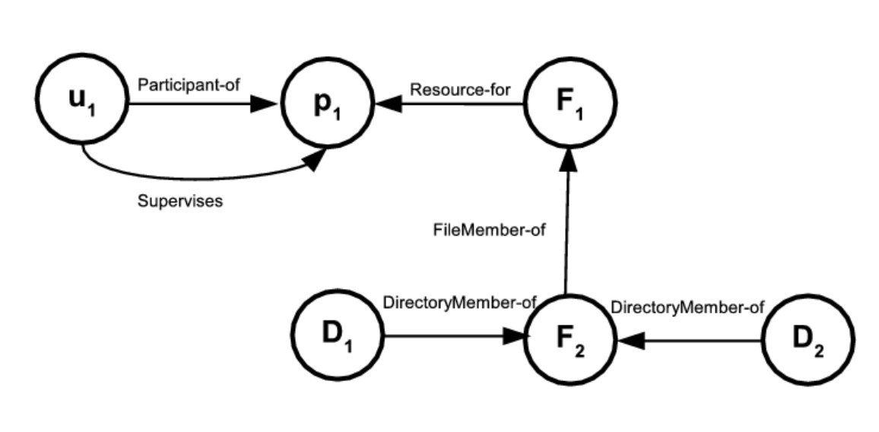
Example
Figure 4.: A Simple Relationship Graph Expressible in ReBAC_{B} [Crampton et al. 2014 ]
© Ravi Sandhu
World-Leading Research with Real-World Impact!

Slide 38
Example (Continued…)
Figure 5: An Example of Node Attributes in Relationship Graph Expressible in ReBAC_{BN}
Figure 6: An Example of Edge Attributes in Relationship Graph Expressible in ReBAC_{BE}
© Ravi Sandhu
World-Leading Research with Real-World Impact!

Slide 39
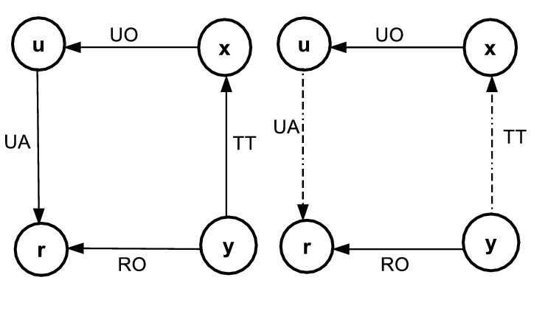
Example (Continued…)
Structure Edge Attribute:
dependsOn
Sub Attributes of dependsON
Source Node
Target Node
RelationshipType
dependsOn (u,r,UA) = (y,x,TT)
Figure 7: An Example of Node Attributes in Relationship Graph Expressible in ReBAC_{BNES} [Cheng et al. 2016]
© Ravi Sandhu
World-Leading Research with Real-World Impact!

Slide 40
ABAC Classification
Figure 8: ABAC Framework
© Ravi Sandhu
World-Leading Research with Real-World Impact!

Slide 41

Expressing Relationship Graph with Attributes
Entity types = {user, project, file , directory}
Attributes:
User attributes ={Participant-of, Supervises}
File attributes = {Resource-for, FileMember-of}
Project attributes = {}
Directory attributes ={DirectoryMember-of}
Relationship Graph in Figure 4 is Expressible with ABAC_{E}
© Ravi Sandhu
World-Leading Research with Real-World Impact!

Slide 42
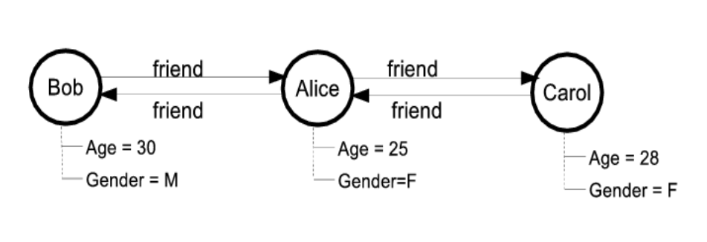
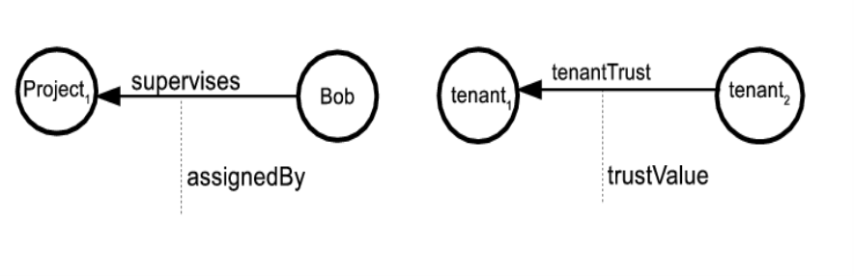
Expressing Relationship Graph with Attributes (Continued…)
entityType = {user}
Attribute:
user’s entity attribute ={friend}
User’s Non Entity Attribute ={Name, Age, Gender}
Relationship Graph in Figure 5 is Expressible with ABAC_{E}
entityType = {user, project, tenant}
Attribute:
user’s atomic entity attribute ={supervises}
User’s structured entity Attribute ={assignedBy}
e.g. assignedBy(Bob) = (“Project1”, “supervises”, “Alice”)
Relationship Graph in Figure 6 is Expressible with ABAC_{ES}
© Ravi Sandhu
World-Leading Research with Real-World Impact!

Slide 43
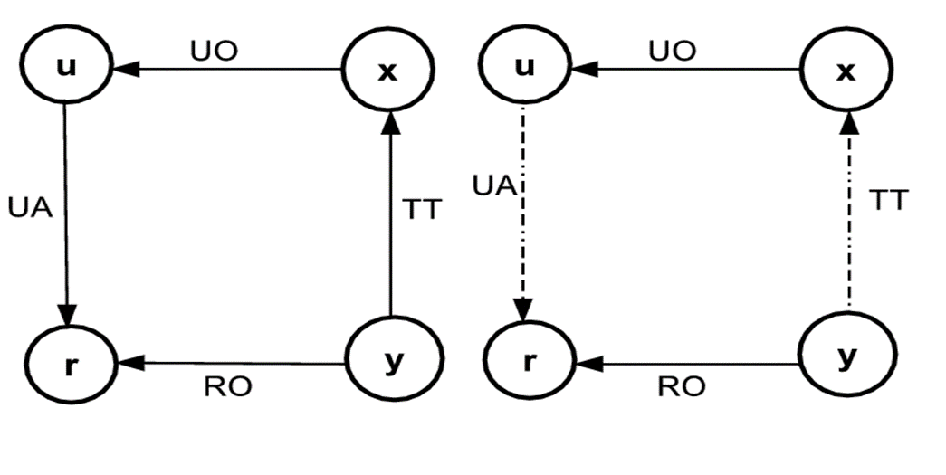
Expressing Relationship Graph with Attributes (Continued…)
Entity types: {user, tenant, role}
Attribute:
User’s atomic entity attribute: {UO,UA}
Users Structured Entity Attribute: {dependentEdge}
dependentEdge(u) = (“r”,“UA”,
{(y,x,TT)} )
Relationship Graph in Figure 7 is Expressible with ABAC_{ES}
© Ravi Sandhu
World-Leading Research with Real-World Impact!

Slide 44
Expressing Multilevel Relationship With Attributes
friend
friend
Alice
Bob
Carol
Figure 9. A simple Relationship Graph
Attribute Composition
Needs one attribute: friend
Policy Expression uses
Attribute composition
friend(Alice)={Bob}
friend(friend(Alice))={Carol}
Composite Attribute
Needs two attribute
1. friend
2. friendoffriend
Policy Expression uses
direct attributes
friend(Alice) ={Bob}
friendoffriend(Alice)={Carol}
© Ravi Sandhu
World-Leading Research with Real-World Impact!

Slide 45
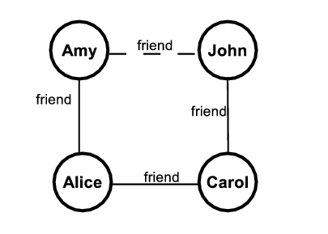
Example:
friend(Alice) = {Amy, Carol}
friendoffriend(Alice) = {John}
friend
Figure 10. A simple Relationship Graph
If the friend relationship between Amy and John deleted
friendoffriend(Alice) = ?
Instead of keeping the end user as attribute value we have to keep the exact path information.
© Ravi Sandhu
World-Leading Research with Real-World Impact!

Slide 46
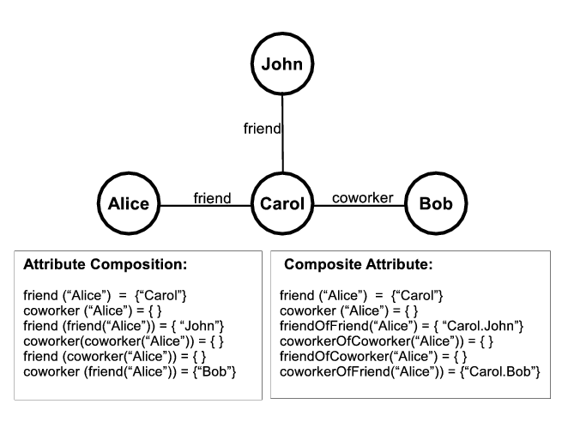
Example
Figure 12: Multilevel Relationship Expression with Attribute
© Ravi Sandhu
World-Leading Research with Real-World Impact!

Slide 47
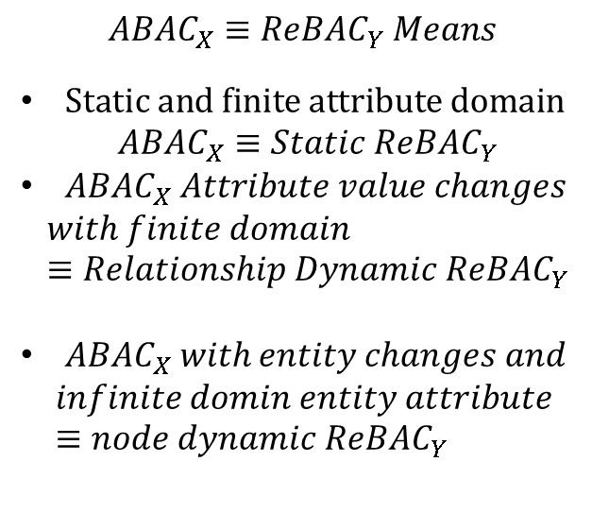
Comparison: On Dynamics
$$ABAC_{X}≡ReBA{C_{Y} Means}_{ }$$
$Static and finite attribute domain$
$$ABAC_{X}≡Static ReBAC_{Y}$$
$ABAC_{X} Attribute value changes$
$$with finite domain≡Relationship Dynamic ReBAC_{Y}$$
$ABAC_{X} with entity changes and$
$$infinite domin entity attribute ≡node dynamic ReBAC_{Y}$$
Figure 12: ReBAC Dynamics, ABAC Dynamics and Attribute Domain wise Comparison between ReBAC and ABAC
© Ravi Sandhu
World-Leading Research with Real-World Impact!

Slide 48
Comparison: Equivalent Structural Models for ReBAC and ABAC
Figure 13: Equivalence of ReBAC and ABAC Structural Classification
© Ravi Sandhu
World-Leading Research with Real-World Impact!

Slide 49
Comparison: Non-Equivalent Structural models for ReBAC and ABAC
Figure 14: Non-Equivalence of ReBAC and ABAC Structural Classification
© Ravi Sandhu
World-Leading Research with Real-World Impact!

Slide 50
Comparison: On Performance
Attribute Composition is similar to ReBAC and Both have polynomial complexity for authorization policy and constant complexity on update
Composite attribute has constant complexity on authorization policy and polynomial complexity on update to maintain relationship changes.
Performance Depends on :
Node Dynamics
Relationship Dynamics
Density of the Relationship Graph
© Ravi Sandhu
World-Leading Research with Real-World Impact!

Slide 51
Comparison: Choice of Models
For static system or only change or non entity attribute------Composite attribute is the best approach
System with huge node dynamics, relationship dynamics and high relationship density----- Attribute composition is the best option
If the system is in the middle between two extremes ---- A hybrid approach where both composite attribute and attribute composition is used.
Hybrid Approach:
To achieve p level relationship composition it uses m level composite attribute and n level attribute composition where p = n X m.
© Ravi Sandhu
World-Leading Research with Real-World Impact!

Slide 52
Comparison: In Respect of PEI Framework
No Difference
Both the approaches differ here
Figure 15: PEI Framework
© Ravi Sandhu
World-Leading Research with Real-World Impact!

