Slide 1
CS 5323
Authentication by Passwords
Prof. Ravi Sandhu
Executive Director and Endowed Chair
Lecture 16
ravi.utsa@gmail.com
www.profsandhu.com
© Ravi Sandhu
World-Leading Research with Real-World Impact!

Slide 2
Authentication Techniques
Authentication
Something
you know
password
“secret” questions
Something
you have
smartphone
registered device
Something
you are
fingerprint
iris
keyboard dynamics
signature dynamics
© Ravi Sandhu
World-Leading Research with Real-World Impact!
2

Slide 3
Authentication Techniques
Authentication
Something
you know
password
“secret” questions
Something
you have
smartphone
registered device
Something
you are
fingerprint
iris
keyboard dynamics
signature dynamics
single factor
multi
factor
© Ravi Sandhu
World-Leading Research with Real-World Impact!
3

Slide 4

Phishing
Personalized image to authenticate webserver to user
© Ravi Sandhu
World-Leading Research with Real-World Impact!

Slide 5
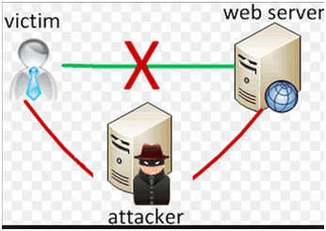
Phishing Man in the Middle
Personalized image passed through
© Ravi Sandhu
World-Leading Research with Real-World Impact!

Slide 6
Password Attacks
Password Attacks
Online
Lock out
Throttling
Offline (Dictionary Attack)
Complex passwords
Salting
© Ravi Sandhu
World-Leading Research with Real-World Impact!
6

Slide 7
Password Storage and Verification
Password Storage
Password Verification
User
ID
Plaintext
Password
User
ID
Plaintext
Password
= ?
User
ID
Stored
Password
User
ID
Stored
Password
Loss of stored passwords =
Catastrophic failure
© Ravi Sandhu
World-Leading Research with Real-World Impact!
7

Slide 8
Password Storage and Verification
Password Storage
Password Verification
User
ID
Plaintext
Password
User
ID
Plaintext
Password
Hashing
Process
Hashing
Process
User
ID
Computed
Hash
Stored
Hash
= ?
Loss of stored hashes =
Attack by single dictionary
User
ID
Stored
Hash
© Ravi Sandhu
World-Leading Research with Real-World Impact!
8

Slide 9
Password Storage and Verification
Password Storage
Password Verification
User
ID
Random
Salt
Plaintext
Password
User
ID
Plaintext
Password
Hashing
Process
Hashing
Process
User
ID
Stored
Salt
Computed
Hash
Stored
Hash
= ?
Loss of stored hashes =
Attack by different dictionary
for each salt value
User
ID
Stored
Salt
Stored
Hash
© Ravi Sandhu
World-Leading Research with Real-World Impact!
9

