Slide 1
TOPIC
SYSTEM Z
Ravi Sandhu
This lecture is primarily based on:
John McLean, Roger R. Schell and Donald L. Brinkley, "Security Models." Encyclopedia of Software Engineering,

Slide 2
BLP
S, fixed set of subjects
O, fixed set of objects
L, fixed lattice of security labels
F: S U O → L, assignment of security labels to subjects and objects
M: S X O → 2^{{read,write}}, access matrix
<F,M>, system state
V is set of all possible system states
A system consists of
  An initial state v₀
  A set of requests R
  A state transition function T: V X R → V

Slide 3
BLP
<F,M> is read secure (simple security) iff for all s, o
read in M[s,o] → F(s) ≥ F(o)
<F,M> is write secure (star-property) iff for all s, o
write in M[s,o] → F(s) ≤ F(o)
<F,M> is state secure iff it is read secure and write secure

Slide 4
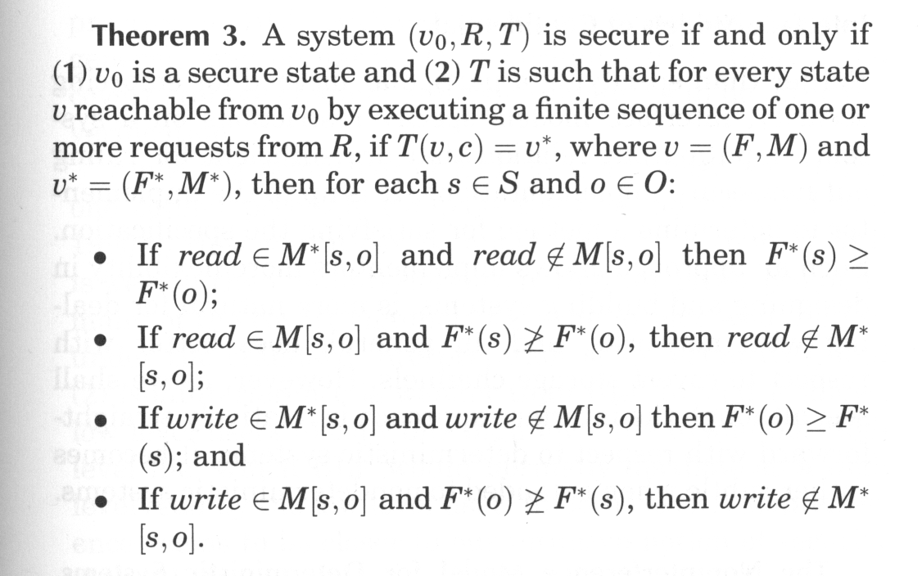
BLP BASIC SECURITY THEOREM (BST)

Slide 5
BLP WITH TRANQUILITY
F does not change
F^{v}(s) = F^{v0}(s)
F^{v}(o) = F^{v0}(o)
BLP with tranquility is intuitively secure
BLP with tranquility satisfies BST and thereby is formally “secure”
BUT
System Z is intuitively (and egregiously) insecure
System Z satisfies BST so BST is useless

Slide 6
SYSTEM Z
Initial state v₀ is state secure
Single transition rule: on any read or write request all subjects and objects are downgraded to system low and the access is allowed
System Z satisfies Basic Security Theorem

Slide 7
BLP WITH HIGH WATER MARK
F(o) does not change, F^{v}(o) = F^{v0}(o)
F(s) can change but
  only upwards, F^{v}(s) ≥ F^{v0}(s)
  only as far as user’s clearance, F^{v}(s) ≤ F(user(s))
  every change upwards in F(s) requires removal of write from M[s,o] cells where after the change F(s) > F(o)
BLP with high water mark is considered intuitively secure (and also satisfies BST)

Slide 8
BLP WITH LOW WATER MARK
F(o) does not change, F^{v}(o) = F^{v0}(o)
F(s) can change but
  only downwards, F^{v}(s) ≤ F^{v0}(s)
  can downgrade all the way to system low
  every change downwards in F(s) requires removal of read from M[s,o] cells where after the change F(s) < F(o)
BLP with low water mark is considered intuitively insecure (and also satisfies BST)
  memory of higher level reads can be retained in RAM, cache, CPU registers, program counter, etc

Slide 9
NON-INTERFERENCE
Views the system as a black box with input/output events that are caused by users
McLean’s paper assigns an input event the same level as the user’s clearance. This is not correct. More correctly an input event can be caused by a user but its security level should be specifiable by the user.
Reasonably intuitive and intuitively secure for deterministic systems
For non-deterministic systems it pushes intuition boundaries

Slide 10
NON-INTERFERENCE
Inputs
H
L
L
H
H
L
H
H
time
H
H
H
L
L
H
L
Outputs

Slide 11
NON-INTERFERENCE
Inputs
H
L
L
H
H
L
H
H
time
L
L
L
Outputs

Slide 12
NON-INTERFERENCE
Inputs
L
L
L
time
L
L
L
Outputs

Slide 13
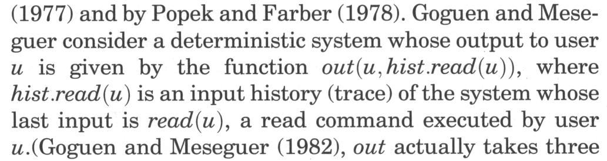
NON-INTERFERENCE

Slide 14
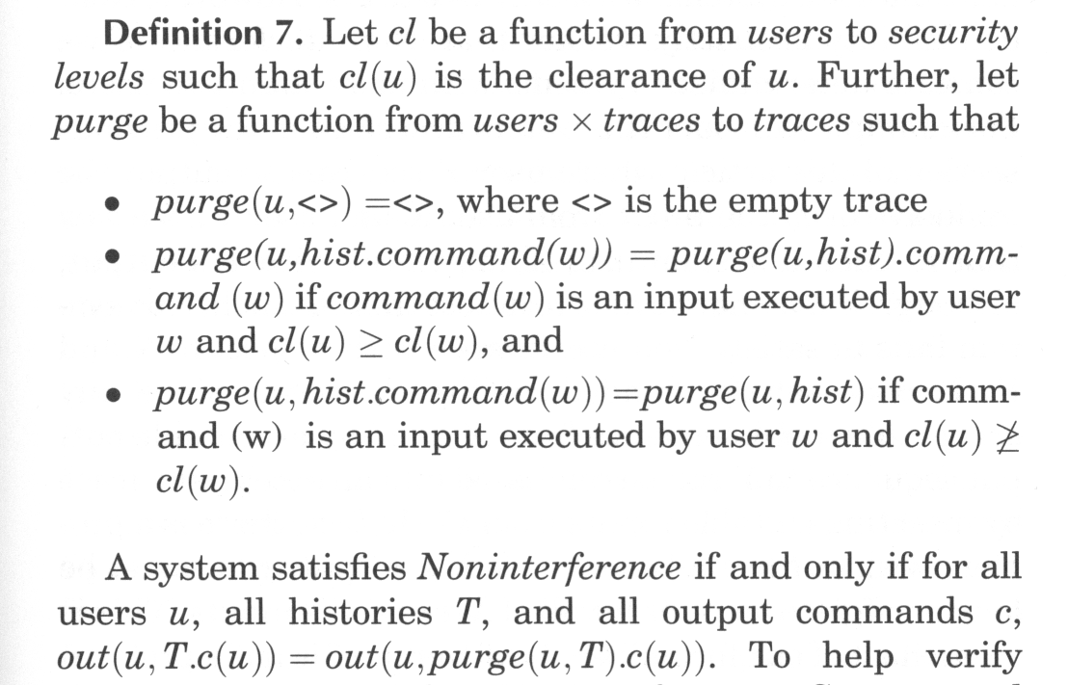
NON-INTERFERENCE

Slide 15
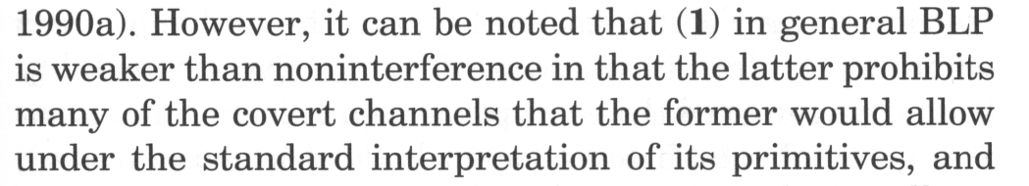
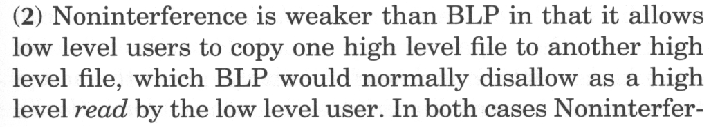
NON-INTERFERENCE vs BLP
Generally understood that non-interference can deal with storage covert channels but not with timing covert channels

Slide 16
NON-INTERFERENCE AND ENCRYPTION
X
V
XOR
X: plaintext
V: encryption key (one-time pad)
Y: ciphertext
Y

