Slide 1
NIST-ANSI RBAC Model
Prof. Ravi Sandhu

Slide 2
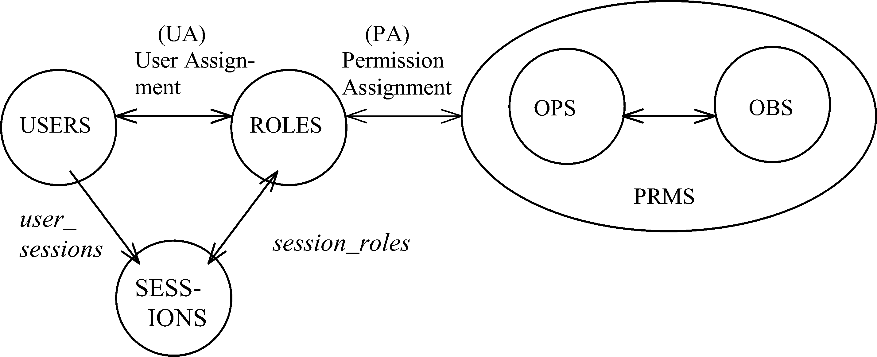
CORE RBAC
Notes:
This is a somewhat busy slide
It shows a bird’s eye view of RBAC
There are many details that need to be debated and filled in
Some of these will be discussed in the subsequent panel
For our purpose the bird’s eye view will suffice

Slide 3
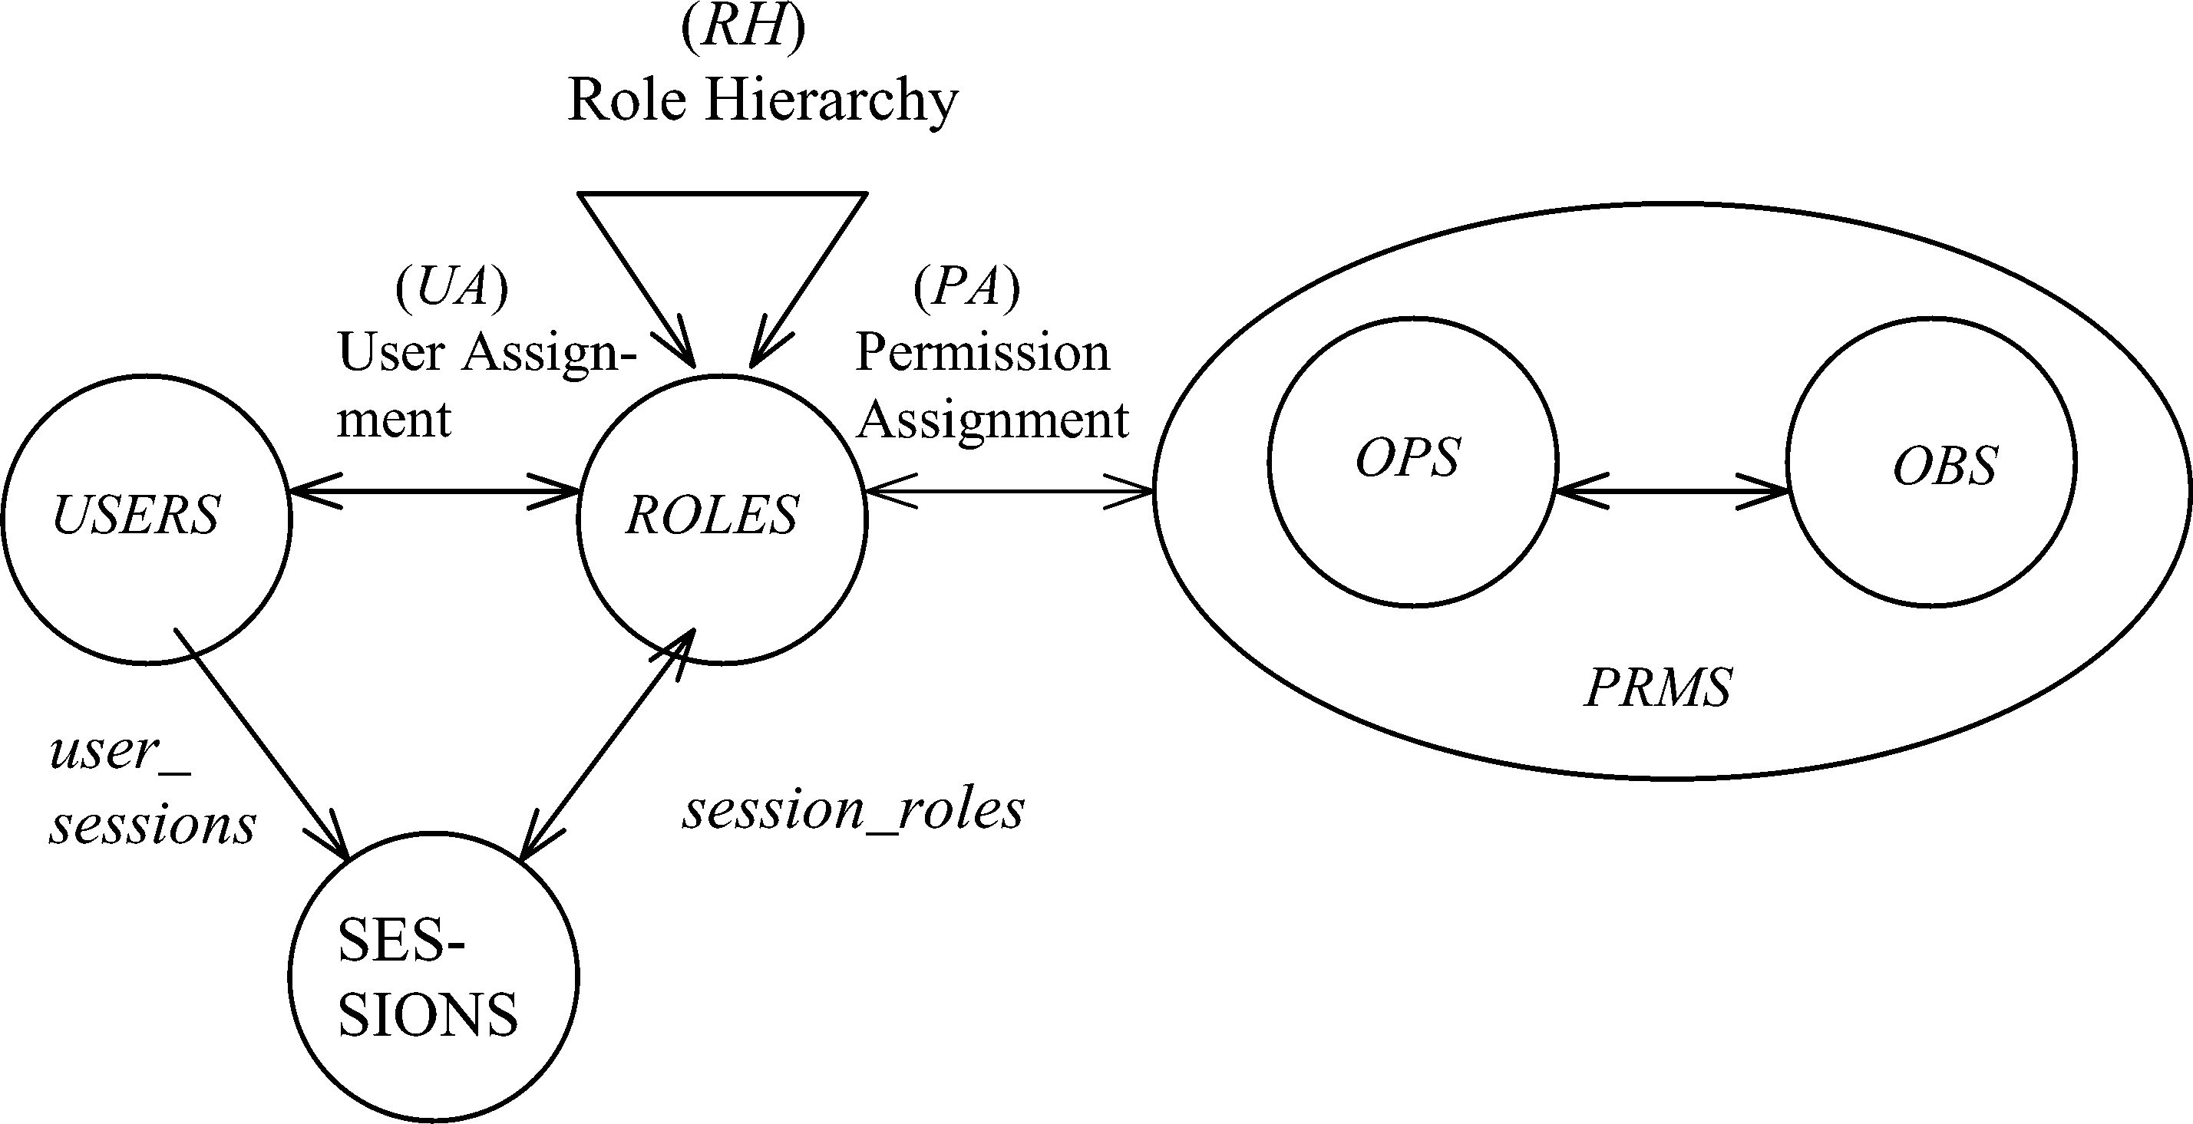
HIERARCHICAL RBAC
Notes:
This is a somewhat busy slide
It shows a bird’s eye view of RBAC
There are many details that need to be debated and filled in
Some of these will be discussed in the subsequent panel
For our purpose the bird’s eye view will suffice

Slide 4
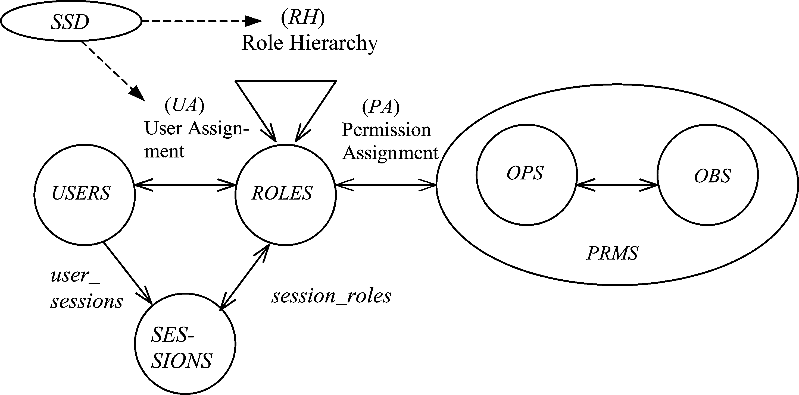
SSD IN HIERARCHICAL RBAC
Notes:
This is a somewhat busy slide
It shows a bird’s eye view of RBAC
There are many details that need to be debated and filled in
Some of these will be discussed in the subsequent panel
For our purpose the bird’s eye view will suffice

Slide 5
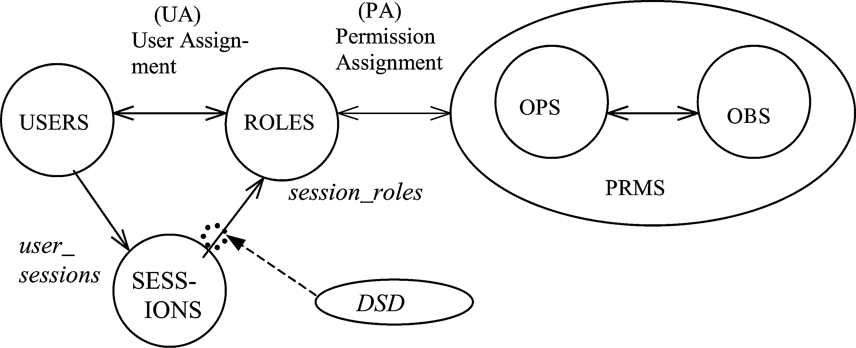
DSD IN HIERARCHICAL RBAC
Notes:
This is a somewhat busy slide
It shows a bird’s eye view of RBAC
There are many details that need to be debated and filled in
Some of these will be discussed in the subsequent panel
For our purpose the bird’s eye view will suffice

Slide 6
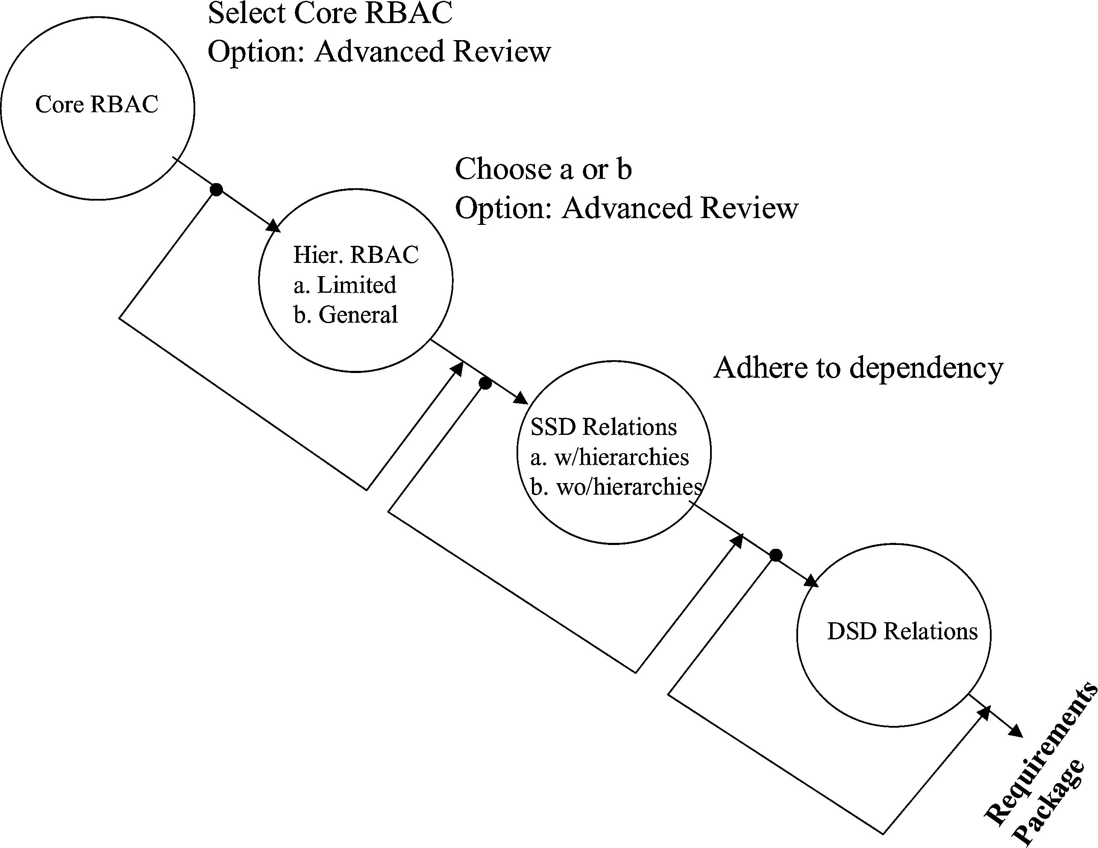
NIST MODEL FAMILY
Notes:
This is a somewhat busy slide
It shows a bird’s eye view of RBAC
There are many details that need to be debated and filled in
Some of these will be discussed in the subsequent panel
For our purpose the bird’s eye view will suffice

Slide 7
COMPARE RBAC96
RBAC3
ROLE HIERARCHIES +
CONSTRAINTS
RBAC1
ROLE
HIERARCHIES
RBAC2
CONSTRAINTS
RBAC0
BASIC RBAC

