Slide 1
CS 6393 Lecture 4
Authentication beyond Passwords
Prof. Ravi Sandhu
Executive Director and Endowed Chair
February 8, 2013
ravi.sandhu@utsa.edu
www.profsandhu.com
© Ravi Sandhu
World-Leading Research with Real-World Impact!

Slide 2
User Authentication
Something you know
e.g., passwords
User
Something you have
e.g., token, smartcard
Something you are
e.g., fingerprint
Single factor
Multi factor
Primary
Secondary
Weak
Strong
Single sign on
Reduced sign on
Reset
Revocation
© Ravi Sandhu
World-Leading Research with Real-World Impact!
2

Slide 3
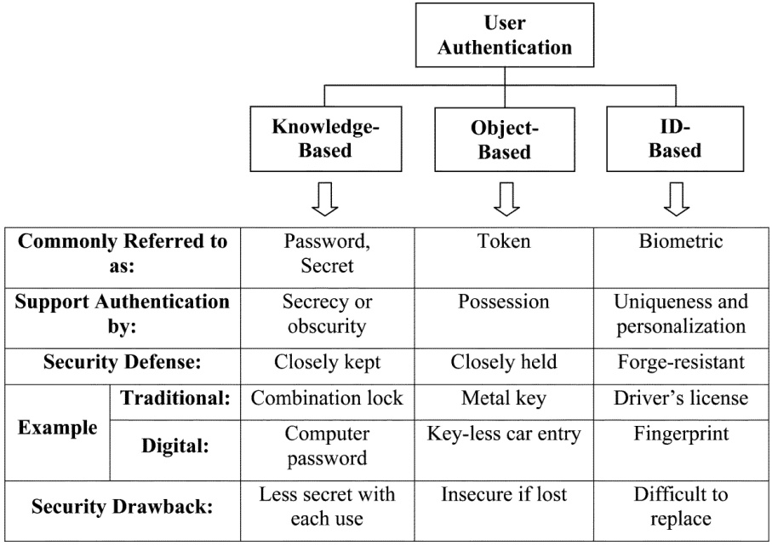
Gorman 2003
“The focus of this paper is a comparison of human authenticators. Comparison factors are security, convenience, and cost. The latter two factors are relatively straightforward and are described only briefly in this paper; however, security as measured by vulnerability to applicable attacks is not so straightforward and thus constitutes the bulk of the paper.”
© Ravi Sandhu
World-Leading Research with Real-World Impact!
3

Slide 4
Gorman 2003
“The focus of this paper is a comparison of human authenticators. Comparison factors are security, convenience, and cost. The latter two factors are relatively straightforward and are described only briefly in this paper; however, security as measured by vulnerability to applicable attacks is not so straightforward and thus constitutes the bulk of the paper.”
Must consider entire lifecycle
Nothing is straightforward in cyber security
© Ravi Sandhu
World-Leading Research with Real-World Impact!
4

Slide 5
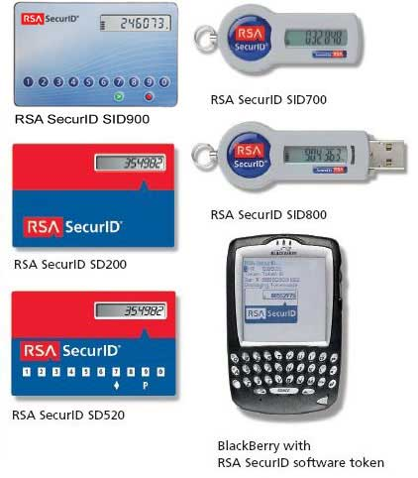
Gorman 2003
Born in early 1990s
symmetric key based
Biggest attacks to date:
lost master secrets
1st half 2011, revealed June 2012
man-in-the-middle
July 2006
© Ravi Sandhu
World-Leading Research with Real-World Impact!
5

Slide 6
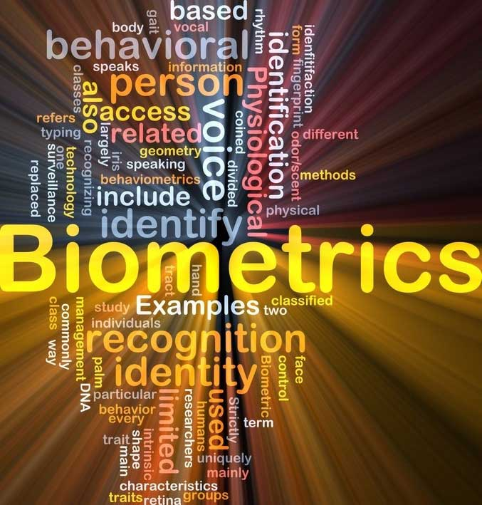
Gorman 2003
Verification
vs
Identification
© Ravi Sandhu
World-Leading Research with Real-World Impact!
6

Slide 7
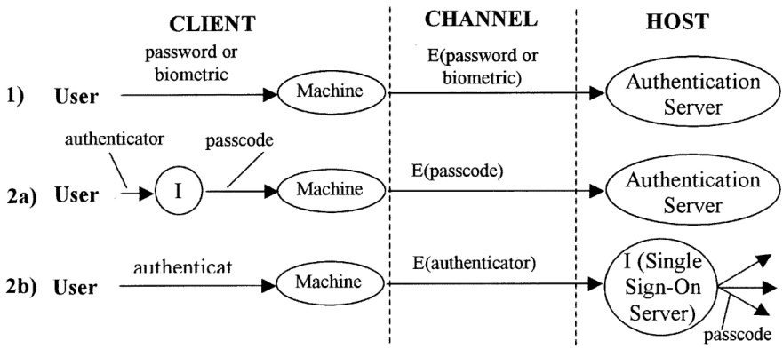
Gorman 2003
We will discuss SSO separately
© Ravi Sandhu
World-Leading Research with Real-World Impact!
7

Slide 8
Gorman 2003
“Authenticators can be attacked at three locations: at the client, in the transmission channel, and at the host. Other papers cover protection of a password or passcode in the channel by protocols that encrypt the password [24]–[26]. We deal in this paper only with security issues at the client and host.”
© Ravi Sandhu
World-Leading Research with Real-World Impact!
8

Slide 9
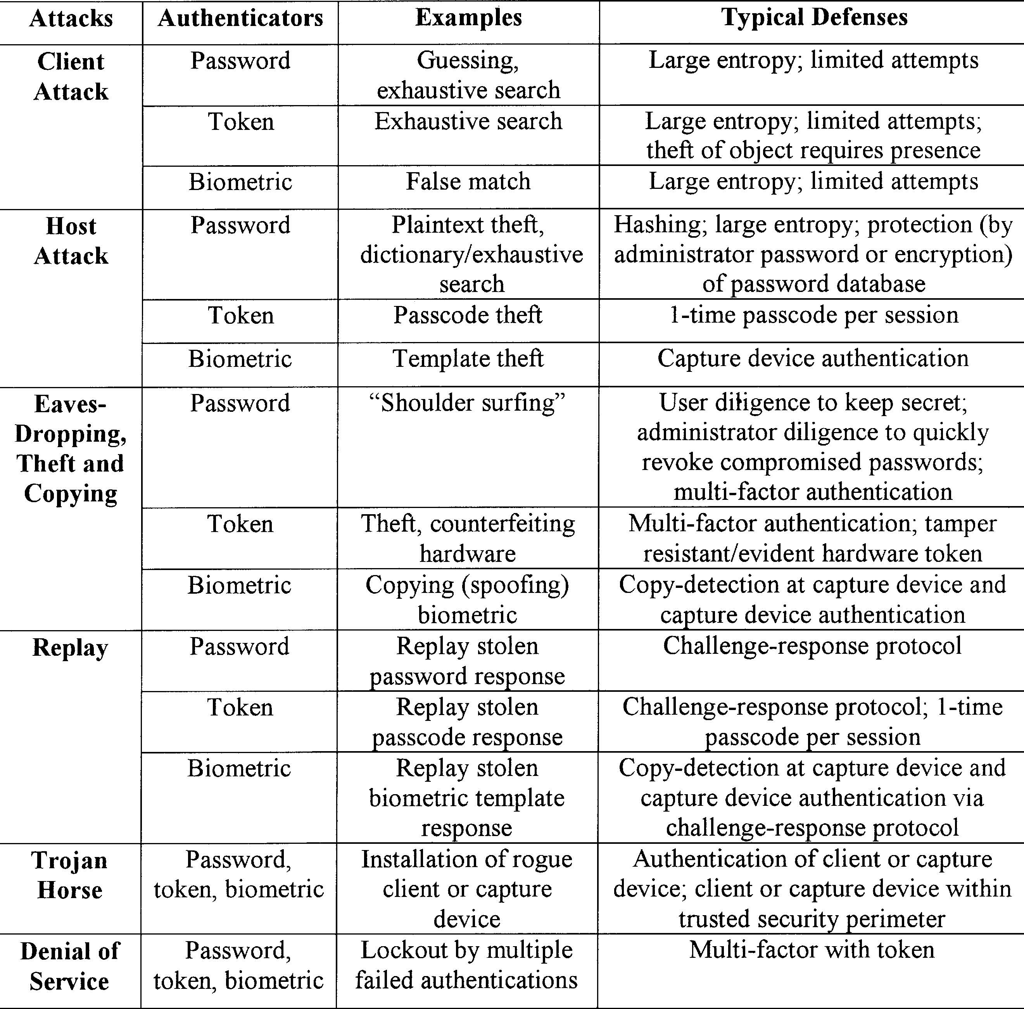
Gorman 2003
© Ravi Sandhu
World-Leading Research with Real-World Impact!
9

Slide 10
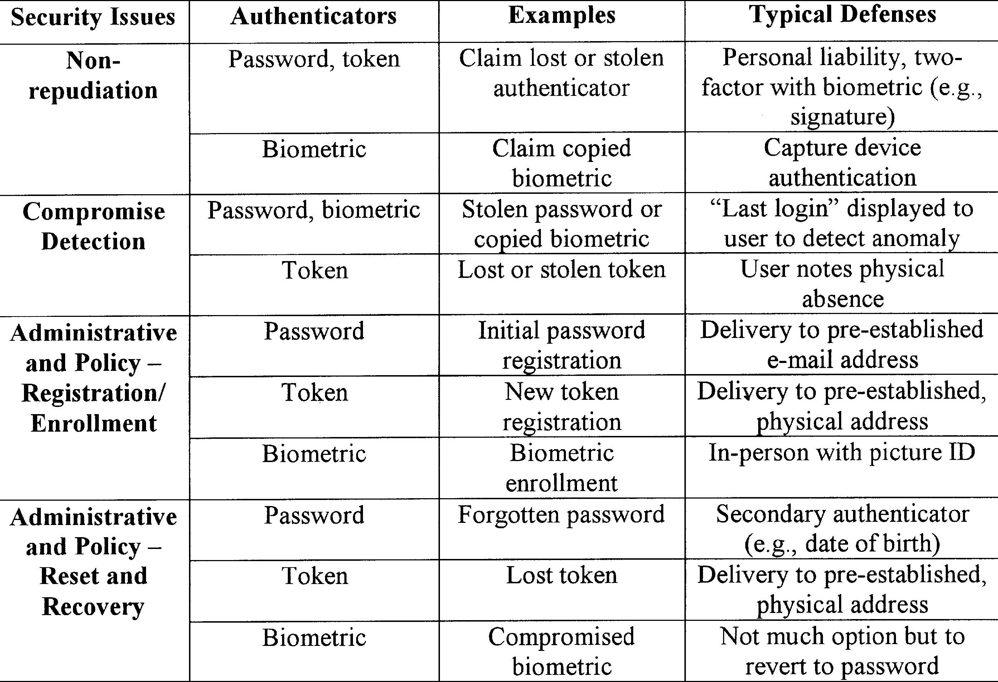
Gorman 2003
© Ravi Sandhu
World-Leading Research with Real-World Impact!
10

Slide 11
Status 2013
Passwords dominate with one-time-password tokens a distant second
Big unresolved threats:
Password reset
Social engineering
Keystroke loggers
Dictionary attacks at the server
Phishing
Man-in-the-middle
Man-in-the-browser
Man-in-the-PC
© Ravi Sandhu
World-Leading Research with Real-World Impact!
11

Slide 12
Futures Panel 2012
Greatest problem:
“… theft of credentials, which comes in different flavors. It could mean that you get phished and hand your password to a phisher, or it could mean that you share passwords across different sites, and one of those sites gets compromised.”
“… people”
“… from the user’s perspective is “too many.” ”
“We need to look at better ways to actually know who’s on the other end before we give them credentials for high-fidelity transactions.”
“… insecure and cumbersome to use.”
“I think we need to leave the current Internet with what it was intended for originally—the sharing of information. If we want to also have a network for high-fidelity transactions, we need to separate them.”
“ I think that having a single identity for all the different purposes that you need to conduct your life on the Internet is really an act in futility in terms of protecting all the things you need to protect.”
“My opinion is you can have a single identity, but the identity has to allow for multiple levels of assurance …”
© Ravi Sandhu
World-Leading Research with Real-World Impact!
12

Slide 13
Futures Panel 2012
What will happen next:
“I think user-visible changes will happen slowly. … Under the hood, I think there’s a constant arms race going on.”
“We’re going to see one of the major players, and by that I mean a Google or Microsoft or Apple or Amazon, take some known technology and weave it seamlessly—including from a user interface perspective—into some widely used service that has a big user base, and that’s going to turn the tide.”
“We will still have to wait a little bit until there’s enough of what I would call catastrophic events, where we just don’t like the state of affairs anymore. Then enough forces in the market will come together.”
“The current system is not sustainable, and I think that we have to move to something that’s bet- ter. It’s got to be something that we don’t have today, because we already know the stuff today doesn’t work.”
“You’re going to see an integration of event data that currently goes into your security event monitor, influencing authentication decisions. I think that you’re going to start seeing these events also going into whether or not you’re actually going to change the authorization corresponding to the initial authentication decision.”
© Ravi Sandhu
World-Leading Research with Real-World Impact!
13

