Slide 1
CS 6393 Lecture 4.sso
The Quest for Single-Sign On
Prof. Ravi Sandhu
Executive Director and Endowed Chair
February 8, 2013
ravi.sandhu@utsa.edu
www.profsandhu.com
© Ravi Sandhu
World-Leading Research with Real-World Impact!

Slide 2
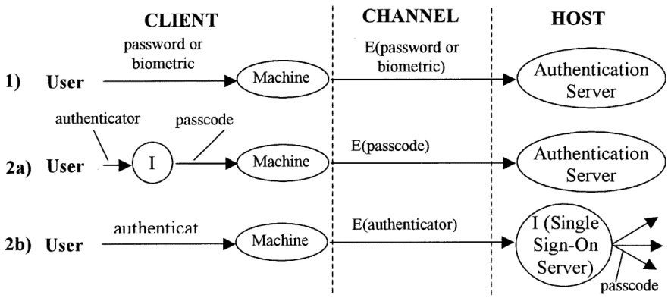
Gorman 2003
Initial authentication
Session establishment and maintenance to authentication server
Authentication to multiple servers
Session establishment and mantenance at multiple servers
Single logout
We will discuss SSO separately
© Ravi Sandhu
World-Leading Research with Real-World Impact!
2

Slide 3
User-Authenticator-Attribute Triangle
User
Attribute
Authenticator
© Ravi Sandhu
World-Leading Research with Real-World Impact!
3

Slide 4
User-Authenticator-Attribute Triangle
1990s
User
X.509
attribute
certificate
X.509
identity
certificate
Attribute
Authenticator
SPKI
certificate
© Ravi Sandhu
World-Leading Research with Real-World Impact!
4

Slide 5
User-Authenticator-Attribute Triangle
2000s
User
SAML
assertion
SAML
assertion
Attribute
Authenticator
SAML
assertion
© Ravi Sandhu
World-Leading Research with Real-World Impact!
5

Slide 6
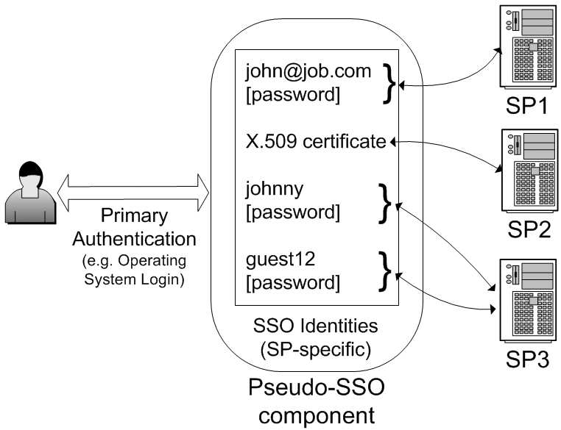
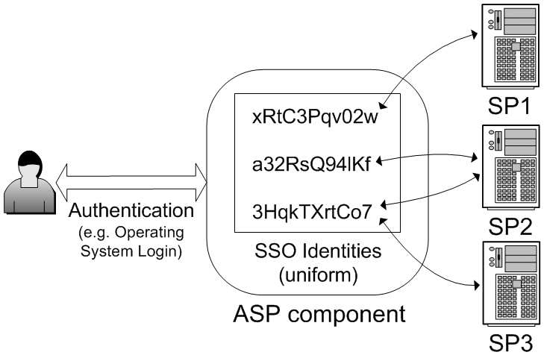
Taxonomy 2003
Pseudo SSO
Identity to SP is n to 1
True SSO
Identity to SP is n to m
SSO: single sign on
SP: service provider (also called relying party)
ASP: authentication service provider
© Ravi Sandhu
World-Leading Research with Real-World Impact!
6

Slide 7
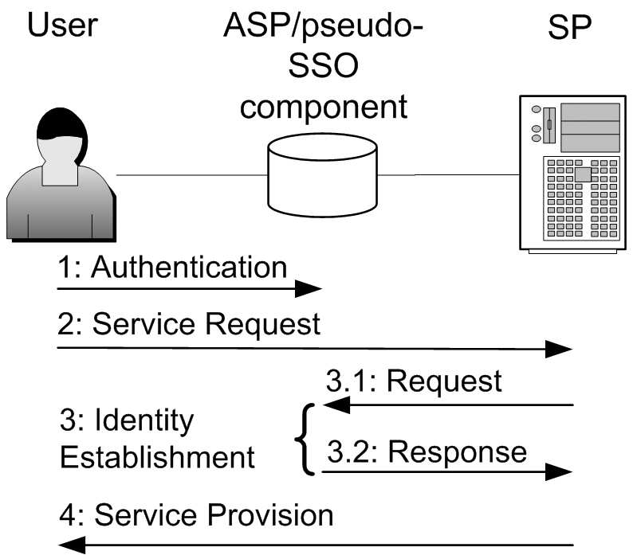
Taxonomy 2003
Local: to user platform
Proxy: provided by external platform
3.1 and 3.2
Pseudo SSO: authenticate
True SSO: pass assertions
Local, Pseudo
Proxy, Pseudo
Local, True
Proxy, True
© Ravi Sandhu
World-Leading Research with Real-World Impact!
7

Slide 8
Taxonomy 2003
PKI (Public Key Infrastructure) does not fall neatly into this characterization
SP1
User
Private
Key
SP2
SP3
Authenticated, confidential channels
2-way SSL also known as mutually authenticated SSL
© Ravi Sandhu
World-Leading Research with Real-World Impact!
8

