Slide 1
CS 6393 Lecture 5
Federated Identity and Single-Sign On
Prof. Ravi Sandhu
Executive Director and Endowed Chair
February 15, 2013
ravi.sandhu@utsa.edu
www.profsandhu.com
© Ravi Sandhu
World-Leading Research with Real-World Impact!

Slide 2
The Web Today
User ID, Password
+ maybe:
Personalized image
Cookie
Knowledge based authentication
One-time password
RP1
Client
RP2
Relying Parties
(Service Providers)
RP3
Encrypted channel
Weak RP to client authentication
Susceptible to RP spoofing and man-in-the-middle
© Ravi Sandhu
World-Leading Research with Real-World Impact!
2

Slide 3
The Web Today
User ID, Password
+ maybe:
Personalized image
Cookie
Knowledge based authentication
One-time password
Relying Parties
(Service Providers)
RP1
Private Key
Public Key
Client
RP2
Private Key
Public Key
Encrypted channel
Weak RP to client authentication
Susceptible to RP spoofing and man-in-the-middle
RP3
Private Key
Public Key
Signature: done by Private Key, Verified by Public Key
Encryption: done by Public Key, Decrypted by Private Key
© Ravi Sandhu
World-Leading Research with Real-World Impact!
3

Slide 4
The Web Today
VERSION
SERIAL NUMBER
SIGNATURE ALGORITHM
ISSUER
VALIDITY
SUBJECT
SUBJECT PUBLIC KEY INFO
SIGNATURE
How to get a public key?
Digital Certificates
PKI: Public Key Infrastructure
Guarantees authentication and integrity
But how does one verify this signature
Need another Public Key
© Ravi Sandhu
World-Leading Research with Real-World Impact!
4

Slide 5
The Web Today
Root certificates are weakly protected in today’s browsers
X
S
T
Q
R
A
C
E
G
I
K
M
O
a
b
c
d
e
f
g
h
i
j
k
l
m
n
o
p
Multi-rooted Certificate Hierarchy
© Ravi Sandhu
World-Leading Research with Real-World Impact!
5

Slide 6
The PKI Vision (1980s Onwards)
Relying Parties
(Service Providers)
RP1
Private Key
Public Key
Client
RP2
Private Key
Public Key
Private Key
Public Key
RP3
Private Key
Public Key
Eliminates man-in-the-middle in the network. Remains vulnerable to man-in-the-browser and man-in-the-PC
© Ravi Sandhu
World-Leading Research with Real-World Impact!
6

Slide 7
The PKI Vision (1980s Onwards)
User ID, Password
User ID, Password
Client
Man-in-the-middle MITM
RP
RP’s
Private Key
Public Key
RP’s Root
MITM’s Root
MITM’s
Private Key
Public Key
Client
Man-in-the-middle MITM
RP
RP’s
Private Key
Public Key
RP’s Root
MITM’s Root
MITM’s
Private Key
Public Key
Client’s
Private Key
Public Key
© Ravi Sandhu
World-Leading Research with Real-World Impact!
7

Slide 8
The PKI Vision (1980s Onwards)
Store as password protected and use in insecure PC
Store and use in smartcard
Store and use in Trusted Platform Module (TPM)
Relying Parties
(Service Providers)
RP1
Private Key
Public Key
Client
RP2
Private Key
Public Key
Private Key
Public Key
RP3
Private Key
Public Key
Store and use in
well protected server
hardware security module (HSM)
© Ravi Sandhu
World-Leading Research with Real-World Impact!
8

Slide 9
The PKI Vision (1980s Onwards)
One authenticator for each client
Protected by one or more additional factors
Usable by every RP who trusts the client’s root
Built-in out-of-the box Single Sign-On (SSO)
Massive expense by US DoD on Common Access Card
© Ravi Sandhu
World-Leading Research with Real-World Impact!
9

Slide 10
Kerberos SSO (1980’s onward)
Symmetric Key Technology
Kerberos
also
TGS
Stored client symmetric key Kc
c
{T_{c,tgs}, K_{c,tgs}} K_{c}
1
2
Client
Client password -> client symmetric key Kc
© Ravi Sandhu
World-Leading Research with Real-World Impact!
10

Slide 11
Kerberos SSO (1980’s onward)
Symmetric Key Technology
TGS
T_{c,tgs}, A_{c,tgs}, s
{T_{c,s}, K_{c,s}} K_{c,tgs}
3
4
Client
5
Server
T_{c,s}, A_{c,s}
© Ravi Sandhu
World-Leading Research with Real-World Impact!
11

Slide 12
Kerberos SSO (1980’s onward)
Kerberos
Realm 1
Kerberos
Realm 2
shared symmetric key
public-private keys
client
server
© Ravi Sandhu
World-Leading Research with Real-World Impact!
12

Slide 13
Kerberos SSO (1980’s onward)
Successful in Enterprise SSO
Scales to 10’s or 100’s of thousands of users
Microsoft Active Directory login is based on Kerberos
Inter-realm rarely deployed
© Ravi Sandhu
World-Leading Research with Real-World Impact!
13

Slide 14
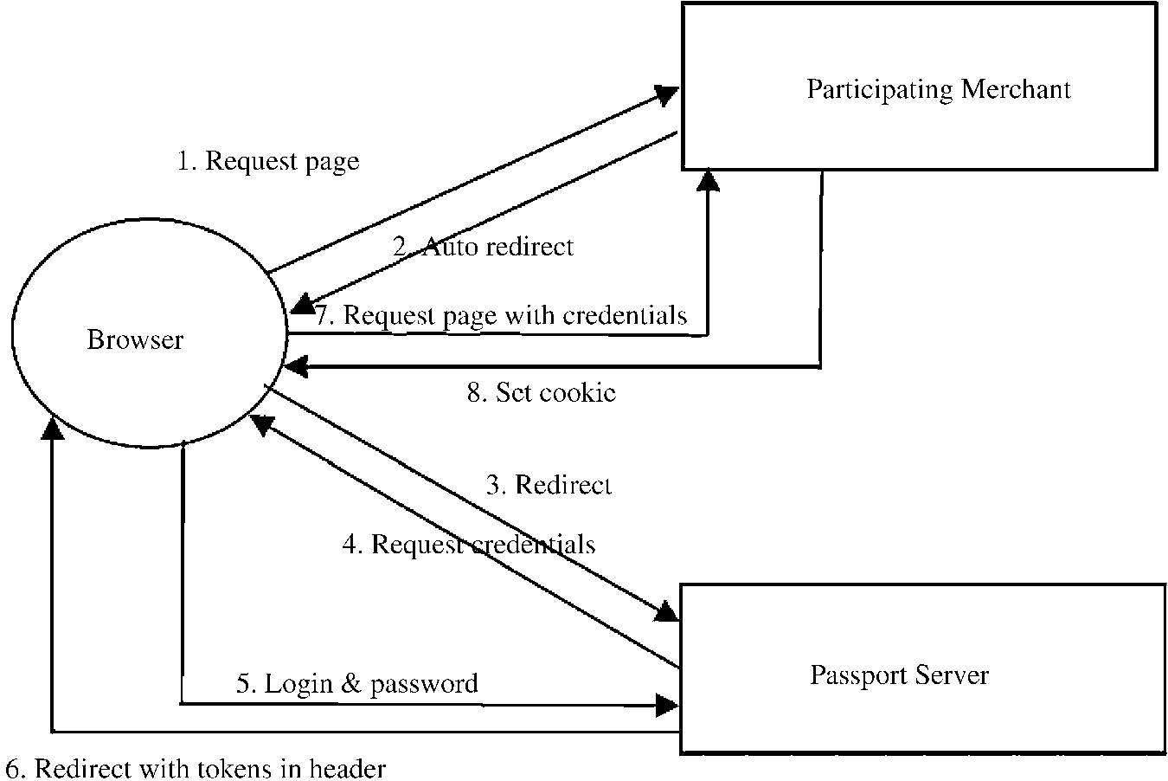
Microsoft SSO (1990’s)
Failed
© Ravi Sandhu
World-Leading Research with Real-World Impact!
14

Slide 15
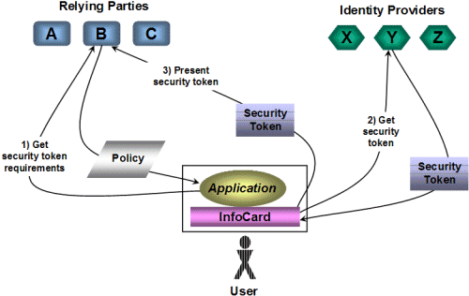
Microsoft Infocard Identity Ecosystem (2000’s)
Failed
© Ravi Sandhu
World-Leading Research with Real-World Impact!
15

Slide 16
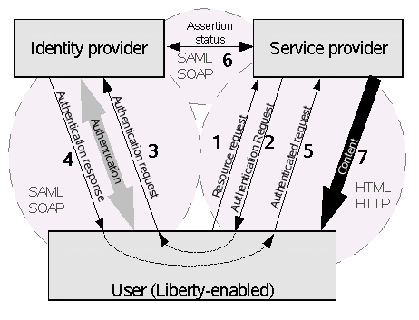
Liberty Alliance (2000’s)
Failed
© Ravi Sandhu
World-Leading Research with Real-World Impact!
16

Slide 17
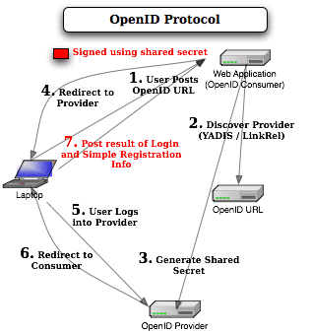
OpenID (2000’s)
Failing
© Ravi Sandhu
World-Leading Research with Real-World Impact!
17

Slide 18
NSTIC (2010’s)
© Ravi Sandhu
World-Leading Research with Real-World Impact!
18

