Slide 1
CS 6393 Lecture 7
Privacy
Prof. Ravi Sandhu
Executive Director and Endowed Chair
March 8, 2013
ravi.sandhu@utsa.edu
www.profsandhu.com
© Ravi Sandhu
World-Leading Research with Real-World Impact!

Slide 2
Privacy versus Security
Privacy
Security
I think this is wrong
© Ravi Sandhu
World-Leading Research with Real-World Impact!
2

Slide 3
Privacy versus Security
Security
Privacy
My preferred view
© Ravi Sandhu
World-Leading Research with Real-World Impact!
3

Slide 4
Privacy versus Security
Privacy
Security
But I could be persuaded to take this view
© Ravi Sandhu
World-Leading Research with Real-World Impact!
4

Slide 5
Security Objectives
USAGE
purpose
INTEGRITY
modification
AVAILABILITY
access
CONFIDENTIALITY
disclosure
© Ravi Sandhu
World-Leading Research with Real-World Impact!
5

Slide 6
Security Objectives
USAGE
purpose
Privacy includes limits on collection and retention
Privacy includes rights to see who has accessed your privacy sensitive information
Privacy includes recourse to correct and consequently recourse to access
INTEGRITY
modification
AVAILABILITY
access
CONFIDENTIALITY
disclosure
© Ravi Sandhu
World-Leading Research with Real-World Impact!
6

Slide 7
Attackers aka Adversaries
Your nation state
Other nation states
Employer
Service provider
Friends
Family
Enemies
Media
Criminals
…
© Ravi Sandhu
World-Leading Research with Real-World Impact!
7

Slide 8
Laws, Regulations and Standards
Overall fragmented and slow to catch up with rapid technological change
Privacy in the workplace is sharply limited
Some US laws
  FCRA (Fair Credit Reporting Act), 1970, enforced by FTC
  FERPA (Family Educational Rights and Privacy Act), 1974
  IRS Disclosure Laws, 1976
  VPPA (Video Privacy Protection Act, 1988
  HIPAA (Health Insurance Portability and Accountability Act), 1996
A failed standard
  P3P (Platform for Privacy Preferences) from W3C
© Ravi Sandhu
World-Leading Research with Real-World Impact!
8

Slide 9
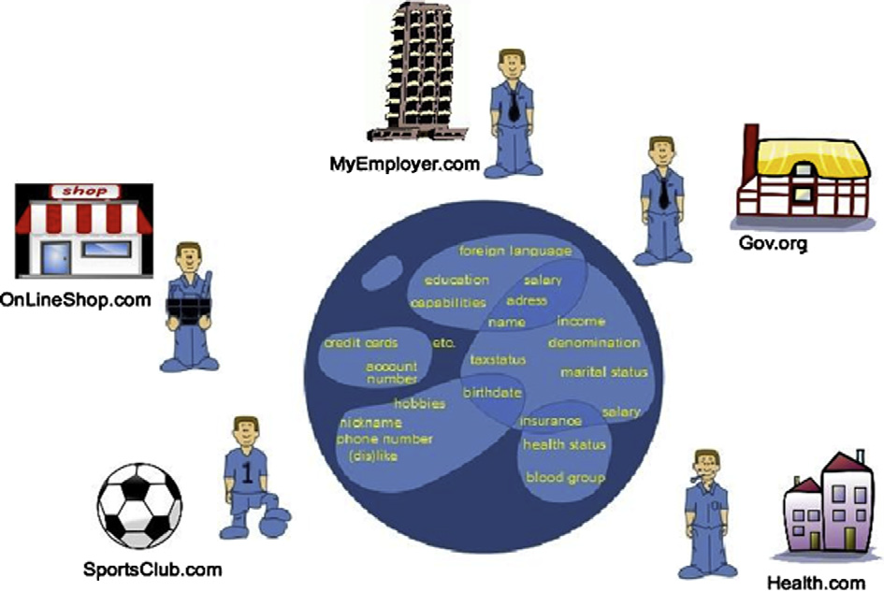
Identity as Attributes
© Ravi Sandhu
World-Leading Research with Real-World Impact!
9

Slide 10
X.509 PKI: Identity Centric, Off-Line
VERSION
SERIAL NUMBER
SIGNATURE ALGORITHM
ISSUER
VALIDITY
SUBJECT
SUBJECT PUBLIC KEY INFO
SIGNATURE
VERSION
SERIAL NUMBER
SIGNATURE ALGORITHM
ISSUER
VALIDITY
HOLDER PUBLIC KEY INFO
ATTRIBUTES
SIGNATURE
Identity
Certificate
Attribute
Certificate
© Ravi Sandhu
World-Leading Research with Real-World Impact!
10

Slide 11
X.509 Characteristics
Privacy friendly
  Certificate issuer is not involved and therefore not aware when a user receives service from a relying party UNLESS
  Certificate revocation needs to be verified in real-time
Privacy unfriendly
  Identity is central
  Attributes strongly linked through identity
  Attributes pre-packaged into certificates
© Ravi Sandhu
World-Leading Research with Real-World Impact!
11

Slide 12
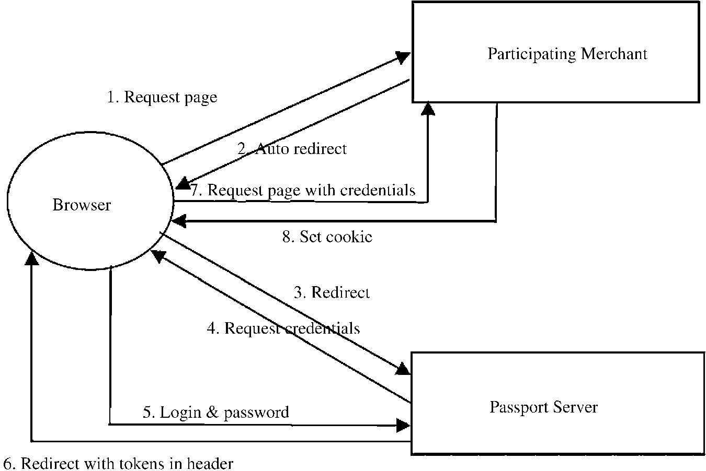
Microsoft SSO (1990’s)
Knows which relying parties are being accessed
Decides which attributes to release to which relying party
© Ravi Sandhu
World-Leading Research with Real-World Impact!
12

Slide 13
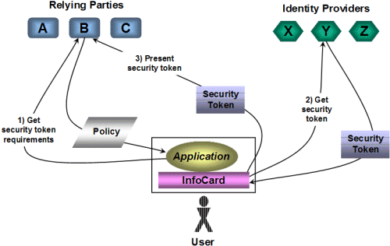
Microsoft Infocard Identity Ecosystem (2000’s)
Identity Provider knows when security tokens are requested BUT does not necessarily know specific relying party
User decides which attributes to release to which relying party
© Ravi Sandhu
World-Leading Research with Real-World Impact!
13

Slide 14
Private Credentials
Single private key
  Multiple unlinkable public keys, generated by the user from the single private key
  “A credential issued to one public key can be (repeatedly) transformed into a credential that’s valid on another public key of the same user. Moreover, the transformed credential can contain a selected subset of the attributes in the original credential.”
  “Transformed credentials are unlinkable. That is, for two transformed credentials with disjoint sets of revealed attributes, you can’t tell whether they originated from the same credential or different credentials.”
  “Instead of revealing attribute values, users can choose to merely reveal that some predicate over the attributes holds.”
  “Private credentials also let users provide attributes in verifiably encrypted form to the relying party, so that they’re available only to a dedicated trusted third party.”
© Ravi Sandhu
World-Leading Research with Real-World Impact!
14

Slide 15
Camenisch’s Privacy Principles
An application should be designed so that only the minimal amount of (personal) information gets revealed to each party that is necessary for the party to perform its task.
Users need to be able to understand and control the usage of the information they have released.
All information related to users must be encrypted, both at rest and in transit.
© Ravi Sandhu
World-Leading Research with Real-World Impact!
15

Slide 16
Camenisch’s Mechanism Hierarchy
The first type of mechanism is concerned with providing privacy at the network layer, to ensure that communication channels can be established without revealing identifying information such as IP addresses.
Once such communication has been established, the second type of mechanism comes into play. They allow users to reveal only information that is necessary for the task at hand.
The third category are mechanisms that implement special purpose applications.
© Ravi Sandhu
World-Leading Research with Real-World Impact!
16

Slide 17
3 Media Items
© Ravi Sandhu
World-Leading Research with Real-World Impact!
17

