Slide 1
CS 6393 Lecture 9
Privacy Preserving Data Publishing
Prof. Ravi Sandhu
Executive Director and Endowed Chair
March 29, 2013
ravi.sandhu@utsa.edu
www.profsandhu.com
© Ravi Sandhu
World-Leading Research with Real-World Impact!

Slide 2
Domingo-Ferrer 2007
Respondent
Database
Privacy
Owner
User
3 independent dimensions
© Ravi Sandhu
World-Leading Research with Real-World Impact!
2

Slide 3
Fung et al 2010
Record Owners
PPDP
Data Publisher
Data Recipient
© Ravi Sandhu
World-Leading Research with Real-World Impact!
3

Slide 4
Fung et al 2010
Record Owners
PPDP
Data Publisher
Data Recipient
Data Miner
Data Collector
© Ravi Sandhu
World-Leading Research with Real-World Impact!
4

Slide 5
Fung et al 2010
Record Owners
PPDP
Data
Collection
Data Publisher
Data Recipient
Data Miner
Data Collector
Data
Publication
© Ravi Sandhu
World-Leading Research with Real-World Impact!
5

Slide 6
Fung et al 2010
Willing
Record Owners
PPDP
Data
Collection
Trusted
Data Publisher
Data Recipient
Data Miner
Data Collector
Data Utility
Privacy Exposure
Potential Attacker
Data
Publication
© Ravi Sandhu
World-Leading Research with Real-World Impact!
6

Slide 7
Related but not Synonymous
Privacy preserving data mining (PPDM)
  How to do data mining when the publisher has modified the data to obscure sensitive information?
  How to modify the data to obscure sensitive information without loosing ability to data mine?
  Techniques often tied to data mining task.
  PPDM is being used even when no data mining as such is being done.
© Ravi Sandhu
World-Leading Research with Real-World Impact!
7

Slide 8
Records in a Table
Single table
Each record pertains to a distinct owner (typically)
4 kinds of attributes (disjoint):
  Explicit identifier
  Quasi identifier (QID)
  Sensitive attributes
  Non-sensitive attributes
Anonymization techniques
  Modified quasi identifier (QID’)
  Add noise
  Generate synthetic data “similar” to original
© Ravi Sandhu
World-Leading Research with Real-World Impact!
8

Slide 9
Privacy Definition: Absolute Privacy
Absolute Privacy, Dalenius 1977
  Access to published data should not enable the attacker to learn anything extra about any target victim compared to no access to the database, even with the presence of any attacker’s background knowledge obtained from other sources.
Impossible, Dwork 2006
  Even if published data does not include target victims record attacker can still learn something about target victim from published data and background knowledge.
© Ravi Sandhu
World-Leading Research with Real-World Impact!
9

Slide 10
Privacy Definition: Differential Privacy
Differential Privacy, Dwork 2006
  Compare risk to target victim’s privacy with or without presence of target victim’s record in published database.
  Risk should not substantially increase if the record is included.
© Ravi Sandhu
World-Leading Research with Real-World Impact!
10

Slide 11
Privacy Definition: Uninformative Principle
Uninformative Principle, Machanavajjhala et al 2006
  Difference between prior and posterior beliefs is small
© Ravi Sandhu
World-Leading Research with Real-World Impact!
11

Slide 12
Privacy Definition: Linkage Attacks
Record linkage
Attribute linkage
Table linkage
© Ravi Sandhu
World-Leading Research with Real-World Impact!
12

Slide 13
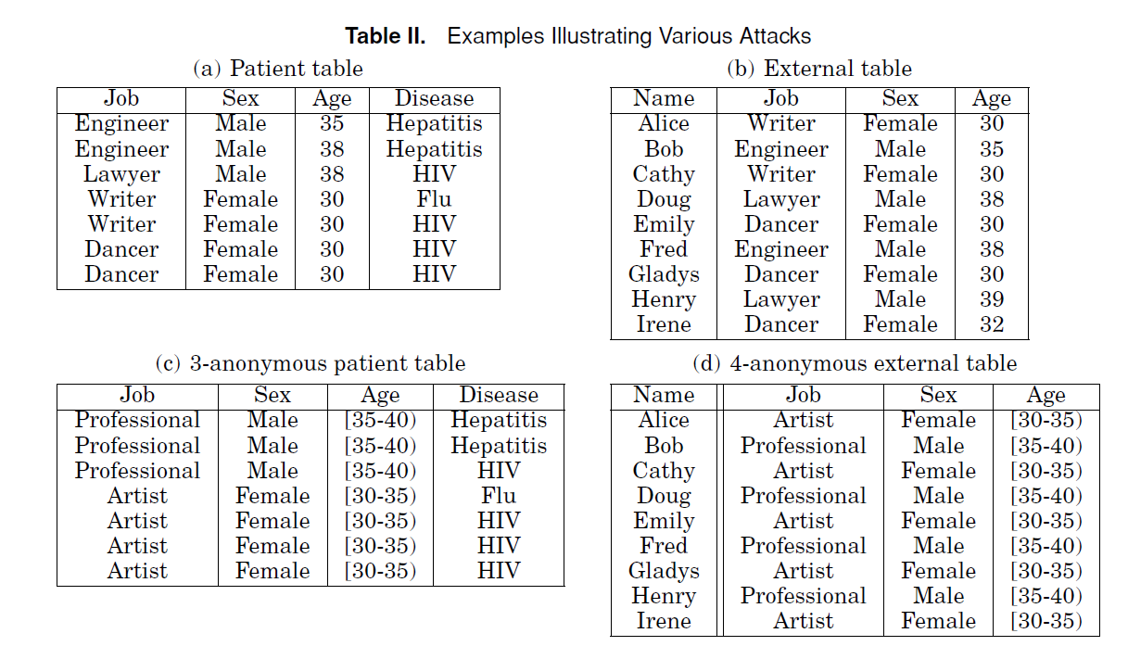
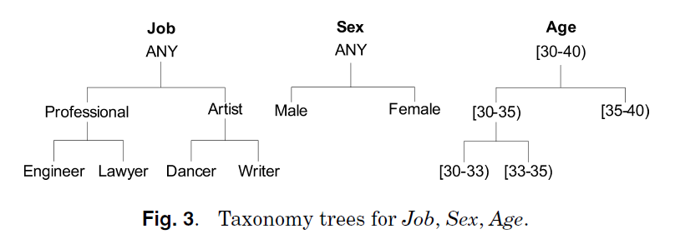
Record Linkage
QID
© Ravi Sandhu
World-Leading Research with Real-World Impact!
13

Slide 14
Attribute Linkage
© Ravi Sandhu
World-Leading Research with Real-World Impact!
14

Slide 15
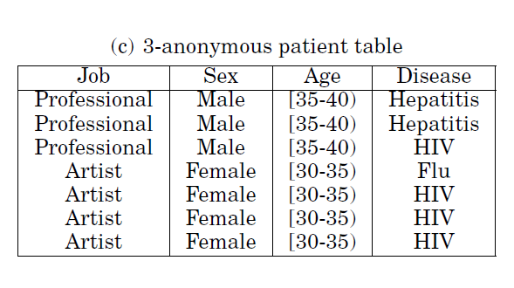
Attribute Linkage
© Ravi Sandhu
World-Leading Research with Real-World Impact!
15

Slide 16
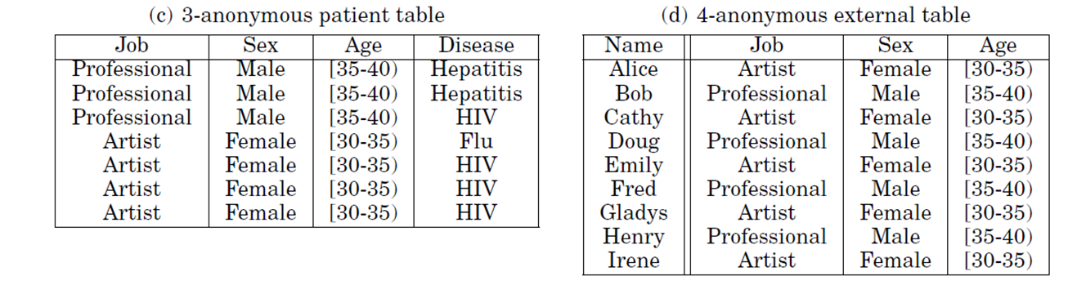
Table Linkage
Published
Known to be
subset of
Public
Probability that Alice is in (c) is 4/5
Probability that Bob is in (c) is 3/4
© Ravi Sandhu
World-Leading Research with Real-World Impact!
16

Slide 17
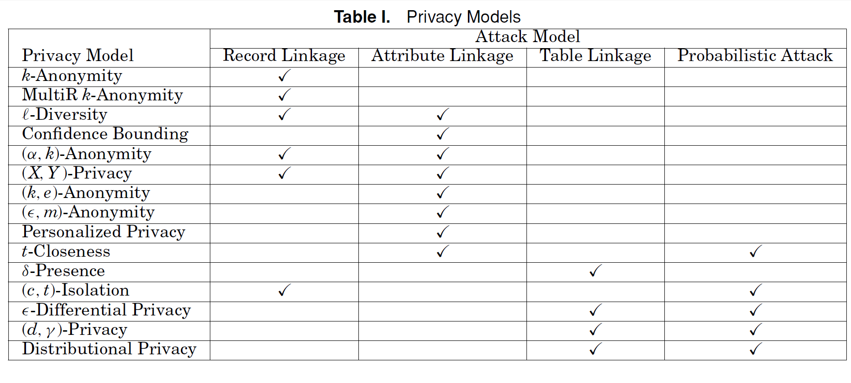
Privacy Models and Attacks
© Ravi Sandhu
World-Leading Research with Real-World Impact!
17

Slide 18
Anonymization Techniques
Generalization and suppression
Anatomization and permutation
Perturbation
© Ravi Sandhu
World-Leading Research with Real-World Impact!
18

Slide 19
Generalization
Full domain generalization
  Generalize to same level in tree
Subtree generalization
Sibling generalization
Cell generalization
  Local recoding versus global recoding for above
Multi-dimensional generalization
© Ravi Sandhu
World-Leading Research with Real-World Impact!
19

Slide 20
Generalization
Full domain generalization
  Generalize to same level in tree
Subtree generalization
Sibling generalization
Cell generalization
  Local recoding versus global recoding for above
Multi-dimensional generalization
© Ravi Sandhu
World-Leading Research with Real-World Impact!
20

Slide 21
Generalization
Full domain generalization
  Generalize to same level in tree
Subtree generalization
Sibling generalization
Cell generalization
  Local recoding versus global recoding for above
Multi-dimensional generalization
© Ravi Sandhu
World-Leading Research with Real-World Impact!
21

Slide 22
Generalization
Full domain generalization
  Generalize to same level in tree
Subtree generalization
Sibling generalization
Cell generalization
  Local recoding versus global recoding for above
Multi-dimensional generalization
© Ravi Sandhu
World-Leading Research with Real-World Impact!
22

Slide 23
Generalization
Full domain generalization
  Generalize to same level in tree
Subtree generalization
Sibling generalization
Cell generalization
  Local recoding versus global recoding for above
Multi-dimensional generalization
  Generalize Engineer,Male -> Engineer,Any
  Generalize Engineer,Female -> Professional,Female
© Ravi Sandhu
World-Leading Research with Real-World Impact!
23

Slide 24
Suppression
Record suppression
Value suppression (globally)
Cell suppression (local value suppression)
© Ravi Sandhu
World-Leading Research with Real-World Impact!
24

Slide 25
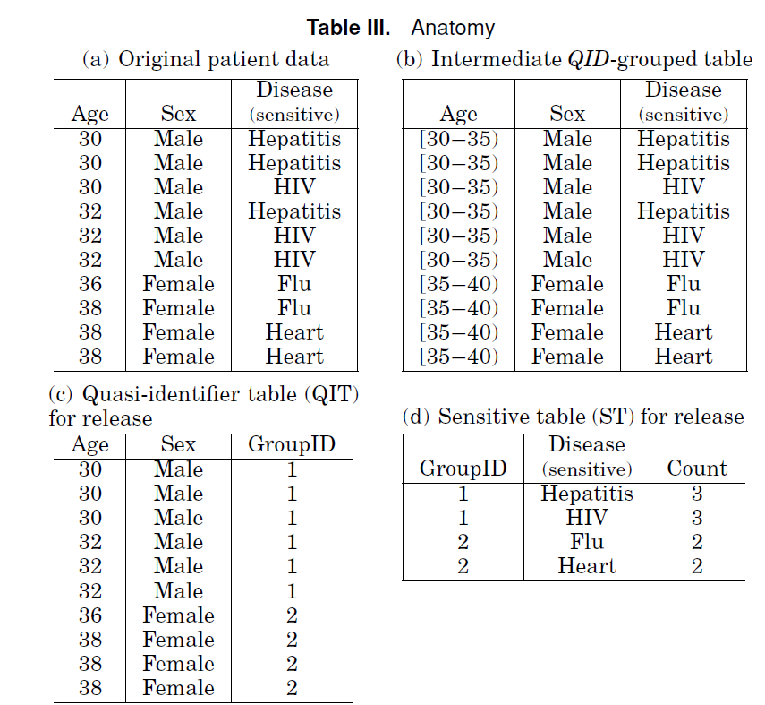
Anatomization
© Ravi Sandhu
World-Leading Research with Real-World Impact!
25

Slide 26
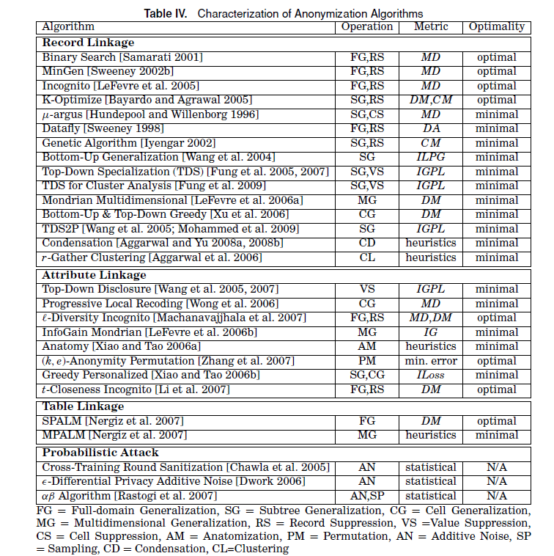
Anonymization Algortihms
© Ravi Sandhu
World-Leading Research with Real-World Impact!
26

