Slide 1
Access Control & Privacy Preservation in Online Social Networks
Institute for Cyber Security
Feb. 22, 2013
CS6393 Lecture 6
Yuan Cheng
Institute for Cyber Security
University of Texas at San Antonio
ycheng@cs.utsa.edu
http://www.my.cs.utsa.edu/~ycheng
World-Leading Research with Real-World Impact!

Slide 2
Outline
Introduction
Security & Privacy Issues in OSNs
Access Control for OSNs
Other Privacy Preservation Solutions
World-Leading Research with Real-World Impact!

Slide 3

Online Social Networks
World-Leading Research with Real-World Impact!

Slide 4
Statistics
Facebook, the largest OSN:
More than a billion monthly active users as of December 2012.
Approximately 82% of our monthly active users are outside the U.S. and Canada.
618 million daily active users on average in December 2012.
680 million monthly active users who used Facebook mobile products as of December 31, 2012.
World-Leading Research with Real-World Impact!

Slide 5
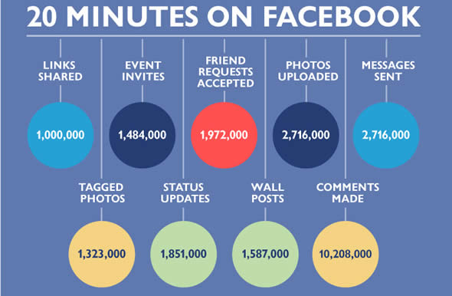
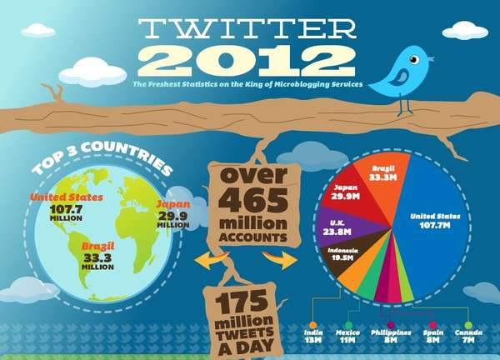

Slide 6
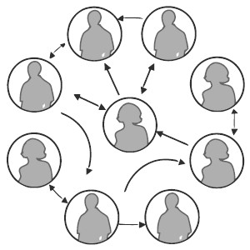
Representation of an OSN
An OSN is represented by means of a graph
Users are denoted as nodes
Relationships are represented as edges
Edges may be labeled to represent types
Edges may be directed

Slide 7
Outline
Introduction
Security & Privacy Issues in OSNs
Access Control for OSNs
Other Privacy Preservation Solutions
World-Leading Research with Real-World Impact!

Slide 8
Security & Privacy Issues
Security issues in OSNs can be organized into four categories
Privacy breaches
Spam and phishing attacks
Sybil attacks
Malware attacks
Privacy breaches
Easy to happen from OSN providers, other users, and 3rd party applications
OSN providers store user data
3rd party applications provide extra functionalities
Major threats are from peer users
Not aware of who they share with and how much
Have difficulty in managing privacy controls
World-Leading Research with Real-World Impact!

Slide 9
Why Privacy is Hard to Protect
Users tend to give out too much information
Unaware of privacy issues
Promote sharing vs. Protect privacy
Users tend to be Reactive rather than Proactive
Privacy policies
Changing over time
Confusing
Privacy thresholds vary by individuals
World-Leading Research with Real-World Impact!

Slide 10
Outline
Introduction
Security & Privacy Issues in OSNs
Access Control for OSNs
Other Privacy Preservation Solutions
World-Leading Research with Real-World Impact!

Slide 11
Control on Social Interactions
A user wants to control other users’ access to her own shared information
Only friends can read my post
A user wants to control other users’ activities who are related to the user
My children cannot be a friend of my co-workers
My activities should not be notified to my co-workers
A user wants to control her outgoing/incoming activities
No accidental access to violent contents
Do not poke me
A user’s activity influences access control decisions
Once Alice sends a friend request to Bob, Bob can see Alice’s profile
World-Leading Research with Real-World Impact!

Slide 12
What existing OSNs offer
Many OSNs allow users to choose from a pre-defined policy vocabulary
“public”, “private”, “friend”, “friend of friend”,…
Some systems support customized relationships
circle, friend list
Either too restrictive or too loose!
World-Leading Research with Real-World Impact!

Slide 13
The Challenges of OSN Access Control
Lack of a Central Administrator
Traditional access control mechanisms, such as RBAC, requires an administrator to manage access control
No such administrator exists in OSNs
Dynamic Changing Environment
Frequent content updates and volatile nature of relationships
Identity and attribute-based access control are not scalable for OSNs
World-Leading Research with Real-World Impact!

Slide 14

Relationship-based Access Control
Users in OSNs are connected by social relationships (user-to-user relationships)
Owner of the resource can control its release based on such relationships between the access requester and the owner
World-Leading Research with Real-World Impact!

Slide 15
Related Works
Fong et al. [ESORICS 09]
Fong et al. [CODASPY 11]
Carminati et al. [ACM TISS 08]
Carminati et al. [SACMAT 09]
World-Leading Research with Real-World Impact!

Slide 16
Fong et al. 11
Relationship-Based Access Control: Protection Model and Policy Language
Features:
Poly-relational, in the sense that it tracks not only whether a relationship exists, but also the type of that relationship
Authorization decision is solely based on the relationship between owner and accessor
A tree-shaped hierarchy of Access Contexts, which supports the scoping of the effectiveness of relationships
World-Leading Research with Real-World Impact!

Slide 17
Fong 11: Policy Examples
Grant access to the owner’s spouse
<spouse> a
Grant access to the owner’s child
<-parent> a
Grant access to grand parents
<parent><parent> a
Grant access to parents, aunts and uncles
<parent> a ∨ <parent><sibling> a ∨ <parent><sibling><spouse> a
World-Leading Research with Real-World Impact!

Slide 18
Fong 11: Policy Examples (cont.)
Grant access unless the accessor is a parent of the owner
¬<parent> a
Grant access to a sibling who is not married
<sibling>(a ∧ [spouse] ⊥)
Grant access to a married sibling
<sibling>(a ∧ [spouse] ⊤)
Grant access if accessor is the only child of the owner
<-parent> a ∧ [-parent] a
World-Leading Research with Real-World Impact!

Slide 19
Carminati et al. 08
Features
Discretionary
Rule-based
Semi-decentralized
Policies are specified in terms of:
Relationship Types
Depth (Maximum length of the path)
Trust Levels (Minimum trust level)
World-Leading Research with Real-World Impact!

Slide 20
C08: Approach
Requestor must prove to the resource’s owner that he/she satisfies the requirement stated in access control policy
Requestor sends access request to resource owner
Owner replies by sending access rules
Requestor provide the owner with a proof
Owner locally verifies the proof by a reasoner
Owner grants or rejects access.
World-Leading Research with Real-World Impact!

Slide 21
C08: Trust Representation
A trust relationship is usually modeled as a directed edge
Trust relationship is transitive
We can use trust paths ABC to determine how much A considers C trustworthy
World-Leading Research with Real-World Impact!

Slide 22
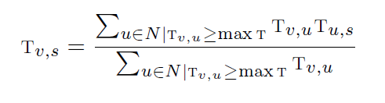
C08: Trust Computation
Variant of the TidalTrust [Golbeck 2005]
1: all the shortest paths are discovered
2: set a trust threshold maxT, which is used to discard trust paths consisting of edges with a trust value less than maxT
3: trust is computed by considering only the paths with a strength >= maxT
World-Leading Research with Real-World Impact!

Slide 23
C08: How Trust Works
Trustworthiness of the proof
Relationship certificates
Certificate path -– a set of certificates
Certificate server –- a trusted third party
Why is certificate server needed?
The requestor may maliciously omit one or more of the paths, providing only the paths with the highest level of trust
The server stores into a central certificate directory all the relationship certificates specified by OSN nodes, and discovers certificates paths
World-Leading Research with Real-World Impact!

Slide 24
C08: Trust-based Access Control
Pros
We do it in reality
Requires little user input
Cons
The concept of trust is complex and vague
Lacks of a standard measurement
World-Leading Research with Real-World Impact!

Slide 25
Carminati et al. 09
A Semantic Web Based Framework for Social Network Access Control
Motivations:
Most of existing OSNs:
Implement very basic access control systems, by marking a given item as public, private, accessible by direct contacts, or some variants of this kind of setting.
Lack flexibility
Platform-specific
World-Leading Research with Real-World Impact!

Slide 26
C09: The Idea
Encode social network-related information by means of an ontology
User Profiles, Relationships among users, Resources, Relationships between users and resources, Actions
Construct the Social Network Knowledge Base (SNKB)
Define security policies as rules
Encode authorizations to obtain the Security Authorization Knowledge Base (SAKB)
Use a centralized reference monitor to enforce the policies
World-Leading Research with Real-World Impact!

Slide 27
C09: Security Policies
Access Control Policies
Regulate how resources can be accessed by SN participants
Filtering Policies
Specify by a user to state which information she prefers not to access
Protect users from inappropriate or unwanted content
Do not equal to negative access control policies
Admin Policies
State who is authorized to specify policies and for which users and objects
World-Leading Research with Real-World Impact!

Slide 28
C09: The Values
Relationships between users and resources
Access control of most existing models is solely based on the relationships between accessing user and resource owner
The only relationship between user and resource is ownership
Annotation based relationships need to be addressed
Admin Policy Model
In SN, users should be recognized as the main authority over AC policies regarding the information related to them
Filtering Policies
Protect users from inappropriate or unwanted data
Hierarchical Structure for Policy Inference
Facilitate automatic policies propagation
World-Leading Research with Real-World Impact!

Slide 29
Our Own Work
Developed access control for OSNs based on relationships on the social graph
UURAC: User-to-User Relationship-based Access Control (DBSec 12)
URRAC: User-to-Resource Relationship-based Access Control (Winner of Best Paper Award at PASSAT 12)
World-Leading Research with Real-World Impact!

Slide 30
Motivating Examples
Related User’s Control
There exist several different types of relationships in addition to ownership
e.g., Alice and Carol want to control the release of Bob’s photo which contains Alice and Carol’s image.
Administrational Control
A change of relationship may result in a change of authorization
Treat administrative activities different from normal activities
Policy specifying, relationship invitation and relationship recommendation
e.g., Bob’s mother Carol may not want Bob to become a friend with her colleagues, to access any violent content or to share personal information with others.
World-Leading Research with Real-World Impact!
Notes:
Rudimentary friend-of-friend approach; focus on U2U relationships; at least implicitly assume ownership is the only manifestation of U2R. Failed to capture many user activities found in OSN applications.
Tagged user want to control other related user’s access to the photo.
Allowing U2R relationships enables users to specify policies for related resources and users. Policy administration becomes critical since OSN needs to ensure only the right users are authorized to do it.

Slide 31
Problems
Traditional access control mechanisms are not suitable for OSNs
OSNs keep massive resources and change dynamically
Existing relationship-based access control approaches are coarse-grained and limited
Commercial systems support either limited types or limited depth of U2U relationships
Academic works are also not flexible and expressive enough in relationship composition
Policy administration and conflict resolution are missing
Multiple users can specify policies for the same resource
World-Leading Research with Real-World Impact!
Notes:
Big bulk of data, Changing dynamically, traditional methods are not scalable
Various types of resources need to be protected, such as user sessions, relationships, policies and events.
Current solutions rely on an implicit relationship, ownership. Authorization is still based on U2U.
Extend social graph to incorporate arbitrary activities and objects

Slide 32
Scope and Assumptions
Assumptions
The threat model does not include OSN providers
Users’ computers are not compromised by malicious intruders or malwares
Do not consider the case when a hacker gains unauthorized access to a site’s code and logic
Scope
Aim to improve the access control mechanism
World-Leading Research with Real-World Impact!
Notes:
Not realistic to fight against the business model of OSN systems

Slide 33
Comparison
The advantages of our approach:
Passive form of action allows outgoing and incoming action policy
Path pattern of different relationship types and hopcount skipping make policy specification more expressive
System-level conflict resolution policy
World-Leading Research with Real-World Impact!

Slide 34
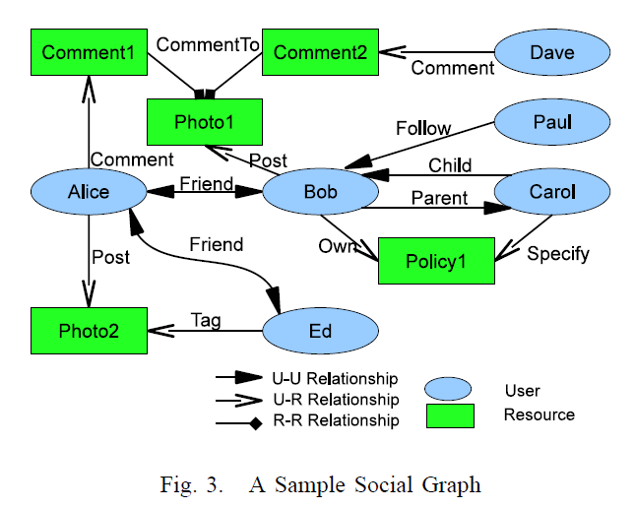
Social Networks
Social graph is modeled as a directed labeled simple graph G=<U, E, Σ>
Nodes U as users
Edges E as relationships
Σ={σ₁, σ₂, …,σ_{n}, σ₁⁻¹, σ₂⁻¹,…, σ_{n}⁻¹}
as relationship types supported
World-Leading Research with Real-World Impact!
Notes:
Relationship is not mutual any more. We consider incoming relationships, so granting access to users who consider him as a friend is plausible (inverse relationship)

Slide 35
Characteristics of Access Control in OSNs
Policy Individualization
Users define their own privacy and activity preferences
Related users can configure policies too
Collectively used by the system for control decision
User and Resource as a Target
e.g., poke, messaging, friendship invitation, etc.
User Policies for Outgoing and Incoming Actions
User can be either requester or target of activity
Allows control on 1) activities w/o knowing a particular resource and 2) activities against the user w/o knowing a particular access requestor
e.g., block notification of friend’s activities; restrict from viewing violent contents
World-Leading Research with Real-World Impact!
Notes:
We summarize four essential characteristics that need to be supported in access control solutions for OSN systems.

Slide 36
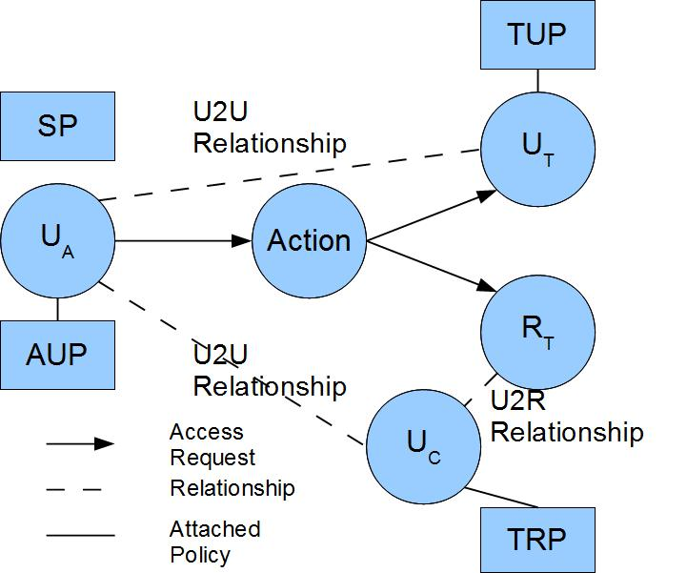
U2U Relationship-based Access Control (UURAC) Model
U_{A}: Accessing User
U_{T}: Target User
U_{C}: Controlling User
R_{T}: Target Resource
AUP: Accessing User Policy
TUP: Target User Policy
TRP: Target Resource Policy
SP: System Policy
Policy Individualization
User and Resource as a Target
Separation of user policies for incoming and outgoing actions
Regular Expression based path pattern w/ max hopcounts (e.g., <u_{a}, (f*c,3)>)
World-Leading Research with Real-World Impact!

Slide 37
Access Request and Evaluation
Access Request <u_{a}, action, target>
u_{a} tries to perform action on target
Target can be either user u_{t} or resource r_{t}
Policies and Relationships used for Access Evaluation
When u_{a} requests to access a user u_{t}
u_{a}’s AUP, u_{t}’s TUP, SP
U2U relationships between u_{a} and u_{t}
When u_{a} requests to access a resource r_{t}
u_{a}’s AUP, r_{t}’s TRP (associated with u_{c}), SP
U2U relationships between u_{a} and u_{c}
World-Leading Research with Real-World Impact!

Slide 38
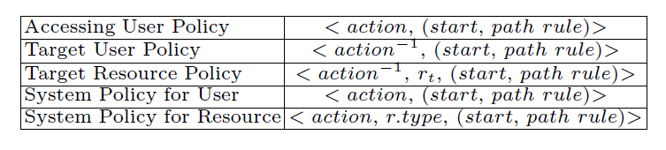
Policy Representations
action⁻¹ in TUP and TRP is the passive form since it applies to the recipient of action
TRP has an extra parameter r_{t} to distinguish the actual target resource it applies to
owner(r_{t})→ a list of u_{c}→U2U relationships between u_{a} and u_{c}
SP does not differentiate the active and passive forms
SP for resource needs r.type to refine the scope of the resource
World-Leading Research with Real-World Impact!

Slide 39
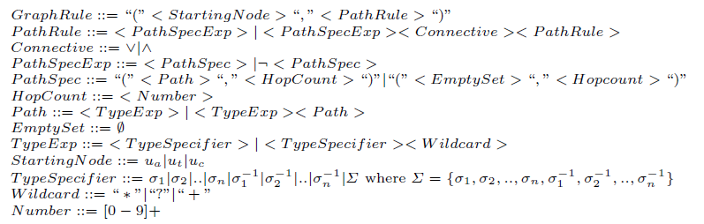
Graph Rule Grammar
World-Leading Research with Real-World Impact!

Slide 40
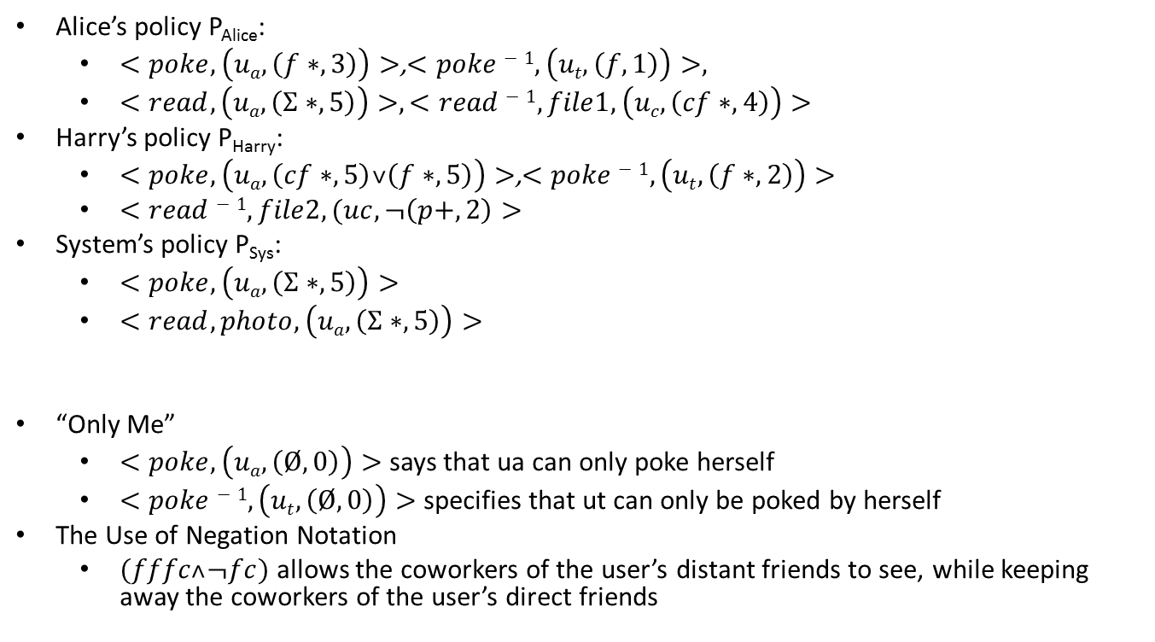
Example
Alice’s policy P_{Alice}:
$<poke,\left(ua,\left(f∗,3\right)\right)>$,$<poke−1,\left(ut,\left(f,1\right)\right)>,$
$<read, \left(ua,\left(Σ∗,5\right)\right)>,<read−1,file1,\left(uc,\left(cf∗,4\right)\right)>$
Harry’s policy P_{Harry}:
$<poke,\left(ua,\left(cf∗,5\right)˅\left(f∗,5\right)\right)>$,$<poke−1,\left(ut,\left(f∗,2\right)\right)>$
$<read−1,file2,(uc,¬\left(p+,2\right)>$
System’s policy P_{Sys}:
$<poke,\left(ua,\left(Σ∗,5\right)\right)>$
$<read,photo,\left(ua,\left(Σ∗,5\right)\right)>$
“Only Me”
$<poke, \left(ua,\left(Ø,0\right)\right)>$ says that ua can only poke herself
$<poke−1,\left(ut,\left(Ø,0\right)\right)>$ specifies that ut can only be poked by herself
The Use of Negation Notation
$(fffc˄¬fc)$ allows the coworkers of the user’s distant friends to see, while keeping away the coworkers of the user’s direct friends
World-Leading Research with Real-World Impact!
Notes:
Change to plaintext

Slide 41
Policy Extraction
It determines the starting node, where the evaluation starts
The other user involved in access becomes the evaluating node
Policy: <action, r.type, graph rule>
Graph Rule: start, path rule
Path Rule: path spec ∧|∨ path spec
Path Spec: path, hopcount
Path-check each path spec using Algorithm 2 (introduced in detail later)
World-Leading Research with Real-World Impact!

Slide 42
Policy Evaluation
Evaluate a combined result based on conjunctive or disjunctive connectives between path specs
Make a collective result for multiple policies in each policy set.
Policy conflicts may arise. We assume system level conflict resolution strategy is available (e.g., disjunctive, conjunctive, prioritized).
Compose the final result from the result of each policy set (AUP, TUP/TRP, SP)
World-Leading Research with Real-World Impact!

Slide 43
Path Checking Algorithm
Parameters: G, path, hopcount, s, t
Traversal Order: Depth-First Search
Activities in OSN typically occur among people with close distance
DFS needs only one pair of variables to keep the current status and history of exploration
Hopcount limit prevents DFS from lengthy useless search
World-Leading Research with Real-World Impact!

Slide 44
Initiation
f
Access Request: (Alice, read, r_{t})
п₁
f
Policy: (read⁻¹, r_{t}, (f*cf*, 3))
f
п₃
п₀
Path pattern: f*cf*
Hopcount: 3
c
c
f
п₂
DFA for f*cf*
World-Leading Research with Real-World Impact!

Slide 45
Path pattern: f*cf*
Hopcount: 3
f
Dave
Bob
Dave
Bob
п₁
f
п₁
f
f
f
f
п₃
п₀
п₃
c
п₀
c
Alice
c
c
Harry
c
f
Alice
f
Ed
Harry
п₂
п₂
f
Case 2: found a matching path and DFA reached an accepting state
Case 1: next node is already visited, thus creates a self loop
Case 3: currentPath matches the prefix of the pattern, but DFA not at an accepting state
f
Carol
Fred
George
f
c
f
f
d: 0
currentPath: Ø
stateHistory: 0
d: 1
currentPath: (H,D,f)
stateHistory: 01
d: 3
currentPath: (H,D,f)(D,B,c)(B,A,f)
stateHistory: 0123
d: 2
currentPath: (H,D,f)(D,B,f)
stateHistory: 011
d: 2
currentPath: (H,D,f)(D,B,c)
stateHistory: 012

Slide 46
Beyond U2U Relationships
There are various types of relationships between users and resources in addition to U2U relationships and ownership
e.g., share, like, comment, tag, etc
U2U, U2R and R2R
U2R further enables relationship and policy administration
World-Leading Research with Real-World Impact!

Slide 47
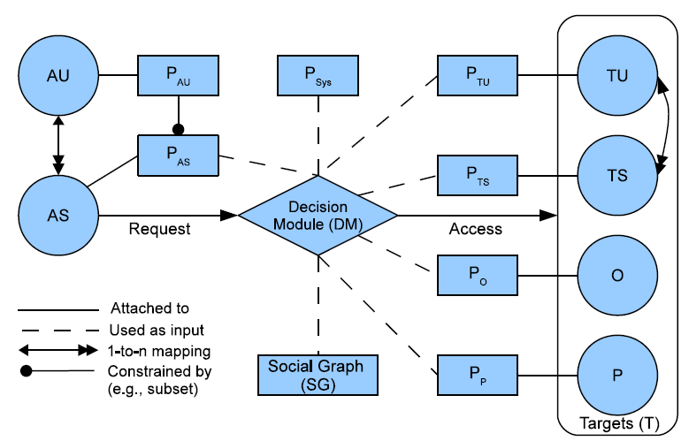
URRAC Model Components
AU: Accessing User
AS: Accessing Session
TU: Target User
TS: Target Session
O: Object
P: Policy
P_{AU}: Accessing User Policy
P_{AS}: Accessing Session Policy
P_{TU}: Target User Policy
P_{TS}: Target Session Policy
P_{O}: Object Policy
P_{P}: Policy for Policy
P_{Sys}: System Policy
World-Leading Research with Real-World Impact!

Slide 48
Differences with UURAC
Access Request
(s, act, T) where T may contain multiple objects
Hopcount Skipping
Option to omit the hops created by resources
Hopcount stated inside [[]] will not be counted in the global hopcount
e.g., ([f*,3][[c*,2]],3)
Policy Administration
User-session Distinction
World-Leading Research with Real-World Impact!

Slide 49
Hopcount Skipping
U2R and R2R relationships may form a long sequence
Omit the distance created by resources
Local hopcount stated inside “[[]]” will not be counted in global hopcount.
E.g., “([f*,3][[c*, 2]],3)”, the local hopcount 2 for c* does not apply to the global hopcount 3, thus allowing f* to have up to 3 hops.
Six degrees of separation
Any pair of persons are distanced by about 6 people on average. (4.74 shown by recent study)
Hopcount for U2U relationships is practically small
World-Leading Research with Real-World Impact!

Slide 50
Policy Conflict Resolution
System-defined conflict resolution for potential conflicts among user-specified policies
Disjunctive, conjunctive and prioritized order between relationship types
∧,∨, > represent disjunction, conjunction and precedence
@ is a special relationship “null’’ that denotes “self”
World-Leading Research with Real-World Impact!
Notes:
Multiple policies having weight in authorization result in decision conflicts inevitably. While assuming policies specified by the system will always be unambiguous, conflict resolution policies are responsible for interpreting how the potential policy conflicts within each category of user-specified policies can be resolved in terms of the precedence or connectives over relationship types

Slide 51
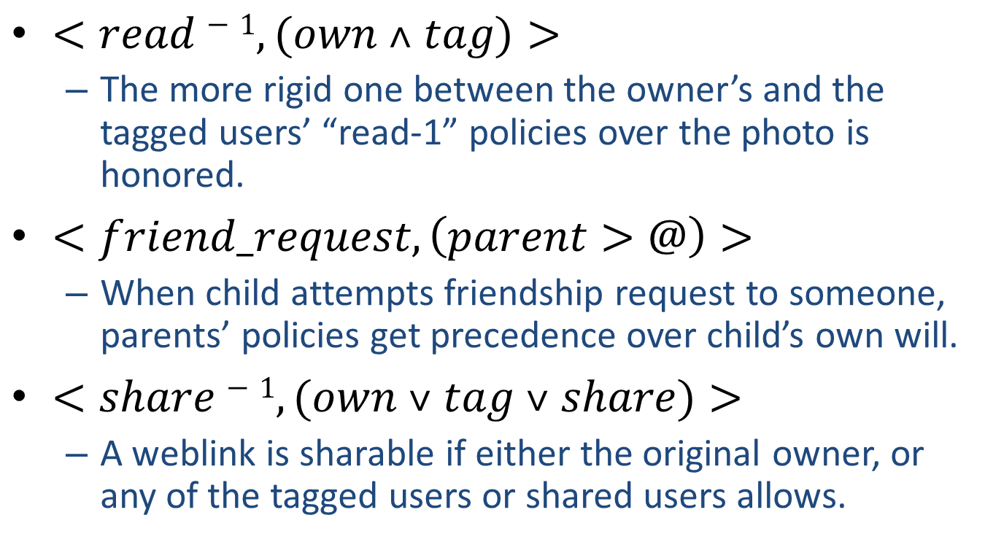
Policy Conflict Resolution (cont.)
$<read−1,(own ˄ tag)>$
The more rigid one between the owner’s and the tagged users’ “read-1” policies over the photo is honored.
$<friend_request,\left(parent>@\right)>$
When child attempts friendship request to someone, parents’ policies get precedence over child’s own will.
$<share−1,(own ˅ tag ˅ share)>$
A weblink is sharable if either the original owner, or any of the tagged users or shared users allows.
World-Leading Research with Real-World Impact!

Slide 52
Example
View a photo where a friend is tagged. Bob and Ed are friends of Alice, but not friends of each other. Alice posted a photo and tagged Ed on it. Later, Bob sees the activity from his news feed and decides to view the photo: (Bob, read, Photo2)
Bob’s P_{AS}(read): <read,(u_{a},([Σ_{u_u}*,2][[Σ_{u_r} ,1]],2))>
Photo2’s P_{O}(read⁻¹) by Alice: <read⁻¹,(t,([post⁻¹,1][friend*,3],4))>
Photo2’s P_{O}(read⁻¹) by Ed: <read⁻¹,(u_{c},([friend],1))>
AP_{Sys}(read): <read,(ua,([Σ_{u_u}*,5][[Σ_{u_r} ,1]],5))>
CRP_{Sys}(read): <read⁻¹,(own∧tag)>
In conflicts
World-Leading Research with Real-World Impact!

Slide 53
Example (cont.)
Parental control of policies. The system features parental control such as allowing parents to configure their children’s policies. The policies are used to control the incoming or outgoing activities of children, but are subject to the parents’ will. For instance, Bob’s mother Carol requests to set some policy, say Policy1 for Bob: (Carol, specify policy, Policy1)
Carol’s P_{AS}(specify_policy): <specify_policy,(u_{a},([own],1)∨([child·own],2))>
Policy1’s P_{P}(specify_policy⁻¹) by Bob: <specify_policy⁻¹,(t,([own⁻¹],1))>
P_{Sys}(specify_policy): <specify_policy,(u_{a},([own],1)∨([child·own],2))>
CRP_{Sys}(specify_policy): <specify_policy, (parent ∧ @)>
World-Leading Research with Real-World Impact!

Slide 54
Outline
Introduction
Security & Privacy Issues in OSNs
Access Control for OSNs
Other Privacy Preservation Solutions
World-Leading Research with Real-World Impact!

Slide 55
flyByNight: Mitigating the Privacy Risks of Social Networking
A Facebook application designed to encrypt and decrypt data with an objective to mitigate privacy risks in OSNs.
Primary goal:
Hide information transferred through the OSN from the provider and the application server.
Key ideas:
Encrypt sensitive data on the client side and send the cipher text to intended parties.
Uses
El-Gamal encryption
Proxy Cryptography
World-Leading Research with Real-World Impact!

Slide 56
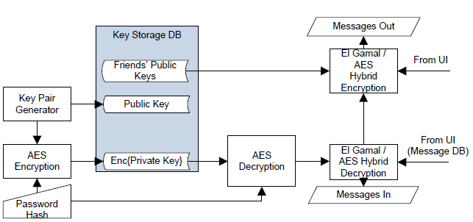
How It Works
Initialization
Client generates Public/Private key pair, password
Client transfers encrypted private key to flyByNight server, and saves in key Database
Send Data:
Client encrypts private data M with friends’ PK, and tags the encrypted data with friends’ ID, saves encrypted data in message Database on flyByNight server
Receive Data:
Client decrypts private key with password, decrypts M with the private key
World-Leading Research with Real-World Impact!

Slide 57
NOYB: Privacy in Online Social Networks
An architecture that scatters user data to protect privacy while preserving the functionality of OSN service
Key Ideas:
Encrypt user data such that the cipher text shares the same semantic and statistical properties with legitimate data
Allow the OSN provider to work on cipher text
World-Leading Research with Real-World Impact!

Slide 58



Architecture
Uses out of band channel for key management
User data is divided into atoms
Atoms of similar type constitute a dictionary
Atoms are replaced with other atoms from the dictionary
(Alice, F, 26)
(Bob, M, 30)
(Carol, F, 27)
(Alice, F)
(26)
(Bob, M)
(30)
(Carol, F)
(27)
(Alice, F, 27)
(Bob, M, 26)
World-Leading Research with Real-World Impact!
58

Slide 59
Conclusion
The emergence of OSNs pose severe privacy risks to users
Lots of work have been done to protect privacy and security of user data
Access control models
Cryptographic solutions
Social networking platforms for third party applications
World-Leading Research with Real-World Impact!

Slide 60
Questions?
World-Leading Research with Real-World Impact!

