Slide 1
Multi-Tenant Access Control for Collaborative Cloud Services
CS6393 Spring 2014
PhD Seminar
Bo Tang
April 11, 2014

Slide 2

What is Multi-Tenancy?

Slide 3
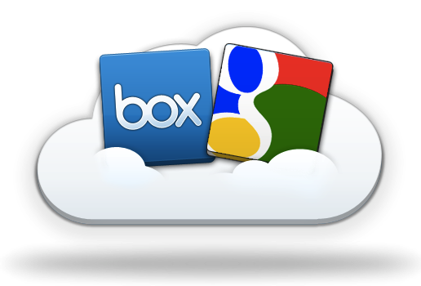
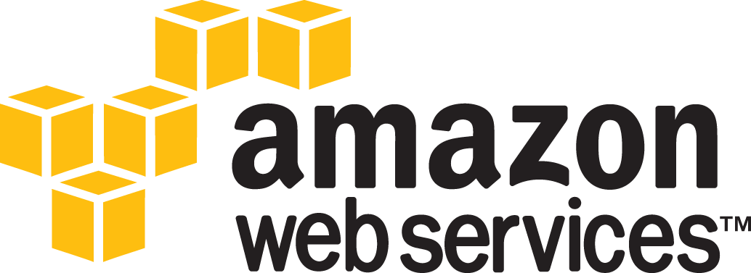
Cloud & Multi-Tenancy
Shared infrastructure
[$$$] -----> [$|$|$]
Multi-Tenancy
Virtually dedicated resources
E.g.: rent-a-car
Problems:
Who owns the data?
How to collaborate across tenants?
Even if across my own tenants?
Source: http://blog.box.com/2011/06/box-and-google-docs-accelerating-the-cloud-workforce/
Notes:
This kind of collaboration is not necessarily among parties. It could be among applications.
Subleasing an apartment for 2 rooms. A living room and a bedroom. Direct access in between.
E.g.: subleasing two rooms in an apartment.
One for storage, the other for living.
Direct accessible in between.

Slide 4
Characteristics of Cloud
Distributed Authority
Each tenant manages its own authorization
Centralized Facility
Resource pooling
Agility
Tenants, users and resources are temporary
Homogeneity
Identical or similar architecture and system settings
Out-Sourcing Trust
Built-in collaboration spirit
Notes:
This kind of collaboration is not necessarily among parties. It could be among applications.
Subleasing an apartment for 2 rooms. A living room and a bedroom. Direct access in between.
E.g.: subleasing two rooms in an apartment.
One for storage, the other for living.
Direct accessible in between.

Slide 5
Define Tenant
All deployment models are multi-tenant
E.g.: public cloud, private cloud and community cloud.
From Cloud Service Provider (CSP) perspective
A billing customer
Manages its own users and cloud resources
From consumer perspective
An individual, an organization or a department in an organization, etc.
virtually dedicated space with on-demand self-service

Slide 6
DevOps in the Cloud

Slide 7
Industry Solutions
Microsoft and IBM: Fine-grained data sharing in SaaS using DB schema
Only feasible in DB
NASA: RBAC + OpenStack (Nebula)
Lacks ability to support multi-org collaborations
Salesforce (Force.com): Single Sign-On + SAML
Focus on authentication and simple authorization
Heavy management of certificates
Source: http://msdn.microsoft.com/en-us/library/aa479086.aspx
http://nebula.nasa.gov/blog/2010/06/03/nebulas-implementation-role-based-access-control-rbac/
http://wiki.developerforce.com/page/Single_Sign-On_with_SAML_on_Force.com
Notes:
Security Assertion Markup Language (SAML) provides a secure, XML-based solution for exchanging user security information between an identity provider (your company) and a service provider (Force.com).

Slide 8
Multi-org/dom A/C Literature
RBAC
CBAC, GB-RBAC, ROBAC
No cross-organization interaction
Require central authority managing collaborations
Delegation Models
dRBAC and PBDM (e.g.: allowing subleasing)
Lacks agility (which the cloud requires)
Grids
CAS, VOMS, PERMIS
Heavy authorization overhead due to the absence of homogeneous infrastructure (which the cloud has)

Slide 9
Literature (Contd.)
Role-based Trust
RT, Traust, RMTN AND RAMARS_TM
Calero et al: towards a multi-tenancy authorization system for cloud services
Implementation level PoC
Open for extensions in trust models
Suits the cloud (out-sourcing trust)
Challenge:
Trust relation
Finer-grained models
Administration

Slide 10
Scope and Assumptions
Standardized APIs
Cross-tenant accesses are functionally available
Proper authentication of users
Removable assumptions:
One Cloud Service
Of a kind: IaaS, PaaS or SaaS etc.
Two-Tenant Trust (rather than community trust)
Unidirectional Trust Relations (like follow in Twitter)
Unilateral Trust Relations (trustor or trustee)

Slide 11
Multi-Tenant Access Control

Slide 12
Tenant Trust
Tenant Trust (TT) relation is not partial order
It is
Reflexive: A ⊴ A
But not transitive: A ⊴ B ∧ B ⊴ C ⇏ A ⊴ C
Neither symmetric: A ⊴ B ⇏ B ⊴ A
Nor anti-symmetric: A ⊴ B ∧ B ⊴ A ⇏ A ≡ B

Slide 13
CTTM Trust Types
Four potential trust types:
Type-α: trustor can give access to trustee.
Type-β: trustee can give access to trustor.
Type-γ: trustee can take access from trustor.
Type-δ: trustor can take access from trustee.
No meaningful use case, since the trustor holds all the control of the cross-tenant assignments of the trustee’s permissions.

Slide 14
Cross-Tenant Trust in DevOps
Example: Temporary DevOps access
[$]: grant Dennis@DEV access to HR.PRD
Trust-α:
PRD trusts DEV so that PRD can say [$].
Trust-β:
DEV trusts PRD so that PRD can say [$].
Trust-γ:
PRD trusts DEV so that DEV can say [$].
DEV
PRD
Dennis
HR

Slide 15
Formalized CTTM Model

Slide 16
Role-Based CTTM

Slide 17
Role-Based CTTM
OpenStack
Identity + RH
v2.0

Slide 18
Multi-Tenant Authz. as a Service (MTAaaS)
Tenant 1
Tenant 2
Tenant n
MTAaaS

Slide 19
Cross-Tenant Trust in DevOps
Example: Temporary DevOps access
[$]: grant Dennis@DEV access to HR.PRD
Trust-α (RT):
PRD trusts DEV so that PRD can say [$].
Trust-β (MTAS):
DEV trusts PRD so that PRD can say [$].
Trust-γ (MT-RBAC):
PRD trusts DEV so that DEV can say [$].
DEV
PRD
Dennis
HR

Slide 20
MTAS
Tenants: issuers

Slide 21
AMTAS
Issuers are administered by the CSP
Each issuer administer:
trust relations with other issuers
entity components: users, roles and permissions
UA, PA and RH assignments
Cross-tenant assignments are issued by the trustee
UA: trustor users to trustee roles
PA: trustee permissions to trustor roles
RH: trustee roles junior to trustor roles

Slide 22
Finer-grained Trust Models
Problem of MTAS trust model
Over exposure of trustor’s authorization information
Trustor-Centric Public Role (TCPR)
Expose only the trustor’s public roles
Relation-Centric Public Role (RCPR)
Expose public roles specific for each trust relation

Slide 23
Example MTAS policy structure
i1 trust-β i2

Slide 24
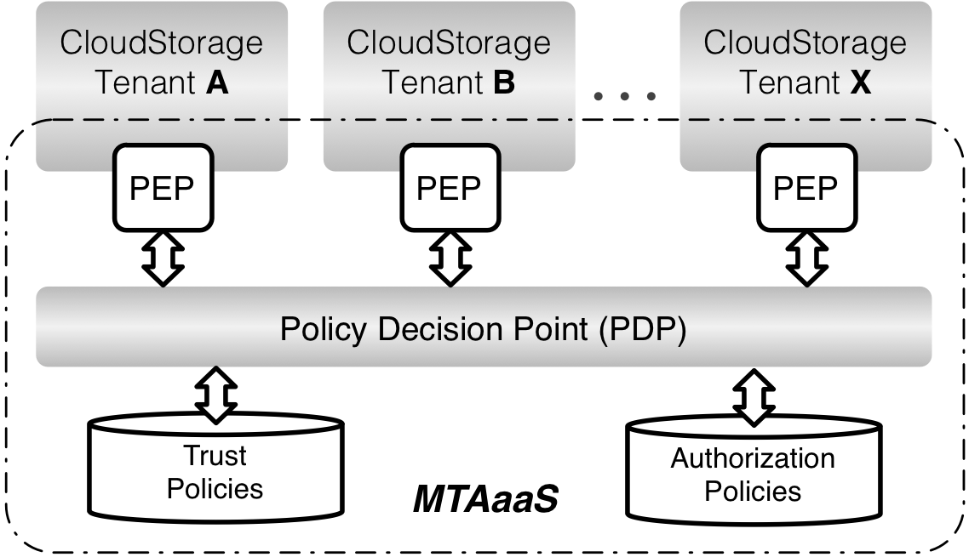
MTAaaS Platform Prototype
Experiment Settings
CloudStorage: an open source web based cloud storage and sharing system.
Joyent, FlexCloud
Authorization Service
Centralized PDP
Distributed PEP

Slide 25
Evaluation
MTAS introduces ≈12 ms overhead in average.
Scalable
Capability proportional to throughput
Performance
Scalability

Slide 26
Cross-Tenant Trust in DevOps
Example: Temporary DevOps access
[$]: grant Dennis@DEV access to HR.PRD
Trust-α (RT):
PRD trusts DEV so that PRD can say [$].
Trust-β (MTAS):
DEV trusts PRD so that PRD can say [$].
Trust-γ (MT-RBAC):
PRD trusts DEV so that DEV can say [$].
DEV
PRD
Dennis
HR

Slide 27
MT-RBAC
Issuers:
Real-world admins

Slide 28
AMT-RBAC
Issuers administer tenants
Each issuer administer:
Trust relations from owned tenants
Entity components: tenants, users, roles and permissions
UA, PA and RH assignments
Cross-tenant assignments are issued by the trustee’s owning issuer
UA: trustee users to trustor roles
PA: trustor permissions to trustee roles
RH: trustor roles junior to trustee roles

Slide 29
Finer-grained Trust Models
Trustee-Independent Public Role (TIPR)
Expose only the trustor’s public roles
Trustee-Dependent Public Role (TDPR)
Expose public roles specific for each trustee

Slide 30
Constraints
Cyclic Role Hierarchy: lead to implicit role upgrades in the role hierarchy
SoD: conflict of duties
Tenant-level
E.g.: SOX compliance companies may not hire the same company for both consulting and auditing.
Role-level
across tenants
Chinese Wall: conflict of interests among tenants
E.g.: do not share infrastructure with competitors.
Tenant 1
Tenant 2
M1
M2
E1
E2

Slide 31
Policy Specification of MT-RBAC

Slide 32
Evaluation: Performance
MT-RBAC vs RBAC
More policy references incur more decision time
MT-RBAC₂ introduces 16 ms overhead in average.
PDP Performance
Client-End Performance

Slide 33
Evaluation: Scalability
Scalable by either
Enhancing PDP capability; or
Increasing PEP amount.
PDP Scalability
PEP Scalability

Slide 34
Evaluation: Scalability
Scalable by either
Enhancing PDP capability; or
Increasing PEP amount.
PDP Scalability
PEP Scalability

Slide 35
Cross-Tenant Trust in DevOps
Example: Temporary DevOps access
[$]: grant Dennis@DEV access to HR.PRD
Trust-α (RT):
PRD trusts DEV so that PRD can say [$].
Trust-β (MTAS):
DEV trusts PRD so that PRD can say [$].
Trust-γ (MT-RBAC):
PRD trusts DEV so that DEV can say [$].
DEV
PRD
Dennis
HR

Slide 36
MT-RT
MT-RT: “P” layer model of RT with MT features
No certificate is required (centralized facility)
Trust (delegation) in OpenStack identity?
TBR

Slide 37
DevOps in OpenStack

Slide 38
OSAC

Slide 39
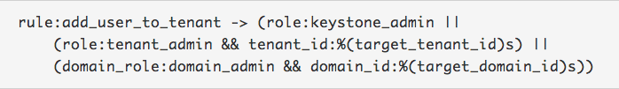

AOSAC
Cloud Admin
Domain A Admin
Domain B Admin
Project A1 Admin
Project A2 Admin
Project B1 Admin
Project B2 Admin
Source: https://wiki.openstack.org/wiki/Domains

Slide 40
Domain Trust in OpenStack
Enhanced security
Limit visibility in the specific domain
Prevent malicious / dumb assignments
Better management with Dtrust
Specified by domain admin available for project admin
Automatic revocation of cross-domain assignments
Finer-grained control enabled
Only expose users with certain roles
May specify collaborating users and projects

Slide 41
MT-ABAC
UID: u1
TID: t1
Trustee: {t1,t2}
TrustType: γ
TID: t1
UID: u1
TID: t1
UID: u1
TID: t2
OID: o1
TID: t1

Slide 42
Conclusion
Completed Work
CTTM
MTAaaS
MTAS
MT-RBAC
On-going research
MT-RT
MT-ABAC
Domain Trust in OpenStack

Slide 43
Q & A

Slide 44
Thank You!

