Slide 1
CS 6393 Lecture 3
Virtualization
Prof. Ravi Sandhu
Executive Director and Endowed Chair
February 7, 2014
ravi.sandhu@utsa.edu
www.profsandhu.com
© Ravi Sandhu
World-Leading Research with Real-World Impact!

Slide 2
Smith, J.E. and Nair, R., The Architecture of Virtual Machines," IEEE Computer , vol.38, no.5, pp.32-38, May 2005.
SCOPE Alliance. Virtualization: State of the Art. Version 1.0, April 3, 2008. 18 pages.
Gabor Pik, Levente Buttyan, and Boldizsar Bencsath. 2013. A survey of security issues in hardware virtualization. ACM Comput. Surv. 45, 3, Article 40 (July 2013), 34 pages.
© Ravi Sandhu
World-Leading Research with Real-World Impact!
2

Slide 3
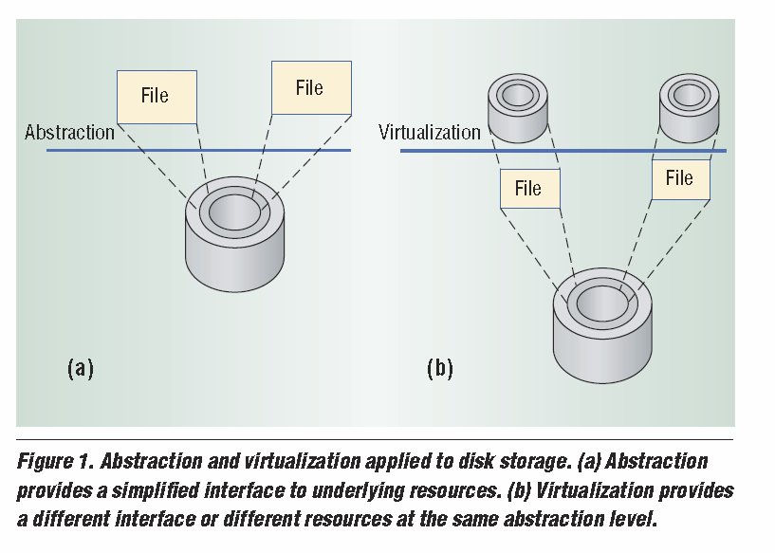
© Ravi Sandhu
World-Leading Research with Real-World Impact!
3

Slide 4
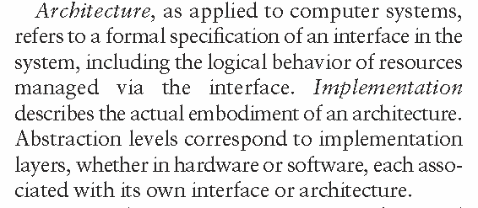
© Ravi Sandhu
World-Leading Research with Real-World Impact!
4

Slide 5
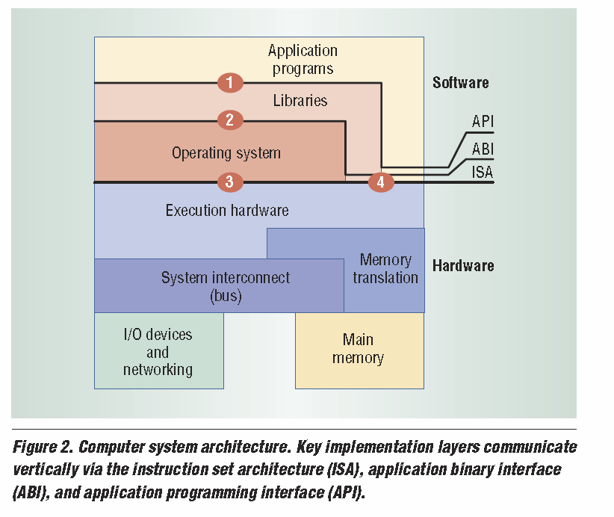
API
System Calls
Privileged ISA
User ISA
© Ravi Sandhu
World-Leading Research with Real-World Impact!
5

Slide 6
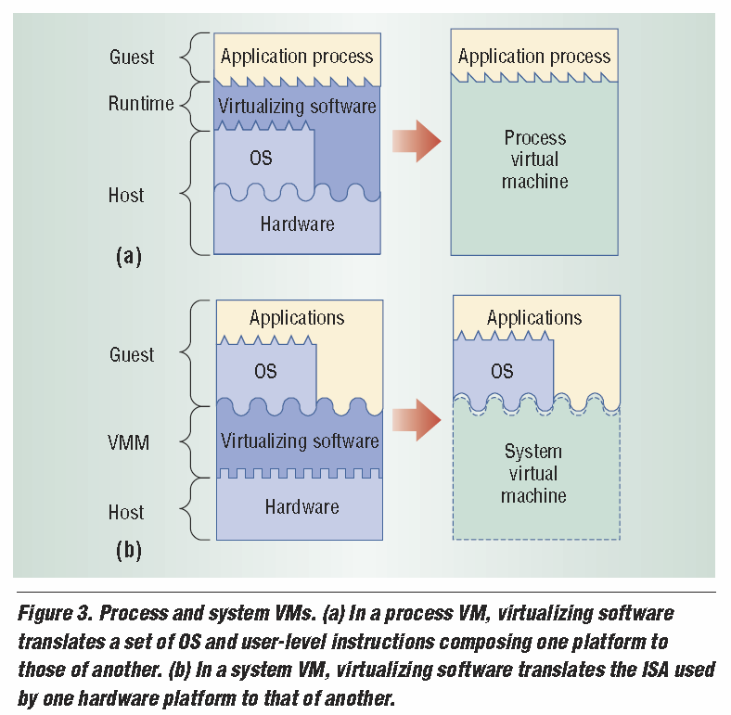
ABI or API level
Process VM
System VM
ISA level
© Ravi Sandhu
World-Leading Research with Real-World Impact!
6

Slide 7
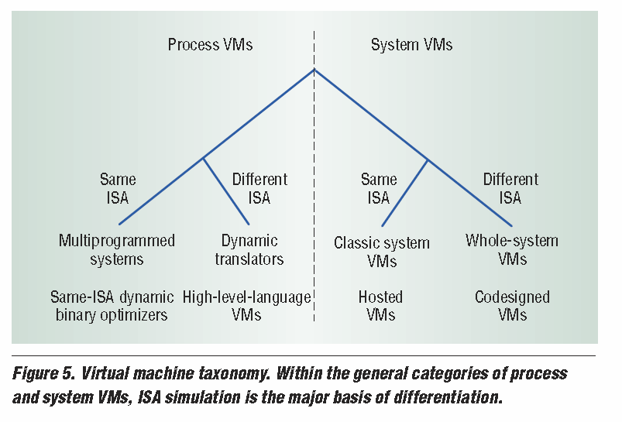
Most OS’s
Intel IA32-EL
VM/370, Xen
Virtual PC
HP Dynamo
Java VM, Microsoft CLI
VMWare GSX, KVM
Transmeta Crusoe
© Ravi Sandhu
World-Leading Research with Real-World Impact!
7

Slide 8
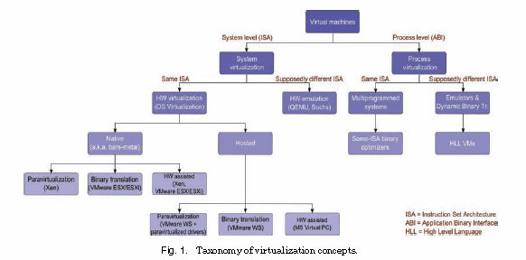
© Ravi Sandhu
World-Leading Research with Real-World Impact!
8

Slide 9
© Ravi Sandhu
World-Leading Research with Real-World Impact!
9

Slide 10
Most OS’s
Intel IA32-EL
VM/370, Xen
Virtual PC
HP Dynamo
Java VM, Microsoft CLI
VMWare GSX, KVM
Transmeta Crusoe
© Ravi Sandhu
World-Leading Research with Real-World Impact!
10

Slide 11
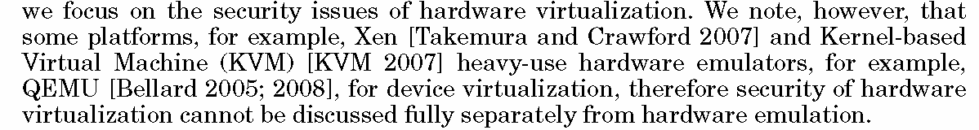
© Ravi Sandhu
World-Leading Research with Real-World Impact!
11

Slide 12
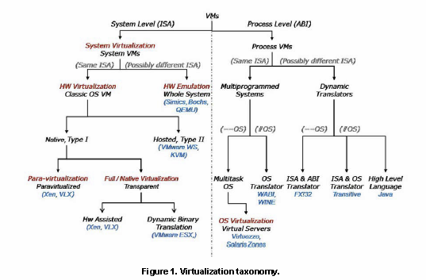
© Ravi Sandhu
World-Leading Research with Real-World Impact!
12

Slide 13
© Ravi Sandhu
World-Leading Research with Real-World Impact!
13

Slide 14
Requires modification to Guest OS to replace
privileged instructions by hypercalls to VMM
© Ravi Sandhu
World-Leading Research with Real-World Impact!
14

