Slide 1
CS 6393 Lecture 4
Virtualization
Prof. Ravi Sandhu
Executive Director and Endowed Chair
February 14, 2014
ravi.sandhu@utsa.edu
www.profsandhu.com
© Ravi Sandhu
World-Leading Research with Real-World Impact!

Slide 2
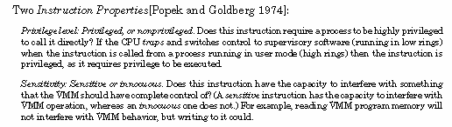
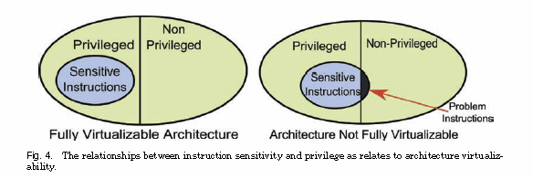
x86 ISA has problem instructions
© Ravi Sandhu
World-Leading Research with Real-World Impact!

Slide 3
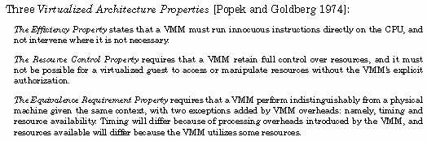
© Ravi Sandhu
World-Leading Research with Real-World Impact!

Slide 4
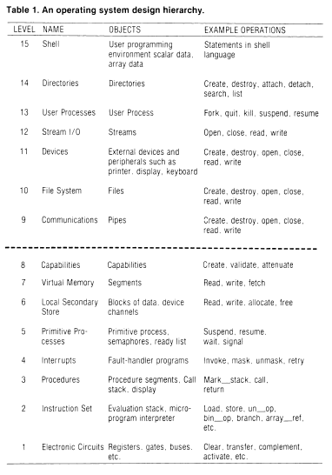
© Ravi Sandhu
World-Leading Research with Real-World Impact!

Slide 5
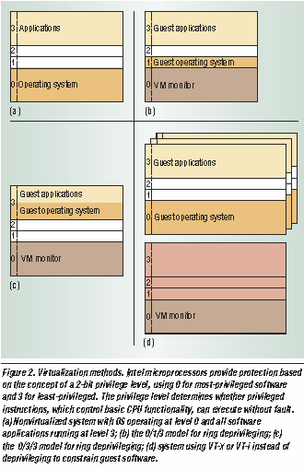
© Ravi Sandhu
World-Leading Research with Real-World Impact!

Slide 6
© Ravi Sandhu
World-Leading Research with Real-World Impact!

