Slide 1
CS 6393 Lecture 5
I/O Virtualization
Prof. Ravi Sandhu
Executive Director and Endowed Chair
March 7, 2014
ravi.sandhu@utsa.edu
www.profsandhu.com
© Ravi Sandhu
World-Leading Research with Real-World Impact!

Slide 2
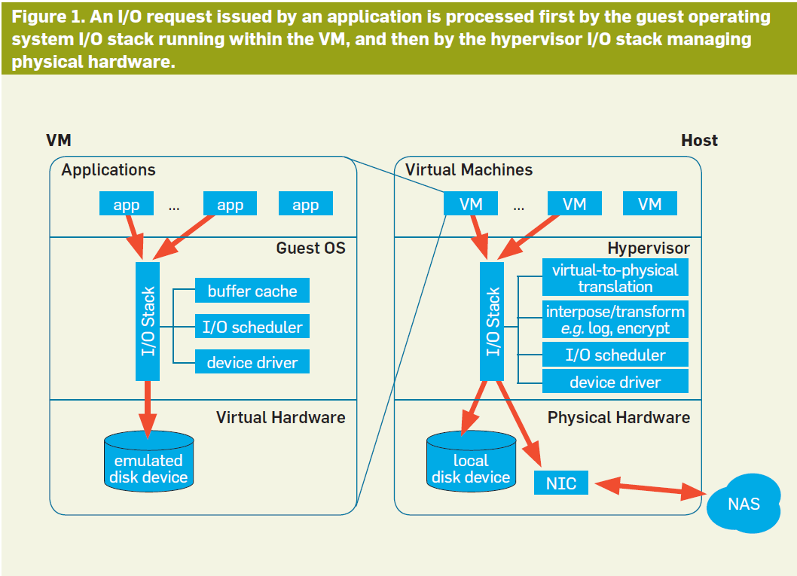
© Ravi Sandhu
World-Leading Research with Real-World Impact!

Slide 3
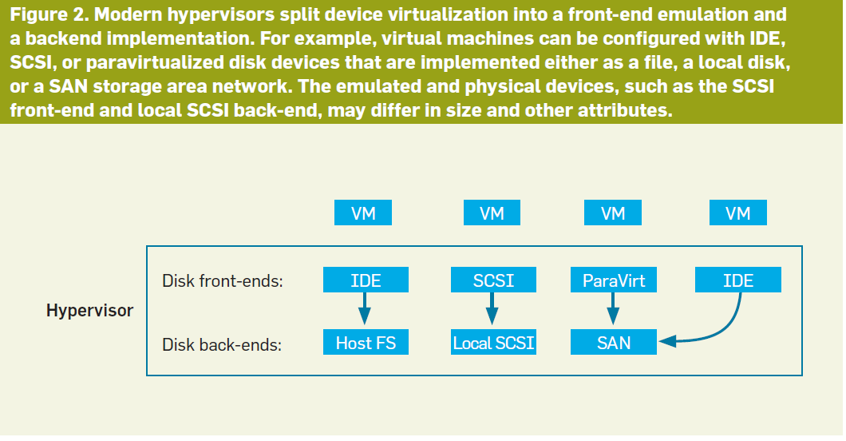
© Ravi Sandhu
World-Leading Research with Real-World Impact!

Slide 4
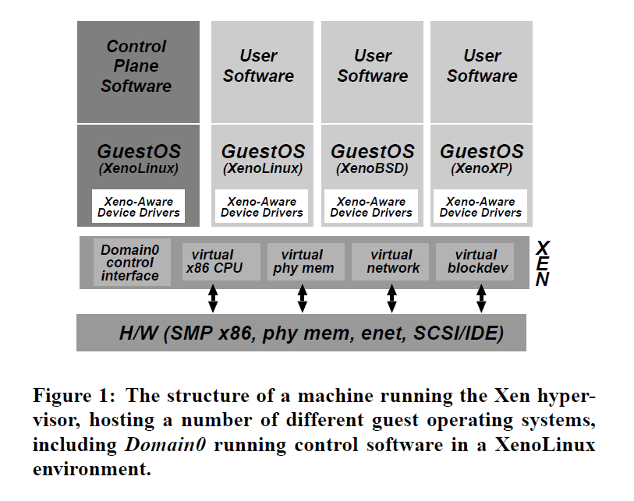
© Ravi Sandhu
World-Leading Research with Real-World Impact!

Slide 5
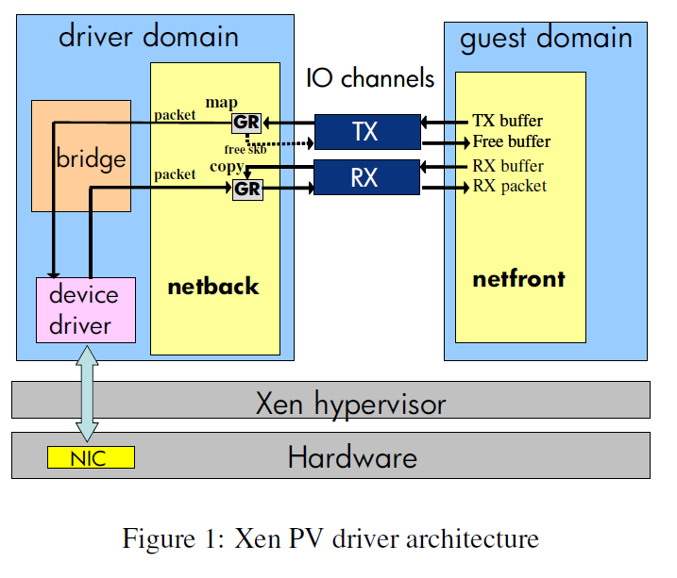
© Ravi Sandhu
World-Leading Research with Real-World Impact!

