Slide 1
Multi Cloud
Navid Pustchi
April 25, 2014
navid.pustchi@utsa.edu
World-Leading Research with Real-World Impact!

Slide 2
Motivation
User seamlessly or by choice can use services from another cloud.
The user belongs to one CSP.
Each cloud has independent administration(different).
User
CSP A
CSP B
Openstack
AWS
World-Leading Research with Real-World Impact!
2

Slide 3
Background
Federation
  Deployment of multiple CSPs (heterogeneous or homogenous) to provide complex services.
Based on deployment
  Hybrid Cloud
  Community Cloud
World-Leading Research with Real-World Impact!
3

Slide 4
Hybrid Cloud
Composition of two or more cloud deployment models that remain unique entities but are bound together by proprietary technology that enables data and application portability.
One organization provides and manages the resources.
  [NIST 2012, p18]
World-Leading Research with Real-World Impact!
4

Slide 5
Community Cloud
Provisioned for exclusive use by a specific community of consumers from organizations that have shared concerns.
It may be owned, managed and operated by one or more of the organizations in the cloud.
  [NIST 2012, p18]
World-Leading Research with Real-World Impact!
5

Slide 6
Multi Cloud Restrictions
Heterogeneity and tight coupling.
Pre-established business agreements.
Service Delivery Model.
World-Leading Research with Real-World Impact!
6

Slide 7
Multi Cloud Architectures
A central management system.
Homogenous federation running the same management system on all infrastructures.
Central front end.
Common API on top of distinct independent management systems.
  [VANDER 2012, p4]
World-Leading Research with Real-World Impact!
7

Slide 8
Central management system
Separate infrastructure replaces their management system with a common one.
Easy to deploy and maintain.
Potential compatibility issues and new software adoption.
  [VANDER 2012, p5]
World-Leading Research with Real-World Impact!
8

Slide 9
Homogenous Federation
Each infrastructure manages its resources independent from a central point.
Each management infrastructure should be replaced with tools capable of federation.
  [VANDER 2012, p6]
World-Leading Research with Real-World Impact!
9

Slide 10
Central front-end
All facilities and associated tools remain unchanged and keep their own user registration, procedures, etc.
The only commonality is a central location, hosting a list of all facilities and their tools.
  [VANDER 2012, p5]
World-Leading Research with Real-World Impact!
10

Slide 11
Common API
Each facility keeps its current management software.
Common interfaces on top of each management software are specified, standardized and made available within the federation.
The need of a common protocol.
  [VANDER 2012, p6]
World-Leading Research with Real-World Impact!
11

Slide 12
Security Prospects Multi Cloud
Replication of application.
Partition of application system into tiers.
Partition of application logic into fragments.
Partition of application data into fragments.
  [BOHLI 2013, p3]
World-Leading Research with Real-World Impact!
12

Slide 13
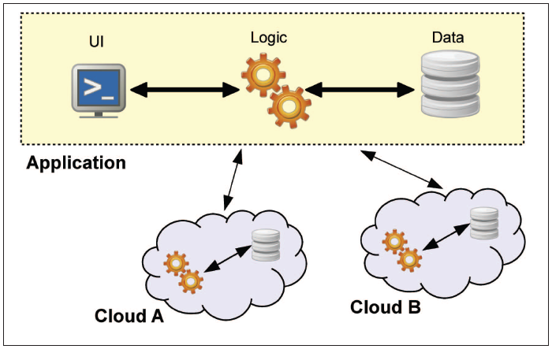
Replication of Application
Allows to receive multiple results from one operation performed in distinct clouds and compare them.
Integrity of the result.
  [BOHLI 2013, p3]
World-Leading Research with Real-World Impact!
13

Slide 14
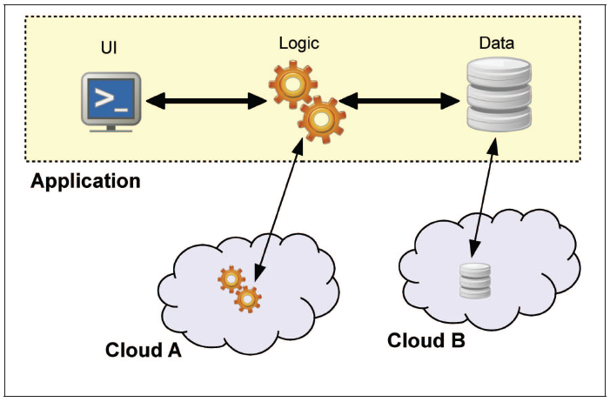
Partition into tiers
Allows to separate the logic from the data.
Additional protection against data leakage due to flaws in application logic.
  [BOHLI 2013, p5]
World-Leading Research with Real-World Impact!
14

Slide 15
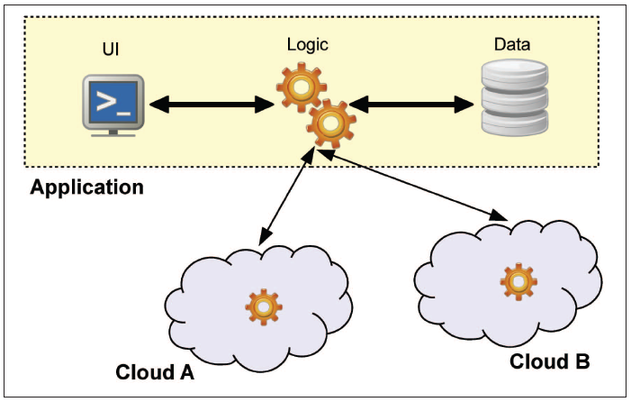
Logic into Fragments
Allows to distribute the application logic into distinct clouds.
No cloud provider learns the complete application.
No cloud provider
learns the overall
calculated result.
  [BOHLI 2013, p5]
World-Leading Research with Real-World Impact!
15

Slide 16
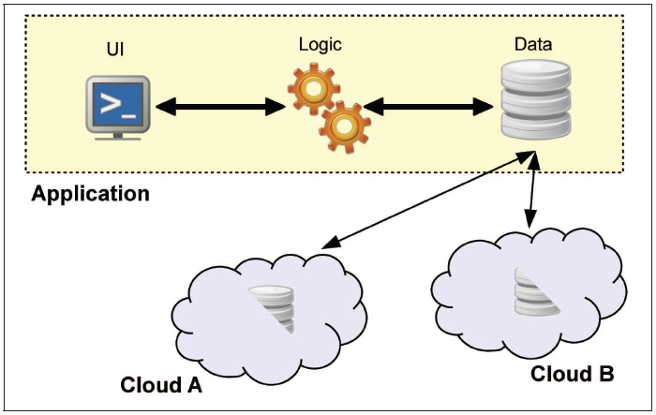
Data into Fragments
Allows distributing fine-grained fragments of data to distinct clouds.
None of the involved cloud providers gains access to all the data.
  [BOHLI 2013, p7]
World-Leading Research with Real-World Impact!
16

Slide 17
Federation
We imagine a university Professor in physics at University of china that is a part of a multi institute scientific collaboration like CERN, who is collaborating on a new data set.
He wants to start an analysis program, which dispatches his code to the remote location where data is stored at University of Switzerland. Hence it contacts his identity provider at university of china, in order to get access to University of Switzerland resources that can be used for his simulation.
World-Leading Research with Real-World Impact!
17

Slide 18


Federation
University of China Idp
Client
Trust
University of Switzerland Recourses
  [CHADWK 2014]
World-Leading Research with Real-World Impact!
18

Slide 19
Federation
Request for a service.
University of China Idp
Client
Trust
1
University of Switzerland Recourses
  [CHADWK 2014]
World-Leading Research with Real-World Impact!
19

Slide 20
Federation
Request for a service.
Determine user’s identity provider.
University of China Idp
Client
Trust
1
2
University of Switzerland Recourses
  [CHADWK 2014]
World-Leading Research with Real-World Impact!
20

Slide 21
Federation
Request for a service.
Determine user’s identity provider.
SP redirect user to his idp for authentication and user identity attributes.
3
University of China Idp
Client
Trust
1
2
3
University of Switzerland Recourses
  [CHADWK 2014]
World-Leading Research with Real-World Impact!
21

Slide 22
Federation
Request for a service.
Determine user’s identity provider.
SP redirect user to his idp for authentication and user identity attributes.
User authentication with his idp.
3
University of China Idp
4
Client
Trust
1
2
3
University of Switzerland Recourses
  [CHADWK 2014]
World-Leading Research with Real-World Impact!
22

Slide 23
Federation
Request for a service.
Determine user’s identity provider.
SP redirect user to his idp for authentication and user identity attributes.
User authentication with his idp.
Idp authentication response to SP with identity attributes of the user.
3
University of China Idp
4
5
Client
Trust
1
2
3
5
University of Switzerland Recourses
  [CHADWK 2014]
World-Leading Research with Real-World Impact!
23

Slide 24
Federation
Request for a service.
Determine user’s identity provider.
SP redirect user to his idp for authentication and user identity attributes.
User authentication with his idp.
Idp authentication response to SP with identity attributes of the user.
6. Access the resource.
3
University of China Idp
4
5
Client
Trust
1
2
3
5
University of Switzerland Recourses
6
  [CHADWK 2014]
World-Leading Research with Real-World Impact!
24

Slide 25
Federation Protocol Sequence
IdP
User calling the client for federated log in, giving it the address of the keystone service.
Client
Trust
Keystone
Federated Keystone
Directory Service
Request Issuing
Attribute Mapping
Credential Validation
Federation Protocol Negotiation
Attribute Issuing Policy
User Provisioning
Token Issuing & Validation Service
  [CHADWK 2014]
World-Leading Research with Real-World Impact!
25

Slide 26
Federation Protocol Sequence
IdP
User calling the client for federated log in, giving it the address of the keystone service.
The client calls the federated keystone for the list of IdPs.
Client
Trust
Keystone
Federated Keystone
Directory Service
Request Issuing
Attribute Mapping
Credential Validation
Federation Protocol Negotiation
Attribute Issuing Policy
User Provisioning
Token Issuing & Validation Service
  [CHADWK 2014]
World-Leading Research with Real-World Impact!
26

Slide 27
Federation Protocol Sequence
IdP
User calling the client for federated log in, giving it the address of the keystone service.
The client calls the federated keystone for the list of IdPs.
Keystone Calls Directory Service to obtain the list of federation IdPs.
Client
Trust
Keystone
Federated Keystone
Directory Service
Request Issuing
Attribute Mapping
Credential Validation
Federation Protocol Negotiation
Attribute Issuing Policy
User Provisioning
Token Issuing & Validation Service
  [CHADWK 2014]
World-Leading Research with Real-World Impact!
27

Slide 28
Federation Protocol Sequence
IdP
User calling the client for federated log in, giving it the address of the keystone service.
The client calls the federated keystone for the list of IdPs.
Keystone Calls Directory Service to obtain the list of federation IdPs.
Keystone sends the set of idps back to the client.
Client
Trust
Keystone
Federated Keystone
Directory Service
Request Issuing
Attribute Mapping
Credential Validation
Federation Protocol Negotiation
Attribute Issuing Policy
User Provisioning
Token Issuing & Validation Service
  [CHADWK 2014]
World-Leading Research with Real-World Impact!
28

Slide 29
Federation Protocol Sequence
IdP
User calling the client for federated log in, giving it the address of the keystone service.
The client calls the federated keystone for the list of IdPs.
Keystone Calls Directory Service to obtain the list of federation IdPs.
Keystone sends the set of idps back to the client.
User chooses the idp.
Client
Trust
Keystone
Federated Keystone
Directory Service
Request Issuing
Attribute Mapping
Credential Validation
Federation Protocol Negotiation
Attribute Issuing Policy
User Provisioning
Token Issuing & Validation Service
  [CHADWK 2014]
World-Leading Research with Real-World Impact!
29

Slide 30
Federation Protocol Sequence
IdP
User calling the client for federated log in, giving it the address of the keystone service.
The client calls the federated keystone for the list of IdPs.
Keystone Calls Directory Service to obtain the list of federation IdPs.
Keystone sends the set of idps back to the client.
User chooses the idp.
The client returns the chosen idp and asks an Idp request message.
Client
Trust
Keystone
Federated Keystone
Directory Service
Request Issuing
Attribute Mapping
Credential Validation
Federation Protocol Negotiation
Attribute Issuing Policy
User Provisioning
Token Issuing & Validation Service
  [CHADWK 2014]
World-Leading Research with Real-World Impact!
30

Slide 31
Federation Protocol Sequence
IdP
User calling the client for federated log in, giving it the address of the keystone service.
The client calls the federated keystone for the list of IdPs.
Keystone Calls Directory Service to obtain the list of federation IdPs.
Keystone sends the set of idps back to the client.
User chooses the idp.
The client returns the chosen idp and asks an Idp request message.
Keystone look up the identity provider for its protocol.
Client
Trust
Keystone
Federated Keystone
Directory Service
Request Issuing
Attribute Mapping
Credential Validation
Federation Protocol Negotiation
Attribute Issuing Policy
User Provisioning
Token Issuing & Validation Service
  [CHADWK 2014]
World-Leading Research with Real-World Impact!
31

Slide 32
Federation Protocol Sequence
IdP
User calling the client for federated log in, giving it the address of the keystone service.
The client calls the federated keystone for the list of IdPs.
Keystone Calls Directory Service to obtain the list of federation IdPs.
Keystone sends the set of idps back to the client.
User chooses the idp.
The client returns the chosen idp and asks an Idp request message.
Keystone look up the identity provider for its protocol.
Keystone asks RI for appropriate format of authentication and attribute request.
Client
Trust
Keystone
Federated Keystone
Directory Service
Request Issuing
Attribute Mapping
Credential Validation
Federation Protocol Negotiation
Attribute Issuing Policy
User Provisioning
Token Issuing & Validation Service
  [CHADWK 2014]
World-Leading Research with Real-World Impact!
32

Slide 33
Federation Protocol Sequence
IdP
User calling the client for federated log in, giving it the address of the keystone service.
The client calls the federated keystone for the list of IdPs.
Keystone Calls Directory Service to obtain the list of federation IdPs.
Keystone sends the set of idps back to the client.
User chooses the idp.
The client returns the chosen idp and asks an Idp request message.
Keystone look up the identity provider for its protocol.
Keystone asks RI for appropriate format of authentication and attribute request.
RI make request to Directory Service to obtain Idp metadata.
Client
Trust
Keystone
Federated Keystone
Directory Service
Request Issuing
Attribute Mapping
Credential Validation
Federation Protocol Negotiation
Attribute Issuing Policy
User Provisioning
Token Issuing & Validation Service
  [CHADWK 2014]
World-Leading Research with Real-World Impact!
33

Slide 34
Federation Protocol Sequence
IdP
User calling the client for federated log in, giving it the address of the keystone service.
The client calls the federated keystone for the list of IdPs.
Keystone Calls Directory Service to obtain the list of federation IdPs.
Keystone sends the set of idps back to the client.
User chooses the idp.
The client returns the chosen idp and asks an Idp request message.
Keystone look up the identity provider for its protocol.
Keystone asks RI for appropriate format of authentication and attribute request.
RI make request to Directory Service to obtain Idp metadata.
RI returns Idp message to keystone.
Client
Trust
Keystone
Federated Keystone
Directory Service
Request Issuing
Attribute Mapping
Credential Validation
Federation Protocol Negotiation
Attribute Issuing Policy
User Provisioning
Token Issuing & Validation Service
  [CHADWK 2014]
World-Leading Research with Real-World Impact!
34

Slide 35
Federation Protocol Sequence
IdP
Keystone returns the request message to client.
Client
Trust
Keystone
Federated Keystone
Directory Service
Request Issuing
Attribute Mapping
Credential Validation
Federation Protocol Negotiation
Attribute Issuing Policy
User Provisioning
Token Issuing & Validation Service
  [CHADWK 2014]
World-Leading Research with Real-World Impact!
35

Slide 36
Federation Protocol Sequence
IdP
Keystone returns the request message to client.
Client or keystone passes request to Idp.
Client
Trust
Keystone
Federated Keystone
Directory Service
Request Issuing
Attribute Mapping
Credential Validation
Federation Protocol Negotiation
Attribute Issuing Policy
User Provisioning
Token Issuing & Validation Service
  [CHADWK 2014]
World-Leading Research with Real-World Impact!
36

Slide 37
Federation Protocol Sequence
IdP
Keystone returns the request message to client.
Client or keystone passes request to Idp.
Idp asks user to authenticate.
Client
Trust
Keystone
Federated Keystone
Directory Service
Request Issuing
Attribute Mapping
Credential Validation
Federation Protocol Negotiation
Attribute Issuing Policy
User Provisioning
Token Issuing & Validation Service
  [CHADWK 2014]
World-Leading Research with Real-World Impact!
37

Slide 38
Federation Protocol Sequence
IdP
Keystone returns the request message to client.
Client or keystone passes request to Idp.
Idp asks user to authenticate.
Client passes the Idps response to keystone.
Client
Trust
Keystone
Federated Keystone
Directory Service
Request Issuing
Attribute Mapping
Credential Validation
Federation Protocol Negotiation
Attribute Issuing Policy
User Provisioning
Token Issuing & Validation Service
  [CHADWK 2014]
World-Leading Research with Real-World Impact!
38

Slide 39
Federation Protocol Sequence
IdP
Keystone returns the request message to client.
Client or keystone passes request to Idp.
Idp asks user to authenticate.
Client passes the Idps response to keystone.
Keystone passes the response to the credential validation function.
Client
Trust
Keystone
Federated Keystone
Directory Service
Request Issuing
Attribute Mapping
Credential Validation
Federation Protocol Negotiation
Attribute Issuing Policy
User Provisioning
Token Issuing & Validation Service
  [CHADWK 2014]
World-Leading Research with Real-World Impact!
39

Slide 40
Federation Protocol Sequence
IdP
Keystone returns the request message to client.
Client or keystone passes request to Idp.
Idp asks user to authenticate.
Client passes the Idps response to keystone.
Keystone passes the response to the credential validation function.
Credential validation calls directory to obtain metadata to validate the response.
Client
Trust
Keystone
Federated Keystone
Directory Service
Request Issuing
Attribute Mapping
Credential Validation
Federation Protocol Negotiation
Attribute Issuing Policy
User Provisioning
Token Issuing & Validation Service
  [CHADWK 2014]
World-Leading Research with Real-World Impact!
40

Slide 41
Federation Protocol Sequence
IdP
Keystone returns the request message to client.
Client or keystone passes request to Idp.
Idp asks user to authenticate.
Client passes the Idps response to keystone.
Keystone passes the response to the credential validation function.
Credential validation calls directory to obtain metadata to validate the response.
Credential validation returns the user’s ID, set of identity attributes and idp to keystone.
Client
Trust
Keystone
Federated Keystone
Directory Service
Request Issuing
Attribute Mapping
Credential Validation
Federation Protocol Negotiation
Attribute Issuing Policy
User Provisioning
Token Issuing & Validation Service
  [CHADWK 2014]
World-Leading Research with Real-World Impact!
41

Slide 42
Federation Protocol Sequence
IdP
Keystone returns the request message to client.
Client or keystone passes request to Idp.
Idp asks user to authenticate.
Client passes the Idps response to keystone.
Keystone passes the response to the credential validation function.
Credential validation calls directory to obtain metadata to validate the response.
Credential validation returns the user’s ID, set of identity attributes and idp to keystone.
Keystone checks with Attribute Issuer Policy to ensure only allowed attributes asserted by Idp.
Client
Trust
Keystone
Federated Keystone
Directory Service
Request Issuing
Attribute Mapping
Credential Validation
Federation Protocol Negotiation
Attribute Issuing Policy
User Provisioning
Token Issuing & Validation Service
  [CHADWK 2014]
World-Leading Research with Real-World Impact!
42

Slide 43
Federation Protocol Sequence
IdP
Keystone returns the request message to client.
Client or keystone passes request to Idp.
Idp asks user to authenticate.
Client passes the Idps response to keystone.
Keystone passes the response to the credential validation function.
Credential validation calls directory to obtain metadata to validate the response.
Credential validation returns the user’s ID, set of identity attributes and idp to keystone.
Keystone checks with Attribute Issuer Policy to ensure only allowed attributes asserted by Idp.
Keystone calls User Provisioning module , deletes expired entries and create temporary entry for the user.
Client
Trust
Keystone
Federated Keystone
Directory Service
Request Issuing
Attribute Mapping
Credential Validation
Federation Protocol Negotiation
Attribute Issuing Policy
User Provisioning
Token Issuing & Validation Service
  [CHADWK 2014]
World-Leading Research with Real-World Impact!
43

Slide 44
Federation Protocol Sequence
IdP
Keystone calls Attribute Mapper to obtain local set authorization attributes.
Client
Trust
Keystone
Federated Keystone
Directory Service
Request Issuing
Attribute Mapping
Credential Validation
Federation Protocol Negotiation
Attribute Issuing Policy
User Provisioning
Token Issuing & Validation Service
  [CHADWK 2014]
World-Leading Research with Real-World Impact!
44

Slide 45
Federation Protocol Sequence
IdP
Keystone calls Attribute Mapper to obtain local set authorization attributes.
Keytone updates these attributes in the temporary user entry and calls the token service to obtain unscoped token.
Client
Trust
Keystone
Federated Keystone
Directory Service
Request Issuing
Attribute Mapping
Credential Validation
Federation Protocol Negotiation
Attribute Issuing Policy
User Provisioning
Token Issuing & Validation Service
  [CHADWK 2014]
World-Leading Research with Real-World Impact!
45

Slide 46
Federation Protocol Sequence
IdP
Keystone calls Attribute Mapper to obtain local set authorization attributes.
Keytone updates these attributes in the temporary user entry and calls the token service to obtain unscoped token.
Keystone returns the token and list endpoints available.
Client
Trust
Keystone
Federated Keystone
Directory Service
Request Issuing
Attribute Mapping
Credential Validation
Federation Protocol Negotiation
Attribute Issuing Policy
User Provisioning
Token Issuing & Validation Service
  [CHADWK 2014]
World-Leading Research with Real-World Impact!
46

Slide 47
Federation Protocol Sequence
IdP
Keystone calls Attribute Mapper to obtain local set authorization attributes.
Keytone updates these attributes in the temporary user entry and calls the token service to obtain unscoped token.
Keystone returns the token and list endpoints available.
The user chooses the service.
Client
Trust
Keystone
Federated Keystone
Directory Service
Request Issuing
Attribute Mapping
Credential Validation
Federation Protocol Negotiation
Attribute Issuing Policy
User Provisioning
Token Issuing & Validation Service
  [CHADWK 2014]
World-Leading Research with Real-World Impact!
47

Slide 48
Federation Protocol Sequence
IdP
Keystone calls Attribute Mapper to obtain local set authorization attributes.
Keytone updates these attributes in the temporary user entry and calls the token service to obtain unscoped token.
Keystone returns the token and list endpoints available.
The user chooses the service.
The client passes the token and chosen domain and project to keystone.
Client
Trust
Keystone
Federated Keystone
Directory Service
Request Issuing
Attribute Mapping
Credential Validation
Federation Protocol Negotiation
Attribute Issuing Policy
User Provisioning
Token Issuing & Validation Service
  [CHADWK 2014]
World-Leading Research with Real-World Impact!
48

Slide 49
Federation Protocol Sequence
IdP
Keystone calls Attribute Mapper to obtain local set authorization attributes.
Keytone updates these attributes in the temporary user entry and calls the token service to obtain unscoped token.
Keystone returns the token and list endpoints available.
The user chooses the service.
The client passes the token and chosen domain and project to keystone.
Keystone calls TS to validate unscoped token and get scoped token.
Client
Trust
Keystone
Federated Keystone
Directory Service
Request Issuing
Attribute Mapping
Credential Validation
Federation Protocol Negotiation
Attribute Issuing Policy
User Provisioning
Token Issuing & Validation Service
  [CHADWK 2014]
World-Leading Research with Real-World Impact!
49

Slide 50
Federation Protocol Sequence
IdP
Keystone calls Attribute Mapper to obtain local set authorization attributes.
Keytone updates these attributes in the temporary user entry and calls the token service to obtain unscoped token.
Keystone returns the token and list endpoints available.
The user chooses the service.
The client passes the token and chosen domain and project to keystone.
Keystone calls TS to validate unscoped token and get scoped token.
Keystone returns to the client scoped token and list of services.
Client
Trust
Keystone
Federated Keystone
Directory Service
Request Issuing
Attribute Mapping
Credential Validation
Federation Protocol Negotiation
Attribute Issuing Policy
User Provisioning
Token Issuing & Validation Service
  [CHADWK 2014]
World-Leading Research with Real-World Impact!
50

Slide 51
Federation Protocol Sequence
IdP
Keystone calls Attribute Mapper to obtain local set authorization attributes.
Keytone updates these attributes in the temporary user entry and calls the token service to obtain unscoped token.
Keystone returns the token and list endpoints available.
The user chooses the service.
The client passes the token and chosen domain and project to keystone.
Keystone calls TS to validate unscoped token and get scoped token.
Keystone returns to the client scoped token and list of services.
Client contact the service provider requesting service.
Client
Trust
CSP
Keystone
Federated Keystone
Directory Service
Request Issuing
Attribute Mapping
Credential Validation
Federation Protocol Negotiation
Attribute Issuing Policy
User Provisioning
Token Issuing & Validation Service
  [CHADWK 2014]
World-Leading Research with Real-World Impact!
51

Slide 52
Federation Protocol Sequence
IdP
Keystone calls Attribute Mapper to obtain local set authorization attributes.
Keytone updates these attributes in the temporary user entry and calls the token service to obtain unscoped token.
Keystone returns the token and list endpoints available.
The user chooses the service.
The client passes the token and chosen domain and project to keystone.
Keystone calls TS to validate unscoped token and get scoped token.
Keystone returns to the client scoped token and list of services.
Client contact the service provider requesting service.
CSP passes the token to Keystone for validation.
Client
Trust
CSP
Keystone
Federated Keystone
Directory Service
Request Issuing
Attribute Mapping
Credential Validation
Federation Protocol Negotiation
Attribute Issuing Policy
User Provisioning
Token Issuing & Validation Service
  [CHADWK 2014]
World-Leading Research with Real-World Impact!
52

Slide 53
Federation Protocol Sequence
IdP
Keystone calls Attribute Mapper to obtain local set authorization attributes.
Keytone updates these attributes in the temporary user entry and calls the token service to obtain unscoped token.
Keystone returns the token and list endpoints available.
The user chooses the service.
The client passes the token and chosen domain and project to keystone.
Keystone calls TS to validate unscoped token and get scoped token.
Keystone returns to the client scoped token and list of services.
Client contact the service provider requesting service.
CSP passes the token to Keystone for validation.
Keystone contact TS.
Client
Trust
CSP
Keystone
Federated Keystone
Directory Service
Request Issuing
Attribute Mapping
Credential Validation
Federation Protocol Negotiation
Attribute Issuing Policy
User Provisioning
Token Issuing & Validation Service
  [CHADWK 2014]
World-Leading Research with Real-World Impact!
53

Slide 54
Federation Protocol Sequence
IdP
Keystone calls Attribute Mapper to obtain local set authorization attributes.
Keytone updates these attributes in the temporary user entry and calls the token service to obtain unscoped token.
Keystone returns the token and list endpoints available.
The user chooses the service.
The client passes the token and chosen domain and project to keystone.
Keystone calls TS to validate unscoped token and get scoped token.
Keystone returns to the client scoped token and list of services.
Client contact the service provider requesting service.
CSP passes the token to Keystone for validation.
Keystone contact TS.
Client
Trust
CSP
Keystone
Federated Keystone
Directory Service
Request Issuing
Attribute Mapping
Credential Validation
Federation Protocol Negotiation
Attribute Issuing Policy
User Provisioning
Token Issuing & Validation Service
  [CHADWK 2014]
World-Leading Research with Real-World Impact!
54

Slide 55
Federation Protocol Sequence
IdP
Keystone calls Attribute Mapper to obtain local set authorization attributes.
Keytone updates these attributes in the temporary user entry and calls the token service to obtain unscoped token.
Keystone returns the token and list endpoints available.
The user chooses the service.
The client passes the token and chosen domain and project to keystone.
Keystone calls TS to validate unscoped token and get scoped token.
Keystone returns to the client scoped token and list of services.
Client contact the service provider requesting service.
CSP passes the token to Keystone for validation.
Keystone contact TS.
Keystone sends the response to CSP.
Client
Trust
CSP
Keystone
Federated Keystone
Directory Service
Request Issuing
Attribute Mapping
Credential Validation
Federation Protocol Negotiation
Attribute Issuing Policy
User Provisioning
Token Issuing & Validation Service
  [CHADWK 2014]
World-Leading Research with Real-World Impact!
55

Slide 56
Federation Protocol Sequence
IdP
CSP checks PDP if authorized, reply is granted.
Client
Trust
CSP
Keystone
Federated Keystone
Directory Service
Request Issuing
Attribute Mapping
Credential Validation
Federation Protocol Negotiation
Attribute Issuing Policy
User Provisioning
Token Issuing & Validation Service
  [CHADWK 2014]
World-Leading Research with Real-World Impact!
56

Slide 57
References
NIST. (2012). Cloud Computing Synopsis and Recommendations. Special Publication 800-146, May 2012
VANDER. (2013). Architecture for the Heterogeneous Federation of Future Internet Experimentation Facilities. Future Network & MobileSummit, 2013
BOHLI. (2013). Security and Privacy-Enhancing Multicloud Architectures. IEEE Transaction on Dependable and Secure Computing, 2013
CASTILO. (2013). OpenStack Federation in Experimentation Multi-cloud Testbeds. UNICO, 2013
CHADWK. (2014). Adding Federated Identity Management to OpenStack. Journal of Grid Computing, 2014
World-Leading Research with Real-World Impact!
57

