Slide 1
ReBAC in ABAC
Institute for Cyber Security
by
Tahmina Ahmed
Department of Computer Science
University of Texas at San Antonio
4/29/2016
World-Leading Research with Real-World Impact!

Slide 2
Outline
Introduction and BackGround
A Simple ReBAC Model
Relationships in ABAC
Attribute Composition
Composite Attribute
A Composite ABAC Model
Comparison
Expressive Power
Complexity
World-Leading Research with Real-World Impact!

Slide 3
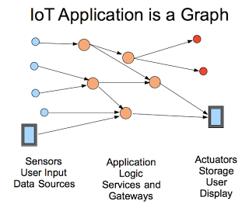
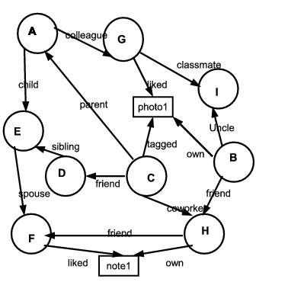
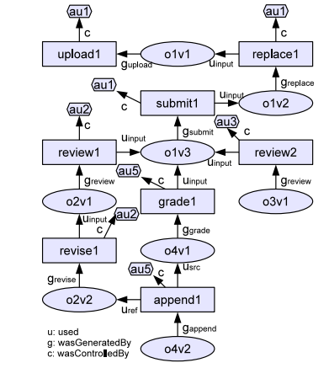
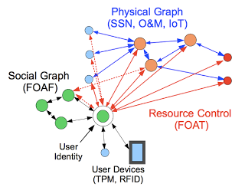
Using Relations For Controlling Access
A sample social graph
Access control for IOT
A sample Provenance Graph (Park et al. 2012 )

Slide 4
Existing Access Control Models those use some kind of Relations for authorization policy Expression
Uses social relationship to access OSN resources
Uses Object’s Data Provenance Relation to access that object
Social
Uses social relationship/relationship between system entities to access resources in any system
Provenance
Based Access Control
PBAC
Beyond Social
ReBAC

Slide 5
What Does ReBAC Mean?
What does relationship based access control mean?
What are the core characteristics of a
ReBAC Model ?

Slide 6
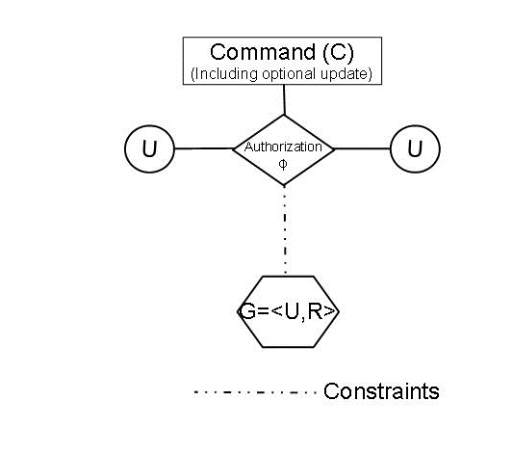

A Simple ReBAC Model (SReBAC[p])
An Example Command Instantiation of SReBAC[3]
Commands
addRelation
deleteRelation
access

Slide 7
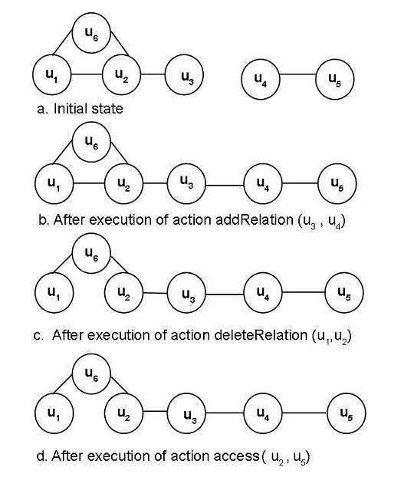
An Example of a Simple ReBAC Command Execution

Slide 8
Expression of Relationship in ABAC
friend
friend
Alice
Bob
Carol
Attribute Composition
Needs one attribute: friend
Policy Expression uses
Attribute composition
friend(Alice)={Bob}
friend(friend(Alice))={Carol}
Composite Attribute
Needs two attribute
1. friend
2. friendoffriend
Policy Expression uses
direct attributes
friend(Alice) ={Bob}
friendoffriend(Alice)={Carol}

Slide 9
Is this enough to keep the end user as an attribute value for Composite Attribute?
friend
friend
Alice
Bob
Carol
friend
John
friend
friend(Alice) = {Bob, John}
friendoffriend(Alice) = {Carol}

Slide 10
Is this enough to keep the end user as an attribute value for Composite Attribute?
Alice
Bob
friend
Carol
friend
John
friend
After execution of deleteRelation(“Alice”, “Bob”)
friend(Alice) = {John}
friendoffriend(Alice) = ?
So we need to keep the relationship path information
as a value of a composite attribute.
friendoffriend(Alice) = {Bob.Carol, John.Carol}----- Before Deletion
friendoffriend(Alice) = {John.Carol} ------ After Deletion

Slide 11
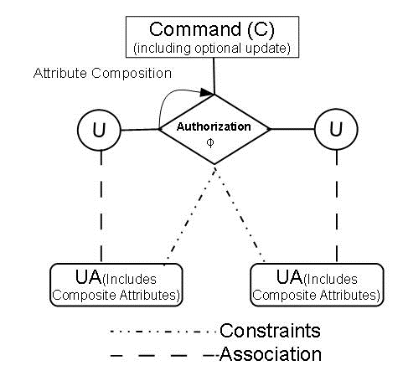
A Composite ABAC Model : ABAC_{C} [n,m]

Slide 12
Comparison: Expressive Power Vs. Complexity
SReBAC [p] : Can Express Authorization Policy upto level p
ABAC_{C} [n,m]: Can do n level attribute composition in authorization policy and has m -1 composite attributes.
So ABAC_{C} [n,m] can express Authorization Policy upto level n X m
Expressive Power Comparison:
So if p = n X m
SReBAC [p] has same expressive power as ABAC_{C} [n,m]

Slide 13
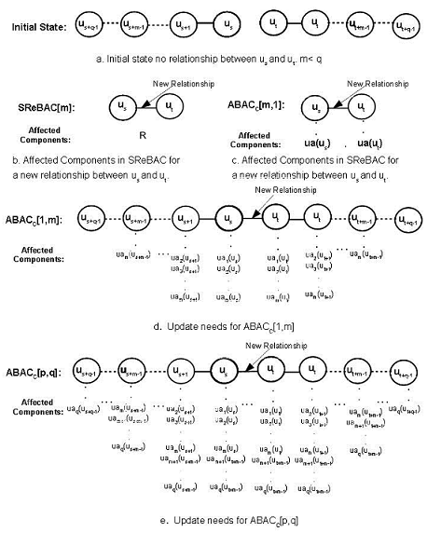
Comparison: Expressive Power Vs. Complexity

Slide 14
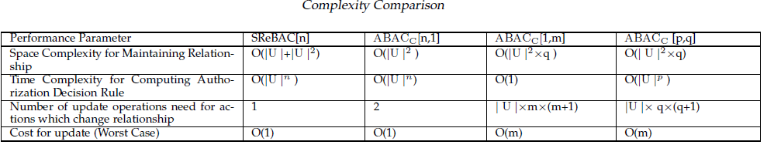
Comparison: Expressive Power Vs. Complexity

Slide 15

Questions/Comments
World-Leading Research with Real-World Impact!

