Slide 1
Policy Machine
Presented By:
Smriti Bhatt
Notes:
What is? Why its designed? What we can do in PM?

Slide 2

Overview
Many policies and access control models –
DAC, MAC, RBAC, ABAC, LaBAC, ReBAC, …
Policy Machine – immense concept and capabilities
PM vs ABAC
Attributes, relationships, etc.
Access Control Models
PM
Policy Definition
Policy Enforcement

Slide 3
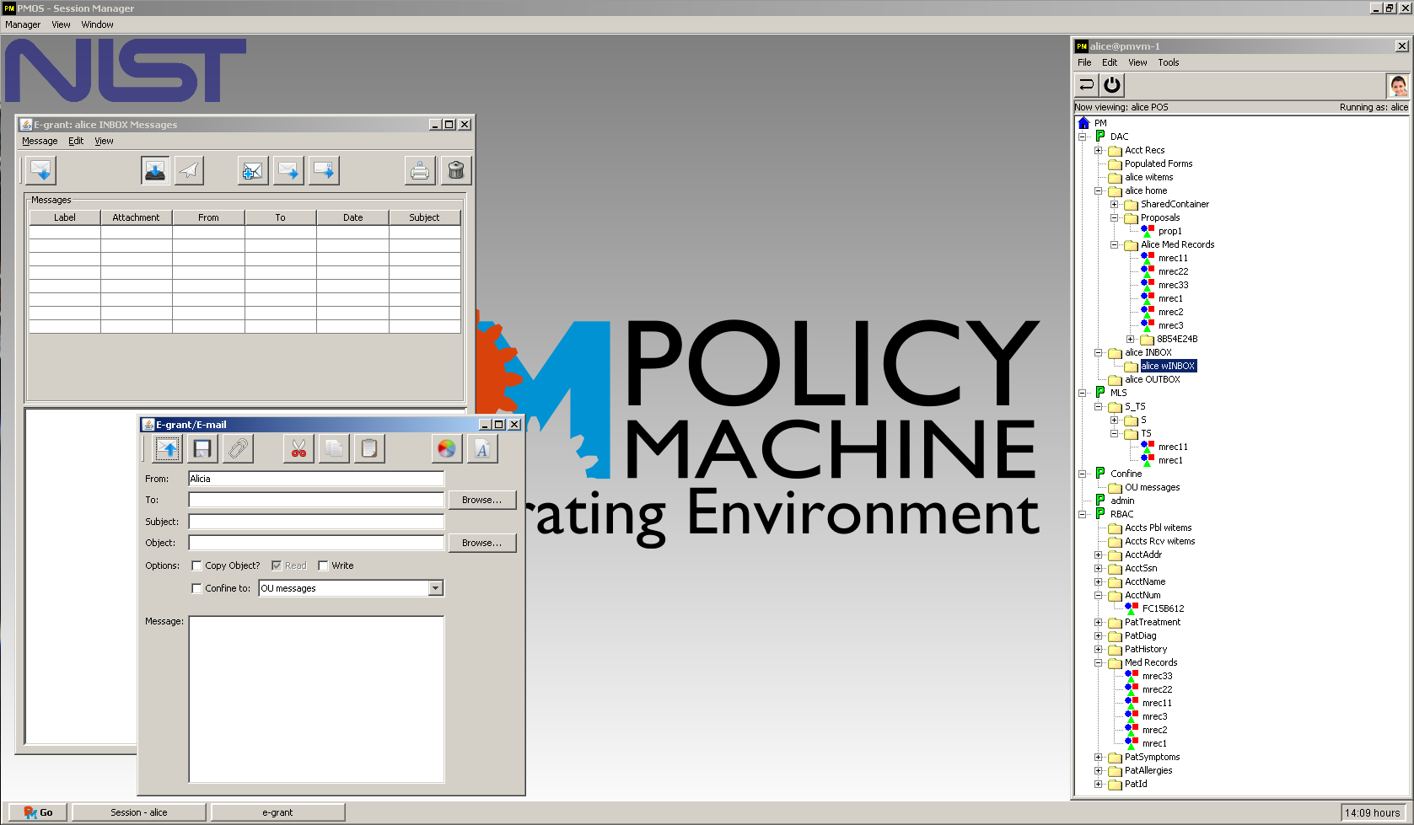
Introduction
Policy Machine (PM):
Unified access control framework
Express and enforce arbitrary access control policies
Attribute-based access control policies
Goal & Objective:
To provide a generic platform that supports
Commonly known and implemented access control policies
Combinations of policies
Policies for which no access control mechanism presently exists

Slide 4

Characteristics of PM
Comprehensive enforcement of many policies across both centralized and distributed systems
Single administrative domain
Comprises of a family of standards that recognizes
Policy Administration Point (PAP),
Policy enforcement points (PEP),
Policy Decision Point(s) (PDP),
A policy database

Slide 5
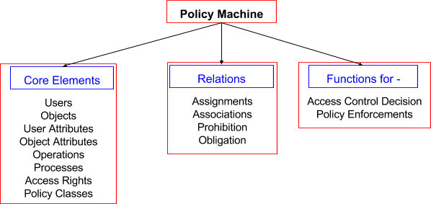
PM Framework- a logical ‘machine’

Slide 6
PM Core Elements
Users (U): actual users/individuals in a system
Objects (O): files, records, resources
User Attributes (UA) and Object Attributes (OA): containers for users and objects respectively
Policy Classes (PC): containers for each access control policies
Processes (p): similar to a subject, issues access request
Operations (Op): actions (r, w, etc.) can be performed on contents of objects/resources or PM data elements and relations
Access Rights (AR): access rights required to carry out an operation

Slide 7
PM vs ABAC Attributes
ABAC attributes
Characteristics/properties of users and objects
Finite domain
Set or atomic valued
Example:
User attribute –
Title = { manager, employee}
Age = {18, 19}
Object attribute –
Owner = Alice
Label = {private, public}
PM attributes
Containers for users and objects
No defined domain
Set of members in the container
Example:
User attribute –
Manager = manager_1, manager 2
Employee = employee_1, employee 2
Object attribute –
Medical records = mrec1, mrec2

Slide 8
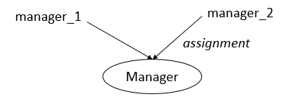

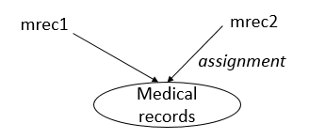
Attributes (User/Object)
assignment
assignment
Fig1: PM user attribute and assigned users
Fig3: ABAC user and attribute-value pair
assignment
assignment
Owner = Alice
Type = private
File
Fig2: PM object attribute and assigned objects
Fig4: ABAC object and object-value pair

Slide 9
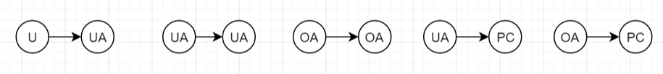

PM Relations
Assignment: x ASSIGN y
Association: relationship between user attributes (UA) and user attributes and objects attributes (AT = UA U OA) via operations/actions, policies
Prohibition: constraints and restrictions on access rights on users, processes or user attributes, SSD
Obligations: dynamically change the policy state in response to user/process event, DSD
When pattern do response
Notes:
These relations allows to express a wide range of attribute-based policies.

Slide 10
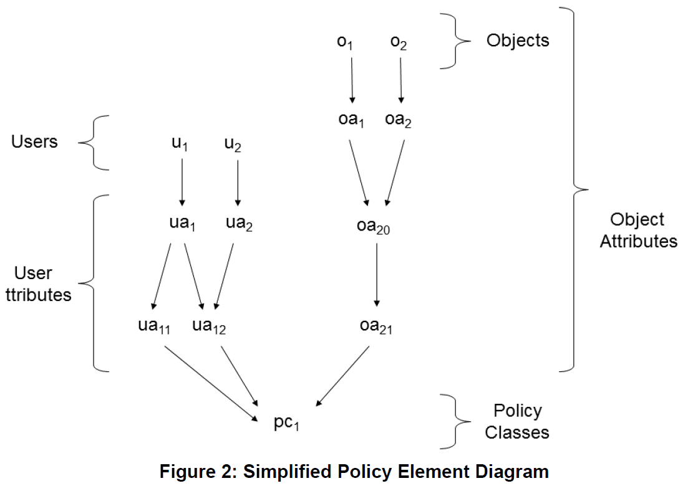

PM Assignments
Containment Property:
Hierarchical relationships
Inheritance shown downwards
x
x contained by y
y
Notes:
both oa1 and oa2 are contained by oa20 and acquire the properties of oa20, and oa1, oa2, and oa20 are contained by oa21 and likewise acquire its properties.
Inverted inheritance

Slide 11
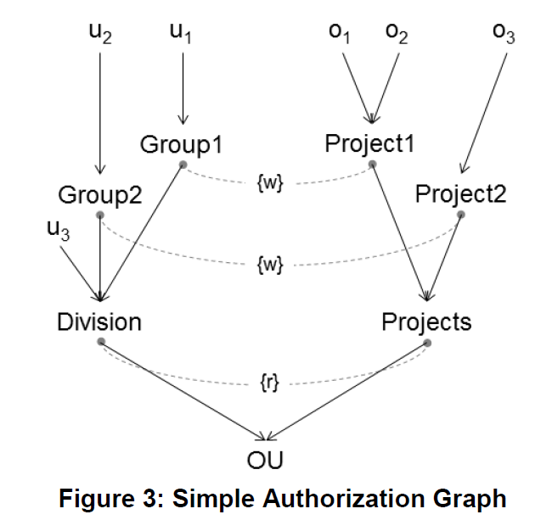
PM Authorization Graph
Assignments
Associations
{r}, {w} - Operations

Slide 12
Derived Privileges - Enumerations
Enumerations all explicit and implicit privileges/accesses
Association →(Group1, {w}, Project1)
Users(Group1)={u1}
Access right={w}
Elements(Project1)={Project1, o1, o2}
Derived privileges for user u1:
(u1, w, Project1), (u1, w, o1), and (u1, w, o2)

Slide 13
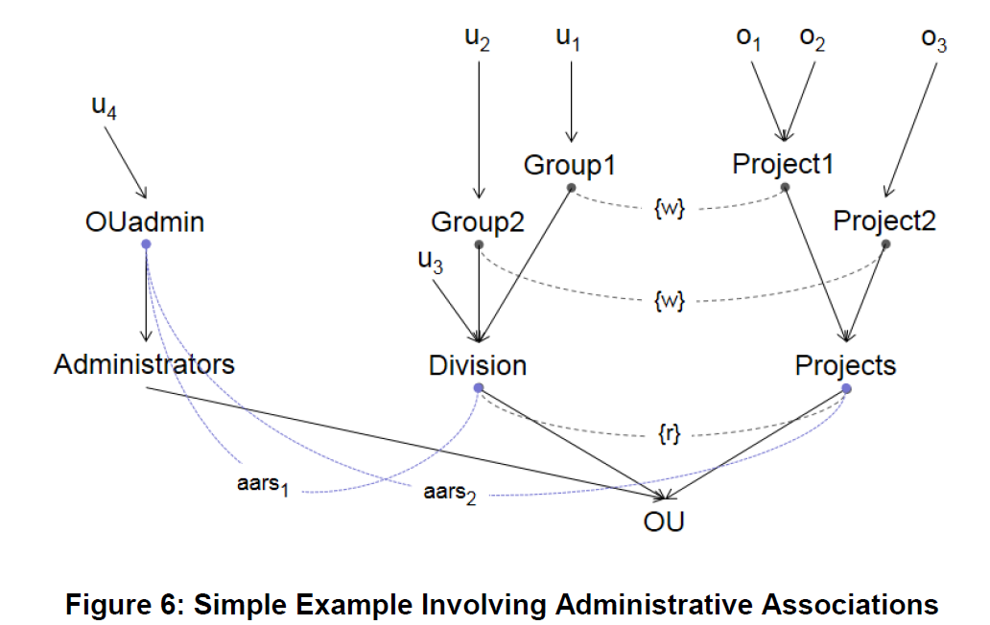
PM Administrative Authorization Graph

Slide 14
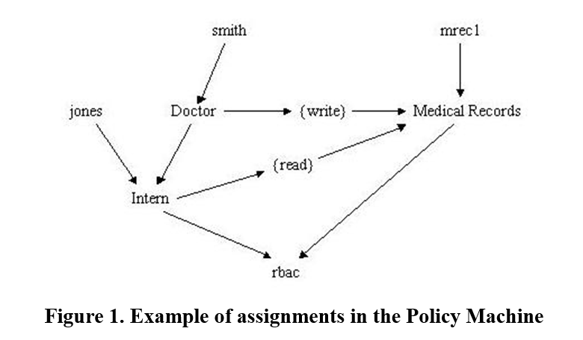
Example – RBAC Policy

Slide 15
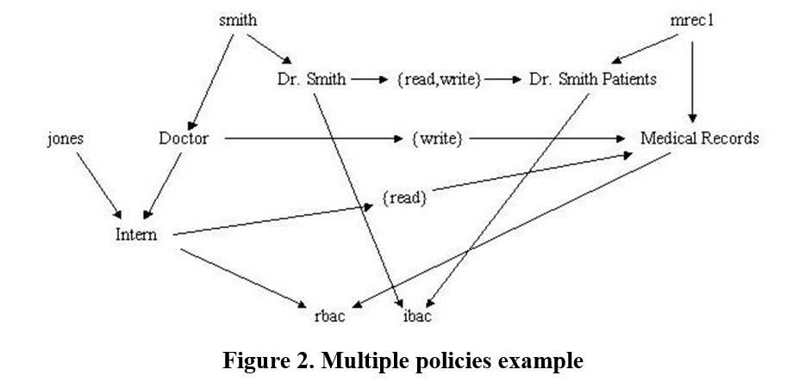
Combination of Policies

Slide 16
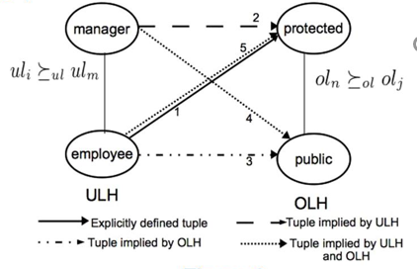
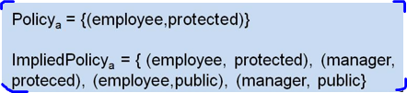
LaBACH
LaBACH Characteristics:
Assignments and Associations relations
User/object label hierarchy
Only operations on objects/resources
(no admin operations)
Enumerated policies

Slide 17
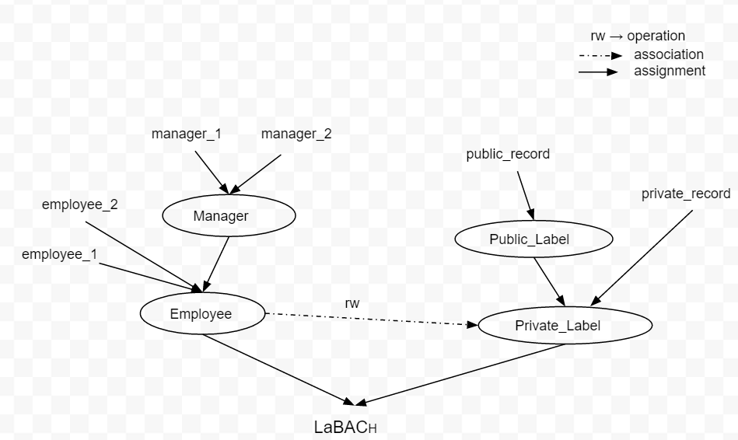
LaBACH in PM

Slide 18
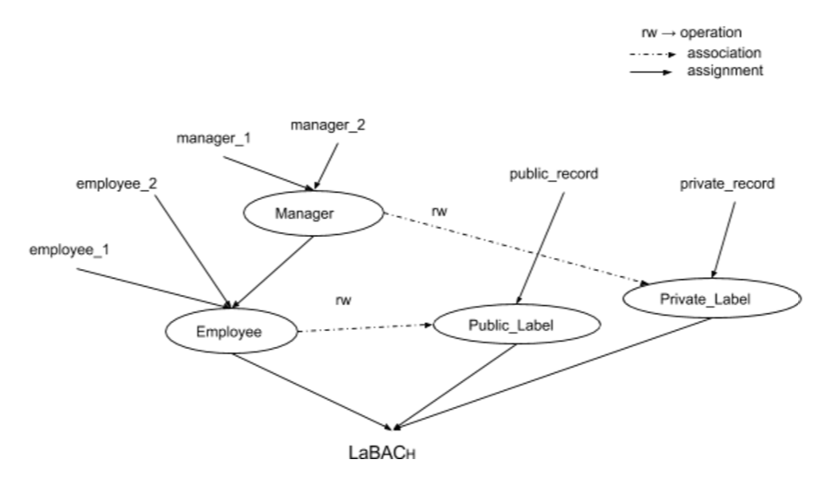
LaBACH in PM
Tweaked

Slide 19
PM Tool
PM Server: Policy Administration Point (PAP), Policy Decision Point (PDP), includes a PM Database, an event processing module
Administrative Client: Admin Tool (PAP)
Database: Active Directory
PM client: PEP, an application programming interfaces (API), and PM-aware applications
User Environment Simulator
Kernel Simulator: acts as PEP
Session Manager

Slide 20
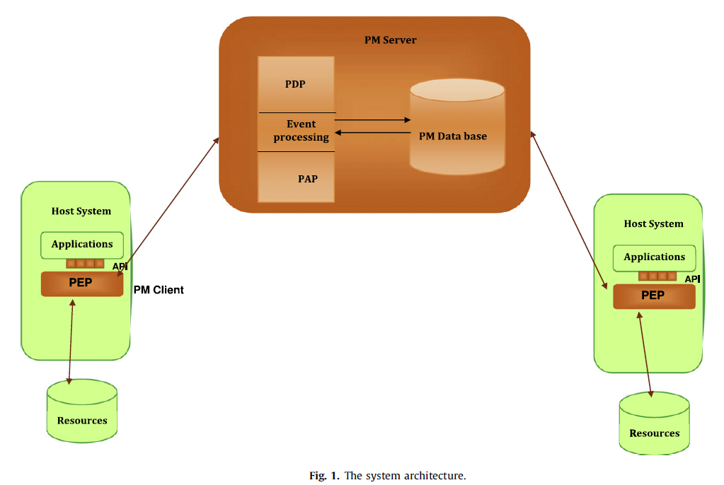
PM System Architecture
Notes:
PEP within the PM client traps each access request, and then asks the PDP within the PM server to decide whether to grant or reject the access request. The physical location of each object is known to the PM server (and transparent to the client).
In the case of a granted request, the server response is accompanied by the physical location of the object.
The PM client exposes a standard set of APIs that can be used to develop PM-aware applications.
PM uses the resource repositories and servers to store and retrieve the physical contents of its objects.
A user may be associated with one or more processes, while a process is always associated with just one user.

Slide 21
LaBACH Configuration in PM
Look into PM Tool at the end!!!

Slide 22

PM and ABAC Analysis
Defining policies in ABAC models:
Logical formula: ABACα, XACML
- Pros: simple, easy, and flexible
- Cons: reviewing, updating policies become NP-complete
Enumerated policies: LaBAC, 2-sorted RBAC, PM
- Pros: good for updating and reviewing policies
- Cons: size might becomes exponential

Slide 23
PM in Cloud
PM & OpenStack
REST API
OpenStack
(PEP)
PM Server
(PAP, PDP)
grant/deny
Nova
Neutron
Swift
access request
Keystone

Slide 24


PM & OpenStack
Better understand PM and OpenStack
Proof of Concept PM-ABAC in cloud
Performance overhead
PM specific issues

Slide 25
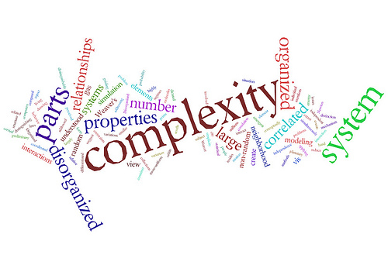
Conclusion & Limitations
Platform for testing and enforcing policies
ABAC attributes vs PM attributes
Configuration overhead
Many details and complexities
Active Directory
Certificates and keys, …

Slide 26



