Slide 1
CS 6393 Lecture 3
Role-Based Access Control
(RBAC)
Prof. Ravi Sandhu
Executive Director and Endowed Chair
January 29, 2016
ravi.sandhu@utsa.edu
www.profsandhu.com
© Ravi Sandhu
World-Leading Research with Real-World Impact!

Slide 2
Access Control
Fixed
policy
Discretionary Access Control (DAC), 1970
Mandatory Access Control (MAC), 1970
Role Based Access Control (RBAC), 1995
Attribute Based Access Control (ABAC), ????
Flexible
policy
© Ravi Sandhu
World-Leading Research with Real-World Impact!
2

Slide 3
The RBAC Story
Standard
Adopted
Proposed
Standard
RBAC96
paper
© Ravi Sandhu
World-Leading Research with Real-World Impact!
3
Notes:
This is a somewhat busy slide
It shows a bird’s eye view of RBAC
There are many details that need to be debated and filled in
Some of these will be discussed in the subsequent panel
For our purpose the bird’s eye view will suffice

Slide 4
RBAC: Role-Based Access Control
Access is determined by roles
A user’s roles are assigned by security administrators
A role’s permissions are assigned by security administrators
First emerged: mid 1970s
First models: mid 1990s
Is RBAC MAC or DAC or neither?
RBAC can be configured to do MAC
RBAC can be configured to do DAC
RBAC is policy neutral
RBAC is neither MAC nor DAC!
© Ravi Sandhu
World-Leading Research with Real-World Impact!
4

Slide 5
RBAC96 Model Family
P model
ROLE HIERARCHIES
USER-ROLE
ASSIGNMENT
PERMISSIONS-ROLE
ASSIGNMENT
USERS
ROLES
PERMISSIONS
...
SESSIONS
CONSTRAINTS
© Ravi Sandhu
World-Leading Research with Real-World Impact!
5
Notes:
This is a somewhat busy slide
It shows a bird’s eye view of RBAC
There are many details that need to be debated and filled in
Some of these will be discussed in the subsequent panel
For our purpose the bird’s eye view will suffice

Slide 6
RBAC96 Model Family
RBAC3
ROLE HIERARCHIES +
CONSTRAINTS
RBAC1
ROLE
HIERARCHIES
RBAC2
CONSTRAINTS
RBAC0
BASIC RBAC
© Ravi Sandhu
World-Leading Research with Real-World Impact!
6
Notes:
This is a somewhat busy slide
It shows a bird’s eye view of RBAC
There are many details that need to be debated and filled in
Some of these will be discussed in the subsequent panel
For our purpose the bird’s eye view will suffice

Slide 7
RBAC SECURITY PRINCIPLES
Abstraction of Privileges
Credit is different from Debit even though both require read and write
Separation of Administrative Functions
Separation of user-role assignment from role-permission assignment
Least Privilege
Right-size the roles
Don’t activate all roles all the time
Separation of Duty
Static separation: purchasing manager versus accounts payable manager
Dynamic separation: cash-register clerk versus cash-register manager
© Ravi Sandhu
World-Leading Research with Real-World Impact!
7

Slide 8
ROLES AS POLICY
A role brings together
a collection of users and
a collection of permissions
These collections will vary over time
A role has significance and meaning beyond the particular users and permissions brought together at any moment
© Ravi Sandhu
World-Leading Research with Real-World Impact!
8

Slide 9
ROLES VERSUS GROUPS
Groups are often defined as
a collection of users
A role is
a collection of users and
a collection of permissions
Some authors define role as
a collection of permissions
Most Operating Systems support groups
BUT do not support selective activation of groups
Selective activation conflicts with negative groups (or roles)
© Ravi Sandhu
World-Leading Research with Real-World Impact!
9

Slide 10
HIERARCHICAL ROLES
Primary-Care
Physician
Specialist
Physician
Physician
Health-Care Provider
© Ravi Sandhu
World-Leading Research with Real-World Impact!
10

Slide 11
HIERARCHICAL ROLES
Supervising
Engineer
Hardware
Engineer
Software
Engineer
Engineer
© Ravi Sandhu
World-Leading Research with Real-World Impact!
11

Slide 12
PRIVATE ROLES
Hardware
Engineer’
Supervising
Engineer
Software
Engineer’
Hardware
Engineer
Software
Engineer
Engineer
© Ravi Sandhu
World-Leading Research with Real-World Impact!
12

Slide 13
EXAMPLE ROLE HIERARCHY
Director (DIR)
Project Lead 1
(PL1)
Project Lead 2
(PL2)
Production 1
(P1)
Quality 1
(Q1)
Production 2
(P2)
Quality 2
(Q2)
Engineer 1
(E1)
Engineer 2
(E2)
PROJECT 1
Engineering Department (ED)
PROJECT 2
Employee (E)
© Ravi Sandhu
World-Leading Research with Real-World Impact!
13

Slide 14
EXAMPLE ROLE HIERARCHY
Project Lead 1
(PL1)
Project Lead 2
(PL2)
Production 1
(P1)
Quality 1
(Q1)
Production 2
(P2)
Quality 2
(Q2)
Engineer 1
(E1)
Engineer 2
(E2)
PROJECT 1
Engineering Department (ED)
PROJECT 2
Employee (E)
© Ravi Sandhu
World-Leading Research with Real-World Impact!
14

Slide 15
EXAMPLE ROLE HIERARCHY
Director (DIR)
Project Lead 1
(PL1)
Project Lead 2
(PL2)
Production 1
(P1)
Quality 1
(Q1)
Production 2
(P2)
Quality 2
(Q2)
Engineer 1
(E1)
Engineer 2
(E2)
PROJECT 1
PROJECT 2
© Ravi Sandhu
World-Leading Research with Real-World Impact!
15

Slide 16
EXAMPLE ROLE HIERARCHY
Project Lead 1
(PL1)
Project Lead 2
(PL2)
Production 1
(P1)
Quality 1
(Q1)
Production 2
(P2)
Quality 2
(Q2)
Engineer 1
(E1)
Engineer 2
(E2)
PROJECT 1
PROJECT 2
© Ravi Sandhu
World-Leading Research with Real-World Impact!
16

Slide 17
CONSTRAINTS
Mutually Exclusive Roles
Static Exclusion: The same individual can never hold both roles
Dynamic Exclusion: The same individual can never hold both roles in the same context
Mutually Exclusive Permissions
Static Exclusion: The same role should never be assigned both permissions
Dynamic Exclusion: The same role can never hold both permissions in the same context
Cardinality Constraints on User-Role Assignment
At most k users can belong to the role
At least k users must belong to the role
Exactly k users must belong to the role
Cardinality Constraints on Permissions-Role Assignment
At most k roles can get the permission
At least k roles must get the permission
Exactly k roles must get the permission
© Ravi Sandhu
World-Leading Research with Real-World Impact!
17

Slide 18
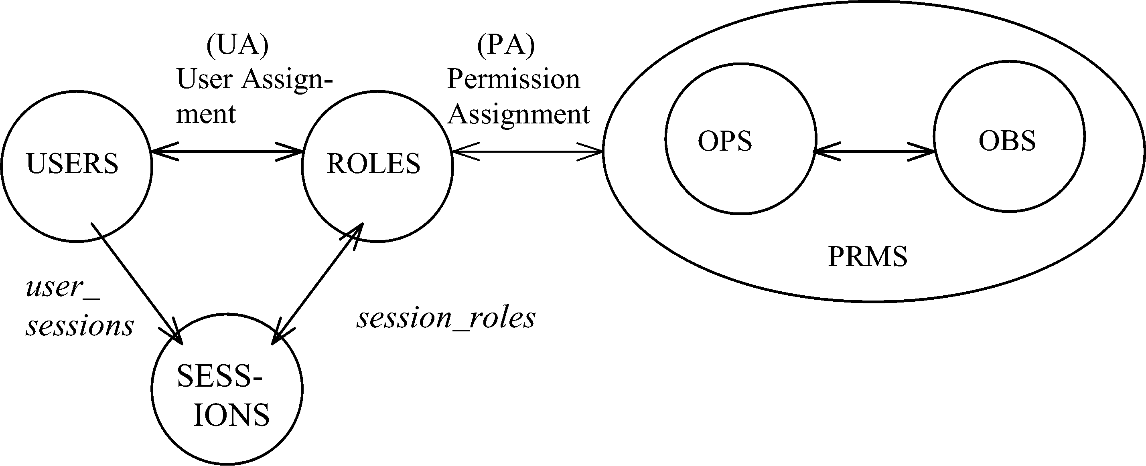
NIST MODEL: CORE RBAC
© Ravi Sandhu
World-Leading Research with Real-World Impact!
18

Slide 19
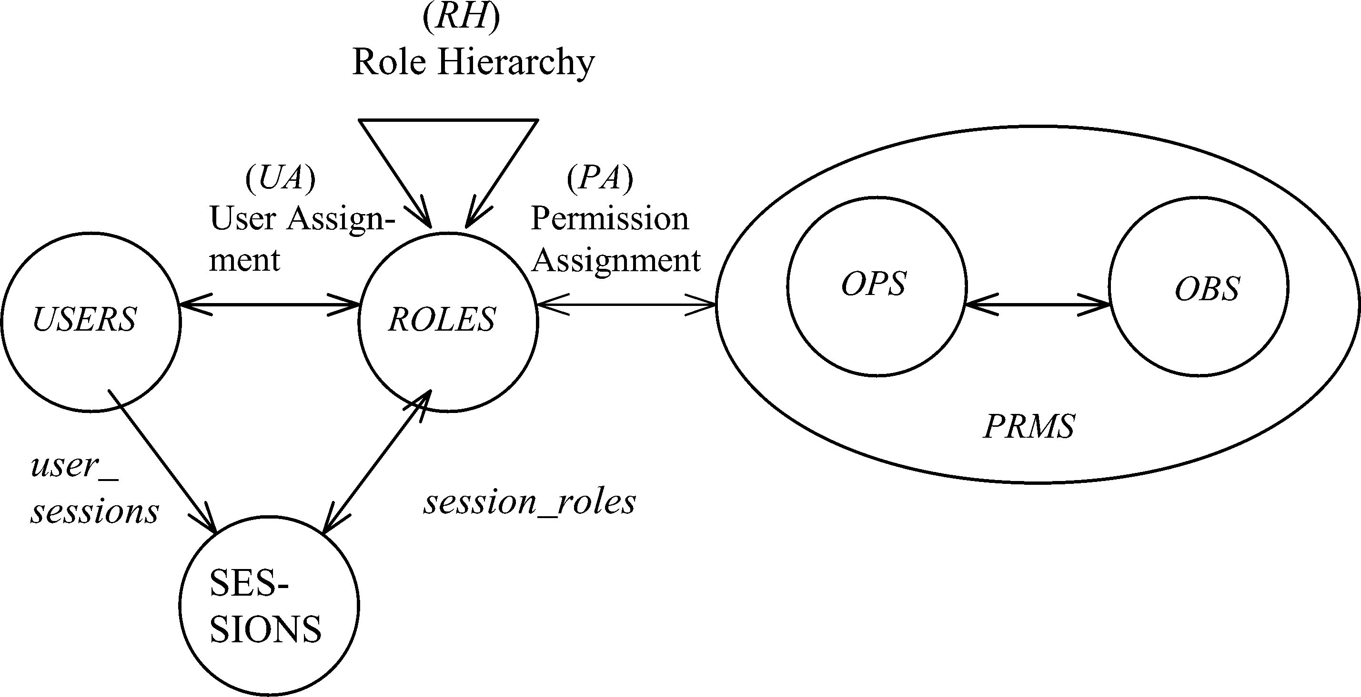
NIST MODEL: HIERARCHICAL RBAC
© Ravi Sandhu
World-Leading Research with Real-World Impact!
19

Slide 20
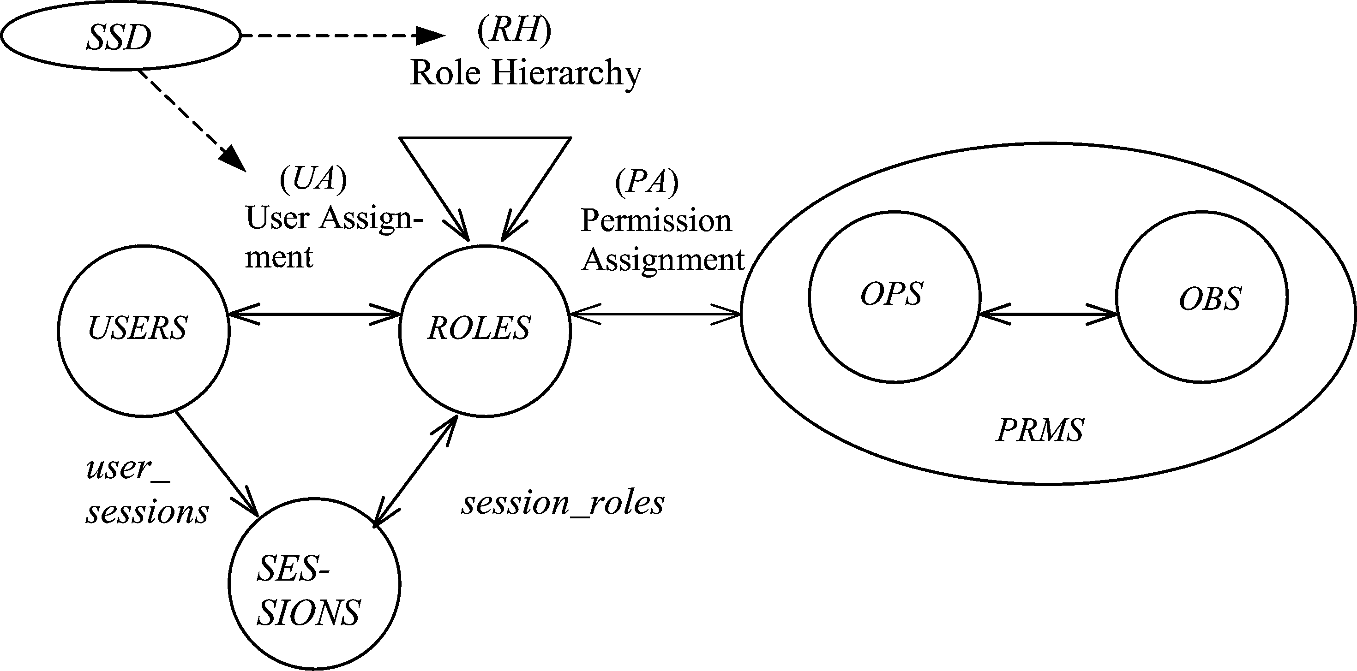
SSD IN HIERARCHICAL RBAC
© Ravi Sandhu
World-Leading Research with Real-World Impact!
20

Slide 21
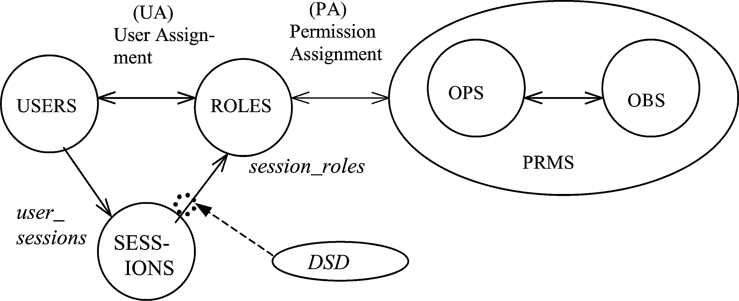
DSD IN HIERARCHICAL RBAC
© Ravi Sandhu
World-Leading Research with Real-World Impact!
21

Slide 22
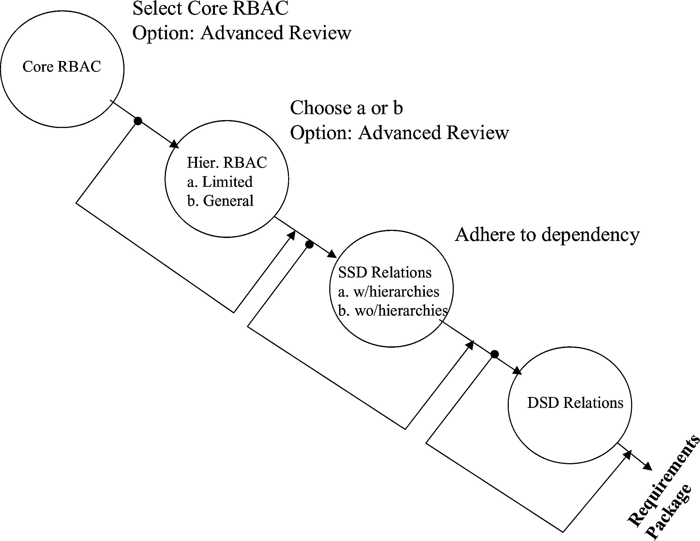
NIST MODEL FAMILY
© Ravi Sandhu
World-Leading Research with Real-World Impact!
22

Slide 23
Compare RBAC96 Model Family
RBAC3
ROLE HIERARCHIES +
CONSTRAINTS
RBAC1
ROLE
HIERARCHIES
RBAC2
CONSTRAINTS
RBAC0
BASIC RBAC
© Ravi Sandhu
World-Leading Research with Real-World Impact!
23
Notes:
This is a somewhat busy slide
It shows a bird’s eye view of RBAC
There are many details that need to be debated and filled in
Some of these will be discussed in the subsequent panel
For our purpose the bird’s eye view will suffice

Slide 24
OM-AM
A
s
s
u
r
a
n
c
e
What?
Objectives
Model
Architecture
Mechanism
How?
© Ravi Sandhu
World-Leading Research with Real-World Impact!
24

Slide 25
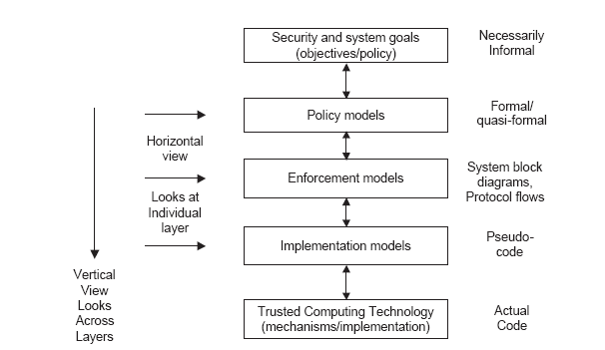
PEI Models
Idealized
Enforceable
(Approximate)
Codeable
© Ravi Sandhu
World-Leading Research with Real-World Impact!
25

Slide 26
RBAC: SERVER PULL
E model
Client
Server
User-role
Authorization
Server
© Ravi Sandhu
World-Leading Research with Real-World Impact!
26
Notes:
This is a somewhat busy slide
It shows a bird’s eye view of RBAC
There are many details that need to be debated and filled in
Some of these will be discussed in the subsequent panel
For our purpose the bird’s eye view will suffice

Slide 27
RBAC: CLIENT PULL
E model
Client
Server
User-role
Authorization
Server
© Ravi Sandhu
World-Leading Research with Real-World Impact!
27
Notes:
This is a somewhat busy slide
It shows a bird’s eye view of RBAC
There are many details that need to be debated and filled in
Some of these will be discussed in the subsequent panel
For our purpose the bird’s eye view will suffice

Slide 28
RBAC: PROXY-BASED
E model
Client
Proxy
Server
Server
User-role
Authorization
Server
© Ravi Sandhu
World-Leading Research with Real-World Impact!
28
Notes:
This is a somewhat busy slide
It shows a bird’s eye view of RBAC
There are many details that need to be debated and filled in
Some of these will be discussed in the subsequent panel
For our purpose the bird’s eye view will suffice

Slide 29
Discuss highlights of reference papers
© Ravi Sandhu
World-Leading Research with Real-World Impact!

