Slide 1
CS 6393 Lecture 4
Attribute-Based Access Control
(ABAC)
Prof. Ravi Sandhu
Executive Director and Endowed Chair
February 19, 2016
ravi.sandhu@utsa.edu
www.profsandhu.com
© Ravi Sandhu
World-Leading Research with Real-World Impact!

Slide 2
Access Control
Discretionary Access Control (DAC), 1970
Mandatory Access Control (MAC), 1970
Role Based Access Control (RBAC), 1995
Attribute Based Access Control (ABAC), ????
© Ravi Sandhu
World-Leading Research with Real-World Impact!
2

Slide 3
Discuss Figs 2 and 3 of NIST SP 800-162
© Ravi Sandhu
World-Leading Research with Real-World Impact!

Slide 4
ABAC Status
Standard
Adopted
Proposed
Standard
RBAC96
paper
1990?
2016
ABAC still in pre/early phase
© Ravi Sandhu
World-Leading Research with Real-World Impact!
4

Slide 5
ABAC is not New
User (Identity)
Attributes
Public-keys +
Secured secrets
© Ravi Sandhu
World-Leading Research with Real-World Impact!

Slide 6
ABAC is not New
User (Identity)
X.500
Directory
X.509
Identity Certificates
Attributes
Public-keys +
Secured secrets
Pre Internet, early 1990s
© Ravi Sandhu
World-Leading Research with Real-World Impact!

Slide 7
ABAC is not New
User (Identity)
X.509
Attribute
Certificates
X.509
Identity Certificates
Attributes
Public-keys +
Secured secrets
Post Internet, late 1990s
© Ravi Sandhu
World-Leading Research with Real-World Impact!

Slide 8
ABAC is not New
User (Identity)
Attributes
SPKI Certificates
Public-keys +
Secured secrets
Post Internet, late 1990s
© Ravi Sandhu
World-Leading Research with Real-World Impact!

Slide 9
ABAC is not New
User (Identity)
Attributes
Anonymous
Credentials
Public-keys +
Secured secrets
Mature Internet, 2000s
© Ravi Sandhu
World-Leading Research with Real-World Impact!

Slide 10
ABAC is not New
Attributes
Action
Authorization Decision
User
Subject
Yes/No
Object
Context
XACML
Policy
Mature Internet, 2000s
© Ravi Sandhu
World-Leading Research with Real-World Impact!

Slide 11
ABAC is not New
unified model integrating
  authorization
  obligation
  conditions
and incorporating
  continuity of decisions
  mutability of attributes
Usage Control Models, early 2000s
ABAC on steroids
© Ravi Sandhu
World-Leading Research with Real-World Impact!

Slide 12
ABAC Status
Standard
Adopted
Proposed
Standard
RBAC96
paper
1990?
2016
ABAC still in pre/early phase
© Ravi Sandhu
World-Leading Research with Real-World Impact!
12

Slide 13
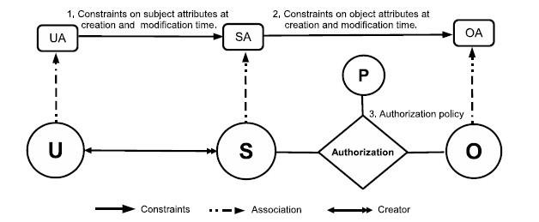
ABACα Model Structure
Policy Configuration Points
Can be configured to do simple forms of DAC, MAC, RBAC
© Ravi Sandhu
World-Leading Research with Real-World Impact!
13

Slide 14
Discuss highlights of Jin 2012 paper
© Ravi Sandhu
World-Leading Research with Real-World Impact!

Slide 15
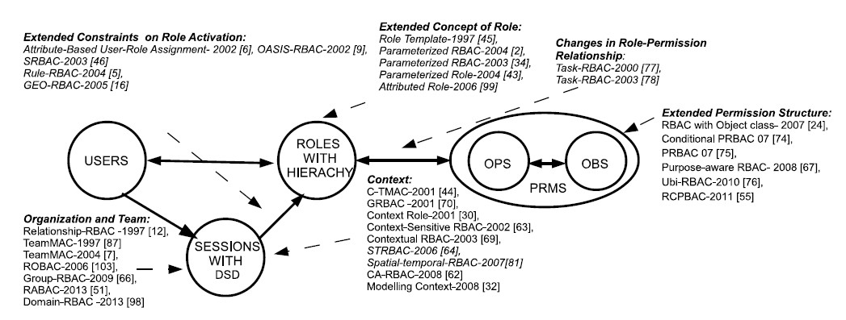
RBAC Extensions
1,4
1, 2, 4, 5
1, 4, 5
4, 5
1, 2, 3, 4, 5
4
1, 4, 5
1. Context Attributes
2. Subject attribute constraints policy are different at creation and modification time.
4. Policy Language
5. Meta-Attributes
3. Subject attributes constrained by attributes of subjects created by the same user.
World-Leading Research with Real-World Impact!
15
Notes:
Give examples about what is excluded

Slide 16
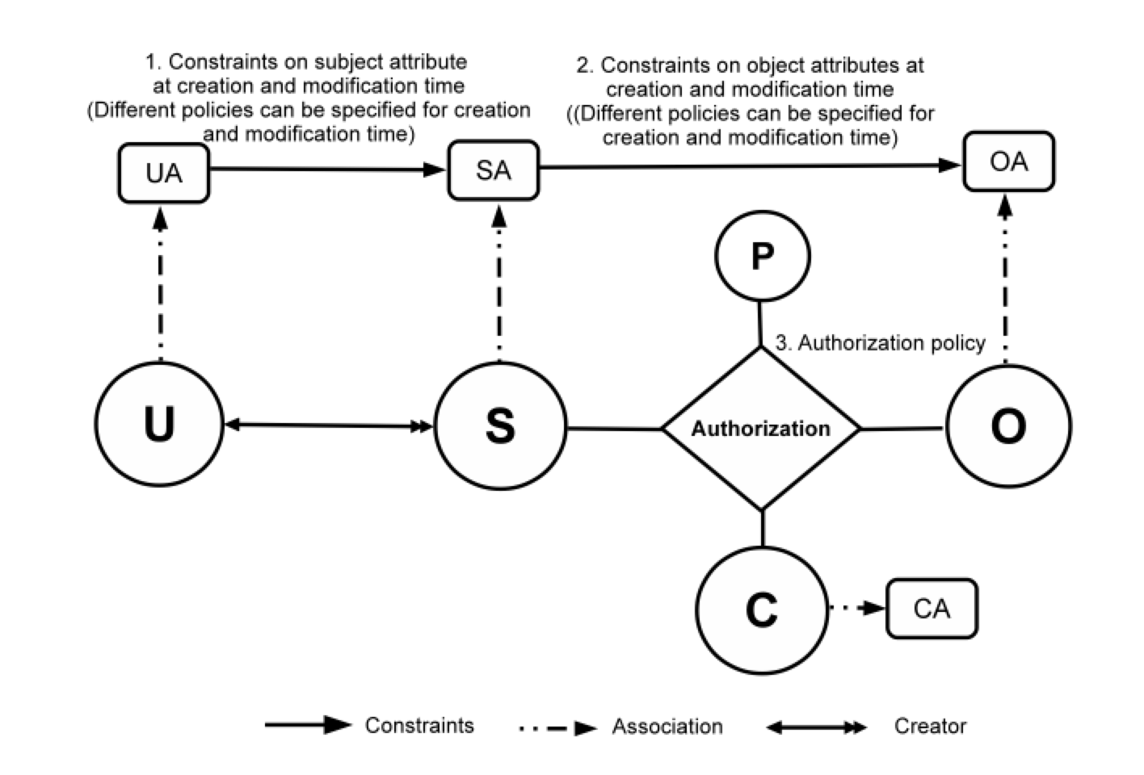
ABAC_{β} Model
Can be configured to do many
RBAC extensions
16
Notes:
Show abac-alpha
Then for each type of extension, highlight the extensions to ABAC
23 and 24 integrated

Slide 17
Ultimate Unified Model
Attributes
Security
Access Control
Trust
Risk
Relationships
Provenance
© Ravi Sandhu
World-Leading Research with Real-World Impact!

Slide 18
Application Domains
  Cloud computing
  Internet of Things
  ……….
© Ravi Sandhu
World-Leading Research with Real-World Impact!
18

Slide 19
Discuss Fig 1 of Kandala 2011 paper
© Ravi Sandhu
World-Leading Research with Real-World Impact!

Slide 20
Discuss Fig 1 and Table 1 of Hu 2015 paper
© Ravi Sandhu
World-Leading Research with Real-World Impact!

Slide 21
Discuss Kuhn 2010 paper
© Ravi Sandhu
World-Leading Research with Real-World Impact!

