Slide 1
CS 6393 Lecture 6
Relationship-Based Access Control (ReBAC or RAC)
Prof. Ravi Sandhu
Executive Director and Endowed Chair
March 4, 2016
ravi.sandhu@utsa.edu
www.profsandhu.com
© Ravi Sandhu
World-Leading Research with Real-World Impact!

Slide 2
RAC Models
U2U, U2R, R2R
with attributes
URRAC_{A}
Cheng et al 2014
U2U, U2R, R2R
URRAC
Cheng et al 2012-09
U2U
UURAC
Cheng et al 2012-07
Cheng et al 2015
© Ravi Sandhu
World-Leading Research with Real-World Impact!
2

Slide 3
RAC Models
U2U, U2R, R2R
with attributes
URRAC_{A}
Cheng et al 2014
U2U, U2R, R2R
URRAC
Cheng et al 2012-09
U2U
UURAC
Cheng et al 2012-07
Cheng et al 2015
© Ravi Sandhu
World-Leading Research with Real-World Impact!
3

Slide 4

UURAC Motivation
Users in Online Social Networks (OSNs) are connected by social relationships (user-to-user relationships U2U)
Owner of a resource can control its release based on U2U relationships between the access requester and the owner
World-Leading Research with Real-World Impact!

Slide 5
UURAC Motivation
OSNs keep massive resources and support varied activities for users
Users want to regulate access to their resources and activities related to them (as a requester or target)
Some related users also expect control on how the resource or user can be exposed
World-Leading Research with Real-World Impact!
Notes:
Huge volume of data, Changing dynamically, traditional methods are not scalable
In mandatory ac system, there is a central administrator for policy configuration.

Slide 6
UURAC Motivation
What current friend-of-friend approach cannot do?
  User who is tagged in a photo wants to keep her image private (Related User’s Control)
  Mom doesn’t want her kid to become friend with her colleagues (Parental Control)
  Employee promotes his resume to headhunters without letting his current employer know (Allowing farther users but preventing closer users)
World-Leading Research with Real-World Impact!
Notes:
Many commercial systems have applied FofF approaches. Not enough. (a little boring and lengthy in this slide)
Purely owner-based control

Slide 7
Characteristics of Access Control in OSNs
Policy Individualization
  Users define their own privacy and activity preferences
  Related users can configure policies too
  Collectively used by the system for control decision
User and Resource as a Target
  e.g., poke, messaging, friendship invitation, etc.
User Policies for Outgoing and Incoming Actions
  User can be either requester or target of activity
  Allows control on 1) activities w/o knowing a particular resource and 2) activities against the user w/o knowing a particular access requestor
  e.g., block notification of friend’s activities; restrict from viewing violent contents
Relationship-based Access Control
World-Leading Research with Real-World Impact!
Notes:
We summarize four essential characteristics that need to be supported in access control solutions for OSN systems.

Slide 8
UURAC Approach
Using regular expression-based path pattern for arbitrary combination of relationship types
Given relationship path pattern and hopcount limit, graph traversal algorithm checks the social graph to determine access
World-Leading Research with Real-World Impact!

Slide 9
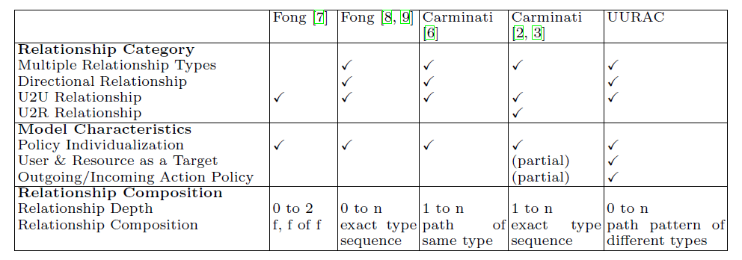
Related Works
The advantages of this approach:
  Passive form of action allows outgoing and incoming action policy
  Path pattern of different relationship types make policy specification more expressive
World-Leading Research with Real-World Impact!
Notes:
Just emphasize our approach

Slide 10
Related Works
Not to forget PGP web of trust (mid 1990s)
World-Leading Research with Real-World Impact!
Notes:
Just emphasize our approach

Slide 11
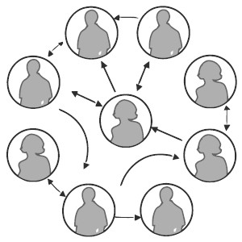
Social Networks
Social graph is modeled as a directed labeled simple graph G=<U, E, Σ>
  Nodes U as users
  Edges E as relationships
  Σ={σ₁, σ₂, …,σ_{n}, σ₁⁻¹, σ₂⁻¹,…, σ_{n}⁻¹}
  as relationship types supported
World-Leading Research with Real-World Impact!
Notes:
Relationship is not mutual any more. We consider incoming relationships, so granting access to users who consider him as a friend is plausible (inverse relationship)

Slide 12
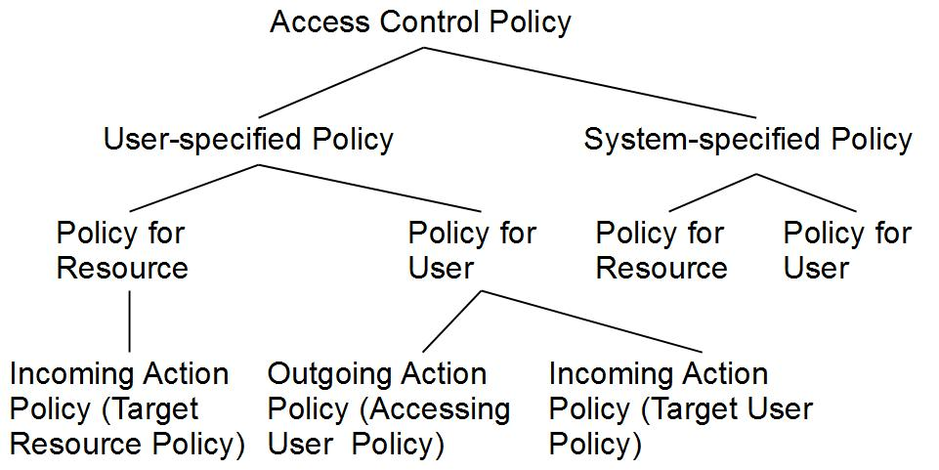
Policy Taxonomy

Slide 13
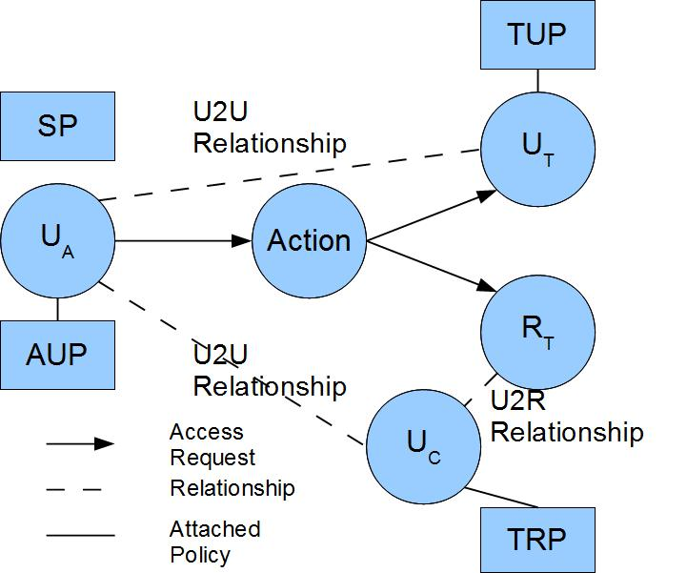
UURAC Model Components
U_{A}: Accessing User
U_{T}: Target User
U_{C}: Controlling User
R_{T}: Target Resource
AUP: Accessing User Policy
TUP: Target User Policy
TRP: Target Resource Policy
SP: System Policy
World-Leading Research with Real-World Impact!

Slide 14
Access Request and Evaluation
Access Request <u_{a}, action, target>
  u_{a} tries to perform action on target
  Target can be either user u_{t} or resource r_{t}
Policies and Relationships used for Access Evaluation
  When u_{a} requests to access a user u_{t}
    u_{a}’s AUP, u_{t}’s TUP, SP
    U2U relationships between u_{a} and u_{t}
  When u_{a} requests to access a resource r_{t}
    u_{a}’s AUP, r_{t}’s TRP (associated with u_{c}), SP
    U2U relationships between u_{a} and u_{c}
World-Leading Research with Real-World Impact!

Slide 15
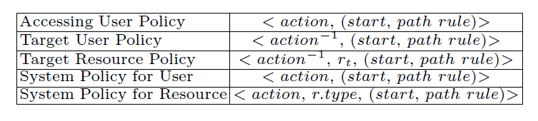
Policy Representations
action⁻¹ in TUP and TRP is the passive form since it applies to the recipient of action
TRP has an extra parameter r_{t} to distinguish the actual target resource it applies to
  owner(r_{t})→ a list of u_{c}→U2U relationships between u_{a} and u_{c}
SP does not differentiate the active and passive forms
SP for resource needs r.type to refine the scope of the resource
World-Leading Research with Real-World Impact!

Slide 16
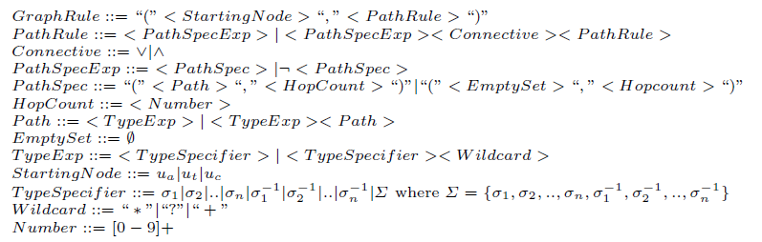
Graph Rule Grammar
World-Leading Research with Real-World Impact!

Slide 17
Example
“Only Me”
  <poke, (ua, (Ø, 0))> says that ua can only poke herself
  <poke⁻¹, (ut, (Ø, 0))> specifies that ut can only be poked by herself
The Use of Negation Notation
  (fffc ˄ ¬fc) allows the coworkers of the user’s distant friends to see, while keeping away the coworkers of the user’s direct friends
World-Leading Research with Real-World Impact!

Slide 18
Policy Collecting
To authorize (u_{a}, action, target) if target = u_{t}
  E.g., (Alice, poke, Harry)
P_{Alice}
<poke, (ua, (f*,3))>
AUP
< poke⁻¹, (ua, (f*,3))>
P_{Harry}
TUP
<poke, (ua, (cf*,5)˅(f*,5))>
<poke⁻¹, (ut, (f*,2))>
SP
P_{Sys}
<poke, (ua, (Σ*,5))>
World-Leading Research with Real-World Impact!

Slide 19
Policy Collecting
To authorize (u_{a}, action, target) if target = u_{t}
  E.g., (Alice, poke, Harry)
P_{Alice}
AUP
< poke⁻¹, (ua, (f*,3))>
<poke, (ua, (f*,3))>
P_{Harry}
TUP
<poke, (ua, (cf*,5)˅(f*,5))>
<poke⁻¹, (ut, (f*,2))>
SP
P_{Sys}
<poke, (ua, (Σ*,5))>
World-Leading Research with Real-World Impact!

Slide 20
Policy Collecting
To authorize (u_{a}, action, target) if target = r_{t}
  Determine the controlling user for r_{t}:
    u_{c} ← owner(r_{t})
  E.g., (Alice, read, file2)
P_{Alice}
<read, (u_{a}, (Σ*, 5))>
AUP
<read⁻¹, file1, (u_{c}, (cf*, 4))>
P_{Harry}
TRP
<read⁻¹, file2, (u_{c}, ¬(p+, 2))>
P_{Sys}
SP
<read, photo, (ua, (Σ*, 5))>
World-Leading Research with Real-World Impact!

Slide 21
Policy Collecting
To authorize (u_{a}, action, target) if target = r_{t}
  Determine the controlling user for r_{t}:
    u_{c} ← owner(r_{t})
  E.g., (Alice, read, file2)
P_{Alice}
AUP
<read⁻¹, file1, (u_{c}, (cf*, 4))>
<read, (u_{a}, (Σ*, 5))>
P_{Harry}
TRP
<read⁻¹, file2, (u_{c}, ¬(p+, 2))>
P_{Sys}
SP
<read, photo, (ua, (Σ*, 5))>
World-Leading Research with Real-World Impact!

Slide 22
Policy Extraction
Policy: <action, r.type, graph rule>
Graph Rule: start, path rule
Path Rule: path spec ∧|∨ path spec
Path Spec: path, hopcount
World-Leading Research with Real-World Impact!

Slide 23
Policy Evaluation
Evaluate a combined result based on conjunctive or disjunctive connectives between path specs
Make a collective result for multiple policies in each policy set.
  Policy conflicts may arise. We assume system level conflict resolution strategy is available (e.g., disjunctive, conjunctive, prioritized).
Compose the final result from the result of each policy set (AUP, TUP/TRP, SP)
World-Leading Research with Real-World Impact!

Slide 24
Path Checking Algorithm Overview
Parameters: G, path, hopcount, s, t
Traversal Order: Depth-First Search
  Why not BFS?
    Activities in OSN typically occur among people with close distance
    DFS needs only one pair of variables to keep the current status and history of exploration
    Hopcount limit prevents DFS from lengthy useless search
World-Leading Research with Real-World Impact!

Slide 25
Path Checking Algorithm Complexity
Time complexity is bounded between [O(dmin^{Hopcount}),O(dmax^{Hopcount}) ], where dmax and dmin are maximum and minimum out-degree of node
  Users in OSNs usually connect with a small group of users directly, the social graph is very sparse
  Given the constraints on the relationship types and hopcount limit, the size of the graph to be explored can be dramatically reduced
World-Leading Research with Real-World Impact!

Slide 26
RAC Models
U2U, U2R, R2R
with attributes
URRAC_{A}
Cheng et al 2014
U2U, U2R, R2R
URRAC
Cheng et al 2012-09
U2U
UURAC
Cheng et al 2012-07
Cheng et al 2015
© Ravi Sandhu
World-Leading Research with Real-World Impact!
26

Slide 27
Limitation of U2U Relationships
We rely on the controlling user and ownership to regulate access to resources in UURAC (U2U Relationship-based AC)
Needs more flexible control
  Parental control, related user’s control (e.g., tagged user)
  User relationships to resources (e.g., U-U-R)
  User relationships via resources (e.g., U-R-U)
World-Leading Research with Real-World Impact!

Slide 28
Beyond U2U Relationships
There are various types of relationships between users and resources in addition to U2U relationships and ownership
  e.g., share, like, comment, tag, etc
U2U, U2R and R2R
U2R further enables relationship and policy administration
World-Leading Research with Real-World Impact!

Slide 29
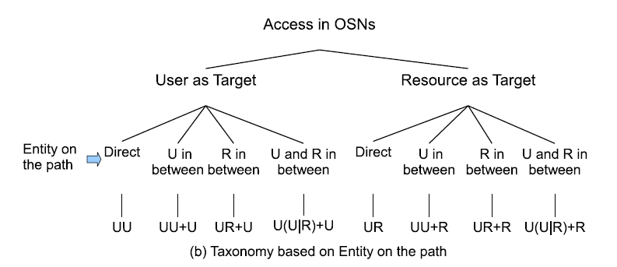
Access Scenarios
World-Leading Research with Real-World Impact!

Slide 30
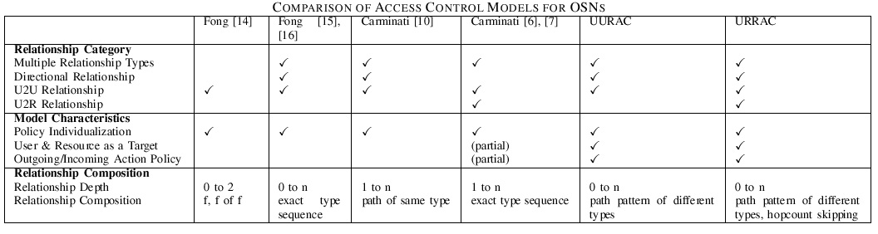
Related Works
Access Control Models for OSNs
The advantages of URRAC:
  Path pattern of different relationship types and hopcount skipping make policy specification more expressive
  System-level conflict resolution policy
World-Leading Research with Real-World Impact!

Slide 31
UURAC Model Components
U_{A}: Accessing User
U_{T}: Target User
U_{C}: Controlling User
R_{T}: Target Resource
AUP: Accessing User Policy
TUP: Target User Policy
TRP: Target Resource Policy
SP: System Policy
World-Leading Research with Real-World Impact!

Slide 32
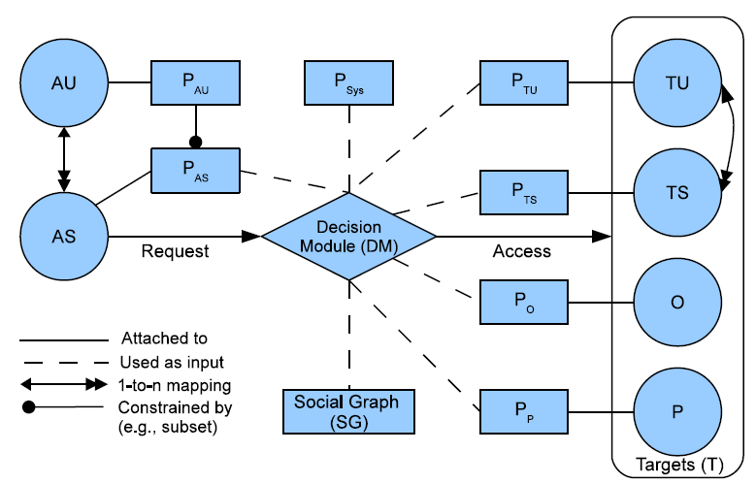
URRAC Model Components
AU: Accessing User
AS: Accessing Session
TU: Target User
TS: Target Session
O: Object
P: Policy
P_{AU}: Accessing User Policy
P_{AS}: Accessing Session Policy
P_{TU}: Target User Policy
P_{TS}: Target Session Policy
P_{O}: Object Policy
P_{P}: Policy for Policy
P_{Sys}: System Policy
World-Leading Research with Real-World Impact!

Slide 33
Action and Access Request
ACT = {act₁, act₂,. . .,act_{n}} is the set of OSN supported actions
Access Request <s, act, T>
  s tries to perform act on T
  Target T ⊆ (2^{TU ∪ R} - Ø) is a non-empty set of users and resources
    T may contain multiple targets
World-Leading Research with Real-World Impact!

Slide 34
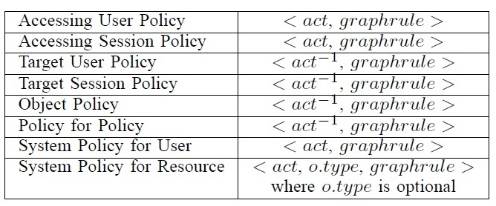
Authorization Policy
action⁻¹ in TUP, TSP, OP and PP is the passive form since it applies to the recipient of action
SP does not differentiate the active and passive forms
SP for resource needs o.type to refine the scope of the resource
World-Leading Research with Real-World Impact!

Slide 35
Hopcount Skipping
Six degrees of separation
  Any pair of persons are distanced by about 6 people on average. (4.74 shown by recent study)
  Hopcount for U2U relationships is practically small
U2R and R2R relationships may form a long sequence
  Omit the distance created by resources
  Local hopcount stated inside “[[]]” will not be counted in global hopcount.
  E.g., “([f*,3][[c*, 2]],3)”, the local hopcount 2 for c* does not apply to the global hopcount 3, thus allowing f* to have up to 3 hops.
World-Leading Research with Real-World Impact!

Slide 36
Policy Conflict Resolution
System-defined conflict resolution for potential conflicts among user-specified policies
Disjunctive, conjunctive and prioritized order between relationship types
  ∧,∨, > represent disjunction, conjunction and precedence
  @ is a special relationship “null’’ that denotes “self”
World-Leading Research with Real-World Impact!
Notes:
Multiple policies having weight in authorization result in decision conflicts inevitably. While assuming policies specified by the system will always be unambiguous, conflict resolution policies are responsible for interpreting how the potential policy conflicts within each category of user-specified policies can be resolved in terms of the precedence or connectives over relationship types

Slide 37
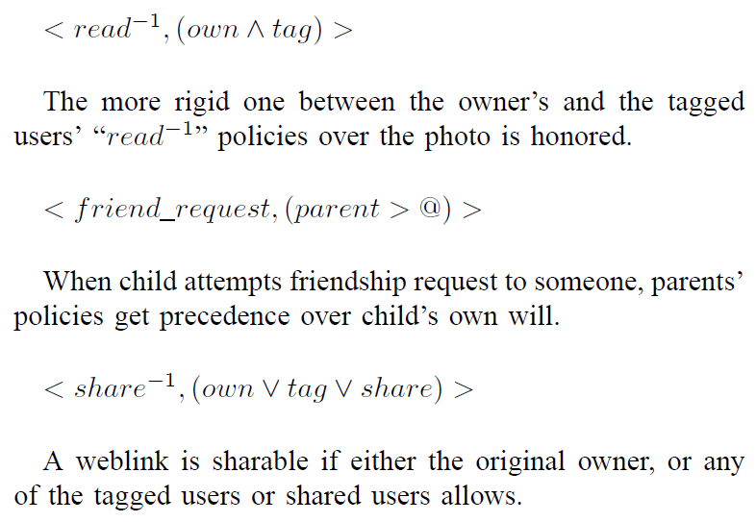
Policy Conflict Resolution (cont.)
World-Leading Research with Real-World Impact!

Slide 38
RAC Models
U2U, U2R, R2R
with attributes
URRAC_{A}
Cheng et al 2014
U2U, U2R, R2R
URRAC
Cheng et al 2012-09
U2U
UURAC
Cheng et al 2012-07
Cheng et al 2015
© Ravi Sandhu
World-Leading Research with Real-World Impact!
38

Slide 39
URRAC_{A} Motivation
ReBAC usually relies on type, depth, or strength of relationships, but cannot express more complicated topological information
ReBAC lacks support for attributes of users, resources, and relationships
Useful examples include common friends, duration of friendship, minimum age, etc.

Slide 40
Attributes in OSNs
Node attributes
  Define user’s identity and characteristics: e.g., name, age, gender, etc.
Edge attributes
  Describe the characteristics of the relationship: e.g., weight, type, duration, etc.
Count attributes
  Depict the occurrence requirements for the attribute-based path specification, specifying the lower bound of the occurrence of such path

Slide 41
RAC Models
U2U, U2R, R2R
with attributes
URRAC_{A}
Cheng et al 2014
U2U, U2R, R2R
URRAC
Cheng et al 2012-09
U2U
UURAC
Cheng et al 2012-07
Cheng et al 2015
© Ravi Sandhu
World-Leading Research with Real-World Impact!
41

