Slide 1
Authorization Federation in Multi-Tenant
Multi-Cloud IaaS
Navid Pustchi
Advisor: Prof. Ravi Sandhu
1

Slide 2
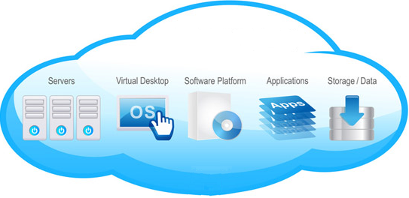

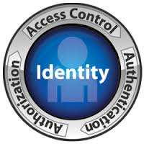

“Moving” to Cloud
Flexibility
Reliability
Accessibility
Mobility
security
World-Leading Research with Real-World Impact!

Slide 3
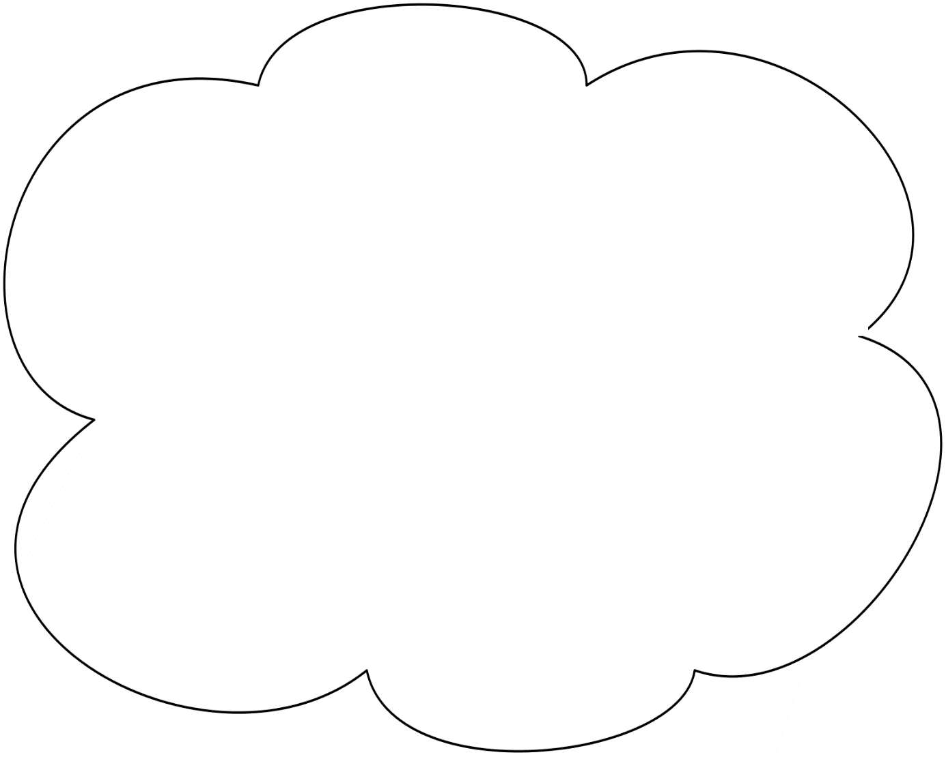
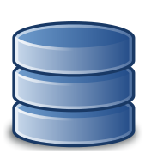





Why Collaboration ?
CERN
Software Development
Tenant
Software Development
Tenant
Acme
Financial
Tenant
Large Organization
with multiple tenants
Distinct Organizations’ Collaborative tasks
Cloud Service Provider
World-Leading Research with Real-World Impact!

Slide 4
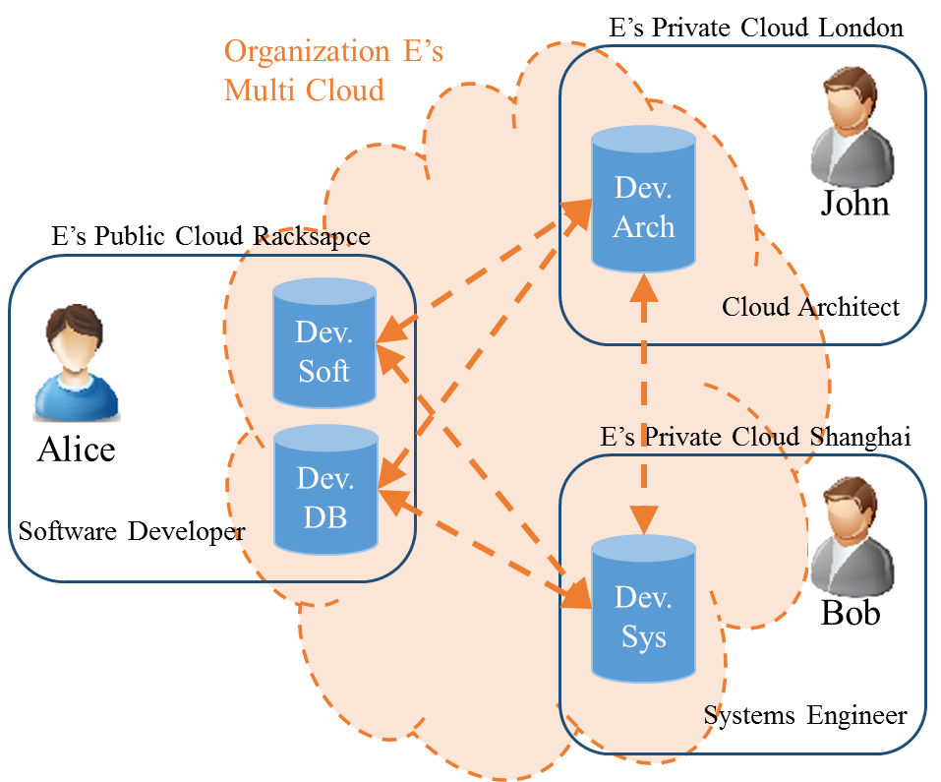
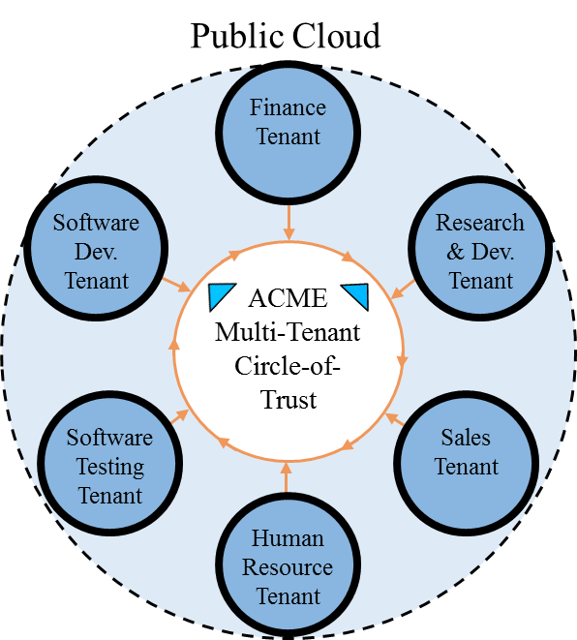
Why Multi Cloud?
World-Leading Research with Real-World Impact!
4

Slide 5
Federation
Cloud Federation
  Collaboration of cloud service providers and identity providers in order to share their services and resources based on trust agreements.
Multi-Cloud
  Collaboration of multiple cloud service providers (public or private) within different administrative domains (Cloud and Domain) to provide complex services at specified service model (Infrastructure, Platform and Software).
Multi-Cloud
Broker
Inter-Cloud
Multi-Cloud
Inter-Cloud
Seamless Communication
Deployment
Broker
Hybrid Cloud
Cloud Federation
Cloud Federation
World-Leading Research with Real-World Impact!
5

Slide 6
Multi Cloud Collaboration
Cloud Federation
    Service (IaaS, PaaS, SaaS)
      Heterogeneous: Google account (Open ID 2.0) Heterogeneous within google.
      Homogeneous: Eduroam federated network access.
    Platform
      Heterogeneous: OpenStack federation with AWS.
      Homogeneous: Keystone to Keystone federation.
    Trust
      Circle-of-Trust: Alliance of institutions for sharing scientific data such as CERN.
      Peer-to-Peer: Best Buy federating with Rackspace.
    Coupling
      Identity Federation: SAML, OAuth, OpenID, SSO.
      Authorization Federation: SAML, OAuth.
World-Leading Research with Real-World Impact!
6

Slide 7
Problem & Thesis
Problem Statement
Thesis Statement
Current access control models provided by cloud platforms are not sufficient to cultivate efficient peer-to-peer and circle-of-trust collaboration between tenants in a cloud or across multiple cloud platforms. Prior role-based and attribute-based access control models in distributed systems are not effectively applicable to cloud IaaS.
The problem of authorization federation in multi-tenant cloud IaaS can be partially solved by integrating multiple types of peer-to-peer and circle-of-trust relations between tenants in single-cloud and multi-cloud environments into role-based and attribute based models.
World-Leading Research with Real-World Impact!
7

Slide 8
Scope of Contribution
Cloud Federation
Service
SaaS
PaaS
IaaS
Platform
Homogenous
Heterogeneous
Trust
Circle-of-Trust
Peer-to-Peer
Coupling
Authentication Federation
Authorization Federation
World-Leading Research with Real-World Impact!
8

Slide 9
Scope of Contribution
Cloud Federation
Service
SaaS
PaaS
IaaS
Platform
Homogenous
Heterogeneous
Trust
Circle-of-Trust
Peer-to-Peer
Coupling
Authentication Federation
Authorization Federation
World-Leading Research with Real-World Impact!
9

Slide 10
Circle-of-Trust
A collaboration group of clouds, relationships are established by a set of contracts defining obligations and access rights of participating clouds.
Member clouds have access to a set of shared services and resources.
Joining the circle of trust requires
agreement of member clouds.
A
B
E
D
C
World-Leading Research with Real-World Impact!
10

Slide 11
Peer-to-Peer Trust
Collaboration of clouds, relationships established between each two participating clouds.
Clouds share resources and services upon trust relationship between trustor and trustee clouds.
Joining a new relationship requires
stablishing trust with other clouds.
A
B
E
D
C
World-Leading Research with Real-World Impact!
11

Slide 12

Identity vs Authorization
Identity (Authentication) Federation:
  Authenticating users (services and applications) in a cloud service provider other than their registered identity provider based on trust between collaborating clouds.
Authorization Federation:
  Granting access to authenticated users by assigning roles in cloud service provider based on trust agreements between two clouds.
Authorization federation is dependent on identity federation to authenticate users.
CSP1
What permissions she should be assigned to? (Authorization Federation)
Users
Alice
Resources
CSP2
Is she a user in CSP1? (Authentication Federation)
Resources
Users
World-Leading Research with Real-World Impact!
12

Slide 13




Contribution
Infrastructure-as-a-Service
Multi-Tenant Multi-Cloud
Multi-Tenant Cloud
Peer-to-Peer
Circle-of-Trust
Peer-to-Peer
Heterogeneous
Homogeneous
$$MT−RBAC$$
$$MT−RABAC_{c}$$
$$MT−RBAC_{c}$$
$$MT−ABAC$$
World-Leading Research with Real-World Impact!
13

Slide 14
Peer-to-Peer Trust
Peer-to-Peer Trust
Initiation
Bilateral
Unilateral
Direction
Bidirectional
Unidirectional
Transitivity
Transitive
Non-transitive
World-Leading Research with Real-World Impact!
14

Slide 15
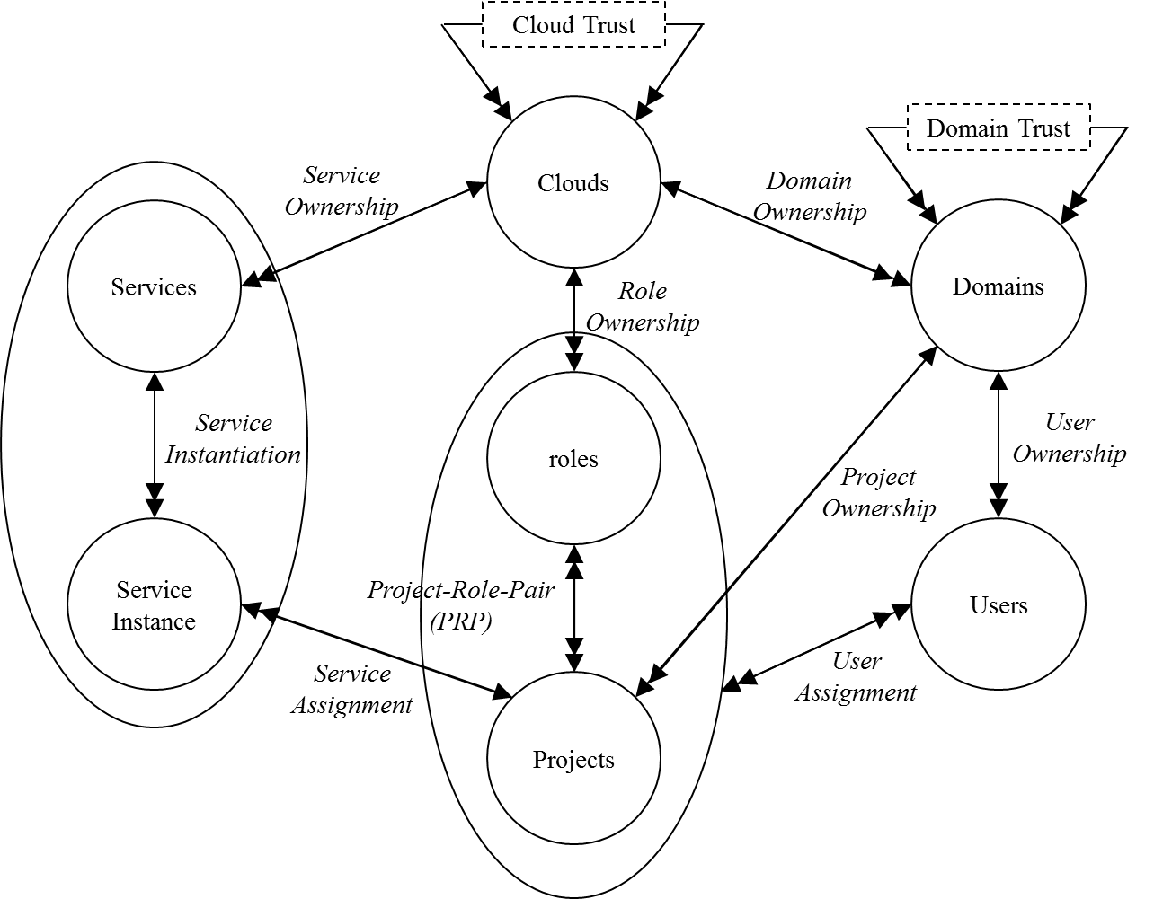
Administrative Realms
World-Leading Research with Real-World Impact!
15

Slide 16
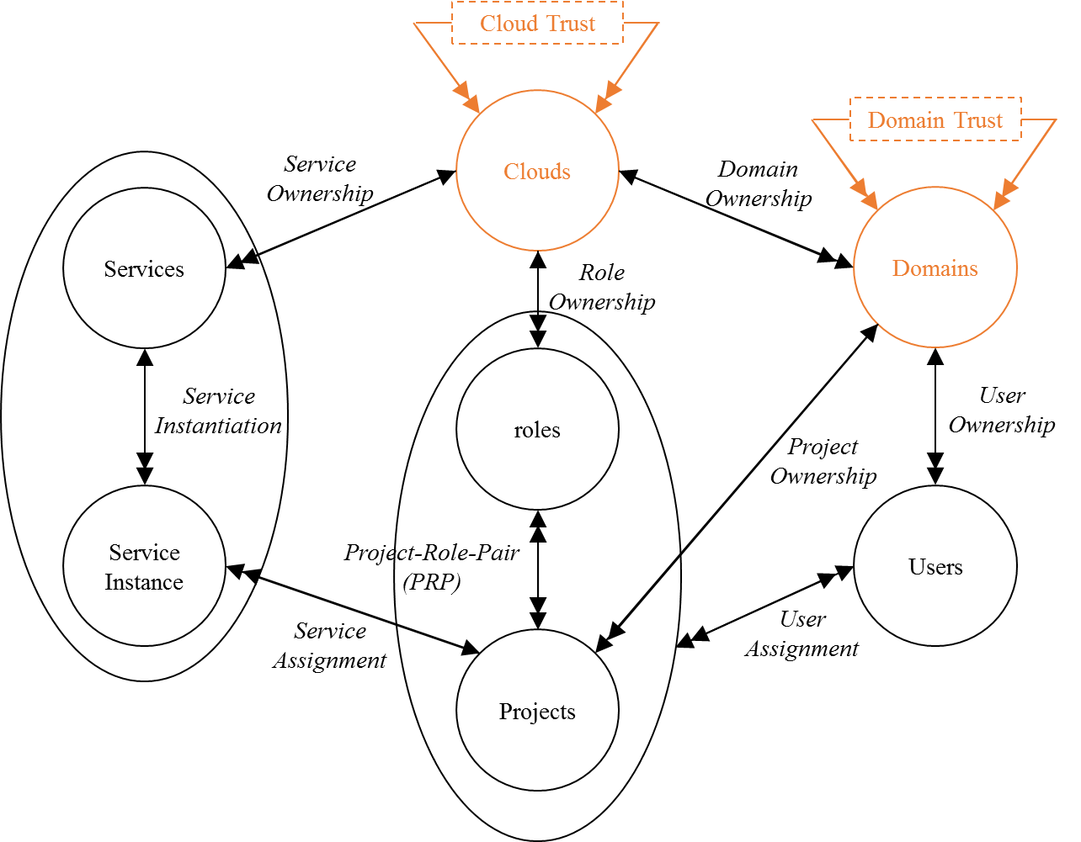
Multi Cloud Trust
Two trust scopes based on administrative realms in cloud:
  Cross Cloud Trust
    Sharing cloud infrastructure resources, such as services.
  Cross Domain Trust
    Sharing domain resources such as projects.
World-Leading Research with Real-World Impact!
16

Slide 17
















Domain Trust
$Type−α:$
  If ${domain}_{A}⊴_{α}{domain}_{B}$, $A$ is authorized to assign $B$'s users to it's resources.$A$ controls trust relation and inter-cloud assignments.
  For example cloud B act as an identity provider to access A’s resources.
$$D_{A}$$
$$D_{A} ⊴_{α}D_{B}$$
$$D_{B}$$
$$U_{1}$$
$$U_{2}$$
$$U_{3}$$
$$U_{4}$$
$$U_{5}$$
$$U_{6}$$
$${PRP}_{1}$$
$${PRP}_{2}$$
$${PRP}_{3}$$
$${PRP}_{4}$$
$${PRP}_{5}$$
$${PRP}_{6}$$
World-Leading Research with Real-World Impact!
17

Slide 18




Domain Trust
$Type−β:$
  If ${domain}_{A}⊴_{β}{domain}_{B}$, $B$ is authorized to assign $A$'s users to it's resources.$A$ controls trust relation and $B$ controls inter-cloud assignments.
  When access to shared resources is controlled by resource owner.
$$D_{A}$$
$$D_{A} ⊴_{β}D_{B}$$
$$D_{B}$$
$$U_{1}$$
$$U_{2}$$
$$U_{3}$$
$$U_{4}$$
$$U_{5}$$
$$U_{6}$$
$${PRP}_{1}$$
$${PRP}_{2}$$
$${PRP}_{3}$$
$${PRP}_{4}$$
$${PRP}_{5}$$
$${PRP}_{6}$$
World-Leading Research with Real-World Impact!
18

Slide 19


Domain Trust
$Type−γ:$
  If ${domain}_{A}⊴_{γ}{domain}_{B}$, $B$ is authorized to assign it’s users to $A$'s resources.$A$ controls trust relation and $B$ controls inter-cloud assignments.
  Sharing resources with group of clouds.
$$D_{A}$$
$$D_{A} ⊴_{γ}D_{B}$$
$$D_{B}$$
$$U_{1}$$
$$U_{2}$$
$$U_{3}$$
$$U_{4}$$
$$U_{5}$$
$$U_{6}$$
$${PRP}_{1}$$
$${PRP}_{2}$$
$${PRP}_{3}$$
$${PRP}_{4}$$
$${PRP}_{5}$$
$${PRP}_{6}$$
World-Leading Research with Real-World Impact!
19

Slide 20


Domain Trust
$Type−δ:$
  If ${domain}_{A}⊴_{δ}{domain}_{B}$, $B$ is authorized to assign $A$'s users to $A$'s resources.$A$ controls trust relation and $B$ controls intra-cloud assignments.
  Administration federation within an organization with multiple clouds.
$$D_{A}$$
$$D_{A} ⊴_{δ}D_{B}$$
$$D_{B}$$
$$U_{1}$$
$$U_{2}$$
$$U_{3}$$
$$U_{4}$$
$$U_{5}$$
$$U_{6}$$
$${PRP}_{1}$$
$${PRP}_{2}$$
$${PRP}_{3}$$
$${PRP}_{4}$$
$${PRP}_{5}$$
$${PRP}_{6}$$
World-Leading Research with Real-World Impact!
20

Slide 21
Attribute Based Access Control (ABAC)
Attributes are name:value pairs
  Represents user and resource properties
Associated with
  Users
  Objects
  Tenants
  Contexts
Converted to rights by authorization policies
  In-time
  Entity attributes
  Set of actions
World-Leading Research with Real-World Impact!

Slide 22
Why Another Model
ABAC
  RBAC shortcomings needs custom extension
    For example real time environmental parameters.
  ABAC is more flexible
    Accommodate environmental parameters.
MT-ABAC
  Multi-tenancy
  Collaboration consistent with trust
World-Leading Research with Real-World Impact!

Slide 23

${ABAC}_{0}$ Model Structure
UATT
OATT
U
Auth
O
A
Association
Access Decision
World-Leading Research with Real-World Impact!

Slide 24

${MT−ABAC}_{0}$ Model Structure
UATT
trustedTenants
uattOwner
U
T
userOwner
oattOwner
objOwner
Auth
O
OATT
A
Association
Access Decision
Many-to-one
atomic-valued function
Many-to-many
set-valued function
World-Leading Research with Real-World Impact!

Slide 25





Tenant-Trust
Tenant-trust type-$α$
  If $T_{A}⊴_{α}T_{B}$, tenant $T_{A}$ is authorized to assign values for$T_{A}$'s user attributes to tenant $T_{B}$'s users. Tenant $T_{A}$controls tenant-trust existence and cross-tenant attribute assignments.
tenant $T_{A}$
$$T_{A}$$
$$T_{B}$$
$$U_{A}$$
$$U_{B}$$
Sec_Mng
Sec_Eng
World-Leading Research with Real-World Impact!

Slide 26


Tenant-Trust
Tenant-trust type-$β$
  If $T_{A}⊴_{β}T_{B}$, tenant $T_{B}$ is authorized to assign values for$T_{B}$'s user attributes to tenant $T_{A}$'s users. Tenant $T_{A}$controls tenant-trust existence while $T_{B}$ controls cross-tenant attribute assignments.
tenant $T_{B}$
$$T_{A}$$
$$T_{B}$$
$$U_{A}$$
$$U_{B}$$
Sec_Mng
Sec_Eng
World-Leading Research with Real-World Impact!

Slide 27


Tenant-Trust
Tenant-trust type-$γ$
  If $T_{A}⊴_{γ}T_{B}$, tenant $T_{B}$ is authorized to assign values for$T_{A}$'s user attributes to tenant $T_{B}$'s users. Tenant $T_{A}$controls tenant-trust existence while $T_{B}$ controls cross-tenant attribute assignments.
tenant $T_{B}$
$$T_{A}$$
$$T_{B}$$
$$U_{A}$$
$$U_{B}$$
Sec_Mng
Sec_Eng
World-Leading Research with Real-World Impact!

Slide 28
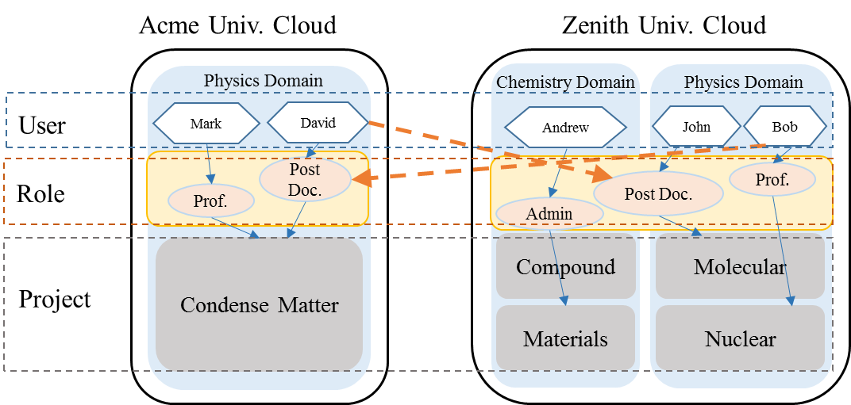
P2P vs. CoT
Public Cloud
Finance Tenant
Software Dev.
Tenant
Research
& Dev. Tenant
ACME
Multi-Tenant Circle-of-Trust
Software Testing Tenant
Sales
Tenant
Human Resource Tenant
World-Leading Research with Real-World Impact!
28

Slide 29
Trust in Circle-of-trust
Circle-of-Trust
Entity Coupling
Heterogeneous
Homogenous
Initiation
Unilateral
Multilateral
Multilateral
Direction
Unidirectional
Bidirectional
Transitivity
Non-Transitive
Transitive
World-Leading Research with Real-World Impact!
29

Slide 30
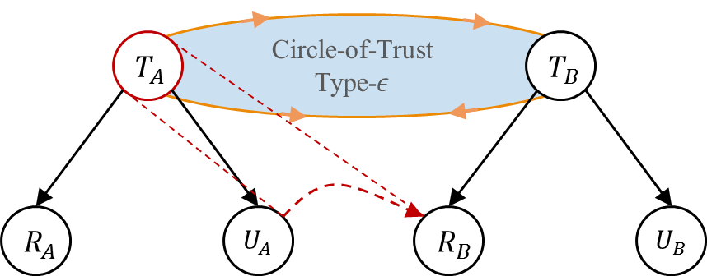
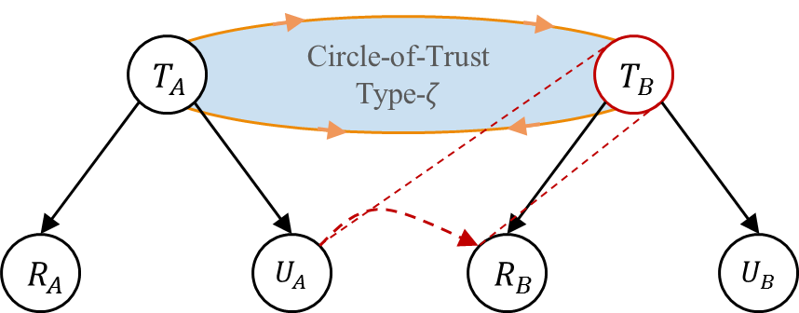

Tenant-Trust in CoT
Four trust types:
  $Type−ε:$
    If ${T_{A}⊴}_{ε}T_{B}$, then tenant $T_{A}$ is authorized to assign its users to $T_{B}$’s roles. Tenant $T_{A}$ controls user assignments.
  $Type−ζ:$
    If ${T_{A}⊴}_{ζ}T_{B}$, then tenant $T_{B}$ is authorized to assign $T_{A}$’s users to its roles. Tenant $T_{B}$ controls user assignments.
World-Leading Research with Real-World Impact!
30

Slide 31



$${MT−RBAC}_{c}$$
CoT
T
UO
RO
OO
U
UA
$$R_{prv}$$
PA
OPS
OBS
Roles
PRMS
$$R_{pub}$$
RH
Many-to-one relation
Many-to-many relation
World-Leading Research with Real-World Impact!
31

Slide 32








${MT−RBAC}_{c}$ Role Hierarchy
$${Public Role}_{T_{B}}1$$
$${Private Role}_{T_{B}}2$$
$${Public Role}_{T_{A}}3$$
$${Private Role}_{T_{B}}4$$
$${Private Role}_{T_{A}}5$$
$${Public Role}_{T_{A}}6$$
$${Private Role}_{T_{A}}7$$
World-Leading Research with Real-World Impact!
32

Slide 33
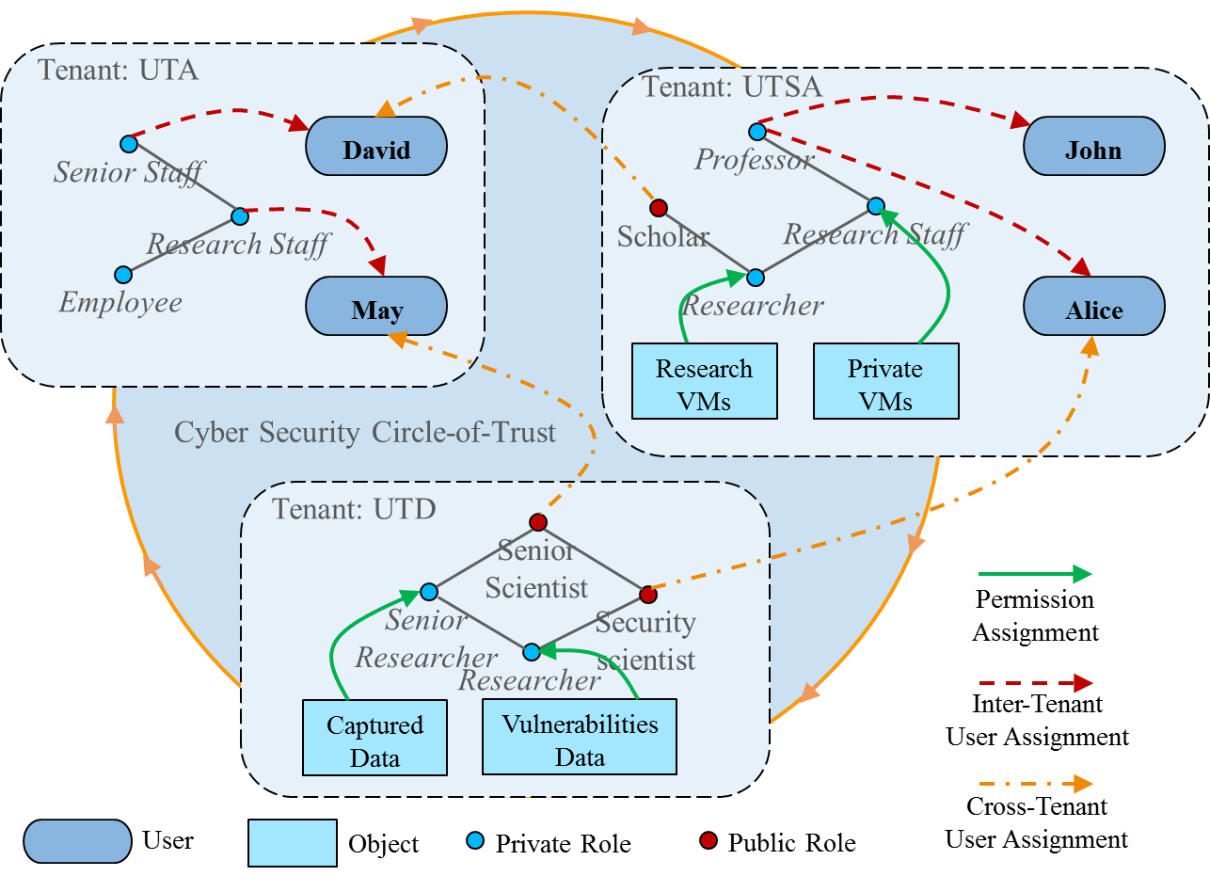

${MT−RBAC}_{c}$ Use Case
World-Leading Research with Real-World Impact!
33

Slide 34

$${MT−RABAC}_{c}$$
TATT
UATT
uattOwner
T
oattOwner
OATT
UO
RO
OO
U
UA
$$R_{prv}$$
PA
OPS
OBS
Roles
PRMS
$$R_{pub}$$
RH
Association
Many-to-one
atomic-valued function
Many-to-one relation
Many-to-many relation
World-Leading Research with Real-World Impact!
34

Slide 35

Openstack Federation
Adding Identity federation to OpenStack cloud, multiple identity providers can federate their users to an OpenStack cloud.
  CHADWK. (2014). Adding Federated Identity Management to OpenStack. Journal of Grid Computing, 2014.
Identity Provider
Service Provider
Trust
5
4
3
1
2
3
5
6
Request for a service.
Determine user’s IdP.
User redirection for authentication.
User Authentication.
IdP redirects user’s attributes.
User access to service is granted.
World-Leading Research with Real-World Impact!
35

Slide 36


Keystone Mapping Engine
Takes SAML assertion as input, and as output OpenStack Token.
OpenStack cloud admin creates a set of mapping rules which determines how to map SAML attributes to groups and users.
  OpenStack Paris Summit, Keystone to Keystone Federation, https://www.openstack.org/summit/openstack-paris-summit-2014/session-videos/presentation/keystone-to-keystone-federation, (2014)
Identity Provider
Service Provider
Mapping Engine
OpenStack
Token
SAML
Assertion
SAML Attributes:
Groups: IBM Regular Employees Canada, SWG Canada
User: Allen
Keystone Attributes:
Groups:
Regular_Employees_ Canada, SWG_Canada
User:
Allen
Mapped
World-Leading Research with Real-World Impact!
36

Slide 37
Keystone SAML Generator
Takes as input: an OpenStack Token, and the service provider the user wants to use.
Outputs a SAML Assertion that can be forwarded to the Service Provider.
Assuming service provider has the Identity Provider created, the Private Cloud user should get a token that is valid at the Service Provider.
  OpenStack Paris Summit, Keystone to Keystone Federation, https://www.openstack.org/summit/openstack-paris-summit-2014/session-videos/presentation/keystone-to-keystone-federation, (2014)
Private Cloud
SAML Generator
Public Cloud
OpenStack
Token
SAML
Assertion
World-Leading Research with Real-World Impact!
37

Slide 38
Keystone to Keystone Federation
  OpenStack Paris Summit, Keystone to Keystone Federation, https://www.openstack.org/summit/openstack-paris-summit-2014/session-videos/presentation/keystone-to-keystone-federation, (2014)
A. Add public cloud as service provider
Keystone
B. Add Private Cloud as Identity Provider
Keystone
Private Cloud
Nova
Nova
Public Cloud
Swift
Swift
2. Return SAML Assertion
3. Present SAML Assertion
4. Return a Keystone token that can be used on Public Cloud
1. Ask for SAML Assertion
World-Leading Research with Real-World Impact!
38

Slide 39
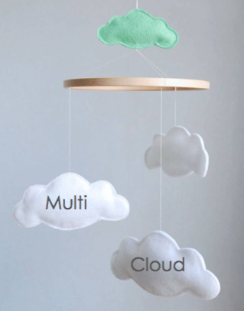
Questions ?
Coarse-grained and fine-grained trust models in cloud.
  Multi-Tenant Cloud.
  Multi-Tenant Multi-Cloud.
Peer-to-Peer Policy
  Multi-cloud role-based model.
  Multi-tenant attribute-based model.
Circle-of-Trust Policy
  Multi-tenant role-based access control model.
  Multi-tenant role-centric attribute-based access control model.
Implementation
  Single-cloud tenant trust.
  Federated-cloud tenant trust.
World-Leading Research with Real-World Impact!

