Slide 1
CS 6393 Lecture 9 Part 1
Provenance-Based Access Control (PBAC)
Prof. Ravi Sandhu
Executive Director and Endowed Chair
April 15, 2016
ravi.sandhu@utsa.edu
www.profsandhu.com
© Ravi Sandhu
World-Leading Research with Real-World Impact!

Slide 2
Ultimate Unified Model
Attributes
Security
Access Control
Trust
Risk
Relationships
Provenance
© Ravi Sandhu
World-Leading Research with Real-World Impact!

Slide 3
What is Provenance?
Art definition of provenance
  Essential in judging authenticity and evaluating worth.
Data provenance in computing systems
  Is different from log data.
  Contains linkage of information pieces.
  Is utilized in different computing areas.
© Ravi Sandhu
World-Leading Research with Real-World Impact!

Slide 4
Provenance Data
Information of operations/transactions performed against data objects and versions
  Actions that were performed against data
  Acting Users/Subjects who performed actions on data
  Data Objects used for actions
  Data Objects generated from actions
  Additional Contextual Information of the above entities
Directed Acyclic Graph (DAG)
Causality dependencies between entities (acting users / subjects, action processes and data objects)
Dependency graph can be traversed for the discovery of Origin, usage, versioning info, etc.
© Ravi Sandhu
World-Leading Research with Real-World Impact!

Slide 5
Provenance-aware Systems
Capturing provenance data
Storing provenance data
Querying provenance data
Using provenance data
Securing provenance data
Provenance Data Model
Access Control
© Ravi Sandhu
World-Leading Research with Real-World Impact!

Slide 6
Access control in Provenance-aware Systems
Provenance Access Control (PAC)
  Controlling access to provenance data which could be more sensitive than the underlying data
  Needs access control models/mechanisms (e.g, RBAC)
  (Meaningful) control granularity? Right level of abstraction?
Provenance-based Access Control (PBAC)
  Using provenance data to control access to the underlying data
  Provenance-based policy specification
© Ravi Sandhu
World-Leading Research with Real-World Impact!

Slide 7
Access control in Provenance-aware Systems
Access control
PBAC
PAC
Extended PBAC
Sanitization/Filtering/Redaction/….
Base PBAC
Role-based
PAC
Prov-based
PAC
……….
Prov Data Trust
Common Foundations:
Base Provenance Data,
DName (named abstraction) and
matching DPath (Dependency Path Pattern)
© Ravi Sandhu
World-Leading Research with Real-World Impact!

Slide 8
Open Provenance Model Example
100g Sugar
100g
Flour
100g
Butter
Two
Eggs
John
used
wasControlledBy
Bake
wasGeneratedBy
wasDerivedFrom
Cake
© Ravi Sandhu
World-Leading Research with Real-World Impact!

Slide 9
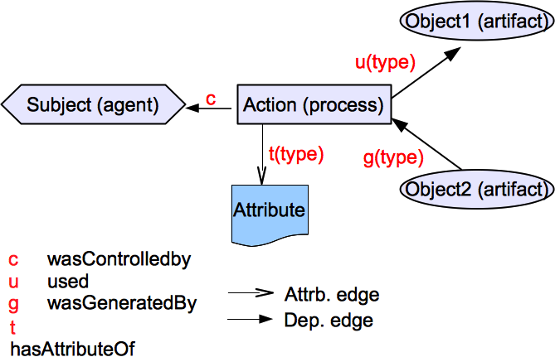
Provenance Data Model
© Ravi Sandhu
World-Leading Research with Real-World Impact!

Slide 10
Direct vs. Indirect Dependencies
Direct dependencies
  Used (u), wasGeneratedBy (g), wasControlledBy (c)
  Captured from transactions as base provenance data\
Indirect dependencies
  System-computable dependencies
    using pre-defined dependency names and matching dependency path patterns
  User-declared dependencies
    using pre-defined dependency names
© Ravi Sandhu
World-Leading Research with Real-World Impact!

Slide 11
Object Dependency List (DL_{O})
A set of pairs of
  abstracted dependency names (DNAME) and
  regular expression-based object dependency path patterns (DPATH)
Examples
  < wasSubmittedVof, g_{submit}.u_{input} >
  < wasAuthoredBy, wasSubmittedVof?.wasReplacedVof ∗.g_{upload}.c >
© Ravi Sandhu
World-Leading Research with Real-World Impact!

Slide 12
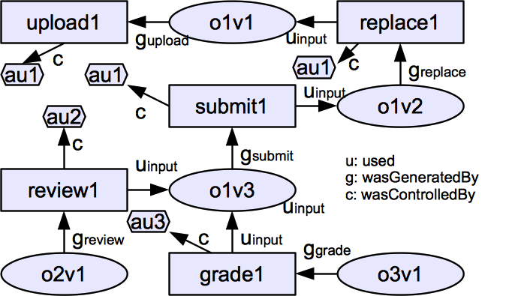
A Sample Base Provenance Data
© Ravi Sandhu

Slide 13
Sample Object Dependency List (DL_{O})
< wasReplacedVof, g_{replace}.u_{input} >
< wasSubmittedVof, g_{submit}.u_{input} >
< wasReviewedOof, g_{review}.u_{input} >
< wasReviewedOby, g_{review}.c >
< wasGradedOof, g_{grade}.u_{input} >
< wasAuthoredBy, wasSubmittedVof?.wasReplacedVof ∗.gupload.c >
< wasReviewedBy, wasReviewedOof−1. wasReviewedOby >
© Ravi Sandhu
World-Leading Research with Real-World Impact!

Slide 14
A Sample Base Provenance Data
wasReviewedOby
wasReplacedVof
DL_{O}: < wasReplacedVof, g_{replace}.u_{input} >
wasSubmittedVof
wasReviewedOof
wasGradedOof
© Ravi Sandhu
14

Slide 15
A Sample Base Provenance Data
wasAuthoredBy
DL_{O}: <wasAuthoredBy, wasSubmittedVof?. wasReplacedVof ∗.g_{upload}.c >
© Ravi Sandhu
15

Slide 16
A Sample Base Provenance Data
wasReviewedBy
DL_{O}: < wasReviewedBy, wasReviewedOof⁻¹. wasReviewedOby >
© Ravi Sandhu
16

Slide 17
A Homework Grading System
Anyone can upload a homework.
A user can replace a homework if she uploaded it (origin-based control) and the homework is not submitted yet.
A user can submit a homework if she uploaded it and the homework is not submitted already. (workflow control)
A user can review a homework if she is not the author of the homework (DSOD), the user did not review the homework earlier, and the homework is submitted already but not graded yet.
A user can grade a homework if the homework is reviewed but not graded yet.
© Ravi Sandhu
World-Leading Research with Real-World Impact!

Slide 18
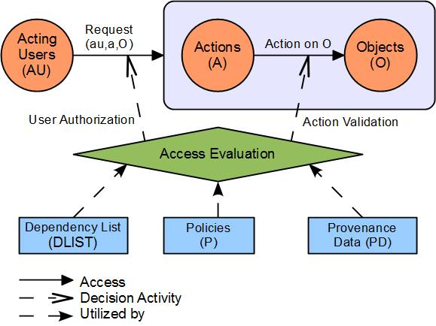
PBAC_{B} Model Components
© Ravi Sandhu
World-Leading Research with Real-World Impact!

Slide 19
PBAC_{B}: A Base Model
System-captured Base Provenance Data only
  Using only 3 direct dependencies (u, g, c)
  No user-declared provenance data
Object dependency only
Policy is readily available
  No policy retrieval required
© Ravi Sandhu
World-Leading Research with Real-World Impact!

Slide 20
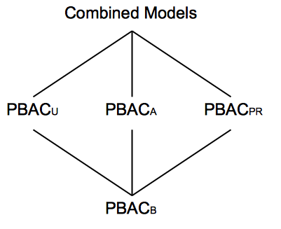
A Family of PBAC Models
© Ravi Sandhu
World-Leading Research with Real-World Impact!

Slide 21
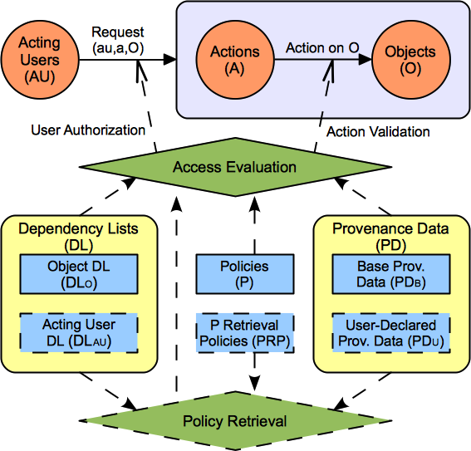

PBAC Model Components
© Ravi Sandhu

