Slide 1



Cryptocurrencies & Blockchains
Murtuza Jadliwala
murtuza.jadliwala@utsa.edu

Slide 2
Traditional Currencies
Barter
Credit
Cash

Slide 3






Barter
This Photo by Unknown Author is licensed under CC BY-SA

Slide 4



Barter
This Photo by Unknown Author is licensed under CC BY-SA

Slide 5
Credit
Debt
Favor or Credit
This Photo by Unknown Author is licensed under CC BY-SA

Slide 6

Cash
This Photo by Unknown Author is licensed under CC BY-SA

Slide 7
Cash vs Credit
Cash requires initial allocation, but allows fine-grained valuation of products.
Credit acquires risk.
When cash and credit are combined?
Cash allow credit to be quantified, for example, how much a person owes another?

Slide 8
Digital Currency
Traditional Financial Tools for the Digital Realm
Digital Credit
First Virtual (1994)
CyberCash
iKP (IBM)
SEPP
STT (MS & Visa)
SET (1996)
Paypal
…..
Digital Cash
Chaum (1983)
Chaum, Fiat and Noar (1988)
Digicash (1989-1988)
MagicMoney
Lucre
HINDE
MONDEX
….

Slide 9
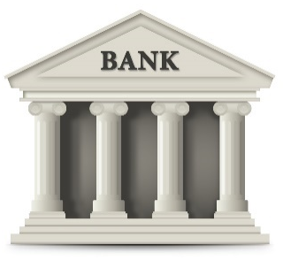
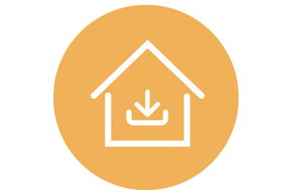
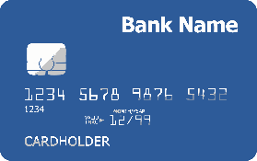

Digital Credit Architecture 1
Financial Institution
Processor
Customer
Online Vendor
This Photo by Unknown Author is licensed under CC BY-SA

Slide 10
Digital Credit Architecture 2
Intermediary
Customer
Online Vendor
Advantages: Hides customer credit card data from online vendors.
Disadvantages: Requires redirection, enrollment, etc.
This Photo by Unknown Author is licensed under CC BY-SA

Slide 11
Digital Cash
In parallel, there has been a lot of research in cash-like systems.
Ideal Requirements:
Higher anonymity (similar to traditional fiat cash).
Offline transactions.

Slide 12

First Proposal for eCash
David Chaum (1983)
Central Entity
Holder of this has $100
-signature

Slide 13
Problems with Chaum’s scheme?
Copying and double spending is easy!
First attempt to fix: Introduce serial numbers.
Shortcoming: Traceability!
Second attempt to fix: use Blind Signatures.
Shortcoming: Requires a centralized entity that records and maintains all transactions!

Slide 14
Drawbacks
Drawbacks of current digital currency systems:
Most require a centralized trusted entity.
Some require specialized hardware.
Some require complex/specialized cryptographic techniques.
Others do not provide enough privacy/anonymity.

Slide 15
Motivation
How can we design a new form of digital currency that
does not require a centralized entity, and,
does not require a specialized hardware, and,
does not require complex cryptography, and,
provides decent anonymity?
This was the main motivation that led to the development of Bitcoin!

Slide 16
Key Enabler
How to create and maintain an append-only, immutable record or ledger of transactions
in a distributed fashion without requiring any centralized entity, and,
without requiring any specialized hardware, and,
without requiring complex cryptography, and,
such that it provides user anonymity?
Result: Bitcoin P2P network that maintains transactions on the Blockchain!

Slide 17
Talk Outline
Crypto Background
Bitcoin Details
What’s Next

Slide 18
Hash Functions
All hash functions satisfy the following properties:
Inputs can be any size (not-fixed).
Outputs are fixed-size (output size <= input size).
Efficiently computable.
possible outputs
possible inputs

Slide 19
Cryptographic Hash Functions
Satisfy the following additional security properties:
Collision Resistance: Infeasible to find x and y such that x != y and H(x)=H(y)
Hiding or Pre-image Resistance: Given H(r | x) and r, where r is random, it is infeasible to find x.
Puzzle-friendliness: Given a y such that H(k | x) = y, and k is random and known, it is infeasible to find x.

Slide 20
Hash Function Applications
Message digest: Verify integrity of data (i.e., whether the data under question has changed).
Commitments: Commit to a value, reveal it later (analogous to sealing something in an envelope)
Search Puzzles:
Given: A random “puzzle ID” id and a target set Y:
Objective: Try to find a “solution” x such that H(id | x) ∈ Y.
Puzzle-friendly property implies that no solving strategy is much better than trying random values of x.

Slide 21
Hash Pointers
What is a Hash pointer?
Pointer to where some info/data is stored, and
(Cryptographic) hash of the info.
What can you do with a hash pointer?
Retrieve or get back the info/data.
Verify that the info/data hasn’t changed.
What else?
Use hash pointers to construct data structures such as blockchains!
H( )
(data)

Slide 22
Blockchains
What is a Blockchain?
Linked or ordered list of hash pointers and data blocks.
What is it used for?
Tamper-evident log or register
prev: H( )
prev: H( )
prev: H( )
data
data
data
NULL
Head of the list (Genesis block)

Slide 23
Tamper-evident Log
H( )
prev: H( )
prev: H( )
prev: H( )
data
data
data
NULL

Slide 24
Encryption
Process of transforming information (a.k.a plaintext) into something that is unintelligible (a.k.a ciphertext) to everyone except authorized receivers.
Encryption Techniques
Symmetric Encryption
Public-key Encryption
e.g., RSA, ElGamal, Elliptic Curve
Block Ciphers
Stream Ciphers
e.g., DES, AES
e.g., RC4

Slide 25
Symmetric Encryption
Algorithm uses the same key for encryption and decryption - also referred to as single-key encryption.
K
K
Encryption Algorithm
Decryption Algorithm
“Hello”
“$%fg#”
“Hello”
Sender
Receiver

Slide 26
Public-Key Encryption
Asymmetric - uses two separate keys:
Public key is made public for others to use.
Private key is secret and is never released.
KPublic_{{Receiver}}
KPrivate_{{Receiver}}
Encryption Algorithm
Decryption Algorithm
“Hello”
“$%fg#”
“Hello”
Sender
Receiver

Slide 27
Digital Signatures
KPrivate_{{Sender}}
KPublic_{{Sender}}
Encryption Algorithm
Decryption Algorithm
“Hello” +
“$%fg#”
“Hello”
“Hello”
Sender’s signature
Sender
Receiver
If they match, signature is verified!
Sender, indeed created that signature!
Why?
Only sender knows his/her private key → Only sender can create signature, anyone can verify!

Slide 28
Digital Signature Properties
Same as properties we need from handwritten signatures:
Security: only you can sign as yourself, but anyone can verify that your signature was indeed made by you.
Unforgeability: signature tied to a particular document - can’t be cut-and-pasted to another document.

Slide 29
Talk Outline
Crypto Background
Bitcoin Details
What’s Next

Slide 30
What is Bitcoin?
Digital cash or financial instrument:
Proposed in 2009 by an anonymous author under pen name “Satoshi Nakamoto” on the cypherpunks mailing list.
Is managed in a completely distributed manner.
No central authority or government controls Bitcoins.
Can be (and is) used for online and other transactions and to settle debts.
Can be (and is) exchanged for other fiat currency.
By means of Bitcoin exchanges.
Can be (and is) traded as other fiat currency.
It is what gives Bitcoins its value!

Slide 31
Bitcoin Summary
A purely distributed system that records and maintains an immutable and consistent ledger (a.k.a. Block chain) of transactions.
Three Important Aspects of Bitcoins:
Data structures → what is stored in these ledgers?
Bitcoin peer-to-peer network → who maintains these ledgers?
Consensus → how is the consistency and immutability of these ledgers maintained?

Slide 32
A Bitcoin Transaction
{ "hash":"5a42590fbe0a90ee8e8747244d6c84f0db1a3a24e8f1b95b10c9e050990b8b6b", "ver":1, "vin_sz":2, "vout_sz":1, "lock_time":0, "size":404, "in":[ { "prev_out":{ "hash":"3be4ac9728a0823cf5e2deb2e86fc0bd2aa503a91d307b42ba76117d79280260", "n":0 },
"scriptSig":"30440..." }, { "prev_out":{ "hash":"7508e6ab259b4df0fd5147bab0c949d81473db4518f81afc5c3f52f91ff6b34e", "n":0 }, "scriptSig":"3f3a4ce81...." } ], "out":[ { "value":"10.12287097", "scriptPubKey":"OP_DUP OP_HASH160 69e02e18b5705a05dd6b28ed517716c894b3d42e OP_EQUALVERIFY OP_CHECKSIG" } ]
}
metadata
input(s)
output(s)

Slide 33
Transaction Metadata
{ "hash":"5a42590...b8b6b", "ver":1, "vin_sz":2, "vout_sz":1, "lock_time":0, "size":404,
...
}
transaction hash
also serves as a unique ID
housekeeping
“not valid before”
housekeeping

Slide 34
Transaction Inputs
"in":[ { "prev_out":{ "hash":"3be4...80260", "n":0 },
"scriptSig":"30440....3f3a4ce81" }, ...
],
previous
transaction
signature
(more inputs)

Slide 35
Transaction Outputs
"out":[
{
"value":"10.12287097",
"scriptPubKey":"OP_DUP OP_HASH160 69e...3d42e OP_EQUALVERIFY OP_CHECKSIG"
},
...
]
output value
recipient address??
(more outputs)
Sum of all output values less than or equal to sum of all input values!
If sum of all output values less than sum of all input values, then difference goes to miner as a transaction fee

Slide 36
Bitcoin Blocks
In a Bitcoin system, multiple transactions are bundled together in blocks.
Rather than recording individual transactions into the ledger (or Blockchain), the system records blocks
Why bundle transactions together?
Efficiency!

Slide 37
Bitcoin Block Structure
Hash chain of blocks
prev: H( )
prev: H( )
prev: H( )
trans: H( )
trans: H( )
trans: H( )
H( ) H( )
Hash tree (Merkle tree) of transactions in each block
H( ) H( )
H( ) H( )
transaction
transaction
transaction
transaction

Slide 38
A Bitcoin block
{
"hash":"00000000000000001aad2...",
"ver":2,
"prev_block":"00000000000000003043...",
"time":1391279636,
"bits":419558700,
"nonce":459459841,
"mrkl_root":"89776...",
"n_tx":354,
"size":181520,
"tx":[
...
],
"mrkl_tree":[
"6bd5eb25...",
...
"89776cdb..."
]
}
Block header
Transaction data

Slide 39
A Bitcoin block header
{
"hash":"00000000000000001aad2...",
"ver":2,
"prev_block":"00000000000000003043...",
"time":1391279636,
"bits":419558700,
"nonce":459459841,
"mrkl_root":"89776...",
...
}
mining puzzle information
hashed during mining
not hashed

Slide 40
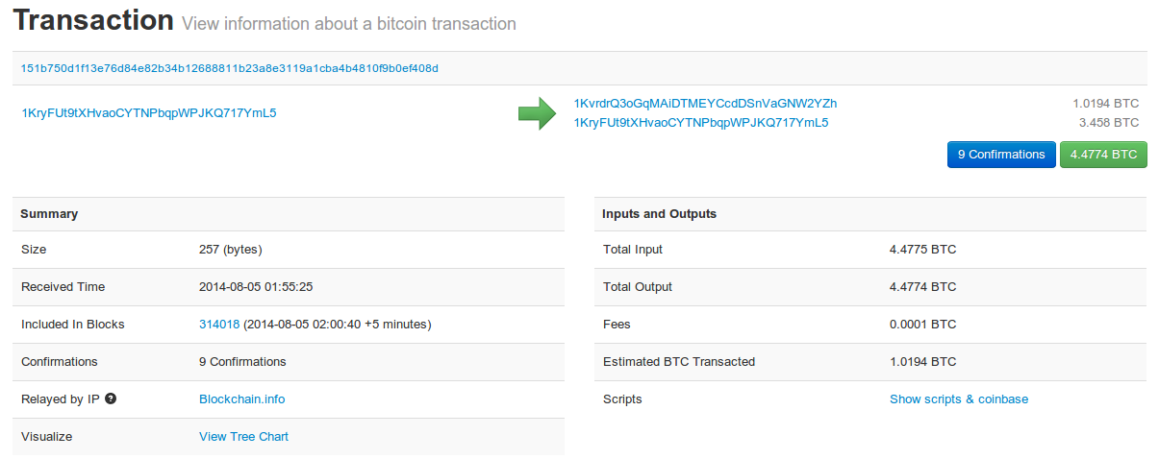
See for yourself!
blockchain.info (and many other sites)

Slide 41
Bitcoin Summary
A purely distributed system that records and maintains an immutable and consistent ledger (a.k.a Blockchain) of transactions.
Three Important Aspects of Bitcoins :
Data structures.
Bitcoin peer-to-peer network.
Consensus.

Slide 42
Bitcoin P2P network
Nodes run a Bitcoin reference (or other) client on TCP port 8333 implementing an ad-hoc communication protocol.
Nodes typically:
Create transactions
Forward transactions
Validate transactions
Add transaction blocks onto the Blockchain
Ad-hoc network has random topology – no centralized coordinating service or authority
All nodes are equal – however two types of nodes typically found:
Fully validating nodes
Thin clients or SPV nodes
New nodes can join any time - forget non-responding nodes after 3 hours
More on this later!

Slide 43
How big is the Bitcoin network?
Impossible to measure exactly.
Estimates - up to 1M new IP addresses/month. (2015)
Only about 5-10k “fully validating nodes”
This number may be dropping!

Slide 44
Fully-validating nodes
Permanently connected
Store entire block chain
Hear and forward every node/transaction
Only about 5-10k “full nodes”
Permanently connected
Fully-validate
This number may be dropping!

Slide 45
Thin/SPV clients
SPV – Simplified Payment Verification (e.g., Wallet nodes)
Idea: Don’t store everything
Store block headers – verify the puzzle was solved correctly, but cannot verify every transaction in each blocl!
Validate only those transactions that affect them → By requesting transactions as needed
To verify incoming payment
Trust fully-validating nodes
1000x cost savings! Requires only a few tens of Megabytes (compare to tens of Gigabytes needed for fully validating nodes)
Notes:
Also called “lightweight nodes”

Slide 46
Bitcoin Summary
A purely distributed system that records and maintains an immutable and consistent ledger (a.k.a Blockchain) of transactions.
Three Important Aspects of Bitcoins
Data structures.
Bitcoin peer-to-peer network.
Consensus.

Slide 47
Bitcoin Consensus
Bitcoin Consensus – most important functionality of the Bitcoin P2P network.
What do Bitcoin nodes need to reach a consensus on?
Which transactions were broadcast on the network.
Order in which these transactions occurred.
Transactions are valid (output<=input and not double spent).
→ Result of the consensus protocol: Consistent, valid and immutable global transaction ledger.

Slide 48

How Centralized Consensus Works
N₁
N₂
T1
Client-server architecture
Tx
Tx
Tx
T1
N₃
Tx
Tx
Tx
T3
…
…
…
T5
Tx
Tx
Tx
Scrooge maintains consistent and valid blockchain (tamper-evident ledger)
T3
N₆
N₄
T6
N₅
T5
Honest nodes/users
Malicious nodes/users

Slide 49
How Bitcoin Consensus Works
N₂ is selected by the consensus algorithm
T1
N₁
N₂
Tx
Tx
Tx
T1
Tx
Tx
Tx
T1
…
…
…
T5
Tx
Tx
Tx
Tx
Tx
Tx
Tx
Tx
Tx
T1
…
…
…
Tx
Tx
Tx
Each node maintains a copy of the blockchain (tamper-evident ledger)
Peer-peer architecture
N₃
Tx
Tx
Tx
T1
Nodes implicitly accept (reject) this block by building on top of it (or not) when they are selected next by the consensus algorithm
Tx
Tx
Tx
…
…
…
Tx
Tx
Tx
New block forwarded to all nodes who update their blockchains
Nodes run some consensus algorithm
Tx
Tx
Tx
Tx
Tx
Tx
T6
…
…
…
Tx
Tx
Tx
N₆
N₄
Tx
Tx
Tx
T5
Tx
Tx
Tx
…
…
…
T6
Tx
Tx
Tx
N₅
T5
Tx
Tx
Tx
T5
Tx
Tx
Tx
T5
…
…
…
Tx
Tx
Tx

Slide 50
How consensus could work in Bitcoin
At any given time (in the bitcoin peer-to-peer network):
All nodes have a sequence of blocks of transactions (called, ledger or block chain) they’ve reached consensus on
Each node has a set of outstanding transactions it’s heard about (but not yet included in the block chain)
For these transactions consensus has not yet happened
Each node may have a slightly different outstanding transaction pool

Slide 51
Consensus algorithm (simplified)
New transactions are broadcast to all nodes
Each node collects new transactions into a block
In each round a random node gets to broadcast its block
Other nodes accept the block only if all transactions in it are valid (unspent, valid signatures)
Nodes express their acceptance of the block by including its hash in the next block they create

Slide 52
Why consensus in Bitcoin is hard?
Nodes may crash or become offline.
Peer-to-peer network is imperfect.
Not all pairs of nodes connected (and may participate).
Faults in network.
Latency.
Nodes may be malicious.
No notion of global time → constraints the set of consensus algorithms that can be used
Notes:
Analogy of talking on the phone and having a lag

Slide 53
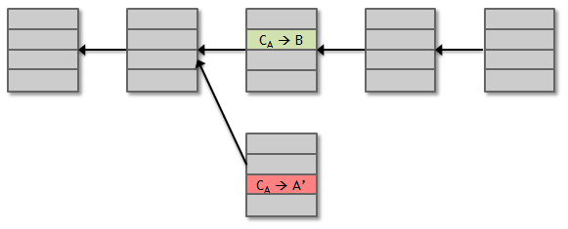

Assumption of Honesty is Problematic
In other words, can we give nodes incentives for behaving honestly?
We can utilize the fact that Bitcoin (the currency) has value to achieve distributed consensus!
Can we reward nodes that created these blocks?
Can we penalize the node that created this block?

Slide 54
Incentive 1: Block Reward
Creator of block gets to
include special coin-creation transaction in the block.
choose recipient address of this transaction.
Value is fixed: currently 12.5 BTC, halves every 210,000 blocks created (or every 4 years at the current rate of block creation).
We are now in the third period – first period block reward was 50 BTC.
Reward drops to 6.25 BTC on 24th May 2020, 16:11:39 (est).
Block creator gets to “collect” the reward only if the block ends up on long-term consensus branch!
Subtle but powerful trick: Incentivizes nodes to behave in way that will get other nodes to extend their block.

Slide 55
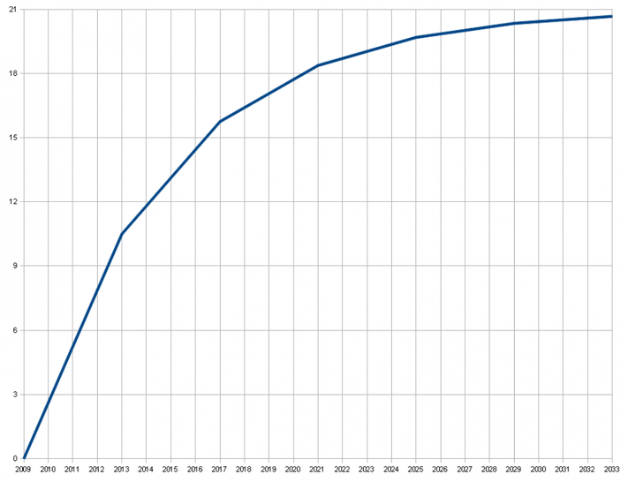
There’s a finite supply of bitcoins
Total supply: 21 million
Block reward is how new bitcoins are created
Runs out in 2040. No new bitcoins unless rules change
Does that mean that after 2040, nodes will no longer have incentive to behave honestly?
Not really!
Total bitcoins in circulation
First inflection point: reward halved from 50BTC to 25BTC
Year

Slide 56
Incentive 2: Transaction Fees
Creator of transaction can choose to make output value less than input value.
Remainder is a transaction fee and goes to block creator.
Purely voluntary, like a tip.
But system will evolve, and will become mandatory, as Block rewards run out.

Slide 57
A Coinbase Transaction
"in":[ { "prev_out":{ "hash":"000000.....0000000", "n":4294967295 },
"coinbase":"..." }, "out":[ { "value":“12.53371419", "scriptPubKey":"OPDUP OPHASH160 ... ”
}
Null hash pointer
redeeming nothing
First ever coinbase parameter:
“The Times 03/Jan/2009 Chancellor on brink of second bailout for banks”
arbitrary
block reward
transaction fees

Slide 58
Remaining Problems
How to pick a random node?
How to avoid a free-for-all system due to rewards?
Everybody may want to run a bitcoin node in order to get free rewards.
How to prevent Sybil attacks?
An adversary may create a large number of Sybil nodes to subvert the consensus process.
Solution: Mining using Proof-of-Work (PoW).

Slide 59
Proof of Work (PoW)
To approximate selecting a random node: select nodes in proportion to a resource that no one can monopolize (we hope):
In proportion to computing power: proof-of-work (Used in Bitcoins).
In proportion to ownership of the currency: proof-of-stake (Not used in Bitcoins – but a legitimate model used in other cryptocurrencies).

Slide 60
Hash Puzzles
To create block, find nonce s.t.
H(nonce ‖ prev_hash ‖ tx ‖ … ‖ tx) is very small.
In other words, H(nonce ‖ prev_hash ‖ tx ‖ … ‖ tx) < target .
nonce
prev_h
Tx
Tx
Output space of hash
Target
space
If hash function is secure (satisfies puzzle-friendliness):
only way to succeed is to try enough nonces until you get lucky
Notes:
If Alice has 100x more computing power than Bob it doesn’t mean she always wins the race. It means she has about a 99% chance of wining. In the long run Bob will create 1% of the blocks

Slide 61
Mining Bitcoins in 6 Easy Steps
Join the network, listen for transactions.
Validate all proposed transactions.
Listen for new blocks, maintain blockchain.
When a new block is proposed, validate it.
Assemble a new valid block.
Find the nonce to make your block valid.
Hope everybody accepts your new block.
Profit!
Useful to Bitcoin network
Incentivize miners to do above
Notes:
Image is public domain (Wikimedia commons)

Slide 62
Advantage of a PoW System?
It completely does away with the problem of magically picking a random node (to propose a block).
Nodes independently compete by attempting to solve hash puzzles.
Once in a while, one (randomly) will succeed and propose the next block.
Result: Completely decentralized system → No one gets to decide which node proposes the next block.
Other advantages:
Not a free-for-all system → Nodes need to work to get paid.
Creating new (Sybil) identities is useless without creating new computing power (to solve PoW) to go along with it!

Slide 63

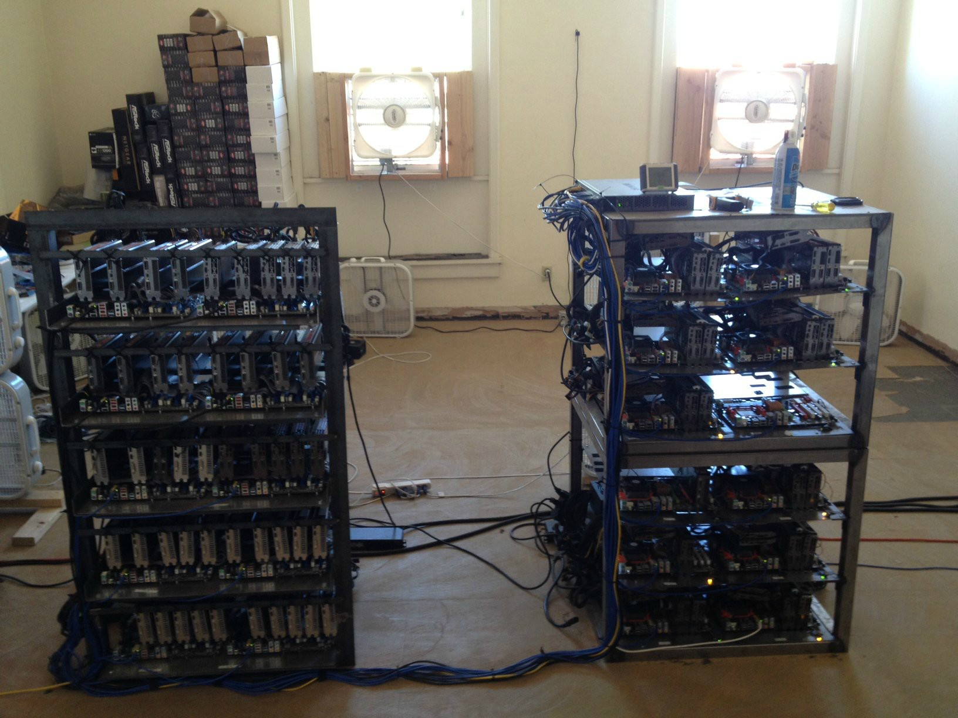
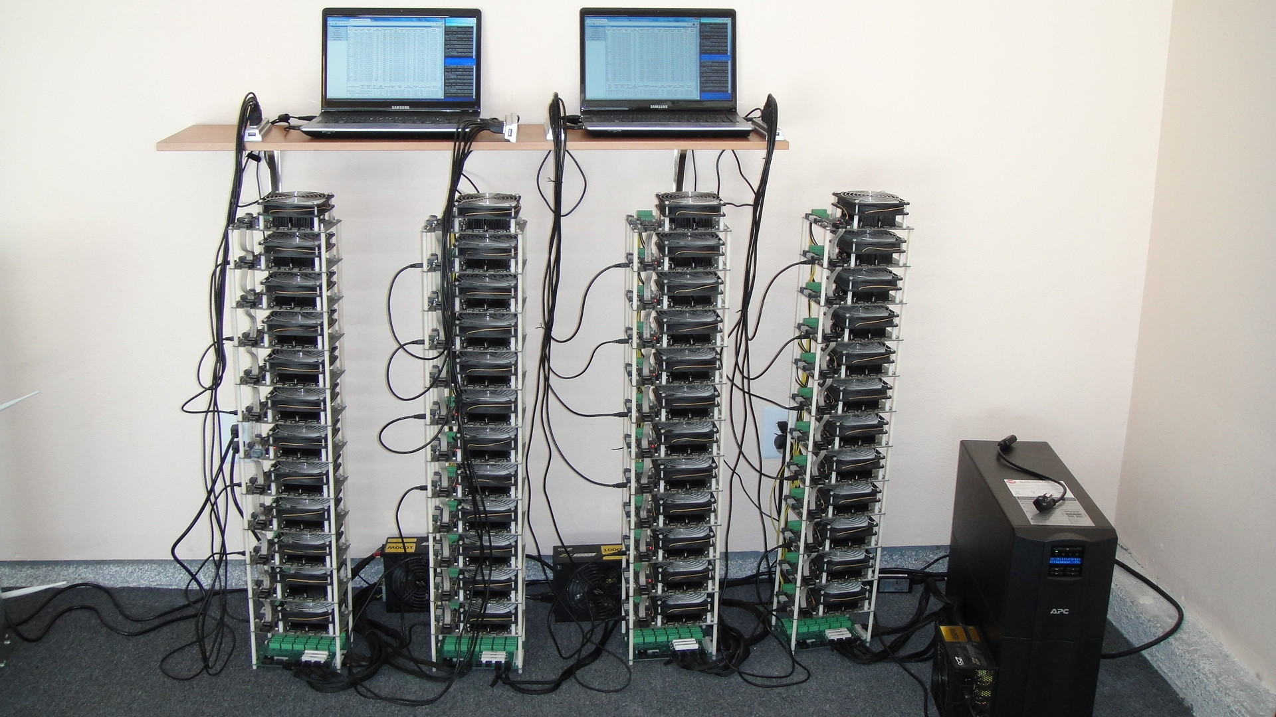
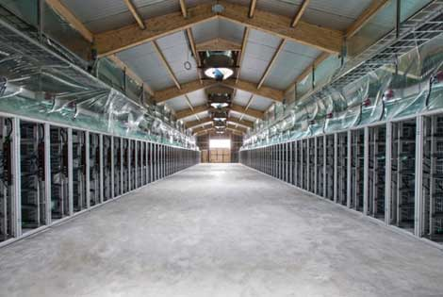
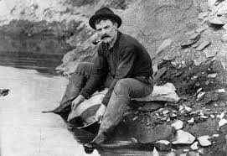
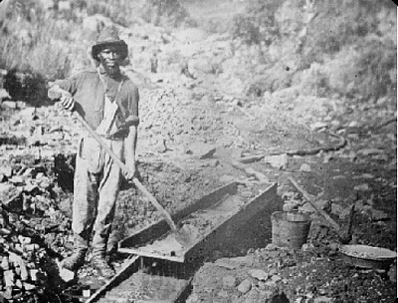
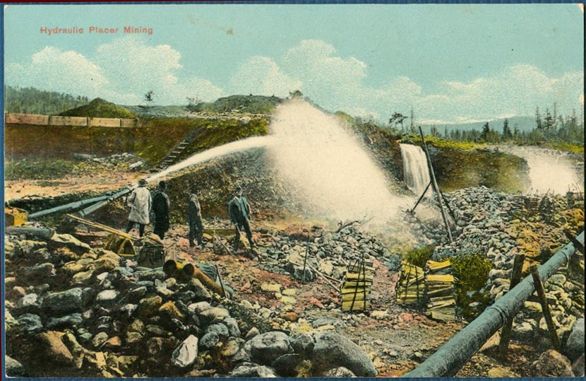
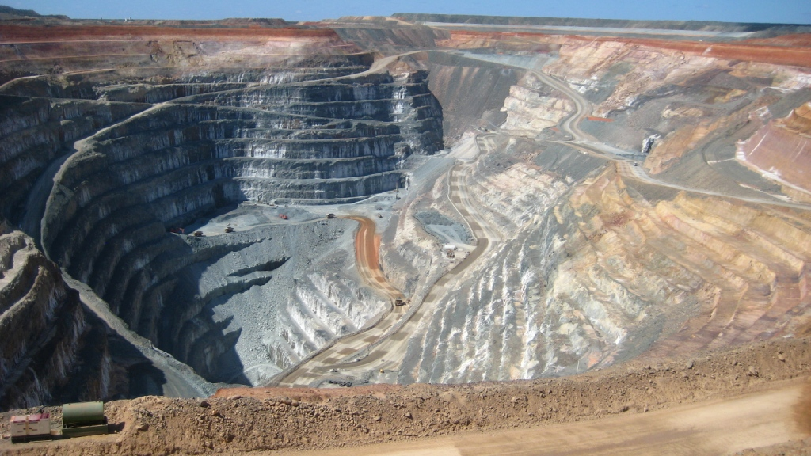
Evolution of Mining
2009
2018
CPU GPU FPGA ASIC
Gold pan Sluice box Placer mining Pit mining

Slide 64
The Future of Mining
Are small miners still in the game for mining Bitcoins?
Do ASICs violate the original Bitcoin vision?
Would we be better off without ASICs?

Slide 65
How to Transact in Bitcoin?
To spend a Bitcoin, you need to know:
Some info from the public blockchain, and
The owner’s secret signing key
So it’s all about key management.

Slide 66
Goals as a Currency
Availability: Being able to spend your coins when you want to.
Security: Making sure nobody else can spend your coins.
Convenience: Managing your keys (and thus your coins)
Achieving all the three simultaneously could be a challenge!

Slide 67


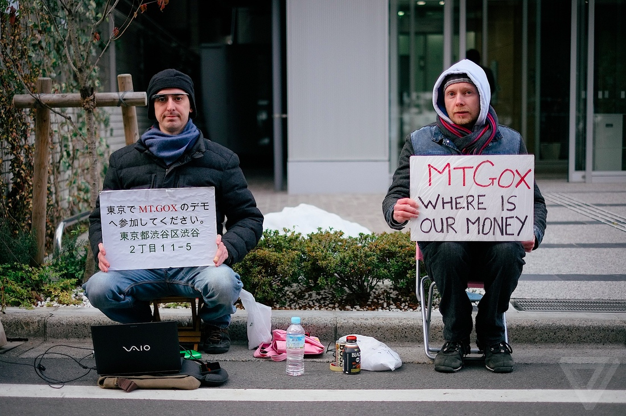
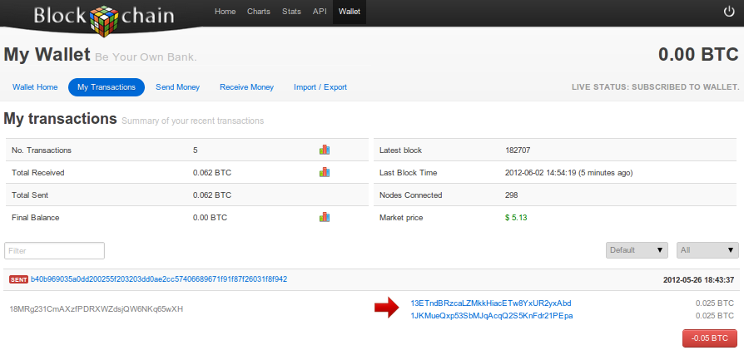
Bitcoin Transaction Tools
Personally manage your keys.
Local wallet software.
Online wallet software.
Bank-like services or Bitcoin exchanges.

Slide 68
Anonymity
Different interactions of the same user with the system should not be linkable to each other (and to the user’s real identity)
Anonymity = pseudonymity + unlinkability

Slide 69
Defining Unlinkability in Bitcoin
Hard to link together different addresses of the same user
Hard to link together different transactions made by the same user
Hard to link sender of a payment to its recipient

Slide 70
Why Anonymous Cryptocurrencies?
Blockchain based currencies are totally, publicly, and permanently traceable.
Without anonymity, privacy is much worse than traditional banking!
Two motivations:
Achieve privacy level at least equivalent to traditional banking
If possible, go beyond the privacy level offered by traditional banking based solutions

Slide 71
Ethical Concerns of Anonymity
Legitimate “goods”: May prevent learning of sensitive information (e.g., someone’s salary).
Legitimate “worries” : Money laundering
Conundrum: Can we keep only the good uses?
Uses that are very different morally are pretty much the same technologically!
Notes:
Researchers should work with AML. Pointer to next lecture
Even for traditional money laundering, difficulty is not technical but rather criminal penalties
Efforts to improve Bitcoin anonymity don’t solve the cashing out problem, so nothing to worry about there

Slide 72
How to de-anonymize Bitcoin?

Slide 73
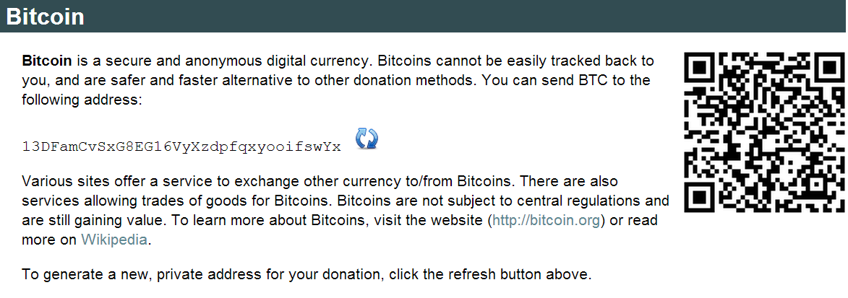

Slide 74
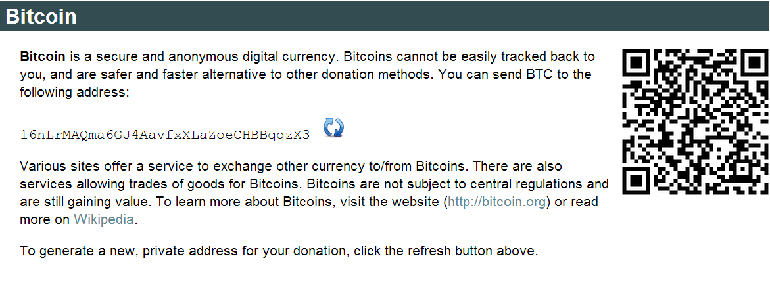

Slide 75
Trivial to create new address
Best practice: Always receive at fresh address.
So, unlinkable?

Slide 76
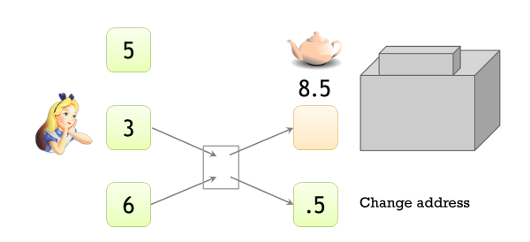
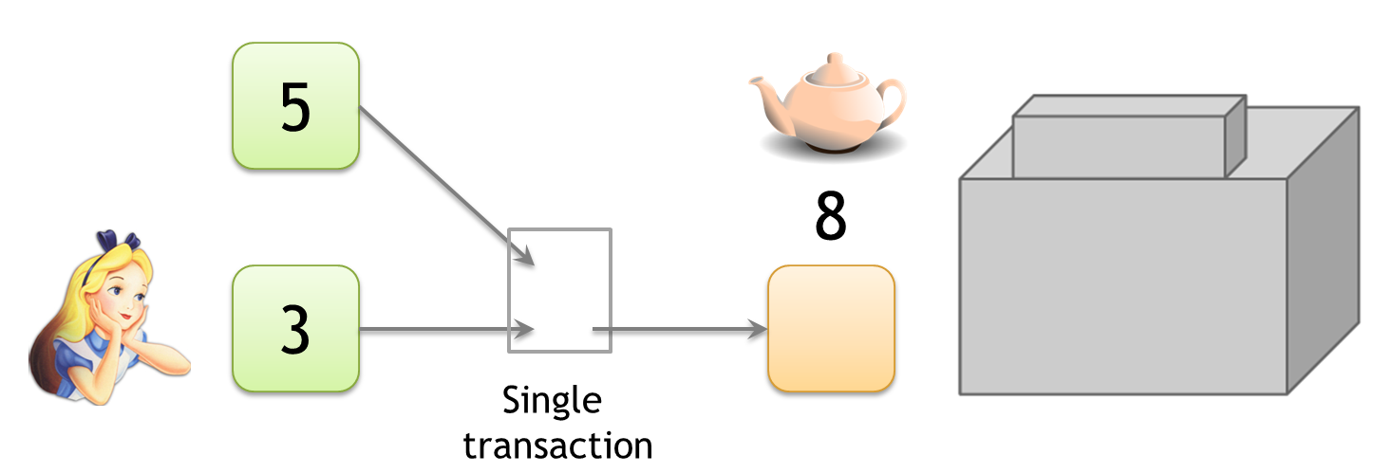
Linking Addresses
Scenario 1: Shared spending
Scenario 2: Change Address
Shared spending and change address can provide evidence of joint control

Slide 77
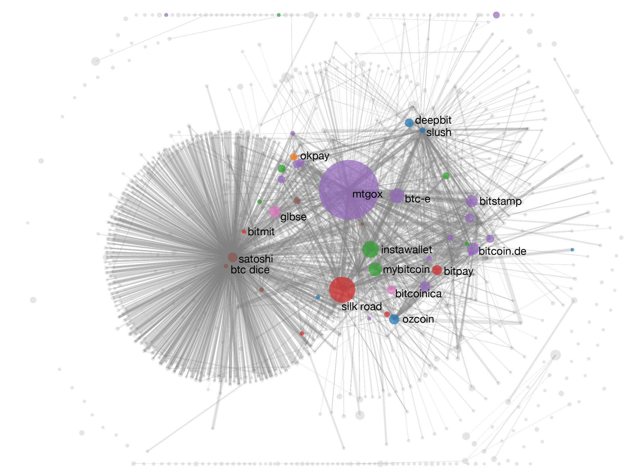
Linking Bitcoins in the Wild
A Fistful of Bitcoins: Characterizing Payments Among Men with No Names
S. Meiklejohn et al.

Slide 78
Talk Outline
Crypto Background
Bitcoin Details
What’s Next

Slide 79
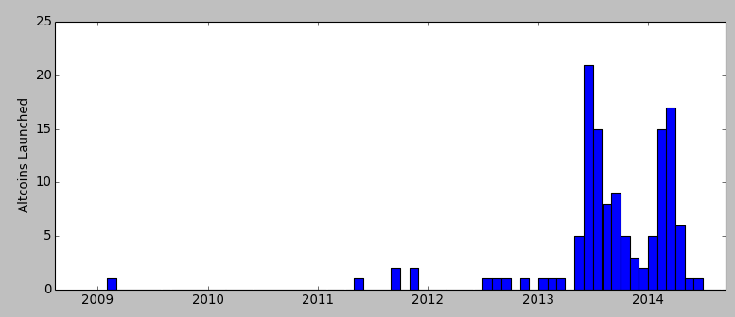
Bitcoin is Not Alone!
As of 2015, 50-500 altcoins launched!
Altcoins launched per month
(genesis block)
Dogecoin
Litecoin
Namecoin
Peercoin
Bitcoin
Data from mapofcoins.com

Slide 80
Reasons for Altcoins
Better (or different) security.
Mining puzzle.
Contract/platform features.
Different parameters and monetary policy.
Inflation.
Inter block time.
Community or common interest support.

Slide 81
Bitcoin’s Blockchain Platform
Works only for Bitcoin!
How to implement a distributed application with a slightly different logic/requirement?
Create a new blockchain to support the application!
Result:
Question: Can we build a single blockchain that supports multiple distributed applications?
Bitcoin
Litecoin
Dogecoin

Slide 82
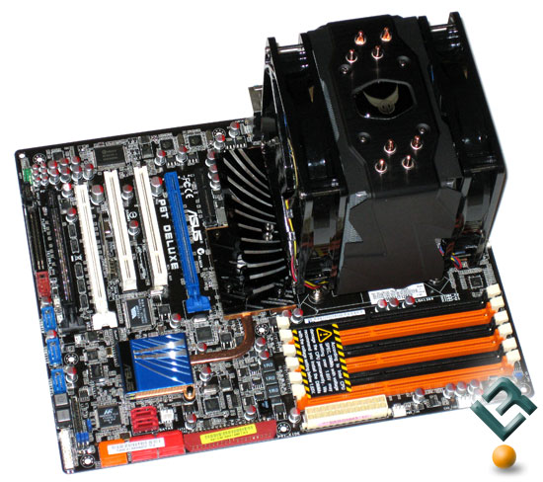
Bitcoin’s Blockchain Platform - Analogy
Versus

Slide 83
Smart Contract Model in Ethereum
Notion of accounts:
Externally Owned Accounts (governed by users).
Contract Accounts (governed by contracts or code).
Smart Contract: A program that lives on the Blockchain (forever).
Written in Solidity – a high-level programming language used by Ethereum.
Anyone can create a contract and upload it.
Pay a small fee, done by means of a special “transaction”.
Users send “specially crafted” transactions to execute these contracts.
Miners agree on order of transactions and actually execute contracts using a PoW-based consensus.
Ethereum clients run a special virtual machine, called EVM, which executes the smart contracts.

Slide 84
Two types of Blockchain Applications
Public Blockchains:
Blockchain participants are not authenticated.
Anyone can participate (also referred to as permission-less blockchains).
Example: Bitcoin, Ethereum.
Private Blockchains:
Blockchain participants are authenticated.
Only authenticated nodes can participate (also referred to as permissioned blockchains).
Example: Hyperledger framework by IBM.

Slide 85
Moving Forward – Main Innovations
Incentives: Why should users participate?
Scalability: How to increase number of transactions per second?
Space: How to reduce the size of the Blockchain?
Applications in other domains/businesses: For authentication, integrity, record-keeping, etc.
IoT
Supply Chain
Financial Services
Spectrum Management
……

Slide 86

Thanks for your attention!

