Slide 1
CS 6393: Cyber Security Models and Systems CS 4593: Cyber Security Models and Systems (cross-listed) Project Guidelines
Ravi Sandhu
Spring 2019

Slide 2
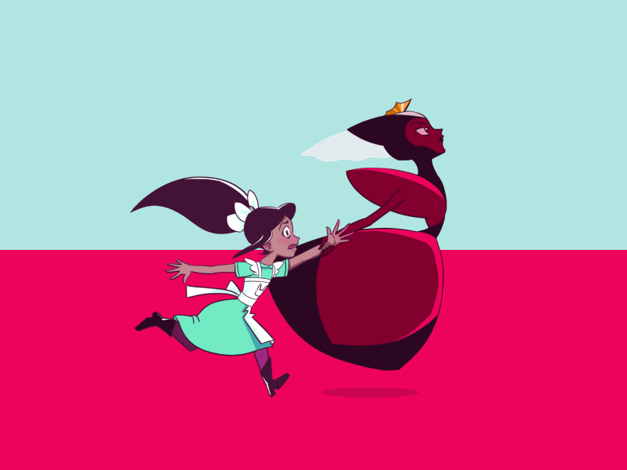
Security is Dynamic
“My dear, here we must run as fast as we can, just to stay in place. And if you wish to go anywhere you must run twice as fast as that.”
― Lewis Carroll, Alice in Wonderland

Slide 3
Security is Chaotic
“My dear, here we must run as fast as we can, just to stay in place. And if you wish to go anywhere you must run twice as fast as that.”
― Lewis Carroll, Alice in Wonderland

Slide 4
2 Part Project
Impactful Attack or Vulnerability
Emerging Technology Challenges

Slide 5
Impactful Attack or Vulnerability
Examples
Heartbleed bug 2014
Meltdown bug 2018
Spectre bug 2018
Mirai botnet 2016
Equifax data breach 2017
Stuxnet 2010
Melissa virus 1999
…..

Slide 6
Emerging Technology Challenges
Examples
Cloud computing
Internet of things
Social media
Blockchain
Wireless 5g
Quantum computing
…..

Slide 7
2 Part Project
Impactful Attack or Vulnerability
No duplication
First come first serve
Emerging Technology Challenges
Duplication ok
Teams must coordinate (with my help) to differentiate duplicate topics

Slide 8
Project Structure
Individual or 2-person team (self-organized)
40 minute in-class presentation, 3 per class meeting
Pick either one as major
20 minute on bigger task
10 minute on smaller task
10 minute class discussion
Both team members must present

Slide 9
Project Grade
3 aspects
Evidence of Effort and Quality of presentation
Content Completeness and Relevance
Content Originality
One grade for team
Additional guidelines will be forthcoming

Slide 10
Time Line and Protocol
Time line
Project teams and topics finalized by Feb 8th
Presentation slots assigned first-come first serve
Protocol
Communicate to me via ravi.utsa@gmail.com
I will post a list of teams and topics as I get them (more or less)

