Slide 1
Institute for Cyber Security: The Galahad Project
A Secure User Computing Environment for the Cloud
James Benson Technology Research Analyst II Bushra Zahed
March 2020
James.Benson@utsa.edu www.ics.utsa.edu https://gitlab.com/utsa-ics/galahad

Slide 2
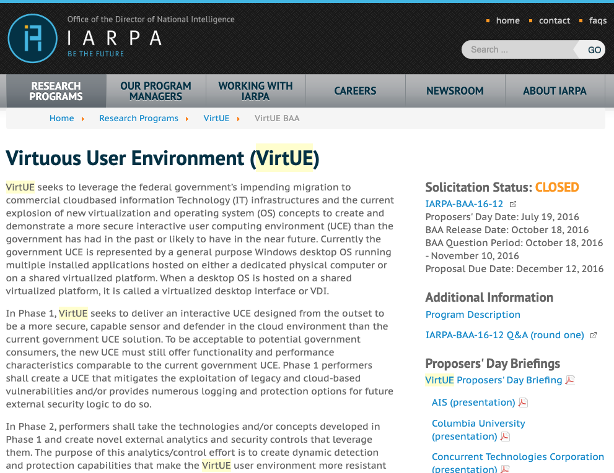
Original IARPA Solicitation

Slide 3
Galahad’s History
Galahad was Star Lab’s solution for Intelligence Advanced Research Project Activity (IARPA) VirtUE program - Virtuous User Environment (VirtUE) proposed in 2016.
Galahad is unique in that it was transitioned from Star Labs to ICS; We have open-sourced it. To create a turn-key opensource deployment tool to share it with others.
Utilizes:
Server, Desktop, Application, & Nested Virtualization
Notes:
Galahad runs as a discrete software components. It utilizes EC2, Elastic File System - EFS, Route53,... a complete software solution.

Slide 4
Overview of Galahad System
Star Lab and Raytheon BBN Technologies proposes to conduct an applied research and development project to create and transition Galahad.
Galahad – a revolutionary User Computer Environment (UCE) for the Amazon Cloud that is designed to be highly interactive while mitigating legacy and cloud specific threats.
UCE – An environment for computation that a user interacts with to launch needed applications and access required informational resources containing one or more Virtues and a presentation interface.

Slide 5
Goals & Motivations
Objective: Detection and mitigation of threats attempting to exploit, collect, and/or effect user computing environments (UCE) within public clouds
Cloud service providers have not offered any game changing security solutions
Adversaries can leverage an arsenal of capabilities used to succeed
Providers cannot necessarily be trusted
Current end-point security solutions and analytical approaches are not tuned for cloud environments
Notes:
Cloud providers simply provide VMs that resemble desktop i.e. general-purpose operating systems. Protecting their resources but not the users.
End-point solutions designed for enterprise workstations that fulfill multiple roles. It is unclear whether they can be tuned give the current all-inclusive VM construct. Role-based VM’s open the door to improved models of expected use.

Slide 6
Security Advantages of Virt.
Better Forensics/Faster Recovery after an attack
Compromised machines can be cloned in compromised state for forensic analysis
After cloning, VM can be restored to known good state.
Control the default state of VM
Patches can be automatically incorporated
Failed upgrades can be reverted faster
Cost effective
Scale infrastructure devices accordingly instead of one size fits all.
Leveraging Virtualization to provide better security
View interactions and contexts

Slide 7
Galahad Approach
To combat threats in a public cloud, isolate, protect what is controlled, and maneuver
Do not attempt to establish trust (Rowhammer, Spectre, Meltdown,…)
Do not require special cloud services, e.g., dedicated servers
Impede the ability of adversaries to operate within AWS by making it more difficult to co-locate
Force adversaries to consume more resources thereby increasing the accuracy, rate, and speed with which threats maybe detected
Facilitate the creation of role-enabled security models
Universal Role: Email and intranet
Administrative: “Universal Role”, internet, word, excel
Programmer: “Universal Role”, internet, PowerShell, SSH, notepad++
Guest: Internet
Reduce attack surface area, hardened kernel, real-time sensing, limit resources.
7
Notes:
No positive control of traditional trust-establishing components
Don’t rely on “dedicated” (exclusively for our use) server
Make it more costly for adversary to find us in the cloud and more difficult to attack us
Role-based isolation, attack surface minimization practices, operating system (OS) and application hardening techniques, real-time sensing, and maneuver / deception

Slide 8
Galahad VirtUE
Containers for easy packaging and security configuration
A small, hardened, de-privileged Linux OS VM
A nested hypervisor to facilitate regular, recurring live migration of Unity VMs inside AWS
8
Notes:
Valor: running directly on our EC2 instance; responsible for supporting migration (VirtUE load/unload) and some sensing
Unity: Can host multiple containers, one-to-one relationship between unity/role/and user.
User can have multiple roles.
A role defines what a user needs access to. For example, word and firefox.
Expra exports the display using a html5 wrapped in a nodejs. nodejs runs on the client side, all roles get displayed on a single canvas.

Slide 9
Galahad Use Case
9
Notes:
Galahad Canvas
User interface
Resource sharing
Single sign-on
Galahad Lifecycle Control
VirtUE Assembler
VirtUE Control API
Galahad Sensors and Loggers
Configurable to allow for performance / logging tradeoffs
Spans entire Galahad VirtUE software stack

Slide 10
AWS Servers…
VM
VM
VM
VM
VM
VM
VM
VM
VM
VM
VM
VM
VM
VM
VM
VM
VM
VM
Hardware
Hardware
Hardware
VM
VM
VM
VM
VM
VM
VM
VM
VM
VM
VM
VM
VM
VM
VM
VM
VM
VM
Hardware
Hardware
Hardware
Notes:
AWS has lots of servers and lots of VM’s running on their servers. In this case, we show 6 AWS servers and 4 galahad VM’s in tan.

Slide 11
VM’s shut down
VM
VM
VM
VM
VM
VM
VM
VM
VM
VM
VM
VM
VM
VM
VM
VM
VM
VM
Hardware
Hardware
Hardware
VM
VM
VM
VM
VM
VM
VM
VM
VM
VM
VM
VM
VM
VM
VM
VM
VM
VM
Hardware
Hardware
Hardware
Notes:
The VM’s can shut down

Slide 12
VM’s turn on
VM
VM
VM
VM
VM
VM
VM
VM
VM
VM
VM
VM
VM
VM
VM
VM
VM
VM
Hardware
Hardware
Hardware
VM
VM
VM
VM
VM
VM
VM
VM
VM
VM
VM
VM
VM
VM
VM
VM
VM
VM
Hardware
Hardware
Hardware
Notes:
And be recreated, they could be on the same server or other servers, we don’t know, and we can’t control it.

Slide 13
Bad actor, probing…
VM
VM
VM
VM
VM
VM
VM
VM
VM
VM
VM
VM
VM
VM
VM
VM
VM
VM
Hardware
Hardware
Hardware
VM
VM
VM
VM
VM
VM
VM
VM
VM
VM
VM
VM
VM
VM
VM
VM
VM
VM
Hardware
Hardware
Hardware
Notes:
Being a public cloud, bad actors, foreign governments, independent hackers, hacker groups like ANON, legion of doom, chaos computer club…can/could/probably do live on AWS and other public cloud providers

Slide 14
Found something?
VM
VM
VM
VM
VM
VM
VM
VM
VM
VM
VM
VM
VM
VM
VM
VM
VM
VM
Hardware
Hardware
Hardware
VM
VM
VM
VM
VM
VM
VM
VM
VM
VM
VM
VM
VM
VM
VM
VM
VM
VM
Hardware
Hardware
Hardware
Notes:
These actors might be passive or actively searching, and if they, for some reason find our VM, how do we respond? Turn off all of our VM’s buy a bunch of servers, and run things in house? Shut it down migrate? Live migrate? Attack back? Tell AWS?

Slide 15
Attack detected.
VM
VM
VM
VM
VM
VM
VM
VM
VM
VM
VM
VM
VM
VM
VM
VM
VM
VM
Hardware
Hardware
Hardware
VM
VM
VM
VM
VM
VM
VM
VM
VM
VM
VM
VM
VM
VM
VM
VM
VM
VM
Hardware
Hardware
Hardware
Notes:
The easiest

Slide 16
Aggressive Attack
VM
VM
VM
VM
VM
VM
VM
VM
VM
VM
VM
VM
VM
VM
VM
VM
VM
VM
Hardware
Hardware
Hardware
VM
VM
VM
VM
VM
VM
VM
VM
VM
VM
VM
VM
VM
VM
VM
VM
VM
VM
Hardware
Hardware
Hardware

Slide 17
Aggressive Migration
VM
VM
VM
VM
VM
VM
VM
VM
VM
VM
VM
VM
VM
VM
VM
VM
VM
VM
Hardware
Hardware
Hardware
VM
VM
VM
VM
VM
VM
VM
VM
VM
VM
VM
VM
VM
VM
VM
VM
VM
VM
Hardware
Hardware
Hardware
Notes:
Now we’ll talk about how this migration happens component wise….

Slide 18
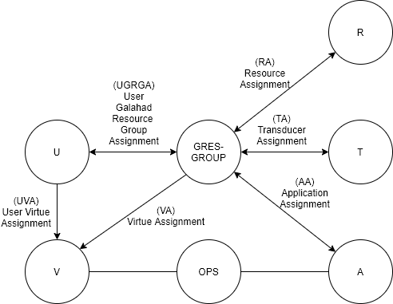
Existing System Framework
Definition
U, V, GRESGROUP, A, R, T and OPS are Users, Virtues, Galahad Resource Group, Applications, Resources, Transducers and operations respectively
OPS is a set of operations on VIRTUES and APPLICATIONS respectively
UGRGA is a many to many user to galahad resource group assignment relation
UGRGA ⊆ USERS×UGRGA
UVA is a one to many user to virtue assignment relation,
UVA ⊆ USERS × VIRTUES
VA is a many to one virtue to galahad resource group assignment relation
VA ⊆ VIRTUES × GRESGROUP
TA is a many to many transducer to galahad resource group assignment relation
TA ⊆ TRANSDUCERS × GRESGROUP
RA is a many to many resource to galahad resource group assignment relation
RA ⊆ RESOURCES × GRESGROUP
AA is a many to many application to galahad resource group assignment relation
AA ⊆ APPLICATIONS × GRESGROUP

Slide 19
Current System Architecture
Step : Login Mechanism
Excaliber
Login Attempt
Virtue-Security API
Virtue-Admin API
Virtue-User API
Token received upon
successful login
User/Admin
19
Notes:
Excaliber is the webserver with a web interface called oAuth. We use oAuth interface for login. All the API’s are hosted by it.
U* or A* are now interchangeable, there is no separation of duties, this is how it’s implemented.
OAuth (Open Authorization) is an open standard for token-based authentication and authorization on the Internet. OAuth, which is pronounced "oh-auth," allows an end user's account information to be used by third-party services, such as Facebook, without exposing the user's password.
OAuth is an authentication protocol that allows a user (resource owner) to grant a third-party application (consumer/client) access to their information on another site (resource).
Extra note: In oAuth you add 2 different profiles and receive 2 different tokens associated with different profiles that can be used to login from home or school or other locations.

Slide 20
Current System Administrative Architecture
Virtue lifecycle management
Excalibur
Admin task
Login Attempt
Token received
upon successful
login
Virtue-Security API
Virtue-Admin API
Admin task
Sensor, Actuator and
Logging Configuration
Admin
Other cli
commands
Admin task
Valor lifecycle management
20
Notes:
What is Excalibur?
It is the webserver with a web interface only for the oAuth interface for login, all the api are hosted by it.
Virtue Lifecycle management involves dynamic protection, virtue creation and associating with the users, packaging and securely placing (storing) in AWS
Valor is a vm that aws (vm ec2 instance) gives us. Each valor (server) has open operating system that we use to create our preferred os vm which valor allows you to create vm on top of valor that vm has the unity layer. Unity is the baseline os that can have our stuff/plugin in it. Virtues are VMs that is configured for particular users based on the roles.
Actuator – any actuator (transducer) that is performing an action. Example, setting firewall rule is an actuator, or any actuator that kills a process with a string that’s setup for.
Sensor is anything that performs without action, for example, logging user commands, memory usage, check the memory for process, any sensor configuration changes, so it is transparent to the user.
IT lifecycle management is defined as the beginning to end process of acquiring, installing, maintaining, tracking and the retirement of an asset
product lifecycle management is the process of managing the entire lifecycle of a product from inception, through engineering design and manufacture, to service and disposal of manufactured products
Valor is a nested hypervisor and unity is a virtual machine running a small hardened deprivileged linux os. Valor includes protections, sensors and vm image authentication, mostly it fascilitates the regular recurring live migration of Unity VMs.
Virtue security api commands
./virtue-security help
exit Return to BASE mode or exit
help Get help
transducer disable Disable a transducer on a Virtue
transducer disable all Disable a transducer on all Virtues
transducer enable Enable a transducer on a Virtue
transducer enable all Enable a transducer on all Virtues
transducer get Get configuration information about a transducer
transducer get configuration Get configuration information about a transducer
transducer get enabled Get list of enabled transducers on a Virtue
transducer list List all transducers
transducer list enabled List all enabled transducers on a Virtue
./virtue-admin help
application add Add an application to the system
application list List available applications
auto migrate start Start Automated Migration
auto migrate status Get Status of Automated Migration
auto migrate stop Stop Automated Migration
exit Return to BASE mode or exit
help Get help
resource attach Attach the indicated resource to the indicated Virtue
resource create Creates a Resource with the given parameters
resource destroy Destroys a resource
resource detach Detaches indicated resource from the indicated Virtue
resource get Get information about indicated resource
resource list List available resources
role create Creates a Role with the given parameters
role destroy Destroys a role
role list List available roles
system export Export the Virtue system to a file
system import Import the Virtue system from an input JSON file
test import application Imports a pre-defined Application that is used during testing
test import role Imports a pre-defined Role that is used during testing
test import user Imports a pre-defined User that is used during testing
user get Gets information about the indicated user
user list List all Users currently present in the system
user logout Force the logout of the indicated User and revoke UserTokens
user role authorize Authorizes the indicated Role for the given User
user role unauthorize Removes authorization for a Role for a User
user virtue list Lists the current Virtue instances for a given User
valor create Create a new Valor instance
valor create pool Create a pool of Valors that can be used
valor destroy Stop and remove a Valor
valor launch Launch a Valor
valor list List available Valor instances
valor migrate virtue Migrate a Virtue to a specific Valor
valor stop Stop a Valor
virtue create Create a Virtue instance for a User/Role combination
virtue destroy Destroy a Virtue
virtue introspect start Start introspection on a specific Virtue
virtue introspect start all Start introspection on a specific Virtue
virtue introspect stop Stop introspection on a specific Virtue
virtue introspect stop all Stop introspection on a specific Virtue
virtue reload state Reload the virtue's state and IP address

Slide 21
Current System Operational Architecture
Role/Virtue
Galahad’s Canvas
Canvas Commands
(GUI clicks)
Galahad’s Canvas
User API Commands
Login Attempt
Virtue User API
Commands
Token received
upon successful
login
User
Launch application
Initiate workloads and
virtue to virtue sharing by
shared drive (copy/paste)
21
Notes:
There is one role associated for one virtue for a user. But a user can have multiple roles and associate with multiple virtues.
Canvas is a client used a presentation interface.
Admin issues to an url with pw/username in the command line using rest (http based) command in python based login (Excalibur , ask). Upon successful login receives token.
This token is stored as env variable in a json file here. This process is implementation dependent. IP address of virtue is only internal.
From a network perspective, only the subscribed organization has access to the Excalibur endpoint (it’s not public.) the organization has dedicated link/connection to the galahad deployed in the aws. This is taken in the network perspective by means of vpn or similar solution.
When user launches an application the canvas open up a ssh tunnel that exports the display of the application by user’s ssh key.
User api commands
./virtue help
application get Get list of available applications
exit Return to BASE mode or exit
help Get help
role get Get information about a role
user role list List roles available to the given user
user virtue list Lists the current Virtues for the given user
virtue application launch Launches an application in a running Virtue
virtue application stop Stops an applcation in a running Virtue
virtue get Get information about a given Virtue
virtue launch Launches a virtue for the curent user
virtue reload state Reload the virtue's state and IP address
virtue stop Stops a user's virtue

Slide 22
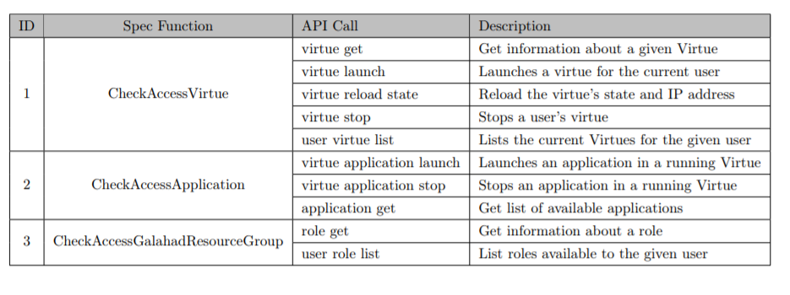
System Functions: Spec Function to User API Call Mapping
Notes:
Checkacessrole is checkaccessgalahadresourcegroup

Slide 23
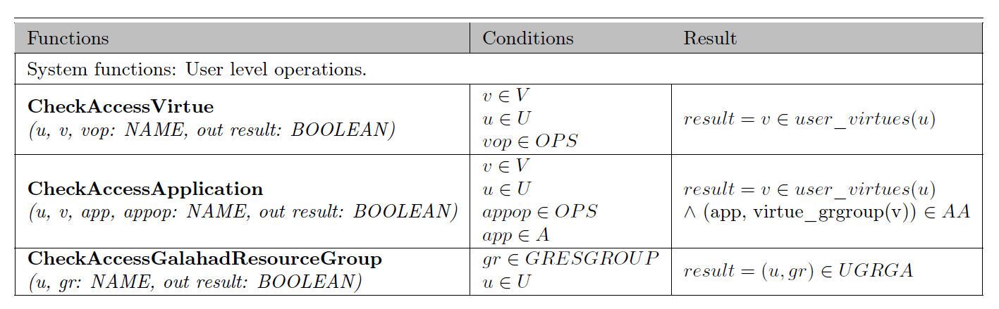
System Functions: Galahad Functional Specification User API
Notes:
Checkacessrole is checkaccessgalahadresourcegroup

Slide 24
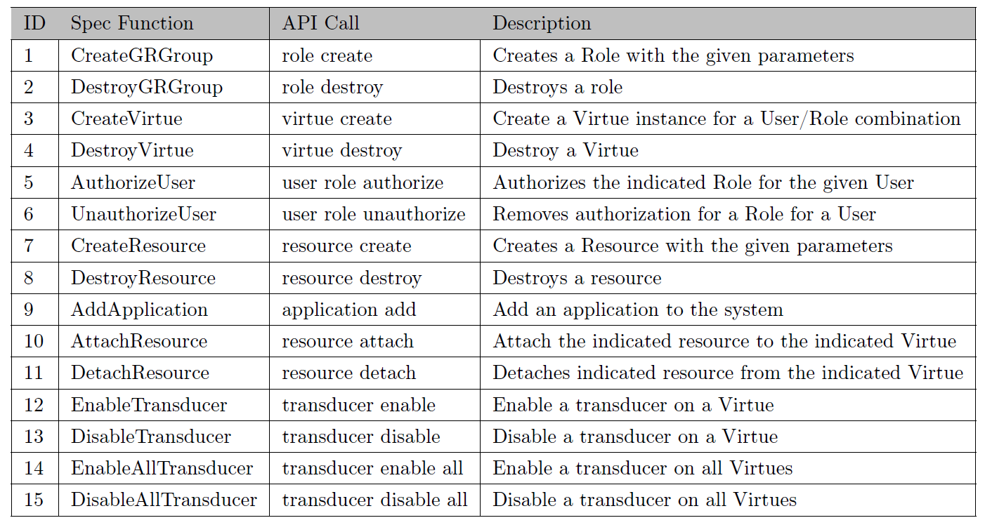
Administrative Functions: Spec Function to Admin API Call Mapping

Slide 25
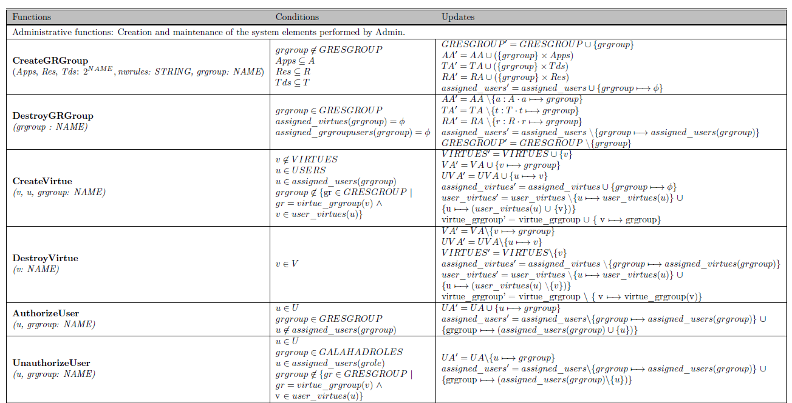
Galahad Functional Specification (Administrative Functions)

Slide 26
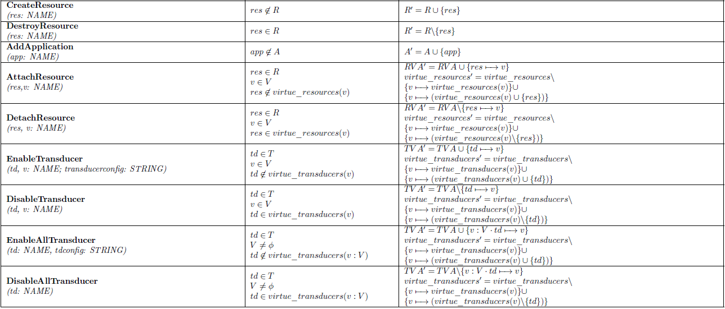
Galahad Functional Specification (Administrative Functions)

Slide 27
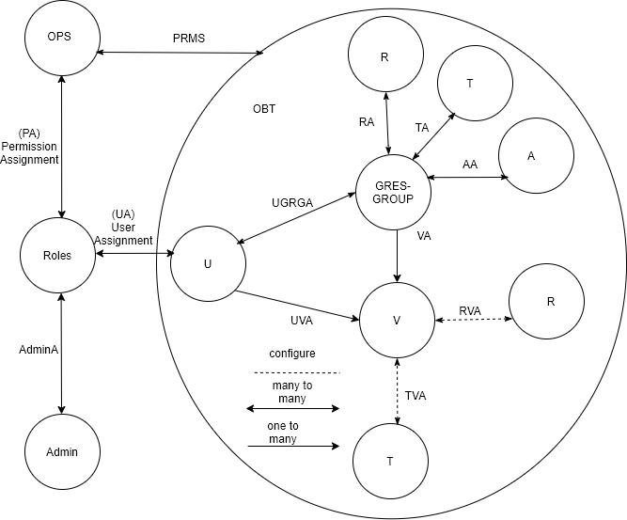
Proposed Administrative Access Control Model
Additional Definition
Roles, Admins and OPS stands for proposed roles, administrative users and operations
UA is a many to many user to roles assignment relation
UA ⊆ USERS X ROLES
PA is a many-to-many permission to role assignment relation
PA ⊆ PRMS X ROLES
PRMS is the set of permissions relation
PRMS ⊆ OPS OBT
AdminA is a many to many Admin and Roles assignment relation
AdminA ⊆ Admin X Roles
RVA is a many to many resource to virtue assignment relation
RVA ⊆ RESOURCES X VIRTUES
TVA is a many to many transducer to virtue assignment relation
TVA ⊆ TRANSDUCERS X VIRTUES
s
Notes:
U, V, GRESGROUP, A, R, T, ROLES, OPS, OBT and PRMS are finite sets of users, virtues, galahad
resource group, applications, resources, transducers, roles, operations, object type and permissions respectively
OPS is a set of operations on VIRTUES and APPLICATIONS respectively
UA is a many to many user to roles assignment relation
UA USERS ROLES
VA is a many to one virtue to galahad resource group assignment relation
VA VIRTUES GRESGROUP
TA is a many to many transducer to galahad resource group assignment relation
TA TRANSDUCERS GRESGROUP
RA is a many to many resource to galahad resource group assignment relation
RA RESOURCES GRESGROUP
AA is a many to many application to galahad resource group assignment relation
AA APPLICATIONS GRESGROUP
UVA is a one to many user to virtue assignment relation
UVA USERS VIRTUES
RVA is a many to many resource to virtue assignment relation
RVA RESOURCES VIRTUES
TVA is a many to many transducer to virtue assignment relation
TVA TRANSDUCERS VIRTUES
PRMS is the set of permissions.
PRMS = OPS OBT
Derived Functions
assigned_users (r: ROLES) ! 2Uformally;
assigned_users(r) = {u 2 U j (u,r) 2 UA }
assigned_virtues (gr: GRESGROUP) ! 2V formally;
assigned_virtues(gr) = {v 2 V j (v, gr) 2 VA }
assigned_permissions(r: ROLES)! 2PRMSformally;
assigned_permissions(r) = {p 2 PRMSU j (p,r) 2 PA }
virtue_grgroup(v: V) ! GRESGROUPformally;
virtue_grgroup(v) = gr 2 GRESGROUP where (v, gr) 2 VA
user_virtues(u: U) ! 2V formally;
user_virtues(u) = {v 2 V j (u, v) 2 UVA }
virtue_resources(v: V) ! 2Rformally;
virtue_resources(v) = {r 2 R j (r, v) 2 RVA }
virtue_transducers(v: V) ! 2T formally;
virtue_transducers(v) = {t 2 T j (t, v) 2 TVA }

Slide 28
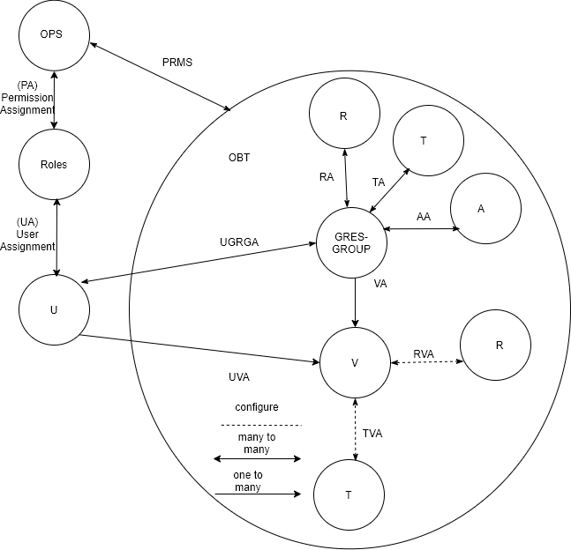
Proposed Operational Access Control Model
Notes:
U, V, GRESGROUP, A, R, T, ROLES, OPS, OBT and PRMS are finite sets of users, virtues, galahad
resource group, applications, resources, transducers, roles, operations, object type and permissions respectively
OPS is a set of operations on VIRTUES and APPLICATIONS respectively
UA is a many to many user to roles assignment relation
UA USERS ROLES
PA is a many-to-many permission to role assignment relationPA⊆PRMS×ROLES
VA is a many to one virtue to galahad resource group assignment relation
VA VIRTUES GRESGROUP
TA is a many to many transducer to galahad resource group assignment relation
TA TRANSDUCERS GRESGROUP
RA is a many to many resource to galahad resource group assignment relation
RA RESOURCES GRESGROUP
AA is a many to many application to galahad resource group assignment relation
AA APPLICATIONS GRESGROUP
UVA is a one to many user to virtue assignment relation
UVA USERS VIRTUES
RVA is a many to many resource to virtue assignment relation
RVA RESOURCES VIRTUES
TVA is a many to many transducer to virtue assignment relation
TVA TRANSDUCERS VIRTUES
PRMS is the set of permissions.
PRMS = OPS OBT
Derived Functions
assigned_users (r: ROLES) ! 2Uformally;
assigned_users(r) = {u 2 U j (u,r) 2 UA }
assigned_virtues (gr: GRESGROUP) ! 2V formally;
assigned_virtues(gr) = {v 2 V j (v, gr) 2 VA }
assigned_permissions(r: ROLES)! 2PRMSformally;
assigned_permissions(r) = {p 2 PRMSU j (p,r) 2 PA }
virtue_grgroup(v: V) ! GRESGROUPformally;
virtue_grgroup(v) = gr 2 GRESGROUP where (v, gr) 2 VA
user_virtues(u: U) ! 2V formally;
user_virtues(u) = {v 2 V j (u, v) 2 UVA }
virtue_resources(v: V) ! 2Rformally;
virtue_resources(v) = {r 2 R j (r, v) 2 RVA }
virtue_transducers(v: V) ! 2T formally;
virtue_transducers(v) = {t 2 T j (t, v) 2 TVA }

Slide 29
Possible Future Directions
Additional access control models
Apply machine learning to characterize application use:
Detect abnormal behavior and automate a response
Help increase detection of zero-day attacks
Help increase detection of unknown viruses
Develop models/white-papers on securing hypervisors better
Apply SDN technology to increase performance on the backend.

Slide 30
Questions?

Slide 31
Resources
https://gitlab.com/utsa-ics/galahad/galahad
https://www.iarpa.gov/index.php/research-programs/virtue/virtue-baa?highlight=WyJ2aXJ0dWUiXQ==

