Slide 1
CS 6393: Cyber Security Models and Systems Cyber Security Perspective
Ravi Sandhu
Lecture 1
Spring 2020

Slide 2
Cyber Security at UTSA
Research Centers
Institute for Cyber Security
Center for Infrastructure Assurance …
Cyber Center for Security Analytics
Open Cloud Institute
National Security Collaboration Center
Academic Colleges Human Development
School of Data Science
NSA/DHS Certifications Human Development
School of Data Science
Sciences
Business
Engineering
Arts
Education
…….
Cyber Operations
Cyber Defense Research
Cyber Defense Education
A strategic priority since 2000

Slide 3
ICS & C-SPECC
Institute for Cyber Security
(ICS)
Scope: All of Cyber Security
NSF Center for Security and Privacy Enhanced Cloud Computing
(C-SPECC)
Scope: Secure Cloud Computing

Slide 4
ICS Mission and History
MISSION
Sustained excellence in graduate-level sponsored research
2007-2012
Founded by start-up funding from State of Texas
2012-2017
Graduated to a self-sustaining operation
2017-2022
Major expansion by winning NSF C-SPECC grant
Established world class laboratories for: Secure cloud computing & Malware research
In collaboration with:
College of Engineering
College of Business
College of Education
Open Cloud Institute
Cyber Center for Security & Analytics
Partnership with 4 NISD High Schools:
Harlan, Woodson, Taft, Business Careers

Slide 5
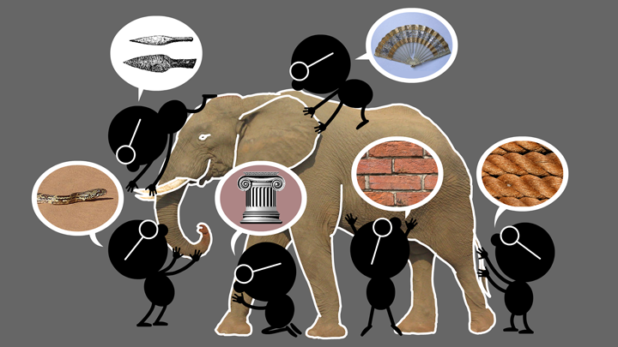
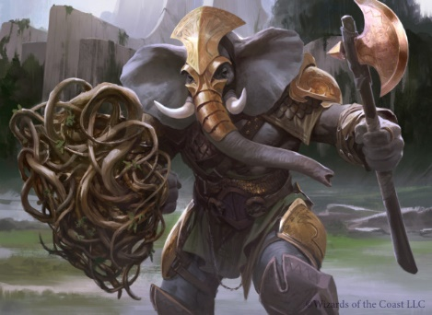
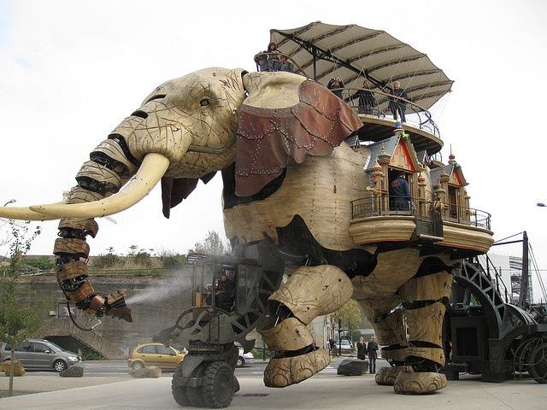
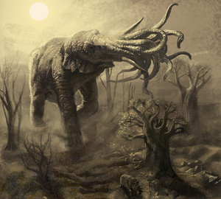
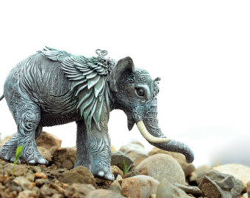
Natural vs Cyber Science
Elephant Problem
Cyber-Elephant Problem
Applied vs Foundational Science: Cyber-elephants require applied and foundational combined
Present vs Future Focus: Rapidly evolving cyber-elephants require future focus

Slide 6
Holistic Cyber Security
Objectives
POLICY
ATTACKS
Enable
What?
Why?
Respond
Enforce
Defend
PROTECT
How?
DETECT
Mechanisms
Complement

Slide 7
Security Objectives
Control of read and write is fundamental to all three
INTEGRITY
modification
AVAILABILITY
access
CONFIDENTIALITY
disclosure

Slide 8
Security Objectives
USAGE
purpose
Covers privacy and intellectual property protection
INTEGRITY
modification
AVAILABILITY
access
CONFIDENTIALITY
disclosure

Slide 9
Security Objectives
USAGE
purpose
USAGE
INTEGRITY
modification
AVAILABILITY
access
CONFIDENTIALITY
disclosure

Slide 10

Security is Dynamic
“My dear, here we must run as fast as we can, just to stay in place. And if you wish to go anywhere you must run twice as fast as that.”
― Lewis Carroll, Alice in Wonderland

Slide 11
Low Assurance Systems
The ATM (Automatic Teller Machine) system is
secure enough
global in scope
Similarly
on-line banking
e-commerce payments

Slide 12
High Assurance Systems
US President’s nuclear football
Secret formula for Coca-Cola

Slide 13
Cyber Security Fundamental Limits
Copy control
Inference
Analog hole
Trusting humans vs trusting software
Trusted computing base vulnerabilities
Side channels and covert channels
…………….

Slide 14
Cyber Security?
Computer security
Information security =
Computer security + Communications security
Information assurance
Cyber Security
Includes cyber physical

Slide 15
Cyber Security?
Computer security
Information security =
Computer security + Communications security
Information assurance
Mission assurance
Includes cyber physical

Slide 16
Other Securities?
Data Security
Network Security
Operating System Security
Privacy
………….

Slide 17
Privacy vs Security
Privacy
Security =
Privacy
Security
Privacy
Security
Security
Security
Privacy
Privacy

Slide 18
Privacy vs Security
Privacy
Security =
Privacy
Security
Privacy
Security
Security
Security
Privacy
Privacy

