Slide 1

Access Control for Smart Home IoT:
EGRBAC Model
CS 6393
Safwa Ameer
James Benson
Ravi Sandhu
Institute for Cyber Security (ICS)
Center for Security and Privacy Enhanced Cloud Computing (C-SPECC)
Department of Computer Science
University of Texas at San Antonio
Safwa.ameer@my.utsa.edu
L11-2
Spring 2020

Slide 2
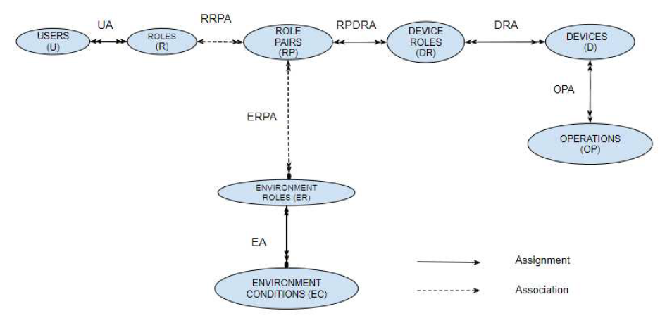
Our view of GRBAC

Slide 3
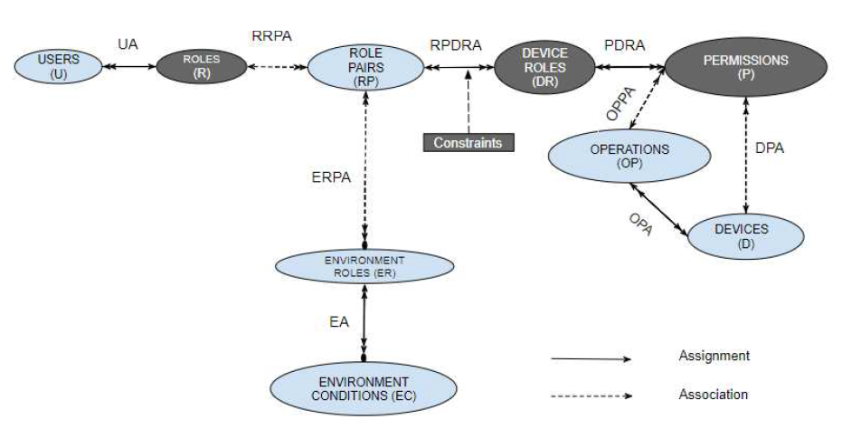

The EGRBAC Model

Slide 4
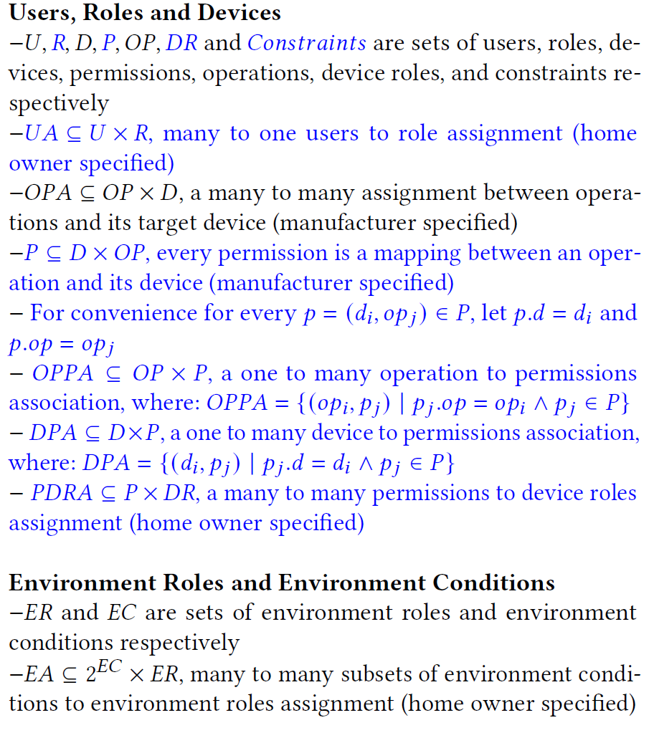
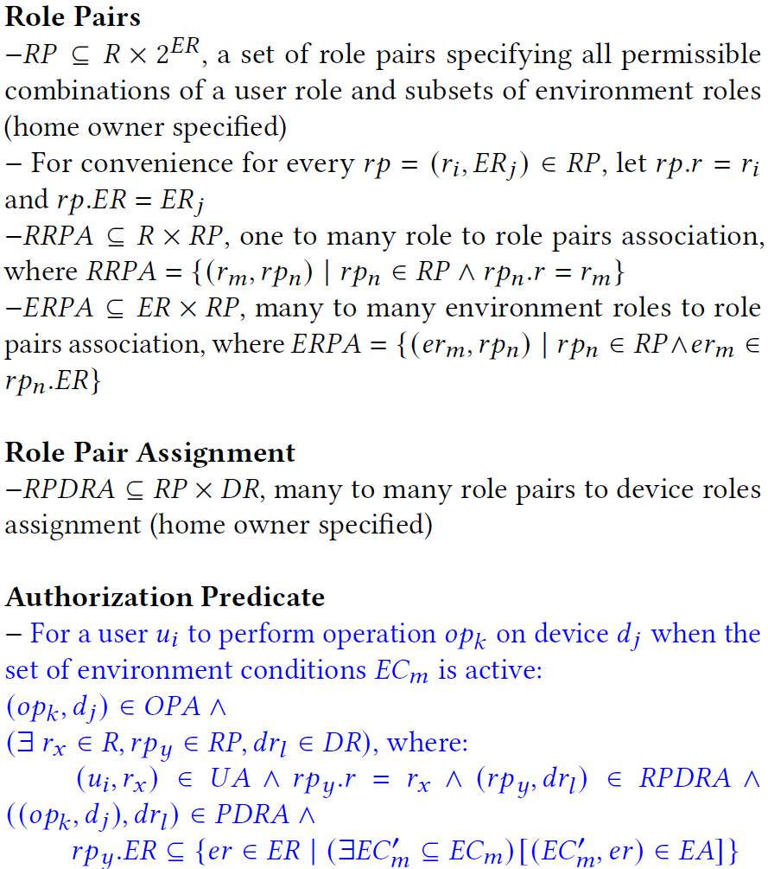

EGRBAC Model Formalization

Slide 5

EGRBAC Vs GRBAC
In EGRBAC, a Role (R) specifically represents the relationship between the user and the family.
Unlike GRBAC, EGRBAC requires each user to have a single role.
There are two newly introduced elements:
  Permissions, an approval to perform an operation on one device, in other words it is a mapping between an operation and its owner device.
  Constraints, which are conditions that need to be satisfied when assigning device roles to role pairs, will be discussed later.
Unlike in GRBAC where a device role is a way of categorizing devices, in EGRBAC a Device Role is a mean of categorizing permissions of different devices.

Slide 6
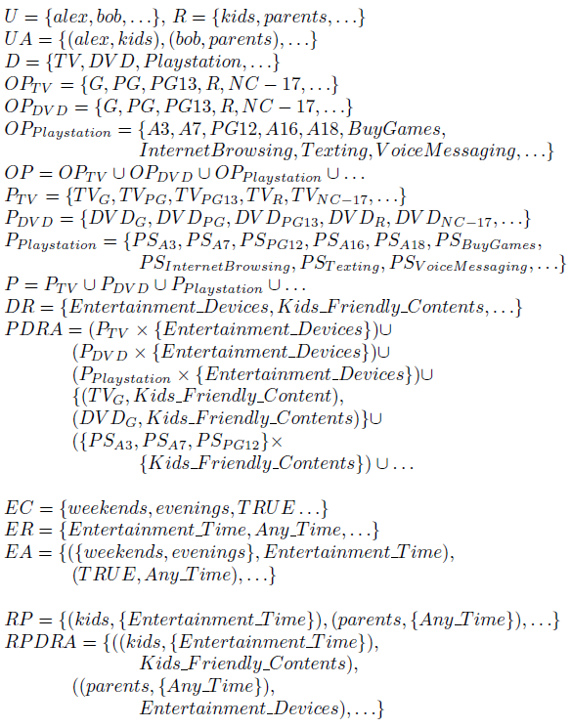

Use Case 1.B Configuration in EGRBAC

Slide 7


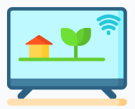



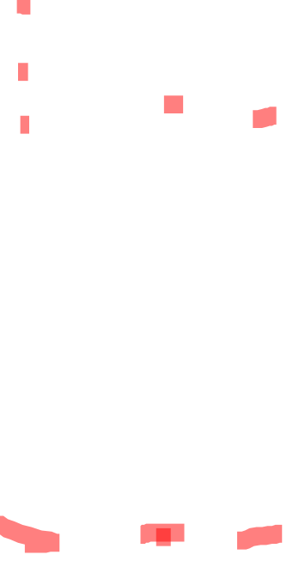



Use Case 1.B
$$PS_{A7}$$
$$PS_{PG13}$$
$$TV_{G}$$
$$DVD_{G}$$
$$PS_{A3}$$

Slide 8

Use Case 1.B
$$PS_{A7}$$
$$PS_{PG13}$$
$$TV_{G}$$
$$DVD_{G}$$
$$PS_{A3}$$

Slide 9


Use Case 1.B
$$PS_{A7}$$
$$PS_{PG13}$$
$$TV_{G}$$
$$DVD_{G}$$
$$PS_{A3}$$

Slide 10



Use Case 1.B
$$PS_{A7}$$
$$PS_{PG13}$$
$$TV_{G}$$
$$DVD_{G}$$
$$PS_{A3}$$

Slide 11

Use Case 1.B
$$PS_{A7}$$
$$PS_{PG13}$$
$$TV_{G}$$
$$DVD_{G}$$
$$PS_{A3}$$

Slide 12
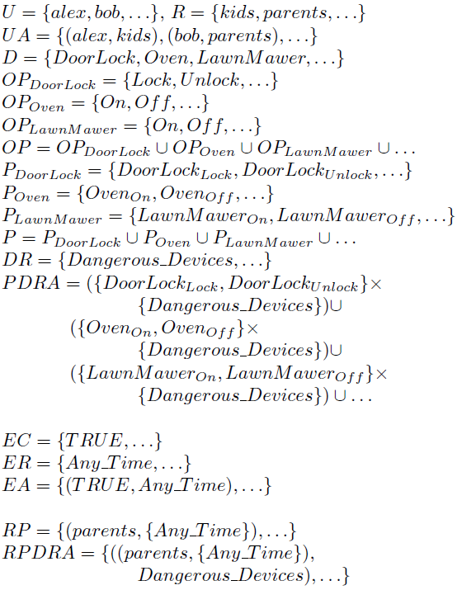

Use Case 2 Configuration in EGRBAC

Slide 13
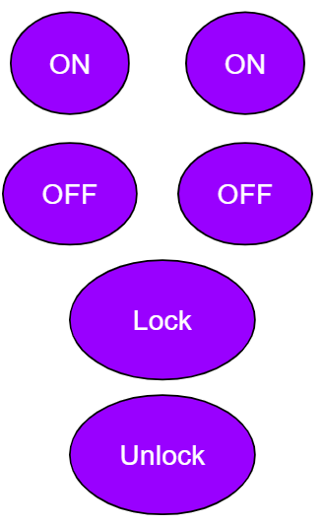

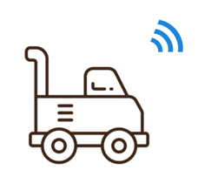
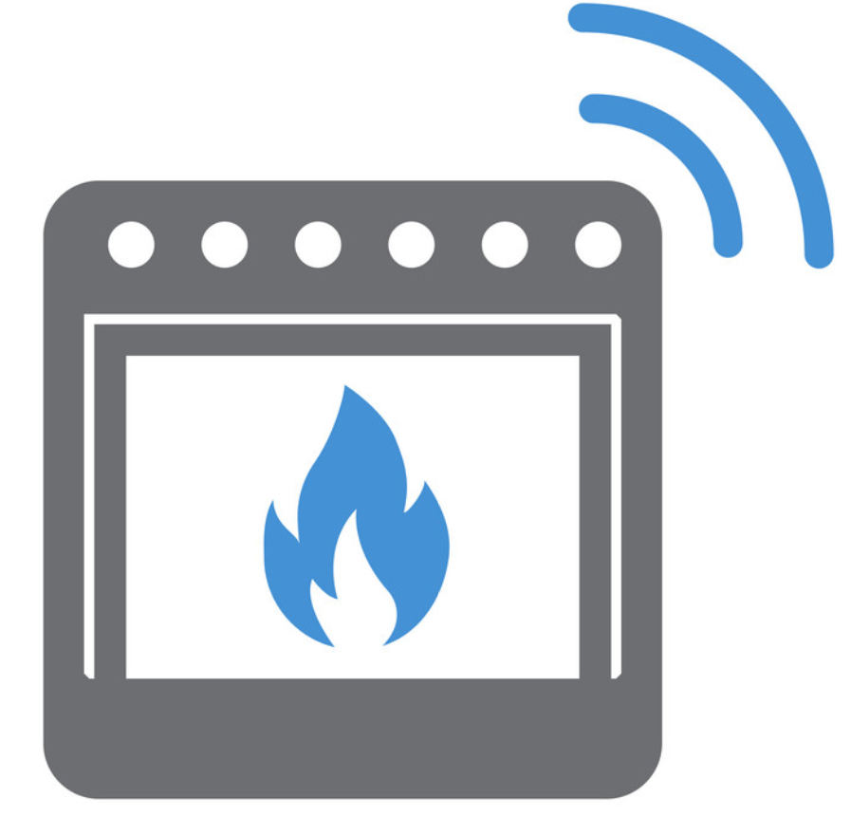


Use Case 2

Slide 14
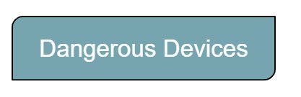

Use Case 2

Slide 15
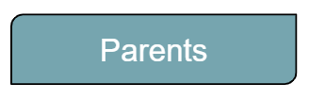

Use Case 2

Slide 16
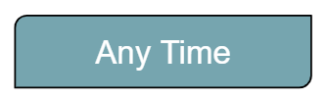
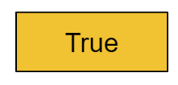

Use Case 2

Slide 17

Use Case 2

Slide 18

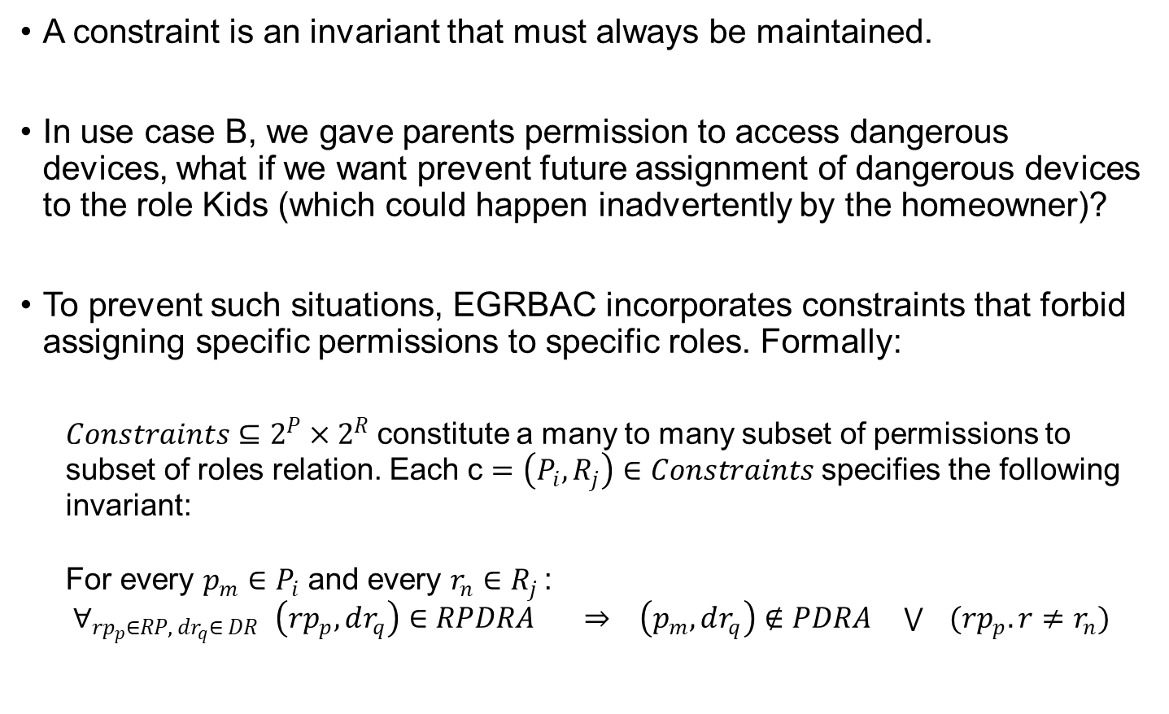
Constraints
A constraint is an invariant that must always be maintained.
In use case B, we gave parents permission to access dangerous devices, what if we want prevent future assignment of dangerous devices to the role Kids (which could happen inadvertently by the homeowner)?
To prevent such situations, EGRBAC incorporates constraints that forbid assigning specific permissions to specific roles. Formally:
  $Constraints⊆2^{P}×2^{R}$constitute a many to many subset of permissions to subset of roles relation. Each c $=\left(P_{i}, R_{j}\right)∈Constraints$specifies the following invariant:
  For every $p_{m}∈P_{i}$ and every $r_{n}∈R_{j }$: ${ ∀_{rp_{p}∈RP, dr_{q}∈ DR }\left(rp_{p},dr_{q}\right)∈RPDRA ⇒ \left(p_{m}, dr_{q}\right)∉PDRA \bigvee{ }(rp_{p}.r≠r_{n})}_{ }$

Slide 19
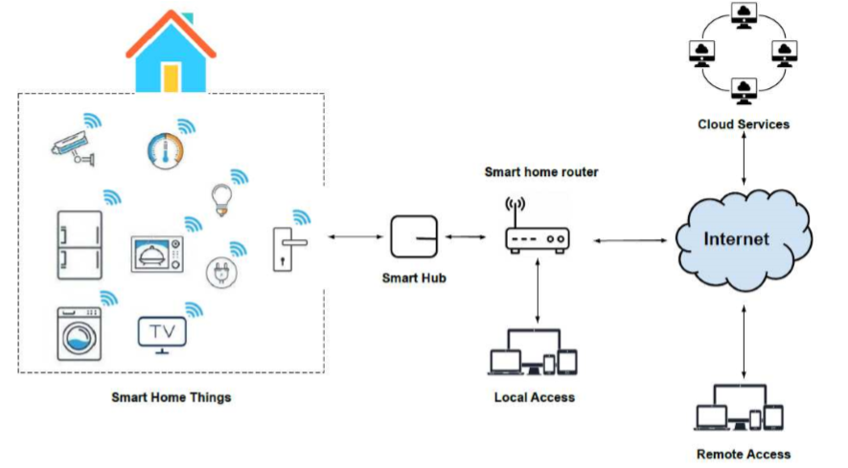

Enforcement Architecture
There are two types of requests: A- Local requests. B- Remote requests.

Slide 20
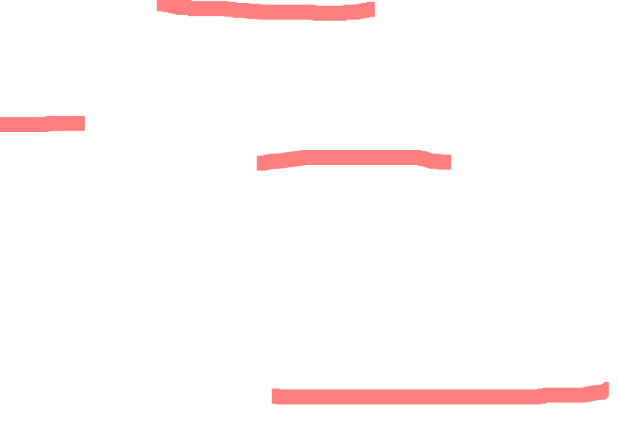
Proof of Concept Implementation
We simulated our model using AWS IoT service.
An AWS account is required to configure and deploy the AWS IoT service known as Greengrass.
The Greengrass SDK extends cloud capabilities to the edge, which in our case is the smart home. This enables devices to collect and analyze data closer to the source of information, react autonomously to local events, and communicate securely with each other on local networks.
In our system Greengrass serves as a smart hub and a policy engine. It runs on a dedicated virtual machine.

Slide 21

Proof of Concept Implementation
Through AWS IoT management console, one virtual object (aka digital shadow) is created for each physical device and the two are cryptographically linked via digital certificates with attached authorization policies.
Each simulated device is run on a separate virtual machine. These devices use MQTT protocol to communicate to the AWS IoT service with TLS security.
To enforce EGRBAC, we utilized two Json files UserRoleAssignment.json and policy.json.
UserRoleAssignment.json defines the assignments of users to their corresponding roles while policy.json defines all other EGRBAC components.

Slide 22
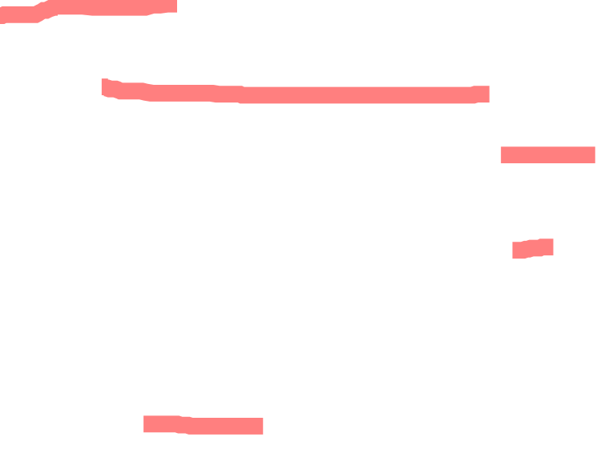
Proof of Concept Implementation
We also utilized the lambda function service in AWS IoT platform to:
  Receive the operation requests of users to access the smart devices in the house.
  Analyze each request according to the content of the policy.json and UserRoleAssignment.json files.
  Trigger the desired actions on the corresponding simulated devices.
We used a long-lived lambda function with 128 MB Memory Limit, 30 second timeout.
The lambda function, the UserRoleAssignment.json file, and the policy.json file are all configured in the Greengrass

Slide 23
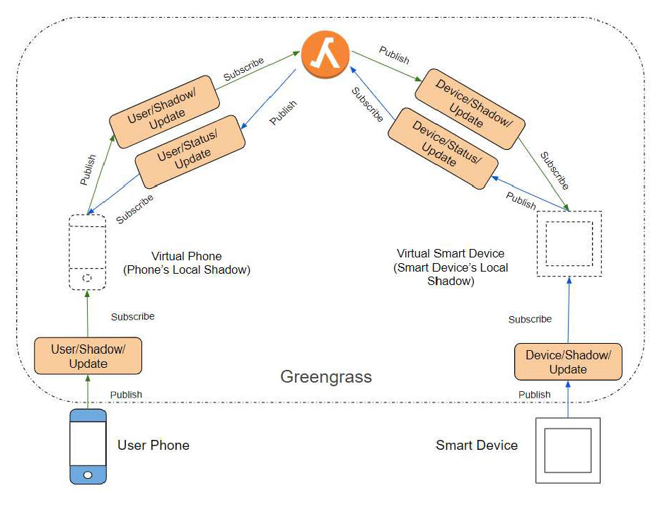

Local Request Processing

Slide 24
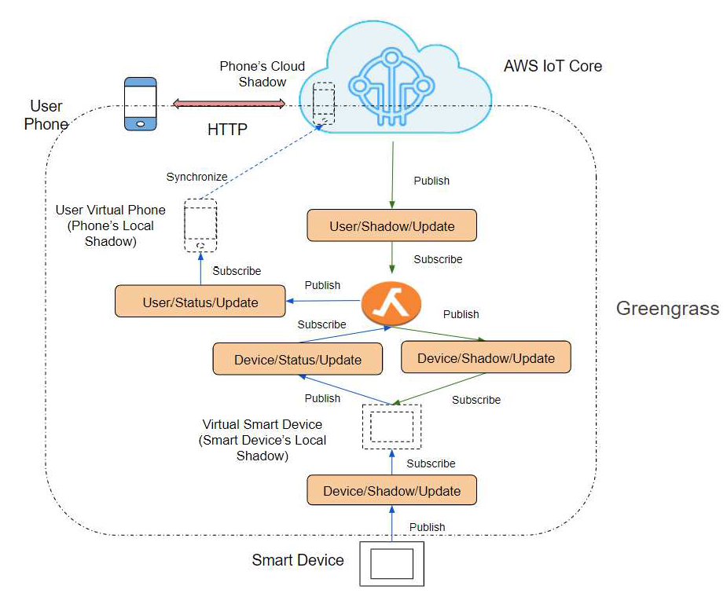

Remote Request Processing

Slide 25
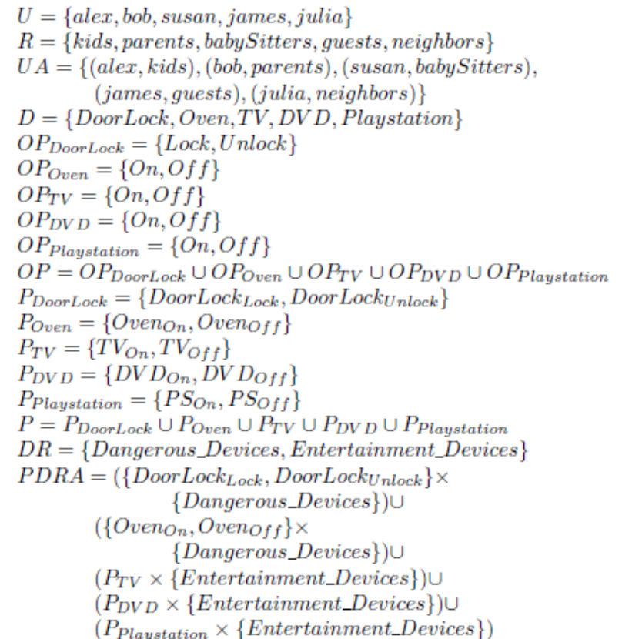
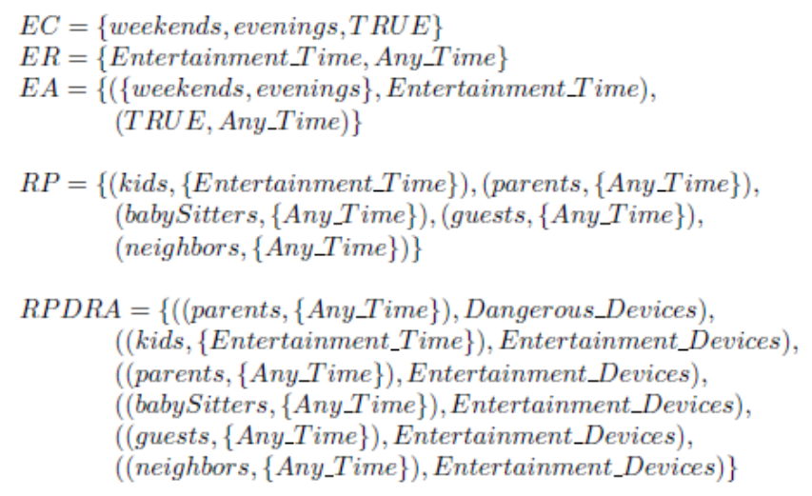

Our Implemented Use Case

Slide 26
Performance Results
We executed multiple test cases to measure the processing time in different scenarios.
we measured the average lambda function execution time under different conditions.
Overall, our model is functional, and can easily applied. Moreover, we can notice that the execution time is generally low.

Slide 27
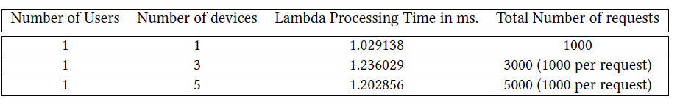

Performance Results
One User Sending Requests to Multiple Devices
The first row shows the average time when the parent Bob requests to unlock the door lock. The second row shows the average time when Bob requests to turn on the oven, the TV, and the DVD at the same time. The third row shows the average time when Bob requests to unlock the door lock, turn on the oven, the TV, the DVD, and the playStation at the same time.
All the requests were approved as they were supposed to according to our configured policies.

Slide 28
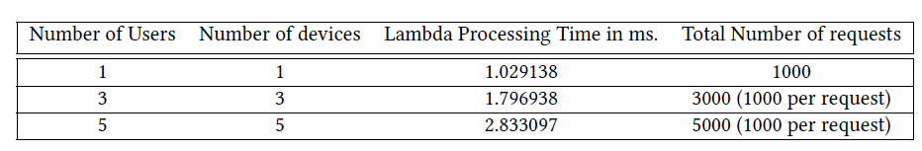

Performance Results
Multiple Concurrent Instances of One User Sending Requests to One Device
The first row shows the average time when the parent Bob requests to unlock the door lock. The second row shows the average time when Bob requests to unlock the door lock, the kid Alex requests to turn on the oven, and the babysitter Susan requests to turn on the TV at the same time. The third row shows the average time when the three access requests tested in the second row are carried again in addition to, the guest James requests to turn on the DVD, and the neighbor Julia requests to turn on the PlayStation.

Slide 29

Performance Results
The system responded correctly where all the requests were approved except for when the kid Alex requests to turn on the oven.
We can conclude that when the number of requests for different users and different devices (one user per device) increases, the lambda processing time also increases.

Slide 30
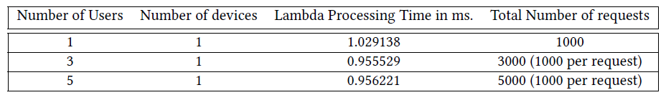

Performance Results
Multiple Users Sending Requests to One Device
This table, shows the average lambda function execution time when we send multiple requests from multiple users to one device at the same time. The first, second, and third rows show the average time when the parent (1 user), the parent the kid and the babysitter (3 users), or the parent the kid the babysitter the guest and the neighbor (5 users) respectively all request to unlock the door at the same time.

Slide 31
Performance Results
The system responded correctly where all the requests were denied except for when the parent Bob requests to unlock the door lock.
Here, we can see that the average lambda processing time decrease when we have more denies.
This result is expected since In order to approve a request the lambda function need to verify each condition in the authorization predicate. On the other hand, if only one of the authorization predicate conditions is violated the lambda function will deny the request without the need to check the rest of the authorization predicate.
To conclude, our system takes more time when approving a request than when denying it.

Slide 32

Conclusion
We propose the EGRBAC access control model for smart home IoT.
Our model’s main goal is to ensure that legitimate users are only permitted to use the devices which they are allowed to access under the appropriate conditions.
It is a dynamic, fine-grained model that grants access based on the specific permission required rather than at device granularity.
In the future we are planning, to develop a family (or series) of models ranging from relatively simple and complete to incorporating increasingly sophisticated and comprehensive features.

