Slide 1
Secure Cloud-Assisted Smart Cars:
Architecture and Authorization Framework
Maanak Gupta and Ravi Sandhu
L13-1
CS6393
Spring 2020

Slide 2
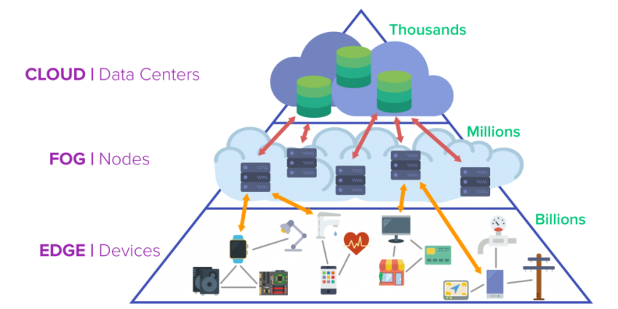
Cloud-Assisted Fog & IoT
Yousefpour et al, All one needs to know about fog computing and related edge computing paradigms: A complete survey. Journal of Systems Architecture, 2019.

Slide 3
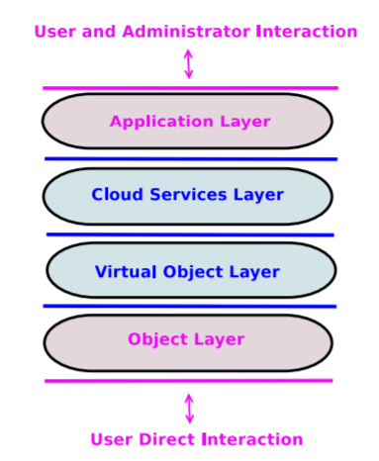
ACO Architecture for Cloud-Enabled IoT
CLOUD
CLOUD
EDGE DEVICES
* Alshehri, A., Sandhu, R.: Access control models for cloud-enabled internet of things: a proposed architecture and research agenda. In: 2nd IEEE International Conference on Collaboration and Internet Computing (CIC), pp. 530–538. IEEE (2016)
© Ravi Sandhu
World-Leading Research with Real-World Impact!
3

Slide 4
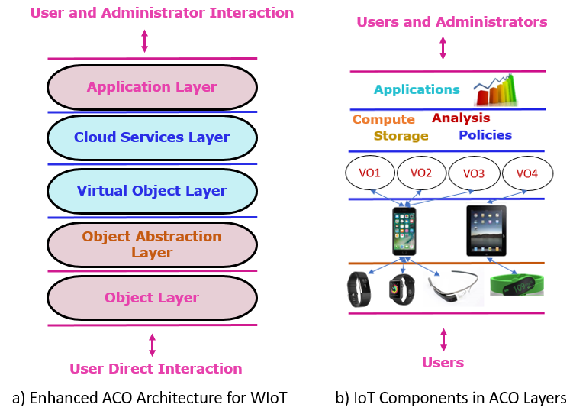
Enhanced ACO Architecture for WIoT
CLOUD
CLOUD
EDGE GATEWAY
EDGE DEVICES
Bhatt et al, An Access Control Framework for Cloud-Enabled Wearable Internet of Things. IEEE CIC 2017.

Slide 5
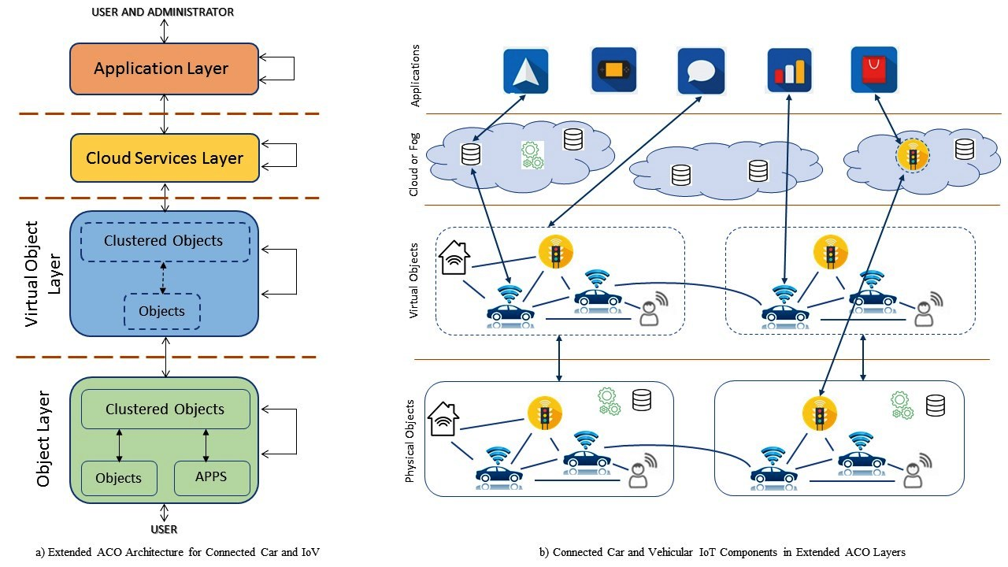
Extended Access Control Oriented Architecture

Slide 6
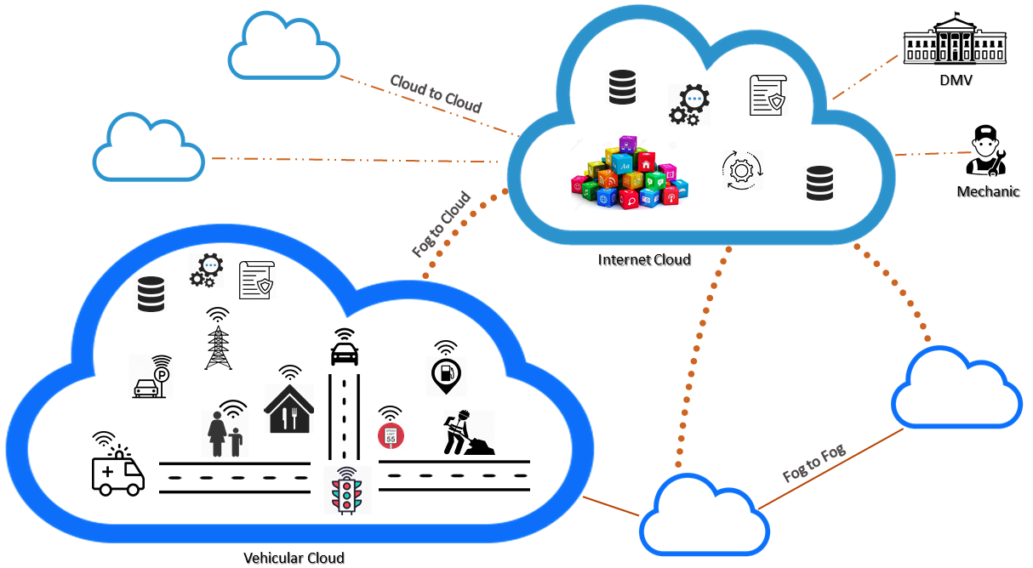
Connected Cars Ecosystem

Slide 7
Smart Cars Ecosystem
Safety and Assistance
High Mobility, Location Centric
Time Sensitive, Dynamic Pairing
Multiple Fog/Cloud Infrastructures
Information and Entertainment

Slide 8
No More Isolated.!
100 million lines of code
Software Reliance , Broad Attack Surface, Untrusted Entities

Slide 9

Security and Privacy Requirements
On-Board Application and Sensors
Over the Air updates
V2X fake messages
In-vehicle ECU communication
Personal Data
Third Party devices
User Privacy Preferences
Spoofing, Ransomware, Injection…
Loss of Information in Cloud

Slide 10
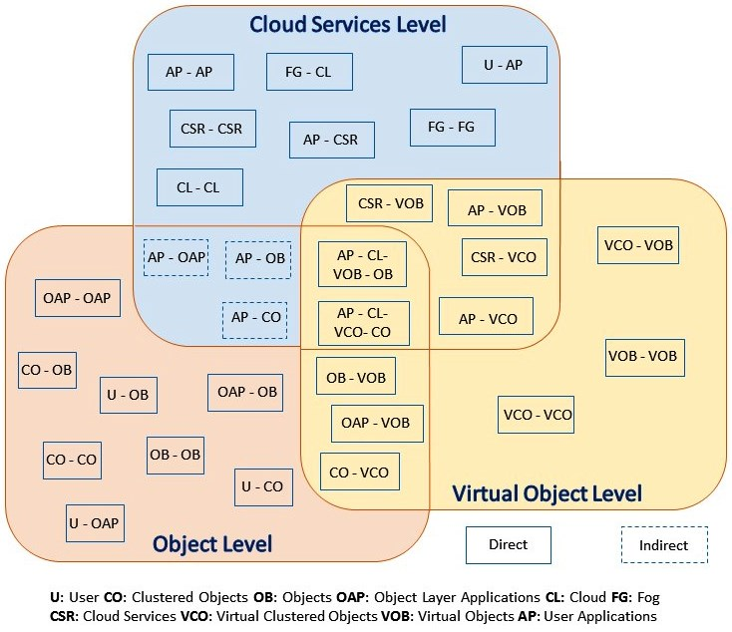
Authorization Framework

Slide 11
Access Control Strategies
Static vs Dynamic
What kind of relationship they have?
Owner, Manufacturer, Friend…
Multi-Layered
Groups Based
Trusted Interaction
How I trust you?
Previous interaction..?
ABAC, ReBAC Models
Who will administer?
Data in Cloud, cross cloud sharing. How?

Slide 12
Authorization Framework
CV-ABAC_{G} Model
Cloud Supported

