Slide 1

Secure Cloud-Assisted Smart Cars:
Dynamic Groups and ABAC
Maanak Gupta, James Benson, Farhan Patwa and Ravi Sandhu
L13-2
CS6393
Spring 2020

Slide 2
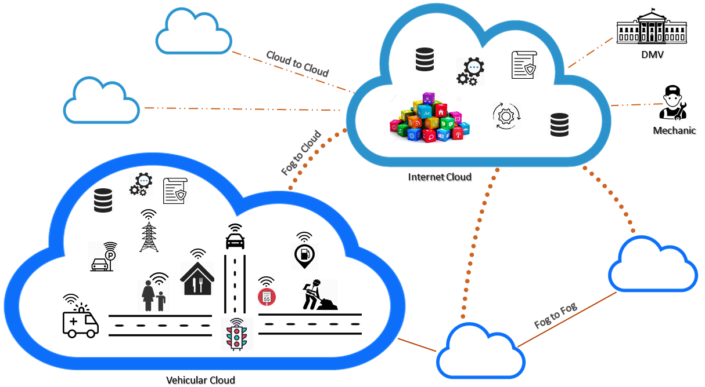

Connected Cars Ecosystem

Slide 3

Scope of Contribution
Contribution
Propose formalized ABAC model for cloud assisted applications.
Dynamic groups and user preferences.
Implementation of the model in AWS.
Scope
  Single Central Cloud
  No direct access and physical tampering
  Communication Channel is encrypted.
  Data in Cloud is secure
  In-vehicle security not considered

Slide 4

Attribute Based Access Control
ABAC: Decision based on the attributes of entities
Attributes are name value pairs: age (Alice) → 29
Core entities in ABAC include:
Users
Objects Attributes
Environment or Context
Operations
Authorization Policies: determine rights just in time
  retrieve attributes of relevant entities in request
Enhance flexibility and fine grained access control
Notes:
User:---age, gender, department, desingatin, role
Object: created by, last modified,
Only nurse in the pediatric department is allowed to read the files of children which visit the clinic.
Only owner iot.

Slide 5
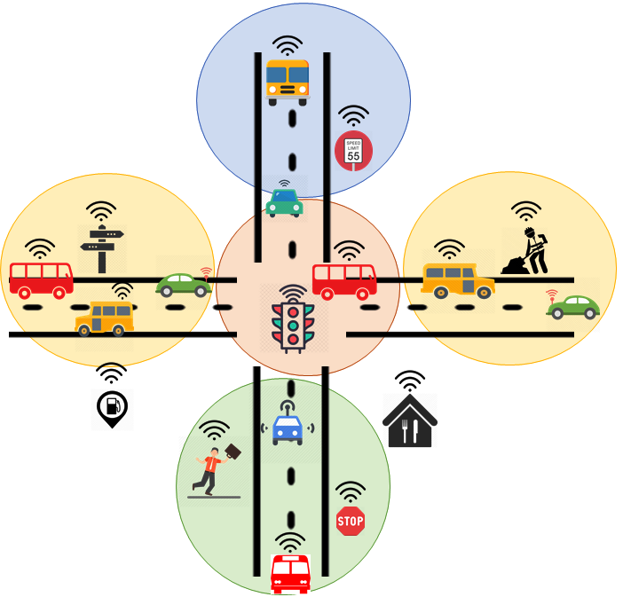

Location Groups
Categorizing wide locations into smaller groups.
Vehicles dynamically become member based on current GPS, vehicle-type or individual user preferences.
Ensure relevance of alerts and notifications

Slide 6

Attributes and Alerts
Speed Limit: 50 mph
Deer Threat: ON
Ice on Road: NO
Speed Limit: 30 mph
Flood Warning: ON
Road Work: ON
Speed Limit: 20 mph
School Zone: ON
Amber Alert: ABC123
Vehicles move and are assigned to different groups and inherit their attributes/alerts.

Slide 7







Using Location Groups
Administrative Questions:
How the attributes or alerts of groups are updated?
How are moving entities assigned to groups?
How groups hierarchy is created?
Operational Questions:
How attributes and groups are used to provide security?
How user privacy preferences are considered?
Speed Limit: 50 mph
Deer Threat: ON
Ice on Road: NO
Speed Limit: 30 mph
Flood Warning: ON
Road Work: ON
Reported MQTT message
Notes:
How to realize dynamic location groups and how it works?

Slide 8
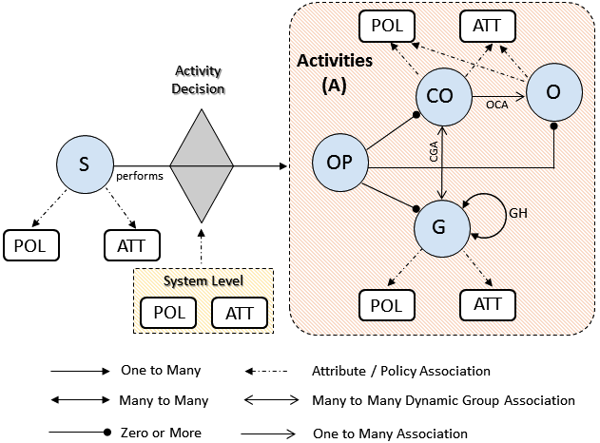

CV-ABAC_{G} Model

Slide 9

Model Components
user, sensor, car, mechanic, restaurant
{ location, size, IP, direction, speed, VIN, cuisine-type}

Slide 10
Model Components
{ read, write, control, notify, administrative actions }

Slide 11

Model Components
Cars, traffic lights, smart-devices
Sensor, ECU,
on-board apps
Location groups, service-specific, vehicle-type

Slide 12

Model Components
Operational and Administrative Activities
{notification, alerts, group hierarchy updates}
System Wide Policies
Individualized Privacy Policies

Slide 13
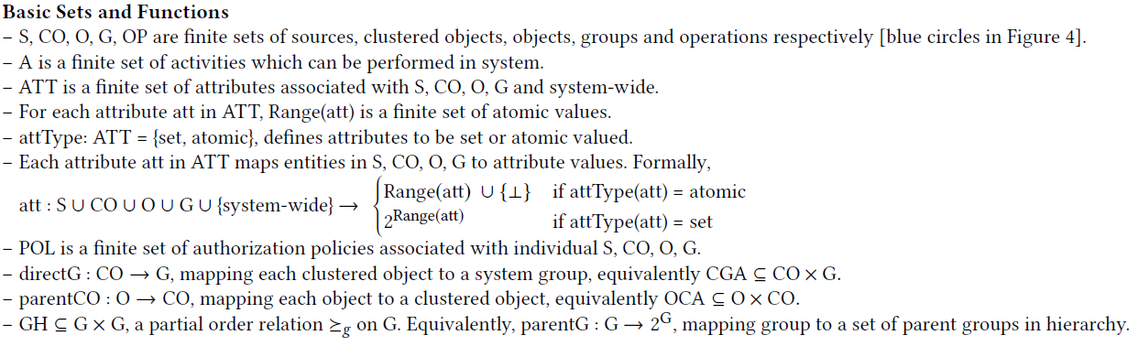

Formal Specification
Attribute Function
Attribute Type
Group Hierarchy
Attribute Mapping

Slide 14
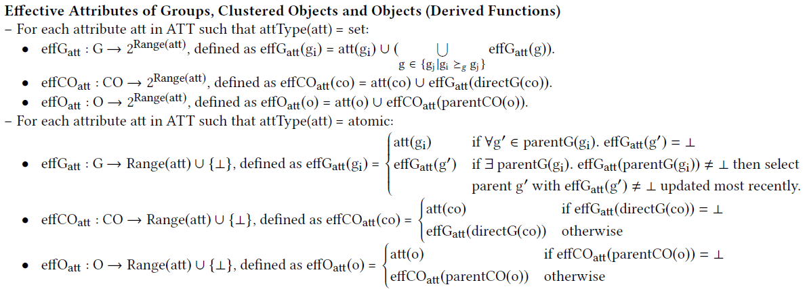

Formal Specification
Attributes more Dynamic
Attributes Inheritance

Slide 15
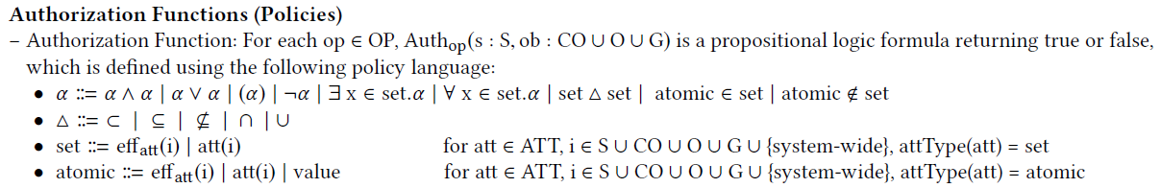

Policy Language
Administrators in the police department can send alert to location-groups in city limits.
Auth_{alert}(u:U, g:G) :: dept (u) Police ʌ parent-city(g) = Austin ʌ
Austin $∈jursidiction \left(u\right).$
Only mechanic in the technician department from Toyota-X dealership must be able to read sensor in Camry LE. Further, this operation must be done between time 9 am to 6 pm.
Auth_{read}(u:U, co:CO) :: role (u) Technician ʌ employer(u) = Toyota-X ʌ
make (co) = Toyota ʌ model(co) = Camry LE ʌ
operation_time(u) $∈$ {9am,10,11…6pm}

Slide 16
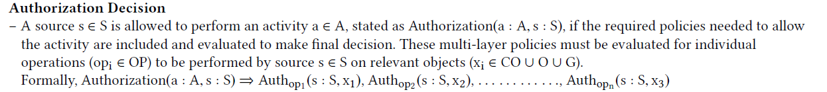

Activity Authorization Decision
Evaluate all relevant policies to make a decision
A restaurant in group A must be allowed to send notifications to all vehicles in location group A and group B.
System defined
DECISION
I only want notifications from Cheesecake factory.
User Preference

Slide 17
Implementation in
Amazon Web Services (AWS)

Slide 18
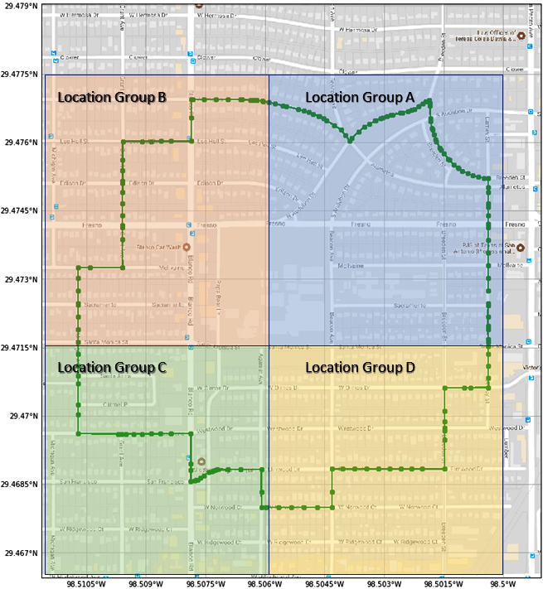
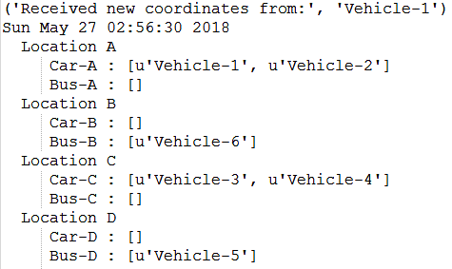

Vehicles and Groups
4 Location Groups
(static demarcation)
Vehicles movement
(coordinates generated using Google API)
Snapshot (table keeps changing)

Slide 19

Implemented Policies
Administrative Policy
  Road side motion sensor with [id = 1] and current GPS in group [Location-A] can only [modify] attribute [Deer Threat] to value [ON, OFF] for group [Location-A].
Operational Policy
Restaurant Notification Use Case
System Defined Policy
A restaurant located within group [Location-A] can only [send notifications] to members of groups [Location-A, Location-B].
User Preferences
Send notifications only between [7 pm to 9 pm] only on [Wednesdays].

Slide 20

Performance Metrics
 | CARS NOTIFIED
n^{th} Request | With ABAC Policy | Without Policy
41st | 2 | 5
42nd | 3 | 5
43rd | 5 | 5
44th | 3 | 5
45th | 2 | 5
46th | 3 | 5
Number of Requests | Policy Enforcer Execution Time (in ms)
10 | 0.0501
20 | 0.1011
30 | 0.1264
40 | 0.1630
50 | 0.1999
Policy Enforcement Time
Relevance of Alerts and Notifications

Slide 21
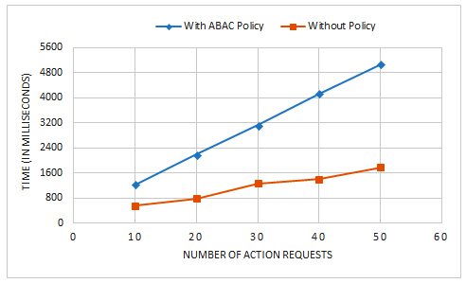
Performance Metrics
Comparing Policy vs No Policy Execution Time

Slide 22

Conclusion and Future Work
Proposed an Attribute Based Access Control solution for cloud assisted Smart Cars.
  Introduced Dynamic Groups
  Supports User Privacy Preferences and Location Centric
  Proof of Concept implementation in AWS
    Future Research
      Extensive and detailed evaluation
      V2V and V2I secure trusted communication using Edge
      Location preserving approaches

