Slide 1
CS 6393: Cyber Security Models and Systems
Views of Cloud Computing
Ravi Sandhu
L6-1
© Ravi Sandhu
World-Leading Research with Real-World Impact!

Slide 2
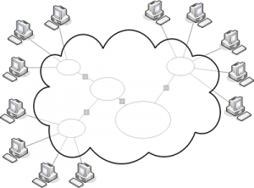
The Cloud
The Cloud is the Computer
- IEEE Spectrum, 2008
The Network is the Computer
- Sun Microsystems, early 1990s
Datacenter as a Computer
- Barroso and Hölzle, 2009
© Ravi Sandhu
World-Leading Research with Real-World Impact!
2

Slide 3
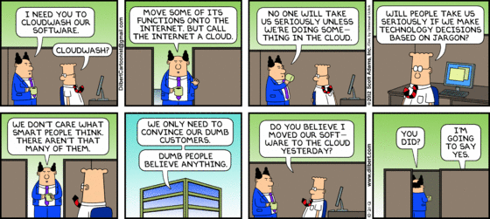
Cloudwashing
© Ravi Sandhu
World-Leading Research with Real-World Impact!
3

Slide 4
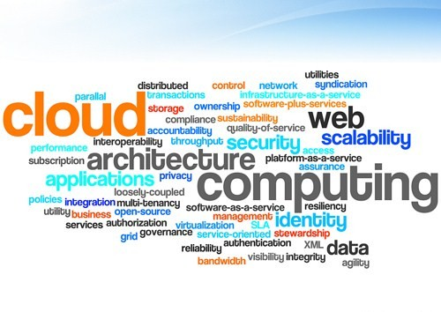
The Cloud: Perspectives and Forces
Science
Business
Engineering
© Ravi Sandhu
World-Leading Research with Real-World Impact!
4

Slide 5
NIST Cloud Computing 3-4-5 Definition
5 Essential Characteristics
2009-2011
16 versions
3 Service Models
4 Deployment Models
© Ravi Sandhu
World-Leading Research with Real-World Impact!
5

Slide 6
NIST Cloud Computing 3-4-5 Definition
5 Essential Characteristics
2009-2011
16 versions
3 Service Models
4 Deployment Models
Software as a Service (SaaS)
Platform as a Service (PaaS)
Infrastructure as a Service (IaaS)
© Ravi Sandhu
World-Leading Research with Real-World Impact!
6

Slide 7
NIST Cloud Computing 3-4-5 Definition
5 Essential Characteristics
2009-2011
16 versions
3 Service Models
4 Deployment Models
Software as a Service (SaaS)
Platform as a Service (PaaS)
Infrastructure as a Service (IaaS)
Public
Private
Community
Hybrid
© Ravi Sandhu
World-Leading Research with Real-World Impact!
7

Slide 8
NIST Cloud Computing 3-4-5 Definition
5 Essential Characteristics
On-demand self service
Broad network access
Resource pooling (multi-tenant)
Rapid elasticity
Measured service
2009-2011
16 versions
3 Service Models
4 Deployment Models
Software as a Service (SaaS)
Platform as a Service (PaaS)
Infrastructure as a Service (IaaS)
Public
Private
Community
Hybrid
© Ravi Sandhu
World-Leading Research with Real-World Impact!
8

Slide 9
NIST Cloud Computing 3-4-5 Definition
5 Essential Characteristics
On-demand self service
Broad network access
Resource pooling (multi-tenant)
Rapid elasticity
Measured service
Other Common Characteristics
2009-2011
16 versions
Geographic distribution
Homogeneity
Resilience
Massive scale
Virtualization
Security
3 Service Models
4 Deployment Models
Software as a Service (SaaS)
Platform as a Service (PaaS)
Infrastructure as a Service (IaaS)
Public
Private
Community
Hybrid
© Ravi Sandhu
World-Leading Research with Real-World Impact!
9

Slide 10
Cloud and Grid: Foster et al 2008
“We argue that Cloud Computing not only overlaps with Grid Computing, it is indeed evolved out of Grid Computing and relies on Grid Computing as its backbone and infrastructure support.”
I don’t think so
© Ravi Sandhu
World-Leading Research with Real-World Impact!
10

Slide 11
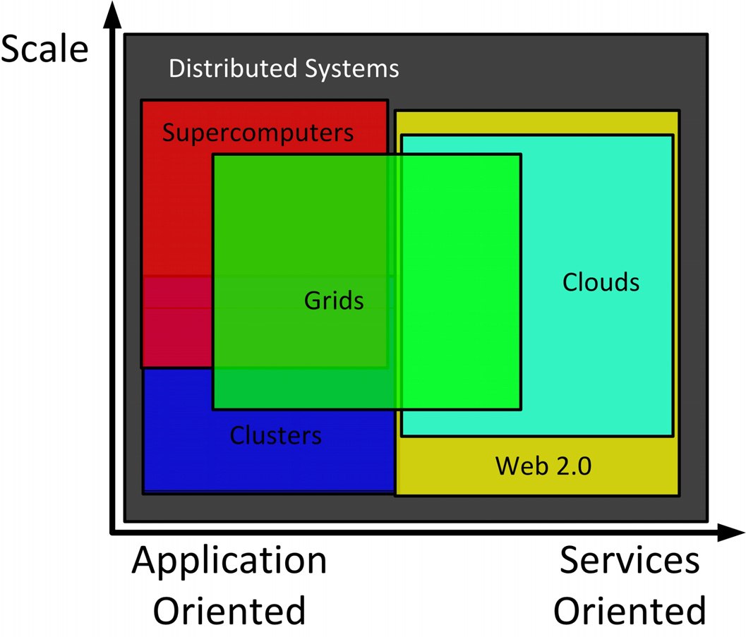
Cloud and Grid: Foster et al 2008
© Ravi Sandhu
World-Leading Research with Real-World Impact!
11

Slide 12
Grid 3 Point Checklist: Foster 2002
Coordinates resources that are not subject to centralized control
  Virtual Organization (VO)
Uses standard, open, general-purpose protocols and interfaces
  Globus toolkit
Delivers non-trivial qualities of service
© Ravi Sandhu
World-Leading Research with Real-World Impact!
12

Slide 13
Grid versus Cloud
Coordinates resources that are not subject to centralized control
  Virtual Organization (VO)
Uses standard, open, general-purpose protocols and interfaces
  Globus toolkit
Delivers non-trivial qualities of service
Grid
No but VOs may be enabled on demand
No but standard opensource software and APIs may emerge
(OpenStack is the current contender)
Yes
On-demand self service
Broad network access
Resource pooling (multi-tenant)
Rapid elasticity
Measured service
Geographic distribution
Homogeneity
Resilience
Massive scale
Virtualization
Security
Cloud
© Ravi Sandhu
World-Leading Research with Real-World Impact!
13

Slide 14
Grid versus Cloud Drivers
Cloud
Grid
Commercially developed
Little or no academic input
Pay-per-use
Payment driven
Centrally owned hardware
Centrally scheduled
Single point of trust
Simple security
Interactive
Commodity computing
Small and medium businesses
Virtualization essential
Not so predictable performance
DoD funded, no commercial traction
Mainly academic driven
Pay-per-seat (one-time payment)
Project oriented, proposal driven
Multiply owned hardware
Distributed scheduling
Multiple trust points
Complex PKI based security
Batch
High performance computing
High end organizations
Virtualization often not used
Predictable performance
© Ravi Sandhu
World-Leading Research with Real-World Impact!
14

Slide 15
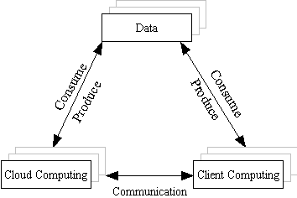
Cloud and Grid: Foster et al 2008
The triangle model of next-generation Internet Computing
© Ravi Sandhu
World-Leading Research with Real-World Impact!
15

Slide 16
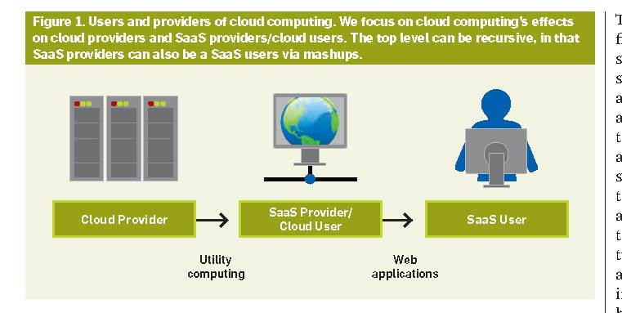
Berkeley View of Cloud: 2010
© Ravi Sandhu
World-Leading Research with Real-World Impact!
16

Slide 17
Berkeley View of Cloud: 2010
Not IaaS or PaaS but classes of utility computing
SalesForce
force.com
Google
AppEngine
Microsoft
Azure
Amazon
EC2
Abstraction
Level
Application
Specificity
© Ravi Sandhu
World-Leading Research with Real-World Impact!
17

Slide 18
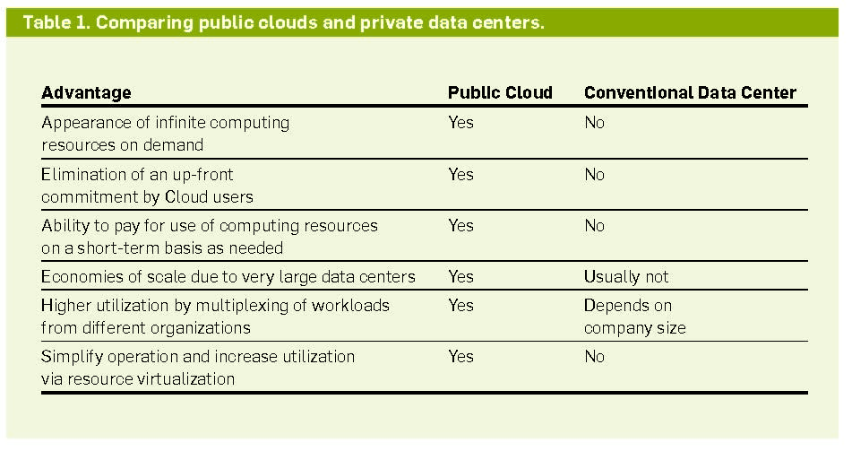
Berkeley View of Cloud: 2010
© Ravi Sandhu
World-Leading Research with Real-World Impact!
18

Slide 19
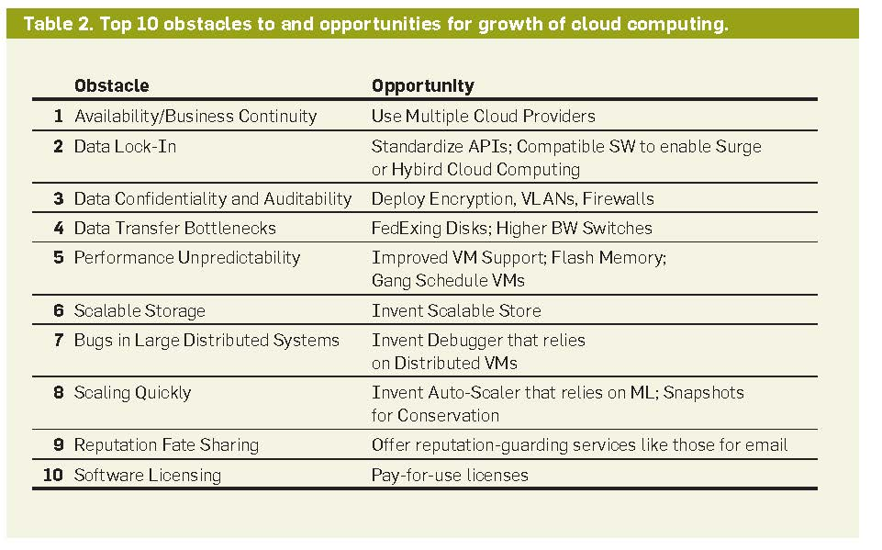
Berkeley View of Cloud: 2010
© Ravi Sandhu
World-Leading Research with Real-World Impact!
19

Slide 20
Cyber Security:
What is Different in the Cloud?
Threats
Risk =
f (Threats, Vulnerabilities, Impact)
Vulnerabilities
Impact
© Ravi Sandhu
World-Leading Research with Real-World Impact!
20

Slide 21
Cyber Security:
What is Different in the Cloud?
Multi-Tenancy
Security
and
Privacy
Compliance and Forensics
Cloud Service Provider
© Ravi Sandhu
World-Leading Research with Real-World Impact!
21

