Slide 1

Access Control for Software Defined Networks:
(SDN-RBAC Model)
Lecture 9-2

Slide 2
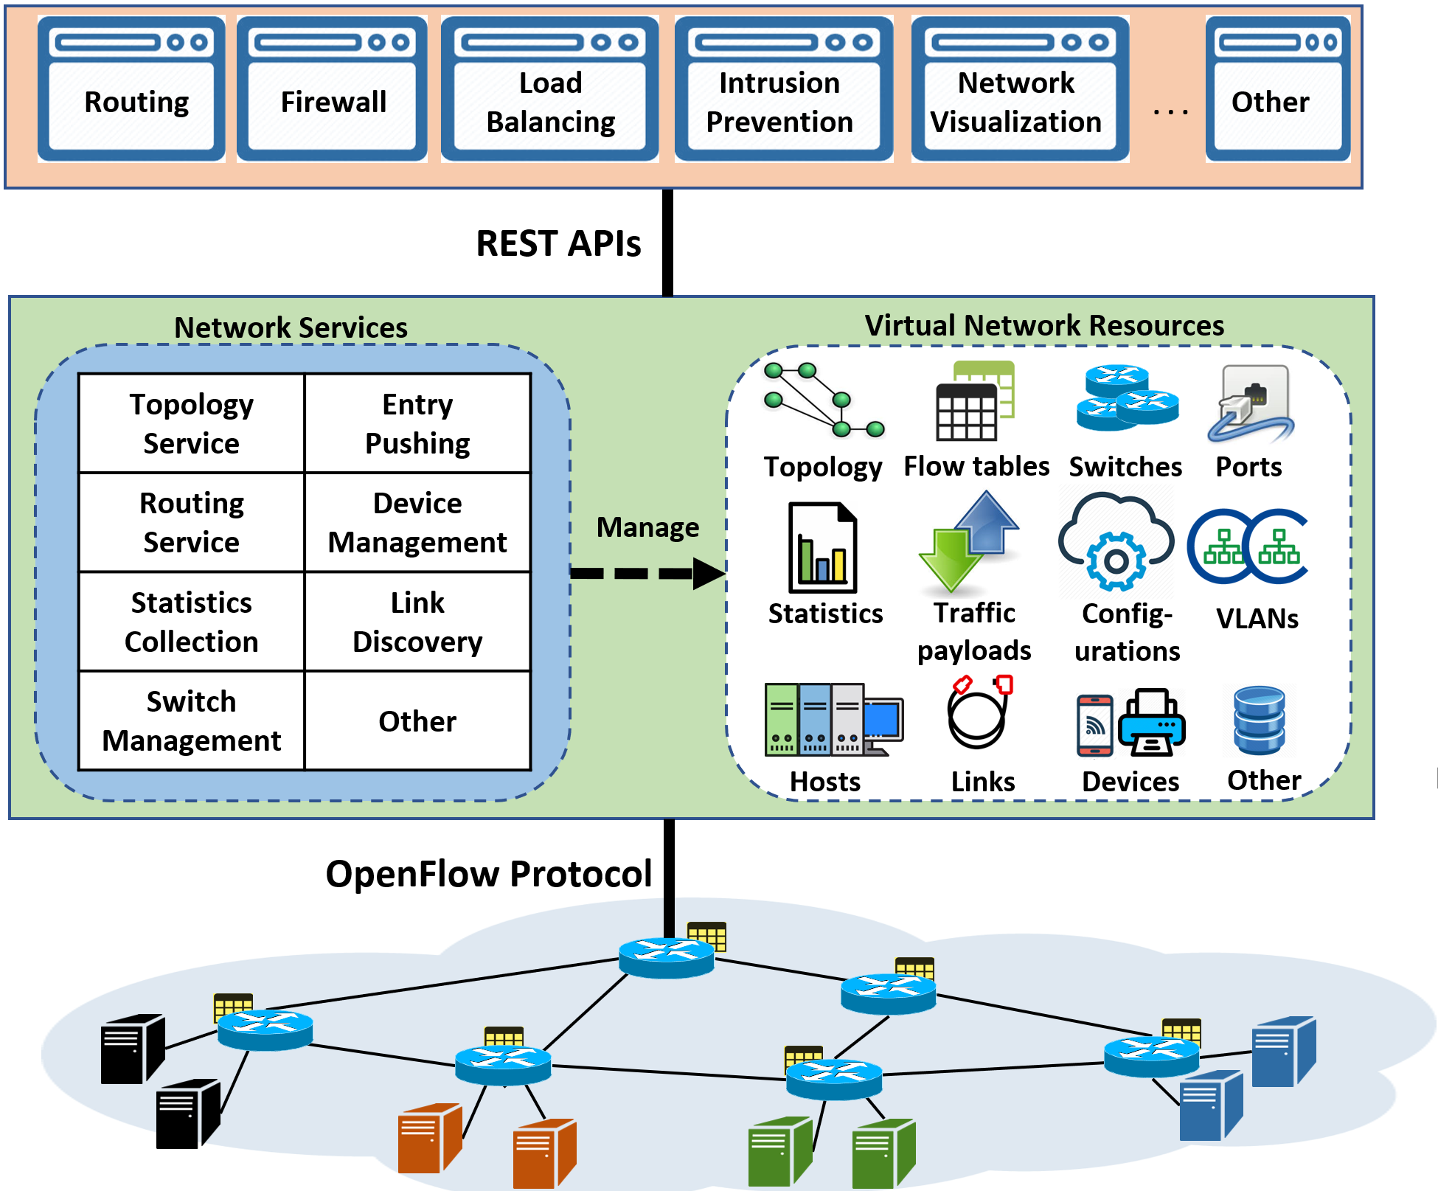

Access Control in SDN
Control which
subjects (network apps) can access which
objects (virtual network resources) for performing which
actions (SDN operations).
Open Interface: needs control

Slide 3
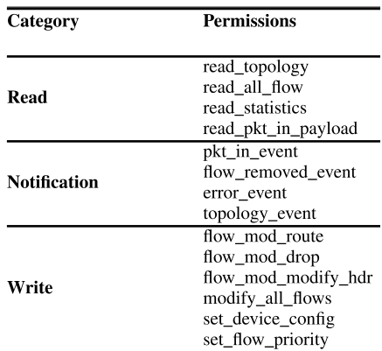

Access Control with capability-based approaches
Capability-based approaches
  Direct relation between operations and apps.
  Well studied and known to have administrative complexities.
P₁ =
P₂ =
P₃ =
P₄ =
P₅ =
P₆ =
P₇ =
P₈ =
P₉ =
P₁₀ =
P₁₁ =
P₁₂ =
P₁₃ =
P₁₄ =
Network apps
Permissions
P1
App1
P2
App2
P3
App3
P4
P5
P6
Total associations =3 x 6 = 18
Ahmad, Ijaz, Suneth Namal, Mika Ylianttila, and Andrei Gurtov. "Security in software defined networks: A survey." IEEE Communications Surveys & Tutorials 17, no. 4 (2015): 2317-2346.

Slide 4
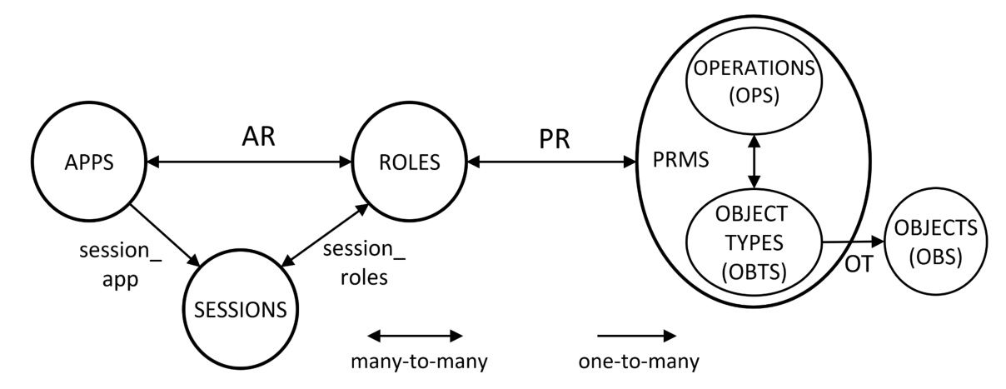

SDN-RBAC Conceptual Model
Al-Alaj, Abdullah, Ram Krishnan, and Ravi Sandhu. "SDN-RBAC: An Access Control Model for SDN Controller Applications." 2019 4th International Conference on Computing, Communications and Security (ICCCS). IEEE, 2019.

Slide 5
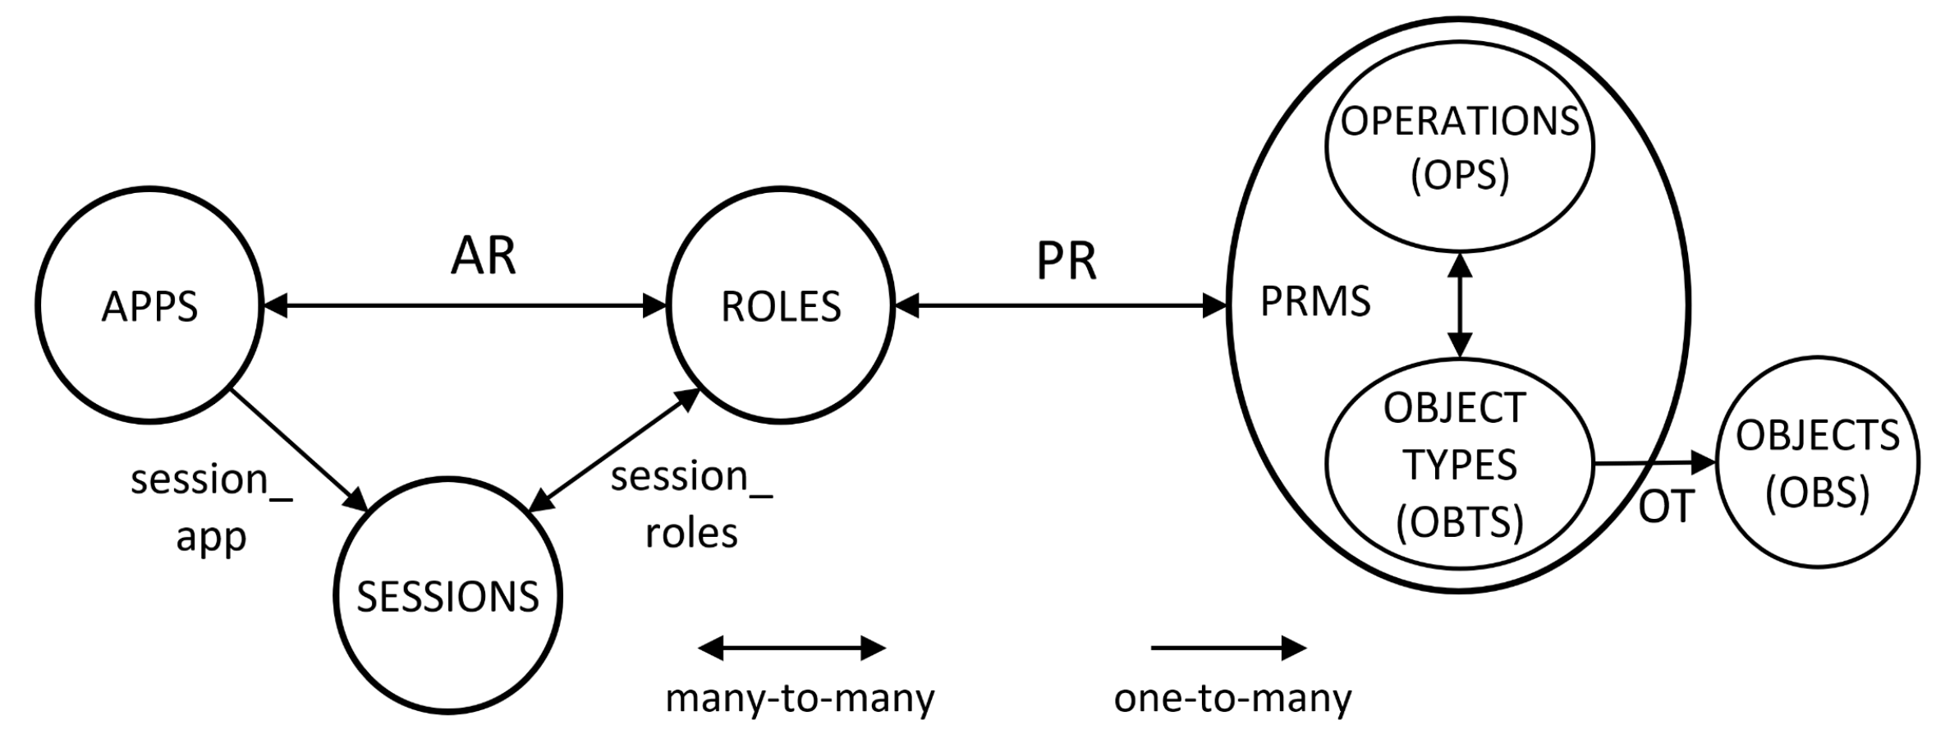
SDN-RBAC: Conceptual Model
Role examples:
Routing
Flow Mod
Device Handler
Bandwidth Monitoring
Link Handler
etc.
Operation examples:
Get Port BW Statistics
Insert Flow to Switch
get All Devices
etc.
App examples:
Routing app
Load Balancing
Topology Visualizer
Network Debugger
etc.
Session examples
deep packet inspection session
transmission rate monitoring session
web-traffic filtering session
shortest path precomputation session
traffic redirection session
etc
Object Type example:
PORT
FLOW-RULE
LINK
DEVICE
PORT-STATS
etc.
Al-Alaj, Abdullah, Ram Krishnan, and Ravi Sandhu. "SDN-RBAC: An Access Control Model for SDN Controller Applications." 2019 4th International Conference on Computing, Communications and Security (ICCCS). IEEE, 2019.

Slide 6
SDN Apps and Sessions
Users has no direct control of running controller apps.
SDN apps usually perform several networking tasks.
Apps could be compromised, buggy, or malicious.
If executed in one session this means:
  Higher exposure to the network attack surface.
Proposed solution: cooperation of multiple sessions to perform all tasks of a complete SDN app.
  Tasks can run sequentially or concurrently.
Goal: minimize or avoid damage caused by one session.

Slide 7
RBAC Sessions for SDN apps:
A motivation
The concept of a session has several motivations:
supports of least privilege principle:
  delay the activation of roles currently unused in a session until they really required.
Delaying the creation of session itself until it is really required.
Goal: Reduce the amount of permissions available to an app at a given time.
  reduces the amount of resources accessible by these operations.
  reduces exposure to network attack surface.

Slide 8
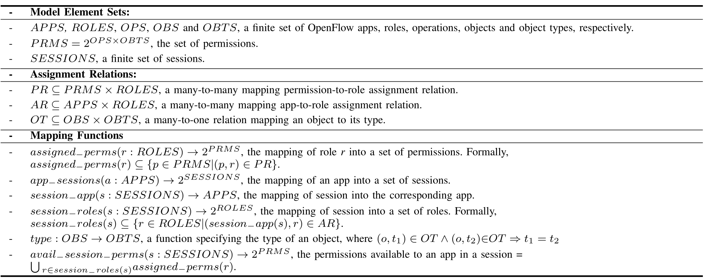

SDN-RBAC: Formal Definitions
Basic Element Sets
Assignment Relations
Mapping Functions
Very Important in Implementing checkAccess system function.
Al-Alaj, Abdullah, Ram Krishnan, and Ravi Sandhu. "SDN-RBAC: An Access Control Model for SDN Controller Applications." 2019 4th International Conference on Computing, Communications and Security (ICCCS). IEEE, 2019.

Slide 9
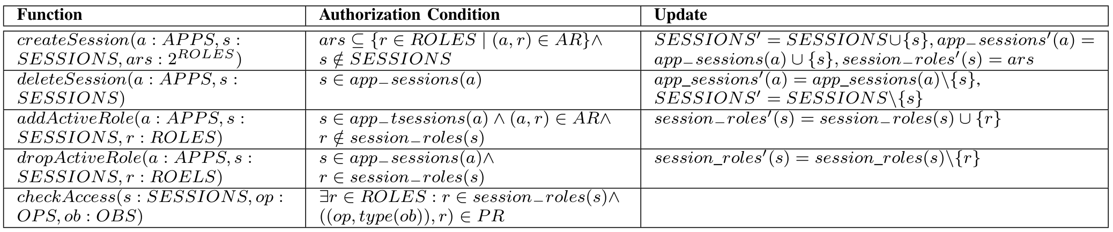
SDN-RBAC: Specifications of System Functions
Session Creation/Deletion
Adding/Dropping Active Role
Access Check
Apps are authorized based on object type.
Al-Alaj, Abdullah, Ram Krishnan, and Ravi Sandhu. "SDN-RBAC: An Access Control Model for SDN Controller Applications." 2019 4th International Conference on Computing, Communications and Security (ICCCS). IEEE, 2019.

Slide 10
Sessions in SDN-RBAC
Two types:
  Atomic network sessions.
      Self-contained task definition.
  Dependent network sessions.
      Inter-session dependency.
      Conduct inter-session interaction at runtime.

Slide 11
1. Atomic Sessions
Has self-contained task definition.
Not dependent on other session instances.
  a session that is not described in terms of other sessions
  has no interaction with other session instances.
Atomic sessions can have an independent existence and run sequentially or simultaneously without reference to each other.

Slide 12

2. Dependent Network Sessions
Sessions has inter-session dependency.
Conduct inter-session interaction at runtime.
The execution of one session affects another one.
Inter-session dependency initiates the need for:
  methods for inter-session interaction.
  conditions for session creation/deletion.
  nomination of session’s active role set.
  adding/dropping an active role.

Slide 13
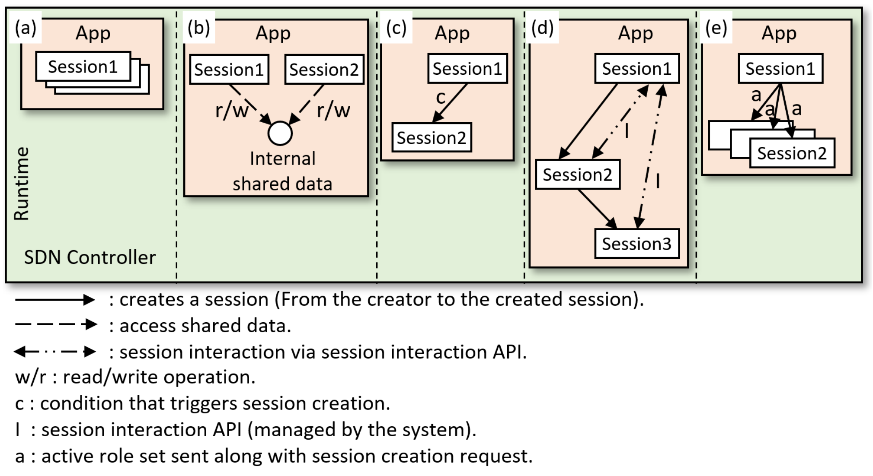
Methods for Inter-session Interaction for SDN-RBAC
Atomic sessions
Two sessions access shared data
Conditional session creation
Interaction via inter-session interaction APIs
Active role set sent from master to slave sessions
Al-Alaj, Abdullah, Ram Krishnan, and Ravi Sandhu. "SDN-RBAC: An Access Control Model for SDN Controller Applications." 2019 4th International Conference on Computing, Communications and Security (ICCCS). IEEE, 2019.

Slide 14

Session Handling Approaches
Who is responsible of specifying:
    (T) the tasks and corresponding sessions.
    (C) the condition for session creation/deletion.
    (A) the active role set.
    (R) role to be added/dropped during execution.
Session Handling Approaches
Developer-driven Approach
System-driven Approach
Session-driven Approach
    (T) DD
    (C) DD
    (A) DD
    (R) DD
    (T) CR
    (C) CR
    (A) CR
    (R) CR
    (T) DD
    (C) SR
    (A) SR
    (R) SR
DD = determined by Developer at Design-time.
CR = determined by Controller at Run-time.
SR = determined by Session at Run-time.

Slide 15
Developer-driven Session Handling (1)
The developer specifies at design time different session handling aspects:
[T] task that will be achieved by each session.
  Programmed by the developer at design time.
[C] condition (or precondition) under which a particular session may be created/deleted
  Condition is hard coded in the application.
  Examples of session creation conditions include:
    exceeding a bandwidth consumption cap,
    new device detected,
    at system start-up
[A] active role set that should be activated during session creation
  Example: ars = {“Packet-in Handler”, “Flow Mod”} for a one-hour deep packet inspection session that will temporarily inspect traffic payload incoming from black-listed hosts.
[R] adding or dropping an active role for a session
  Example: add role “Device Hander” to a transmission rate monitoring session.
    (T) DD
    (C) DD
    (A) DD
    (R) DD

Slide 16

Developer-driven Session Handling (2) - Example
App: Data Usage Cap Mngr.
Data Usage Analysis Session
Host exceeded bandwidth consumption cap.
Data Cap Enforcing session

Slide 17
System-driven Session Handling
(1)
Controller has full control on session handling.
The developer only provides the set of roles required by the app
Developer has no discretion on determining any of other sessions’ properties at runtime.
Controller should be shipped with adequate capabilities to specify at runtime what session instances will be created and how to handle them.
Given an app and the set of roles required by the app, the controller should figure out:
  each task that might execute in a separate session
  set of roles required for each session.
This approach is challenging and the hardest to implement.
    (T) CR
    (C) CR
    (A) CR
    (R) CR

Slide 18
System-driven Session Handling
(2)
The controller should specify dynamically at runtime the various properties:
[T] The set of tasks required to achieve the entire app’s functionality.
[C] the condition under which a particular session instance may be created/deleted.
  Examples : after attack detected, completion of another session, change of risk value, etc.
  Developer doesn’t know why a particular session could be created/terminated.
  The criteria for creating a session could be computed dynamically by the controller or configured by the administrator at runtime.
[A] active role set that should be activated during session creation.
  Example: ars = {“Routing”, “Link Handler”} for a session that recomputes shortest path after a new link discovery.
[R] adding or dropping an active role for a session.
    (T) CR
    (C) CR
    (A) CR
    (R) CR

Slide 19
System-driven Session Handling
(3)
App: Network Intrusion Prevention
Statistical analysis session
anomaly detected
anomaly detected
anomaly detected
Blocking offending hosts session
Server isolation session.
Connections reset session

Slide 20

Session-driven Approach
(1)
Inter-session interaction should be conducted via a well-defined set of session interaction APIs.
The app developer should comply to these APIs during app design.
Inter-session interaction APIs allow sessions to
  Prob for information from other sessions, for example :
    getting names of current active sessions.
    getting active role set of a session.
    getting session’s status. (e.g., idle time, up time, etc).
  Passing information and notifications between sessions. e.g., results of calculations.
These sessions are smart.
  take decisions based on the result of communications via inter-session interaction APIs.
  adjust its behavior to take knowledgeable decisions on future session interaction API calls and on different session handling aspects.
    (T) DD
    (C) SR
    (A) SR
    (R) SR

Slide 21
Session-driven Approach
(2)
Sessions adjust its behavior to take knowledgeable decisions on future session interaction API calls and on the following session handling aspects:
[T] task that will be achieved by each session.
  Programmed by the developer at design time.
  The app developer should comply to session interaction APIs during app design.
[C] condition under which a particular session instance may be created/deleted
  Example: start traffic redirection session after an alarm is fired by packet inspection session.
[A] active role set that should be activated during session creation
  Example: ars = {“Packet-in Handler”, “Flow Mod”} role for a deep packet inspection session if web-traffic filtering session detected malicious payloads.
[R] adding or dropping an active role for a session.
    (T) DD
    (C) SR
    (A) SR
    (R) SR

Slide 22
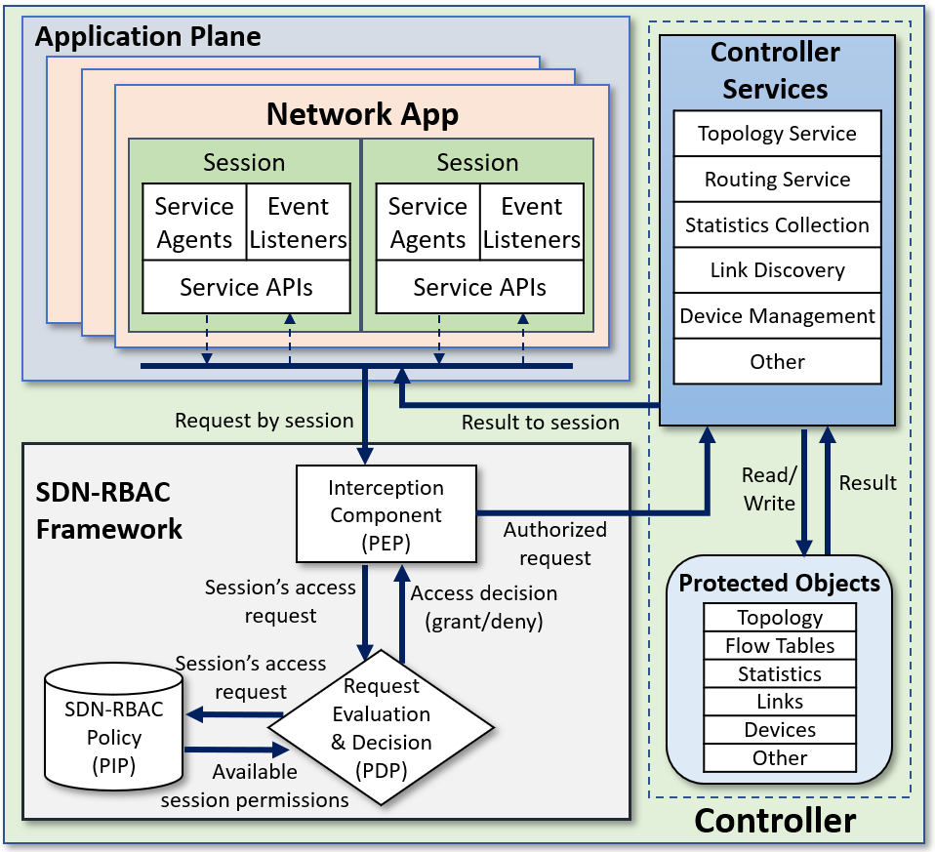

SDN-RBAC Framework Architecture
AspectJ Hooking
Al-Alaj, Abdullah, Ram Krishnan, and Ravi Sandhu. "SDN-RBAC: An Access Control Model for SDN Controller Applications." 2019 4th International Conference on Computing, Communications and Security (ICCCS). IEEE, 2019.

Slide 23
SDN-RBAC Model Characteristics
SDN-RBAC model and implementation promotes SDN authorization system by:
  Covering northbound and southbound interfaces.
  Defining sufficient roles.
  Supporting Many-to-Many app-to-role and permission-to-role relations.
  The use of sessions.
  The use of expressive roles compliant with various network functions – helps in creating expressive security policy.

Slide 24
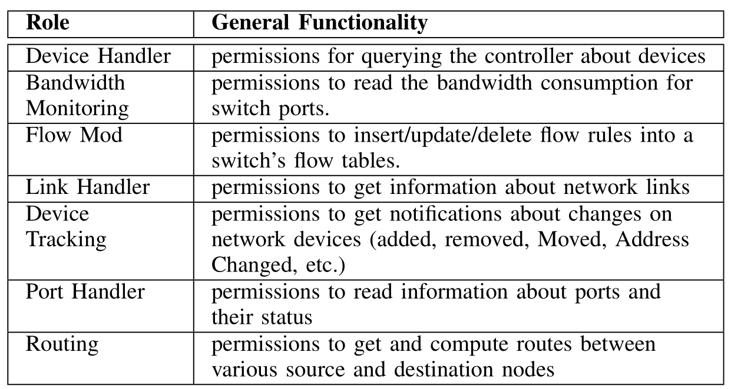

Selected roles in SDN-RBAC
Al-Alaj, Abdullah, Ram Krishnan, and Ravi Sandhu. "SDN-RBAC: An Access Control Model for SDN Controller Applications." 2019 4th International Conference on Computing, Communications and Security (ICCCS). IEEE, 2019.

Slide 25

SDN-RBAC Configuration Example
PRMS
(OPS , OBTS)
(Read topology, TOPOLOGY)
(Receive updates, TOPOLOGY)
(getRoute, TOPOLOGY)
(route Exists, TOPOLOGY)
Roles
(addFlow, FLOW-TABLE)
(deleteFlow, FLOW-TABLE)
Apps
(deleteFlowsForSwitch, FLOW-TABLE)
(getFlows, FLOW-TABLE)
Topology Viewer
(read Packet, PACKET-IN)
Routing
(get Device, DEVICE)
Flow Mod
(getAllDevices, DEVICE)
Load Balancer
Device Handler
(queryDevice, DEVICE)
(listPools, LB-POOL)
Data Usage Manager
Pool Manager
(createPool, LB-POOL)
…
Bandwidth
Monitoring
(updatePool, LB-POOL)
…
(removePool, LB-POOL)
(listMembers, LB-POOL-MEMBER)
(listMembersByPool, LB-POOL-MEMBER)
(createMember, LB-POOL-MEMBER)
Capability-based approaches
(updateMember, LB-POOL-MEMBER)
Using roles
(removeMember, LB-POOL-MEMBER)
P1
P1
(createVip, LB-VIP)
App1
P2
App1
P2
(updateVip, LB-VIP)
App2
P3
App2
Role
P3
(removeVip, LB-VIP)
App3
P4
App3
P4
P5
P5
(listVips, VIP-LIST)
P6
…
P6
(getBandwidthConsumption, PORT-STATS)
Total associations =3 x 6 = 18
Total associations = 3 + 6 = 9

Slide 26
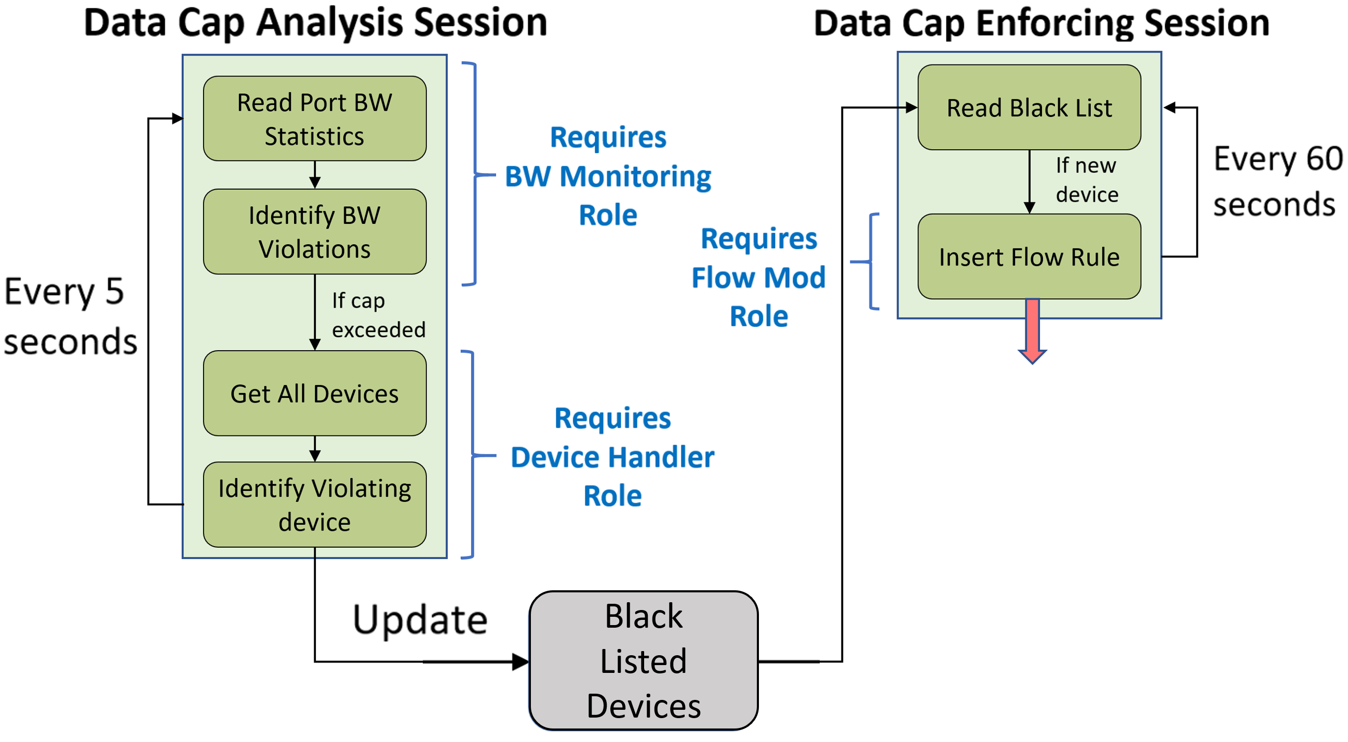

Access control use case
Data Usage Cap Manager - Multi-session App

Slide 27
Data Usage Cap Manager
Use-case app
App developed in Floodlight: DataUsageCapMngr.
Session1: DataUsageAnalysisSession:
  probes for port bandwidth statistics on a regular basis (every 5 seconds). After reading the bandwidth consumption for switch ports and analyzing the data to find cap limit violations, it stores the list of hosts who has exceeded the cap limit into a list ‘usageCapBlackList’ managed by the system.
  Required roles: “Device Handler” and “Bandwidth Monitoring”.
Session2: DataCapEnforcingSession:
  checks periodically (every 60 seconds) for black-listed hosts stored in ‘usageCapBlackList’.
  inserts flow rules to isolate violating hosts from the network.
  Required roles: “Flow Mod”.
SDN-RBAC authorization system:
  mediates all sessions access requests.
  identifies each session,
  sends sessions request for authorization check.
  allows or blocks the request based on PDP response.

Slide 28
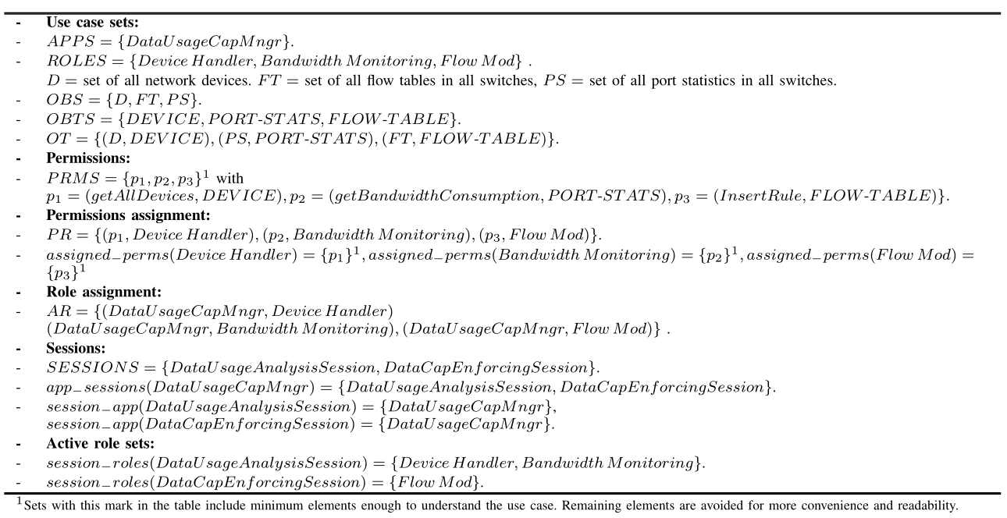

Use Case: Configuration in SDN-RBAC
.
3 roles
2 sessions
2 sessions
2 roles
1 role
Al-Alaj, Abdullah, Ram Krishnan, and Ravi Sandhu. "SDN-RBAC: An Access Control Model for SDN Controller Applications." 2019 4th International Conference on Computing, Communications and Security (ICCCS). IEEE, 2019.

Slide 29
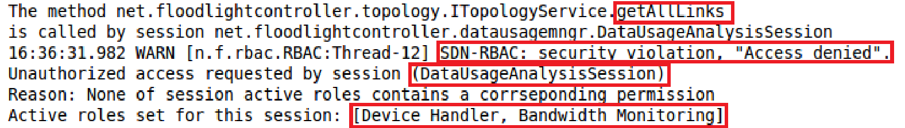

Usability demonstration (1)
Access Denies
To show that SDN-RBAC authorization system can identify and reject any unauthorized operations:
We forced DataUsageAnalysisSession to read link information via operation getAllLinks.
The permission (getAllLinks, LINK) is assigned to the role LinkHandler.
Role LinkHandler is not a member of the active role set of DataUsageAnalysisSession.
A snapshot of the execution result is shown below.
Unauthorized
Snapshot1

Slide 30
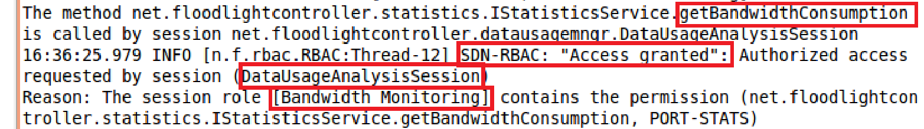

Usability demonstration (2)
Access Allowed
We forced DataUsageAnalysisSession to read device statistics via operation getBandwidthConsumption.
The permission (getBandwidthConsumption, PORT-STATS) is assigned to the role BandwidthMonitoring.
Role BandwidthMonitoring is a member of the active role set of DataUsageAnalysisSession.
A snapshot of the execution result is shown below.
The snapshot below shows how DataUsageAnalysisSession was able to pass the authorization.
Authorized
Snapshot2

Slide 31
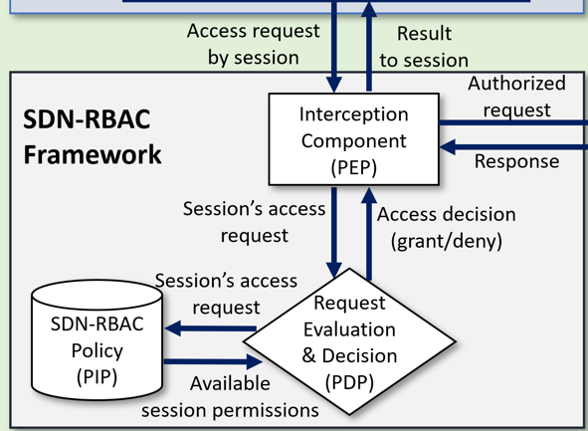

SDN-RBAC Average Authorization Time
Timer Started
Timer Ended
Average execution time required by SDN-RBAC components to check for authorization of 50 operations with varying number of roles.
On average: 0.031 ms overhead for 50 operations.
Al-Alaj, Abdullah, Ram Krishnan, and Ravi Sandhu. "SDN-RBAC: An Access Control Model for SDN Controller Applications." 2019 4th International Conference on Computing, Communications and Security (ICCCS). IEEE, 2019.
Notes:
For each security policy, the session executes all fifty operations. The system is set to find the time required by all SDN-RBAC components to finish execution and make an access control decision for each operation submitted by the session. The timer starts at the beginning of the Policy Enforcement Point (PEP) and stops when Policy Decision Point (PDP) finishes execution. The total time is calculated for all fifty operations. We repeated this test hundred times for each security policy. The average elapsed time for authorizing fifty operations is reported as shown in Fig. 4.6. It should be noted here that execution times does not include floodlight’s boot-up time, loading AspectJ libraries, the time for loading the SDN-RBAC policy, and creating the corresponding relations.
This evaluation of SDN-RBAC shows that SDN-RBAC adds on average 0.031 millisecond overhead on the performance of Floodlight controller to execute fifty network operations. Authorization overhead is inevitable in SDN-RBAC. Therefore, we believe that SDN-RBAC introduces acceptable performance overheads.

Slide 32
References
Al-Alaj, Abdullah, Ram Krishnan, and Ravi Sandhu. "SDN-RBAC: An Access Control Model for SDN Controller Applications." 2019 4th International Conference on Computing, Communications and Security (ICCCS). IEEE, 2019.

