Slide 1
Module 1.2 Cyber Security Objectives
CS 6393 and CS 4483
Cyber Security Foundations and Practice
Ravi Sandhu
Spring 2021

Slide 2
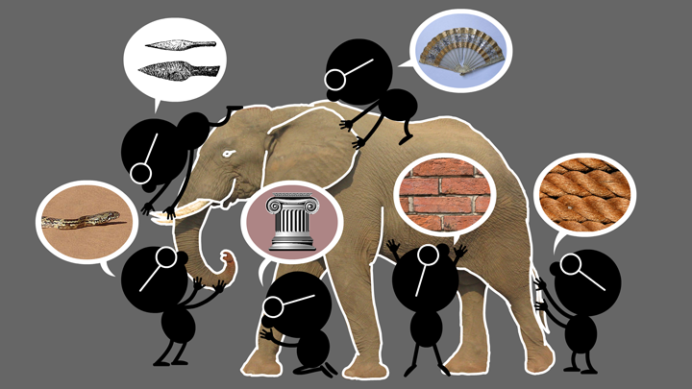
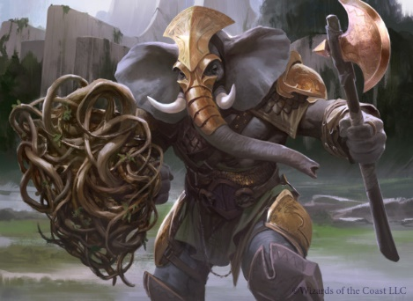
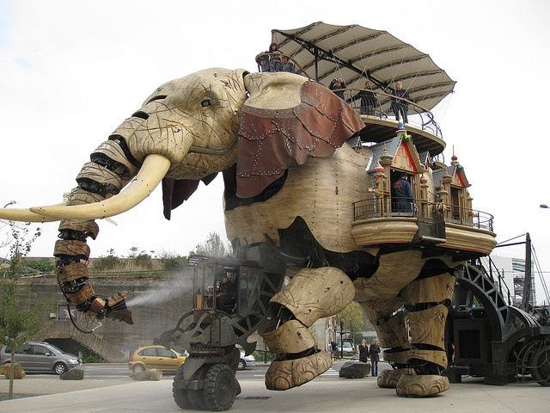

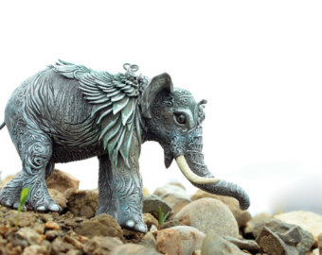
Natural vs Cyber Science
Elephant Problem
Cyber-Elephant Problem
Applied vs Foundational Science: Cyber-elephants require applied and foundational combined
Present vs Future Focus: Rapidly evolving cyber-elephants require future focus

Slide 3
Risk Triangle
Threats
RISK
Vulnerabilities
Assets

Slide 4
Security Objectives
Control of read and write is fundamental to all three
INTEGRITY
modification
AVAILABILITY
access
CONFIDENTIALITY
disclosure

Slide 5
Security Objectives
USAGE
purpose
Covers privacy and intellectual property protection
INTEGRITY
modification
AVAILABILITY
access
CONFIDENTIALITY
disclosure

Slide 6
Security Objectives
USAGE
purpose
USAGE
INTEGRITY
modification
AVAILABILITY
access
CONFIDENTIALITY
disclosure

Slide 7
Security Tradeoffs
USAGE
purpose
Evaluation of tradeoffs requires
application context
INTEGRITY
modification
AVAILABILITY
access
CONFIDENTIALITY
disclosure

Slide 8
Security Tradeoffs
Cost
CIAU
Convenience
Cannot have it all within CIAU
Need to reconcile with non-Security Objectives
Evaluation of tradeoffs requires application context
Growth
Safety

Slide 9
Risk Triangle
Threats
RISK
Vulnerabilities
Assets

