Slide 1

Module 1.5
Security Practice Stories and Lessons
CS 6393 and CS 4483
Cyber Security Foundations and Practice
Ravi Sandhu
Spring 2021

Slide 2
Low Assurance Systems
The ATM (Automatic Teller Machine) system is
  secure enough
  global in scope
Similarly
  on-line banking
  e-commerce payments

Slide 3
High Assurance Systems
US President’s nuclear football
Secret formula for Coca-Cola

Slide 4
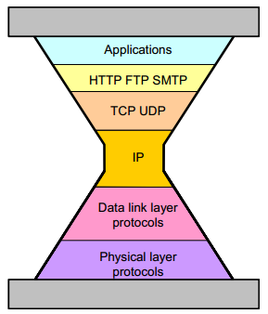
Internet Protocols
TCP RFC 793
Sept. 1981
IPv4 RFC 791
Sept. 1981

Slide 5
IP Spoofing Story
ALLOW GOOD GUYS IN
KEEP BAD GUYS OUT
IP Spoofing predicted in Bell Labs report ≈ 1985
Unencrypted Telnet with passwords in clear
1st Generation firewalls deployed ≈ 1992
IP Spoofing attacks proliferate in the wild ≈ 1993
Virtual Private Networks emerge ≈ late 1990’s
Vulnerability shifts to the client PC
Network Admission Control ≈ 2000’s
Persists as a Distributed Denial of Service mechanism
Most of these fixes have not changed or extended IPv4

Slide 6
The TCP/IP Lesson
Agility trumps perfection
Not quite the same as
Good enough trumps perfect
Agility =
Good enough for now
+
Future-proof for uncertain future

Slide 7
Laws of Attackers
  Attackers exist
    You will be attacked
  Attackers have sharply escalating incentive
    Money, terrorism, war, espionage, sabotage, …
  Attackers have an infinite supply
    No limit to attacks
  Attackers are lazy (follow path of least resistance)
    Attacks will escalate BUT no faster than necessary
  Attackers are innovative (and stealthy)
    Eventually all feasible attacks will manifest
  Attackers are copycats
    Known attacks will be automated and proliferate
  Attackers have asymmetrical advantage
    Need one point of failure

Slide 8
Principles of Defense
  Prepare for tomorrow’s attacks, not just yesterday’s
    Good defenders strive to stay ahead of the curve, bad defenders forever lag
  Take care of tomorrow’s attacks before next year’s attacks
    Researchers will and should pursue defense against attacks that will manifest far in the future BUT these solutions will deploy only as attacks catch up
  Use future-proof barriers
    Defenders need a roadmap and need to make adjustments
  It’s all about trade-offs
    Security, Convenience, Cost
Beware of “silver bullets”

