Slide 1
Module 2.2 Internet Security Protocols
CS 6393 and CS 4483
Cyber Security Foundations and Practice
Ravi Sandhu
Spring 2021

Slide 2
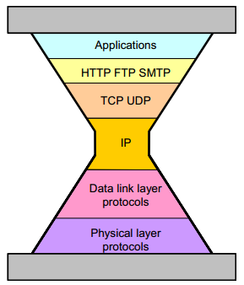
Internet Security Protocols
TCP RFC 793
Sept. 1981
Where to inject security?
IPv4 RFC 791
Sept. 1981
© Ravi Sandhu
World-Leading Research with Real-World Impact!

Slide 3
Internet Security Protocols
SET,1996
TCP RFC 793
Sept. 1981
SSL,1994
IPv4 RFC 791
Sept. 1981
IPsec, 1998
© Ravi Sandhu
World-Leading Research with Real-World Impact!

Slide 4
Internet Security Protocols
Dozens of other security protocols
Half successful
SSL,1994
Some successes
Many failures
IPsec, 1998
Largely failed
© Ravi Sandhu
World-Leading Research with Real-World Impact!

Slide 5

1-way vs 2-way SSL
Client
(Browser)
1-way SSL
Server
Client
(Browser)
2-way SSL
Server
© Ravi Sandhu
World-Leading Research with Real-World Impact!

Slide 6
1-way vs 2-way SSL
Client
(Browser)
1-way SSL
Server
RSA encryption
certificate
Client
(Browser)
2-way SSL
Server
RSA signature
certificate
RSA encryption
certificate
© Ravi Sandhu
World-Leading Research with Real-World Impact!

Slide 7
1-way vs 2-way SSL
Client
(Browser)
1-way SSL
Server
LESS SECURE
Phishing
Man-in-the-middle
Client
(Browser)
2-way SSL
Server
MORE SECURE
Phishing
Man-in-the-middle
© Ravi Sandhu
World-Leading Research with Real-World Impact!

Slide 8
1-way vs 2-way SSL
Client
(Browser)
1-way SSL
Server
LESS SECURE
Phishing
Man-in-the-middle
MASS DEPLOYMENT
Client
(Browser)
2-way SSL
Server
MORE SECURE
Phishing
Man-in-the-middle
MINIMAL DEPLOYMENT
© Ravi Sandhu
World-Leading Research with Real-World Impact!

Slide 9
The SSL Lesson
Client-less trumps client-full
Start-ups (SSL) trump committees (IPSEC)
© Ravi Sandhu
World-Leading Research with Real-World Impact!
9

