Slide 1

Module 2.5 SSL Man-in-the-Middle Attack
CS 6393 and CS 4483
Cyber Security Foundations and Practice
Ravi Sandhu
Spring 2021

Slide 2

1-way SSL MITM
Client
(Browser)
Server
https
RSA encryption
certificate
© Ravi Sandhu
World-Leading Research with Real-World Impact!

Slide 3
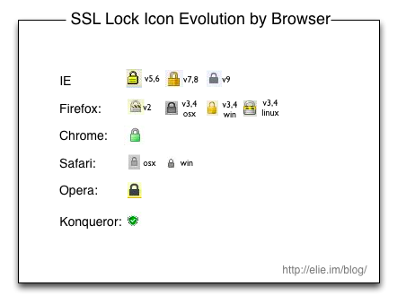
SSL
© Ravi Sandhu
World-Leading Research with Real-World Impact!

Slide 4

1-way SSL MITM
Client
(Browser)
MITM
Server
http
https
RSA encryption
certificate
© Ravi Sandhu
World-Leading Research with Real-World Impact!

Slide 5

1-way SSL MITM
Client
(Browser)
MITM
Server
https
https
RSA encryption
certificate
© Ravi Sandhu
World-Leading Research with Real-World Impact!

Slide 6
1-way SSL MITM
Client
(Browser)
MITM
Server
https
https
fake server
certificate
RSA encryption
certificate
© Ravi Sandhu
World-Leading Research with Real-World Impact!

Slide 7

Server-Side Masquerading
Bob
Web browser
www.host.com
Web server
1 way SSL
Ultratrust
Security
Services
www.host.com
© Ravi Sandhu
World-Leading Research with Real-World Impact!

Slide 8

Server-Side Masquerading
Bob
Web browser
www.host.com
Web server
1-way SSL
1-way SSL
Ultratrust
Security
Services
Mallory’s
Web server
www.host.com
BIMM
Corporation
www.host.com
© Ravi Sandhu
World-Leading Research with Real-World Impact!

Slide 9
Server-Side Masquerading
Bob
Web browser
www.host.com
Web server
1-way SSL
1-way SSL
Ultratrust
Security
Services
BIMM
Corporation
Mallory’s
Web server
www.host.com
Ultratrust
Security
Services
www.host.com
© Ravi Sandhu
World-Leading Research with Real-World Impact!

Slide 10

1-way SSL MITM
Client
(Browser)
MITM
Server
https
https
fake server
certificate
RSA encryption
certificate
RSA signature
certificate
fake client
certificate
© Ravi Sandhu
World-Leading Research with Real-World Impact!

