Slide 1
CS 6393 and CS 4483
Cyber Security Foundations and Practice
Module 3.2
Access Control Models:
Alphabet Soup
Ravi Sandhu
Spring 2021
© Ravi Sandhu
World-Leading Research with Real-World Impact!

Slide 2
Access Control Models
Discretionary Access Control (DAC)
1970
Mandatory Access Control (MAC) 1970
Fixed
policy
Role Based Access Control (RBAC) 1995
Attribute Based Access Control (ABAC)
2020s (Hopefully)
Flexible
policy

Slide 3
Access Control Models
Discretionary Access Control (DAC)
1970
Mandatory Access Control (MAC) 1970
Fixed
policy
Role Based Access Control (RBAC) 1995
Attribute Based Access Control (ABAC)
Encompasses
Relationship-Based Access Control (ReBAC)
Usage Control (UCON)
Rule-Based, Policy-Based, etc
2020s (Hopefully)
Flexible
policy

Slide 4
Access Decision Function
(s,o,r) allowed or not?
s: subject (aka actor)
o: object (aka target)
r: right (aka operation)
(s,o,r,c) allowed or not?
s, o, r: as above
c: context (aka environment)
© Ravi Sandhu
World-Leading Research with Real-World Impact!
4

Slide 5
Access Decision Function
(s,o,r) allowed or not?
s: subject (aka actor)
o: object (aka target)
r: right (aka operation)
(s,o,r,c) allowed or not?
s, o, r: as above
c: context (aka environment)
Access decision triple
Access decision quad
© Ravi Sandhu
World-Leading Research with Real-World Impact!
5

Slide 6
Access Decision Function
(s,o,r) allowed or not?
s: subject (aka actor)
o: object (aka target)
r: right (aka operation)
(s,o,r,c) allowed or not?
s, o, r: as above
c: context (aka environment)
Access decision triple
Access decision quad
c: beyond Access Matrix
c integrates well with ABAC
© Ravi Sandhu
World-Leading Research with Real-World Impact!
6

Slide 7
Access Control Model
Operational model
specify the decision function for the access decision triple or quad
Administrative
specify the model’s dynamics
dynamics change the system state and modify the outcome of some access decision triple or quads
© Ravi Sandhu
World-Leading Research with Real-World Impact!
7

Slide 8
Access Matrix Model
Operational model
(s,o,r)?
authorized iff r ϵ [s,o] cell of the matrix
Administrative
specify the semantics of the administrative rights: own, parent etc
© Ravi Sandhu
World-Leading Research with Real-World Impact!
8

Slide 9
Access Control Model
Our focus
Operational model
specify the decision function for the access decision triple or quad
Administrative
specify the model’s dynamics
dynamics change the system state and modify the outcome of some access decision triple or quads
© Ravi Sandhu
World-Leading Research with Real-World Impact!
9

Slide 10
Access Control Model
Mix and Match
Operational model
specify the decision function for the access decision triple or quad
Administrative
specify the model’s dynamics
dynamics change the system state and modify the outcome of some access decision triple or quads
MAC, RBAC, ABAC
DAC, RBAC, ABAC
© Ravi Sandhu
World-Leading Research with Real-World Impact!
10

Slide 11
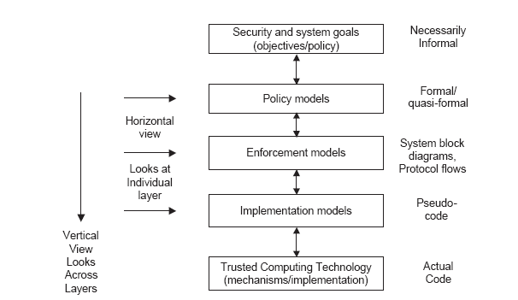
Access Control PEI Layers
Big decisions
Idealized
Enforceable
Codeable
Code

Slide 12
Access Control PEI Layers
Big decisions
Our focus
Idealized
Enforceable
Codeable
Code

Slide 13
Enforcement Models
PUSH
MODEL
Client
Server
Authentication +
Authorization
Credentials
PULL
MODEL
Client
Server
Authentication
Credentials
Authorization
Credentials

