Slide 1
Module 4.1 Role-Based Access Control (RBAC)
CS 6393 and CS 4483
Cyber Security Foundations and Practice
Ravi Sandhu
Spring 2021

Slide 2
Access Control Models
Discretionary Access Control (DAC)
1970
Mandatory Access Control (MAC) 1970
Fixed
policy
Role Based Access Control (RBAC) 1995
Attribute Based Access Control (ABAC)
2020s (Hopefully)
Flexible
policy

Slide 3
RBAC: Role-Based Access Control
Access is determined by roles
A user’s roles are assigned by security administrators
A role’s permissions are assigned by security administrators
First emerged: mid 1970s
First models: mid 1990s
Is RBAC MAC or DAC or neither?
RBAC can be configured to do MAC
RBAC can be configured to do DAC
RBAC is policy neutral
RBAC is neither MAC nor DAC!
© Ravi Sandhu
World-Leading Research with Real-World Impact!
3

Slide 4
Role-Based Access Control (RBAC)
Core concept:
All accesses are mediated through Roles
Core drawback:
Roles are a natural concept for human users
Not so natural for:
Information objects
Smart objects (Internet of Things)
Contextual attributes
Sophistication:
Role hierarchies
Role constraints

Slide 5
RBAC
Operational model
specify the decision function for the access decision triple or quad
Administrative
specify the model’s dynamics
dynamics change the system state and modify the outcome of some access decision triple or quads
Our RBAC focus
DAC, RBAC, …
© Ravi Sandhu
World-Leading Research with Real-World Impact!
5

Slide 6
Founding Principles of RBAC96
Abstraction of Privileges
Credit is different from Debit even though both require read and write
Separation of Administrative Functions
Separation of user-role assignment from role-permission assignment
Least Privilege
Right-size the roles
Don’t activate all roles all the time
Limit roles of a user
Limit users in a role
Separation of Duty
Static separation: purchasing manager vs accounts payable manager
Dynamic separation: cash-register clerk versus cash-register manager
© Ravi Sandhu
World-Leading Research with Real-World Impact!
6

Slide 7
RBAC96 Model Family
RBAC3
ROLE HIERARCHIES +
CONSTRAINTS
RBAC1
ROLE
HIERARCHIES
RBAC2
CONSTRAINTS
RBAC0
BASIC RBAC
© Ravi Sandhu
World-Leading Research with Real-World Impact!
7
Notes:
This is a somewhat busy slide
It shows a bird’s eye view of RBAC
There are many details that need to be debated and filled in
Some of these will be discussed in the subsequent panel
For our purpose the bird’s eye view will suffice

Slide 8
RBAC96 Model Family: RBAC0
USER-ROLE
ASSIGNMENT
PERMISSIONS-ROLE
ASSIGNMENT
USERS
ROLES
PERMISSIONS
...
SESSIONS
© Ravi Sandhu
World-Leading Research with Real-World Impact!
8
Notes:
This is a somewhat busy slide
It shows a bird’s eye view of RBAC
There are many details that need to be debated and filled in
Some of these will be discussed in the subsequent panel
For our purpose the bird’s eye view will suffice

Slide 9
ROLES AS POLICY ANCHORS
A role brings together
a collection of users and
a collection of permissions
These collections will vary over time
A role has significance and meaning beyond the particular users and permissions brought together at any moment
Roles versus Operating System (OS) groups
Most OS’s support groups as ACL entries
An OS group is a collection of users
Selective activation typically not supported
© Ravi Sandhu
World-Leading Research with Real-World Impact!
9

Slide 10
RBAC96 Model Family: RBAC1
ROLE HIERARCHIES
USER-ROLE
ASSIGNMENT
PERMISSIONS-ROLE
ASSIGNMENT
USERS
ROLES
PERMISSIONS
...
SESSIONS
© Ravi Sandhu
World-Leading Research with Real-World Impact!
10
Notes:
This is a somewhat busy slide
It shows a bird’s eye view of RBAC
There are many details that need to be debated and filled in
Some of these will be discussed in the subsequent panel
For our purpose the bird’s eye view will suffice

Slide 11
HIERARCHICAL ROLES
Primary-Care
Physician
Specialist
Physician
Physician
Health-Care Provider
© Ravi Sandhu
World-Leading Research with Real-World Impact!
11

Slide 12
HIERARCHICAL ROLES
Supervising
Engineer
Hardware
Engineer
Software
Engineer
Engineer
© Ravi Sandhu
World-Leading Research with Real-World Impact!
12

Slide 13
EXAMPLE ROLE HIERARCHY
Director (DIR)
Project Lead 1
(PL1)
Project Lead 2
(PL2)
Production 1
(P1)
Quality 1
(Q1)
Production 2
(P2)
Quality 2
(Q2)
Engineer 1
(E1)
Engineer 2
(E2)
PROJECT 1
Engineering Department (ED)
PROJECT 2
Employee (E)
© Ravi Sandhu
World-Leading Research with Real-World Impact!
13

Slide 14
EXAMPLE ROLE HIERARCHY
Project Lead 1
(PL1)
Project Lead 2
(PL2)
Production 1
(P1)
Quality 1
(Q1)
Production 2
(P2)
Quality 2
(Q2)
Engineer 1
(E1)
Engineer 2
(E2)
PROJECT 1
Engineering Department (ED)
PROJECT 2
Employee (E)
© Ravi Sandhu
World-Leading Research with Real-World Impact!
14

Slide 15
EXAMPLE ROLE HIERARCHY
Director (DIR)
Project Lead 1
(PL1)
Project Lead 2
(PL2)
Production 1
(P1)
Quality 1
(Q1)
Production 2
(P2)
Quality 2
(Q2)
Engineer 1
(E1)
Engineer 2
(E2)
PROJECT 1
PROJECT 2
© Ravi Sandhu
World-Leading Research with Real-World Impact!
15

Slide 16
EXAMPLE ROLE HIERARCHY
Project Lead 1
(PL1)
Project Lead 2
(PL2)
Production 1
(P1)
Quality 1
(Q1)
Production 2
(P2)
Quality 2
(Q2)
Engineer 1
(E1)
Engineer 2
(E2)
PROJECT 1
PROJECT 2
© Ravi Sandhu
World-Leading Research with Real-World Impact!
16

Slide 17
RBAC96 Model Family: RBAC3
ROLE HIERARCHIES
USER-ROLE
ASSIGNMENT
PERMISSIONS-ROLE
ASSIGNMENT
USERS
ROLES
PERMISSIONS
...
SESSIONS
CONSTRAINTS
© Ravi Sandhu
World-Leading Research with Real-World Impact!
17
Notes:
This is a somewhat busy slide
It shows a bird’s eye view of RBAC
There are many details that need to be debated and filled in
Some of these will be discussed in the subsequent panel
For our purpose the bird’s eye view will suffice

Slide 18
SEPARATION OF DUTY (SOD)
Static Separation of Duty
The same individual can never hold both roles
Applies to User-Role Assignment
Example: Purchasing Manager, Accounts Payable Manager
Dynamic Separation of Duty
The same individual can never hold both roles in the same session
Applies to Session-Role Activation
Example: Cash-Register Clerk, Cash-Register Manager
Example: Course-Teaching-Assistant, Course-Student
© Ravi Sandhu
World-Leading Research with Real-World Impact!
18

Slide 19
CARDINALITY CONSTRAINTS
Cardinality Constraints on User-Role Assignment
At most k users can belong to the role
At least k users must belong to the role
Exactly k users must belong to the role
Cardinality Constraints on Permissions-Role Assignment
At most k roles can get the permission
At least k roles must get the permission
Exactly k roles must get the permission
© Ravi Sandhu
World-Leading Research with Real-World Impact!
19

Slide 20
RBAC96 Model Family
RBAC3
ROLE HIERARCHIES +
CONSTRAINTS
RBAC1
ROLE
HIERARCHIES
RBAC2
CONSTRAINTS
RBAC0
BASIC RBAC
© Ravi Sandhu
World-Leading Research with Real-World Impact!
20
Notes:
This is a somewhat busy slide
It shows a bird’s eye view of RBAC
There are many details that need to be debated and filled in
Some of these will be discussed in the subsequent panel
For our purpose the bird’s eye view will suffice

Slide 21
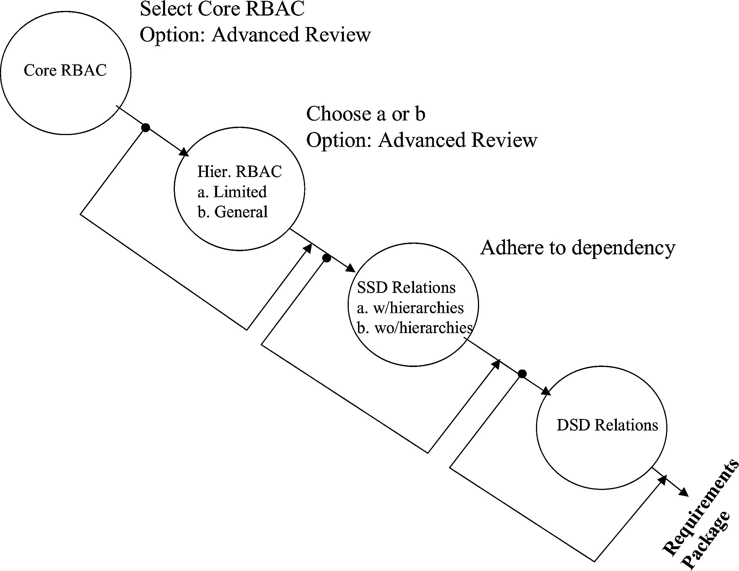
NIST MODEL FAMILY
© Ravi Sandhu
World-Leading Research with Real-World Impact!
21

Slide 22
RBAC Administration
ROLE HIERARCHIES
USER-ROLE
ASSIGNMENT
PERMISSIONS-ROLE
ASSIGNMENT
USERS
ROLES
PERMISSIONS
...
SESSIONS
CONSTRAINTS
© Ravi Sandhu
World-Leading Research with Real-World Impact!
22
Notes:
This is a somewhat busy slide
It shows a bird’s eye view of RBAC
There are many details that need to be debated and filled in
Some of these will be discussed in the subsequent panel
For our purpose the bird’s eye view will suffice

