Slide 1
Module 4.2
Attribute-Based Access Control
(ABAC)
CS 6393 and CS 4483
Cyber Security Foundations and Practice
Ravi Sandhu
Spring 2021

Slide 2
Access Control Models
Discretionary Access Control (DAC)
1970
Mandatory Access Control (MAC) 1970
Fixed
policy
Role Based Access Control (RBAC) 1995
Attribute Based Access Control (ABAC)
2020s (Hopefully)
Flexible
policy

Slide 3
Access Control Models
Discretionary Access Control (DAC)
1970
Mandatory Access Control (MAC) 1970
Fixed
policy
Access decision triple (s,o,r)
Fixed decision rule
Role Based Access Control (RBAC) 1995
Attribute Based Access Control (ABAC)
2020s (Hopefully)
Flexible
policy
Access decision quad (s,o,r,c)
Flexible decision rule

Slide 4
ABAC Decision Quad (s,o,r,c)
Right
r
Computed based on
attributes of s, o, r, c
Via customized rules
Access
Decision?
Yes/No
Subject
s
Object
o
Context
c

Slide 5
Compare DAC, MAC, RBAC triple (s,o,r)
Computed via fixed rules:
DAC: s:r ϵ ACL(o)
MAC: BLP rules
RBAC: s has an active role that authorizes o,r
Right
r
Access
Decision?
Yes/No
Subject
s
Object
o
X
Context
c

Slide 6
Attribute-Based Access Control (ABAC)
Core concept:
  Attributes determine everything
  No fixed access decision rule
Core drawback:
  Flexibility at the cost of complexity
Sophistication:
  Chained attributes
  Group attributes
  Distributed decision rules
  Automation
  Adaptation

Slide 7
ABAC
Operational model
  specify the decision function for the access
  decision triple or quad
Administrative
  specify the model’s dynamics
  dynamics change the system state and
  modify the outcome of some access decision
  triple or quads
Our ABAC focus
DAC, RBAC, ABAC …
© Ravi Sandhu
World-Leading Research with Real-World Impact!
7

Slide 8
ABAC is not New
User (Identity)
Attributes
Public-key Certificate +
Secured secrets
© Ravi Sandhu
World-Leading Research with Real-World Impact!

Slide 9
ABAC is not New
User (Identity)
X.500
Directory
X.509
Identity Certificates
Attributes
Public-key Certificate +
Secured secrets
Pre Internet, early 1990s
© Ravi Sandhu
World-Leading Research with Real-World Impact!

Slide 10
ABAC is not New
User (Identity)
X.509
Attribute
Certificates
X.509
Identity Certificates
Attributes
Public-key Certificate +
Secured secrets
Post Internet, late 1990s
© Ravi Sandhu
World-Leading Research with Real-World Impact!

Slide 11
ABAC is not New
User (Identity)
Attributes
SPKI Certificates
Public-keys +
Secured secrets
Post Internet, late 1990s
© Ravi Sandhu
World-Leading Research with Real-World Impact!

Slide 12
ABAC is not New
User (Identity)
Attributes
Anonymous
Credentials
Public-keys +
Secured secrets
Mature Internet, 2000s
© Ravi Sandhu
World-Leading Research with Real-World Impact!

Slide 13
ABAC is not New
Attributes
Action
Authorization Decision
User
Subject
Yes/No
Object
Context
XACML
Policy
Mature Internet, 2000s
© Ravi Sandhu
World-Leading Research with Real-World Impact!

Slide 14
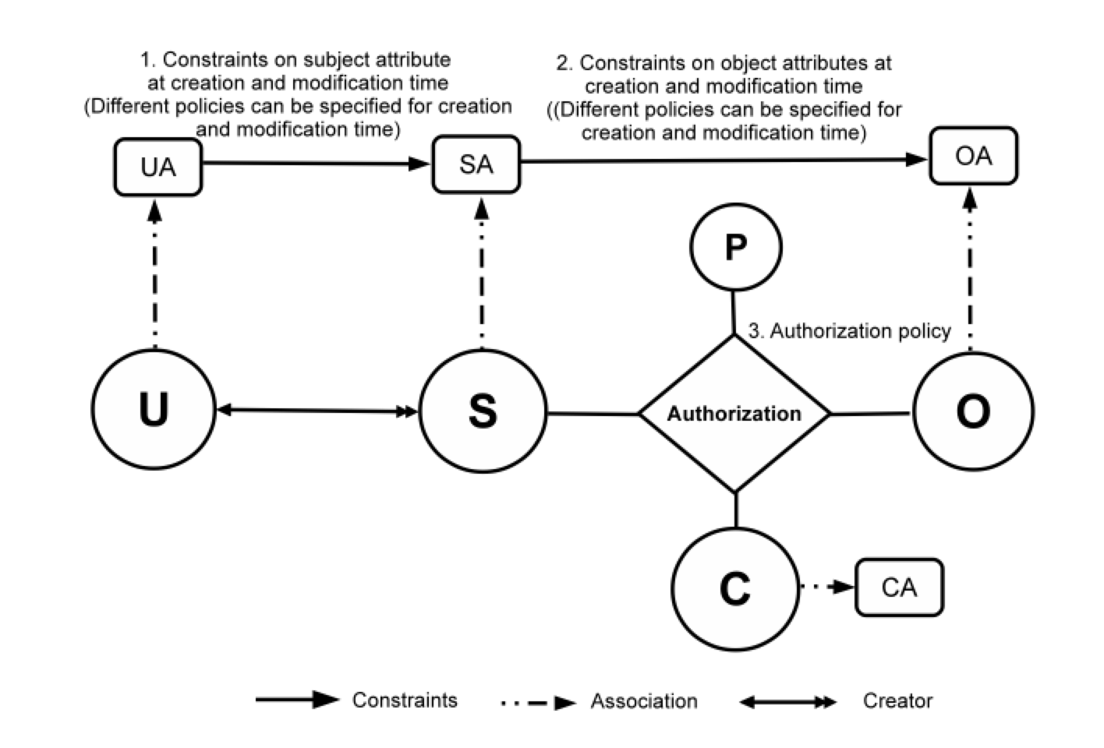
ABAC Policy Configuration
14
Notes:
Show abac-alpha
Then for each type of extension, highlight the extensions to ABAC
23 and 24 integrated

Slide 15
ABAC Policy Configuration
Policy Configuration Points
Can be configured to do many variations of DAC, MAC, RBAC
15
Notes:
Show abac-alpha
Then for each type of extension, highlight the extensions to ABAC
23 and 24 integrated

Slide 16
Access Control Models
Discretionary Access Control (DAC)
1970
Mandatory Access Control (MAC) 1970
Fixed
policy
Role Based Access Control (RBAC) 1995
Attribute Based Access Control (ABAC)
2020s (Hopefully)
Flexible
policy

Slide 17
Access Control Models
Discretionary Access Control (DAC)
1970
Mandatory Access Control (MAC) 1970
Fixed
policy
Role Based Access Control (RBAC) 1995
Attribute Based Access Control (ABAC)
Encompasses
Relationship-Based Access Control (ReBAC)
Usage Control (UCON)
Rule-Based, Policy-Based, etc
2020s (Hopefully)
Flexible
policy

Slide 18
Access Control Convergence
ABAC
ReBAC
RBAC
…
DAC
MAC
Convergent Access Control (CAC)
Access Control Policy Models
Access Control Enforcement Models
Application
Context

