Slide 1

Module 5.2
Intrusion Detection Evaluation
CS 6393 and CS 4483
Cyber Security Foundations and Practice
Ravi Sandhu
Spring 2021

Slide 2
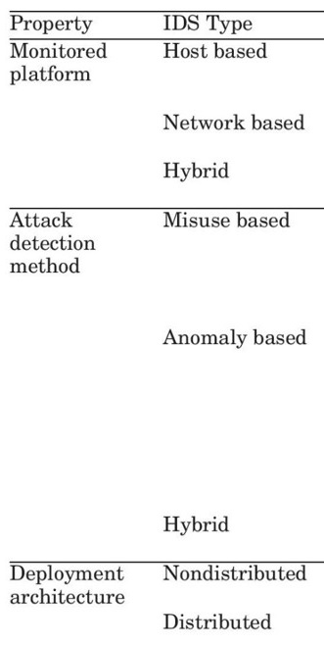
IDS Categorization
Milenkoski, A., Vieira, M., Kounev, S., Avritzer, A. and Payne, B.D., 2015. Evaluating computer intrusion detection systems: A survey of common practices. ACM Computing Surveys (CSUR), 48(1)
Table 1, p12-3
© Ravi Sandhu
World-Leading Research with Real-World Impact!
2

Slide 3
IDS Categorization
Milenkoski, A., Vieira, M., Kounev, S., Avritzer, A. and Payne, B.D., 2015. Evaluating computer intrusion detection systems: A survey of common practices. ACM Computing Surveys (CSUR), 48(1)
Table 1, p12-3
© Ravi Sandhu
World-Leading Research with Real-World Impact!
3

Slide 4
Design Space
Workloads
Metrics
Measurement methodology
© Ravi Sandhu
World-Leading Research with Real-World Impact!
4

Slide 5
Workloads
© Ravi Sandhu
World-Leading Research with Real-World Impact!
5

Slide 6
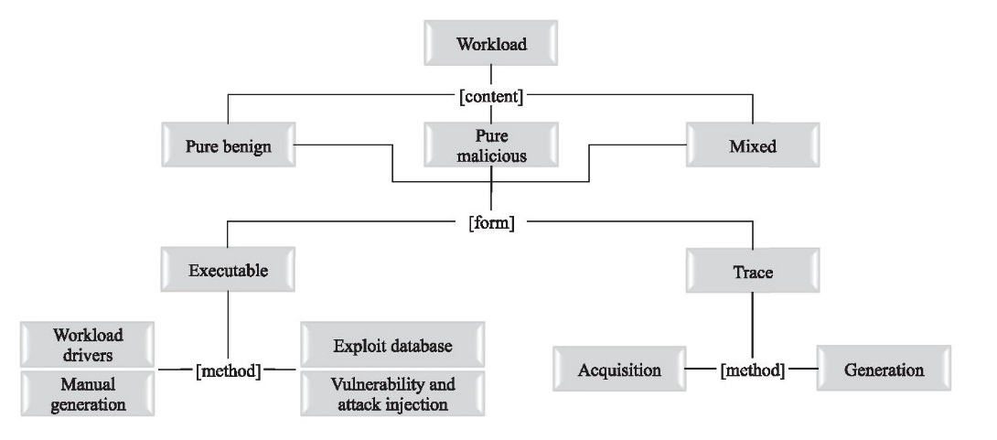
Workloads
Milenkoski, A., Vieira, M., Kounev, S., Avritzer, A. and Payne, B.D., 2015. Evaluating computer intrusion detection systems: A survey of common practices. ACM Computing Surveys (CSUR), 48(1),
Figure 1, p 12-4
© Ravi Sandhu
World-Leading Research with Real-World Impact!
6

Slide 7
Workloads
Table III and IV
Table II
Figure 2
Publicly available traces
DARPA 98, 99, 00
KDD 99 (derivative)
Symantec onsite testing
Table V
Milenkoski, A., Vieira, M., Kounev, S., Avritzer, A. and Payne, B.D., 2015. Evaluating computer intrusion detection systems: A survey of common practices. ACM Computing Surveys (CSUR), 48(1),
Figure 1, p 12-4
© Ravi Sandhu
World-Leading Research with Real-World Impact!
7

Slide 8
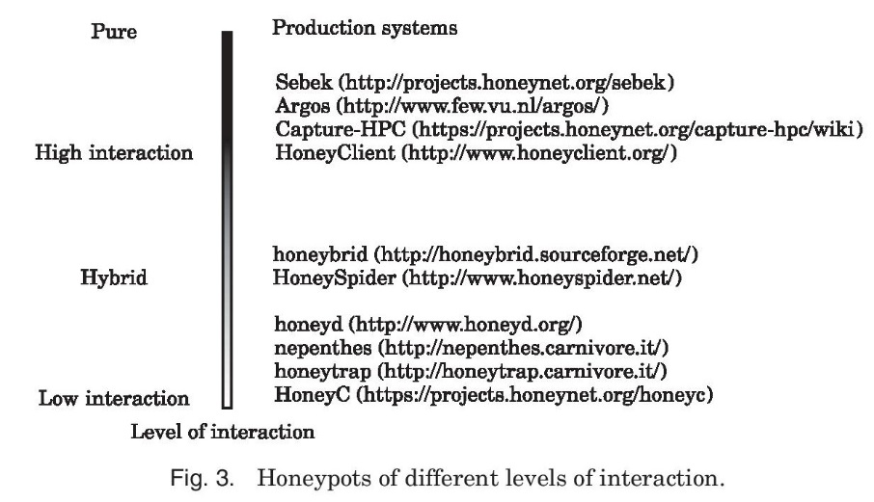
Honeypots
Milenkoski, A., Vieira, M., Kounev, S., Avritzer, A. and Payne, B.D., 2015. Evaluating computer intrusion detection systems: A survey of common practices. ACM Computing Surveys (CSUR), 48(1),
Figure 3, p 12-14
© Ravi Sandhu
World-Leading Research with Real-World Impact!
8

Slide 9
Metrics
© Ravi Sandhu
World-Leading Research with Real-World Impact!
9

Slide 10
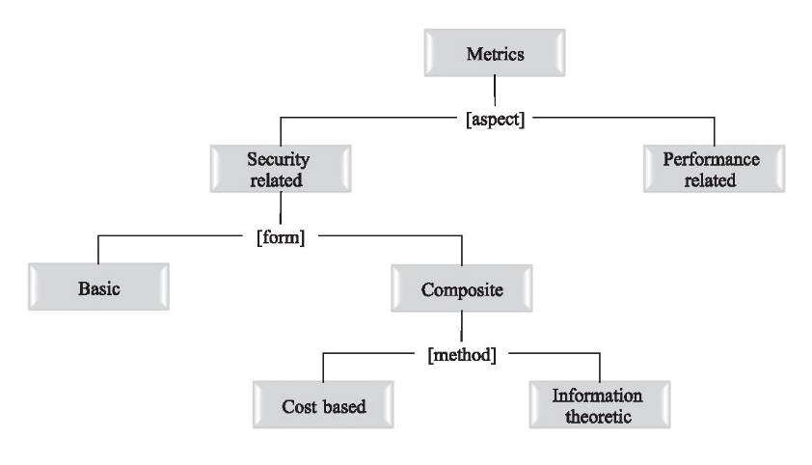
Metrics
Not discussed
in lecture
Milenkoski, A., Vieira, M., Kounev, S., Avritzer, A. and Payne, B.D., 2015. Evaluating computer intrusion detection systems: A survey of common practices. ACM Computing Surveys (CSUR), 48(1),
Figure 4, p12-15
© Ravi Sandhu
World-Leading Research with Real-World Impact!
10

Slide 11
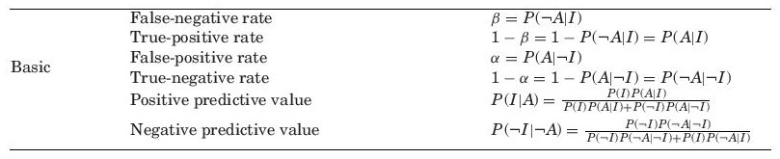

Metrics: Basic
Dependent on
base rate
Milenkoski, A., Vieira, M., Kounev, S., Avritzer, A. and Payne, B.D., 2015. Evaluating computer intrusion detection systems: A survey of common practices. ACM Computing Surveys (CSUR), 48(1),.
Table VI, p 12-16
© Ravi Sandhu
World-Leading Research with Real-World Impact!
11

Slide 12
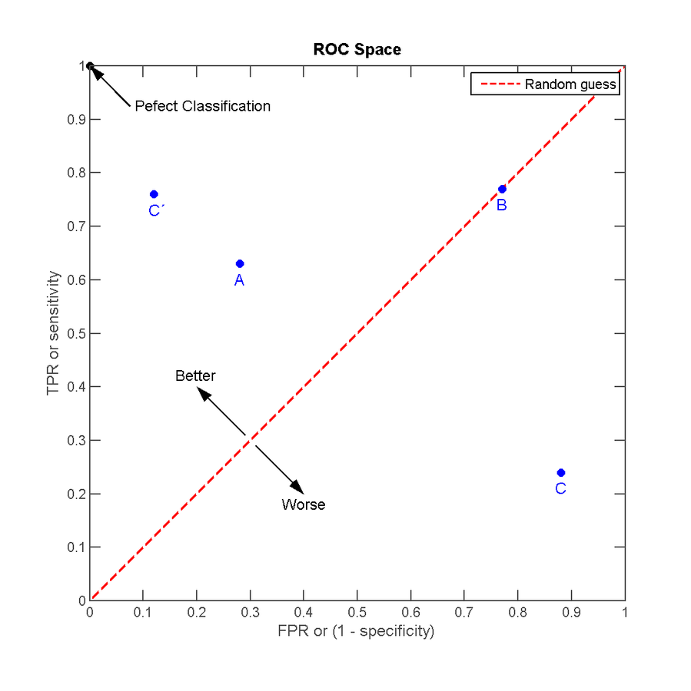

Receiver Operating Curve (ROC)
https://en.wikipedia.org/wiki/Receiver_operating_characteristic
© Ravi Sandhu
World-Leading Research with Real-World Impact!
12

Slide 13
ROC Limitations
Intrusion detection is not a binary yes/no problem
Unit of measurement is ambiguous
  Flow versus packet
Does not account for base rate P(I)
© Ravi Sandhu
World-Leading Research with Real-World Impact!
13

Slide 14
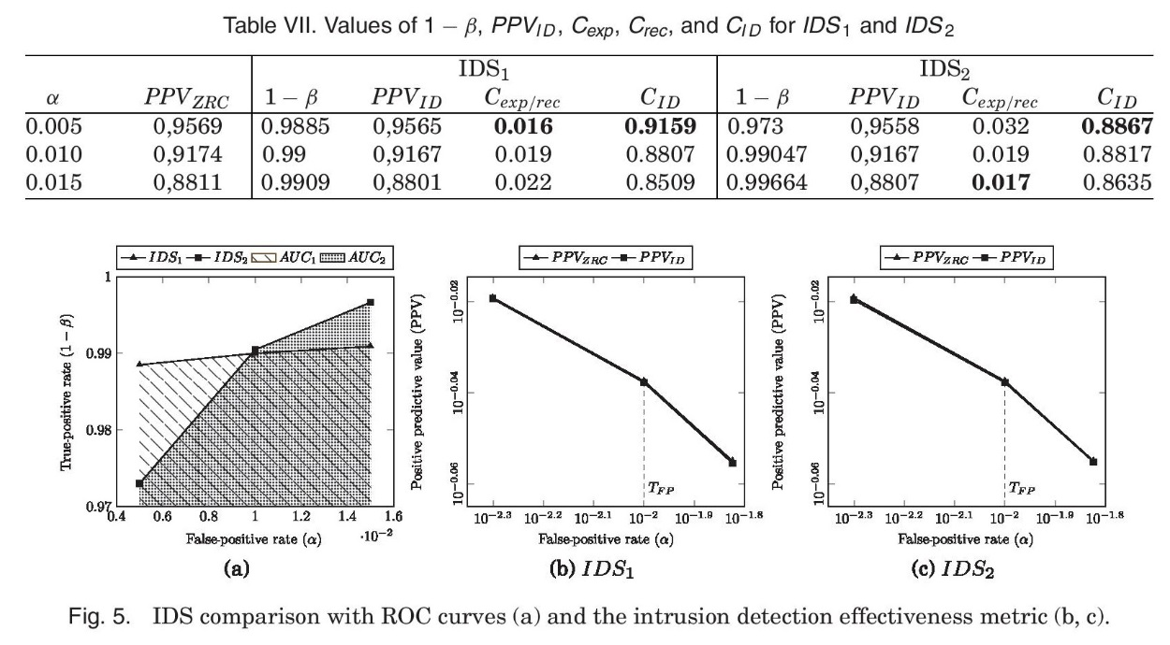

Intrusion Detection Effectiveness
Milenkoski, A., Vieira, M., Kounev, S., Avritzer, A. and Payne, B.D., 2015. Evaluating computer intrusion detection systems: A survey of common practices. ACM Computing Surveys (CSUR), 48(1)
© Ravi Sandhu
World-Leading Research with Real-World Impact!
14

Slide 15
Intrusion Detection Effectiveness
ZRC
Zero Reference Curve
Compare area
under ROC curve
Milenkoski, A., Vieira, M., Kounev, S., Avritzer, A. and Payne, B.D., 2015. Evaluating computer intrusion detection systems: A survey of common practices. ACM Computing Surveys (CSUR), 48(1)
© Ravi Sandhu
World-Leading Research with Real-World Impact!
15

Slide 16

Intrusion Detection Effectiveness
Assumes Base rate, P(I) = 0.1
ZRC
Zero Reference Curve
Compare area
under ROC curve
T_{FP}: max acceptable false positive rate
Compare area difference between
PPV_{ZRC} and PPV_{IDS} up to T_{FP}
Milenkoski, A., Vieira, M., Kounev, S., Avritzer, A. and Payne, B.D., 2015. Evaluating computer intrusion detection systems: A survey of common practices. ACM Computing Surveys (CSUR), 48(1)
.
© Ravi Sandhu
World-Leading Research with Real-World Impact!
16

Slide 17
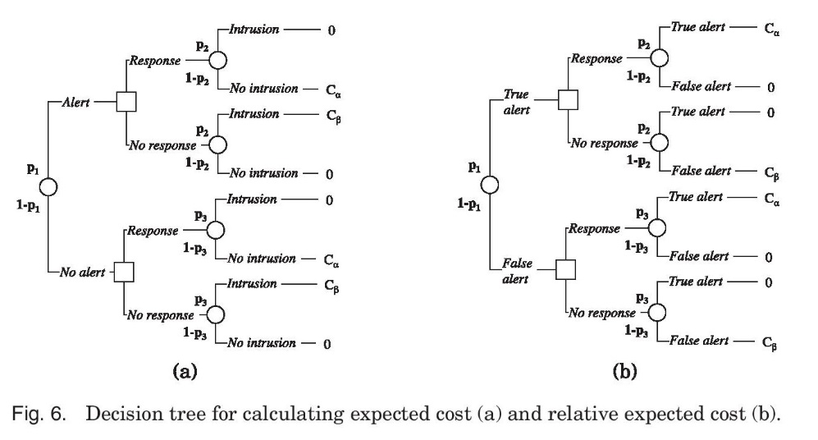

Metrics: Cost-Based
These p₁ p₂ p₃ are different, apply to false alert filter
C_{α}: cost of false positive
C_{β}: cost of false negative
C = C_{β}/C_{α}
p₁ = P(A)
p₂ = P(I|A)
p₃ = P(I|¬A)
C_{exp} = Min(CβB,(1-α)(1-B)) + Min(C(1-β)B,α(1-B))
C_{rec} = CβB + α(1-B)
Milenkoski, A., Vieira, M., Kounev, S., Avritzer, A. and Payne, B.D., 2015. Evaluating computer intrusion detection systems: A survey of common practices. ACM Computing Surveys (CSUR), 48(1)
Figure 6
© Ravi Sandhu
World-Leading Research with Real-World Impact!
17

Slide 18
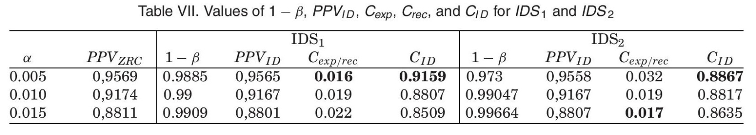
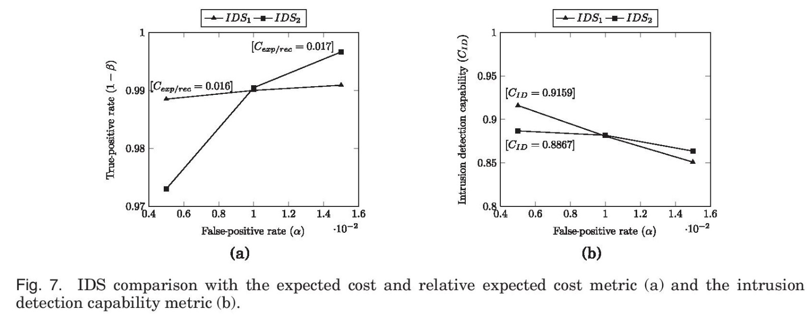

Metrics: Cost-Based
Assumptions:
B = 0.1
C = 10
α, β same for
base IDS and
its false alarm
filter
Milenkoski, A., Vieira, M., Kounev, S., Avritzer, A. and Payne, B.D., 2015. Evaluating computer intrusion detection systems: A survey of common practices. ACM Computing Surveys (CSUR), 48(1)
© Ravi Sandhu
World-Leading Research with Real-World Impact!
18

Slide 19
Measurement
Methodology
© Ravi Sandhu
World-Leading Research with Real-World Impact!
19

Slide 20
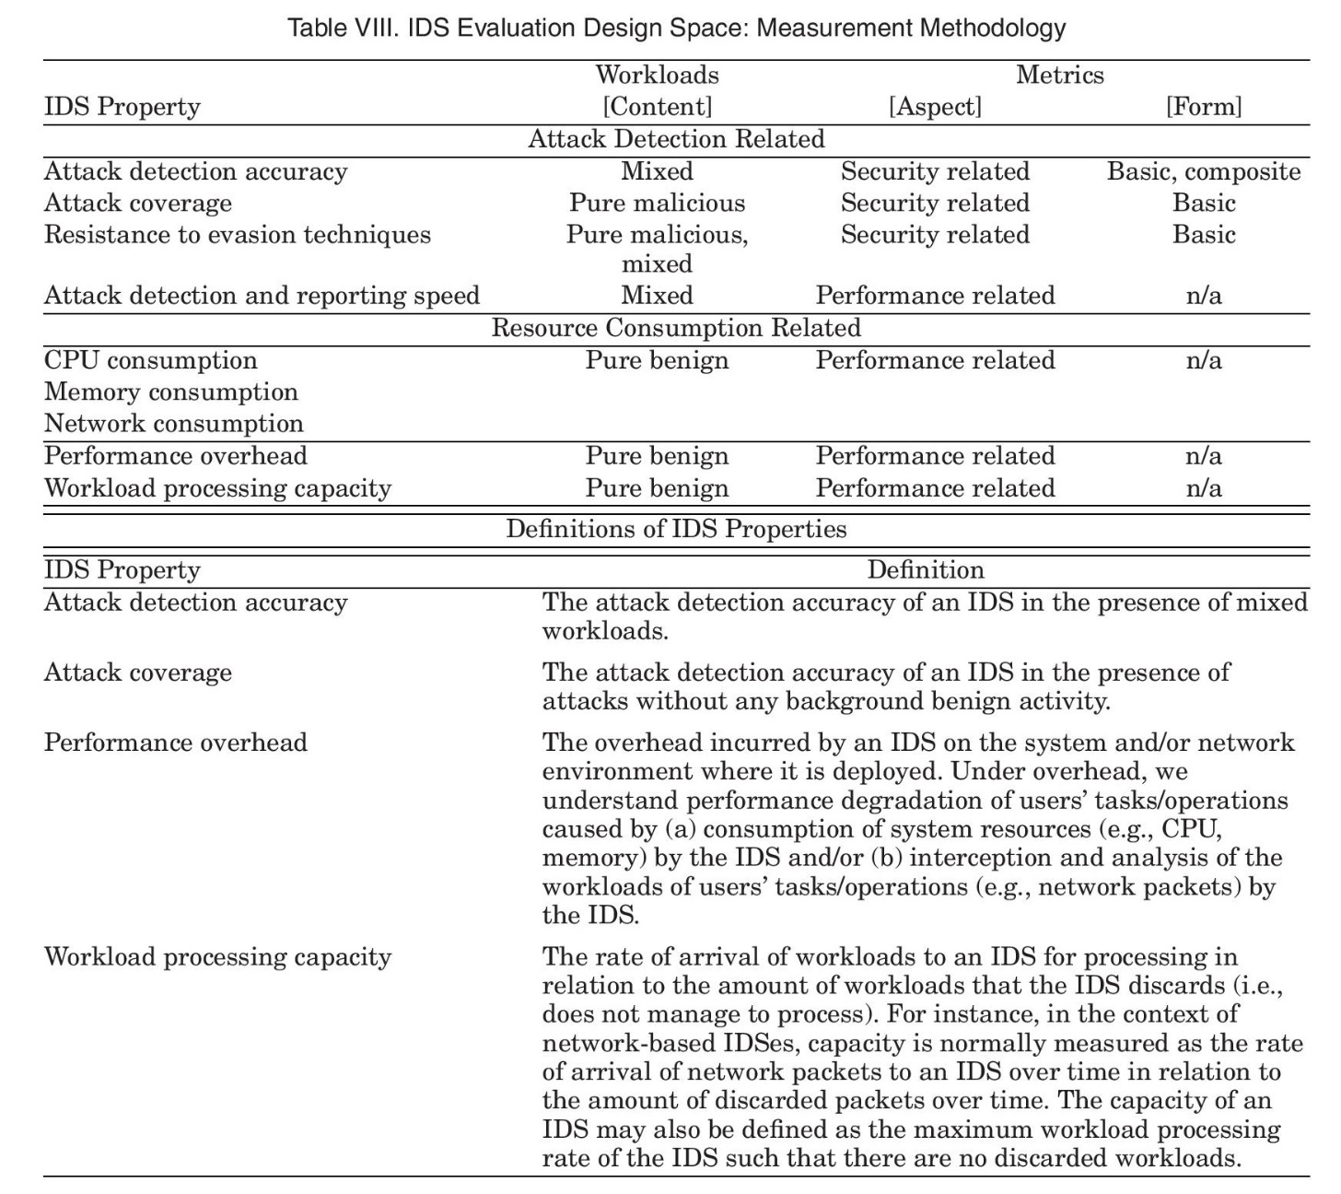
Measurement Methodology
Milenkoski, A., Vieira, M., Kounev, S., Avritzer, A. and Payne, B.D., 2015. Evaluating computer intrusion detection systems: A survey of common practices. ACM Computing Surveys (CSUR), 48(1)
© Ravi Sandhu
World-Leading Research with Real-World Impact!
20

Slide 21
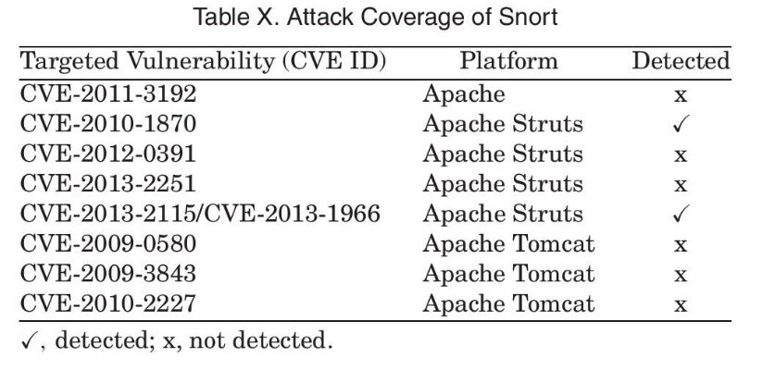
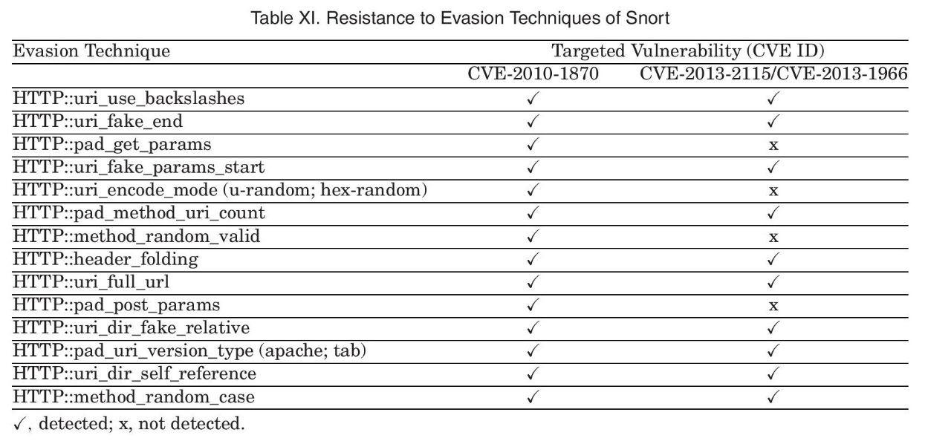
Case Study: Snort
True positive rate = 2/8 = 0.25
True positive rate = 24/28 = 0.85
Milenkoski, A., Vieira, M., Kounev, S., Avritzer, A. and Payne, B.D., 2015. Evaluating computer intrusion detection systems: A survey of common practices. ACM Computing Surveys (CSUR), 48(1)
© Ravi Sandhu
World-Leading Research with Real-World Impact!
21

Slide 22
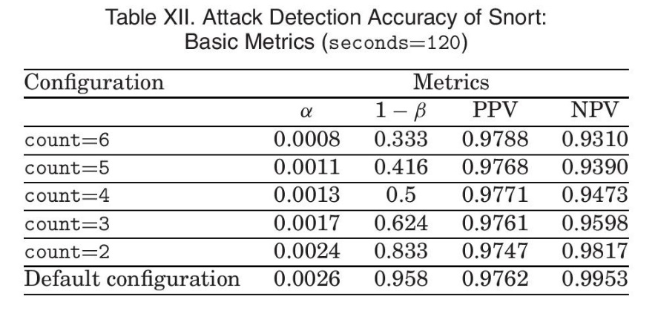
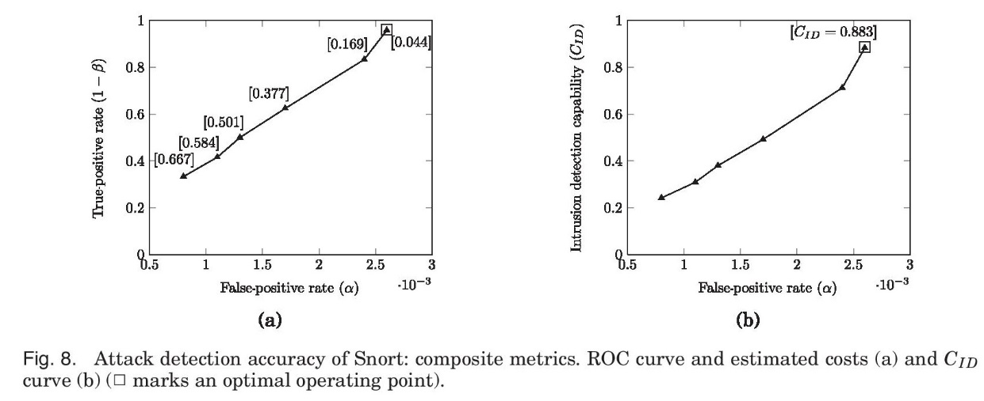

Case Study: Snort
Milenkoski, A., Vieira, M., Kounev, S., Avritzer, A. and Payne, B.D., 2015. Evaluating computer intrusion detection systems: A survey of common practices. ACM Computing Surveys (CSUR), 48(1),
© Ravi Sandhu
World-Leading Research with Real-World Impact!
22

Slide 23
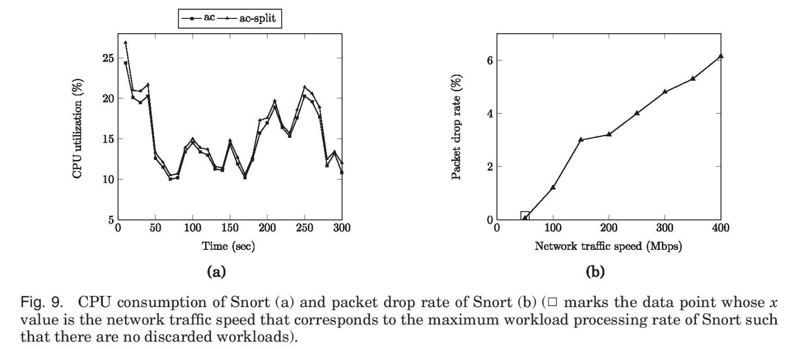

Case Study: Snort
Milenkoski, A., Vieira, M., Kounev, S., Avritzer, A. and Payne, B.D., 2015. Evaluating computer intrusion detection systems: A survey of common practices. ACM Computing Surveys (CSUR), 48(1)
© Ravi Sandhu
World-Leading Research with Real-World Impact!
23

