Slide 1

Module 6.2
Access Control for Smart Home IoT:
Introduction and GRBAC Model
CS 6393 and CS 4483
Cyber Security Foundations and Practice
Ravi Sandhu
Spring 2021
Slides prepared by Safwa Ameer
Lecture by Ravi Sandhu

Slide 2

Introduction
The Internet of Things (IoT) is a new technology paradigm envisioned as a global network of machines and devices capable of interacting with each other.
Currently, IoT is one of the most talked about topics in technology, it has already become indispensable components of our lives.

Slide 3
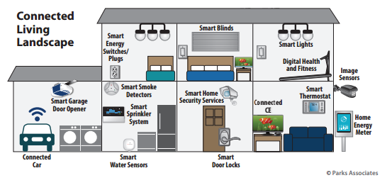
Introduction
One of the most popular domains for deploying smart connected devices is the smart home.
The global smart home market is forecast to reach a value of more than 53 billion US dollars by 2022.

Slide 4

Motivation
Surprisingly, little attention has been paid to AC in home IoT.
AC issues have been explored extensively for many different domains.
Home IoT is signiﬁcantly different from traditional domains in:
  In home IoT we have many users who use the same device, for example: smart door lock, smart light,.. .

Slide 5
Motivation
  House residents usually have complex social relationship between them, which introduce a new threat model, e.g. an annoying child trying to control the smart light in his sibling’s room, a current or ex-partner trying to abuse one or all house residents.
  The majority of IoT devices do not have screens and keyboards making them hands free for convenience while making authentication and access control more challenging.
  Smart home things are usually constrained resources in term of computational power, and storage.

Slide 6

Motivation
He et al [1] have recently proposed a new perspective of access control policies specifications for home IoT. They re-envisioned access control and authentication for the home IoT through a 425-participant user study.
They concluded that the characteristics that make IoT distinct from prior computing domains necessitate a rethinking of access control and authentication.
Ouaddah et al [2] provided and extensive review of different access control solutions in IoT within the Objectives, Models, Architectures, and Mechanisms (OM-AM).
They believe that the need arises for a dynamic and ﬁne-grained access control mechanism, where users and resources are constrained .

Slide 7
Our Criteria for Smart Home IoT Access
Control Models
Based on the literature review that we have done, we believe that a smart home IoT access control model (whether it is device to device (D-D), user to device (U-D) or both) should exhibit, at least, the following characteristics:
  Dynamic, to capture environment and object contextual information..
  Fine-grained, so that a subset of the functionality of a device can be authorized rather than all-or-nothing access to the device.
  Suitable for constrained home environment. IoT AC model should not require extensive computation or communication on the part of resource constrained devices. Furthermore, any access control solution for smart home IoT should consider the fact that a generic interoperability standard among IoT devices is still missing.

Slide 8
Our Criteria for Smart Home IoT Access
Control Models
  Constructed speciﬁcally for smart home IoT or otherwise be interpreted for the smart home domain such as by appropriate use cases. To ensure that the model is suitable for smart home different specifications such as, social relationships between house members (which implies He et al second characteristic), cost effectiveness, usability, and so on
  The model should be demonstrated in a proof-of-concept, to be credible using commercially available technology with necessary enhancements.
  The model should have a formal deﬁnition, so that there is a precise and rigorous speciﬁcation of the intended behavior.
We investigated literature’s IoT access control models that govern user to device access against our criteria, and notably no model satisfies all desired specifications.

Slide 9
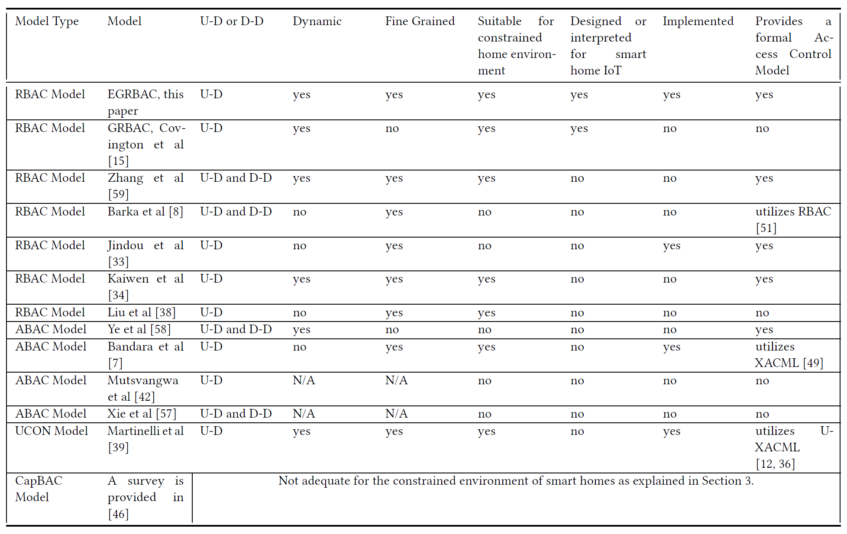













Our Criteria for Smart Home IoT Access
Control Models
Analysis of Published IoT Access Control Models Based on Desirable Characteristics

Slide 10



Our Threat Model
  In smart houses we have two types of adversaries:
    a- Outsider hacker who is trying to get digital or physical access to the house by exploiting system vulnerabilities.
    b- The household members themselves, that is insiders who have legitimate digital and physical access to the house, such as family members, guests, and workers.
  The central focus of our paper is making sure that those legitimate users get access only to what they are authorized to by the house owner.

Slide 11

Our Threat Model
There are other types of insider threats such as, Revocation evasion, and logging evasion. We didn’t consider them for the following reasons:
Revocation evasion:
  In our adopted architecture, the user cannot access the smart devices directly, each request must go through the smart hub which contains the access policies. If a revocation happened, the access policies will be updated, and this will be reflected in any future access request.
Logging evasion:
  We believe that this threat is implementation specific more than design specific.

Slide 12

The GRBAC Model
Covington et al introduced the Generalized Role-Based Access Control (GRBAC) model [14].
In addition to the usual concept of Subject Role, GRBAC incorporates the notion of Object Roles and Environment Roles.
A subject role is analogous to a traditional RBAC role.
An object role is defined as the properties of the resources in the system, such as images, source code, streaming videos, devices.
An environment role is defined as the environment state during access.

Slide 13

The GRBAC Model
In [3] they subsequently provided a high level but incomplete formal definition of environment role-based access control model, building upon [15].
They neither considered formalizing the object role part of GRBAC, nor provided a model diagram.
We provide a complete detailed formalization of GRBAC accompanied with a model diagram.

Slide 14
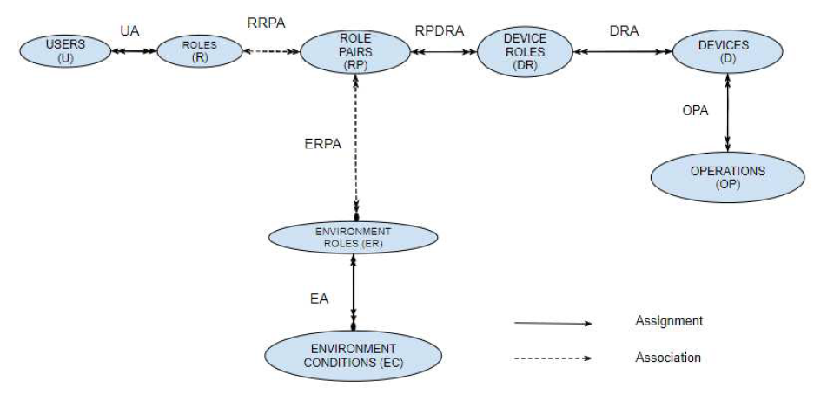

Our view of GRBAC

Slide 15
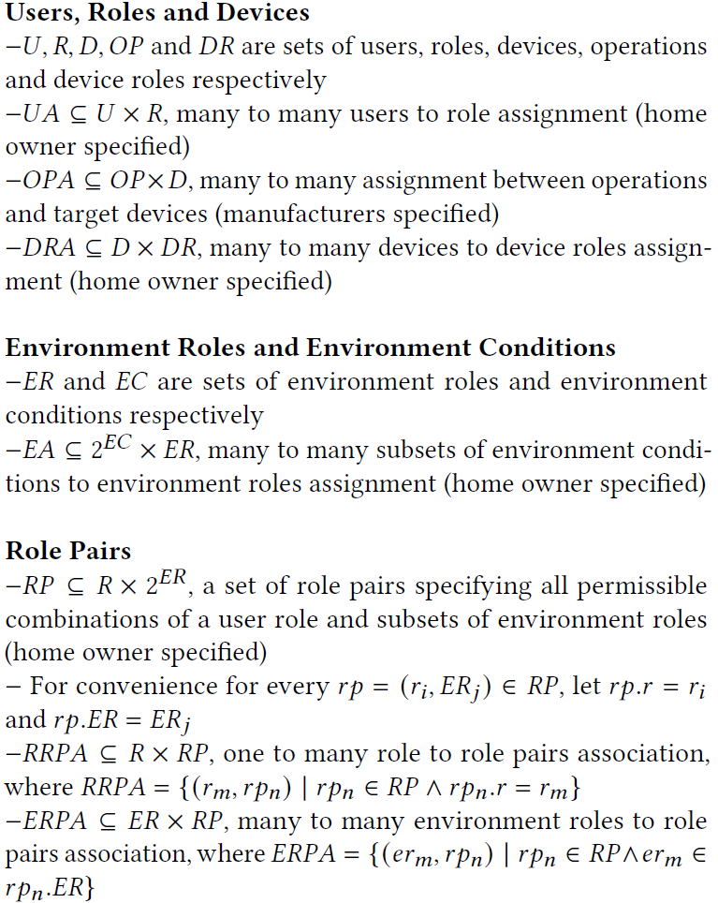
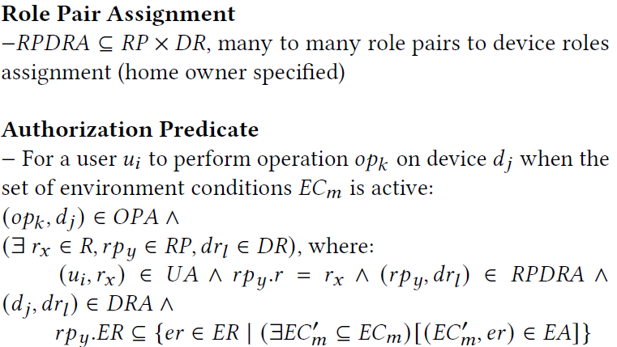

Our formalization of GRBAC

Slide 16
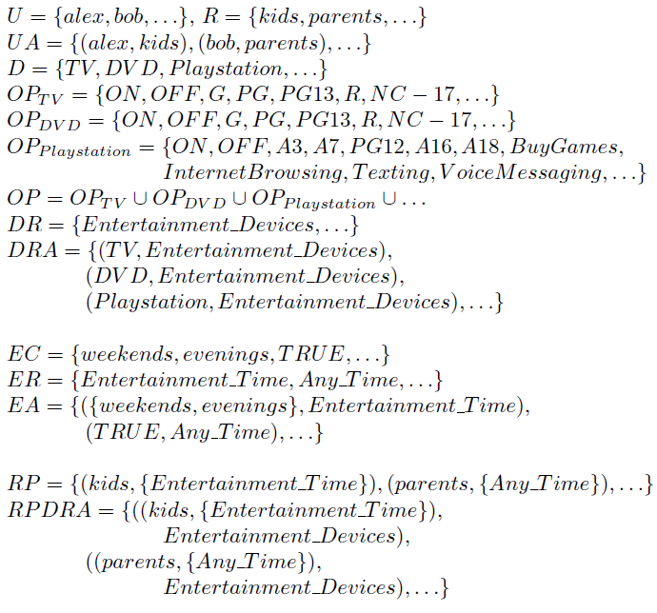

Use Case 1.A Configuration in GRBAC

Slide 17


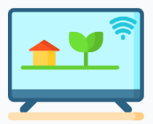

Use Case 1.A

Slide 18


Use Case 1.A

Slide 19

Use Case 1.A

Slide 20


Use Case 1.A

Slide 21

Use Case 1.A

Slide 22
References
[1] W. He, M. Golla, R. Padhi, J. Ofek, M. D¨urmuth, E. Fernandes, and B. Ur, “Rethinking access control and authentication for the home internet of things (IoT),” in 27th USENIX Security Symposium (USENIX Security 18), 2018, pp. 255–272.
[2] A.Ouaddah,H.Mousannif,A.A.Elkalam,andA.A.Ouahman,“Access control in the internet of things: Big challenges and new opportunities,” Computer Networks, vol. 112, pp. 237–262, 2017.
[3] M. J. Covington, M. J. Moyer, and M. Ahamad, “Generalized role based access control for securing future applications,” Georgia Institute of Technology, Tech. Rep., 2000.
[4] G. Zhang and J. Tian, “An extended role based access control model for the internet of things,” in 2010 International Conference on Information, Networking and Automation (ICINA), vol. 1. IEEE, 2010, pp. V1–319.
[5] E. Barka, S. S. Mathew, and Y. Atif, “Securing the web of things with role-based access control,” in International Conference on Codes, Cryptology, and Information Security. Springer, 2015, pp. 14–26.

Slide 23
References
[6] J. Jindou, Q. Xiaofeng, and C. Cheng, “Access control method for web of things based on role and sns,” in 2012 IEEE 12th International Conference on Computer and Information Technology. IEEE, 2012, pp. 316–321.
[7] S. Kaiwen and Y. Lihua, “Attribute-role-based hybrid access control in the internet of things,” in Asia-Paciﬁc Web Conference. Springer, 2014, pp. 333–343.
[8] J. Liu, Y. Xiao, and C. P. Chen, “Authentication and access control in the internet of things,” in 2012 32nd International Conference on Distributed Computing Systems Workshops. IEEE, 2012, pp. 588–592.
[9] N. Ye, Y. Zhu, R.-c. Wang, R. Malekian, and L. Qiao-Min, “An efﬁcient authentication and access control scheme for perception layer of internet of things,” Applied Mathematics & Information Sciences, vol. 8, no. 4, p. 1617, 2014.
[10] S. Bandara, T. Yashiro, N. Koshizuka, and K. Sakamura, “Access control framework for api-enabled devices in smart buildings,” in 2016 22nd Asia-Paciﬁc Conference on Communications (APCC). IEEE, 2016, pp. 210–217.

Slide 24
References
[11] A. Mutsvangwa, B. Nleya, and B. Nleya, “Secured access control architecture consideration for smart grids,” in 2016 IEEE PES PowerAfrica. IEEE, 2016, pp. 228–233.
[12] Y. Xie, H. Wen, J. Wu, Y. Jiang, J. Meng, X. Guo, A. Xu, and Z. Guan, “Three-layerssecureaccesscontrolforcloud-basedsmartgrids,”in2015 IEEE 82nd Vehicular Technology Conference (VTC2015-Fall). IEEE, 2015, pp. 1–5.
[13] F. Martinelli, C. Michailidou, P. Mori, and A. Saracino, “Too long, did not enforce: a qualitative hierarchical risk-aware data usage control model for complex policies in distributed environments,” in Proceedings of the 4th ACM Workshop on Cyber-Physical System Security. ACM, 2018, pp. 27–37.
[14] M. J. Covington, W. Long, S. Srinivasan, A. K. Dev, M. Ahamad, and G. D. Abowd, “Securing context-aware applications using environment roles,” in Proceedings of the sixth ACM symposium on Access control models and technologies. ACM, 2001, pp. 10–20.
[15] R. S. Sandhu, “Role-based access control,” in Advances in computers. Elsevier, 1998, vol. 46, pp. 237–286.

