Slide 1
Access Control Models for Cloud-Enabled Internet of Things
Ph.D. Dissertation Defense
By
Asma Alshehri
Department of Computer Science
University of Texas San Antonio
Advisor: Dr. Ravi Sandhu
Committee: Dr. Gregory B. White Dr. Matthew Gibson Dr. Palden Lama
Dr. Ram Krishnan

Slide 2
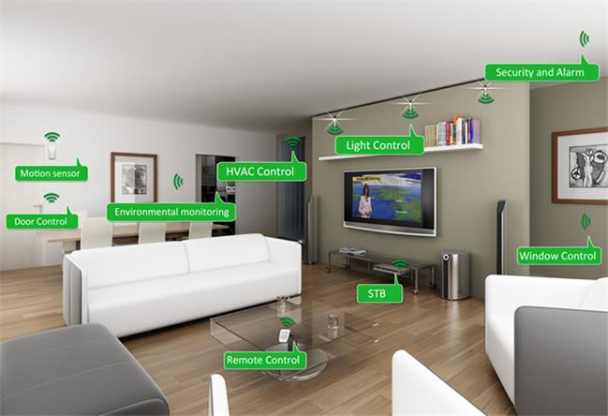

Internet of Things

Slide 3
Outline
Introduction and Background.
Access Control Oriented (ACO) Architecture for Cloud-Enabled IoT
Access Control Models for VO Communication in ACO Architecture.
Access Control Model for VO Communication and Implementation in AWS IoT
Conclusion and Future Work

Slide 4
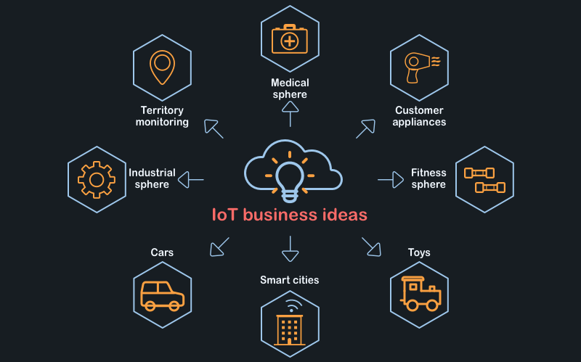
IoT Projects

Slide 5
IoT Proposed Architectures
Architecture:
Integrating the Cloud
Unlimited computational capabilities
Low-cost
On-demand storage
Resources usable from everywhere
Integrating Virtual objects
Solution for major IoT Issues
Homogeneous communication style
IoT Security

Slide 6
Problem Scope
The Cloud
The VO
The VO

Slide 7
Thesis Statement
It is feasible to develop a set of access control models for virtual objects communication in cloud-enabled Internet of Things within the Access control Oriented (ACO) architecture by adapting traditional access control models, specifically, Cap-ACL, RBAC, ABAC and Policy-Based.

Slide 8
Summary of Contribution

Slide 9

Access Control Oriented (ACO) Architecture for Cloud-Enabled IoT

Slide 10
Access Control Oriented (ACO) Architecture for IoT
The Object layer:
Physical objects
Collect data
Communication
The Virtual Object Layer:
Presents status of objects
Communication
O-VO Association

Slide 11
Access Control Oriented (ACO) Architecture for IoT
The Cloud Layer:
Big data
Functionality
Communication
The Application Layer:
Interface
Users and Admin
Generate AC policies

Slide 12
ACO Architecture for IoT
Communication
Data
Intra-Layer
Cross-Layer
Sub-Data
Accumulated
Data
Individual-Data

Slide 13
Access Control Issues in ACO Architecture for IoT

Slide 14
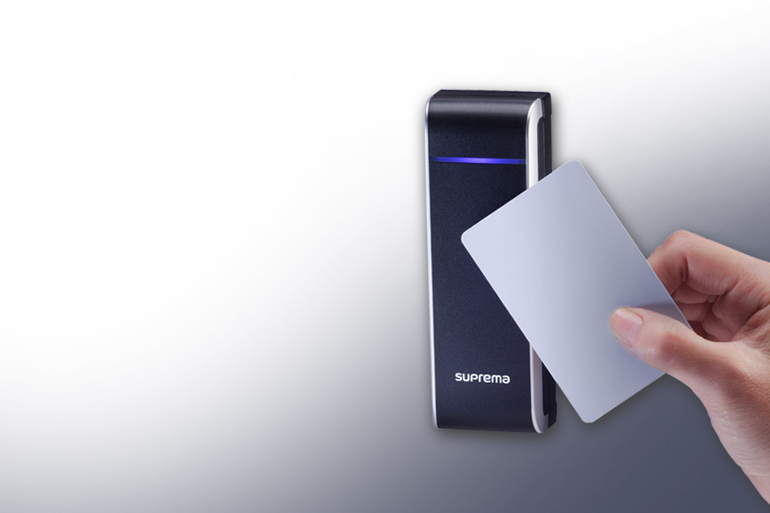
Access Control Models for VO Communications in ACO Architecture

Slide 15
Use Case within ACO
Notes:
This shows the privacy benefit of separating the

Slide 16
Access Control Models for VO Communication
Develop access control models for VO communication in two layers:
A - Operational models
B - Administrative models

Slide 17
Operational Access Control for VO Communication
ACL and Capability Based (ACL-Cap) Operational Model
ABAC Operational Model
Four Questions:
Which VOs are allowed to publish or send a subscription request to a topic?
Which topics should VOs publish or send a subscription request to?
Which VOs should a topics forward data to?
Which topics should VOs receive data from?

Slide 18
A. ACL and Capability Based (ACL-Cap) Operational Model
The operational models recognize sets of entities:
Virtual objects (VO) and topics (T)
A set of rights R={Publish, Subscribe}.
F={Forward}

Slide 19
A. ACL and Capability Based (ACL-Cap) Operational Model
The authorization rule for publish is expressed as follows.
Auth-Publish(VO,T) ≡ (T,p) ∈ Cap(VO)∧ (VO, p) ∈ ACL(T)
The authorization rule for subscribe is expressed as follows.
Auth-Subscribe(VO,T) ≡ (T,s) ∈ Cap(VO)∧ (VO, s) ∈ ACL(T )
The authorization rule for forwarding of published data by a topic’s MB to a VO expressed as follows.
Auth-Forward(T, VO) ≡ VO ∈ Subscribers(T )∧T ∈ Subscriptions(VO)

Slide 20
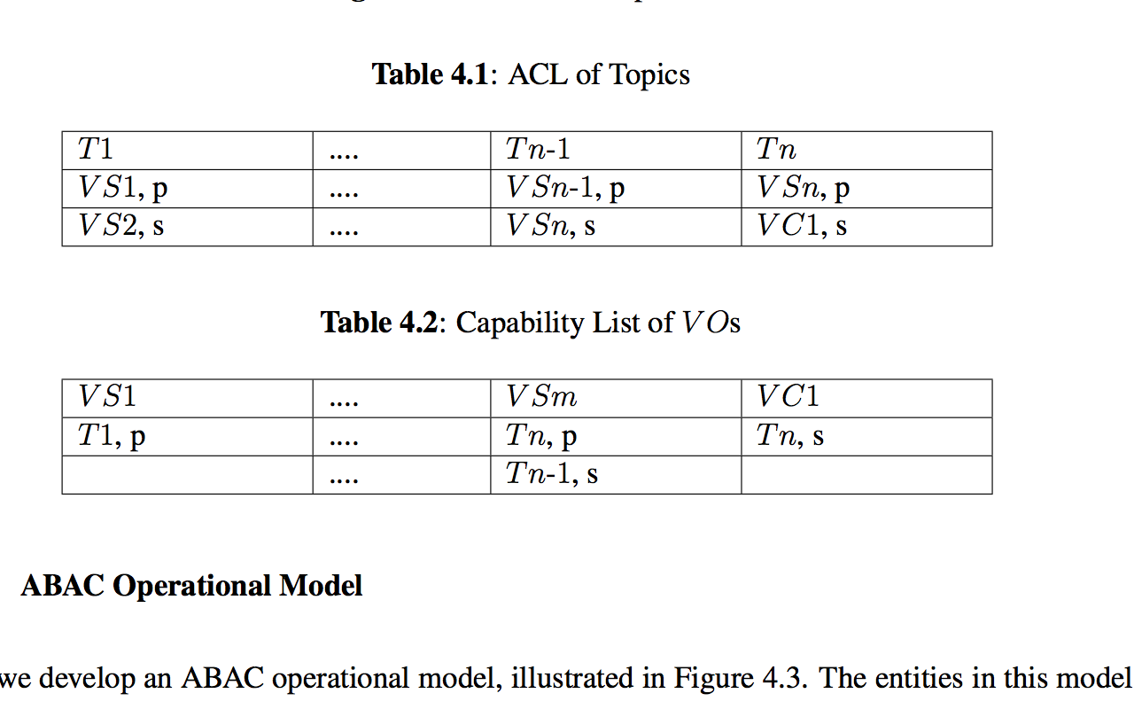
A. ACL and Capability Based (ACL-Cap) Operational Model
ACL of T
Cap of VO

Slide 21
B. ABAC Operational Model
The operational models recognize sets of entities:
Virtual objects (VO) and topics (T)
A set of rights R={p,s} and F = {Forward}, as before
Sets of attributes, virtual object attributes (VOA ) and topic attributes (TA) , as follows.
VOA = {VO-Publish, VO-Subscribe, VO-Subscriptions, VO-Location}
TA= {T-Publish, T-Subscribe, T-Subscribers, T-Location}

Slide 22
B. ABAC Operational Model
The authorization rule for publish is expressed as follows.
Auth-Publish(VO,T) ≡ T ∈ VO-Publish(VO)∧VO ∈ T-Publish(T)
The authorization rule for subscribe is expressed as follows.
Auth-Subscribe(VO,T) ≡ T ∈ VO-Subscribe(VO)∧VO ∈ T-Subscribe(T)
The authorization rule for forward published data is expressed as follows.
Auth-Forward(T, VO) ≡ T ∈ VO-Subscriptions(VO)∧VO ∈ T-Subscribers(T )
We can conjunctively add the following condition to each of the three equations above.
T-Location(T) ≈ VO-Location(VO)

Slide 23
Administrative Access Control
for VO Communication
Admins mean users who are authorized to control VO communication, by adjusting configuration of the operational model.
Administrative ACL Model
Administrative RBAC Model
Administrative ABAC Model
For the ACL-Cap operational model:
Who is allowed to add or delete (VO,p) or (VO,s) from ACL of T?
Who is allowed to add or delete (T,p) or (T,s) from Capability list of VO?
For the ABAC operational model:
Who is allowed to assign or delete values to or from attributes of T?
Who is allowed to assign or delete values to or from attributes of VO?

Slide 24
A. Administrative ACL Model
The administrative ACL model introduces a set of admin users (A) and admin permissions (AP) as follows.
A = {U1, .., Um-1, Um}
AP = {Own, Control}

Slide 25
A. Administrative ACL Model
The authorization rule for admin user U to control T or VO as follow.
Auth-Control(U,T) ≡ (U,ap) ∈ ACL(T)
Auth-Control(U,VO) ≡ (U,ap) ∈ ACL(VO)
Difficult to maintain

Slide 26
B. Administrative RBAC Model
Additionally, RBAC introduces set of administrative roles (AR) and admin permissions set(APS) as follows.
AR = {AR1, .., ARs},
APS ={(VO×AP)∪ (T×AP)}, A set of VO-AP and T-AP pairs.
Easier to maintain

Slide 27
C. Administrative ABAC Model
Additionally, ABAC introduces administrative attributes for topics (TAA), VOs (VOAA), and users (UAA), as follows.
TAA = {T-Location, T-Department}
VOAA = {VO-Type, VO-Location, VO-Department}
UAA = {UA-Type, UA-Location, UA-Department}
27

Slide 28
C. Administrative ABAC Model
Authorize users who have own or control permission to control sensors and cameras from the same department and close location
Auth-Control(U,VO) ≡
(UA-Type(U) = Own∨ UA-Type(U) = Control)∧
UA-Department(U )= VO-Department(VO)∧
(VO-type = sensor∨ VO-type = camera)∧
UA-location ≈ VO-Location(VO)
Flexible, scalable, and adaptable:
Identity, roles, and resource information of ACL and RBAC into attributes
incorporating collected data for making a decision
28

Slide 29

Access Control Models for VO Communication and Implementation in AWS IoT

Slide 30
The AWS-IoT-ACMVO Model for AWS IoT
AWS
IOT

Slide 31
The Publish/Subscribe Topic-Based Scheme

Slide 32
Communication Channel in AWS IoT

Slide 33
The Sensing Speeding Cars Use Case
n

Slide 34
Sensing the Speed of One Car with two sensors

Slide 35
Role2 Policy that is Attached to Role2

Slide 36
Sensing the Speed of Multiple Cars with Multiple sensors

Slide 37
Performance

Slide 38

Conclusion and Future Work

Slide 39
Future Work

Slide 40
Conclusion
ACO Architecture for Cloud-Enabled IoT
Integrating the Cloud
Integrating virtual object
Access Control Models for VO Communications within ACO
Operational models
Administrative models
Access Control Models for VO Communications in AWS IoT

Slide 41
Publications
Dissertation published papers:
Asma Alshehri and Ravi Sandhu. Access control models for cloud-enabled internet of things: A proposed architecture and research agenda. In the 2nd IEEE International Conference on Collaboration and Internet Computing (CIC), pages 530-538. IEEE, 2016.
Asma Alshehri and Ravi Sandhu. Access control models for virtual object communication in cloud-enabled iot. In The 18th International Conference on Information Reuse and Integration (IRI). IEEE, 2017.
Asma Alshehri, James Benson, Farhan Patwa, and Ravi Sandhu. Access control model for virtual objects (shadows) communication for aws internet of things. In Proceedings of the Eighth ACM on Conference on Data and Application Security and Privacy. ACM, 2018.
Other published papers:
Asma Alshehri and Ravi Sandhu. On the relationship between finite domain ABAM and PreUCON_A. In International Conference on Network and System Security, pages 333–346, 2016.

Slide 42


Questions

