Slide 1
Multi-Tenant Access Control for Cloud Services
PhD Dissertation Defense
Bo Tang
Committee Members:
Dr. Ravi Sandhu, Chair
Dr. Kay Robbins
Dr. Gregory White
Dr. Weining Zhang
Dr. Jaehong Park
07/31/2014

Slide 2

The Cloud
Anytime
Anywhere
Notes:
The cloud emerged around 2007 and is now everywhere in the commercials, especially for technology. It enables people to access their data anytime anywhere.

Slide 3
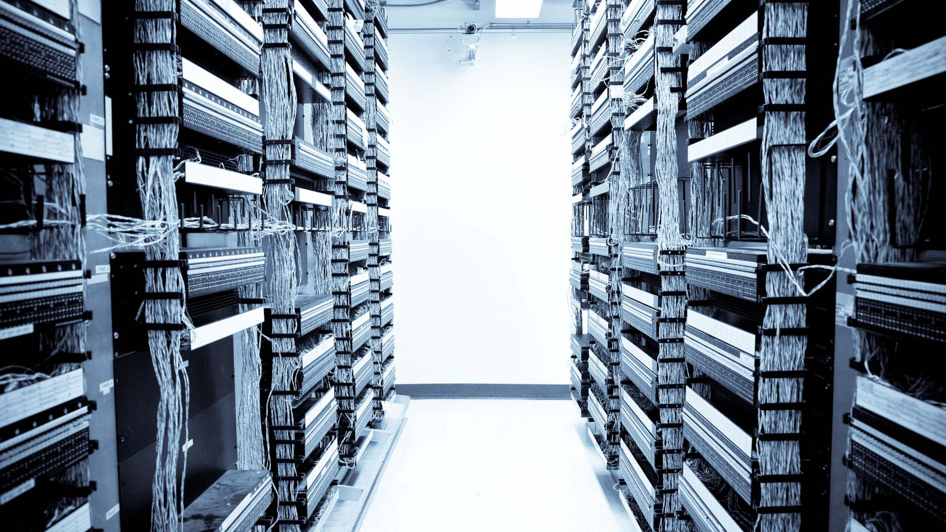
Really? But where is my data?
Notes:
The fact is no body knows where the data is. We just trust the cloud service provider or CSP to manage our data securely and privately in their data centers.

Slide 4

Really? But where is my data?
Multi-Tenancy
Notes:
As computer scientists we know a little bit more. They use multi-tenancy.

Slide 5
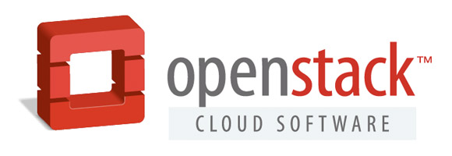
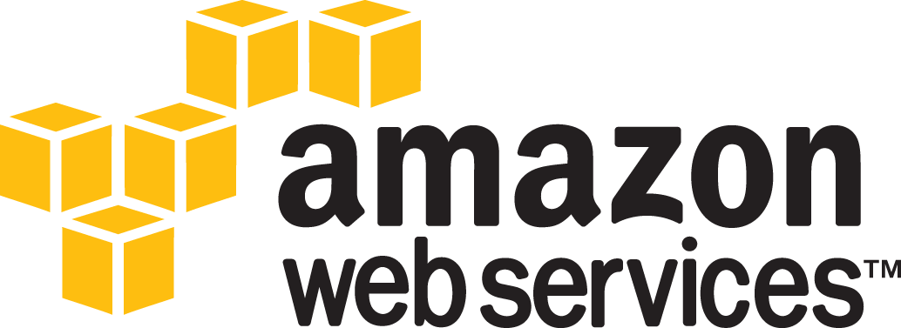
Cloud & Multi-Tenancy
Shared infrastructure
  [$$$] -----> [$|$|$]
Multi-Tenancy
  Isolated workspace for customers
  Virtually temporarily dedicated resources
Problem:
  How to collaborate across tenants?
    Even if across my own tenants?

Slide 6
Define Tenant
All deployment models are multi-tenant
  E.g.: public cloud, private cloud and community cloud.
From Cloud Service Provider (CSP) perspective
  A billing customer
  Manages its own users and cloud resources
The owner of a tenant can be
  An individual, an organization or a department in an organization, etc.

Slide 7
Characteristics of Cloud
Centralized Facility
  Resource pooling
Self-Service Agility
  Each tenant manages its own authorization
  Tenants, users and resources are temporary
Homogeneity
  Identical or similar architecture and system settings
Out-Sourcing Trust
  Built-in collaboration spirit
Notes:
This kind of collaboration is not necessarily among parties. It could be among applications.
Subleasing an apartment for 2 rooms. A living room and a bedroom. Direct access in between.
E.g.: subleasing two rooms in an apartment.
One for storage, the other for living.
Direct accessible in between.

Slide 8
Multi-Tenant Access Control (MTAC)
Chapter 3
Top-Down Approach
Chapter 4
Chapter 5

Slide 9
Motivation

Slide 10
Problem & Thesis
Problem Statement
Thesis Statement
The fact that contemporary cloud services are intrinsically not designed to cultivate collaboration between tenants limits the development of the cloud. Fine-grained access control models in traditional distributed environments are not directly applicable.
The problem of multi-tenant access control in the cloud can be partially solved by integrating various types of unidirectional and unilateral trust relations between tenants into role-based and attribute-based access control models.

Slide 11
Chapter 2: Related Work
Centralized Approaches
  RBAC extensions: ROBAC, GB-RBAC
  Multi-domain role mapping
Decentralized Approaches
  RT, dRBAC: credential-based delegation
  Delegation models: PBDM, RBDM
Attribute-Based Approaches
  NIST ABAC: application framework for collaboration
  ABAC models: ABURA, RBAC-A, ABAC_{α}, ABAC_{β}
Enforcement and Implementation
  Grid: PERMIS, VOMS, CAS
  Web: ABAC for SOA systems
  Cloud: centralized authorization service with trust models

Slide 12
Scope and Assumptions
Standardized APIs
  Cross-tenant accesses are functionally available
Properly authenticated users
One Cloud Service
  Of a kind: IaaS, PaaS or SaaS.
Two-Tenant Trust (rather than community trust)
Unidirectional Trust Relations
  “I trust you” does not mean “you trust me”
Unilateral Trust Relations (trustor trusts trustee)
  Trustee cannot control the trust relation

Slide 13
Multi-Tenant Access Control (MTAC)
Chapter 3
Top-Down Approach
Chapter 4
Chapter 5

Slide 14
MTAS
Formalizing Calero et al work

Slide 15
Tenant Trust
Tenant Trust (TT) relation is not partial order
  Reflexive: A ⊴ A
  But not transitive: A ⊴ B ∧ B ⊴ C ⇏ A ⊴ C
  Neither symmetric: A ⊴ B ⇏ B ⊴ A
  Nor anti-symmetric: A ⊴ B ∧ B ⊴ A ⇏ A ≡ B

Slide 16
Administrative MTAS
Tenants are managed by CSP
  on self-service basis
Each tenant administer:
  Trust relations with other tenants
  Entity components:
    users, roles and permissions
  UA, PA and RH assignments
    Cross-tenant assignments are issued by the trustee (t1)
      UA: trustor (t2) users to trustee (t1) roles
      PA: trustee (t1) permissions to trustor (t2) roles
      RH: trustee (t1) roles junior to trustor (t2) roles
t2 β-trusts t1
Tenant t1
Tenant t2
u1
UA
u2
R1
RH
R2
PA
P1
P2

Slide 17
Fine-grained Trust Extensions
Problem of MTAS trust model
  Over exposure of trustor’s authorization information
Trustor-Centric Public Role (TCPR)
  Expose only the trustor’s public roles
    E.g.: OS expose only the dev.OS role to all the trustees
Relation-Centric Public Role (RCPR)
  Expose public roles specific for each trust relation
    E.g.: OS expose only the dev.OS role to E when OS trusts E

Slide 18
Trust Types Between Tenants
Intuitive Trust (Type-α)
  Delegations: RT, PBDM, etc.
  Trustor gives access to trustee
    Trustor has full control
MTAS trust (Type-β)
  Trustee gives access to trustor
Other Types?
  Trustee takes access from trustor (Type-γ)
  Trustor takes access from trustee (Type-δ)
  And more?

Slide 19
Example of Cross-Tenant Trust
[$]: grant the access
OS
E
Charlie
Dev.E
Example:
  Type-α: E trusts OS so that E can say [$].
  Type-β: OS trusts E so that E can say [$].
  Type-γ: E trusts OS so that OS can say [$].
  Type-δ: OS trusts E so that OS can say [$].

Slide 20
Example of Cross-Tenant Trust
[$]: grant the access
OS
E
Charlie
Dev.E
Example:
  Type-α: E trusts OS so that E can say [$].
  Type-β: OS trusts E so that E can say [$].
  Type-γ: E trusts OS so that OS can say [$].
  Type-δ: OS trusts E so that OS can say [$].

Slide 21
Multi-Tenant Access Control (MTAC)
Chapter 3
Top-Down Approach
Chapter 4
Chapter 5

Slide 22
MT-RBAC
Issuers:
Real-world Owners
e.g. E and OS
Type-γ Trust

Slide 23
Administrative MT-RBAC
t1 γ-trusts t2
Issuers administer tenants
Each issuer administer:
  Trust relations from owned tenants
  Entity components:
    tenants, users, roles and permissions
  UA, PA and RH assignments
    Cross-tenant assignments are issued by the trustee’s (t2’s) issuer
      UA: trustee (t2) users to trustor (t1) roles
      RH: trustor (t1) roles junior to trustee (t2) roles
    Cross-tenant PA assignments are intentionally banned
      PA: trustee (t2) assign trustor (t1) permissions to trustee (t2) roles
      Problem:
        Trustor cannot revoke PA other than remove the trust
Tenant t1
Tenant t2
u1
UA
u2
R1
RH
R2
P1
P2

Slide 24
Finer-grained Trust Models
MT-RBAC0: Base Model
  Trustor exposes all the roles to trustees
MT-RBAC1: Trustee-Independent Public Role (TIPR)
  Expose only the trustor’s public roles
    E.g.: E expose only the dev.E role to all the trustees
MT-RBAC2: Trustee-Dependent Public Role (TDPR)
  Expose public roles specific for each trustee
    E.g.: E expose only the dev.E role to OS when E trusts OS
Notes:
More details

Slide 25
Constraints
Cyclic Role Hierarchy: lead to implicit role upgrades in the role hierarchy
SoD: conflict of duties
  Tenant-level
    E.g.: SOX compliant companies
    may not hire the same company
    for both consulting and auditing.
  Role-level
    Checks across tenants
Chinese Wall: conflict of interests among tenants
    E.g.: never share resources with competitors.
Tenant 1
Tenant 2
M1
M2
E1
E2

Slide 26
Multi-Tenant Access Control (MTAC)
Chapter 3
Top-Down Approach
Chapter 4
Chapter 5

Slide 27
CTTM Trust Types
Four potential trust types:
  Type-α: trustor can give access to trustee. (e.g. RT)
  Type-β: trustee can give access to trustor. (e.g. MTAS)
  Type-γ: trustee can take access from trustor. (e.g. MT-RBAC)
  Type-δ: trustor can take access from trustee.
    No meaningful use case, since the trustor holds all the control of the cross-tenant assignments of the trustee’s permissions.

Slide 28
Formalized CTTM Model

Slide 29
Role-Based CTTM

Slide 30
Multi-Tenant Access Control (MTAC)
Chapter 3
Top-Down Approach
Chapter 4
Chapter 5

Slide 31
MT-ABAC
uid: u2
utid: t2
γ-trustee: {t2}
tid: t1
sowner: u2
sid: s2
oid: o1
otid: t1

Slide 32
Multi-Tenant Access Example

Slide 33
Real-World Clouds
AWS
  Collaboration between accounts
    E.g.: E trusts OS
  Unilateral trust relation (Type-α)
    The trustor needs to map the roles
OpenStack
  User-level delegation (trust) can be established
  Cross-domain assignments bear no control

Slide 34
Multi-Tenant Access Control (MTAC)
Chapter 3
Top-Down Approach
Chapter 4
Chapter 5

Slide 35
MTAaaS Platform Prototype
Centralized (Chosen)
  Centralized PDP with distributed PEP
    Pros: easy management
    Cons: volume of requests may be high
Decentralized
  Distributed PDP and PEP
    Pros: requests handling
    Cons: keep decision
    consistent

Slide 36
Example MTAS policy structure
OS β-trusts E

Slide 37
MT-RBAC2 Policy Example
tr γ-trusts te

Slide 38
Experiment Environment
FlexCloud Testbed
  PEP×8: SmartOS 1.8.1 / CPU Cap=350 / 256MB RAM
  PDP: 64-bit CentOS 6 / 1-, 2-, 4-, 8-, 16-Units
  ATC: SmartOS 1.8.4 / CPU Cap=350 / 1GB RAM
  PEPs in a same network which is different with PDP’s
1 unit = 1CPU/1GB RAM

Slide 39
Evaluation: Performance
MT-RBAC vs RBAC
  More policy references incur more decision time
MT-RBAC2 introduces 12 ms authz. overhead.
PDP Performance
Client-End Performance when downloading 1KB file

Slide 40
Evaluation: Performance
MTAS introduces 12 ms authz. overhead.
PDP Response Delay with various PEP amount
PDP Response Delay with various hardware capability and 1k tenants

Slide 41
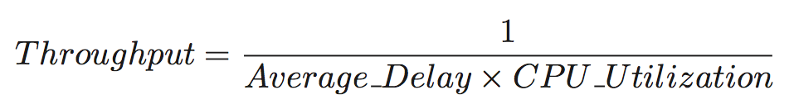
Evaluation: Scalability
Scalable in terms of both
  PDP hardware capacity
  Policy complexity
Policy Complexity Scalability Results
Policy Complexity Scalability Results

Slide 42
Multi-Tenant Access Control (MTAC)
Chapter 3
Top-Down Approach
Chapter 4
Chapter 5

Slide 43
OSAC

Slide 44
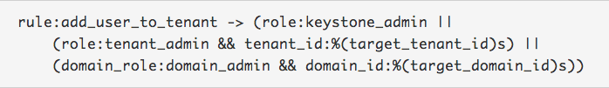

AOSAC
Cloud Admin
Domain A Admin
Domain B Admin
Project A1 Admin
Project A2 Admin
Project B1 Admin
Project B2 Admin
Source: https://wiki.openstack.org/wiki/Domains

Slide 45
Trust Framework

Slide 46
Prototype & Evaluation
Sequential request handling (Queuing)
  Domain trust introduces 0.7% authz. Overhead
  Scalability changes little with domain trust
Performance
Scalability

Slide 47
Chapter 6: Conclusion
Policy
  MTAS: role-based Type-β trust
  MT-RBAC: role-based Type-γ trust
  CTTM: trust type taxonomy for role-based models
  MT-ABAC: attribute-based model trusts
Enforcement
  MTAaaS: centralized PDP with distributed PEP
Implementation
  Domain Trust in OpenStack

Slide 48
Chapter 6: Future Work
MT-ABAC
  Finer-grained extensions
  Administration, enforcement and implementation.
More and finer-grained trust models
  Trust negotiation and graded trust relations
More MTAC models
  MT-PBAC, MT-RAdAC, etc.
Attribute-based MTAC models in OpenStack

Slide 49
Publications
Bo Tang and Ravi Sandhu. Extending OpenStack Access Control with Domain Trust. In Proceedings 8th International Conference on Network and System Security (NSS), Xi’an China, October 2014.
Bo Tang, Ravi Sandhu and Qi Li. Multi-Tenancy Authorization Models for Collaborative Cloud Services. Concurrency and Computation: Practice & Experience (CCPE), WILEY, 2014. (under review)
Bo Tang and Ravi Sandhu. Cross-Tenant Trust Models in Cloud Computing. In Proceedings 14th IEEE Conference on Information Reuse and Integration (IRI), San Francisco, California, August 2013.
Bo Tang, Qi Li and Ravi Sandhu. A Multi-Tenant RBAC Model for Collaborative Cloud Services. In Proceedings 11th IEEE Conference on Privacy, Security and Trust (PST), Tarragona, Spain, July 2013.
Bo Tang, Ravi Sandhu and Qi Li. Multi-Tenancy Authorization Models for Collaborative Cloud Services. In Proc. 14th IEEE Conference on Collaboration Technologies and Systems (CTS), San Diego, California, May 2013.

Slide 50
Q & A

Slide 51
Thank You!

