Slide 1
Access Control for Online Social Networks using Relationship Type Patterns
Institute for Cyber Security
Dissertation Defense
Yuan Cheng
Department of Computer Science
University of Texas at San Antonio
4/16/2014
World-Leading Research with Real-World Impact!
Notes:
Welcome ladies and gentlemen to my dissertation defense today. It’s so awesome to having you all here.
The title of my dissertation is … The dissertation is co-advised by Dr Sandhu and Dr Park.

Slide 2
Roadmap
2008 | 2009 | 2010 | 2011 | 2012 | 2013 | 2014
Entered the program | Joined the SNGuard project | Passed the qualifying exam |  | Passed the proposal |  | Expected to graduate
 | Literature review | Identified the problems | ACON[5], IEEE IC[6] |  | UURAC Evaluation[1]
 |  |  | Delved into ReBAC | UURAC[4] |  | UURAC_{A}[2]
 |  |  |  | URRAC[3]
 |  |  |  | 3rd party applications | PSOSM[7]
World-Leading Research with Real-World Impact!
Notes:
These are the milestones for my phd career.
Subsequently, we proposed two ReBAC models based on different relationships.

Slide 3
Outline
Introduction
UURAC
UURAC_{A}
URRAC
Conclusion
World-Leading Research with Real-World Impact!
Notes:
This is an overview of what I’m going to present today. First, I will drive you through the introduction of my dissertation, including the background, motivation, problems to be investigated. Next, I will talk about the three models we proposed. At the end I will conclude my work.

Slide 4
Background
Security issues in OSNs can be organized into at least four categories
  Privacy breaches (focus of this work)
  Spam and phishing attacks
  Sybil attacks
  Malware attacks
Privacy breaches
  Easy to happen from OSN providers, other users, and 3rd party applications
  OSN providers store user data
  3rd party applications provide extra functionalities
  Major threats are from peer users
    Not aware of who they share with and how much
    Have difficulty in managing privacy controls
World-Leading Research with Real-World Impact!
Notes:
Over the recent years, OSNs have thrived rapidly and now have more than 1 billion active users. People share a tremendous amount of content with others in OSNs. However, users are severely exposed to potential threats to their data security and privacy. Many incidents have been observed, highlighting the need for better security mechanisms for OSNs.
The emergence of OSNs make large-scale privacy breaches feasible. Others are not new by themselves but are worth reexamining.
There are three parties interact with one another in OSNs.

Slide 5
Why Privacy is Hard to Protect in OSNs
Users tend to give out too much information
  Unaware of privacy issues
  Promote sharing vs. Protect privacy
Users tend to be Reactive rather than Proactive
Privacy policies
  Changing over time
  Confusing
  Privacy thresholds vary by individuals
World-Leading Research with Real-World Impact!
Notes:
A majority of information is shared without user’s careful consideration.
Face an embarrassing dilemma: should we share more content or protect the privacy?
Users could be falling behind the threats.
It’s important for users to keep their knowledge of privacy policies up-to-date.
However, users aren't aware of the social network's privacy control settings or simply don't use them at all.
Google and Facebook privacy policies can be more confusing to users than credit card agreements and government notices. Hard to make an consensus on privacy thresholds

Slide 6
The Challenges of OSN Access Control
Lack of a Central Administrator
  Traditional access control mechanisms, such as RBAC, requires an administrator to manage access control
  No such administrator exists in OSNs
Dynamic Changing Environment
  Frequent content updates and volatile nature of relationships
  Identity and attribute-based access control are not effective for OSNs
World-Leading Research with Real-World Impact!
Notes:
The number of users and relationships among users are enormous and changing dynamically
It’s not practical to specify a particular set of users to who the acp apply in a traditional way
Identity and attribute-based approaches fail to cope with the scalability and dynamicity of Osns.

Slide 7

Relationship-based Access Control
Users in OSNs are connected by social relationships (user-to-user relationships)
Owner of the resource can control its release based on such relationships between the access requester and the owner
World-Leading Research with Real-World Impact!
Notes:
So how does access control in OSNs look like? Social relationships form the social graph. AC is based on the topology of the social graph.
Owners can specify access control without knowing the user name space of the entire network or all their direct or indirect contacts.
Mention the approach used by the most dominant OSNs today

Slide 8
Motivating Examples
Related User’s Control
  There exist several different types of relationships in addition to ownership
  e.g., Alice and Carol want to control the release of Bob’s photo which contains Alice and Carol’s image.
Administrative Control
  A change of relationship may result in a change of authorization
  Treat administrative activities different from normal activities
    Policy specifying, relationship invitation and relationship recommendation
  e.g., Bob’s mother Carol may not want Bob to become a friend with her colleagues, to access any violent content or to share personal information with others.
Attribute-aware ReBAC
  Exploit more complicated topological information
  Utilize attributes of users and relationships
  e.g., common friends, duration of friendship, minimum age, etc.
World-Leading Research with Real-World Impact!
Notes:
Still far from perfect. Rudimentary friend-of-friend approach; focus on U2U relationships; at least implicitly assume ownership is the only manifestation of U2R. Failed to capture many user activities found in OSN applications.
Tagged user want to control other related user’s access to the photo.
Allowing U2R relationships enables users to specify policies for related resources and users. Policy administration becomes critical since OSN needs to ensure only the right users are authorized to do it.
Cannot express requirements on multiple occurrences of such path

Slide 9
Problem Statement
Traditional access control mechanisms are not suitable for OSNs
  OSNs keep massive resources and change dynamically
Existing relationship-based access control approaches are coarse-grained and limited
  Commercial systems support either limited types or limited depth of U2U relationships
  Academic works are also not flexible and expressive enough in relationship composition
Policy administration and conflict resolution are missing
  Multiple users can specify policies for the same resource
Using relationships alone does not meet users’ expectations
World-Leading Research with Real-World Impact!
Notes:
Big bulk of data, Changing dynamically, traditional methods are not scalable
Various types of resources need to be protected, such as user sessions, relationships, policies and events.
Current solutions rely on an implicit relationship, ownership. Authorization is still based on U2U.
Extend social graph to incorporate arbitrary activities and objects
It is beneficial to incorporate attribute-based policies to ReBAC

Slide 10
Thesis
Users and resources are interconnected through U2U, U2R and R2R relationships, which form the basis of an OSN system, the social graph.
By utilizing regular expression notation for policy specification, it is efficient and effective to regulate access in OSNs in terms of the pattern of relationship path on the social graph and the hopcount limit on the path.
Integrating attribute-based policies further enables finer-grained controls that are not available in ReBAC alone.
World-Leading Research with Real-World Impact!

Slide 11
Scope and Assumptions
Assumptions
  The threat model does not include OSN providers
  Users’ computers are not compromised by malicious intruders or malwares
  Do not consider the case when a hacker gains unauthorized access to a site’s code and logic
Scope
  Aim to improve the access control mechanism
    ReBAC
World-Leading Research with Real-World Impact!
Notes:
Not realistic to fight against the business model of OSN systems
Easy to exploit a single flaw in the system.

Slide 12
Contributions
Identified access control characteristics for OSNs based on relationships
  Supporting essential characteristics that need to be addressed by OSN access control
Further built two ReBAC models that utilize different kinds of relationships, using regular expression notation.
  Greater generality and flexibility of path patterns in policy specifications
  Addressed administrative control and policy conflict resolution
Integrated attribute-based policies into ReBAC.
Provided two effective path checking algorithms for access control policy evaluation.
  With proof of correctness and complexity analysis
  Enhanced the algorithms for attribute-aware ReBAC
Implemented the algorithms and evaluated the performance.
World-Leading Research with Real-World Impact!

Slide 13
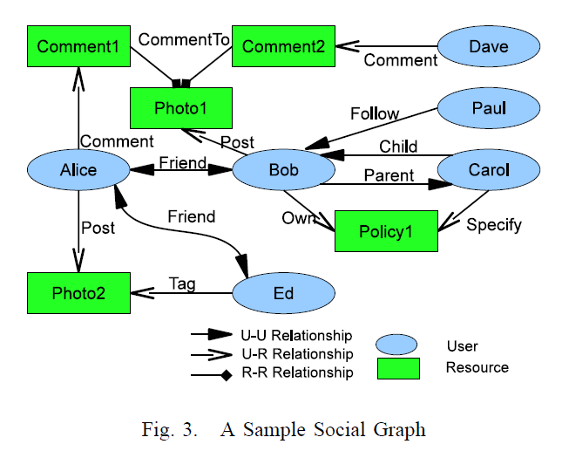
Social Networks
Social graph is modeled as a directed labeled simple graph G=<U, E, Σ>
  Nodes U as users
  Edges E as relationships
  Σ={σ₁, σ₂, …,σ_{n}, σ₁⁻¹, σ₂⁻¹,…, σ_{n}⁻¹}
  as relationship types supported
World-Leading Research with Real-World Impact!
Notes:
Relationship is not mutual any more. We consider incoming relationships, so granting access to users who consider him as a friend is plausible (inverse relationship)

Slide 14
Characteristics of Access Control in OSNs
Policy Individualization
  Users define their own privacy and activity preferences
  Related users can configure policies too
  Collectively used by the system for control decision
User and Resource as a Target
  e.g., poke, messaging, friendship invitation, etc.
User Policies for Outgoing and Incoming Actions
  User can be either requester or target of activity
  Allows control on 1) activities w/o knowing a particular resource and 2) activities against the user w/o knowing a particular access requestor
  e.g., block notification of friend’s activities; restrict from viewing violent contents
World-Leading Research with Real-World Impact!
Notes:
We summarize four essential characteristics that need to be supported in access control solutions for OSN systems.

Slide 15
Outline
Introduction
UURAC
UURAC_{A}
URRAC
Conclusion
World-Leading Research with Real-World Impact!

Slide 16
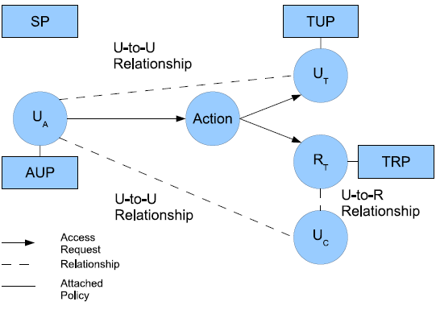
U2U Relationship-based Access Control (UURAC) Model
U_{A}: Accessing User
U_{T}: Target User
U_{C}: Controlling User
R_{T}: Target Resource
AUP: Accessing User Policy
TUP: Target User Policy
TRP: Target Resource Policy
SP: System Policy
Policy Individualization
User and Resource as a Target
Separation of user policies for incoming and outgoing actions
Regular Expression based path pattern w/ max hopcounts (e.g., <u_{a}, (f*c,3)>)
World-Leading Research with Real-World Impact!

Slide 17
Access Request and Evaluation
Access Request <u_{a}, action, target>
  u_{a} tries to perform action on target
  Target can be either user u_{t} or resource r_{t}
Policies and Relationships used for Access Evaluation
  When u_{a} requests to access a user u_{t}
    u_{a}’s AUP, u_{t}’s TUP, SP
    U2U relationships between u_{a} and u_{t}
  When u_{a} requests to access a resource r_{t}
    u_{a}’s AUP, r_{t}’s TRP, SP
    U2U relationships between u_{a} and u_{c}
World-Leading Research with Real-World Impact!

Slide 18
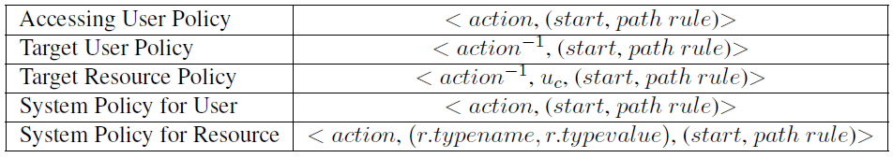
Policy Representations
action⁻¹ in TUP and TRP is the passive form since it applies to the recipient of action
TRP has an extra parameter u_{c} to specify the controlling user
  U2U relationships between u_{a} and u_{c}
SP does not differentiate the active and passive forms
SP for resource needs r.typename, r.typevalue to refine the scope of the resource
World-Leading Research with Real-World Impact!

Slide 19
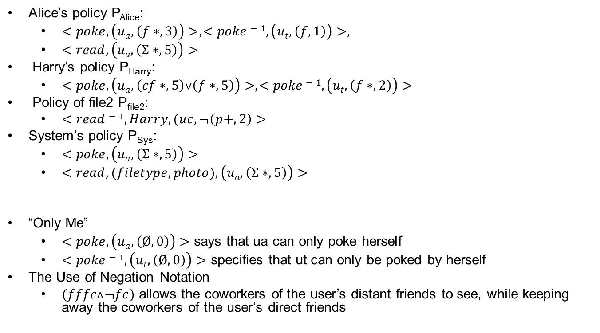
Example
Alice’s policy P_{Alice}:
  $<poke,\left(ua,\left(f∗,3\right)\right)>$,$<poke−1,\left(ut,\left(f,1\right)\right)>,$
  $<read, \left(ua,\left(Σ∗,5\right)\right)>$
Harry’s policy P_{Harry}:
  $<poke,\left(ua,\left(cf∗,5\right)˅\left(f∗,5\right)\right)>$,$<poke−1,\left(ut,\left(f∗,2\right)\right)>$
Policy of file2 P_{file2}:
  $<read−1,Harry,(uc,¬\left(p+,2\right)>$
System’s policy P_{Sys}:
  $<poke,\left(ua,\left(Σ∗,5\right)\right)>$
  $<read,(filetype, photo),\left(ua,\left(Σ∗,5\right)\right)>$
“Only Me”
  $<poke, \left(ua,\left(Ø,0\right)\right)>$ says that ua can only poke herself
  $<poke−1,\left(ut,\left(Ø,0\right)\right)>$ specifies that ut can only be poked by herself
The Use of Negation Notation
  $(fffc˄¬fc)$ allows the coworkers of the user’s distant friends to see, while keeping away the coworkers of the user’s direct friends
World-Leading Research with Real-World Impact!

Slide 20
Policy Extraction
It determines the starting node, where the evaluation starts
The other user involved in access becomes the evaluating node
Policy: <action, r.type, graph rule>
Graph Rule: start, path rule
Path Rule: path spec ∧|∨ path spec
Path Spec: path, hopcount
Path-check each path spec using Algorithm 2 (introduced in detail later)
World-Leading Research with Real-World Impact!

Slide 21
Path Checking Algorithms
Two strategies: DFS and BFS
Parameters: G, path, hopcount, s, t
Access Request: (Alice, read, r_{t})
f
Policy: (read⁻¹, r_{t}, (f*cf*, 3))
п₁
f
f
п₃
Path pattern: f*cf*
Hopcount: 3
п₀
c
c
f
п₂
DFA for f*cf*
World-Leading Research with Real-World Impact!

Slide 22
Path pattern: f*cf*
Hopcount: 3
f
Dave
Bob
Dave
Bob
п₁
f
п₁
f
f
f
f
п₃
п₀
п₃
c
п₀
c
Alice
c
c
Harry
c
f
Alice
f
Ed
Harry
п₂
п₂
f
Case 2: found a matching path and DFA reached an accepting state
Case 1: next node is already visited, thus creates a self loop
Case 3: currentPath matches the prefix of the pattern, but DFA not at an accepting state
f
Carol
Fred
George
f
c
f
f
d: 0
currentPath: Ø
stateHistory: 0
d: 1
currentPath: (H,D,f)
stateHistory: 01
d: 3
currentPath: (H,D,f)(D,B,c)(B,A,f)
stateHistory: 0123
d: 2
currentPath: (H,D,f)(D,B,f)
stateHistory: 011
d: 2
currentPath: (H,D,f)(D,B,c)
stateHistory: 012

Slide 23
Complexity
Time complexity is bounded between [O(dmin^{Hopcount}),O(dmax^{Hopcount}) ], where dmax and dmin are maximum and minimum out-degree of node
  Users in OSNs usually connect with a small group of users directly, the social graph is very sparse
  Given the constraints on the relationship types and hopcount limit, the size of the graph to be explored can be dramatically reduced
World-Leading Research with Real-World Impact!

Slide 24
Evaluation
Experiment 1 examines the performance w.r.t policies with different hopcount limit
  1000 users, single relationship type
  *-pattern and enumeration path
Experiment 2 studies the performance w.r.t different node degrees
  1000 users, two relationship types
  Various density: 100, 200, 500 and 1000
  Enumeration path
World-Leading Research with Real-World Impact!

Slide 25
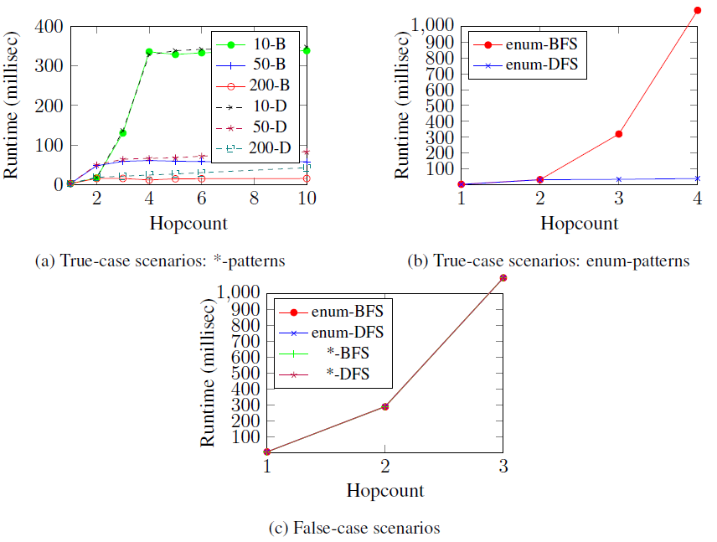
World-Leading Research with Real-World Impact!

Slide 26
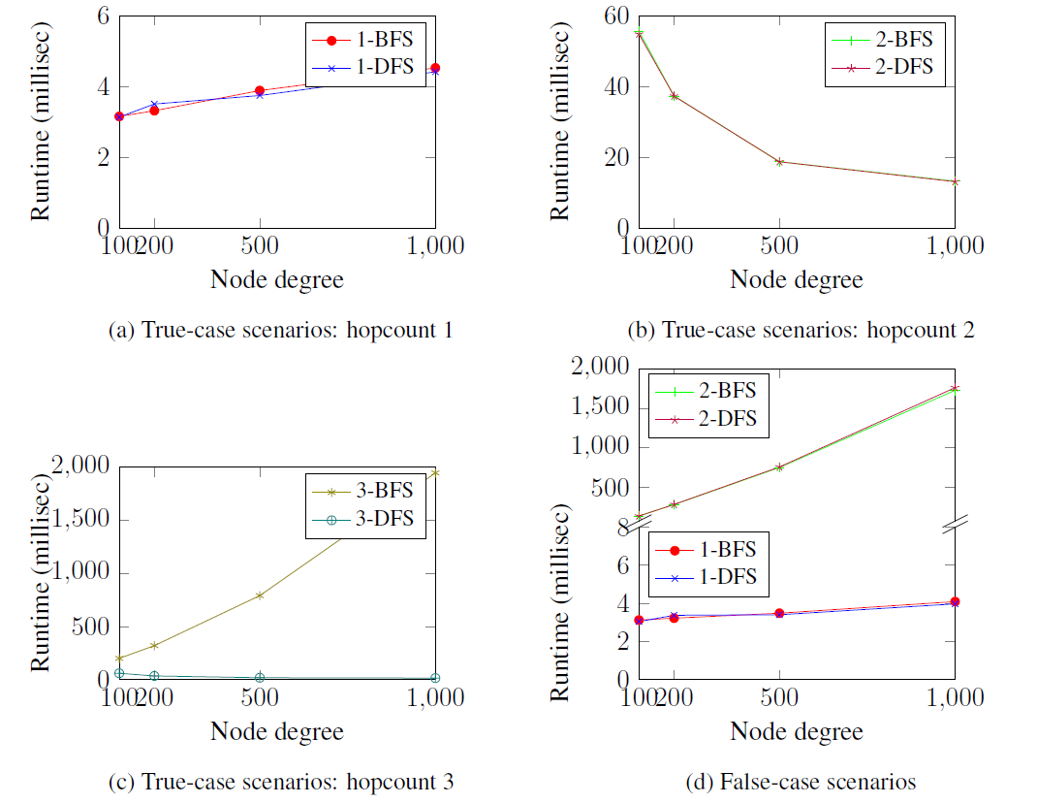
World-Leading Research with Real-World Impact!

Slide 27
Observations
Exp. 1:
  1) For *-pattern, a qualified path can be always found within 4 hops; BFS outplays DFS for large hopcount in sparse graph
  2) For enum-path, time cost of BFS leaps
Exp. 2:
  1) Hopcount increases, search space expands
  2) It’s more likely to find a path at a shorter time in denser graphs when hopcount is 2
  3) BFS suffers from the increase of search space
In false cases, both are exhaustive search. But large hopcount is barely seen in practical OSN scenarios.
BFS vs DFS:
  Similar for 1, 2-hop, but DFS in general better for intermediate hopcount values (3, 4, 5, etc.)
World-Leading Research with Real-World Impact!

Slide 28
Outline
Introduction
UURAC
UURAC_{A}
URRAC
Conclusion
World-Leading Research with Real-World Impact!

Slide 29
Beyond Relationships
ReBAC usually relies on type, depth, or strength of relationships, but cannot express more complicated topological information
ReBAC lacks support for attributes of users, resources, and relationships
Useful examples include common friends, duration of friendship, minimum age, etc.

Slide 30
Attribute-based Policy
<quantifier, f(ATTR(N), ATTR(E)), count ≥ i>
+1
+2
-2
-1
+0
+1
+2
-2
-2
-1
-0
∀[+1, -2], age(u) > 18
∃[+1, -1], weight(e) > 0.5
∃{+1, +2, -1}, gender = “male”
World-Leading Research with Real-World Impact!

Slide 31
Example: Node Attributes
+1
-1
Bob
f
Dave
f
f
Occupation = ‘student’
Occupation = ‘student’
+1
f
Alice
f
Ed
Harry
Occupation = ‘teacher’
f
+1
-1
f
Carol
Fred
George
f
Occupation = ‘student’
f
Occupation = ‘teacher’
f
Occupation = ‘student’
f
<access, (u_{a}, ((f*, 4): ∃[+1, -1], occupation = ‘student’, count ≥ 3)))>
World-Leading Research with Real-World Impact!

Slide 32
Example: Edge Attributes
Since = Feb, 2014
Bob
f
Dave
Since = June, 2013
f
f
Since = Aug, 2008
f
Alice
f
Ed
Since = May, 2009
Harry
Since = Aug, 2010
f
f
Carol
Fred
George
f
f
f
f
<read, Photo1, (u_{a}, ((f*, 3): ∀[+1, -1], duration ≥ 3 month, _)))>
World-Leading Research with Real-World Impact!

Slide 33
Outline
Introduction
UURAC
UURAC_{A}
URRAC
Conclusion
World-Leading Research with Real-World Impact!

Slide 34
Beyond U2U Relationships
There are various types of relationships between users and resources in addition to U2U relationships and ownership
  e.g., share, like, comment, tag, etc
U2U, U2R and R2R
U2R further enables relationship and policy administration
World-Leading Research with Real-World Impact!

Slide 35
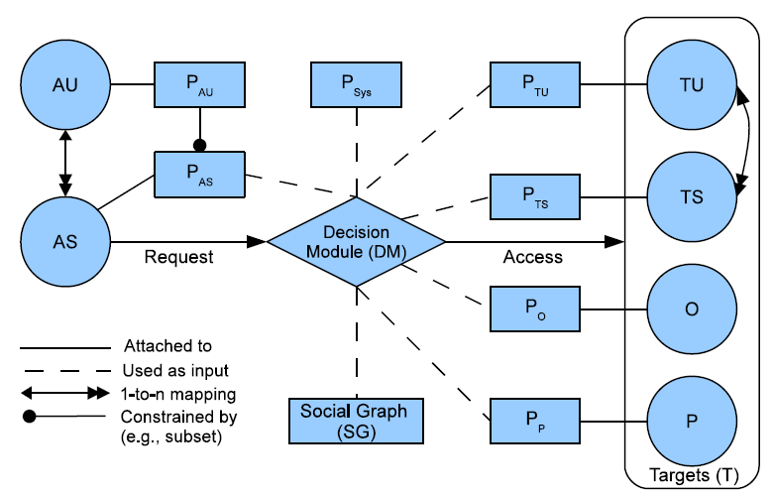
URRAC Model Components
AU: Accessing User
AS: Accessing Session
TU: Target User
TS: Target Session
O: Object
P: Policy
P_{AU}: Accessing User Policy
P_{AS}: Accessing Session Policy
P_{TU}: Target User Policy
P_{TS}: Target Session Policy
P_{O}: Object Policy
P_{P}: Policy for Policy
P_{Sys}: System Policy
World-Leading Research with Real-World Impact!

Slide 36
Differences with UURAC
U2R Relationship-based Access Control
Access Request
  (s, act, T) where T may contain multiple objects
Policy Administration
User-session Distinction
Hopcount Skipping
  Local hopcount stated inside “[[]]” will not be counted in global hopcount.
  E.g., “([f*,3][[c*, 2]],3)”, the local hopcount 2 for c* does not apply to the global hopcount 3, thus allowing f* to have up to 3 hops.
World-Leading Research with Real-World Impact!

Slide 37
Policy Conflict Resolution
System-defined conflict resolution for potential conflicts among user-specified policies
Disjunctive, conjunctive and prioritized order between relationship types
  <share⁻¹, (own ∨ tag ∨ share)>
  <read⁻¹, (own ∧ tag)>
  <friend_request, (parent > @)>
World-Leading Research with Real-World Impact!
Notes:
Multiple policies having weight in authorization result in decision conflicts inevitably. While assuming policies specified by the system will always be unambiguous, conflict resolution policies are responsible for interpreting how the potential policy conflicts within each category of user-specified policies can be resolved in terms of the precedence or connectives over relationship types

Slide 38
Example
A
friend
B
post
friend
E
tag
P2
View a photo where a friend is tagged. Bob and Ed are friends of Alice, but not friends of each other. Alice posted a photo and tagged Ed on it. Later, Bob sees the activity from his news feed and decides to view the photo: (Bob, read, Photo2)
  Bob’s P_{AS}(read): <read,(u_{a},([Σ_{u_u}*,2][[Σ_{u_r} ,1]],2))>
  Photo2’s P_{O}(read⁻¹) by Alice:
  <read⁻¹,(t,([post⁻¹,1][friend*,3],4))>
  Photo2’s P_{O}(read⁻¹) by Ed: <read⁻¹,(u_{c},([friend],1))>
  AP_{Sys}(read): <read,(ua,([Σ_{u_u}*,5][[Σ_{u_r} ,1]],5))>
  CRP_{Sys}(read): <read⁻¹,(own∧tag)>
In conflicts
World-Leading Research with Real-World Impact!

Slide 39
Example
parent
own
C
B
P1
child
Parental control of policies. The system features parental control such as allowing parents to configure their children’s policies. The policies are used to control the incoming or outgoing activities of children, but are subject to the parents’ will. For instance, Bob’s mother Carol requests to set some policy, say Policy1 for Bob: (Carol, specify policy, Policy1)
  Carol’s P_{AS}(specify_policy): <specify_policy,(u_{a},([own],1)∨([child·own],2))>
  Policy1’s P_{P}(specify_policy⁻¹) by Bob: <specify_policy⁻¹,(t,([own⁻¹],1))>
  P_{Sys}(specify_policy): <specify_policy,(u_{a},([own],1)∨([child·own],2))>
  CRP_{Sys}(specify_policy): <specify_policy, (parent ∧ @)>
World-Leading Research with Real-World Impact!

Slide 40
Outline
Introduction
UURAC
UURAC_{A}
URRAC
Conclusion
World-Leading Research with Real-World Impact!

Slide 41
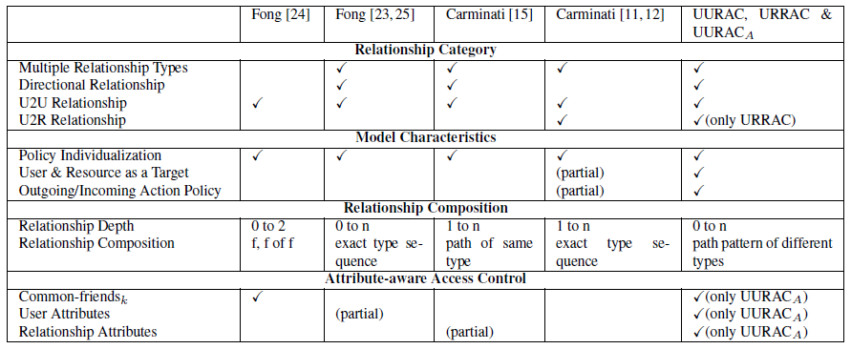
Comparison with Our Approach
  Passive form of action allows outgoing and incoming action policy
  Path pattern of different relationship types and hopcount skipping make policy specification more expressive
  Attribute-aware access control based on attributes of users and relationships
  System-level conflict resolution policy
World-Leading Research with Real-World Impact!

Slide 42
Publications
Yuan Cheng, Jaehong Park and Ravi Sandhu, An Access Control Model for Online Social Networks Using User-to-user Relationships. Submitted to IEEE TDSC.
Yuan Cheng, Jaehong Park and Ravi Sandhu, Attribute-aware Relationship-based Access Control for Online Social Networks. Submitted to DBSec 2014.
Yuan Cheng, Jaehong Park and Ravi Sandhu, Relationship-based Access Control for Online Social Networks: Beyond User-to-User Relationships. In Proceedings 4th IEEE International Conference on Information Privacy, Security, Risk and Trust (PASSAT), Amsterdam, Netherlands, September 3-5, 2012. (Winner of Best Paper Award)
Yuan Cheng, Jaehong Park and Ravi Sandhu, A User-to-User Relationship-based Access Control Model for Online Social Networks. In Proceedings 26th Annual IFIP WG 11.3 Working Conference on Data and Applications Security and Privacy (DBSec 2012), Paris, France, July 11-13, 2012.
Jaehong Park, Ravi Sandhu and Yuan Cheng, ACON: Activity-Centric Access Control for Social Computing. Proceedings 5th International Conference on Availability, Reliability and Security (ARES), Vienna, Austria, August 22-26, 2011.
Jaehong Park, Ravi Sandhu and Yuan Cheng, A User-Activity-Centric Framework for Access Control in Online Social Networks. IEEE Internet Computing, 15(5): 62-65, September 2011.
Yuan Cheng, Jaehong Park and Ravi Sandhu, Preserving User Privacy from Third-party Applications in Online Social Networks. In Proceedings of the 2nd International Workshop on Privacy and Security in Online Social Media (PSOSM), Rio de Janeiro, Brazil, May 14, 2013. (Runner-up of The Best Paper Award)
Jaehong Park, Yuan Cheng and Ravi Sandhu, Towards A Framework for Cyber Social Status Based Trusted Open Collaboration. In Proceedings of the 5th IEEE International Workshop on Trusted Collaboration (TrustCol 2010), Chicago, Illinois, October 9, 2010.
Yuan Cheng, Dang Nguyen, Khalid Bijon, Ram Krishnan, Jaehong Park and Ravi Sandhu, Towards Provenance and Risk-Awareness in Social Computing. First International Workshop on Secure and Resilient Architectures and Systems, Minneapolis, Minnesota, September 19, 2012.
World-Leading Research with Real-World Impact!

Slide 43
Summary
UURAC
  Proposed a U2U relationship-based model and a regular expression-based policy specification language for OSNs
  Provided a DFS-based path checking algorithm
URRAC
  Proposed a U2U, U2R and R2R relationship-based access control model for users’ usage and administrative access in OSNs
    Access control policies are based on regular expression-based path patterns
    Hopcount skipping for more expressiveness
  Provided a system-level conflict resolution policies based on relationship precedence
UURAC_{A}
  Incorporated attribute-awareness to UURAC model
  Enhanced the path checking algorithm
World-Leading Research with Real-World Impact!

Slide 44
Future Research
Access control for 3rd party applications
  Current strategy: all-or-nothing
  Apps often gain much more rights than necessary
User-specified conflict resolution policy
  Specified by users
  Applies to a smaller context
  Raises ambiguity
Unconventional relationships
World-Leading Research with Real-World Impact!

Slide 45

Questions/Comments
World-Leading Research with Real-World Impact!

Slide 46
Numbers and Facts
Survey Data from PEW Internet (2011)
  47% of American adults use at least one OSN.
  close to double the 26% of adults who used an OSN in 2008.
Statistics from Facebook
  One billion monthly active users as of Oct 2012.
  552 million daily active users on average in June 2012.
  600 million monthly active users who used Facebook mobile products in Sep 2012.

Slide 47
Control on Social Interactions
A user wants to control other users’ access to her own shared information
  Only friends can read my post
A user wants to control other users’ activities who are related to the user
  My children cannot be a friend of my co-workers
  My activities should not be notified to my co-workers
A user wants to control her outgoing/incoming activities
  No accidental access to violent contents
  Do not poke me
A user’s activity influences access control decisions
  Once Alice sends a friend request to Bob, Bob can see Alice’s profile
World-Leading Research with Real-World Impact!
Notes:
Apparently we don’t want to share everything with everyone. What kind of control do users need on those social interactions?
The first and foremost requirement from users is that their information is only shared with whom they are willing to share.
They also want to regulate other user’s access if they are related. My colleagues should not be informed about the update on my personal life.
For a given activity, a user can play as an initiator or a recipient. Consequently, she wants to control both her outgoing and incoming activities. (You don’t have to specify a particular target.)

Slide 48
Privacy Breaches
Easy to happen from OSN providers, other users, and 3rd party applications
OSN providers store user data
  Users have to trust OSNs to protect and not to misuse the data
  OSNs can benefit from analyzing and sharing the data (e.g., targeted advertisement)
3rd party applications provide extra functionalities
  Simply all-or-nothing control
  Access to more information than actual need
  Be able to post or access user data without user’s knowledge
Another major threats are from peer users
  Not aware of who they share with and how much
  Have difficulty in managing privacy controls

Slide 49
Limitation of U2U Relationships
We rely on the controlling user and ownership to regulate access to resources in UURAC (U2U Relationship-based AC)
Needs more flexible control
  Parental control, related user’s control (e.g., tagged user)
  User relationships to resources (e.g., U-U-R)
  User relationships via resources (e.g., U-R-U)
World-Leading Research with Real-World Impact!

Slide 50
Motivating Examples
Related User’s Control
  There exist several different types of relationships in addition to ownership
  e.g., Alice and Carol want to control the release of Bob’s photo which contains Alice and Carol’s image.
  e.g., Betty shares Ed’s original post and acquires the ability to decide how the shared post can be available to others.
World-Leading Research with Real-World Impact!
Notes:
Many commercial systems have applied FofF approaches. Not enough. (a little boring and lengthy in this slide)
Purely owner-based control

Slide 51
Motivating Examples (cont.)
Administrational Control
  Policy administration is important
  A change of relationship may result in a change of authorization
  Treat administrative activities different from normal activities
    Policy specifying, relationship invitation and relationship recommendation
  e.g., Bob’s mother Carol may not want Bob to become a friend with her colleagues, to access any violent content or to share personal information with others.

Slide 52
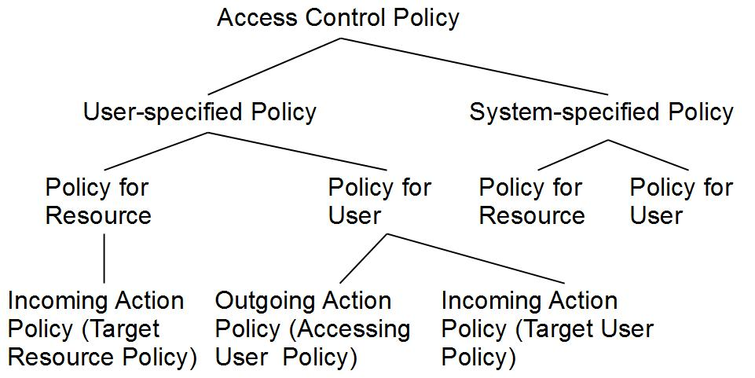
Policy Taxonomy

Slide 53
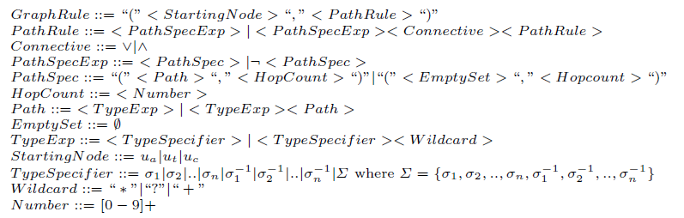
UURAC Graph Rule Grammar
World-Leading Research with Real-World Impact!

Slide 54
Policy Evaluation
Evaluate a combined result based on conjunctive or disjunctive connectives between path specs
Make a collective result for multiple policies in each policy set.
  Policy conflicts may arise. We assume system level conflict resolution strategy is available (e.g., disjunctive, conjunctive, prioritized).
Compose the final result from the result of each policy set (AUP, TUP/TRP, SP)
World-Leading Research with Real-World Impact!

Slide 55
Policy Collecting
To authorize (u_{a}, action, target) if target = u_{t}
  E.g., (Alice, poke, Harry)
P_{Alice}
<poke, (ua, (f*,3))>
AUP
< poke⁻¹, (ua, (f*,3))>
P_{Harry}
TUP
<poke, (ua, (cf*,5)˅(f*,5))>
<poke⁻¹, (ut, (f*,2))>
SP
P_{Sys}
<poke, (ua, (Σ*,5))>
World-Leading Research with Real-World Impact!

Slide 56
Policy Collecting
To authorize (u_{a}, action, target) if target = r_{t}
  Determine the controlling user for r_{t}:
    u_{c} ← owner(r_{t})
  E.g., (Alice, read, file2)
P_{Alice}
<read, (u_{a}, (Σ*, 5))>
AUP
<read⁻¹, file1, (u_{c}, (cf*, 4))>
P_{Harry}
TRP
<read⁻¹, file2, (u_{c}, ¬(p+, 2))>
P_{Sys}
SP
<read, photo, (ua, (Σ*, 5))>
World-Leading Research with Real-World Impact!

Slide 57
Additional Characteristics of URRAC
Policy Administration
  Policy and Relationship Management
  Users specify policies for other users and resources
User-session Distinction
  A user can have multiple sessions with different sets of privileges
  Especially useful in mobile and location-based applications
World-Leading Research with Real-World Impact!
Notes:
Combine it with p28; policy is treated as resource. Urrac is able to deal with it.

Slide 58
URRAC Action and Access Request
ACT = {act₁, act₂,. . .,act_{n}} is the set of OSN supported actions
Access Request <s, act, T>
  s tries to perform act on T
  Target T ⊆ (2^{TU ∪ R} - Ø) is a non-empty set of users and resources
    T may contain multiple targets
World-Leading Research with Real-World Impact!

Slide 59
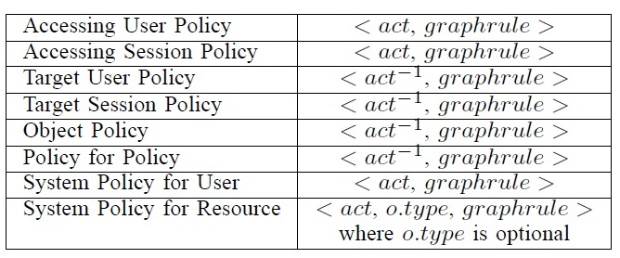
URRAC Authorization Policy
action⁻¹ in TUP, TSP, OP and PP is the passive form since it applies to the recipient of action
SP does not differentiate the active and passive forms
SP for resource needs o.type to refine the scope of the resource
World-Leading Research with Real-World Impact!

Slide 60
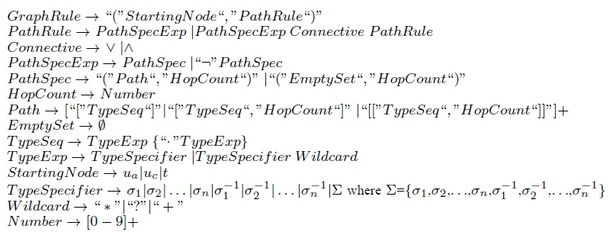
URRAC Graph Rule Grammar
World-Leading Research with Real-World Impact!

Slide 61
Hopcount Skipping
U2R and R2R relationships may form a long sequence
  Omit the distance created by resources
  Local hopcount stated inside “[[]]” will not be counted in global hopcount.
  E.g., “([f*,3][[c*, 2]],3)”, the local hopcount 2 for c* does not apply to the global hopcount 3, thus allowing f* to have up to 3 hops.
World-Leading Research with Real-World Impact!

Slide 62
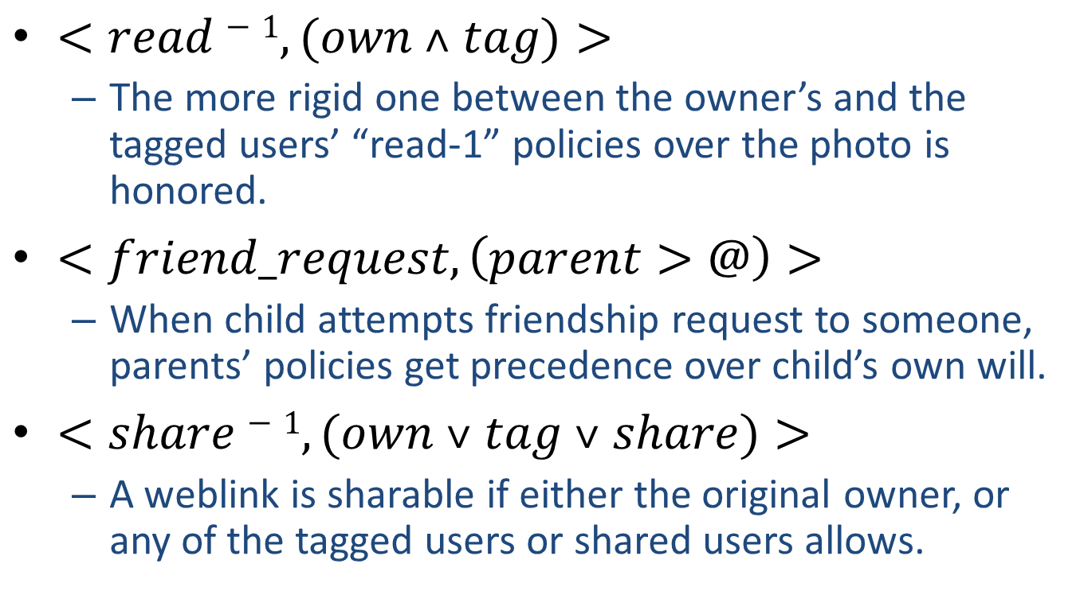
Policy Conflict Resolution (cont.)
$<read−1,(own ˄ tag)>$
  The more rigid one between the owner’s and the tagged users’ “read-1” policies over the photo is honored.
$<friend_request,\left(parent>@\right)>$
  When child attempts friendship request to someone, parents’ policies get precedence over child’s own will.
$<share−1,(own ˅ tag ˅ share)>$
  A weblink is sharable if either the original owner, or any of the tagged users or shared users allows.
World-Leading Research with Real-World Impact!

Slide 63
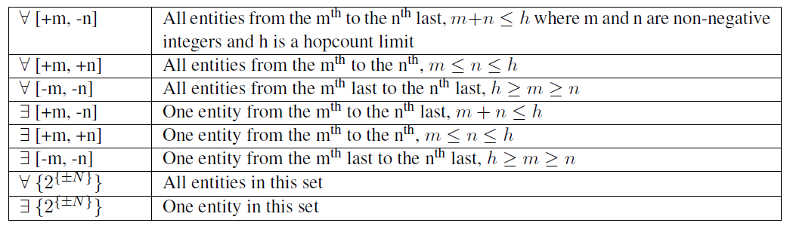
Attribute Policy Taxonomy

