Slide 1
Reconstructing Alert Trees for Cyber Triage
Eric Ficke
PhD Dissertation Defense
The University of Texas at San Antonio
April 13, 2022
Committee Co-Chairs
Prof. Ravi Sandhu
Prof. Shouhuai Xu
Committee Members
Prof. Xiaoyin Wang
Prof. Greg White
Prof. Mimi Xie

Slide 2
Publications
Published
  S. He, E. Ficke, M. Pritom, H. Chen, Q. Tang, Q. Chen, M. Pendleton, L. Njilla, and S. Xu. Blockchain-based Automated and Robust Cyber Security Management, Journal of Parallel Distributed Computing, 163: 62-82 (2022)
  E. Ficke and S. Xu. APIN: Automatic Attack Path Identification in Computer Networks, IEEE International Conference on Intelligence and Security Informatics (ISI), 2020. [Dissertation Chapter 2]
  E. Ficke, K. Schweitzer, R. Bateman, and S. Xu. Analyzing Root Causes of Intrusion Detection False-Negatives: Methodology and Case Study. IEEE Military Communications Conference (MILCOM), 2019.
  J. Mireles, E. Ficke, J. Cho, P. Hurley, and S. Xu. Metrics Towards Measuring Cyber Agility. IEEE Transactions on Information Forensics and Security (IEEE T-IFS), 14(12): 3217-3232 (2019).
  E. Ficke, K. Schweitzer, R. Bateman, and S. Xu. Characterizing the Effectiveness of Network-Based Intrusion Detection Systems. IEEE Military Communications Conference (MILCOM), 2018.
Manuscripts to be submitted for review
  E. Ficke, R. Bateman, and S. Xu. AutoCRAT: Automatic Cumulative Reconstruction of Alert Trees. [Dissertation Chapter 3]
  R. Garcia-LeBron, E. Ficke, W. Wu, S. Xu. Characterizing Cyber Attack Reconnaissance Trajectories.
  E. Ficke, R. Bateman, and S. Xu. Alert Tree Reduction and Visualization. [Dissertation Chapter 4]

Slide 3
Dissertation Outline
Introduction
APIN: Alert Path Identification in Computer Networks
AutoCRAT: Automatic Cumulative Reconstruction of Alert Trees
Alert Tree Reduction and Visualization
Conclusion

Slide 4
Introduction
Chapter 1

Slide 5

Background – Alert Trees
Cyber Triage (Network-level)
  Alert prioritization
  Alert correlation
  Attack lifecycle
Attack Prediction
  Attack graphs / trees / paths
  Vulnerability graphs

Slide 6
Background
Alert Trees
Attack Trees
Attack tracking
  Prioritization / Triage
Attack prediction
  Formulation
  Outcomes

Slide 7
Motivation
Alert volume
  Unrealistically low in ad hoc datasets
  Overwhelms human analysis in real data
Alert graph / tree / path formalization
  Varies by usage
  Depends on spatial and temporal dependencies

Slide 8

Chapter Themes
Alert Path Identification (APIN)
  Alert path reconstruction
  Threat score (TS) ranking
Cumulative Reconstruction (AutoCRAT)
  Alert tree reconstruction
  Alternative path reconstruction method
  Asymptotic and real analysis
Reduction and Visualization
  Mitigates emergent problem of tree size

Slide 9
Dissertation Outline
Introduction
APIN: Alert Path Identification in Computer Networks
AutoCRAT: Automatic Cumulative Reconstruction of Alert Trees
Alert Tree Reduction and Visualization
Conclusion

Slide 10
APIN: Alert Path Identification in Computer Networks
Chapter 2

Slide 11

Motivation: Cyber Triage
Time sensitive
Resource intensive
Error prone
Large search space

Slide 12

Contributions
Attack Tracking
  Alert paths show footprints between victim computers
  Spatiotemporal path reconstruction method
Heuristics
  Threat score shows attacker effort
  (Actual compromise may vary)

Slide 13
APIN Framework
Inputs
Outputs
Automatic Path Identification
NIDS
Alerts
ITS
CTS
Ranked Attack Paths
Guided Path Identification
Known
Target
NIDS: Network Intrusion Detection System
ITS: Independent Threat Score
CTS: Composite Threat Score

Slide 14

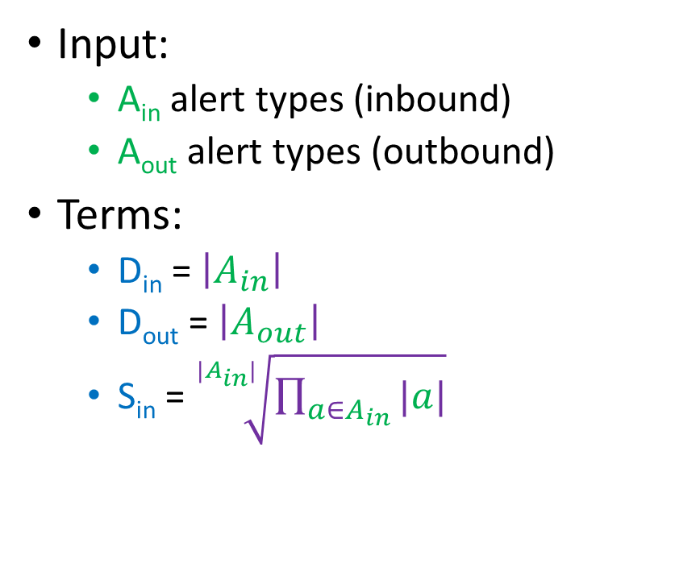
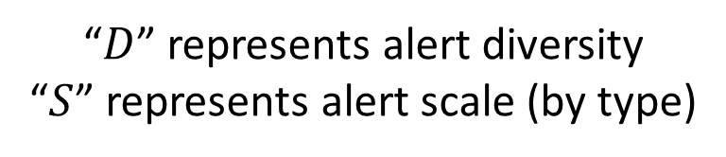
Metric: Independent Threat Score
Input:
  A_{in} alert types (inbound)
  A_{out} alert types (outbound)
Terms:
  D_{in} = $\left|A_{in}\right|$
  D_{out} = $\left|A_{out}\right|$
  S_{in} = $\sqrt[|A_{in}|]{\prod_{a∈A_{in}}{|a|}}$
ITS = $\sqrt[3]{D_{in}∙D_{out}∙S_{in}}$
“$D$” represents alert diversity
“$S$” represents alert scale (by type)

Slide 15
Methods (Alert Path Identification)
Approach: breadth-first search in reverse-chronological order
8
Not a valid path:
Violates temporal
attack dependency
4
5
16
20
10
Edges indexed by timestamp

Slide 16
Preliminary Analysis
Scans (high volume, low threat)
  Prioritize inbound alerts
  Prioritize alert diversity
Highly connected nodes (high volume, unclear threat)
  Causes exponential graph growth
  Blacklist nodes
    Restricts path identification
    Leaves nodes unmonitored
High-granularity network segmentation improves performance significantly

Slide 17
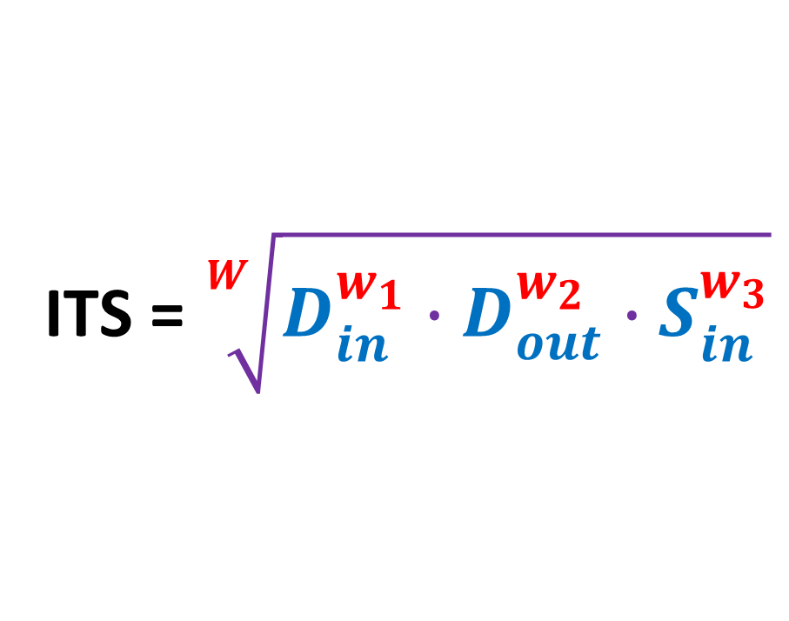
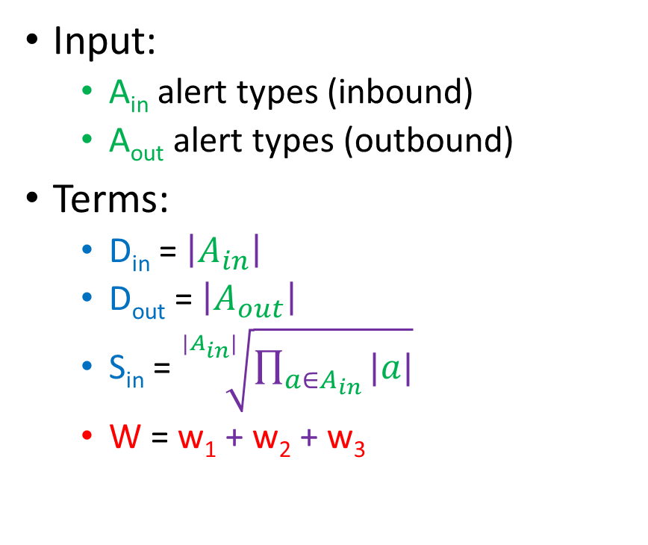
Metric: Weighted Independent Threat Score
Input:
  A_{in} alert types (inbound)
  A_{out} alert types (outbound)
Terms:
  D_{in} = $\left|A_{in}\right|$
  D_{out} = $\left|A_{out}\right|$
  S_{in} = $\sqrt[|A_{in}|]{\prod_{a∈A_{in}}{|a|}}$
  W = w₁ + w₂ + w₃
ITS = $\sqrt[W]{D_{in}^{w_{1}}∙D_{out}^{w_{2}}∙S_{in}^{w_{3}}}$
“$D$” represents alert diversity
“$S$” represents alert scale (by type)

Slide 18

Metric: Composite Threat Score
Node A
Node B
Node C
Attack Path
Alert List
Alert List
Alert List
Independent
Threat Score
Independent
Threat Score
Independent
Threat Score
Composite Threat Score
CTS = $\sum_{n∈N}{ITS(n)}$

Slide 19
Preliminary Results: DARPA ’99
Notable paths, using queries from top 5 nodes
[Path Origin, Path Target] | Composite Threat Score ∇ | Length (#edges) | Notable Alerts
172.16.116.201 209.67.29.11 | 3.83 | 1 | Windows 95 Malware
172.16.116.194 | 3.43 | 1 | Windows 95 Malware
207.25.71.141 | 3.41 | 1 | Windows 95 Malware
192.168.1.30 172.16.112.5 | 3.41 | 1 | Public SNMP Access
206.132.25.51 | 3.36 | 1 | Windows 95 Malware
Artificial datasets need multi-step attacks
Hidden IPs are repeated from higher-ranked paths

Slide 20
Results: CSE-CIC-IDS2018
[Path Origin, Path Target] | Composite Threat Score ∇ | Length (#Edges) | Notable Alerts
103.47.124.154 54.172.47.69 | 34.31 | 4 | EternalBlue (WannaCry) NAT Traversal
172.31.67.54 52.87.201.4 | 33.60 | 3 | EternalBlue (WannaCry) NAT Traversal
71.6.165.200 172.31.64.78 | 26.42 | 3 | Blacklisted IP group SQL Scan
77.222.106.20 172.31.66.112 | 21.30 | 3 | EternalBlue (WannaCry) SMB Share Access
172.31.64.78 172.31.0.2 | 21.11 | 1 | Suspicious DNS Query

Slide 21
Results: CSE-CIC-IDS2018
EternalBlue NAT Traversal
EternalBlue NAT Traversal
Blacklisted IP group SQL Scan
EternalBlue SMB Share Access
Suspicious DNS Query
103.47.124.154
172.31.67.46
103.68.10.188
172.31.66.112
54.172.47.69
172.31.67.54
212.174.232.94
172.31.64.46
52.87.201.4
71.6.165.200
172.31.64.71
149.255.35.24
172.31.64.78
77.222.106.20
172.31.67.46
103.68.10.188
172.31.66.112
172.31.64.78
172.31.0.2

Slide 22
Results: CSE-CIC-IDS2018
EternalBlue NAT Traversal
EternalBlue SMB Share Access
EternalBlue NAT Traversal
Blacklisted IP group SQL Scan
Suspicious DNS Query
1.
4.
2.
3.
5.
172.31.66.112
54.172.47.69
172.31.67.46
103.68.10.188
172.31.66.112
103.47.124.154
172.31.67.46
103.68.10.188
77.222.106.20
172.31.67.54
212.174.232.94
172.31.64.46
52.87.201.4
71.6.165.200
172.31.64.71
149.255.35.24
172.31.64.78
172.31.64.78
172.31.0.2
Origin
Target

Slide 23
Results: CSE-CIC-IDS2018
EternalBlue
NAT Traversal
54.172.47.69
212.174.232.94
52.87.201.4
172.31.67.54
172.31.64.46
103.68.10.188
172.31.66.112
103.68.10.188
172.31.66.112
172.31.0.2
EternalBlue
NAT Traversal
103.47.124.154
172.31.67.46
Suspicious DNS Query
172.31.67.46
172.31.64.78
172.31.64.78
172.31.64.71
149.255.35.24
Internal Network
77.222.106.20
71.6.165.200
EternalBlue
SMB Share Access
Blacklisted IP group
SQL Scan
Origin
Target

Slide 24
Dissertation Outline
Introduction
APIN: Alert Path Identification in Computer Networks
AutoCRAT: Automatic Cumulative Reconstruction of Alert Trees
Alert Tree Reduction and Visualization
Conclusion

Slide 25
AutoCRAT: Automatic Cumulative Reconstruction of Alert Trees
Chapter 3

Slide 26
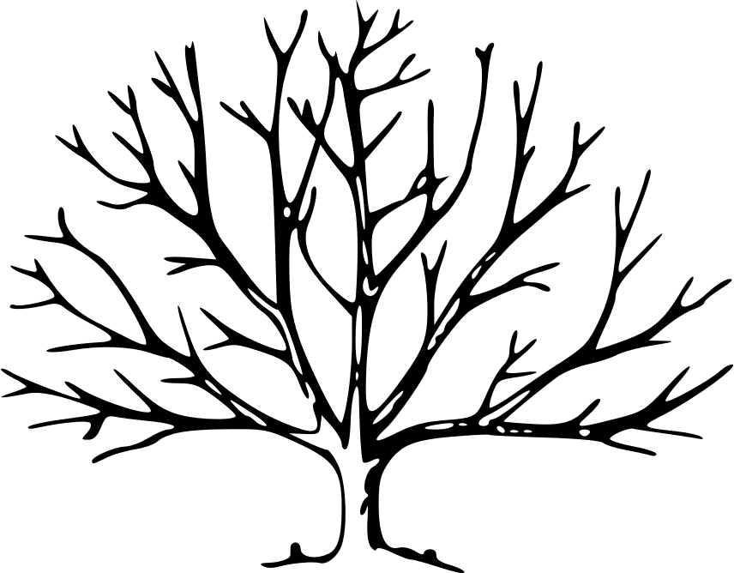
Motivation: Alert Tree Optimization
Improve reconstruction
Identify optimization tradeoffs
Formalize alert trees

Slide 27

AutoCRAT Architecture
Management
Core
Alert Feed
Security Device
Graph/Path Maintenance
Update
(continuous)
Database
Update
(as needed)
Endpoints
Alert
Reinsert
Reinsertion
Alerts
Source
Destination
ETS
Query
Update
(as needed)
Update
Query
Threat Calculation
Outputs
Data
Retrieval
Paths
Exposure Paths
Path Query
Query
Path Retrieval
Retrieve
Nodes
Edges
PTS
Children
Return
Retrieve& Merge
Exposure Trees
Query
Tree Construction
Return
Tree Query

Slide 28
Methods (Path Maintenance)
Approach: maintain every path at all times, merging as they join
A
E
H
J
B
E
H
J
C
F
I
J
D
G
I
J
Paths grow sequentially
Paths remain independent until linked
Trees form spontaneously

Slide 29
Methods (Tree Reconstruction)
Approach: maintain every path at all times, merging as they join
A
E
H
J
B
E
H
J
C
F
I
J
D
G
I
J
Paths grow sequentially
Paths remain independent until linked
Trees form spontaneously

Slide 30
Methods (Tree Reconstruction)
Approach: maintain every path at all times, merging as they join
A
E
H
J
B
C
F
I
D
G
Paths grow sequentially
Paths remain independent until linked
Trees form spontaneously

Slide 31
Methods (Tree Reconstruction)
Approach: maintain every path at all times, merging as they join
A
E
B
H
F
J
C
I
G
D
Paths grow sequentially
Paths remain independent until linked
Trees form spontaneously

Slide 32
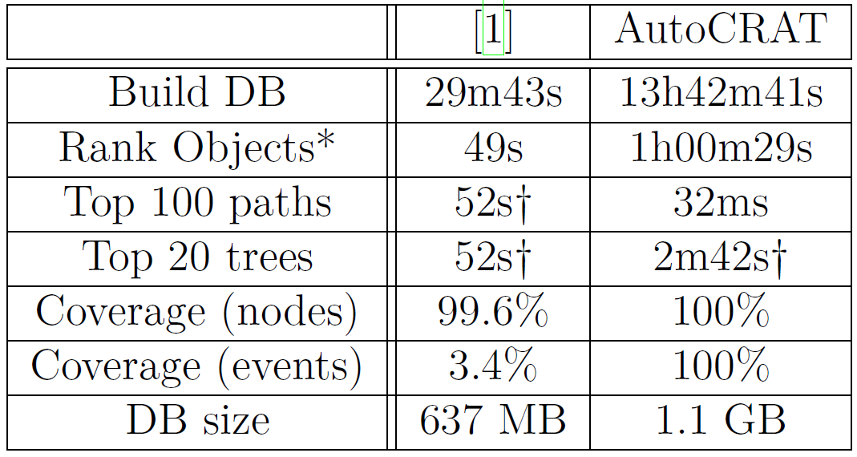
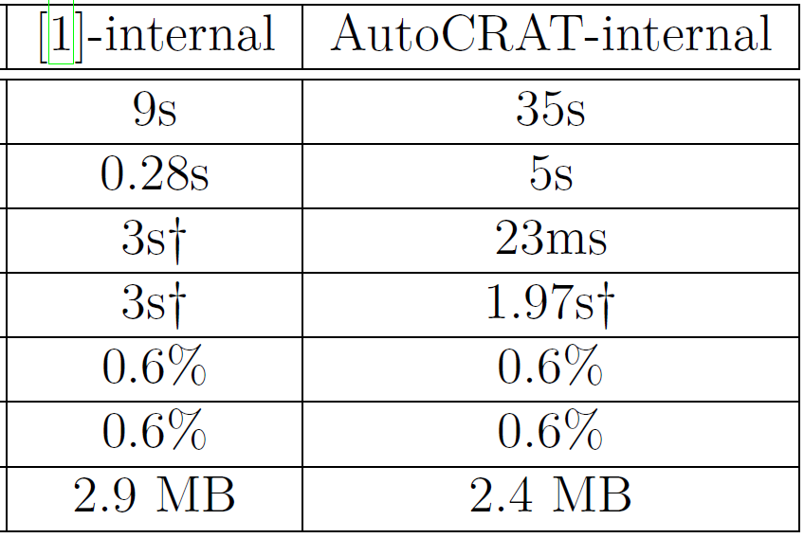
Results Comparison

Slide 33

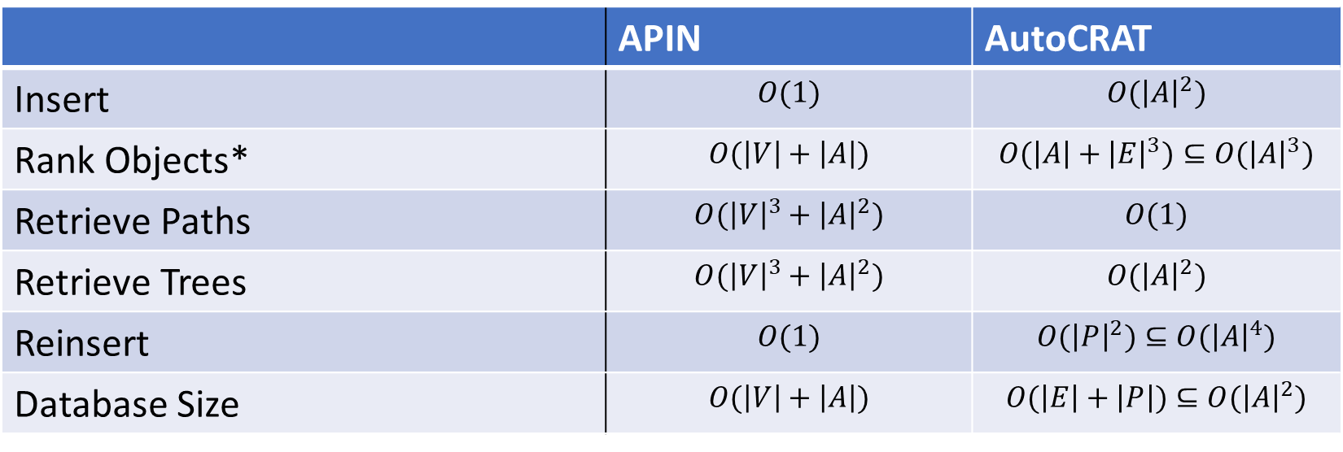
Asymptotic Comparison
 | APIN | AutoCRAT
Insert | $$O(1)$$ | $$O({\left|A\right|}^{2})$$
Rank Objects* | $$O(\left|V\right|+\left|A\right|)$$ | $$O({\left|A\right|+\left|E\right|}^{3})⊆O({\left|A\right|}^{3})$$
Retrieve Paths | $$O({\left|V\right|}^{3}+{\left|A\right|}^{2})$$ | $$O(1)$$
Retrieve Trees | $$O({\left|V\right|}^{3}+{\left|A\right|}^{2})$$ | $$O({\left|A\right|}^{2})$$
Reinsert | $$O(1)$$ | $$O({\left|P\right|}^{2})⊆O({\left|A\right|}^{4})$$
Database Size | $$O(\left|V\right|+\left|A\right|)$$ | $$O(\left|E\right|+\left|P\right|)⊆O({\left|A\right|}^{2})$$
$A$ – alerts
$V$ – vertices (computers)
$E$ – endpoints
$P$ – paths
APIN dominates insertion and storage;
AutoCRAT conditionally dominates retrieval
*APIN ranks nodes, while AutoCRAT ranks endpoints and paths.

Slide 34
Results Comparison
 | APIN | AutoCRAT | APIN-Internal | AutoCRAT-Internal
Build DB | 29m43s | 13h42m41s | 9s | 35s
Rank Objects* | 49s | 1h00m29s | 0.28s | 5s
Retrieve Top 100 Paths | 52s† | 32ms | 3s† | 23ms
Retrieve Top 20 Trees | 52s† | 2m42s† | 3s† | 1.97s†
Coverage (Nodes) | 99.6% | 100% | 0.6% | 0.6%
Coverage (Events | 3.4% | 100% | 0.6% | 0.6%
Database Size | 637 MB | 1.1 GB | 2.9 MB | 2.4 MB
AutoCRAT dominates path retrieval and, under comparable restraints, tree retrieval
The vast majority of alerts span network borders
*APIN ranks nodes, while AutoCRAT ranks endpoints and paths.
†These ranks are inferred from their ends (for paths) or root (for trees)

Slide 35
Dissertation Outline
Introduction
APIN: Alert Path Identification in Computer Networks
AutoCRAT: Automatic Cumulative Reconstruction of Alert Trees
Alert Tree Reduction and Visualization
Conclusion

Slide 36
Alert Tree
Reduction and Visualization
Chapter 4

Slide 37

Motivation
Facilitate cyber triage by selectively pruning alert trees
Reduce visual strain
  “Which nodes can be removed to facilitate tree interpretation?”
Preserve salient information
  “What nodes must be kept based on relevant metrics?”

Slide 38
Motivating Example
This tree (from real data) has 3090 nodes.
Graphviz is forced to render it at 6% of its original resolution.*
*If you have difficulty reading any of the node labels, that’s exactly the problem we need to solve

Slide 39
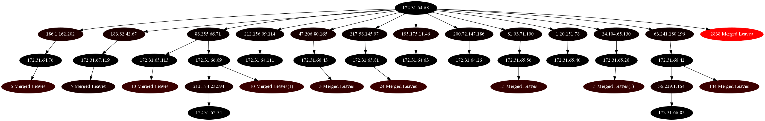
Motivating Example
After reduction, 3090 nodes becomes 40 nodes (98.7% reduction)
So how do we do it???

Slide 40
Alert Tree Reduction Architecture
Annotate Tree
Merge Similar Sibling Branches
Reduction 1
Input
Alert Trees
Reduction 2
Output Reduced Trees
Merge Sibling Leaves
Reduction 3
Truncate
Internal Hypotrees
Reduction 4
Reduction 5

Slide 41
Terminology
A
Siblings:
B
C
D
E
F
G
H
F
G
B
F
G
H
F
G
H
Duplicate labels may exist in a tree but not in a path

Slide 42
Terminology
A
Branch:
B
C
D
E
F
G
H
F
G
B
F
G
H
F
G
H

Slide 43
Terminology (Graph Theory vs Data Structures)
A
B
C
D
E
F
G
H
F
G
B
F
G
H
F
G
H

Slide 44
Terminology (Graph Theory vs Data Structures)
B
B
F
G
F
G
H

Slide 45
Terminology (Graph Theory vs Data Structures)
T₁:
T₂:
B
B
F
G
F
G
H
In Graph Theory:
T₁ is a subtree of T₂
F is a subtree of T₁ (or T₂)
In Data Structures:
F is a subtree of B (in either tree)
We need a new term for the relationship T₁:T₂ that eliminates ambiguity
45

Slide 46
Hypotree and Hypertree
T₁:
T₂:
B
B
F
G
F
G
H
Designate: T₁ is a hypotree of T₂ (T₁ ⪨ T₂)
Designate: T₂ is a hypertree of T₁ (T₂ ⪩ T₁)
Every tree is both a hypotree and a hypertree of itself
We also designate proper hypotree (⪦) and proper hypertree (⪧)

Slide 47
Hypotree and Hypertree
T_{hypo}:
B
T_{hyper}:
B
F
G
F
G
H
Definition: A tree T_{hypo} is a hypotree of a tree T_{hyper} if:
∀ n∈𝑇_{ℎ𝑦𝑝𝑜}, ∃ 𝑛’∈𝑇_{ℎ𝑦𝑝𝑒𝑟}:
∀ i ∈ {0,1, …, |𝑛.ancestors|}, 𝑛.ancestors_{i} =n’.ancestors_{i}
*Hypertree is derived from hypotree. Refer to the paper for exact detail

Slide 48
Merging Sibling Leaves
[MSL(A)]
A
E
M3
G
H
B
C
D
F
F
M2
B
M2
H
G
F
G
F
G
H
M3
Node labels represent IP addresses
Duplicate labels may exist in a tree but not in a path within that tree
Here, node colors show labels (rather than threat score) for ease of understanding

Slide 49
Merging Similar Sibling Branches
[MSB(A)]
A
B
M2
E
F
G
H
C
D
F
G
B
F
G
H
F
G
H
Similar Branches: A set of branches for which all subtrees excluding the branch root exist in both branches

Slide 50
Merging Sibling Branches & Leaves
[MSL(MSB(A))]
A
M2
E
M3
G
H
B
C
D
F
F
B
M2
H
F
G
F
G
F
G
H
M3

Slide 51
Truncating Hypotrees
[TH(A)]
A
T_{hypo}:
B
C
D
E
F
G
H
F
T2
B
F
G
H
G
T_{hyper}:
F
G
H

Slide 52
TH∘MSSB(T)
A
B
M2
E
F
G
H
C
D
F
G
B
F
G
H
F
G
H
52

Slide 53
MSSB∘TH(T)
A
B
C
D
E
F
G
H
F
T
B
F
G
H
G
F
G
H
53

Slide 54
Truncating Hypotrees & Merging Sibling Leaves
[MSL(TH(A))]
A
T_{hypo}:
E
M3
G
H
B
C
D
F
F
T2
B
M2
H
F
G
F
G
T_{hyper}:
F
G
H
M3

Slide 55
Method Restrictions
MSL makes some trees similar (because “M2” = “M2”)
  MSB(MSL(T)) is unsafe (but MSL(MSB(T)) is safe)
  TH(MSL(T)) is unsafe (but MSL(TH(T)) is safe)
MSB and TH may target the same branches
  MSB(TH(T)) ≠ TH(MSB(T))
The 5 valid reduction schedules:
  MSB(T)
  MSL(MSB(T))
  MSL(T)
  MSL(TH(T))
  TH(T)
MSL:
MSB:
TH:
Merge Sibling Leaves
Merge Sibling Branches
Truncate Hypotrees

Slide 56
Method Comparisons (Toy Example)
MSL(A):
A
MSB(A):
A
B
C
D
E
M3
C
M2
E
F
G
H
M2
B
M2
H
B
F
G
H
M3
35% reduction
F
G
H
18% reduction
TH(A):
A
MSL:
MSB:
TH:
Merge Sibling Leaves
Merge Sibling Branches
Truncate Hypotrees
B
C
D
E
F
G
H
T2
B
F
G
H
F
G
H
6% reduction

Slide 57
Method Comparisons (Toy Example)
MSL(A):
A
MSL(MSB(A)):
A
E
M3
B
C
D
F
M2
E
M3
C
D
F
M2
B
M2
G
F
H
B
M2
H
F
F
G
47% reduction
M3
35% reduction
G
M3
MSL(TH(A)):
A
MSL:
MSB:
TH:
Merge Sibling Leaves
Merge Sibling Branches
Truncate Hypotrees
B
D
E
M3
C
F
T2
M2
H
G
B
F
F
G
35% reduction
M3

Slide 58
Visualization
Black (low threat) -> red (high threat)
  Min-max normalized
Merged nodes
  Color shows highest threat of those merged

Slide 59
Results (Visual):
Forward Tree 204.237.142.47
Full Tree
Tree with branches merged (R1)
Tree with branches and leaves merged (R2)

Slide 60


Metrics
Visual Strain Reduction (VSR)
Node Retention (NR)
Threat Score Retention (TSR)
Reduction Index (RI)
  $RI= 3/{\left({VSR}^{−1}+{NR}^{−1}+{TSR}^{−1}\right)}$

Slide 61
Results (Numerical)
Reduction | Tree Set | VSR | NR | TSR | RI
MSB | Top 5 | 0.243 | 0.539 | 0.278 | 0.313
 | Random 5 | 0.352 | 0.553 | 0.254 | 0.349
 | Bottom 5 | 0.433 | 0.493 | 0.36 | 0.42
MSL | Top 5 | 0.363 | 0.577 | 0.611 | 0.489
 | Random 5 | 0.282 | 0.824 | 0.799 | 0.499
 | Bottom 5 | 0.791 | 0.744 | 0.73 | 0.754
TH | Top 5 | 0.009 | 1 | 0.999 | 0.026
 | Random 5 | 0 | 1 | 1 | 0
 | Bottom 5 | 0.037 | 1 | 0.983 | 0.103
MSB: Merge Sibling Branches
MSL: Merge Sibling Leaves
TH: Truncate Hypotrees
VSR: Visual Strain Reduction
NR: Node Retention
TSR: Threat Score Retention
RI: Reduction Index

Slide 62
Dissertation Outline
Introduction
APIN: Alert Path Identification in Computer Networks
AutoCRAT: Automatic Cumulative Reconstruction of Alert Trees
Alert Tree Reduction and Visualization
Conclusion

Slide 63
Conclusion
Chapter 5

Slide 64

Discussion
APIN
  Relies on network segmentation
  Dominates maintenance time
AutoCRAT
  Relies on ordering assumption
  Dominates retrieval time
Reduction improves visualization
eric.ficke@utsa.edu
Images courtesy of pixabay.com and publicdomainvectors.org

Slide 65
Thanks for Listening!
eric.ficke@utsa.edu

