Slide 1
Secure Cloud Assisted Smart Cars and Big Data:
Access Control Models and Implementation
Ph.D. Dissertation Defense
Maanak Gupta
Institute for Cyber Security,
Department of Computer Science
The University of Texas at San Antonio
Committee:
Ravi Sandhu, Ph.D. (Advisor and Chair)
Murtuza Jadliwala, Ph.D.
Palden Lama, Ph.D.
Gregory B. White, Ph.D.
Ram Krishnan, Ph.D.
November 27, 2018

Slide 2
Outline
Introduction and Motivation
Group Based Attributes Administration and Analysis
Access Control for Smart Cars
Extended ACO Architecture
Authorization Framework
Dynamic Groups and ABAC
Big Data Security in Hadoop
Family of Access Control Models
HeAC, OT-RBAC, and HeABAC Model
Conclusion and Future Work

Slide 3




Access Control
Information needed for authorization
creates
Access Control
Enforcer
GRANT DENY NOT APPLICABLE
USER
SUBJECT
OBJECT
manages
Discretionary Access Control – DAC
Mandatory Access Control – MAC
Role Based Access Control – RBAC
Relationship based -- ReBAC
Attribute based -- ABAC
………………………
………………………
………………………
ARBAC97
GURA
ADMIN

Slide 4
Problem and Thesis Statement
Problem Statement
New and emerging technologies such as smart connected cars and multi-tenant big data platforms require innovative access control models.
Thesis Statement
The established paradigms of role-based and attribute-based access control can be adapted and extended to provide fine-grained and dynamic authorization for cloud assisted smart cars and Hadoop big data framework.

Slide 5
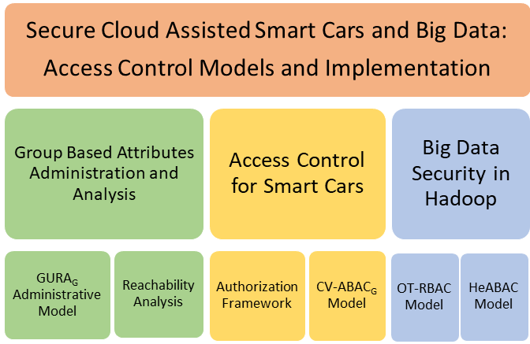
Summary of Contributions

Slide 6
Section I

Slide 7
Group Based Attributes Administration
and Analysis
Maanak Gupta and Ravi Sandhu, “The GURA_{G} Administrative Model for User and Group Attribute Assignment.” In Proceedings of the 10th International Conference on Network and System Security (NSS), Taipei, Taiwan, September 28-30, 2016, pages 318-332.
Maanak Gupta and Ravi Sandhu, “Reachability Analysis for Role-Based Administration of Group and User Attributes.” To be submitted to IEEE Trans. on Dependable and Secure Computing.

Slide 8
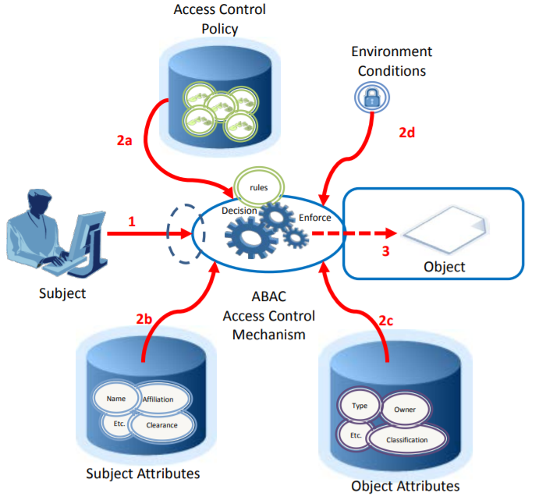
NIST ABAC Scenario

Slide 9
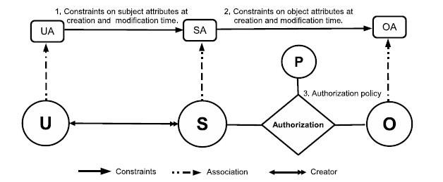
ABAC_{α} Model
Can be configured to do simple forms of DAC, MAC, RBAC (Jin, Krishnan, Sandhu 2012)

Slide 10
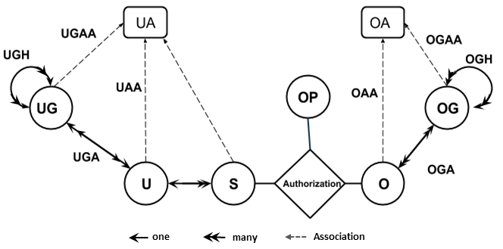
Hierarchical Group - ABAC
Hierarchical Group and Attribute Based Access Control (HGABAC)
Introduces User and Object Groups
Simplifies administration of attributes
Servos and Osborn, 2015

Slide 11
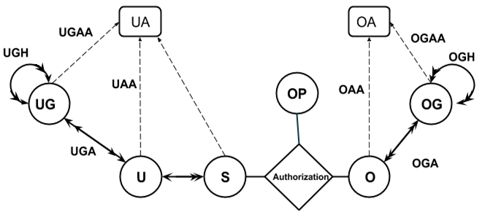
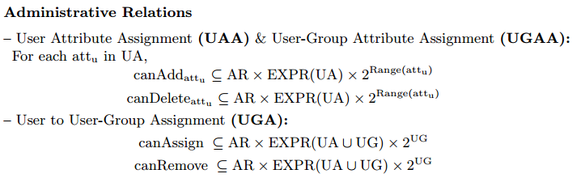
GURA_{G} Administrative Model
UAA: User Attribute Assignment
UGAA: User Group Attribute Assignment
UGA: User to User-Group Assignment

Slide 12
GURA_{G} Policies
Administrators request to
add or delete attributes of users
add or delete attributes of user groups
assign or remove users from user groups
Administrative Polices
UAA -- Administrative users with [administrative roles] can [modify] value [value] to [attribute name] attribute of a user if [condition].
UGAA -- Administrative users with [administrative roles] can [modify] value [value] to [attribute name] attribute of a user groups if [condition].
UGA -- Administrative users with [administrative roles] can [modify] membership in user-group [group name] of a user if [condition].

Slide 13
Reachability Analysis Problem
att1(u1)={v1}
att2(u2)={v2}
att1(g1)={v3}
att4(g2)={v4}
directUg(u1)={g1}
directUg(u2)={g2}
GURA_{G} Administrative
Policies
STATE
Not reachable with defined policies
S₀
…..
…..
If there exists a state where user u1 have effective values for att1 contain x and for att2 is equal to y?
…..
…..
…..
…..
…..
…..
Reachable with defined policies

Slide 14
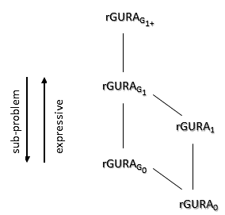
Reachability Query and Analysis Results
rGURA_{G1+}
[rGURA_{G1+}]
PSPACE-Complete
No Negation
No Deletion,
Single Rule Direct
Polynomial Time
[rGURA_{G1+}--]
[rGURA_{G1+}--,SR_{d}]
rGURA_{G} is different from GURA_{G} only in condition specification language in rules.
Only conjunction and negation is allowed.

Slide 15
Section II

Slide 16
Access Control for Smart Cars
Maanak Gupta and Ravi Sandhu, “Authorization Framework for Secure Cloud Assisted Connected Cars and Vehicular Internet of Things.” In Proceedings of the 23rd ACM Symposium on Access Control Models and Technologies (SACMAT), Indianapolis, Indiana, June 13-15, 2018, pages 193-204.
Maanak Gupta, James Benson, Farhan Patwa, and Ravi Sandhu, “Dynamic Groups and Attribute Based Access Control for Next Generation Smart Cars.” (To Appear) In Proceedings of the 9th ACM Conference on Data and Application Security and Privacy (CODASPY), Dallas, Texas, Mar 25-27, 2019.

Slide 17

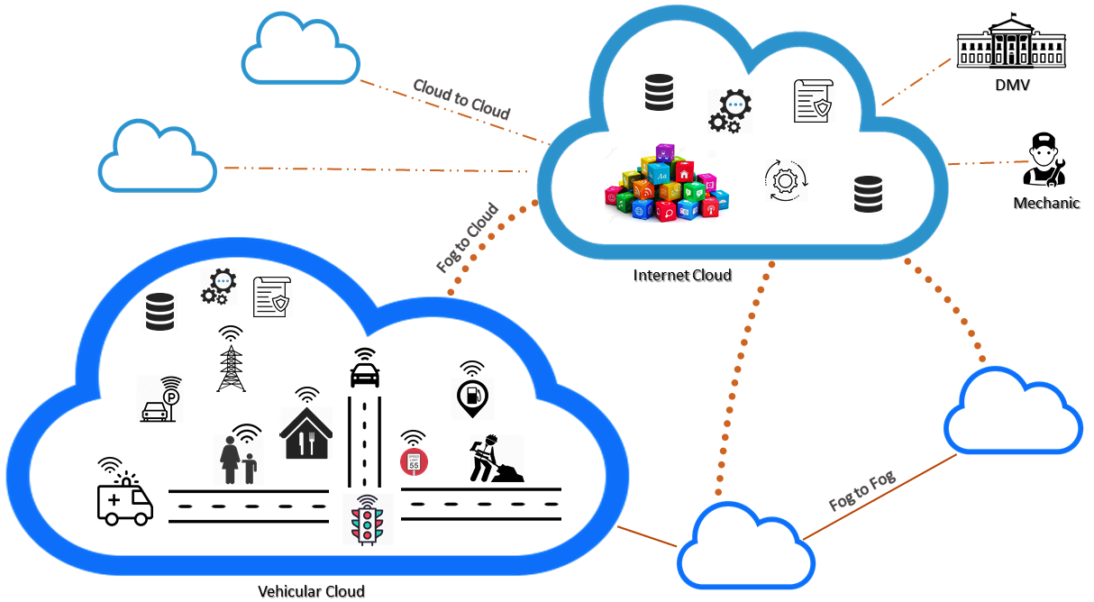
Security and Privacy Requirements
On-Board Application and Sensors
Over the Air updates
V2X fake messages
In-vehicle ECU communication
Personal Data
Third Party devices
User Privacy Preferences
Spoofing, Ransomware, Injection…
Loss of Information in Cloud

Slide 18
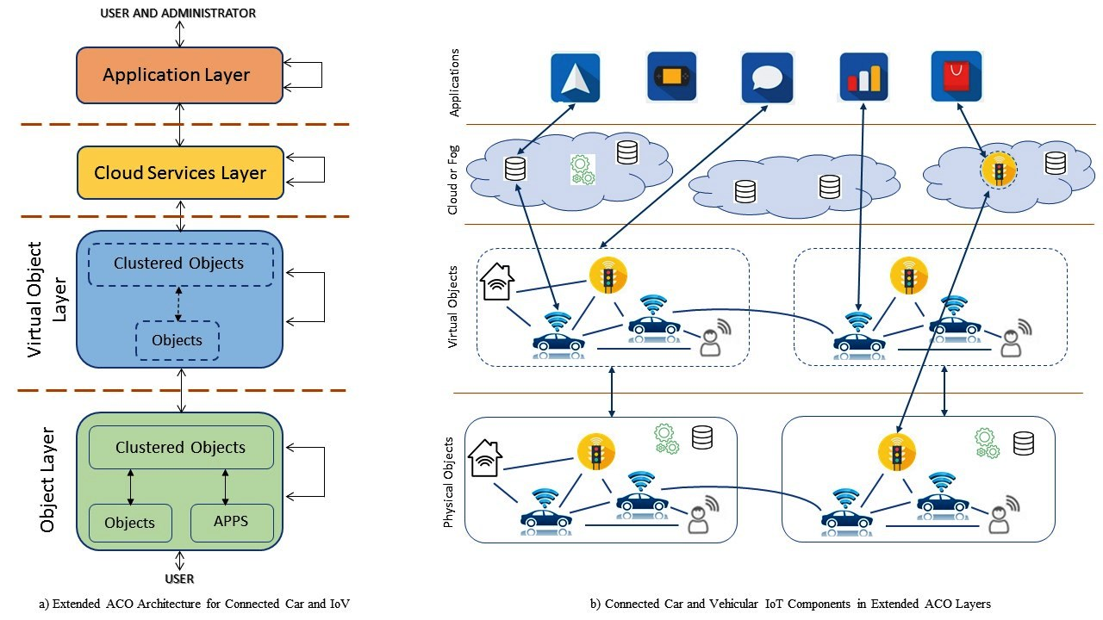
Extended Access Control Oriented Architecture

Slide 19
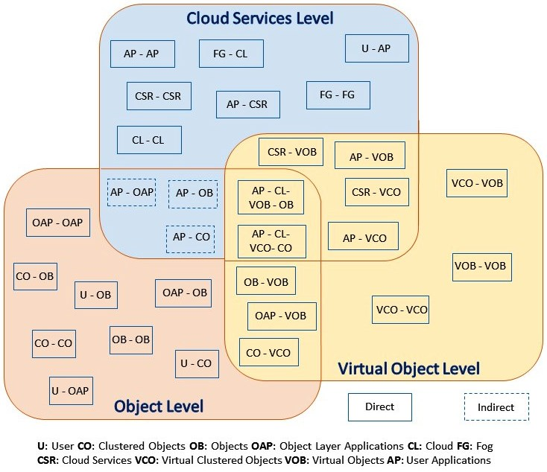
Authorization Framework

Slide 20
Access Control Strategies
Static vs Dynamic
What kind of relationship they have?
Owner, Manufacturer, Friend…
Multi-Layered
Groups Based
Trusted Interaction
How I trust you?
Previous interaction..?
ABAC, ReBAC Models
Who will administer?
Data in Cloud, cross cloud sharing. How?

Slide 21
Authorization Framework
Bhatt et al, 2017
AWS-IoTAC Model
Alsehri and Sandhu, 2017
AWS-IoT-ACMVO Model
CV-ABAC_{G} Model
Cloud Supported

Slide 22
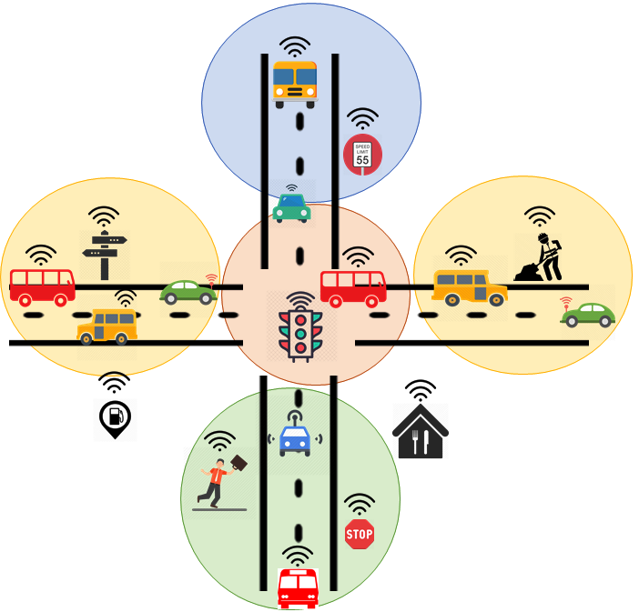
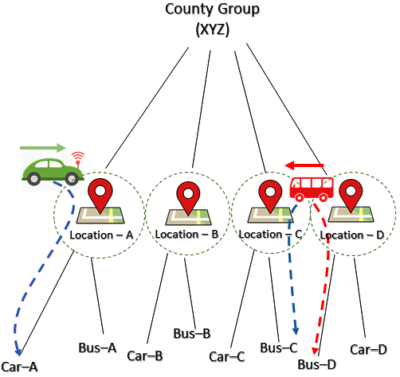
Dynamic Location Groups

Slide 23
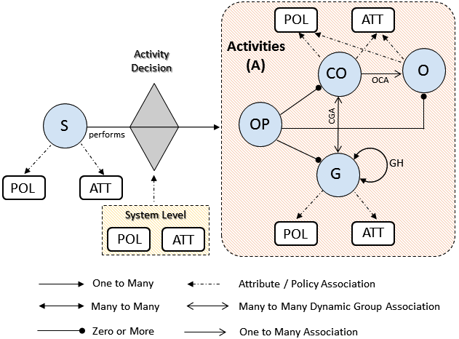
CV-ABAC_{G} Model
Dynamic Groups and Attribute-based Access Control for Connected Vehicles

Slide 24
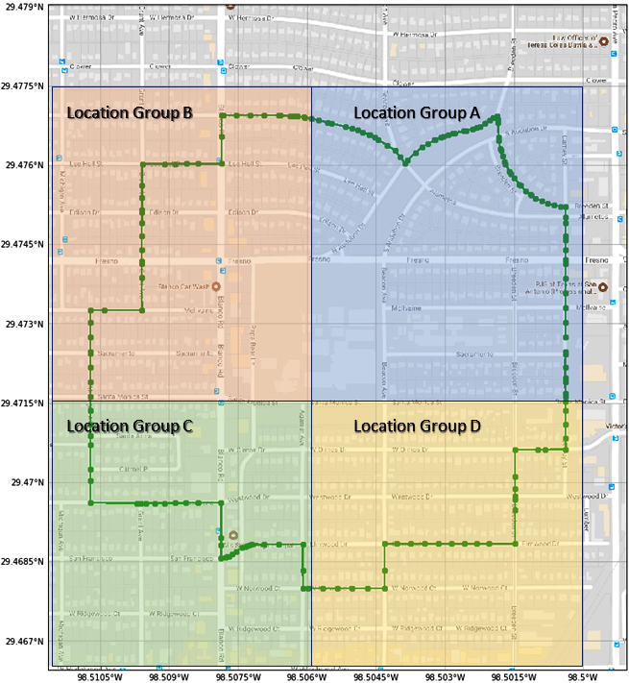
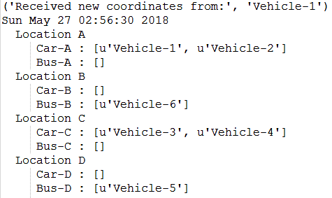
Implementation in AWS

Slide 25
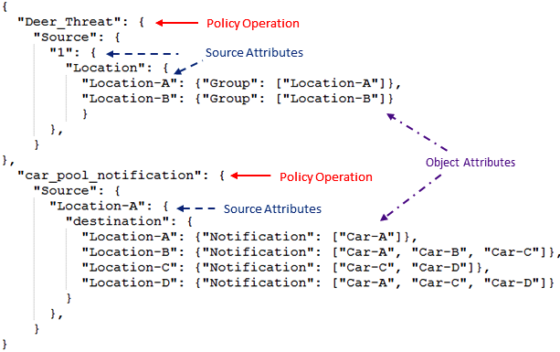
ABAC Policy

Slide 26
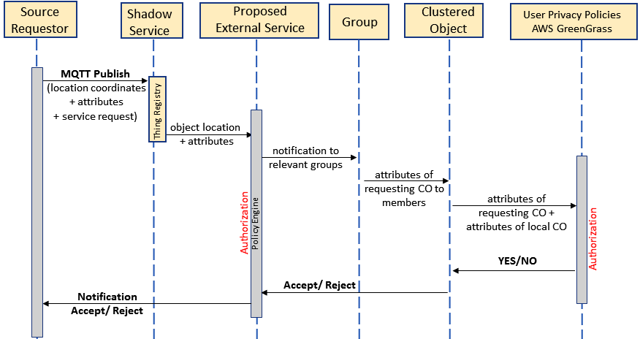
Sequence Diagram

Slide 27
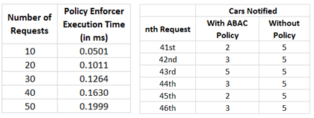
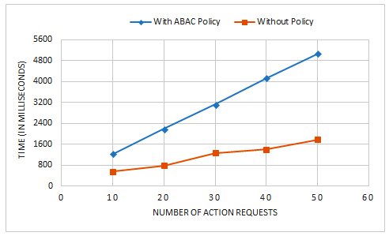
Performance Metrics

Slide 28
Section III

Slide 29
Big Data Security in Hadoop
Maanak Gupta, Farhan Patwa and Ravi Sandhu, “An Attribute-Based Access Control Model for Secure Big Data Processing in Hadoop Ecosystem.” In Proceedings of the 3rd ACM Workshop on Attribute-Based Access Control (ABAC), March 19-21, 2018, Tempe, Arizona, pages 13-24.
Maanak Gupta, Farhan Patwa and Ravi Sandhu, “Object-Tagged RBAC Model for the Hadoop Ecosystem.” In Proceedings of the 31st Annual IFIP WG 11.3 Working Conference on Data and Applications Security and Privacy (DBSec), Philadelphia, Pennsylvania, July 19-21, 2017, pages 63-81.
Maanak Gupta, Farhan Patwa, James Benson and Ravi Sandhu, “Multi-Layer Authorization Framework for a Representative Hadoop Ecosystem Deployment.” In Proceedings of the 22nd ACM Symposium on Access Control Models and Technologies (SACMAT), Indianapolis, Indiana, June 21-23, 2017, pages 183-190.

Slide 30
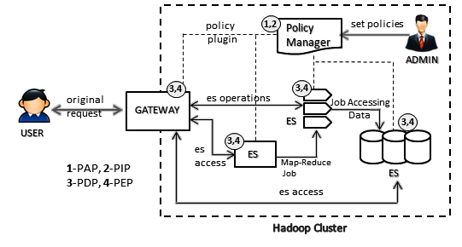
Hadoop Ecosystem
Authorization Architecture
Policy Manager : Apache Ranger, Apache Sentry
Gateway : Apache Knox
Ecosystem Service (ES) : Apache Hive, HDFS, Apache Storm, Apache Kafka, YARN

Slide 31
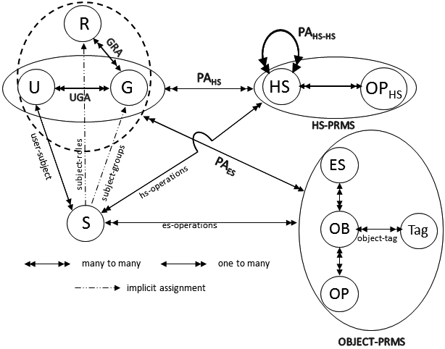
HeAC Model: Consolidated View
Hadoop Ecosystem
Access Control Model
ACLs based permissions on Objects and Object-Tags
Users (U), Groups (G) , Subjects (S)
Hadoop Services (HS)
Hadoop Service Operations (OPHS)
Objects (OB), Operations (OP)
Ecosystem Service (ES), Objects (OB)
Operations (OP), Tag

Slide 32
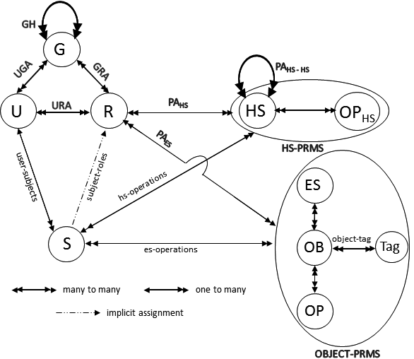
OT-RBAC Model
Object-Tagged RBAC
RBAC based permissions on Objects and Object-Tags

Slide 33
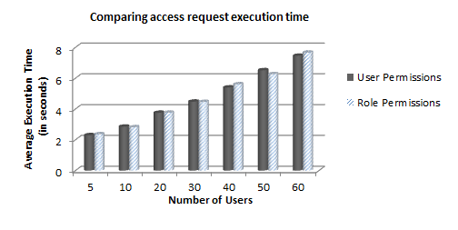
Performance Evaluation of OT-RBAC

Slide 34
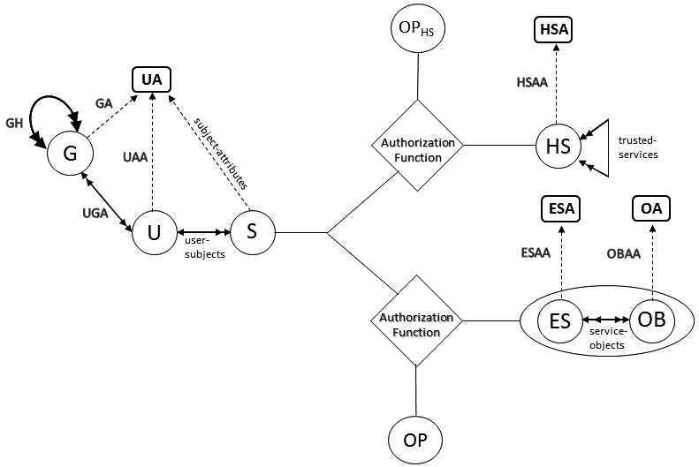
HeABAC Model
Hadoop Ecosystem Attribute-Based
Access Control Model
User Attributes (UA),
Hadoop Services Attributes (HSA)
Objects Attributes (OA),
Ecosystem Service Attributes (ESA)

Slide 35
HeABAC Example Policies
Authorization_{access}(s:S, es:ES) ≡ diagnostic ∈ effective_{department}(s) ∧ technician ∈ effective_{role}(s) ∧ serviceType(es) = HIVE ∧ createdBy(es) = admin1.
Authorization_{select}(s:S, es:ES, ob:OB) ≡ Authorization_{access}(s:S, es:ES) = True ∧ diagnostic ∈ effective_{department}(s) ∧ effective_{role}(s) ∈ readerType(ob) ∧ tableType(ob) = sensor-data ∧ car(ob) = FVR1234.
Authorization_{access}(s:S, hs:HS) ≡ diagnostic ∈ effective_{department}(s) ∧ technician ∈ effective_{role}(s) ∧ serviceType(hs) = DataNode ∧ createdBy(hs) = admin2

Slide 36
Summary of Contributions

Slide 37
Conclusion and Future Work
Foundational aspects of groups based ABAC
Administrative Model
Reachability Analysis
Access Control Solutions for Smart Cars
Authorization Framework
Dynamic Groups and ABAC
Access Control Solutions for Big Data in Hadoop
Family of Models – HeAC, OT-RBAC and HeABAC
Some Future Work Directions
Trust Based Cloud and Smart Cars Solutions
Location preserving approaches
Data Ingestion Security and privacy concerns
Cloudlet supported Intelligent Transportation

Slide 38
Dissertation Publications
Journal Paper
Maanak Gupta and Ravi Sandhu, “Reachability Analysis for Role-Based Administration of Group and User Attributes.” To be submitted to IEEE Trans. on Dependable and Secure Computing.
Conference Papers
Maanak Gupta, James Benson, Farhan Patwa, and Ravi Sandhu, “Dynamic Groups and Attribute Based Access Control for Next Generation Smart Cars.” (To Appear) In Proceedings of the 9th ACM Conference on Data and Application Security and Privacy (CODASPY), Dallas, Mar 25-27, 2019.
Maanak Gupta and Ravi Sandhu, “Authorization Framework for Secure Cloud Assisted Connected Cars and Vehicular Internet of Things.” In Proceedings of the 23rd ACM Symposium on Access Control Models and Technologies (SACMAT), Indianapolis, Indiana, June 13-15, 2018, pages 193-204.
Maanak Gupta, Farhan Patwa and Ravi Sandhu, “An Attribute-Based Access Control Model for Secure Big Data Processing in Hadoop Ecosystem.” In Proceedings of the 3rd ACM Workshop on Attribute-Based Access Control (ABAC), March 19-21, 2018, Tempe, Arizona, pages 13-24.
Maanak Gupta, Farhan Patwa and Ravi Sandhu, “Object-Tagged RBAC Model for the Hadoop Ecosystem.” In Proceedings of the 31st Annual IFIP WG 11.3 Working Conference on Data and Applications Security and Privacy (DBSec), Philadelphia, Pennsylvania, July 19-21, 2017, pages 63-81.
Maanak Gupta, Farhan Patwa, James Benson and Ravi Sandhu, “Multi-Layer Authorization Framework for a Representative Hadoop Ecosystem Deployment.” In Proceedings of the 22nd ACM Symposium on Access Control Models and Technologies (SACMAT), Indianapolis, Indiana, June 21-23, 2017, pages 183-190.
Maanak Gupta and Ravi Sandhu, “The GURAG Administrative Model for User and Group Attribute Assignment.” In Proceedings of the 10th International Conference on Network and System Security (NSS), Taipei, Taiwan, September 28-30, 2016, pages 318-332.

