Slide 1
Operation and Administration of Access Control in IoT Environments
Ph.D. Dissertation Defense
Mehrnoosh Shakarami
Institute for Cyber Security (ICS),
Department of Computer Science
The University of Texas at San Antonio
Committee:
Prof. Ravi Sandhu (Advisor and Chair)
Dr. Murtuza Jadliwala
Dr. Ram Krishnan
Dr. Palden Lama
Dr. Xiaoyin Wang
April 2022

Slide 2
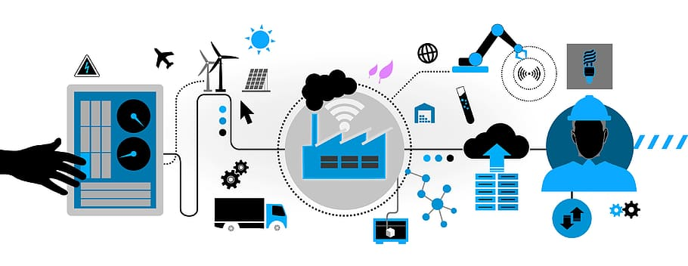
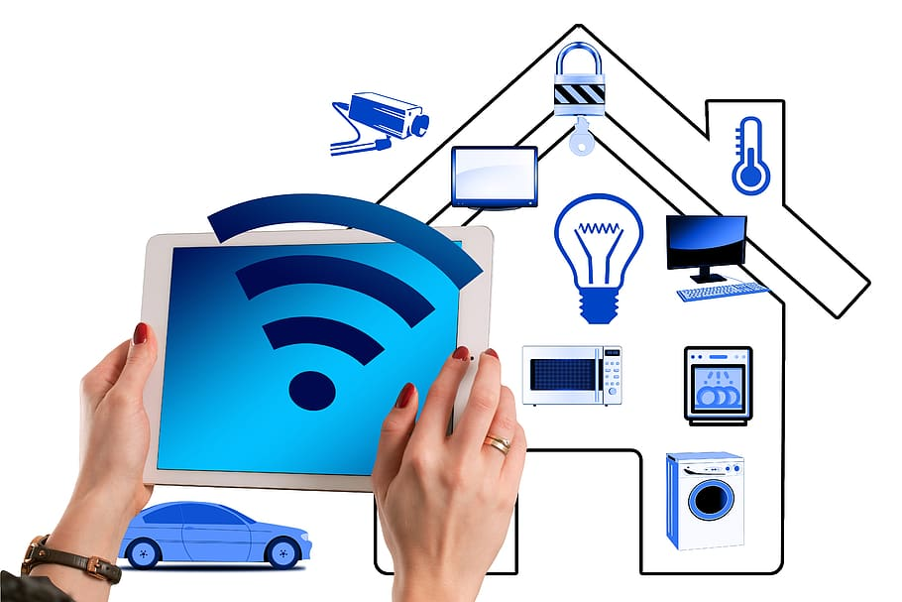
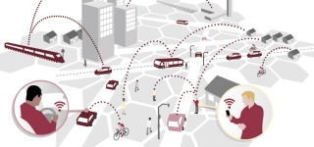

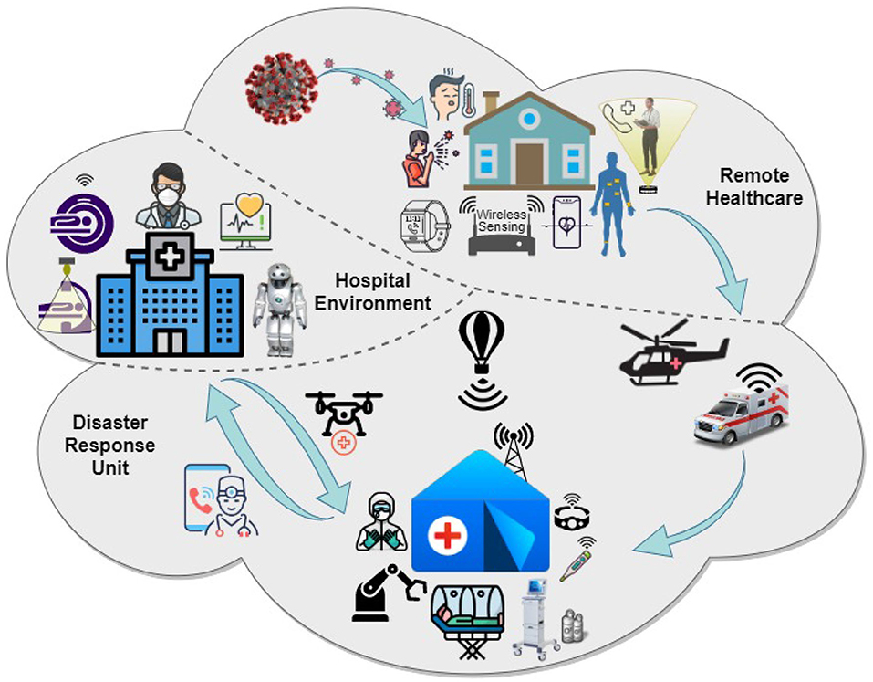

Internet of Things
The Internet of Things (IoT) denotes a network of evolving and expanding number of technologies embedded in smart things with at least one network interface to connect, interact, and exchange data and information.
Smart Manufacturing
Smart Home
Smart Transportation
IoT-Enabled Smart Environments
Smart City
Smart Health
Smart Agriculture

Slide 3








Access Control in IoT Environments
We recognize smart home IoT unique characteristics necessitate oriented authorization models to be particularly designed.
Little attention has been paid to administration of access in IoT environments.
The potential security violations which may happen in device-to-device interactions are largely uninvestigated.
Policy Specification
Granularity
Context Awareness
Policy Management
Policy Enforcement
Handling the complexity of Environment
Usability
Minimum user involvement
Light-weight
Reliability and Availability
Multi-domain Administration

Slide 4
Problem Statement
The uptick of smart home technology adoption while its authorization is less investigated compared to other domains.
We investigate three major access control-related topics which affect or directly provide authorization in the home IoT environment.
ABAC is a widely adopted paradigm to provide access control in different IoT access, including smart home. Using ABAC expose smart environments to the risk of access violation due to inconsistency.
While overall system security is crucially dependent on both administrative and operational authorization models, administration of access in smart home environments is overlooked.
There is a hype around utilizing blockchain for access control in IoT environments, but it is not clear if the provided benefits could overcome inherent blockchain drawbacks.
A holistic view of home automation demands catered access control specifications to facilitate
device-to-device interactions.

Slide 5
Thesis Statements
The established paradigm of role-based access control can be utilized for access administration of user-to-device in corresponding operational access control models, which could be based on either role-based or attribute-based access control.
If the operational authorization is based on attribute-based access control, a detailed analysis of required consistency for both mutable and immutable attribute values can ultimately benefit the overall safety of the system by providing a decision point with most recent values of attribute credentials.
The established paradigm of attribute-based access control can be adapted and extended to provide a device-to-device access control approach towards considering heterogeneous IoT devices in a smart home as an ecosystem with intercommunication.

Slide 6
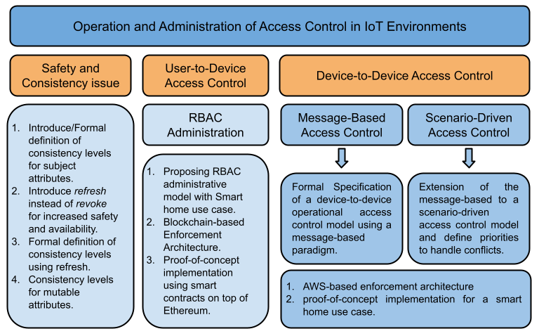
Summary of Contributions

Slide 7

Summary of Contributions

Slide 8


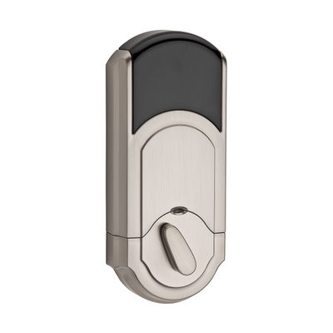


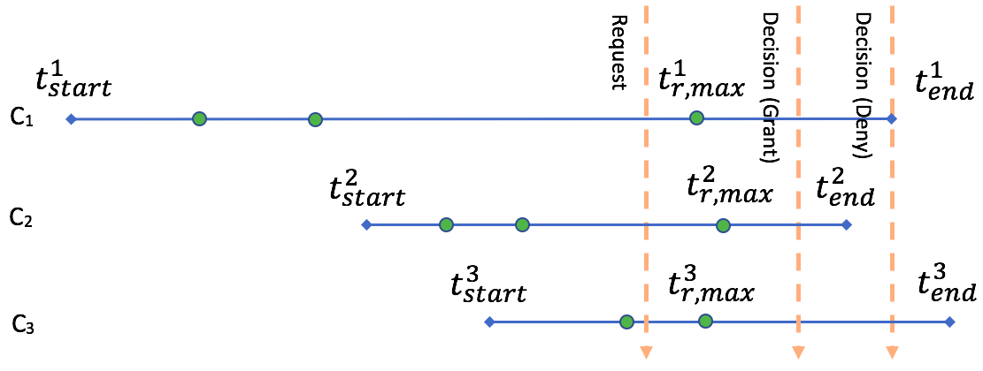
Safety and Consistency- a Smart Home IoT Use Case
Consider a smart lock with its access control deployed on the vendor’s cloud.
Smart lock would authenticate and pair with a user's mobile in its Bluetooth range, then receive the status of that specific user's access key from the cloud.
The key status would be also saved in the local database of the lock.
Due to intermittent Internet connection and limited storage space of home IoT devices, required authorization information might not be available in real time.
There is an increased risk of making access control decisions based on outdated information.
This problem may arise in any attribute-based access control environment in which attributes are provided incrementally to the decision point.
We investigate this problem in general, interpreted with use cases in a smart home IoT environment.
Exposure of decision point to stale attributes, hence access violation.
State Consistency Attack

Slide 9
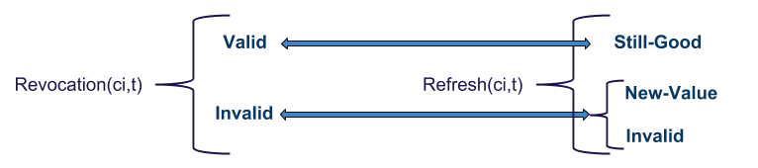
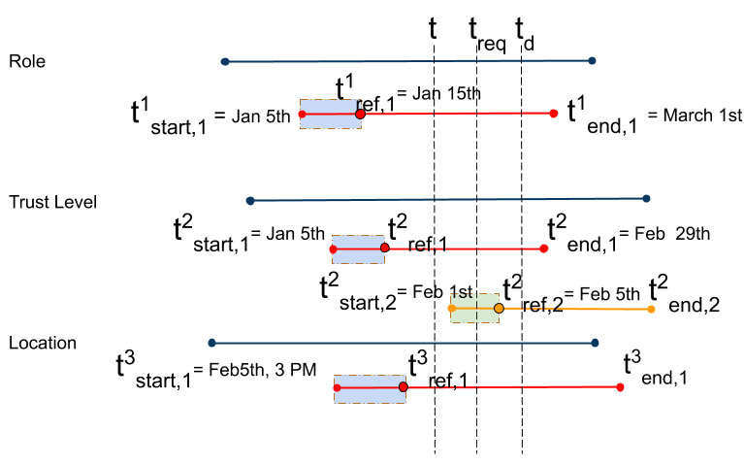

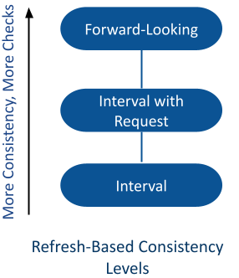



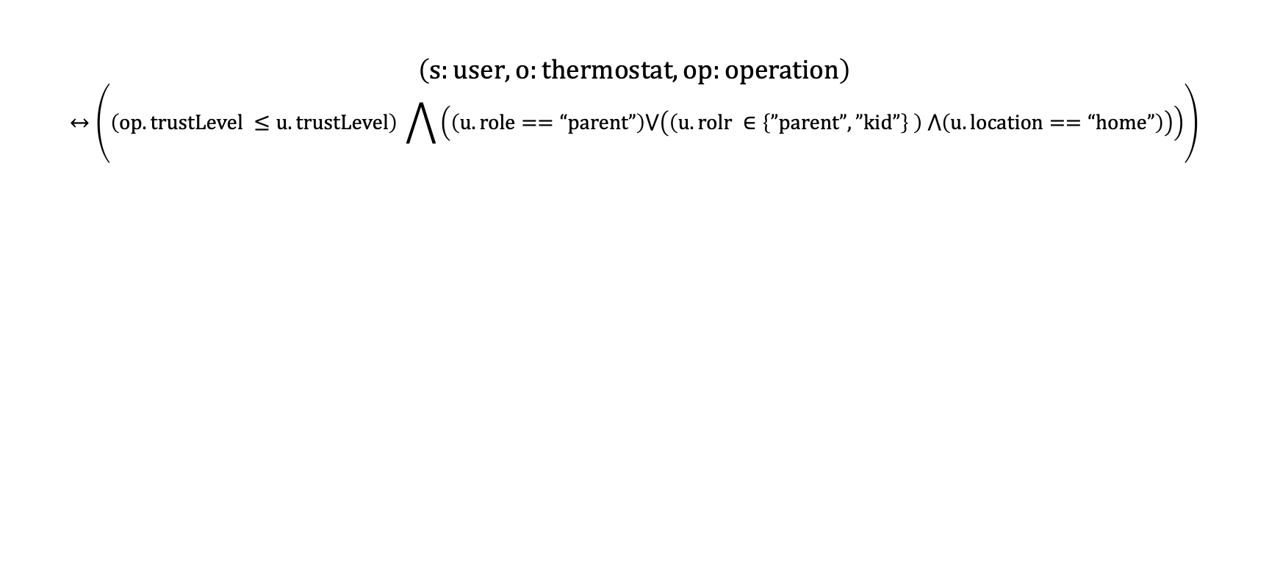
Refresh instead of Revoke – A smart Home IoT Use Case
Refresh replaces an older value with a newer one, while Revoke simply invalidates the old value.
$$\left(s:user, o:thermostat, op:operation\right)$$
$$↔\left(\left(op.trustLevel ≤u.trustLevel\right) \bigwedge{\left(\left(u.role==“parent”\right)⋁\left(\left(u.rolr ∈\left\{”parent”,”kid”\right\} \right) ⋀\left(u.location==“home”\right)\right)\right)}\right)$$
What if babysitter tries to adjust the thermostat after leaving home?
Access Violation
Interval Consistency with Request Time

Slide 10

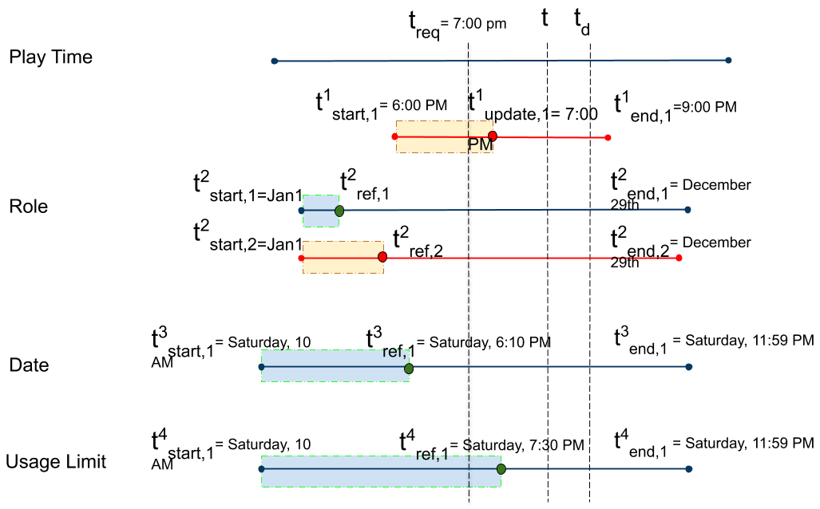

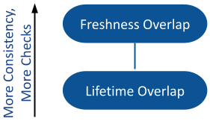


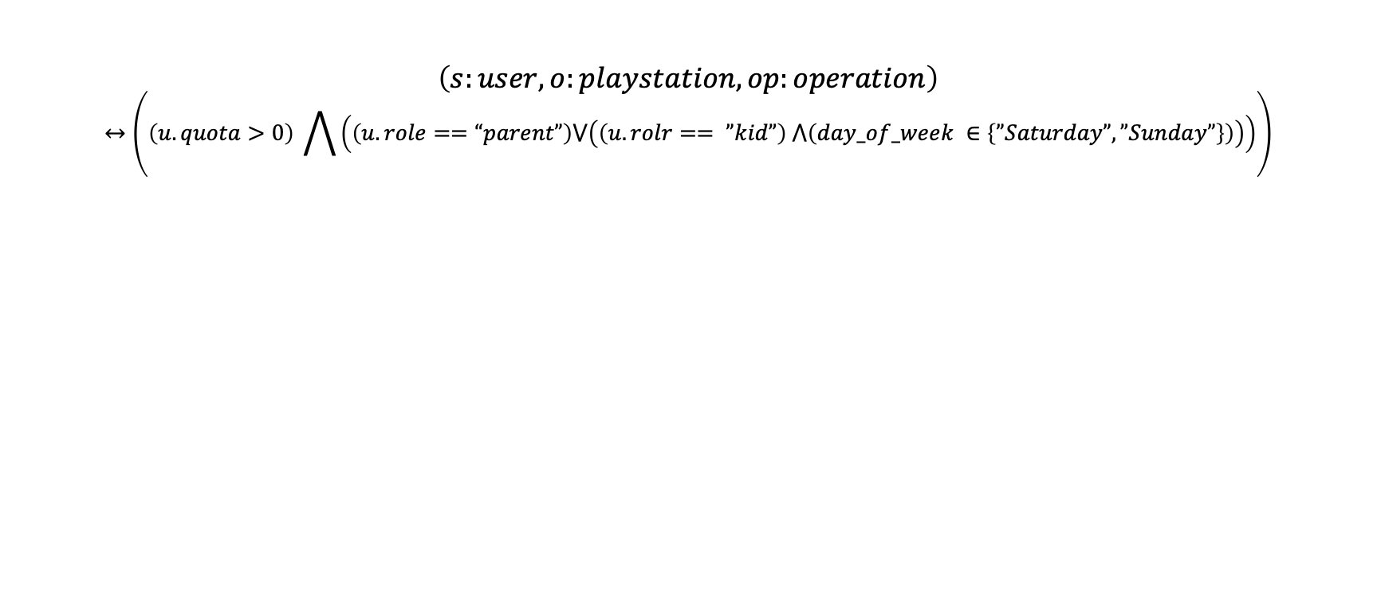
Safety and Consistency of Mutable Attributes Using Quotas – A smart Home IoT Use Case
Mutable Attribute: Attribute changes are the consequence of access utilization by subject. We claim the revocation scenario to be inappropriate for mutable attributes.
$$\left(s:user, o:playstation, op:operation\right)$$
$$↔\left(\left(u.quota>0\right) \bigwedge{\left(\left(u.role==“parent”\right)⋁\left(\left(u.rolr== ”kid”\right) ⋀\left(day_of_week ∈\left\{”Saturday”,”Sunday”\right\}\right)\right)\right)}\right)$$
What if parents decide to reduce the usage limit?
Access Violation
Lifetime Overlap Consistency Level

Slide 11

Summary of Contributions

Slide 12
Administration of Access
Access administration has been overlooked.
  Overall system security is crucially dependent on both the administrative and operational models.
  Many lack the support of a formal model and rely on informally assumed policy objectives.
Administration of access must be carefully crafted to ensure that policy does not drift away from its original objectives.
Access administration in a smart home environment is a particular access management problem due to:
  lack of expertise in home users.
  shared ownership of IoT devices.
We follow PEI (Policy, Enforcement Architecture, Implementation) as our reference model.
We opt for EGRBAC as our underlying operational model, for it being:
  Granular at permission level, instead of device level.
  Capture the environment conditions and provide contextuality.

Slide 13

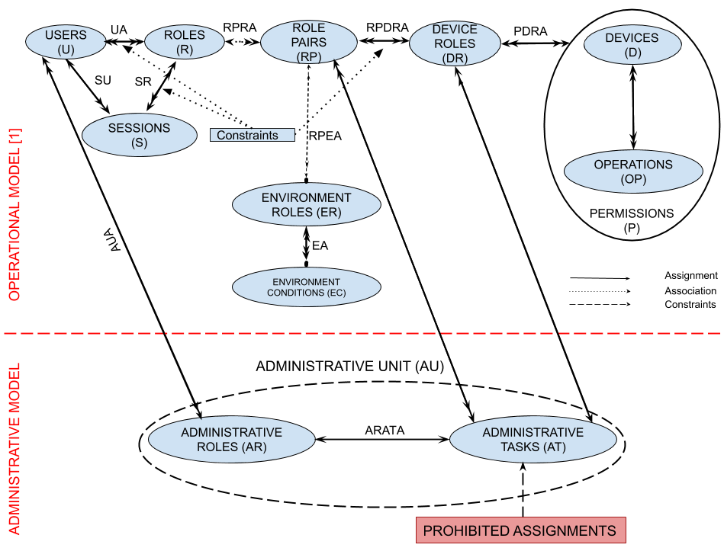









PEI: Policy – Basic Administrative Model
{(parent,Any_Time),(kid,Entertainment_Time)}
Entertainment_Devices
Bob
Alex
Julia
$P_{1}$={Turn On, Turn Off, PG, R}
Susan
Kids_Friendly_Content
$P_{2}$={Turn On, Turn Off, PG}
Basic Model to manage RPDRA Assignment
We recognize administration is best to be done decentralized. Decentralization provided through Administrative Units (AU).
We define one administrative unit per operational assignment to be managed, which includes a unique administrative role (AR) and a set of administrative tasks (AT).
Authorization is scoped as a set of administrative tasks defined to manage corresponding assignments in the operational model.

Slide 14
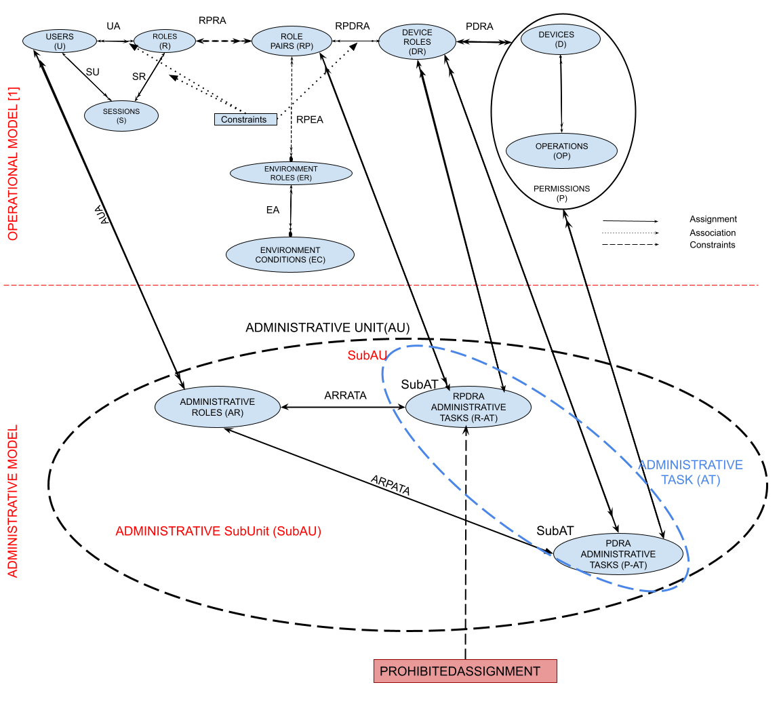
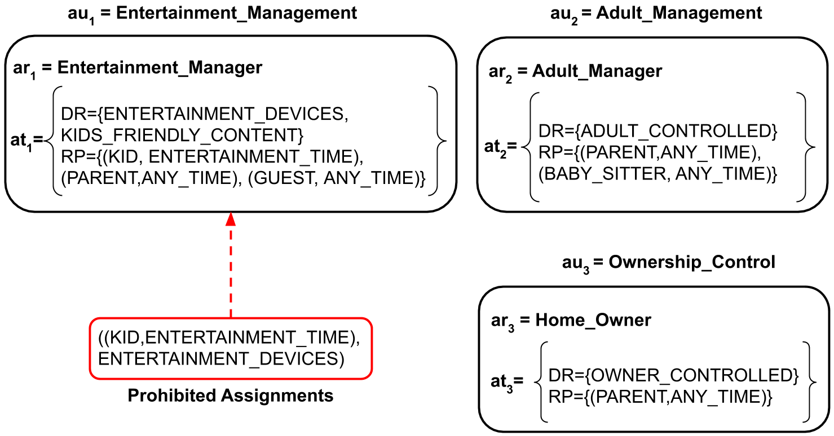
PEI: Policy – Extended Administrative Model
We extended our administrative model by defining one administrative unit per operational assignment to be managed.
Each administrative unit includes a unique administrative role which controls a predefined set of administrative tasks which represents its scope of administration.
Extended Model

Slide 15
Summary of Contributions

Slide 16
PEI: Blockchain-Based Enforcement Architecture
Blockchain for Access Control:
Threat Model and Blockchain Benefits:
Benefits:
Decentralized Control
Transparency and Auditability
Distributed Information
Tamper-proof
Why NOT Blockchain for Operational Access Control:
IoT Constraints
Long Transaction Confirmation Time
Financially Prohibitive
Why Blockchain for Administrative Access Control:
Less Frequency of Administrative Tasks
Posteriori Analysis
Scalable
No need for IoT devices to be engaged in blockchain
Threat Model:
Insider Attack:
Assumptions:
Users’ communication with edge is secure over local network.
Blockchain Security Benefits:
Administrator account cannot be faked
Routing attacks are out-of-scope
Attacks against Web3 API are out-of-scope
API attacks against user’s private keys in their wallets considered to be out-of-scope
Administrative policy is encoded in a smart contract recorded to ledger via consensus
System is equipped with transparency and auditability
Spoofing, Tampering, Privilege Escalation, Repudiation

Slide 17
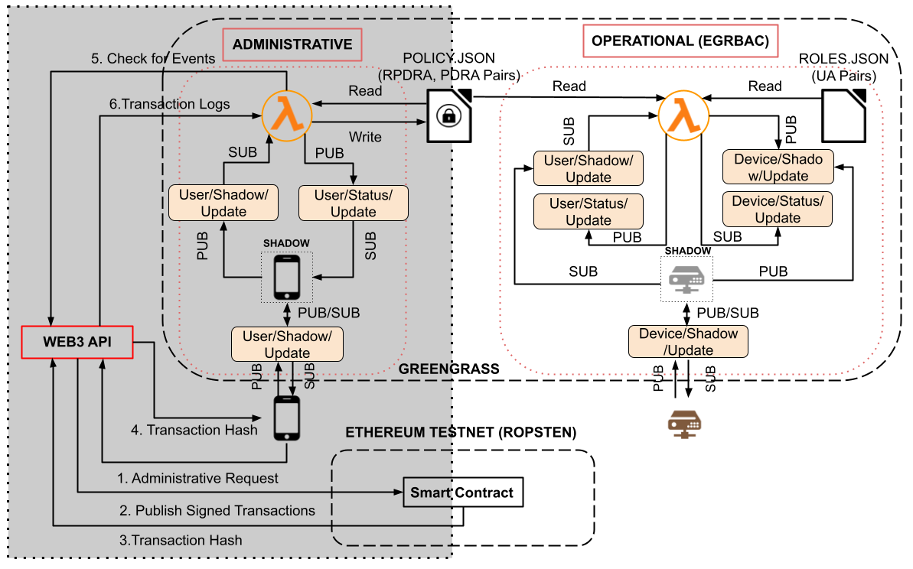
PEI: Enforcement Architecture
Decentralized
Ledger-based
Publish-subscribe

Slide 18
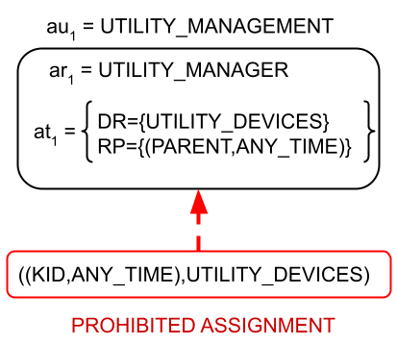
Sequence Diagram

Slide 19
Summary of Contributions

Slide 20
PEI: Implementation Setup
Administrative access control policy implemented in a single smart contract on the Ropsten.
Different administrative controls are coded as functions, which would be triggered by transactions.
Smart contract is programmed in Solidity and tested it on Remix IDE.
Infura is used as web3.0 API to interact with blockchain.
Experiment Environment:
  AWS IoT Greengrass v1.
  Greengrass runs on a dedicated virtual machine: one virtual CPU, 2 GB of RAM and 20 GB hard drive.
  The virtual machine’s operating system is Ubuntu 20.4.2 LTS and it is connected to a 1 Gbps network.
  Our AWS lambda code on the Greengrass is written in Python 3.8 and is running in a long-lived isolated runtime environment with limited RAM of 256 MB
Experiments are done for a normal distribution with a 99.9% confidence interval.
We ran our experiments in two settings with the policy sizes of n=20 and n=500.
  Both experiments were run for a total of 500 times.

Slide 21
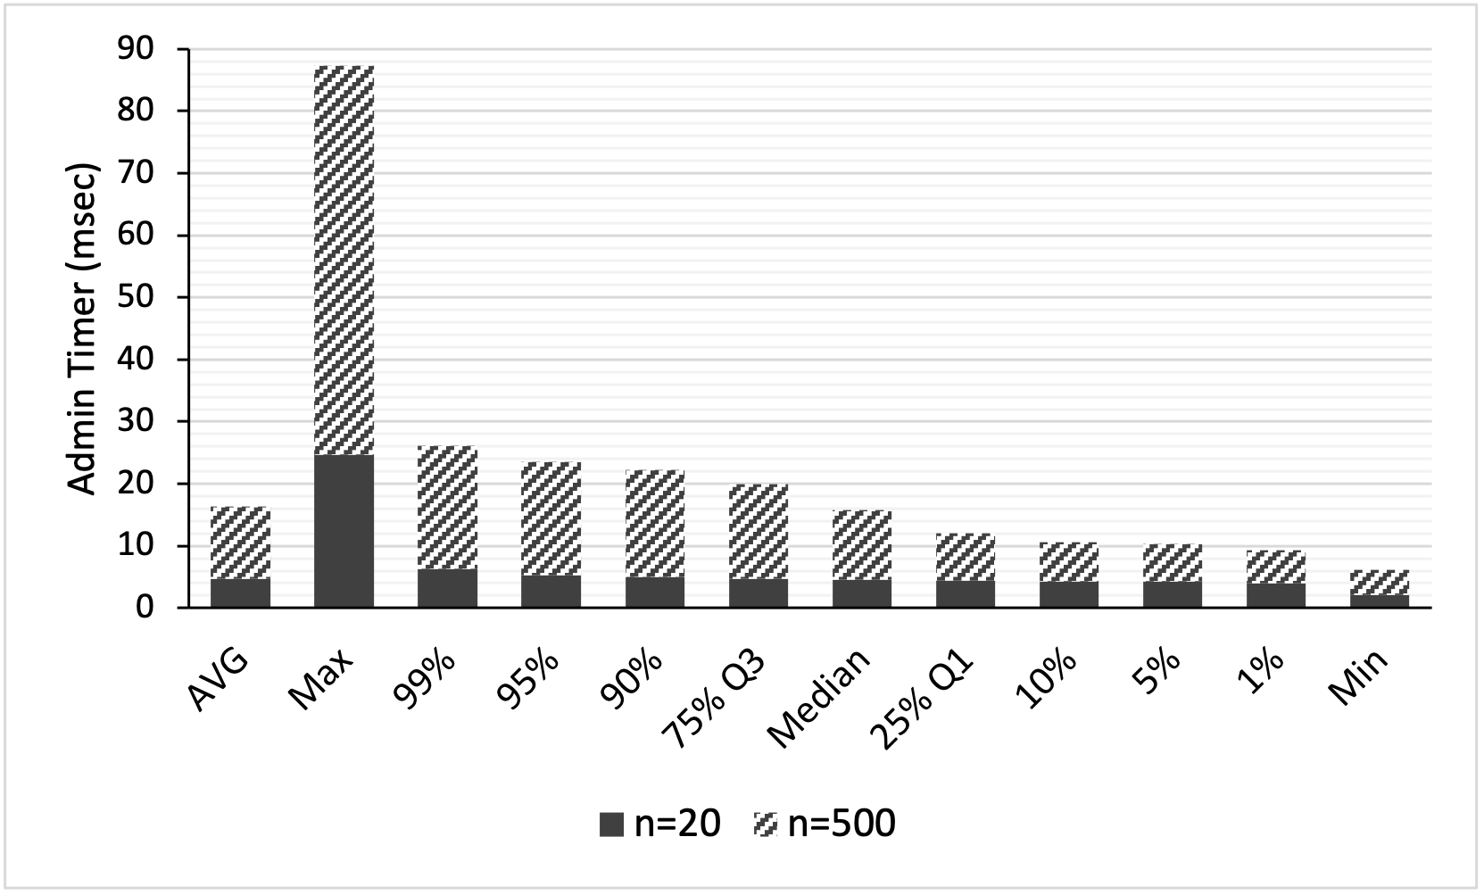
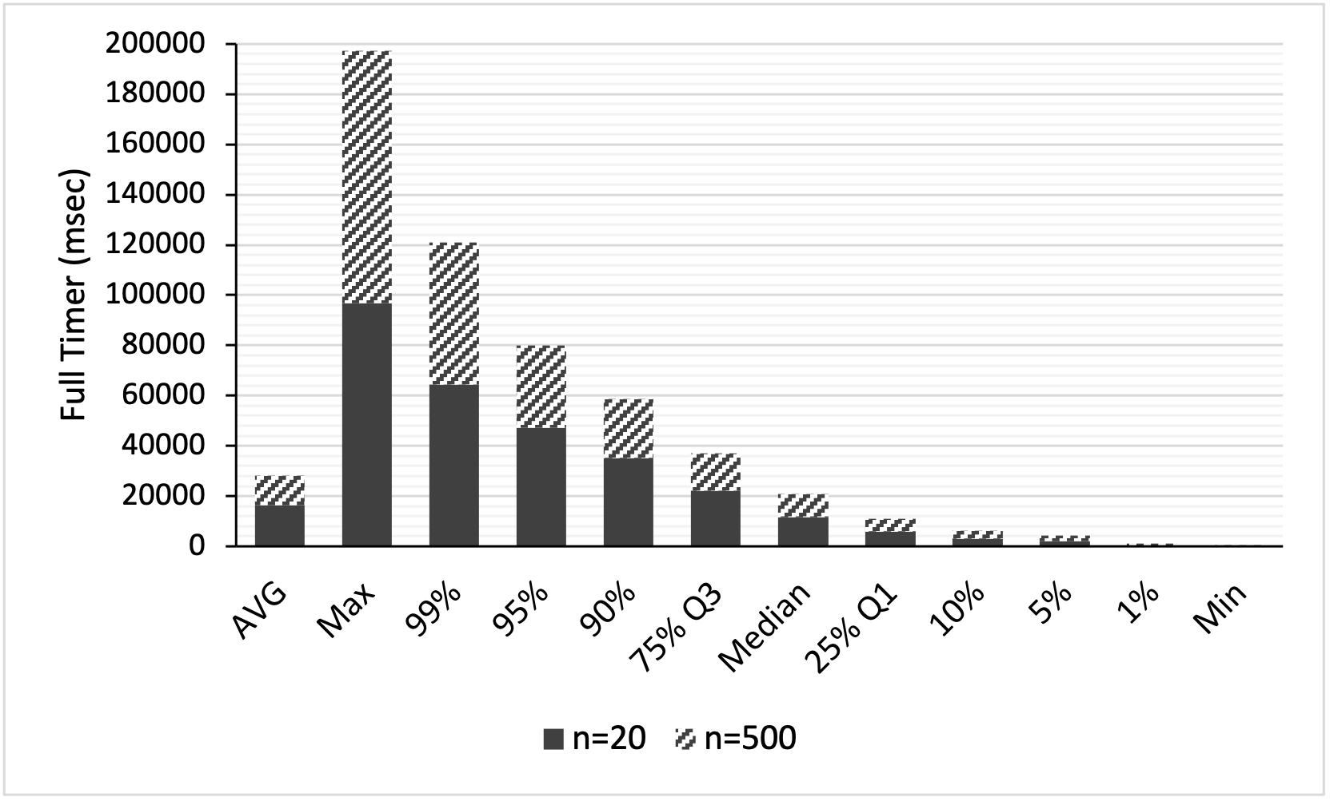
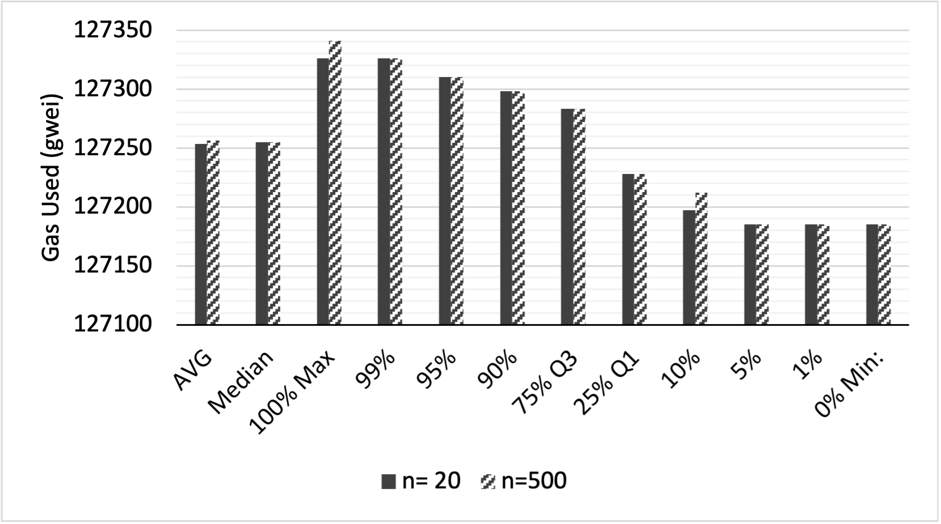
Implementation Results:
Admin Timer: After a transaction has been successfully mined, Lambda checks the logs to search out the succeeded transactions. Then, it makes appropriate changes to the “policy.json” file and publishes the results to the User/Status/Update to inform the user about his/her administrative request.
Full Timer: Complete cycle of an administrator submitting a request, to that request being mined, and the lambda function processing the results and updating as necessary.
Gas Used: the actual amount of gas which was used during execution. Gas prices are denoted in GWEI, which equals to 10⁻⁹ ETH. We calculated the monetary cost of each transaction to be 28 cents.

Slide 22


Discussions
Our administrative model features:
  Decoupled Assignment and Revocation
  Symmetric Assignment and Revocation
  Generalizability
  Transparency and Auditability
  Privacy
Security considerations specific to our architecture:
  Smart Contract Security
  Device-Cloud Communications
Limitations:
  Continuous Access control and Mutability
  Handling Conflicts
Our implementation results are reassuring that although the use of blockchain for operational access control is NOT promising, BUT it is promising to be utilized at administrative level.
Blockchain Hype
EGRBAC is not chosen as a de-facto!

Slide 23
Summary of Contributions

Slide 24
Motivation
Seamless interoperability among IoT devices, device-to-device communication, is imperative for incipient evolution of the IoT ecosystem.
Many standardization efforts as well as proposals for integration of heterogenous IoT platforms are going on in both academic and industry, but there is no de-facto standard and there would be none in foreseeable future.
There is heterogeneity in all levels of IoT technology, including device, networking, middleware, application, and data/semantics of IoT scenarios, makes heterogeneous IoT devices cumbersome.
There is no access control model specification to provide an access control model for device-to-device interoperability.
Scenarios of device-to-device interactions are inevitable for real-life home automation, which brings added convenience but also inherent security risks.
We present an access control model which governs authorized flow of information for device-to-device interactions in a smart home IoT using Attribute-Based Access Control (ABAC) for the first time, utilizing a message passing paradigm.

Slide 25
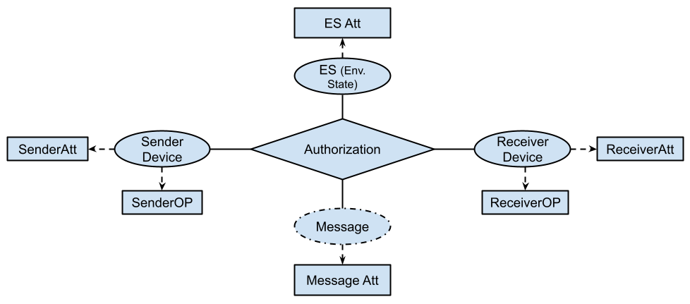
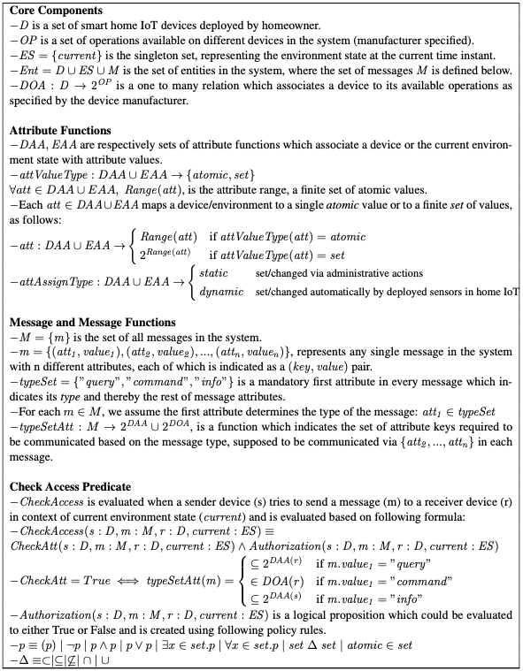
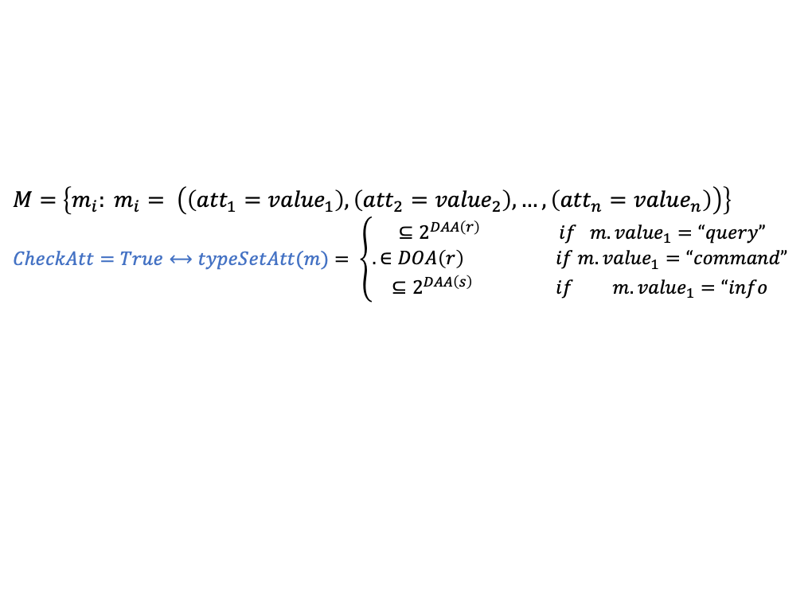
PEI: Message-Based Device-to-Device ABAC Access Control Model
Static/Dynamic
Atomic/Set
Static/Dynamic
Atomic/Set
Manufacturer-defined
Manufacturer-defined
$M=$ $\left\{m_{i}: m_{i}= \left(\left({att}_{1}={value}_{1}\right),\left({att}_{2}={value}_{2}\right),…,\left({att}_{n}={value}_{n}\right)\right)\right\}$
$$CheckAtt=True⟷typeSetAtt(m)= \left\{\begin{aligned} ⊆2^{DAA\left(r\right)} if m.{value}_{1}=“query” \\ . ∈DOA\left(r\right) if m.{value}_{1}=“command” \\ ⊆2^{DAA\left(s\right)} if m.{value}_{1}=“info\end{aligned}\right.$$

Slide 26
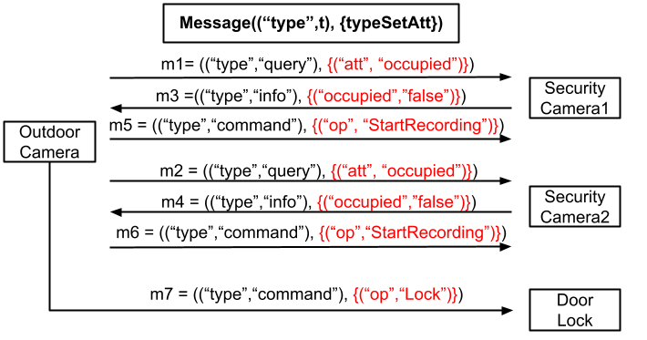
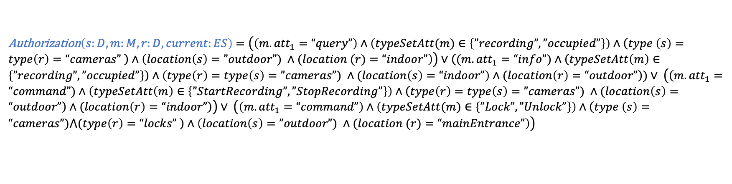
A Smart Home IoT Use Case
$\text{CheckAccess}\text{(}\text{s}\text{:}\text{D}\text{, }\text{m}\text{:}\text{M}\text{, }\text{r}\text{:}\text{D}\text{, }\text{current}\text{:}\text{ES}\text{)}$ $≡CheckAtt\left(s:D, m:M, r:D, current:ES\right)∧$ Authorization$\left(s:D, m:M, r:D, current:ES\right)$
Authorization$\left(s:D, m:M, r:D, current:ES\right)$ $=\left(\left(m.{att}_{1}=“query”\right)∧\left(typeSetAtt(m)∈\left\{”recording”,”occupied”\right\}\right)∧\left(type \left(s\right)=type\left(r\right)=“cameras” \right)∧\left(location\left(s\right)=”outdoor”) ∧(location (r)=“indoor”\right)\right)∨\left((m.{att}_{1}=“info”)∧\left(typeSetAtt\left(m\right)∈\left\{”recording”,”occupied”\right\}\right)∧\left(type\left(r\right)=type\left(s\right)=”cameras”) ∧(location\left(s\right)=“indoor”\right)∧(location\left(r\right)=“outdoor”\right))∨ \left(\left(m.{att}_{1}=“command”)∧\left(typeSetAtt\left(m\right)∈\left\{”StartRecording”,”StopRecording”\right\}\right)∧\left(type\left(r\right)=type\left(s\right)=”cameras”) ∧(location\left(s\right)=“outdoor”\right)∧(location\left(r\right)=“indoor”\right)\right)∨ \left(\left(m.{att}_{1}=“command”\right)∧\left(typeSetAtt(m)∈\left\{”Lock”,”Unlock”\right\}\right)∧\left(type \left(s\right)=“cameras”)⋀(type\left(r\right)=“locks” \right)∧\left(location\left(s\right)=”outdoor”) ∧(location (r)=“mainEntrance”\right)\right)$

Slide 27
Threat Model
IoT devices’ susceptibility to cyberattacks could make them disturbing security holes.
  A hacker with access to your thermostat could fiddle with it, causing your HVAC system to malfunction.
  An attacker may lock you out of your home in case the door lock is hacked.
We adopt the Dolev-Yao (DY) threat model in which communicating endpoints cannot be assumed as trusted nodes in the network.
  An adversary can tamper with the data through modification, deletion, or insertion of fake information as the communications rely on wireless medium.
Our Assumptions:
  As many IoT devices are not IP-enabled, using a gateway (GW) node in the network is inevitable. We assume the GW node in our model is trustworthy and available, which is a common assumption.
  Attacker is assumed to be an outsider to the network with the goal of obtaining illegitimate access to available functionalities/operations of smart home IoT devices.
  We do not consider adversaries to have physical access to IoT devices.
Our access control approach provides a defense-in-depth prevention/protection against any outsider attack, through restricting the set of authorized messages being communicated among IoT devices.

Slide 28
Summary of Contributions

Slide 29
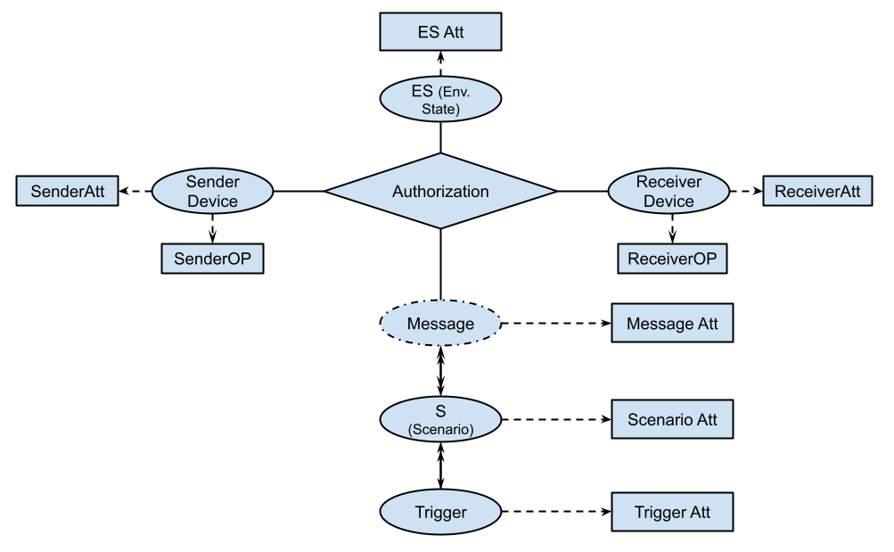
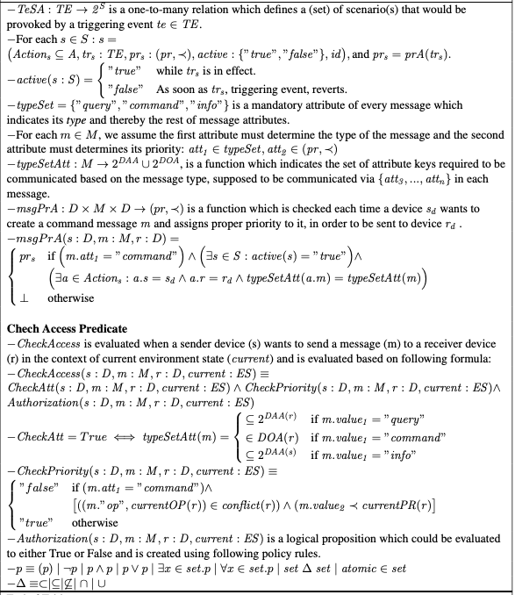
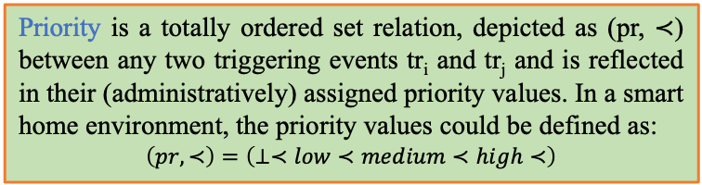

PEI: Scenario-Based Device-to-Device ABAC Access Control Model
Check Priority
Check Access
An action a indicates a message m being communicated from a specific sender s to a
specific receiver r and defined as a triplet of:
$$a=(s:D,m:M,r:D)$$
A triggering event is a specific event or status from the IoT device’s operation
Priority is a totally ordered set relation, depicted as (pr, ≺) between any two triggering events tr_{i} and tr_{j} and is reflected in their (administratively) assigned priority values. In a smart home environment, the priority values could be defined as:
$$\left(pr,≺\right)=\left(⊥≺low≺medium≺high≺\right)$$
Scenario-driven access control model resolves a class of conflicts due to receiving two conflicting command messages by the the same device .
A scenario is defined as a set of actions to be done in the smart home

Slide 30
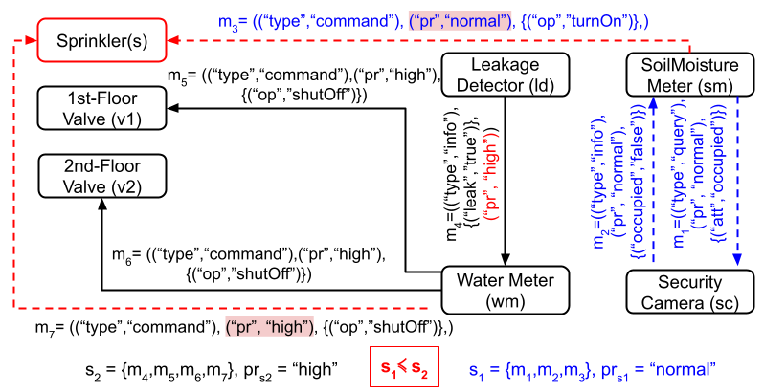
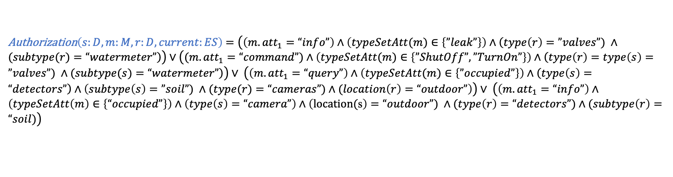
A Smart Home IoT Use Case
$\text{CheckAccess}\text{(}\text{s}\text{:}\text{D}\text{, }\text{m}\text{:}\text{M}\text{, }\text{r}\text{:}\text{D}\text{, }\text{current}\text{:}\text{ES}\text{)}$ $≡CheckAtt\left(s:D, m:M, r:D, current:ES\right)∧CheckPriority\left(s:D, m:M, r:D, current:ES\right)∧$ Authorization$\left(s:D, m:M, r:D, current:ES\right)$
Authorization$\left(s:D, m:M, r:D, current:ES\right)$ $=\left(\left(m.{att}_{1}=“info”\right)∧\left(typeSetAtt(m)∈\left\{”leak”\right\}\right)∧\left(type\left(r\right)=”valves”) ∧(subtype(r)=“watermeter”\right)\right)∨\left((m.{att}_{1}=“command”)∧\left(typeSetAtt(m)∈\left\{”ShutOff”,”TurnOn”\right\}\right)∧\left(type\left(r\right)=type\left(s\right)=”valves”) ∧(subtype(s)=“watermeter”\right)\right)∨ \left(\left(m.{att}_{1}=“query”\right)∧\left(typeSetAtt(m)∈\left\{”occupied”\right\}\right)∧\left(type\left(s\right)=“detectors”\right)∧\left(subtype\left(s\right)=”soil”) ∧(type(r)=“cameras”)∧(location\left(r\right)=“outdoor”\right)\right)∨ \left(\left(m.{att}_{1}=“info”\right)∧\left(typeSetAtt\left(m\right)∈\left\{“occupied”\right\}\right)∧\left(type\left(s\right)=“camera”\right)∧\left(\text{location}\text{(}\text{s}\right)=“outdoor”) ∧(type\left(r\right)=“detectors”)∧(subtype\left(r\right)=“soil)\right)$

Slide 31
Summary of Contributions

Slide 32
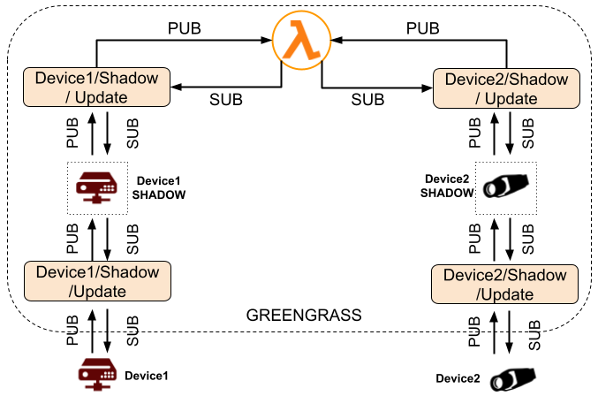



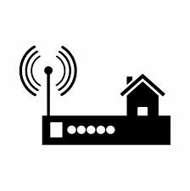
PEI: Enforcement Architecture
Direct communication over wireless network
Manufacturer1
Manufacturer2
HTTP/TLS/TCP/IP
COAP/DTLS/UDP/IP
Application Server Provider
Manufacturer1
Manufacturer2
Bluetooth Smart/IEEE 802.11/
IEEE 802.15.4
Application Server Provider
Greengrass utilization enables devices to autonomously react
to local events and securely communicate with each other over the local network.
Using MQTT, devices will communicate on their private topics, device/shadow/update, to update their shadows, and trigger the local computation function, known as Lambda function.
When Lambda is triggered, it executes the code we developed to check the policy.
Manufacturer1
Manufacturer2

Slide 33
Summary of Contributions

Slide 34
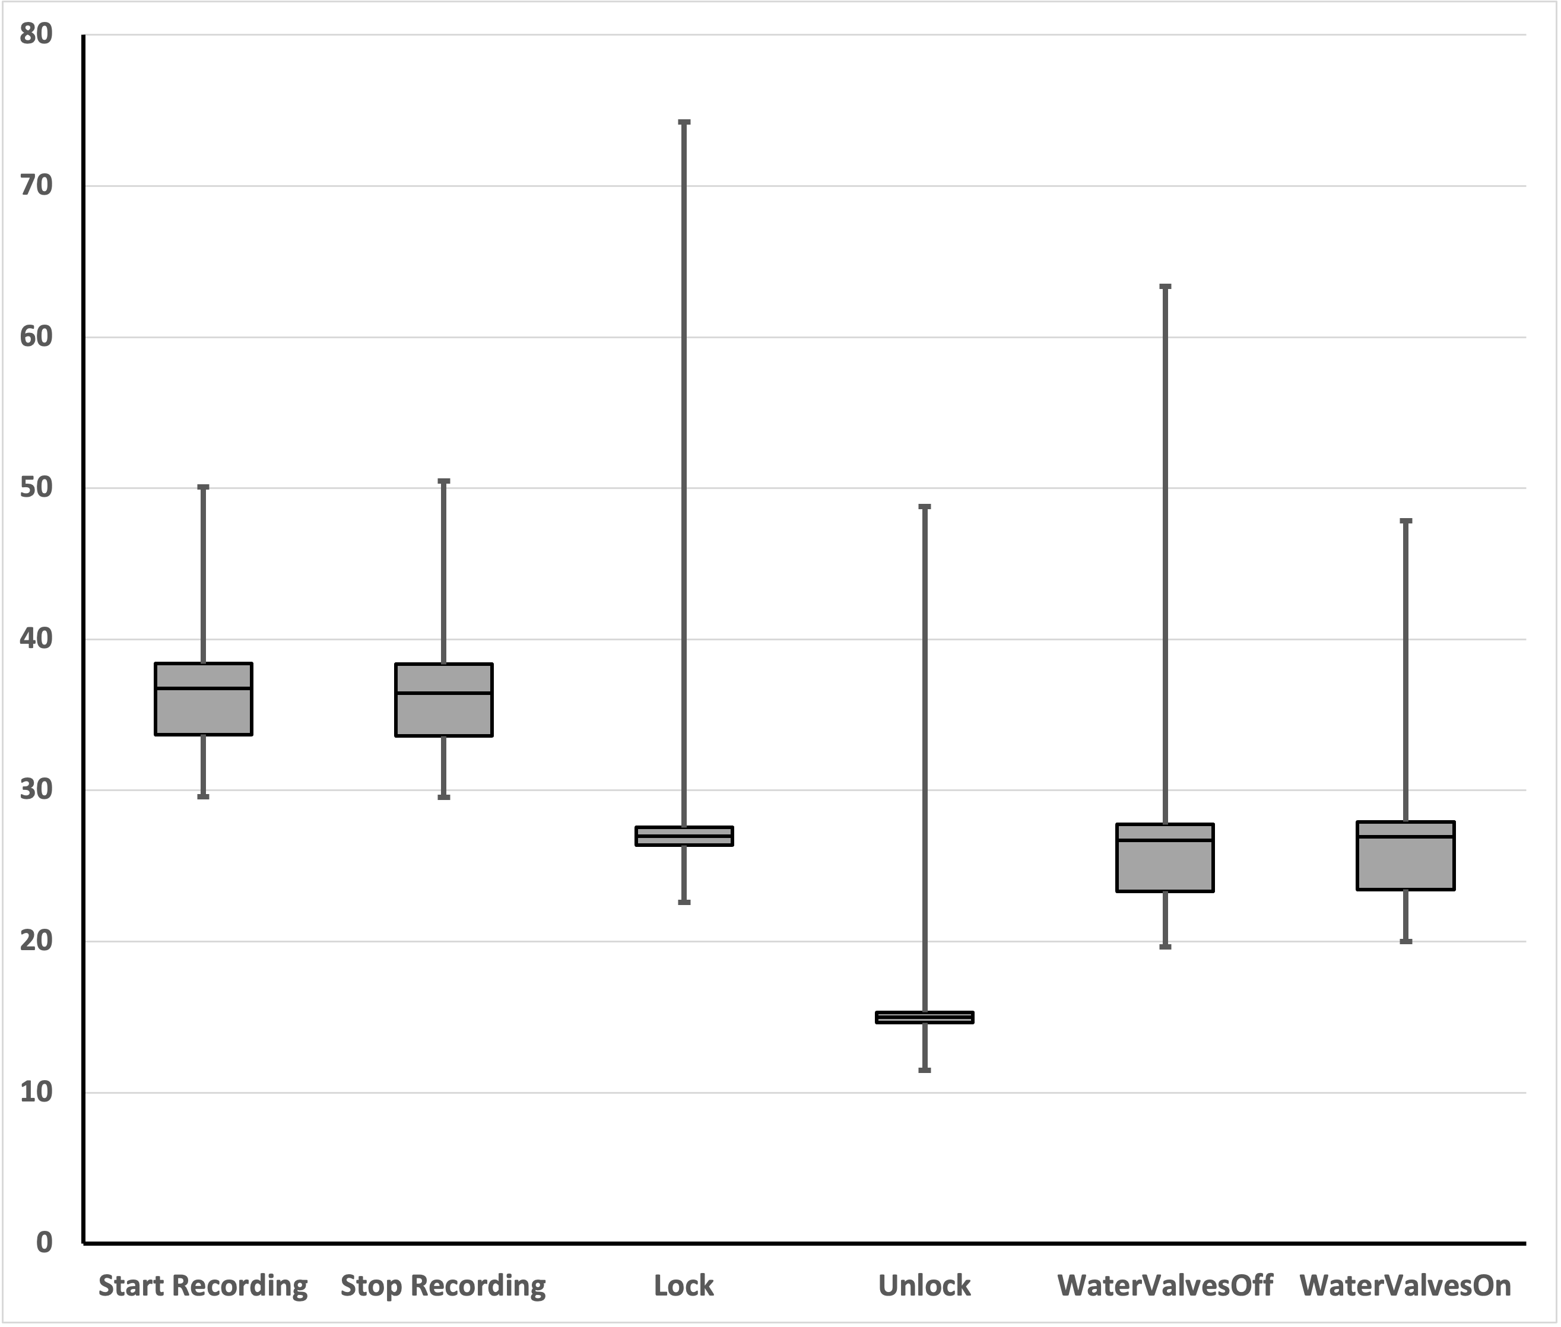
PEI: Implementation
Experiment | Min | 10% | 25% | Median | 75% | 90% | 95% | 99% | Max
Full Timer | 24.2 | 25.4 | 26.0 | 34.9 | 36.7 | 39.1 | 42.9 | 47.2 | 67.2
State Update | 3.5 | 3.6 | 3.7 | 5.7 | 6.6 | 6.9 | 7.4 | 10.2 | 21.8
A proof-of-concept implementation of two previously discussed smart home use cases. Statistics collected across 500 trials. All statistics are in milliseconds.
Full timer: a device to execute an action using our model/architecture, have lambda process it, and update the respective devices. The average full timer is 35 milliseconds.
State Update: The time to update a device’s state, e.g., a door lock going from unlocked to locked, is on average 6 milliseconds.
Time per Action: depicted in the box-whisker plot. The box shows the 25 percentile and 75 percentile of the data, with median as the line contained inside the box.

Slide 35
Discussion
Our model provides specification for mediating access in device-to-device communications for the first time. Presented model is context-aware, dynamic and lightweight.
Continuity of Access: Any change in participating devices’ attributes triggers the lambda which then re-evaluates the policy and adjusts the access authorizations accordingly.
  In order to provide continuity as one of the model’s elements, regardless of its enforcement method, the continuous retrieval and evaluation of entity/environment attributes should be incorporated in the model.
  Continuity of access control could be concluded when the proposed model is able to revoke the previously granted access in case of any unintended change in attributes.
Post-Authorization: Any message communication may result in a change of its sender/receiver attributes which is indicated through Impact function in our model.
Architecture Agnostic: Our model is not peculiar to Amazon AWS.
  We use AWS because of its simplicity, security and flexibility and being agnostic to device type and OS.
  AWS IoT Device Management is agnostic to device type and OS.

Slide 36
Conclusion

Slide 37
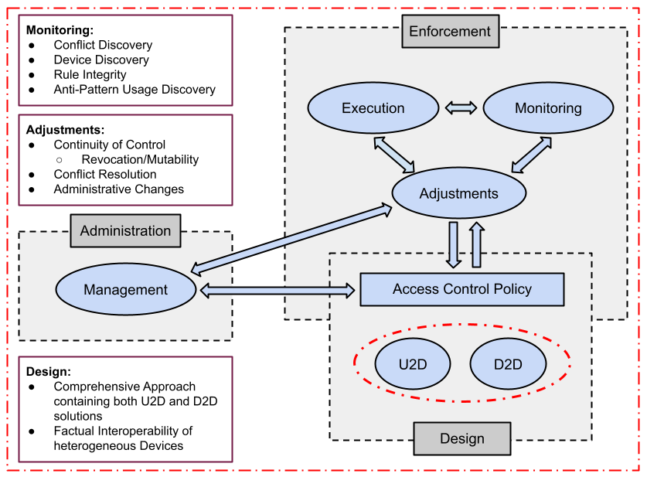
Some Future Directions

Slide 38
Dissertation Publications
Conference/Workshop Papers:
Mehrnoosh Shakarami, and Ravi Sandhu. "Safety and Consistency of Subject Attributes for Attribute-Based Pre-Authorization Systems", In Proceedings of National Cyber Summit (NCS’19), pp. 248-263. Springer, Cham, 2019. (Published)
Mehrnoosh Shakarami, and Ravi Sandhu. "Refresh instead of revoke enhances safety and availability: A formal analysis." In IFIP Annual Conference on Data and Applications Security and Privacy (DBSec’19), pp. 301-313. Springer, Cham, 2019. (Published)
Mehrnoosh Shakarami, and Ravi Sandhu. "Safety and Consistency of Mutable Attributes Using Quotas: A Formal Analysis." In 2019 First IEEE International Conference on Trust, Privacy and Security in Intelligent Systems and Applications (TPS’19), pp. 1-9. IEEE, 2019. (Published)
Mehrnoosh Shakarami, and Ravi Sandhu. "Role-Based Administration of Role-Based Smart Home IoT", In Proceedings of the 2021 ACM Workshop on Secure and Trustworthy Cyber-Physical Systems (SaT-CPS’21), pp. 49-58. 2021. (Published)
Mehrnoosh Shakarami, James Benson, and Ravi Sandhu. "Blockchain-Based Administration of Access in Smart Home IoT", In Proceedings of the 2022 ACM Workshop on Secure and Trustworthy Cyber-Physical Systems (SaT-CPS’22), 2022. (Published)
Mehrnoosh Shakarami, James Benson, and Ravi Sandhu. "Scenario-Driven Device-to-Device Access Control in Smart Home IoT". IFIP Annual Conference on Data and Applications Security and Privacy (DBSec’22), Springer, Cham, 2022. (To be Submitted at Mid-April)
Chapter 3
Chapter 4
Chapter 5

Slide 39

Q & A
THANKS FOR TAKING THE TIME TO BE HERE!

