Slide 1
Institute for Cyber Security
Authorization Federation in Multi-Tenant
Multi-Cloud IaaS
Navid Pustchi
Dissertation Defense
Department of Computer Science
University of Texas San Antonio
Advisor: Dr. Ravi Sandhu
Co-Advisor: Dr. Ram Krishnan
Dr. Gregory B. White
Dr. Matthew Gibson
Dr. Palden Lama
1

Slide 2
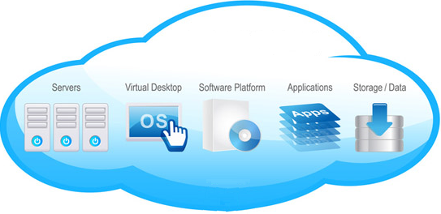
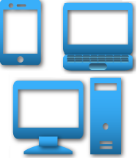
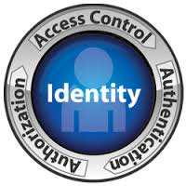

“Moving” to Cloud
Flexibility
Reliability
Accessibility
Mobility
Security
World-Leading Research with Real-World Impact!
2

Slide 3

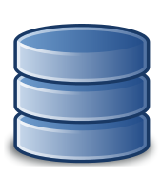





Why Federation ?
Large organization with multiple tenants
Distinct organizations’ federation
Service Provider
CERN
Software Development
Tenant
Software Development
Tenant
Acme
Financial
Tenant
World-Leading Research with Real-World Impact!
3

Slide 4


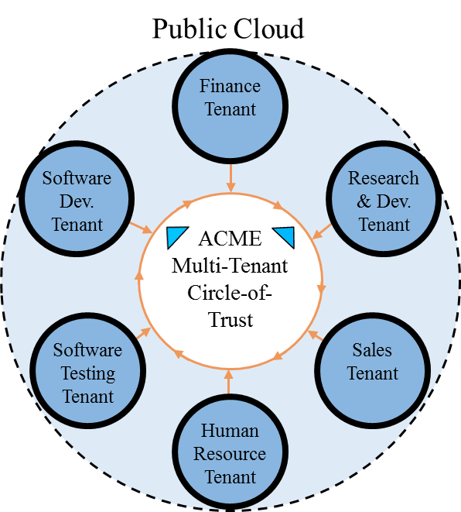
Why Multi-Cloud?
London Private Cloud
Federation consist of multiple clouds or multiple tenants.
Amazon Public Cloud
ACME Multi-Cloud
Shanghai Private Cloud
World-Leading Research with Real-World Impact!
4

Slide 5
Problem & Thesis Statement
Problem Statement
Thesis Statement
Current access control models provided by cloud platforms are not sufficient to cultivate effective peer-to-peer and circle-of-trust federation between tenants in a cloud or across multiple cloud platforms. Prior role-based and attribute-based access control models in distributed systems are not effectively applicable to cloud IaaS.
The problem of authorization federation in multi-tenant cloud IaaS can be partially solved by integrating multiple types of peer-to-peer and circle-of-trust relations between tenants in cloud and multi-cloud environments into role-based and attribute-based access control models.
World-Leading Research with Real-World Impact!
5

Slide 6
What is Cloud Federation?
Multi-Cloud, Federation of multiple cloud service providers (public or private) within different administrative domains (Cloud and Domain) to provide complex services at specified service model (Infrastructure, Platform and Software).
Multi-Cloud
Broker
Inter-Cloud
Multi-Cloud
Inter-Cloud
Seamless Communication
Deployment
Broker
Hybrid Cloud
Cloud Federation
Cloud Federation, Federation of cloud service providers and identity providers in order to share their services and resources based on trust agreements.
Cloud Federation
Hybrid Cloud, “A composition of two or more distinct cloud infrastructures (private, community, or public) that remain unique entities. ”
World-Leading Research with Real-World Impact!
6

Slide 7
Federation in Cloud
Cloud Federation
Service
Platform
Trust
Identity
Heterogeneous
Homogeneous
Heterogeneous
Homogeneous
Circle-of-Trust
Peer-to-Peer
Authentication
Authorization
World-Leading Research with Real-World Impact!
7

Slide 8
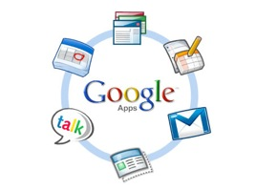
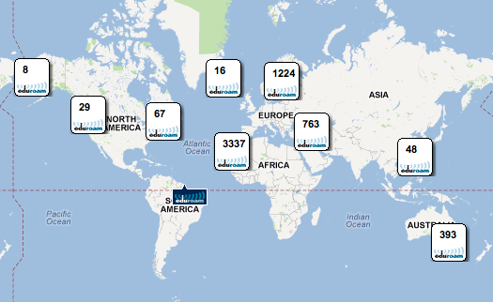
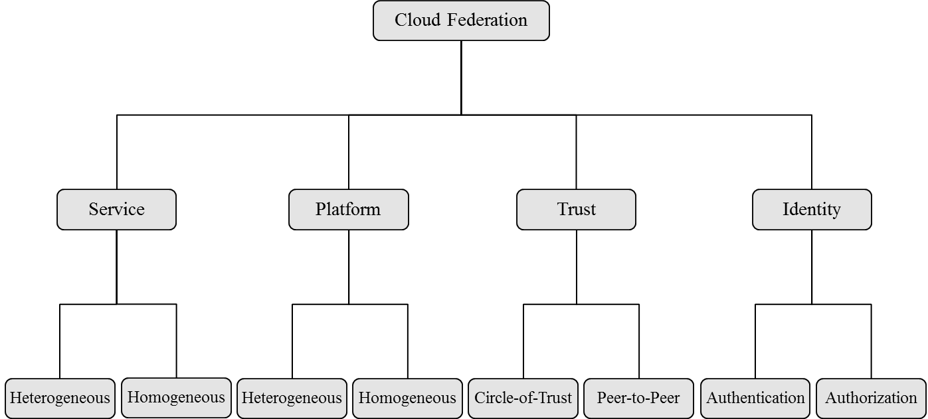
Service in Cloud Federation
Service
Heterogeneous
Google account (Open ID 2.0) Heterogeneous within google.
Homogeneous
Eduroam federated network access.
OpenStack Federation.
Heterogeneous Service Federation
Homogeneous Service Federation
World-Leading Research with Real-World Impact!
8
Amazon Public AWS Cloud
ICS Private OpenStack Cloud

Slide 9
Platform in Cloud Federation
Heterogeneous Platform Federation
Amazon Public AWS Cloud
ICS Private OpenStack Cloud
Platform
Heterogeneous
OpenStack federation with AWS.
Homogeneous
Keystone to Keystone federation.
Homogeneous Platform Federation
Rackspace Public OpenStack Cloud
ICS Private OpenStack Cloud
World-Leading Research with Real-World Impact!
9
Amazon Public AWS Cloud
ICS Private OpenStack Cloud

Slide 10
Peer-to-Peer vs Circle-of-Trust
Peer-to-Peer Federation
Trust between a pair of tenants.
Specific set of actions between tenants.
Only trusted tenant.
Circle-of-Trust Federation
Trust between a group of tenants.
Similar policies and rules.
Acceptance of all tenants in the circle.
Tenant A
Tenant B
Tenant A
Tenant B
Tenant C
Tenant D
Tenant E
Tenant F
World-Leading Research with Real-World Impact!
10

Slide 11
Authentication vs Authorization
Authentication Federation
Authenticating users (services and applications) in a cloud service provider other than their registered identity provider.
SAML, OAuth, OpenID, SSO.
Authorization Federation
Determining federated users’ permissions to access federated resources and services.
SAML, OAuth.
Authorization federation is dependent on authenticated users.
What permissions she should be granted? (Authorization Federation)
Is the user the one she claims to be? (Authentication Federation)
World-Leading Research with Real-World Impact!
11

Slide 12
Scope of Contribution
Cloud Federation
Service
SaaS
PaaS
IaaS
Platform
Homogeneous
Heterogeneous
Trust
Circle-of-Trust
Peer-to-Peer
Identity
Authentication
Authorization
World-Leading Research with Real-World Impact!
12

Slide 13


Scope of Contributed Models
Cloud IaaS
Multi-Tenant Multi-Cloud
Multi-Tenant Cloud
Peer-to-Peer
Circle-of-Trust
Peer-to-Peer
Heterogeneous
Homogeneous
MC MT-RBAC
MT-RABA$C_{c}$
MT-RBA$C_{c}$
MT-ABAC
World-Leading Research with Real-World Impact!
13

Slide 14
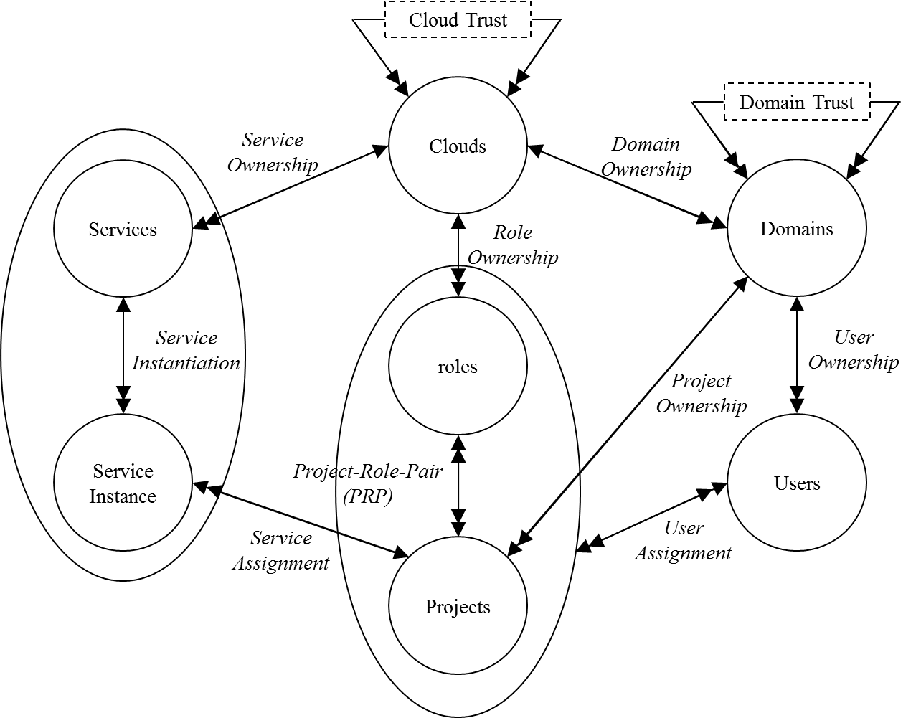
Administrative Domains
Cloud Domain
Administration of services (compute, storage, network, and identity) and tenant domains.
Cloud bursting.
Tenant Domain
Administration of resources (users, groups and projects in OpenStack).
Resource federation (cross-tenant access).
World-Leading Research with Real-World Impact!
14

Slide 15
Peer-to-Peer Federation Models
Cloud IaaS
Multi-Tenant Multi-Cloud
Multi-Tenant Cloud
Peer-to-Peer
Circle-of-Trust
Peer-to-Peer
Heterogeneous
Homogeneous
MC MT-RBAC
MT-RABA$C_{c}$
MT-RBA$C_{c}$
MT-ABAC
World-Leading Research with Real-World Impact!
15

Slide 16
Peer-to-Peer Federation Trust
Tenant-Trust
Unilateral, Unidirectional, and Non-Transitive.
Peer-to-Peer Trust
Initiation
Bilateral
Unilateral
Direction
Bidirectional
Unidirectional
Transitivity
Transitive
Non-transitive
World-Leading Research with Real-World Impact!
16

Slide 17

P2P Trust Types Use Case
UTSA and BoA contract
BoA employees can get UTSA courses at discounted rates.
UTSA students can get student accounts at BoA.
BoA can select courses for its employee students at UTSA.
UTSA
BoA
World-Leading Research with Real-World Impact!
17

Slide 18

P2P Trust Types Use Case
UTSA and BoA contract
BoA employees can get UTSA courses at discounted rates.
UTSA can assign BoA employees to courses.
UTSA students can get student accounts at BoA.
BoA can select courses for its employee students at UTSA.
UTSA
$$Type−α:$$
BoA
World-Leading Research with Real-World Impact!
18

Slide 19

P2P Trust Types Use Case
UTSA and BoA contract
BoA employees can get UTSA courses at discounted rates.
BoA can assign employees to UTSA courses.
UTSA students can get student accounts at BoA.
BoA can select courses for its employee students at UTSA.
UTSA
$$Type−γ:$$
BoA
World-Leading Research with Real-World Impact!
19

Slide 20

P2P Trust Types Use Case
UTSA and BoA contract
BoA employees can get UTSA courses at discounted rates.
UTSA students can get student accounts at BoA.
BoA can select courses for its employee students at UTSA.
UTSA
$$Type−β:$$
BoA
World-Leading Research with Real-World Impact!
20

Slide 21

P2P Trust Types Use Case
UTSA and BoA contract
BoA employees can get UTSA courses at discounted rates.
UTSA students can get student accounts at BoA.
BoA can select courses for its employee students at UTSA.
UTSA
$$Type−δ:$$
BoA
World-Leading Research with Real-World Impact!
21

Slide 22
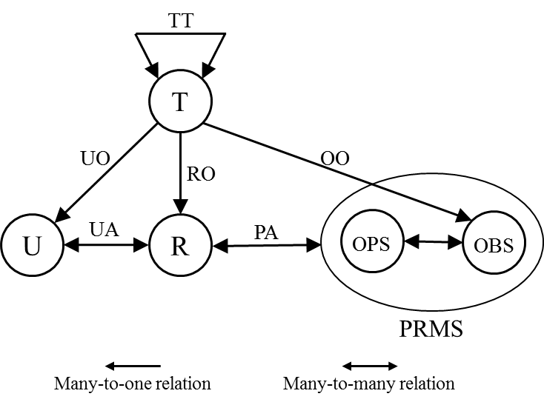

Multi-Cloud MT-RBAC
Multi-Cloud Multi-Tenant Role-Based Access Control
Homogeneous multi-cloud IaaS (OpenStack).
Peer-to-Peer federation between tenants across cloud service providers.
User-role assignments.
Trust is defined as tenant-trust.
Trust types $α,β,γ,\text{and} δ$ authorizes user-role assignments.
World-Leading Research with Real-World Impact!
22

Slide 23
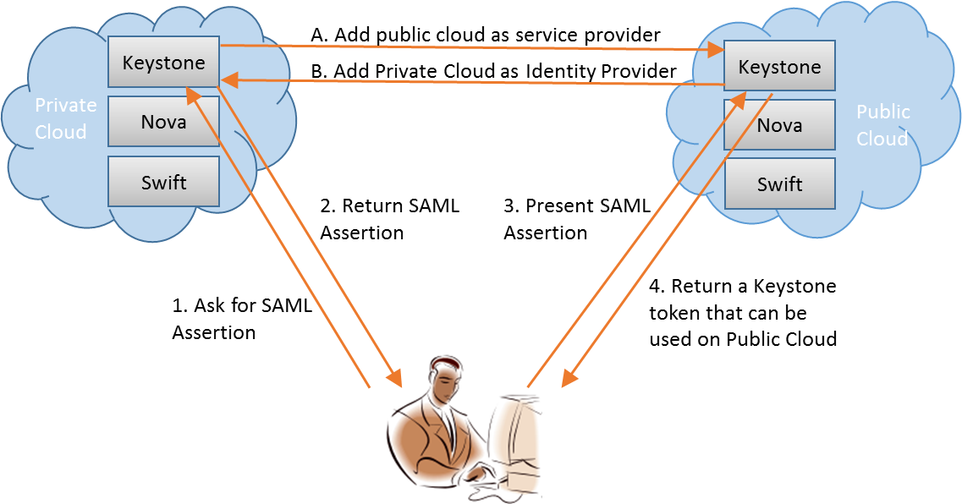
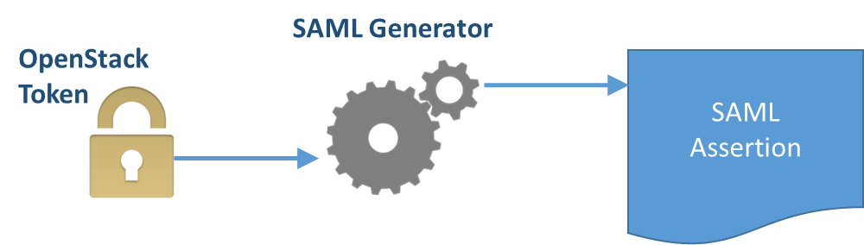
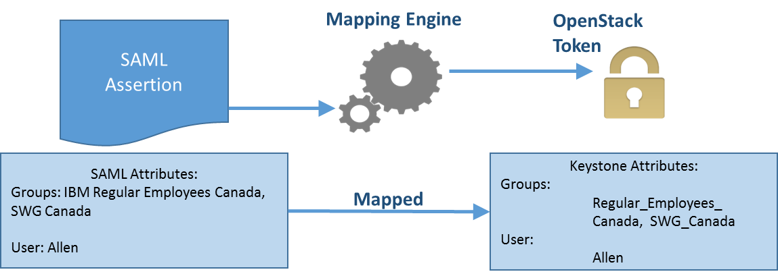
Keystone to Keystone Federation
OpenStack Paris Summit, Keystone to Keystone Federation, https://www.openstack.org/summit/openstack-paris-summit-2014/session-videos/presentation/keystone-to-keystone-federation, (2014)
World-Leading Research with Real-World Impact!
23

Slide 24
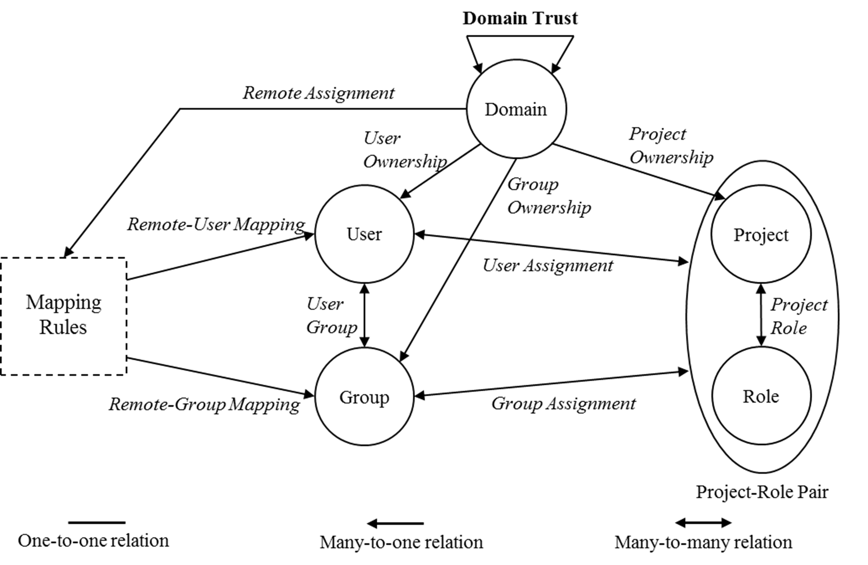
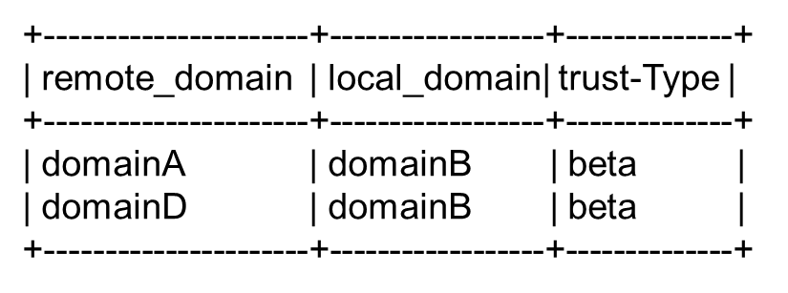
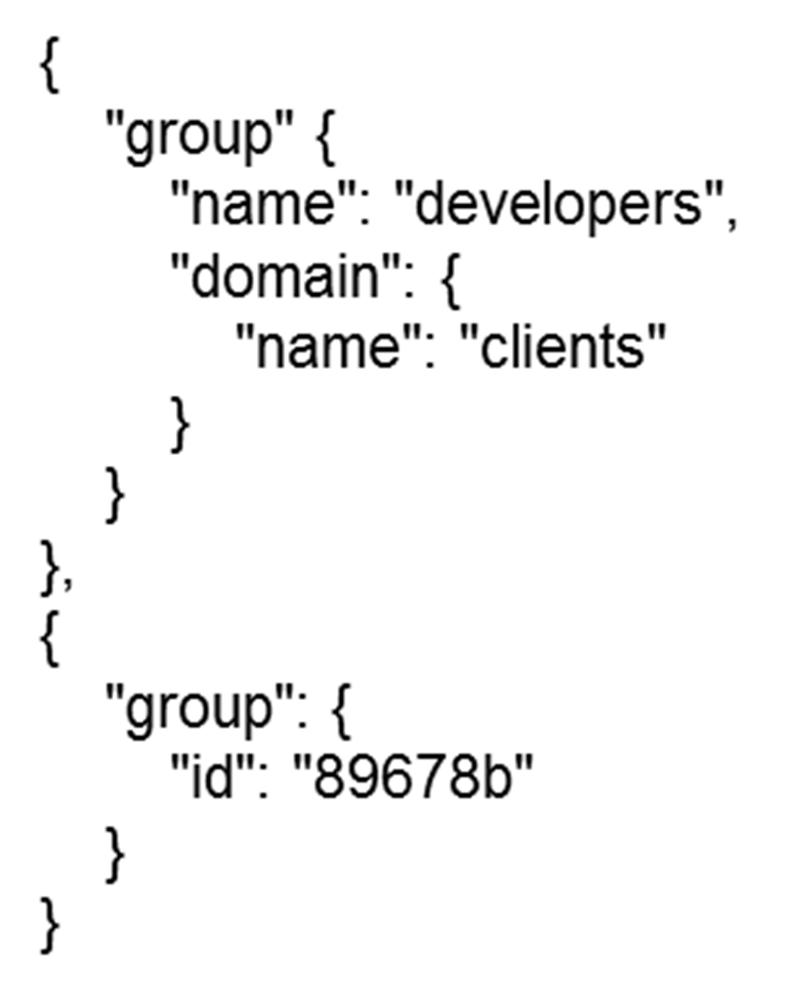

Multi-Cloud MT-RBAC OpenStack
Cloud 1
Cloud 2
𝑻𝒚𝒑𝒆−$β$
Domain A
Domain B
Project-Role-Pair
domain_admin
Project-Role-Pair
World-Leading Research with Real-World Impact!
24

Slide 25

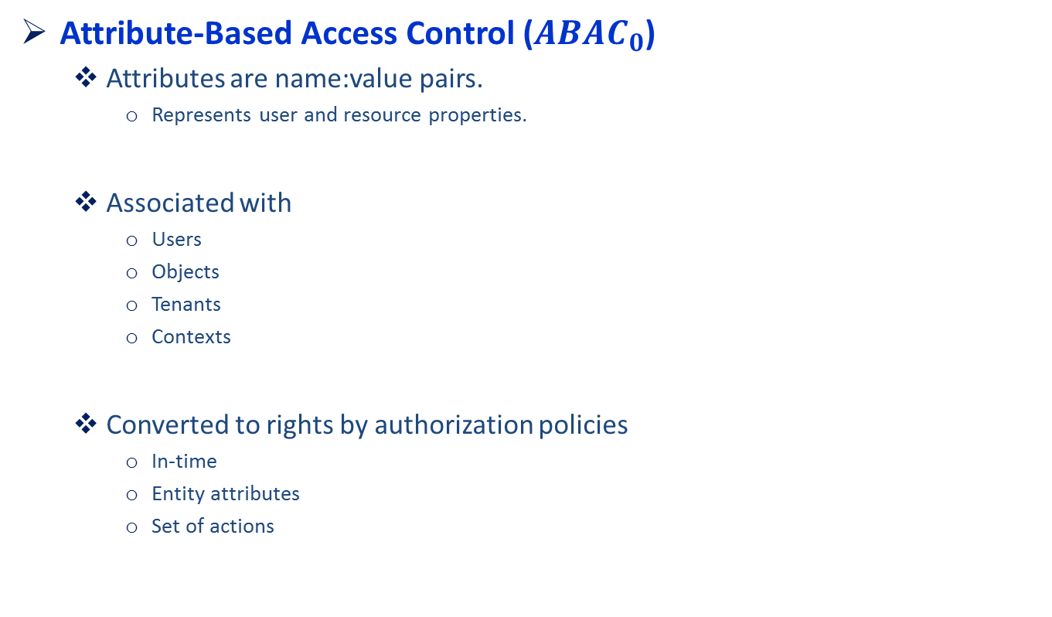
$$ABAC_{0}$$
Attribute-Based Access Control ($ABAC_{0}$)
Attributes are name:value pairs.
Represents user and resource properties.
Associated with
Users
Objects
Tenants
Contexts
Converted to rights by authorization policies
In-time
Entity attributes
Set of actions
UATT
OATT
U
Auth
O
A
Association
Access Decision
World-Leading Research with Real-World Impact!
25

Slide 26
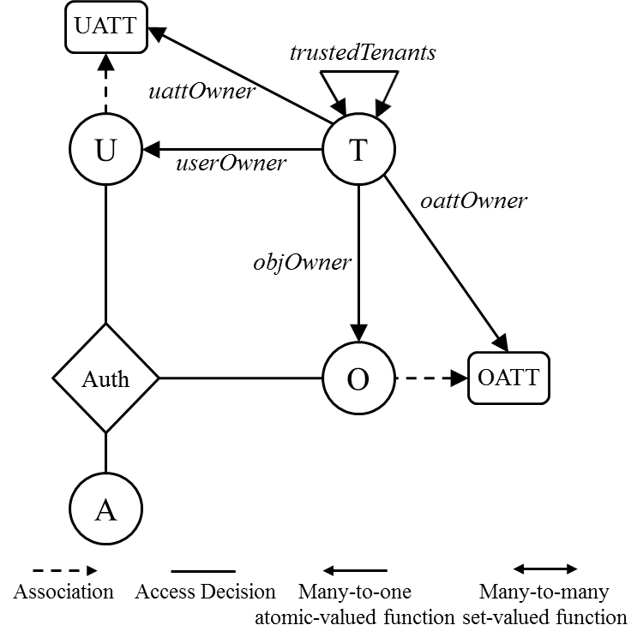


$${MT−ABAC}_{0}$$
Multi-Tenant Attribute-Based Access Control (${MT−ABAC}_{0}$)
Multi-tenant cloud IaaS.
Peer-to-Peer Federation.
Attribute assignments.
Trust is defined as tenant-trust.
Trust types $α,β,γ,\text{and} δ$ authorizes attribute assignments.
World-Leading Research with Real-World Impact!
26

Slide 27


Contributed Models
Cloud IaaS
Multi-Tenant Multi-Cloud
Multi-Tenant Cloud
Peer-to-Peer
Circle-of-Trust
Peer-to-Peer
Heterogeneous
Homogeneous
MC MT-RBAC
MT-RABA$C_{c}$
MT-RBA$C_{c}$
MT-ABAC
World-Leading Research with Real-World Impact!
27

Slide 28
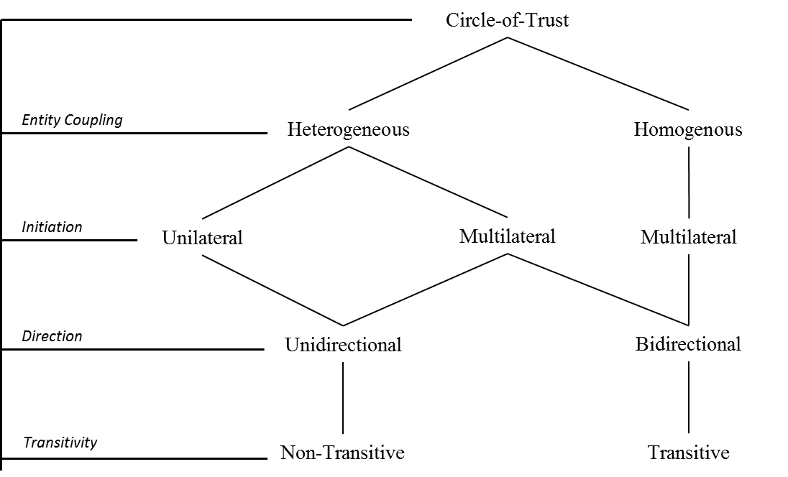
Circle-of-Trust Federation Trust
Homogeneous Circles
Multilateral, Bidirectional, Transitive.
Heterogeneous Circles
Multilateral, Unidirectional, Non-Transitive.
World-Leading Research with Real-World Impact!
28

Slide 29


CoT Trust Types Use Case
UT System CoT Federation.
UT system students can take courses at any UT campus.
Students can access to libraries in UT system.
UTA
UTD
UTSA
UT
World-Leading Research with Real-World Impact!
29

Slide 30

CoT Trust Types Use Case
UT System CoT Federation.
UT system students can take courses at any UT campus.
UTSA can assign students in UT to its courses.
UTA
UTD
UTSA
UT
$$CoT Type−ζ$$
World-Leading Research with Real-World Impact!
30

Slide 31

CoT Trust Types Use Case
UT System CoT Federation.
Students can access to libraries in UT system.
UTA can assign its students to libraries in UT system.
UTA
UTD
UTSA
UT
$$CoT Type−ε$$
World-Leading Research with Real-World Impact!
31

Slide 32
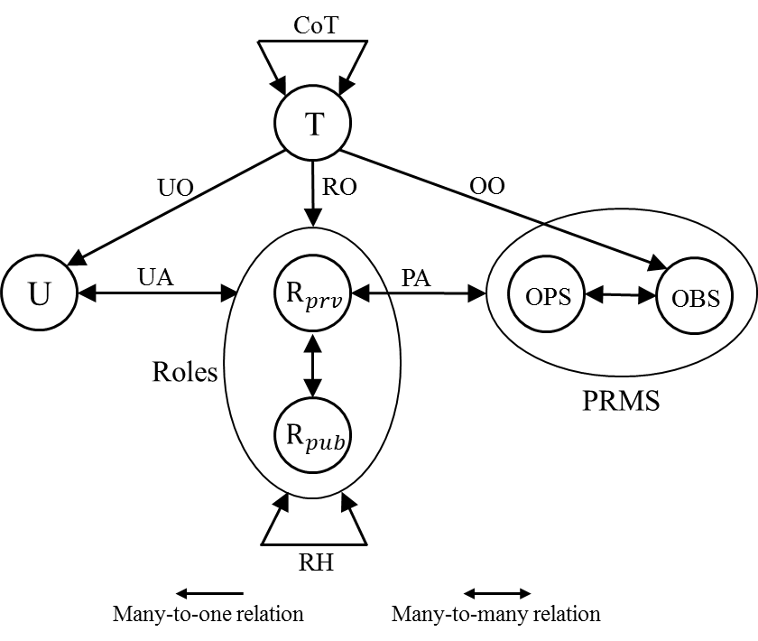


$${MT−RBAC}_{c}$$
Multi-Tenant Role-Based Access Control in Circle (${MT−RBAC}_{c}$)
Multi-tenant cloud IaaS.
Circle-of-Trust Federation.
Homogeneous circles.
User-role assignments.
Trust is defined as tenant-trust.
Trust types $ε \text{and} ζ$ authorizes user-role assignments.
World-Leading Research with Real-World Impact!
32

Slide 33


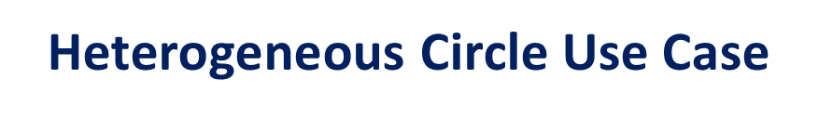
$\text{Heterogeneous}$ Circle Use Case
Heterogeneous circle of BoA, Chase, UTSA, Geico, Allstate.
Each tenant can make user-role assignment based on its type to a domain.
UTSA can assign its students to discounted insurance offers and student accounts.
UTSA
University domain
BoA
Geico
Bank domain
Insurance domain
Chase
Allstate
World-Leading Research with Real-World Impact!
33

Slide 34
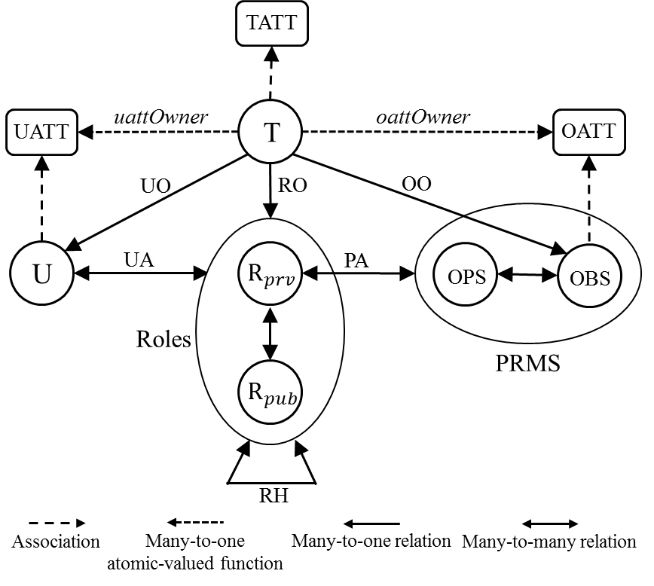


$${MT−RABAC}_{c}$$
Multi-Tenant Role-Centric Attribute-Based Access Control (${MT−RABAC}_{c}$)
Multi-tenant cloud IaaS.
Circle-of-Trust Federation.
Heterogeneous circles.
Attributes are associated with
Tenants
Users
Objects
Tenant attributes separate tenants with tenant type attribute.
World-Leading Research with Real-World Impact!
34

Slide 35
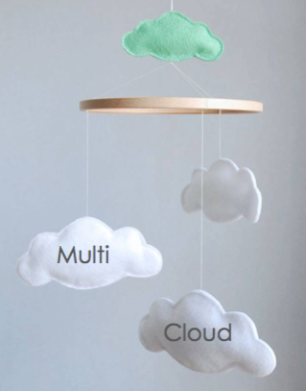
Questions ?
Peer-to-Peer Policy
Multi-cloud multi-tenant role-based model.
Multi-tenant attribute-based model.
Circle-of-Trust Policy
Multi-tenant role-based access control model in circle.
Multi-tenant role-centric attribute-based access control model.
Implementation
Federated-cloud role-based tenant trust.
World-Leading Research with Real-World Impact!

