Slide 1
Group-Centric Secure Information Sharing Models
Ram Krishnan
PhD Candidate
Dissertation Directors:
Dr. Ravi Sandhu and Dr. Daniel Menascé
Dissertation Defense
Nov 25th 2009

Slide 2
Presentation Outline
Introduction
Policy Models for Group-Centric Secure Information Sharing (g-SIS)
Enforcement Models for g-SIS
Implementation Model for g-SIS

Slide 3
Introduction and Motivation
Secure Information Sharing
Share but protect
A fundamental problem in cyber security
Dissemination-Centric Sharing
Dissemination chain with “sticky” policies on objects
E.g. ORCON, DRM ,ERM, XrML, ODRL, etc.
Attribute + Policy Cloud
Attribute + Policy Cloud
Attribute + Policy Cloud
Attribute + Policy Cloud
Object
Object
Object
Object
Alice
Bob
Charlie
Eve
Susie
Attribute Cloud
Attribute Cloud
Attribute Cloud
Attribute Cloud
Attribute Cloud
Query-Centric Sharing
Queries wrt a particular dataset
More generally, addresses de-aggregation/inference problem

Slide 4
Introduction and Motivation (contd)
Group-Centric Sharing
Sharing for a specific purpose or mission
E.g. Collaboration in joint product design, merger and acquisition, etc.
Emerging needs in Government and Commercial Organizations
E.g. Mission critical operations post 9/11, Inter-organizational collaboration, etc.
Brings users & objects together in a group
Secure Meeting Room
Subscription Model
Users
join
leave
Group
Authz (u,o,r)?
add
remove
Objects

Slide 5
Problem Statement
One of the central problems in information sharing is the ability to securely share information for a specific purpose or mission by bringing together users and information
There is no existing model that addresses this problem
Contribution
A first step towards a formal and systematic study of Group-Centric Secure Information Sharing Models

Slide 6
Thesis Statement
It is possible to systematically develop Policy, Enforcement and Implementation models for Group-Centric Sharing
Security and system goals
(objectives/policy)
Necessarily informal
Specified using users, subjects, objects, admins, labels, roles, groups, etc. in an ideal setting.
Security analysis (objectives, properties, etc.).
Policy models
Approximated policy realized using system architecture with trusted servers, protocols, etc.
Enforcement level security analysis (e.g. stale information due to network latency, protocol proofs, etc.).
Enforcement models
Implementation models
Technologies such as Cloud Computing, Trusted Computing, etc.
Implementation level security analysis (e.g. vulnerability analysis, penetration testing, etc.)
Concrete System
Software and Hardware

Slide 7
Group-Centric Sharing (g-SIS)
Operational aspects
Group Characteristics
Core properties
Membership semantics
Membership renewal semantics
g-SIS specification
Object Model
Read-only
Read-write (versioning?)
User-Subject Model
Read-only subjects may read multiple groups
Read-write subjects restricted to single group
Administrative aspects
Inter-group relations
Authorizations for Join, Add, etc.
Subordination
Conditional Membership
Mutual Exclusion

Slide 8
g-SIS Operations
Users
Strict Leave
Strict Join
Users
Join
Leave
Liberal
Join
GROUP
Authz (u,o,r)?
LiberalLeave
GROUP
Authz (u,o,r)?
Strict
Add
Strict
Remove
Liberal Remove
Liberal Add
Remove
Add
Objects
Objects

Slide 9
Core g-SIS Properties
Authorization Persistence
Authorization cannot change if no group event occurs
Authorization Provenance
Authorization can begin to hold only after a simultaneous period of user and object membership

Slide 10
Core g-SIS Properties (contd)
Bounded Authorization
Authorization cannot grow during non-membership periods
Availability
On add, authorization should hold for all existing users at add time

Slide 11
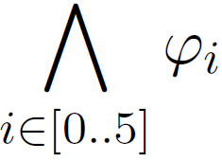
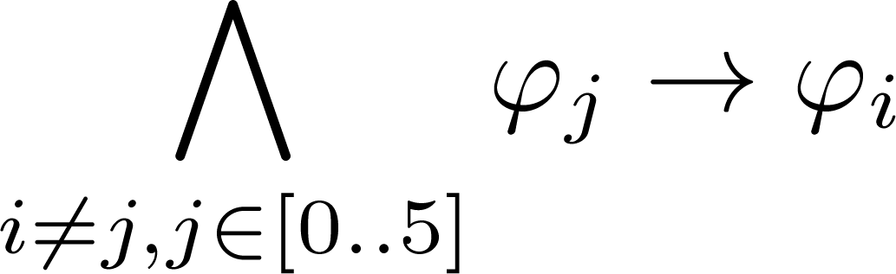

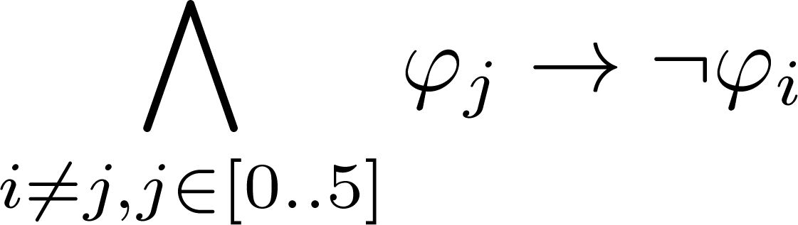
Satisfaction and Independence
The Core Properties are Satisfiable
There exists a trace in which
is true
The Core Properties are Independent
Neither prove nor refute one of the properties from others
is not valid
is not valid

Slide 12
Membership Semantics
Strict Vs Liberal Operations
User operations: <SJ, LJ> and <SL, LL>
Object operations: <SA, LA> and <SR, LR>
u not authorized to access objects added prior to join time
Users joining after add time not authorized to access o
SJ (u)
SA (o)
Users authorized to access o at remove time retain access
u retains access to objects authorized at leave time
LL (u)
LR (o)

Slide 13
Membership Renewal Semantics
Lossless Vs Lossy Join
Lossless: Authorizations from past membership period not lost
Lossy: Some authorizations lost at rejoin time
Restorative Vs Non-Restorative Join
Restorative: Authorizations from past membership restored
Non-Restorative: Past authorizations not restored at rejoin time
Gainless Vs Gainful Leave
Restorative Vs Non-Restorative Leave

Slide 14
The π-System Specification
Allows all membership ops (Strict and Liberal user/object ops)
Allows selected membership renewal ops
Lossless and Non-Restorative Join
Gainless and Non-Restorative Leave

Slide 15
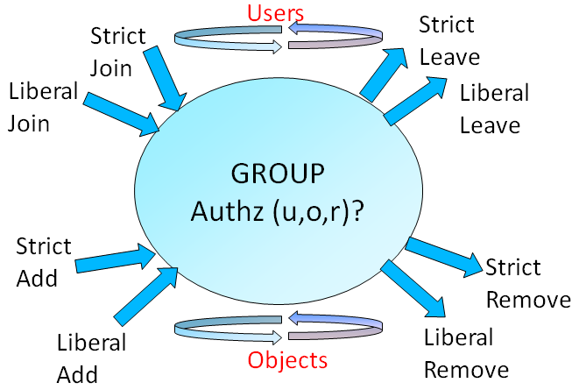
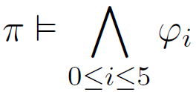
The π-System Specification (contd)
Well-formed traces
π-system g-SIS Specification:
Add after Join
Add before Join
The π-system satisfies the core g-SIS properties
That is, the π-system
is a g-SIS specification
Notes:
15

Slide 16
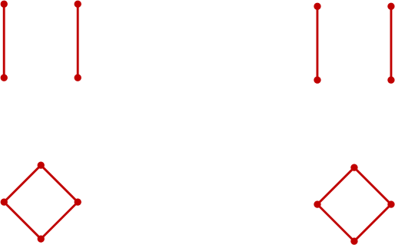
Fixed Operation Models
16 possible initial models with fixed operations
E.g. (SJ, SL, SA, SR) or (LJ, LL, LA, LR) for all users and objects
SJ
SL
SA
SR
LJ
LL
LA
LR
User Model
Object Model
<SJ, SL>
<SA, SR>
<LJ, SL>
<SJ, LL>
<LA, SR>
<SA, LR>
<LJ, LL>
<LA, LR>
Typical group model in traditional operating systems
Typical in secure multicast
Can be reduced to 8 fixed operation models
E.g. With SJ, object add semantics has no significance on user’s authorization

Slide 17
Enforcement Models for g-SIS
Security and system goals
(objectives/policy)
Policy models
Enforcement models
Implementation models
Concrete System

Slide 18
g-SIS Enforcement Model
Enforcement Components
Control Center (CC)
Group Administrator (GA)
Users
Allows Offline Access
Assumes a Trusted Reference Monitor (TRM)
Resides on group user’s access machines
Enforces group policy
Synchronizes attributes periodically with server
Objects Available Via Super-distribution

Slide 19
Interaction b/w Various Components
Att (u) = {JoinTS, LeaveTS, gKey, N, ORL}
Att (o) = {AddTS}
5.2 Update:
LeaveTS (u) =
Current Time
5.2 Update:
a. RemoveTS (o) = Current Time
b. ORL = ORL {AddTS (o), RemoveTS(o)}
2.2 Approve and Release Object o
Object Cloud
CC
1.3 Fwd authorization to Join with integrity evidence
1.4 Provision Group Attributes
2.1 Add Object o
Obtain o
5.1 Leave User u
4.1 Request Refresh
{JoinTS, LeaveTS, ORL, gKey, N}
5.2 Remove Object o
4.2 Update Attributes
3. Access objects
1.1 Request Join
…
New User
GA
Existing users
1.2 Authorize Join
Fixed Operation Model: (<SJ, SL>, <LA, SR>)

Slide 20
Concept of Stale-Safety
Update
AIP: Authorization Information Point
AIP
AIP
AIP
AIP
ADP: Authorization Decision Point
ADP
ADP
ADP
AEP:
Authorization Enforcement Point
AEP

Slide 21
Staleness in g-SIS
Authz never held
RT_{i}: Refresh Times
Request (u, o2, r)
Join (u)
Add (o1)
Add (o2)
RT₃
RT₄
RT₅
RT₆
RT₇
Leave (u)
Request (u, o1, r)
Authz held at RT₆
Fixed Operation Model: (<SJ, SL>, <LA, SR>)

Slide 22
Stale-Safe Security Properties
If a user is able to perform an action on an object, the authorization to perform the action is guaranteed to have held sometime prior to perform
Weak Stale-Safety
Allows safe authorization decision without contacting the CC
Achieved by requiring that authorization held at the most recent refresh time
Strong Stale-Safety
Need to obtain up to date authorization information from CC after a request is received
If CC is not available, decision cannot be made

Slide 23







Weak and Strong Stale-Safe Properties
Request
Perform
Request
Perform
Formula
Formula
Weak Stale-Safety:
Strong Stale-Safety:

Slide 24
Verification using Model Checking

Slide 25
Implementation Model and PoC
Security and system goals
(objectives/policy)
Policy models
Enforcement models
Implementation models
Concrete System

Slide 26
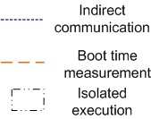
Implementation Model
Specified TPM-based protocols for g-SIS Enforcement Model
Proof-of-Concept
Assumed the presence of a Trusted Computing Base on client machines
Implemented secure provisioning of group credentials on the user machine

Slide 27

Contribution
Policy Layer
Formal characterization of Group-Centric models
Identification of a core set of properties required of all g-SIS specifications
Proof of Independence and Satisfaction of core properties
A set of useful group operation semantics
A family of g-SIS specifications ( -system) supporting a variety of group operation semantics
A formal proof that the -system satisfies the core properties
Enforcement Layer
Identification and specification of stale-safe security properties
Verification of stale-safety of g-SIS enforcement model
Implementation Layer
TPM-based protocols for g-SIS enforcement model
Provisioning protocol proof-of-concept

Slide 28
A few things that I did not talk about…
Policy Layer
Detailed versioning model
Case-study of inter-organizational collaboration scenario
Administrative Component
Operational Component with a user-subject model
A framework for developing more sophisticated g-SIS models
Enforcement Layer
Super-distribution, Micro-distribution and Hybrid enforcement models
Model checking g-SIS enforcement model using NuSMV
Implementation Layer
Approach for access control of group credentials in user’s machine
TPM-based protocols for super-distribution and hybrid model
Proof of Concept design of provisioning protocol

Slide 29
Future Work
Inter-group Relations
Subordination, conditional membership, mutual exclusion
Handling relationship changes
Handling information flow
Administrative Models for g-SIS
Need Other Access Control Components in Practical Scenarios
Meaningfully combine DAC, LBAC, RBAC and ABAC in g-SIS
Generalization of Stale-safety to Multiple Authorization Information Points
Extension to ABAC
Complete Implementation

Slide 30
Related Publications
Ram Krishnan, Ravi Sandhu , Jianwei Niu and William Winsborough, Towards a Framework for Group-Centric Secure Collaboration, Proceedings of IEEE International Conference on Collaborative Computing (CollaborateCom), Crystal City, Washington D.C., Nov 11-14, 2009.
Ram Krishnan and Ravi Sandhu, A Hybrid Enforcement Model for Group-Centric Secure Information Sharing, Proceedings of IEEE International Symposium on Secure Computing (SecureCom 2009), August 29-31, Vancouver, Canada.
Ram Krishnan, Ravi Sandhu , Jianwei Niu and William Winsborough, Foundations for Group-Centric Secure Information Sharing Models, Proceedings of ACM Symposium on Access Control Models and Technologies (SACMAT 2009), June 3-5, Stresa, Italy.
Ram Krishnan and Ravi Sandhu, Enforcement Architecture and Implementation Model for Group-Centric Information Sharing, International Workshop on Security and Communication Networks (IWSCN 2009), May 20-22, 2009, Trondheim, Norway.
Ram Krishnan, Ravi Sandhu , Jianwei Niu and William Winsborough, A Conceptual Framework for Group-Centric Secure Information Sharing Models, Proceedings of ACM Symposium on Information, Computer and Communications Security (ASIACCS 2009) , March 10 – 12 2009, Sydney, Australia.
Ram Krishnan, Jianwei Niu, Ravi Sandhu and William Winsborough, Stale-Safe Security Properties for Group-Based Secure Information Sharing, Proceedings of ACM workshop on Formal Methods in Security Engineering (FMSE 2008). Oct 27- Oct 31 2008, Alexandria, Virginia, USA.
Manoj Sastry, Ram Krishnan and Ravi Sandhu, A New Modeling Paradigm for Dynamic Authorization in Multi-domain Systems, Proceedings of International Conference on Mathematical Methods, Models, and Architectures for Computer Network Security (MMM-ACNS 2007) . September 13-15, 2007, St. Petersburg, Russia.
Ram Krishnan, Ravi Sandhu and Kumar Ranganathan, PEI Models towards Scalable, Usable and High-Assurance Information Sharing, Proceedings of ACM Symposium on Access Control Models and Technologies (SACMAT 2007) . June 20-22, 2007, Nice-Sophia Antipolis, France.
P
E
P
EI
P
E
P
PEI

Slide 31
Questions and Comments
Thank you!

Slide 32
Backup

Slide 33
Introduction & Motivation
Users
Secure Information Sharing
Share but protect
A fundamental problem in cyber security
Dissemination-Centric Sharing
Dissemination chain with sticky policies on objects
E.g. ORCON, DRM, ERM, XrML, ODRL, etc.
Query-Centric Sharing
Queries wrt a particular dataset
More generally addresses de-aggregation/inference problem
Group-Centric Sharing
Sharing for a specific purpose or mission
E.g. Collaboration in joint product design, merger and acquisition, etc.
Emerging needs in Government and Commercial Organizations
E.g. Mission critical operations post 9/11, Inter-organizational collaboration, etc.
Brings users & objects together in a group
Secure Meeting Room
Subscription Model
join
leave
Group
Authz (u,o,r)?
add
remove
Objects
Notes:
Secure information sharing or to share but protect is a fundamental problem in cyber security. Nevertheless it has remained a challenging problem to solve. At a high-level, there are at least 3 forms of information sharing.
The first form can be characterized as dissemination-centric. Conceptually, in dissemination-centric sharing, as an object moves from one user to another (or from one org to another), new policies (or attributes) may be stuck to the object. These policies are sometimes referred to as being sticky. A user will be allowed to access the object only if the sticky policy is satisfied. Some examples include models such as ORCON in which the originator of the info has the ultimate control on who can access the information. Many Digital and Enterprise rights management solutions exist from the industry. XrML and ODRL are policy languages that have been specifically invented for this purpose.
Unlike dissemination-centric sharing, Query-centric sharing is not primarily concerned with controlling access after information release. The primary objective is inference protection where the user should not be able to infer unauthorized information from one or more authorized information. A lot of work in the area of privacy exist in this arena.
In contrast to these two modes of sharing, Group-Centric sharing is concerned about sharing information for a specific purpose or a mission. Examples include collaboration scenarios such as joint product design, merger and acquisition, etc. Furthermore, this form of sharing has recently gained more prominence. For instance, post 9/11 there has been a compelling need for multiple govt and military orgs to share and collaborate for a specific purpose. Modern businesses also collaborate in spite of being competitors for mutual benefit.
Thus in group-centric sharing, users and objects are brought together to promote sharing in a group. Two metaphors serve to illustrate group-centric sharing. Secure meeting room metaphor illustrates a potentially small-scale sharing.

Slide 34
Thesis Statement
It is feasible to systematically develop Policy, Enforcement and Implementation models for Group-Centric Sharing
Consider temporal aspects in this initial work

Slide 35
Technical Approach
Study Policy, Enforcement and Implementation aspects of Group-Centric Secure Information Sharing
Security and system goals
(objectives/policy)
Necessarily informal
Specified using users, subjects, objects, admins, labels, roles, groups, etc. in an ideal setting.
Security analysis (objectives, properties, etc.).
Policy models
Approximated policy realized using system architecture with trusted servers, protocols, etc.
Enforcement level security analysis (e.g. stale information due to network latency, protocol proofs, etc.).
Enforcement models
Implementation models
Technologies such as SOA, Cloud, SaaS, Trusted Computing, MILS, etc.
Implementation level security analysis (e.g. vulnerability analysis, penetration testing, etc.)
Concrete System
Software and Hardware

Slide 36
Related Publications
Ram Krishnan, Ravi Sandhu , Jianwei Niu and William Winsborough, Towards a Framework for Group-Centric Secure Collaboration, To appear in the 5th IEEE International Conference on Collaborative Computing (CollaborateCom), Crystal City, Washington D.C., Nov 11-14, 2009.
Ram Krishnan and Ravi Sandhu, A Hybrid Enforcement Model for Group-Centric Secure Information Sharing, Proceedings of IEEE International Symposium on Secure Computing (SecureCom 2009), August 29-31, Vancouver, Canada.
Ram Krishnan, Ravi Sandhu , Jianwei Niu and William Winsborough, Foundations for Group-Centric Secure Information Sharing Models, Proceedings of 14th ACM Symposium on Access Control Models and Technologies (SACMAT 2009), June 3-5, Stresa, Italy.
Ram Krishnan and Ravi Sandhu, Enforcement Architecture and Implementation Model for Group-Centric Information Sharing, International Workshop on Security and Communication Networks (IWSCN 2009), May 20-22, 2009, Trondheim, Norway.
Ram Krishnan, Ravi Sandhu , Jianwei Niu and William Winsborough, A Conceptual Framework for Group-Centric Secure Information Sharing Models, Proceedings of 4th ACM Symposium on Information, Computer and Communications Security (ASIACCS 2009) , March 10 – 12 2009, Sydney, Australia.
Ram Krishnan, Jianwei Niu, Ravi Sandhu and William Winsborough, Stale-Safe Security Properties for Group-Based Secure Information Sharing, Proceedings of 6th ACM workshop on Formal Methods in Security Engineering (FMSE 2008). Oct 27- Oct 31 2008, Alexandria, Virginia, USA.
Manoj Sastry, Ram Krishnan and Ravi Sandhu, A New Modeling Paradigm for Dynamic Authorization in Multi-domain Systems, Proceedings of 4th International Conference on Mathematical Methods, Models, and Architectures for Computer Network Security (MMM-ACNS 2007) . September 13-15, 2007, St. Petersburg, Russia.
Ram Krishnan, Ravi Sandhu and Kumar Ranganathan, PEI Models towards Scalable, Usable and High-Assurance Information Sharing, Proceedings of 12th ACM Symposium on Access Control Models and Technologies (SACMAT 2007) . June 20-22, 2007, Nice-Sophia Antipolis, France.

Slide 37
Information Protection Models
Traditional models do capture important SIS aspects
But not satisfactory
Discretionary Access Control (DAC)
Owner based discretion
Fails to distinguish copy from read
Lattice Based Access Control (E.g. Bell-LaPadula)
One directional information flow in a lattice of security labels
Rigid and coarse-grained due to strict one-directional information flow within predefined security labels
Role Based Access Control (E.g. RBAC96)
Effective administration
Too flexible; does not directly address information sharing
Attribute Based Access Control (E.g. UCON)
Obligations, Conditions, etc.
Too flexible; does not directly address information sharing

Slide 38
Secure Information Sharing (SIS)
Share but protect
A fundamental problem in cyber security
Traditional models do capture important SIS aspects
But not satisfactory
Discretionary Access Control (owner control)
Too fine-grained, lacks copy control
Bell-LaPadula (information flow)
Too rigid and coarse-grained
Role-Based Access Control (effective administration)
Too general and does not directly address information sharing
UCON/ABAC also too general
Primary issues
Copy control
Manageability

Slide 39
Dissemination-Centric Sharing
Extensive research in the last two decades
ORCON, DRM, ERM, XrML, ODRL, etc.
Copy/usage control has received major attention
Manageability problem largely unaddressed
Attribute + Policy Cloud
Attribute + Policy Cloud
Attribute + Policy Cloud
Attribute + Policy Cloud
Object
Object
Object
Object
Alice
Bob
Charlie
Eve
Susie
Attribute Cloud
Attribute Cloud
Attribute Cloud
Attribute Cloud
Attribute Cloud
Dissemination Chain with Sticky Policies on Objects

Slide 40
Roles Vs Groups in SIS
Roles
Users get same set of privileges on role assignment
Does not consider timing of assignment/activation
Temporal RBAC considers specific timing aspects
E.g. authorizations for when a role can be activated
Groups
Privileges may differ with time of join, leave, etc.
Sharing is promoted within and across groups
Inter-group relationship may differ from that of roles

Slide 41
Group-Centric Sharing (g-SIS)
Brings users & objects together in a group
Two metaphors
Secure Meeting Room
Subscription Model
Operational aspects
Group characteristics
E.g. What are the properties of a group?
Group operation semantics
E.g. What is authorized by join, add, etc.?
Administrative aspects
E.g. Who authorizes join, add, etc.?
May be application dependant
Inter-group relations
Users
join
leave
Group
Authz (u,o,r)?
add
remove
Objects

Slide 42
Group-Centric Sharing (g-SIS)
Operational aspects
Object Model
Read-only
Read-Write (With and without versioning)
User-Subject Model
Read-only subjects can read from multiple groups
Read-write subjects can read and write only in one group
Group characteristics
Core properties
Independence and Satisfiability
Operation semantics
Membership semantics
Membership renewal semantics
Administrative aspects
E.g. Who authorizes join, add, etc.?
Inter-group relations
Subordination, Conditional Membership, Mutual Exclusion

Slide 43
Linear Temporal Logic (summary)
Next p
Formula p holds in the next state
Henceforth p
Starting from current state, p will continuously hold in all the future states
p until q
q will occur sometime in the future and p will hold at least until the first occurrence of q
p unless q
p holds either until the next occurrence of q or if q never occurs, it holds throughout
Previous p
Formula p held in the previous state
Once p
Formula p held at least once in the past
p since q
q happened in the past and p held continuously from the position following the last occurrence of q to the present

Slide 44
Notations
Use Join, Leave, Add and Remove to refer to some respective event type occurring
Drop the parameters for convenience

Slide 45
Well-Formed Traces
Multiple events cannot occur in a state for the same user (or object)
E.g. 1 User cannot join and leave in the same state
E.g. 2 Two types of join cannot occur in the same state
s₀
s₁
s₂
s₃
Malformed trace
E.g. 1
E.g. 2
User events should occur alternatively beginning with a join event
E.g. 1 leave cannot occur before join
E.g. 2 join should be followed by a leave before another join
Malformed trace
s₀
s₁
s₂
s₃
E.g. 1
E.g. 2

Slide 46
LTL Specification of Well-Formed Traces

Slide 47
g-SIS Specification (Syntactic Correctness)
Defines precisely when authorization holds
A g-SIS specification is syntactically correct if
Stated in terms of past user and object operations
Satisfies well-formedness constraints
specified using join, leave, add and remove
Well-formedness constraints
A g-SIS specification is semantically correct if it satisfies following core properties

Slide 48
g-SIS Specification (Semantic Correctness)
Semantically correct if it satisfies the core g-SIS properties

Slide 49
Group Operation Semantics
Membership semantics
Authorizations enabled by current membership (join & add)
And authorizations disabled at the time of leave and remove
Membership Renewal Semantics
Authorizations enabled from prior membership period
And those disabled at subsequent leave time

Slide 50
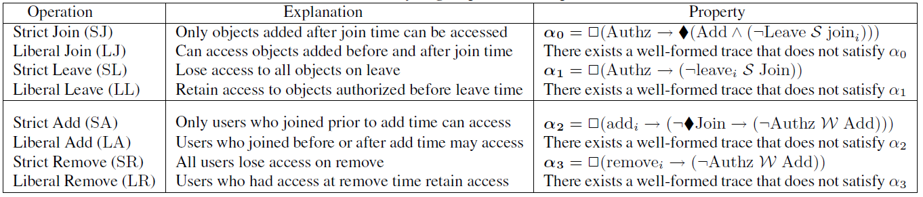
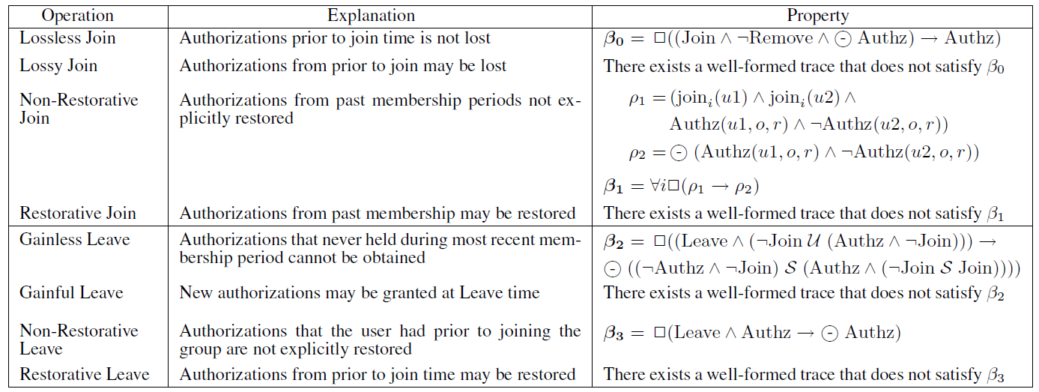
LTL spec for Membership and Membership Renewal Properties (contd)

Slide 51
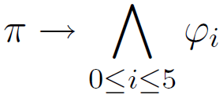
Verification Using Model Checker
Model allows join, leave, add and remove to occur concurrently, non-deterministically and in any order
The above implication is used as the LTLSPEC
The model checker generates a counter-example if the specification is false
Used the open-source NuSMV model checker

Slide 52
Read-Write Object Model
No Versioning | Versioning
1. Multiple users may update, latest write is committed (destructive write). | 1. Multiple users may update, each update creates a new version.
2. No write after leave. | 2. No write after leave.
3. Coarse-grained authorization (specified on the whole object). | 3. Fine-grained. Authorization can differ for different versions of the same object.
4. Tricky issues with Liberal operations. E.g. On LL, past users may read new writes by group users. 4.1 Fix: Past LL users cannot read after write. | 4. No such issues. Past LL users may continue to read versions authorized at leave time. Provenance property rules out access to new versions after leave.

Slide 53

Core Properties (no versioning)
New Operation: Update(o)
Provenance Both user and object should be current members
Bounded Authorization
Past users cannot read after update
Past users cannot write. No write on past objects.
Join
Authz (u,o,r)
Leave
Update
Join

Slide 54
Core Properties (versioning)
New operation: Update(o.v_{i}, o.v_{j})
Version to update
New updated Version
Authorization Provenance
User needs to be a current member to write
Access can be frozen at leave time even with Liberal Leave or Remove
Join(u)
Update(o.v₁,o.v₂)
Update(o.v₂,o.v₃)
LL(u)
Update(o.v₃,o.v₄)
Authz(u, o.v₃, r)
Authz(u, o.v₄, r)
Bounded Authorization

Slide 55
Read-Write (versioning)
An object is composed of multiple versions
An update operation creates a new version
A specific version of an object may be updated
Basically, versions are immutable
New operation:
Update(o.v_{i}, o.v_{j})
Version to update
New updated Version

Slide 56
Core Properties (Continued)
Version dependency properties
If current user can read base version of o, all other versions of o can also be read
If some version of o can be read, all prior versions of o can also be read
If user can write some version of o, then he/she can write all versions of o
Note only current members can write

Slide 57
Core Properties (versioning)
New operation: Update(o.v_{i}, o.v_{j})
Authorization Persistence
Version to update
New updated Version
Authorization Provenance
User needs to be a current member to write
Access can be frozen at leave time even with Liberal Leave or Remove
Join(u)
Update(o.v₁,o.v₂)
Update(o.v₂,o.v₃)
LL(u)
Update(o.v₃,o.v₄)
Authz(u, o.v₃, r)
Authz(u, o.v₄, r)

Slide 58
Core Properties (continued)
Bounded Authorization
Availability

Slide 59
Super-distribution
User1
Object Cloud
CC
User2
Add (c)
c= Enc (o, k)
Distribute o
Set AddTS for o
Get (o)
Provide (c)
Store c locally
Dec (c, k) and read o

Slide 60
Micro-Distribution and Hybrid Approach
User1
CC
User2
User1
Object Cloud
CC
User2
Add (c)
Encrypt o with key k1 shared with CC
(c= Enc (o, k1))
Add (c)
Encrypt o with encryption key e
(c= Enc (o, e))
Distribute c
Dec (c,k1),
Set AddTS for o and store locally
Get (o)
Set AddTS
for o
Provide (c)
Get (o)
Encrypt o with key k2 shared with User (c’=Enc (o,k2))
Read (c)
Provide (c)
Send (m’)
Decrypt c using split decryption key d2 (M’=Dec(c, d2))
Store c’ locally
m= Dec (m’, d1) and read o
Dec (c’, k2) and read o
Store m’ locally
Micro-distribution:
Obtain custom encrypted object from CC the first time
Subsequent accesses can be offline
Hybrid approach:
Split-key RSA, One split per user
CC participates in initial decryption
Subsequent accesses can be offline

Slide 61

Properties
Stale-unsafe Decision
Join
Add
Authz
RT
Perform
Request
Perform
Request
Perform
Formula
Formula
Weak Stale-Safety:
Strong Stale-Safety:

Slide 62
Verification (continued)
Let
¢₀: composition of stale-unsafe FSMs
¢₁: composition of weak stale-safe FSMs
¢₂: composition of strong stale-safe FSMs
Verified using model checking that:
Authz is enforced by ¢₀, ¢₁ and ¢₂
¢₀ fails Weak and Strong Stale-Safe security properties
¢₁ satisfies Weak Stale-Safe security property
¢₁ fails Strong Stale-Safe security property
¢₂ satisfies Strong Stale-Safe security property

Slide 63
Strong Stale-Safe Machine

